Slide 1
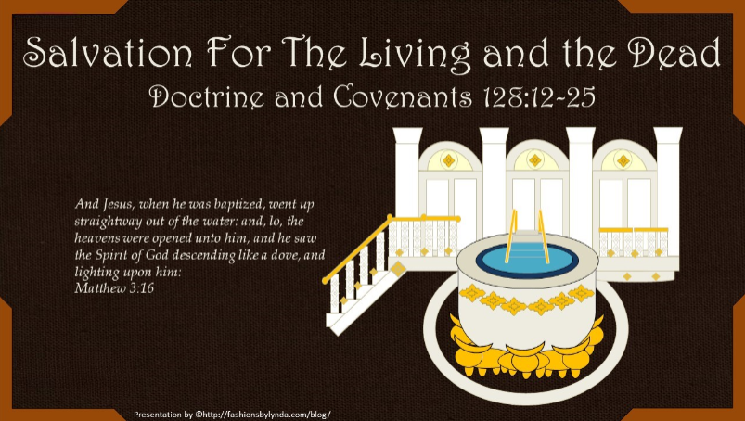

Slide 2

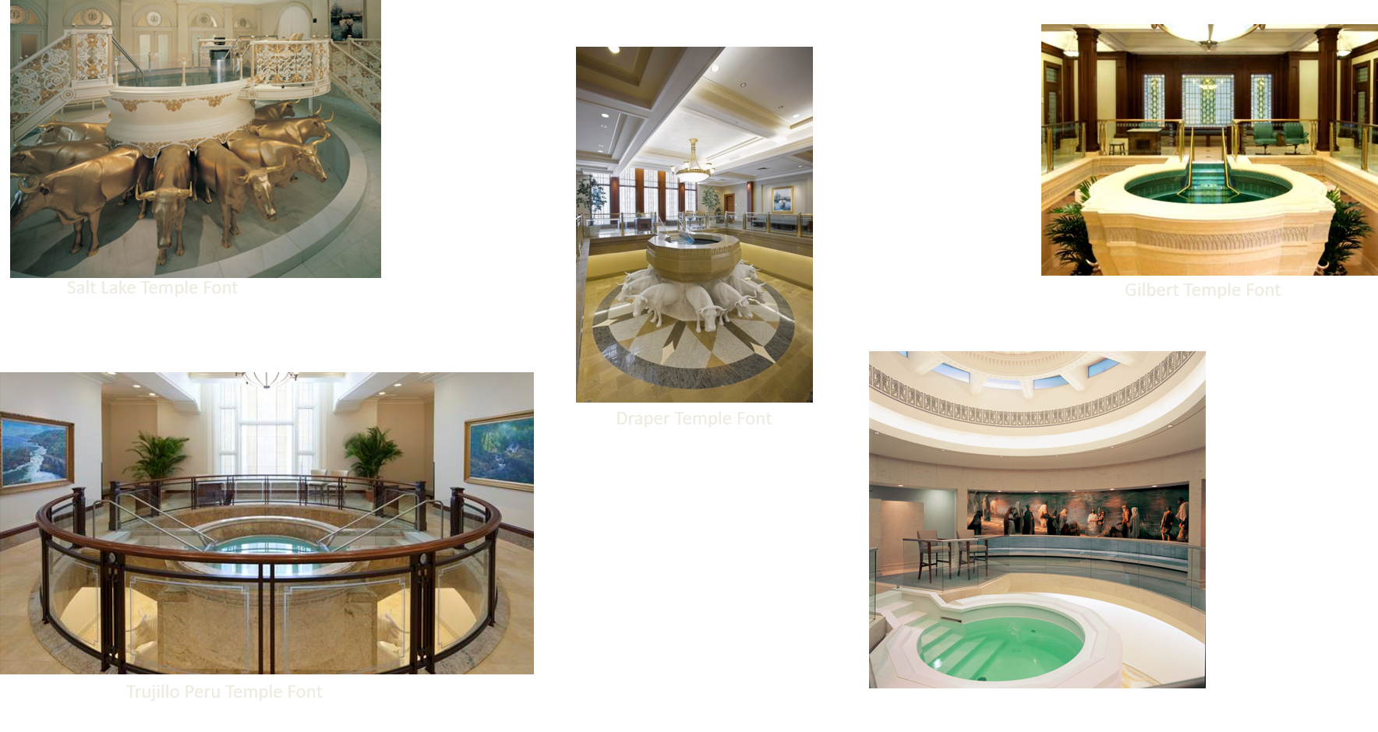
Temple Fonts
The Church of Jesus Christ of Latter-day Saints

Slide 3
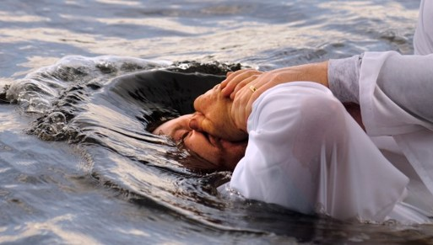
By Immersion
“Verily, verily, I say unto thee, Except a man be born of water and of the Spirit, he cannot enter into the kingdom of God.”
John 3:5
Baptism is by immersion in water. … Baptism cannot be by any other means than immersion of the entire body in water, for the following reasons:
(1) It is in the similitude of the death, burial and resurrection of Jesus Christ, and of all others who received the resurrection.
(2) Baptism is also a birth and in the similitude of the birth of a child into this world.
(3) Baptism is literally, as well as a figure of the resurrection, a transplanting, or resurrection from one life to another—the life of sin to the life of spiritual life.
The baptismal font in which baptisms are performed for the dead in our temples is always to be placed below the surface of the earth
McConkie and Ostler
D&C 128:12-13
President James E. Faust

Slide 4
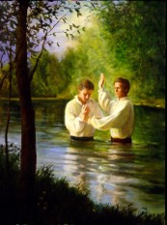
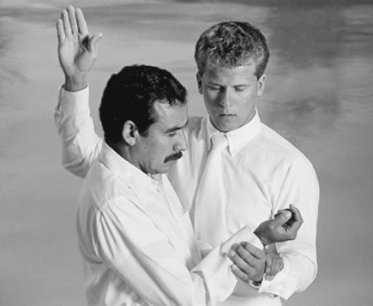
Baptism The Lord’s Way
Baptism by immersion in water by one having authority is the first saving ordinance of the gospel and is necessary for an individual to become a member of The Church of Jesus Christ of Latter-day Saints and to receive eternal salvation.
The Savior revealed the true method of baptism to the Prophet Joseph Smith, making clear that the ordinance must be performed by one having priesthood authority and that it must be done by immersion:
“The person who is called of God and has authority from Jesus Christ to baptize, shall go down into the water with the person who has presented himself or herself for baptism, and shall say, calling him or her by name: Having been commissioned of Jesus Christ, I baptize you in the name of the Father, and of the Son, and of the Holy Ghost. Amen.
”Then shall he immerse him or her in the water, and come forth again out of the water“ (D&C 20:73–74).
D&C 128:12-13
Bible Dictionary

Slide 5
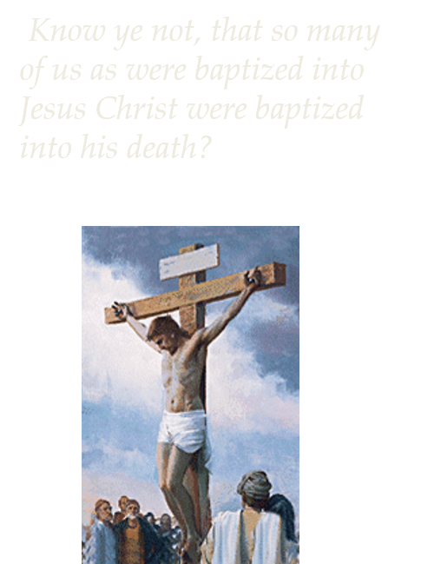
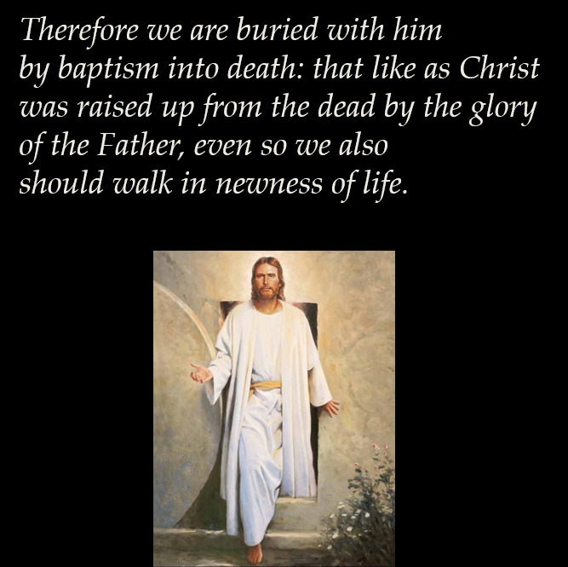
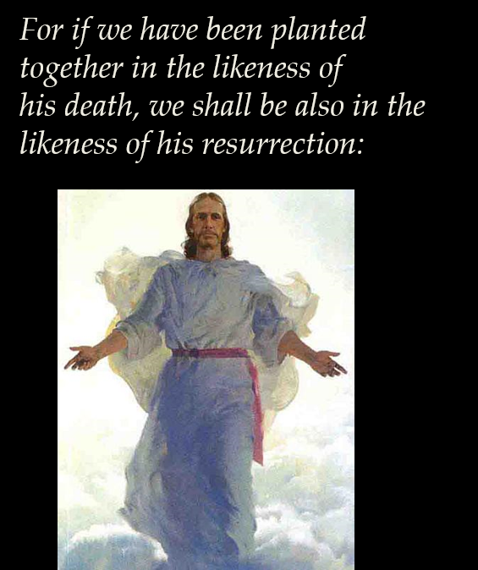
Burial and Resurrection
Symbolic—coming fourth from their grave into the kingdom of God
D&C 128:12-13
Romans 6:3-5

Slide 6
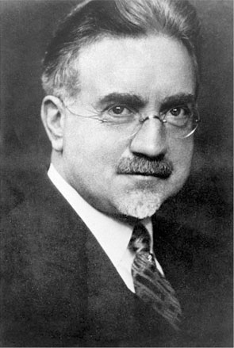

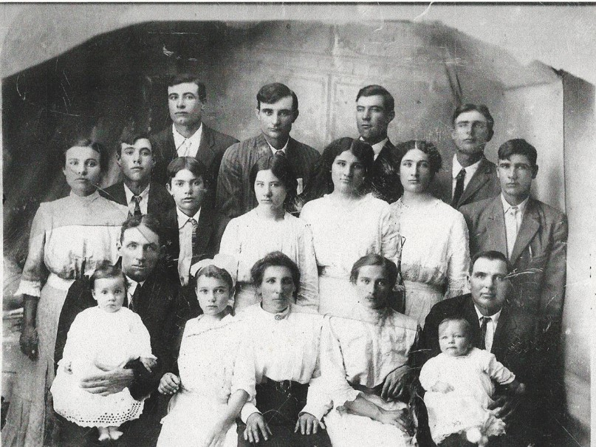
Salvation of Our Ancestors
The salvation of our dead ancestors is “essential to our salvation.” Our lives are closely tied to our ancestors’ lives, for we cannot become perfect without them nor they without us.
“In our preexistent state…we made a certain agreement with the Almighty.
The Lord proposed a plan…We accepted it. Since the plan is intended for all men, we became parties to the salvation of every person under that plan.
We agreed to be not only saviors for ourselves but…saviors for the whole human family.
Elder John A. Widtsoe
D&C 128:14-15
Student Manual

Slide 7
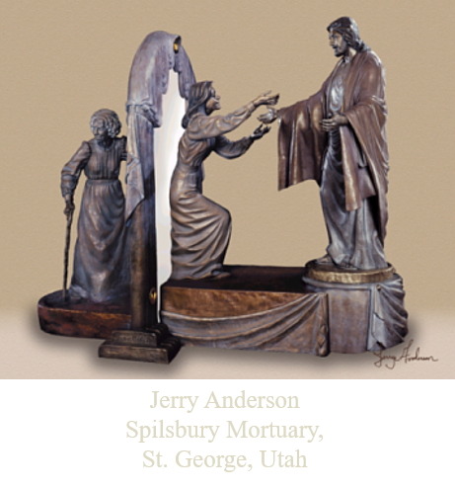
Receiving the Same Blessings
Baptism for the dead and other vicarious work makes it possible for all our Father’s children to receive the same blessings, and be judged on the same terms, whether or not they had a chance to accept the gospel in mortality.
“Your deceased ancestors live in a place called the spirit world. There they have the opportunity to hear and accept the gospel of Jesus Christ. However, they cannot receive the ordinances of the gospel for themselves, and they cannot progress until others provide these ordinances for them.
“Your privilege and responsibility is to give your ancestors this gift by identifying them and ensuring that ordinances are performed in their behalf in the temple. They may then choose whether to accept the work that has been done.”
Member’s Guide to Temple and Family History Work [2009], 2).
Our ancestors who die without the gospel cannot progress toward perfection until the saving ordinances of the gospel are performed for them
D&C 128:14-15

Slide 8
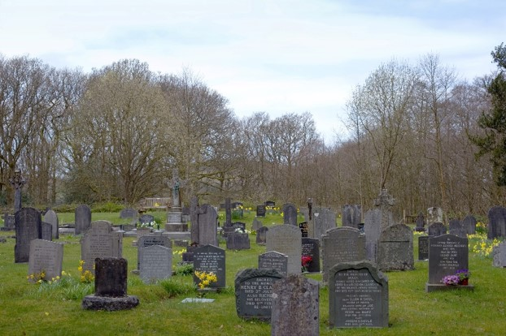
Between Fathers and Children
Welding together of dispensation— Bringing together all things that are Christ’s, is the gathering of the scattered house of Israel.
For we without them cannot be made perfect; neither can they without us be made perfect.
Neither can they nor we be made perfect without those who have died in the gospel also;
D&C 128:18
Student Manual

Slide 9
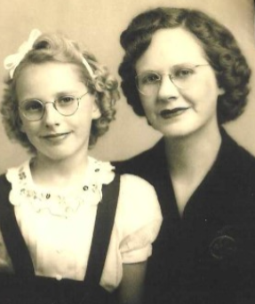
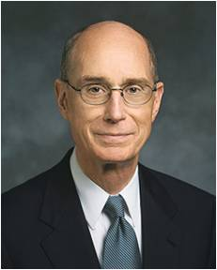

Many of your ancestors did not receive those ordinances. But in the providence of God, you did. And God knew that you would feel drawn to your ancestors in love and that you would have the technology necessary to identify them. He also knew that you would live in a time when access to holy temples, where the ordinances can be performed, would be greater than ever in history. And He knew that He could trust you to accomplish this work in behalf of your ancestors. …
… Many youth have discovered that giving of their time to do family history research and temple work has deepened their testimony of the plan of salvation. It has increased the influence of the Spirit in their lives and decreased the influence of the adversary. It has helped them feel closer to their families and closer to the Lord Jesus Christ. They have learned that this work saves not just the dead; it saves all of us [see Doctrine and Covenants 128:18].
Henry B. Eyring
D&C 128:18

Slide 10
Psalm of Joy
Now, what do we hear in the Gospel which we have received?
A voice of gladness!
A voice of mercy from heaven;
And a voice of truth out of the earth
And thou shalt be brought down, and shalt speak out of the ground, and thy speech shall be low out of the dust, and thy voice shall be, as of one that hath a familiar spirit, out of the ground, and thy speech shall whisper out of the dust.
Isaiah 29:4
And the angel said unto them, Fear not: for, behold, I bring you good tidings of great joy, which shall be to all people.
Luke 2:10
Glad tidings for the dead;
A voice of gladness for the living and the dead;
Glad tidings of great joy
How beautiful upon the mountains
Are the feet of those that bring glad tidings of good things,
And that say unto Zion:
Behold, thy God reigneth!
How beautiful upon the mountains are the feet of him that bringeth good tidings, that publisheth peace; that bringeth good tidings of good, that publisheth salvation; that saith unto Zion, Thy God reigneth!
Isaiah 52:7
D&C 128:19

Slide 11
Dispensation of the Fulness of Time
A dispensation is a period of time when the Lord reveals His doctrines, ordinances, and priesthood. The current dispensation began with Joseph Smith and is called the dispensation of the fulness of times.
Adam
Enoch
Noah
Abraham
Moses
Jesus Christ
Joseph Smith
4000 B.C.
3300 B.C.
2300 B.C.
1900 B.C.
1480 B.C.
30 A.D.
1820-44
“The dispensation of the fullness of times will bring to light the things that have been revealed in all former dispensations; also other things that have not been before revealed. He shall send Elijah, the Prophet, etc., and restore all things in Christ”
Teachings of Presidents of the Church: Joseph Smith
D&C 128:20

Slide 12
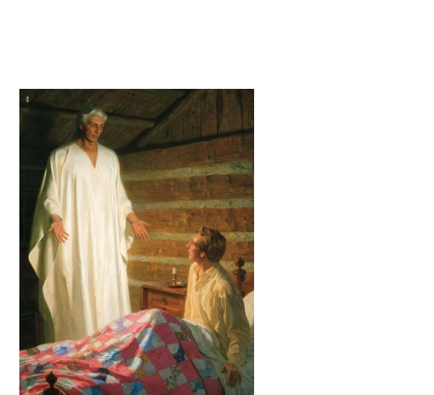
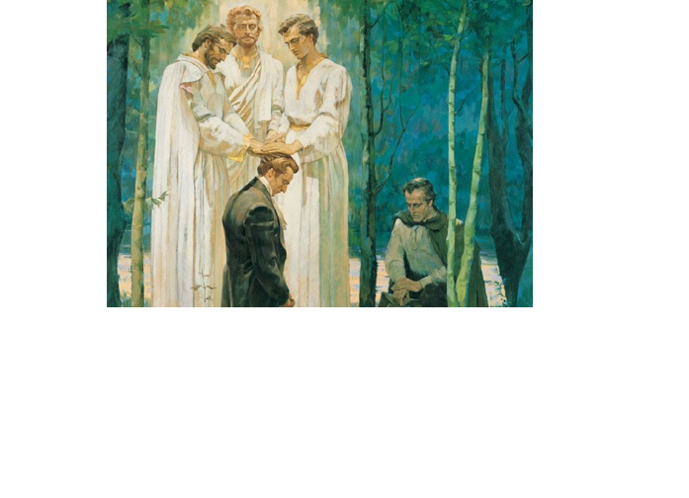
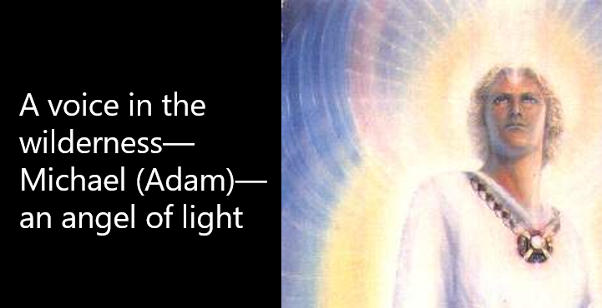
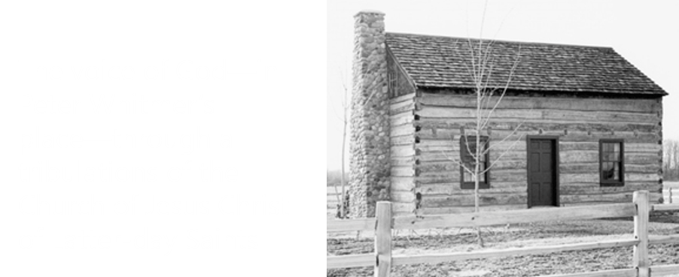
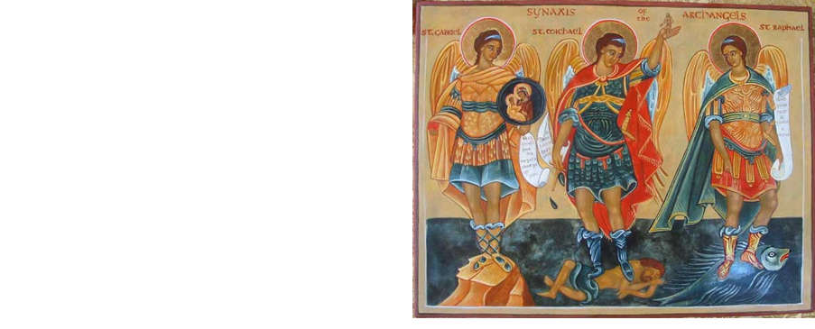
Glad Tidings—Heavenly Messengers
The Gospel of Jesus Christ is the Glad News we can receive and we can teach to others
D&C 128:20-21

Slide 13
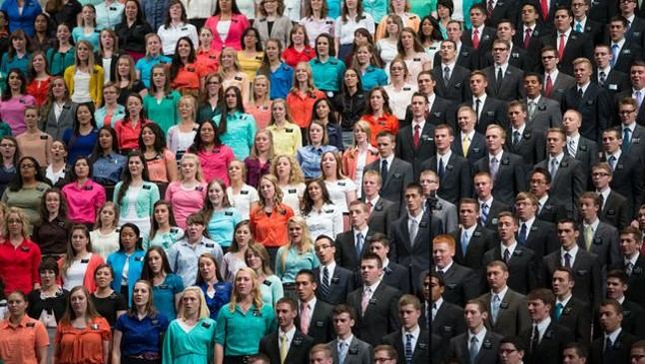
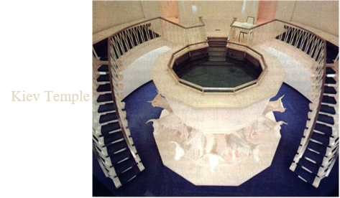
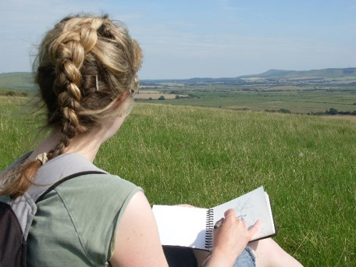
Go Forward Not Backward
“Most members of the Church are aware of our intense interest in the missionary work in the Church and the appeals we have made in many lands for the rededication to preaching the gospel and preparing missionaries to carry the good news of the restoration to the people everywhere.
I feel the same sense of urgency about temple work for the dead as I do about the missionary work for the living, since they are basically one and the same. I have told my brethren of the General Authorities that this work for the dead is constantly on my mind.”
“We feel an urgency for this great work to be accomplished and encourage members to accept this responsibility. Members do so by writing their personal and family histories, participating in the name extraction program when called to do so, completing their four-generation research, and then continuing their family research in order to redeem their kindred dead.”
D&C 128:22
President Spencer W. Kimball

Slide 14
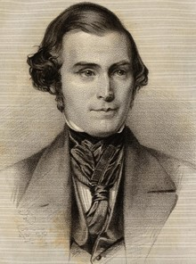
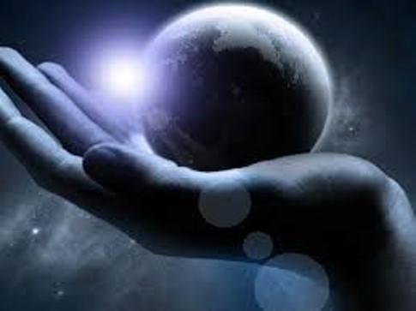

“We are willing to go the earth over to save the living; we are willing to build temples and administer in ordinances to save the dead; we are willing to enter the eternal worlds and preach to every creature who has not placed himself beyond the reach of mercy. We are willing to labour both in this world and in the next to save men.
“… Let all rejoice that the great day of the dispensation of the fulness of times has come. Let the living rejoice; let the dead rejoice; let the heavens and the earth rejoice; let all creations shout hosannah! glory to God in the highest! for he hath brought salvation, and glory, and honour, and immortality, and eternal life to the fallen sons of men.”
D&C 128:23
Elder Orson Pratt

Slide 15
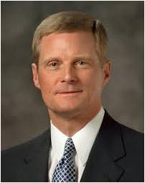
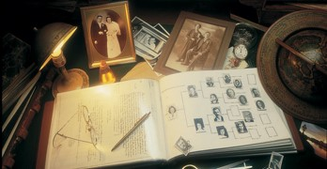
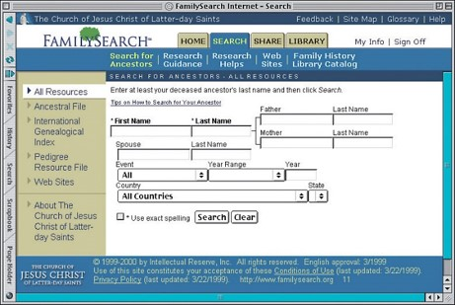
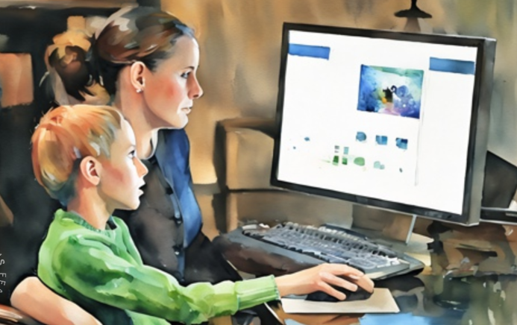
The Book
“Many of you may think family history work is to be performed primarily by older people. But I know of no age limit described in the scriptures or guidelines announced by Church leaders restricting this important service. …
“It is no coincidence that … tools have come forth at a time when young people are so familiar with a wide range of information and communication technologies. …
The skills and aptitude evident among many young people today are a preparation to contribute to the work of salvation.
“… I encourage you to study, to search out your ancestors, and to prepare yourselves to perform proxy baptisms in the house of the Lord for your kindred dead. … And I urge you to help other people identify their family histories.”
D&C 128:24
Elder David A. Bednar

Slide 16
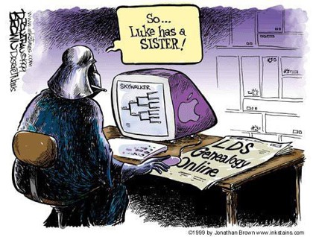
Sources:
Videos:
A Sacrifice of Time (2:54)
Your Fingers Have Been Trained (1:47)
Jesus Teaches of Being Born Again (5:48)
Time Well Spent (2:40)
“The Promised Blessings of Temple and Family History Work” (3:26)
“The Promised Blessings of Temple and Family History Work 2” (4:04).
Teachings of the Prophet Joseph Smith, sel. Joseph Fielding Smith (1976), 314.
President James E. Faust Born Again April 2001 Gen. Conf.
Bible Dictionary, “Baptism,” 618
Joseph Fielding McConkie and Craig J. Ostler Revelations of the Restoration pg. 1030-31
Doctrine and Covenants Student Manual Religion 324-325 Section 128
Elder John A. Widtsoe Worth of Souls pg. 25:189
Spencer W. Kimball (In Conference Report, Apr. 1978, p. 4; or Ensign, May 1978, p. 4.)
(In Conference Report, Apr. 1980, p. 5; or Ensign, May 1980, p. 5.)
Presentation by ©http://fashionsbylynda.com/blog/
Elder Orson Pratt (In Journal of Discourses, 7:90–91.)
Elder David A. Bednar(“The Hearts of the Children Shall Turn,” Ensign or Liahona, Nov. 2011, 26).
Henry B. Eyring, “Gathering the Family of God,” Ensign or Liahona, May 2017, 21, 22
Teachings of Presidents of the Church: Joseph Smith [2007], 510–11;
Presentation by ©http://fashionsbylynda.com/blog/

Slide 17
According to Collected Discourses, Vol.3, Appendix, Wilford Woodruff, December 13, 1893, the following men were baptized by proxy in the St. George Temple on August 21, 1877:
All the Signers of the Declaration of Independence except John Hancock and William Floyd.
("Proxy work for both William Floyd and John Hancock had been performed by relatives previous to this work by President Woodruff. William Floyd (Floid) was baptized 13 March 1877, with the Endowment work being performed on 22 August 1877 with Addison Everett acting as proxy in both instances. The baptismal work for John Hancock was performed 29 May 1877." Benjamin Franklin was ordained an LDS High Priest by proxy on August 22-24)
Also receiving proxy baptisms in August of 1877:
Charles Louis Napoleon Bonaparte (Military Leader)
Lord Henry Brougham (British reformer, lawyer, and politician)
Edward George Earl Lytton Bulwer (English member of Parliament and author)
Robert Burns (Scottish Poet)
Lord George Gordon Byron (English Poet)
John Calwell Calhoon(US Senator and Vice-President)
Count Camillo Bonso di Cavour (Italian Statesman)
Thomas Chalmers (Scottish theologian and philanthropist)
Henry Clay (US Senator)
Richard Cobden (British reformer)
Christopher Columbus (Explorer - Ordained an LDS High Priest by proxy on August 22-24)
Daniel O. Connell (First Catholic member of British Parliament)
Michael Faraday (English chemist and physicist)
David Glascoe Farragut (American Civil War naval officer)
David Garrick (English actor and stage manager)
Edward Gibbon (Historian and author of The Decline and Fall of the Roman Empire)
Johann Wolfgang Goethe (Writer and poet)
Oliver Goldsmith (Author, playwright, poet)
Henry Grattan(Irish orator and member of Irish Parliament)
Washington Irving (Author)
Thomas Jonathan "Stonewall" Jackson (Confederate general in the American Civil War)
Samuel Johnson (English lexicographer, essayist, poet, and critic)
Benito Juarez (Mexican President)
John Philip Kemple (English actor)
Baron Justus von Liebig (German chemist)
David Livingstone (Christian Missionary)
Thomas Babington Macauley (English historian, essayist, and statesman)
Lord Horatio Nelson (British naval admiral)
George Peabody (American Philanthropist)
Frederick II - A.K.A. "Frederick the Great" (King of Prussia)
Hiram Powers (American sculptor)
Sir Joshua Reynolds (English portrait painter)
Frederick Von Schiller (German poet, dramatist, philosopher, and historian)
Sir Walter Scott (Scottish novelist and poet)
William Henry Seward (US Senator)
George Stephenson (English inventor and engineer)
William Makepeace Thackeray (English novelist)
Frederick Henry Alexander Von Humboldt (German naturalist, explorer)
Daniel Webster (American Statesman)
John Wesley (Christian Evangelist/Pastor - ordained an LDS High Priest by proxy on August 22-24)
William Wordsworth (English poet)
Between August 22-23, 1877 all of the remaining US Presidents were baptized by proxy except James Buchannan, Martin Van Buren, and Ulysses S. Grant. President Grant was still alive, but "President Woodruff declined the performance of the Temple work for these two deceased Presidents due to the actions they performed against the Saints during their administrations. The baptism for President James Buchanan was performed 4 June 1932 in the Salt Lake Temple, and endowments were given 19 October 1932 (#20580, Book 4T, pg. 924). Baptismal work for President Martin Van Buren was performed 4 May 1938 in the Salt Lake Temple, and endowments were given 21 June 1938 (#4564, Book 6H, pg. 203)" (Collected Discourses, Vol.3, Appendix, Wilford Woodruff, December 13, 1893).
According to the Salt Lake Tribune (8/17/91, p.A6) the following have also been baptized Mormon:
Abigail Adams (Wife of US President John Adams)
Louise Adams (Wife of US President John Quincy Adams)
Dwight Eisenhower (US President)
Patrick Henry (American Statesman)
Thomas Kearns (US Senator)
Abraham Lincoln (US President)
Miguel Pro (Catholic Priest)
Paul Revere (American patriot and silversmith)
William Shakespeare (Playwright)
Leo Tolstoy (Russian novelist)
Mormonism Research Ministry, PO Box 1746, Draper, Utah 84020-1746
http://www.mrm.org/prominent-people-baptized-by-proxy

Slide 18
Continued Article:
The May 2, 2001 edition of the Mormon-owned Deseret News reported that following people of Jewish descent were also baptized by proxy in Mormon temples. The Simon Wiesenthal Center (named after the famous Nazi hunter) has asked that several names be taken off LDS records. The following are among that list. (Would a Mormon assume that just because a name has been stricken from the record that the work already done had no effect?)
David Ben Gurion (Israel's first prime minister)
Menachem Begin (Prime minister)
Moshe Dayan (Military hero)
Golda Meir (Prime minister)
Theodore Hertzel (Zionism founder)
Anne Frank and several of her family members (Holocaust victim and autobiographer)
Zacharias Frankel (Father of the Conservative Jewish movement)
Sigmund Freud (Father of psychoanalysis)
Albert Einstein (Scientist)
Marek Edelman* (Leader of Warsaw ghetto uprising)
Leopold Page* (The man who brought the story of Oskar Schindler to the world)
The Jewish community has often expressed its outrage over the proxy baptisms of holocaust victims. Despite numerous apologies and promises from the Mormon leadership to the Jewish community, proxy baptisms for holocaust victims continue. "Over the years, they've duly held baptism ceremonies for around 650,000 Holocaust victims, along with countless late celebrities, including John Lennon, and Albert Einstein. Thanks to her prominence, Ms Frank is believed to have been baptized at least nine times."
ABC News reported in 2009 that "the day after then-Sen. Obama secured enough delegates to win the Democratic presidential nominee — someone had the president’s mother Stanley Ann Dunham, who died in 1995 of cancer, baptized. On June 11, she received the endowment."
Let's not forget Adolph Hitler (German dictator), who was baptized and endowed by proxy on December 10, 1993 and sealed to his parents (Alois Hitler and Klara Poelzl) on March 12, 1994; all of which took place in the London LDS temple.
Linked Together:
“There must be a family organization, a family unit, and each generation must be linked to the chain that goes before in order to bring perfection in family organization. Thus eventually we will be one large family with Adam at the head, Michael, the archangel, presiding over his posterity” (Doctrines of Salvation, comp. Bruce R. McConkie, 3 vols. [1954–56], 2:175).
“If there is not a welding link between the fathers and the children—which is the work for the dead—then we will all stand rejected; the whole work of God will fail and be utterly wasted” (Doctrines of Salvation, 2:122).
Archangels:
Michael and Gabriel are recognized as archangels in Judaism, Islam, and by most Christians. The Book of Tobit—recognized in the Catholic and Orthodox Bibles, but considered apocryphal by Protestants—mentions Raphael, who is also considered to be an archangel. The archangels Michael, Gabriel and Raphael are venerated in the Roman Catholic Church with a feast on September 29 (between 1921 and 1969, March 24 for Gabriel and October 24 for Raphael), and in the Eastern Orthodo Church on November 8 (if the Julian calendar is used, this corresponds to November 21 in the Gregorian). The named archangels in Islam are Gabriel, Michael, Israfil and Azrael. Jewish literature, such as the Book of Enoch, mentions Metatron as an archangel, called the "highest of the angels", though the acceptance of this angel is not canonical in all branches of the faith.
Some branches of the faiths mentioned have identified a group of seven Archangels, but the actual angels vary, depending on the source. Michael, Gabriel, and Raphael are always mentioned; the other archangels vary, but most commonly include Uriel, who is mentioned in 2 Esdras.
Wikipedia
Gabriel and Raphael.
The Prophet learned by revelation that Gabriel was Noah (Teachings of the Prophet Joseph Smith, 157). Raphael may have been Enoch. This conclusion is deduced by listing the six major gospel dispensations prior to our own—Adam’s, Enoch’s, Noah’s, Abraham’s, Moses’, and the meridian of time, then noting that we can identify someone coming to restore keys from each of them except Enoch’s. Since we have both a name and a dispensation unaccounted for, the answer may be found in putting the two together. McConkie and Ostler
“Temple and family history work is one work divided into two parts. …
“President Howard W. Hunter taught:
“‘We must accomplish the priesthood temple ordinance work necessary for our own exaltation; then we must do the necessary work for those who did not have the opportunity to accept the gospel in life. Doing work for others is accomplished in two steps: first, by family history research to ascertain our progenitors; and second, by performing the temple ordinances to give them the same opportunities afforded to the living. …
“‘I have learned that those who engage in family history research and then perform the temple ordinance work for those whose names they have found will know the additional joy of receiving both halves of the blessing’ [“A Temple-Motivated People,” Ensign, Feb. 1995, 4–5].

Slide 19
Jan 1st - 1st illustrated weekly magazine in US publishes 1st issue, NYC
Jan 2nd - 1st US wire suspension bridge for general traffic opens in Penn
Feb 15th - 1st adhesive postage stamps in US (private delivery company), NYC
Feb 21st - 1st known sewing machine patented in US, John Greenough, Wash DC
Mar 3rd - 1st US child labor law regulating working hours passed (Mass)
Mar 5th - Over 500 Mexican troops led by Rafael Vasquez invade Texas, briefly occupy San Antonio and then head back to the Rio Grande.
Mar 17th - Indians land in Ohio, a 12 square mile area in Upper Sandusky
Mar 30th - Ether used as an anaesthetic for 1st time by Dr Crawford Long (Ga)
Apr 13th - Lord Rosse successfully casts 72" (183-cm) mirror for a telescope
May 5th - City-wide fire burns for over 100 hours (Hamburg Germany)
May 22nd - Farmers Lester Howe and Henry Wetsel discover Howe Caverns when they stumble upon a large gaping hole in the ground.
May 25th - Christian Doppler presents his idea, now known as the Doppler Effect, to the Royal Bohemian Society, Prague (The Doppler Effect (the change in frequency of a wave for an observer moving relative to its source, best illustrated by the changing sound of a siren as it approaches, passes, and recedes from an observer)
Jul 9th - Notary Stamp Law passes
Aug 1st - Rotherhithe Tunnel under the Thames opens
Aug 1st - Lombard Street Riot erupts
Aug 9th - US-Canada border defined by Webster-Ashburton Treaty
Aug 14th - Second Seminole War declared over by Colonel Worth; Indians go on to be removed from Florida to Oklahoma
Aug 29th - Great Britain & China sign Treaty of Nanking, ends Opium war
Aug 31st - Micah Rugg patents a nuts & bolts machine
Nov 8th - Belgium King Leopold I proclaims child labor laws (for 1889)
Nov 22nd - Mount St Helens in Washington erupts
Nov 26th - The University of Notre Dame is founded.
Dec 7th - New York Philharmonic's 1st concert
Dec 19th - US recognizes independence of Hawaii
What was Happening in 1842 around the World

