Slide 1


Doctrine and Covenants 130:12-23
Godhead
and
When Will He Come?

Slide 2
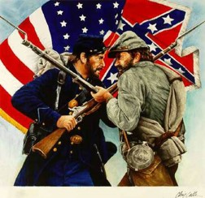
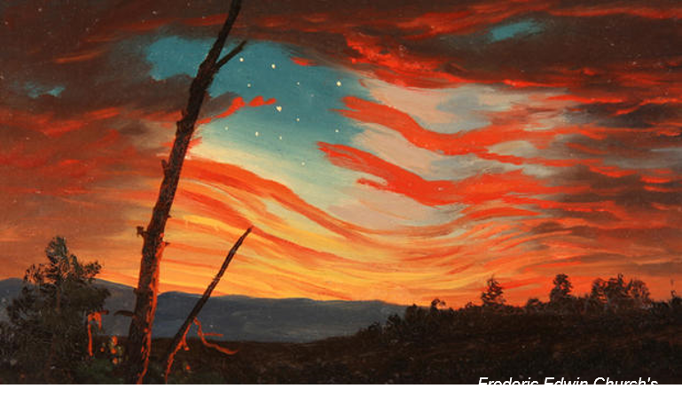

Another Prophecy of the Civil War
Section 87 foretells a war between the northern and southern sections of the United States.
The Prophet Joseph Smith learned of this impending war on Christmas Day 1832, and these verses written eleven years later are a second mention of the same disaster.
Other wars:
Crimean War (1854-56)
Second Opium War (1856)
Second War of Italian Independence (1859)
Civil War began April 12, 1861
D&C 130:12-13

Slide 3
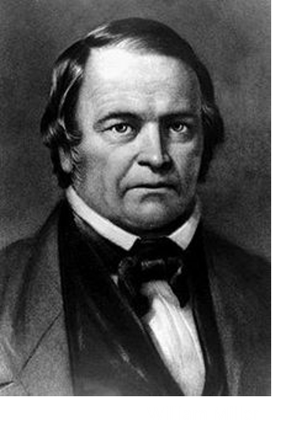

When is the Second Coming of the Savior?
Church meeting in Ramus, Illinois, on April 2, 1843.
A prominent Christian preacher named William Miller claimed the Savior’s Second Coming would happen on April 3, 1843.
One day before Miller’s predicted date of the Second Coming, the Prophet Joseph Smith spoke to Saints in Ramus, Illinois, and mentioned that he had prayed to know the time of the Second Coming.

Slide 4
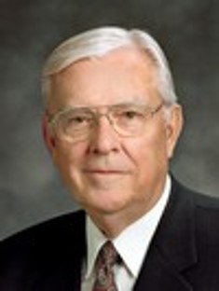
“I am called as one of the Apostles to be a special witness of Christ, … and I do not know when He is going to come again. As far as I know, none of my brethren in the Quorum of the Twelve or even in the First Presidency knows. And I would humbly suggest that if we do not know, then nobody knows. …
The Savior said that ‘of that day, and hour, no one knoweth; no, not the angels of God in heaven, but my Father only’
“I believe that when the Lord says ‘no one’ knows, He really means that no one knows.”
M. Russell Ballard
Joseph Smith—Matthew 1:40].

Slide 5
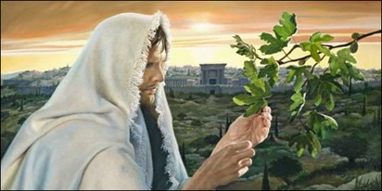
Trouble Me No More
And he spake to them a parable; Behold the fig tree, and all the trees;
When they now shoot forth, ye see and know of your own selves that summer is now nigh at hand.
So likewise ye, when ye see these things come to pass, know ye that the kingdom of God is nigh at hand.
Verily I say unto you, This generation shall not pass away, till all be fulfilled.
Heaven and earth shall pass away: but my words shall not pass away.
Luke 21:29-33
“Judah must return, Jerusalem must be rebuilt, and the Temple, and the water come out from under the Temple and the waters of the Dead Sea be healed. It will take some time to rebuild the walls of the city and the temple, etc., and all this must be done before the Son of Man will make His appearance.”
HC
D&C 130:14-15

Slide 6
“I Was Left Thus”—Joseph Smith
“I took the liberty to conclude that if I did live to that time, He would make His appearance. But I do not say whether He will make His appearance (on Earth) or I shall go where He is.”
HC
But of that day and that hour knoweth no man, no, not the angels which are in heaven, neither the Son, but the Father.
Mark 13:32
But of that day and hour knoweth no man, no, not the angels of heaven, but my Father only.
Matthew 24:36
“It appears that the prophet was knowingly asking for something for which he should not have asked.”
McConkie and Ostler
D&C 130:16-17

Slide 7
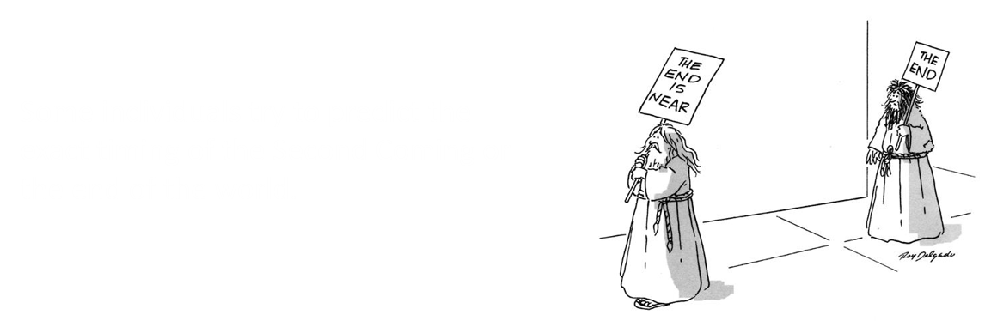
Signs of the Coming of the Savior
There will be wars and rumors of wars, signs in the heavens above and on the earth beneath, the sun turned into darkness and the moon to blood, earth quakes in divers places, the seas heaving beyond their bounds, then will appear one grand sign of the Son of Man in heaven .
Only God knows the exact time when the Second Coming will occur
2900 BC-The oldest known prediction of the end of the world is recorded on Assyrian tablets: "Our Earth is degenerate in these later days; there are signs that the world is speedily coming to an end; bribery and corruption are common; children no longer obey their parents; every man wants to write a book and the end of the world is evidently approaching.” Rationalwiki
D&C 130:16-17

Slide 8



Knowledge
“It is not the knowledge obtained from textbooks that rises with us in the resurrection.”
“The intelligences that arise with us are equated with “light and truth.”
The knowledge and intelligence we gain in this life will rise with us in the resurrection
The glory of God is intelligence, or, in other words, light and truth. D&C 93:36
D&C 130:18-19

Slide 9

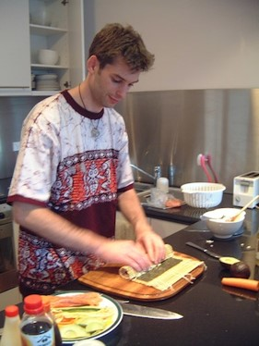


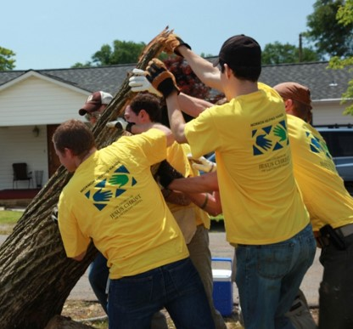

“You … should not complain about schooling.
Do not immerse yourself so much in the technical that you fail to learn things that are practical.
Everything you can learn that is practical—in the house, in the kitchen cooking, in the yard—will be of benefit to you. Never complain about schooling.
Study well, and attend always. …
“You can learn about fixing things and painting things and even sewing things and whatever else is practical.
That is worth doing.
If it is not of particular benefit to you, it will help you when you are serving other people”
D&C 130:18-19 President Boyd K. Packer

Slide 10
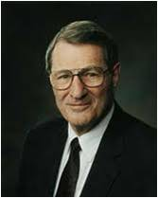


“If we ponder just what it is that will rise with us in the resurrection, it seems clear that our intelligence will rise with us, meaning not simply our IQ, but also our capacity to receive and apply truth.”
“Our talents, attributes, and skills will rise with us; certainly also our capacity to learn, our degree of self-discipline, and our capacity to work.”
D&C 130:18-19 Elder Neal A. Maxwell

Slide 11



Obedience to the Laws
Obedience is the basic law of heaven, and obedience to specific laws will result in specific blessings, culminating in the greatest blessing.
Student Manual
“If we want to live we must conform to the physical laws by obedience to which life is sustained.”
Smith and Sjodahl
Sitting around will not help you obtain knowledge
If we want to obtain a blessing from God, then we must obey the law upon which it is predicated.
D&C 130:20-21

Slide 12
D&C 10:5
Pray always, that you may come off conqueror; yea, that you may conquer Satan, and that you may escape the hands of the servants of Satan that do uphold his work.
D&C 88:124
Cease to be idle; cease to be unclean; cease to find fault one with another; cease to sleep longer than is needful; retire to thy bed early, that ye may not be weary; arise early, that your bodies and your minds may be invigorated.
If we want to obtain a blessing from God, then we must obey the law upon which it is predicated.
2 Nephi 32:3
Angels speak by the power of the Holy Ghost; wherefore, they speak the words of Christ. Wherefore, I said unto you, feast upon the words of Christ; for behold, the words of Christ will tell you all things what ye should do.
John 7:17
If any man will do his will, he shall know of the doctrine, whether it be of God, or whether I speak of myself

Slide 13

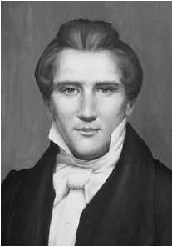
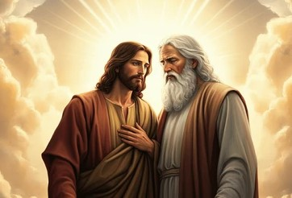
Background
On April 2, 1843, the Prophet Joseph Smith met with Saints in Ramus, Illinois, about 20 miles outside of Nauvoo.
Joseph taught various gospel truths, including details about the Godhead, the importance of gaining knowledge in this life, and how we can receive God’s blessings.
There are three separate personages in the Godhead. The Father and the Son have tangible, glorified bodies of flesh and bone. The Holy Ghost is a personage of spirit.

Slide 14
Doctrinal Mastery
The Father has a body of flesh and bones as tangible as man’s; the Son also; but the Holy Ghost has not a body of flesh and bones, but is a personage of Spirit. Were it not so, the Holy Ghost could not dwell in us.
A man may receive the Holy Ghost, and it may descend upon him and not tarry with him.
D&C 130:22-23

Slide 15
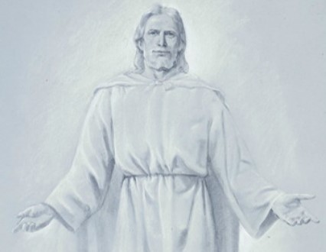
God the Father
It is generally the Father, or Elohim, who is referred to by the title God. He is called the Father because He is the father of our spirits. … God the Father is the supreme ruler of the universe. He is all powerful … , all knowing … , and everywhere present through his Spirit. … Mankind has a special relationship to God that sets man apart from all other created things: men and women are God’s spirit children. …
D&C 130:22-23

Slide 16
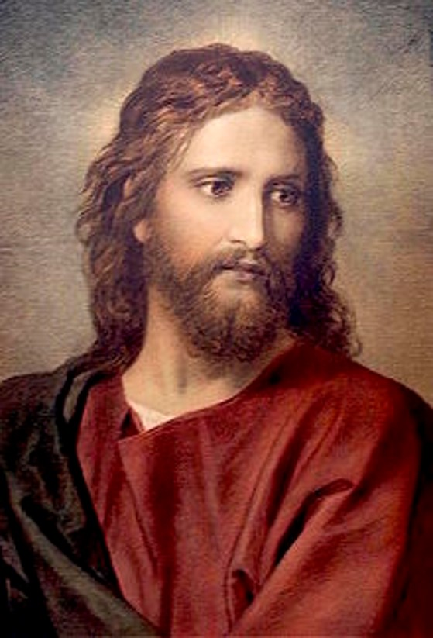
God the Son
The God known as Jehovah is the Son, Jesus Christ. … Jesus works under the direction of the Father and is in complete harmony with him. All mankind are His brothers and sisters, for He is the eldest of the spirit children of Elohim. [He is the Redeemer who suffered the sins and pains of all mankind and overcame physical death for all. …
D&C 130:22-23

Slide 17
God the Holy Ghost
The Holy Ghost is also a God and is called the Holy Spirit, the Spirit, and the Spirit of God, among other similar names and titles [such as the Comforter].
With the aid of the Holy Ghost, man can know the will of God the Father and know that Jesus is the Christ”
The primary role of the Holy Ghost is to bear witness of God the Father and Jesus Christ. The Holy Ghost teaches and confirms truth.
(Guide to the Scriptures, “God, Godhead,” scriptures.lds.org).
D&C 130:22-23

Slide 18
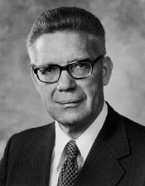
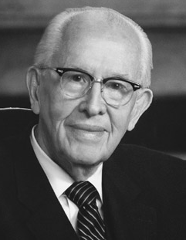
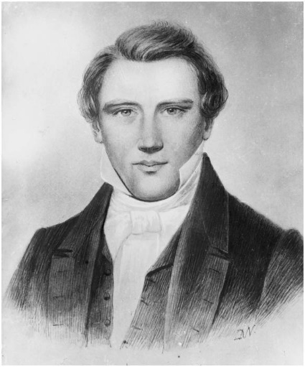
Testimonies
“The body in which He performed His mission in the flesh was sired by that same Holy Being we worship as God, our Eternal Father.
Jesus was not the son of Joseph, nor was He begotten by the Holy Ghost. He is the Son of the Eternal Father!”
President Ezra Taft Benson
“The Holy Ghost is a spirit man, a spirit son of God the Father.”
Elder Bruce R. McConkie
“…an everlasting covenant was made between three personages before the organization of this earth, and relates to their dispensation of things to men
on the earth; these personages…
are called God the first, the Creator;
God the second, the Redeemer, and
God the third, the witness or
Testator.” Prophet Joseph Smith
D&C 130:22

Slide 19

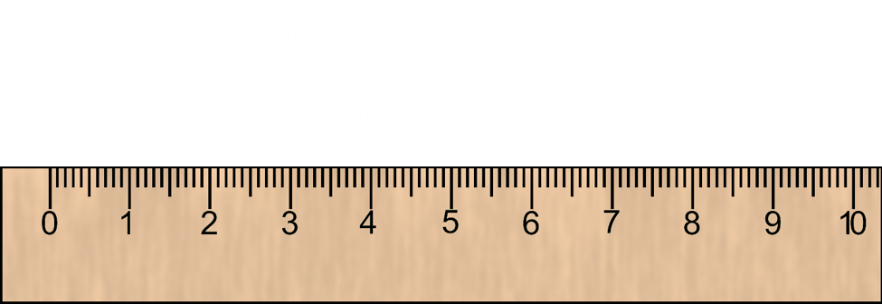
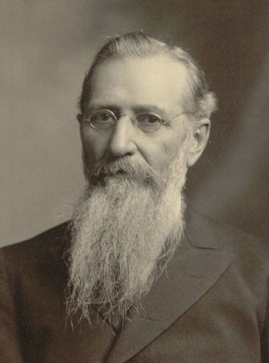
May or May Not
“Man can neither predict nor program the Spirit of the Lord.”
Referring to the Holy Spirit
“…simply confers upon a man the right to receive at any time, when he is worthy of it and desires it, the power and light of truth of the Holy Ghost…”
President Joseph F. Smith
D&C 130:23 McConkie and Ostler

Slide 20
Sources:
Videos:
“What Is the Godhead?” (7:03)
The Second Coming Segment 1 (1:06)
The Glory of God Is Intelligence (3:09)
Education Is the Key to Opportunity (1:35)
M. Russell Ballard ” (“When . These Things Be?” Ensign, Dec. 1996, 56).
History of the Church 5:336-337
Joseph Fielding McConkie and Craig J. Ostler Revelations of the Restoration pg. 1048-50
President Boyd K. Packer (“Counsel to Young Men,” Ensign or Liahona, May 2009, 51).
Elder Neal A. Maxwell (We Will Prove Them Herewith [1982], 12).
Hyrum M. Smith and Janne M. Sjodahl Doctrine and Covenants Commentary pg. 817
President Ezra Taft Benson Come Unto Christ p. 4
Elder Bruce R. McConkie Doctrinal New Testament Commentary 1:728
Teachings of the Prophet Joseph Smith, 190
Presentation by ©http://fashionsbylynda.com/blog/
President Joseph F. Smith Gospel Doctrine, 60-61
Presentation by ©http://fashionsbylynda.com/blog/

Slide 21
Scripture passage | Law | Blessing
D&C 10:5
D&C 88:124
2 Nephi 32:3
John 7:17
Scripture passage | Law | Blessing
D&C 10:5
D&C 88:124
2 Nephi 32:3
John 7:17

Slide 22
“God the Father: It is generally the Father, or Elohim, who is referred to by the title God. He is called the Father because He is the father of our spirits. … God the Father is the supreme ruler of the universe. He is all powerful … , all knowing … , and everywhere present through his Spirit. … Mankind has a special relationship to God that sets man apart from all other created things: men and women are God’s spirit children. …
“God the Father: It is generally the Father, or Elohim, who is referred to by the title God. He is called the Father because He is the father of our spirits. … God the Father is the supreme ruler of the universe. He is all powerful … , all knowing … , and everywhere present through his Spirit. … Mankind has a special relationship to God that sets man apart from all other created things: men and women are God’s spirit children. …
“God the Son: The God known as Jehovah is the Son, Jesus Christ. … Jesus works under the direction of the Father and is in complete harmony with him. All mankind are His brothers and sisters, for He is the eldest of the spirit children of Elohim. [He is the Redeemer who suffered the sins and pains of all mankind and overcame physical death for all.] …
“God the Son: The God known as Jehovah is the Son, Jesus Christ. … Jesus works under the direction of the Father and is in complete harmony with him. All mankind are His brothers and sisters, for He is the eldest of the spirit children of Elohim. [He is the Redeemer who suffered the sins and pains of all mankind and overcame physical death for all.] …
“God the Holy Ghost: The Holy Ghost is also a God and is called the Holy Spirit, the Spirit, and the Spirit of God, among other similar names and titles [such as the Comforter]. With the aid of the Holy Ghost, man can know the will of God the Father and know that Jesus is the Christ” (Guide to the Scriptures, “God, Godhead,” scriptures.lds.org). The primary role of the Holy Ghost is to bear witness of God the Father and Jesus Christ. The Holy Ghost teaches and confirms truth.
“God the Holy Ghost: The Holy Ghost is also a God and is called the Holy Spirit, the Spirit, and the Spirit of God, among other similar names and titles [such as the Comforter]. With the aid of the Holy Ghost, man can know the will of God the Father and know that Jesus is the Christ” (Guide to the Scriptures, “God, Godhead,” scriptures.lds.org). The primary role of the Holy Ghost is to bear witness of God the Father and Jesus Christ. The Holy Ghost teaches and confirms truth.
Handouts

Slide 23
The Godhead: D&C 130:22-23
We believe these three divine persons constituting a single Godhead are united in purpose, in manner, in testimony, in mission. We believe Them to be filled with the same godly sense of mercy and love, justice and grace, patience, forgiveness, and redemption. I think it is accurate to say we believe They are one in every significant and eternal aspect imaginable except believing Them to be three persons combined in one substance. … We declare it is self-evident from the scriptures that the Father, the Son, and the Holy Ghost are separate persons, three divine beings. (Jeffrey R. Holland, “The Only True God and Jesus Christ Whom He Hath Sent,” Ensign or Liahona, Nov. 2007, 40–41)
Education D&C 130:18-19
is yours to obtain. No one else can gain it for you. Wherever you are, develop a deep desire to learn. For us as Latter-day Saints, gaining an education is not just a privilege, it is a religious responsibility. The glory of God is intelligence (see Doctrine and Covenants 93:36). Indeed, our education is for the eternities. … Education is the difference between wishing you could help other people and being able to help them. (Russell M. Nelson, “Will You Choose to Increase in Learning?,” New Era, Sept. 2014, 2–3)

Slide 24
William Millers Prediction:
(February 15, 1782 – December 20, 1849) was a Baptist preacher, from the United States, who is credited with beginning the mid-nineteenth century North American religious movement that was known as the Millerites. After his prophetic interpretations did not happen as he expected, new heirs of his message emerged, including Seventh-day Adventists and Advent Christians. Later movements found inspiration in Miller's emphasis on Bible prophecy.
Basing his calculations principally on Daniel 8:14: "Unto two thousand and three hundred days; then shall the sanctuary be cleansed", Miller assumed that the cleansing of the sanctuary represented the Earth's purification by fire at Christ's Second Coming. Then, using the interpretive principle of the "day-year principle", Miller (and others) interpreted a day in prophecy to read not as a 24-hour period, but rather as a calendar year. Further, Miller became convinced that the 2,300 day period started in 457 B.C. with the decree to rebuild Jerusalem by Artaxerxes I of Persia. Simple calculation then revealed that this period would end in 1843. Miller records, "I was thus brought... to the solemn conclusion, that in about twenty-five years from that time 1818 all the affairs of our present state would be wound up. Wikipedia
Controlling with Light and Truth:
The spirit within man is eternal, whereas his present body is mortal or temporal. Therefore, the spirit is more powerful than the body and is able to control the body. Sometimes we think ourselves sick. There are also times when we can think ourselves well. But there is no need to let the body and bodily appetites control our actions. The spirit within us is more powerful than the body, and we can use that spirit to commit ourselves to righteous actions. We can control the body and its bodily appetites. It is fallacious to say that we were created with propensities and appetites we cannot control. It is simply not true that people are born with such powerful appetites and passions that they are powerless to control them. God would not be a righteous God if man were created with drives he could not control.
I admit that some people have greater drives and appetites than others, but I say that a righteous God has given us minds and wills by means of which, if we desire, we can control and limit those passions and appetites. Satan has no control over us unless we give him that control.
I admit that except for the Savior no person alone can completely harness his appetites and passions. I do say, however, that with the help of God we can all learn to control those appetites and passions. As we practice righteousness and approach ever closer to God, the easier it becomes to resist temptation and to live in accordance with that light and truth which emanates from Jesus Christ.
To summarize then, light and truth is, simply, pure intelligence.
Now, there are those who believe that this is just another church. There are even some members within the Church who regard the restored gospel as just another religious philosophy. As one of the especial witnesses, I testify to you in all earnestness that this Church was divinely founded. It is not just another church. It is the Church of Jesus Christ. The gospel doctrine it teaches is the divine word of God. It is light. It is truth. To ignore it or treat it as just another religious philosophy is one of the greatest mistakes a person can make. This doctrine I bear to you is the light and truth I have received to strengthen my own witness, in the name of Jesus Christ, amen.
Light and Truth
Theodore M. Burton April 1981 Gen. Conf.
D&C 20-21 Elder Marion G. Romney explained: “The perfection upon which exaltation hangs, I repeat, is an individual matter. It is conditioned upon the observance of celestial laws as they apply to earth life. The Word of Wisdom is one of them, so also are chastity, tithing, observance of the Sabbath day, prayer, honesty, industry, love of God and fellow men, patience, kindness, charity, and all the rest of the principles and ordinances of the gospel of Jesus Christ. Each individual who observes one or more of these laws shall receive the blessings predicated thereon, and each Church member who will, with all the energy of his soul, diligently strive to live them all, shall receive the blessings predicated upon such striving. Eternal life, the greatest gift of God, is that blessing, and it will follow the living of the gospel as the night the day, regardless of statistics or averages, or of what others think or say or do.” (In Conference Report, Oct. 1956, pp. 15–16

Slide 25
2900 BC-The oldest known prediction of the end of the world is recorded on Assyrian tablets: "Our Earth is degenerate in these later days; there are signs that the world is speedily coming to an end; bribery and corruption are common; children no longer obey their parents; every man wants to write a book and the end of the world is evidently approaching.
Sextus Julius Africanus revised the date of Doomsday from 500 to 800.
Following the failure of the January 1, 1000 prediction, some theorists proposed that the end would occur 1000 years after Jesus' death, instead of his birth.
Pope Innocent III (d. 1216) predicted that the world would end 666 years after the rise of Islam
Jehovah's Witnesses, and its predecessor groups, have predicted the start of the battle of Armageddon would be in 1873, 1874, 1914, 1918, 1925, 1942, and 1975.
1978: Jim Jones took his cult with him. Jonestown.
Edgar Whisenant is best known as the author of 88 Reasons Why the Rapture Will Be in 1988 sometime between the 11th and 13th of September
Elizabeth Clare Prophet--She prophesied global thermonuclear war would occur March 15, 1990
Rollen Stewart-Convinced the rapture would take place September 28, 1992, he began writing apocalyptic letters and a series of stink bomb attacks at newspapers, bookstores, and even a few televangelist ministries to call attention to his rapture prophecy. When nobody listened, he took hostages at a California hotel (while covering the hotel room windows with John 3:16 signs) and threatened to shoot down passenger jets departing nearby Los Angeles International Airport unless he got three hours of free TV time. Alas, he is now in prison for life on kidnapping charges, still sticking to his "impending rapture" story
Harold Egbert Camping -- radio evangelist who famously predicted that the return of Jesus would be September 6, 1994. When Jesus didn't return, he modified his "prophecy" to claim that September 6 was the day that God removed his Holy Spirit from the earth and that nobody could be saved after this date and that God was calling all those already saved to exit the organized churches. He then changed his predicted date for Jesus to return to May 21, 2011, and October 21, 2011 after that prediction failed.
Applewhite, leader of the Heaven's Gate cult, claimed that a spacecraft was trailing the Comet Hale-Bopp and argued that suicide was "the only way to evacuate this Earth" so that the cult members' souls could board the supposed craft and be taken to another "level of existence above human". Applewhite and 38 of his followers committed mass suicide.
2000—Y2K, the collapse of civilization (yes…I did go out and shop and stocked up on items…it lasted for years)
The idea that the year 2012 presaged a world cataclysm, described the end of the world, or of human civilization, on that date became a subject of popular media speculation as the date of 21 December 2012 approached. This idea was promulgated by many hoax pages on the Internet, particularly on YouTube. The Discovery Channel was criticized for its "quasi-documentaries" about the subject that "sacrifice[d] accuracy for entertainment".
Mark Biltz in 2008 and John Hagee claim that four "blood moons" in 2014 and 2015 may represent prophecies allegedly given in the Bible relating to the second coming of Jesus Christ.
Jeane Dixon claimed that Armageddon would take place in 2020 and Jesus would return to defeat the unholy Trinity of the Antichrist, Satan and the False prophet between 2020 and 2037. Dixon previously predicted the world would end on February 4, 1962.
Rationalwiki and Wikipedia See also: List of dates predicted for apocalyptic events Wikipedia…it is fascinating
Other Predictions of Armageddon and/or Coming of Christ

Slide 26
