Slide 1

Doctrine and Covenants 131
Celestial Marriage,
Celestial Glory
Presentation by ©http://fashionsbylynda.com/blog/

Slide 2

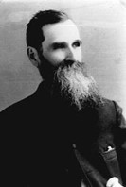
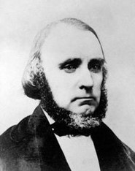
Background
May 16, 1843
Joseph Smith and William Clayton stayed at the home of Benjamin F. Johnson, where before retiring the Prophet gave some instructions on the priesthood to Brother and Sister Johnson.
During that evening he turned to William Clayton, placed his hand on his knee, and said,
“Your life is hid with Christ in God, and so are many others. Nothing but the unpardonable sin can prevent you from inheriting eternal life for you are sealed up by the power of the Priesthood unto eternal life, having taken the step necessary for that purpose.”
The Prophet Joseph Smith, in company with William Clayton, George Miller, Eliza and Lydia Partridge, and J.M. Smith, left Nauvoo for Ramus, Illinois, twenty-two miles to the southeast from Nauvoo.
(History of the Church, 5:391.)

Slide 3
Doctrine and Covenants 131
If the lock represents entrance into the highest degree of the celestial kingdom, what does the combination represent?
0….5...10…15…20...25...30...35….

Slide 4
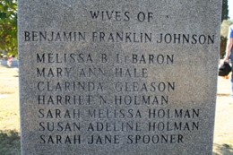
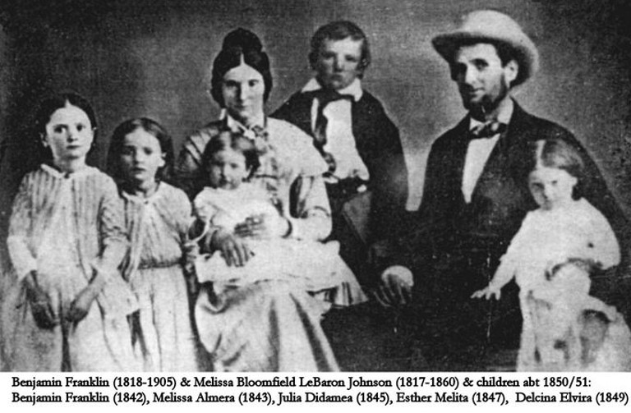
Sealing—Celestial Glory
Joseph Smith performed the sealing as husband and wife for eternity for Benjamin F. and Melissa Johnson.
He also taught them how eternal marriage is related to the celestial kingdom.
Receiving the highest degree of glory within the celestial kingdom as exaltation or eternal life.
D&C 131:1-4

Slide 5
New and Everlasting Covenant
To become like God and live with Him again in the celestial kingdom, we must enter the new and everlasting covenant of marriage.
The word new in this context means that this covenant was newly restored in our dispensation.
The term everlasting means that this essential covenant will endure through eternity.
In what ways do you think celestial marriage between a man and a woman prepares them for exaltation?
D&C 131:1-4

Slide 6
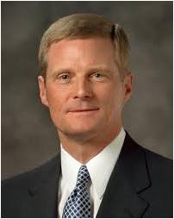

“Two compelling doctrinal reasons help us to understand why eternal marriage is essential to the Father’s plan.
“Reason 1: The natures of male and female spirits complete and perfect each other, and therefore men and women are intended to progress together toward exaltation. …
“By divine design, men and women are intended to progress together toward perfection and a fulness of glory. Because of their distinctive temperaments and capacities, males and females each bring to a marriage relationship unique perspectives and experiences.
The man and the woman contribute differently but equally to a oneness and a unity that can be achieved in no other way.
The man completes and perfects the woman and the woman completes and perfects the man as they learn from and mutually strengthen and bless each other. …
“Reason 2: By divine design, both a man and a woman are needed to bring children into mortality and to provide the best setting for the rearing and nurturing of children.”
D&C 131:1-4 Elder David A. Bednar

Slide 7



Marriage in the Lord’s House
Why is marriage between a man and a woman necessary for our exaltation?
How could understanding the doctrine that celestial marriage is essential for exaltation affect what you look for in a future spouse?
Why is it important at your age to make it a priority to prepare to be married eternally in the temple?
D&C 131:1-4

Slide 8


Exaltation Available To All
The blessings of exaltation will be available to those who do not have the opportunity for a celestial marriage in this life
“Some members of the Church remain single through no fault of their own, even though they want to marry.
If you find yourself in this situation, be assured that ‘all things work together for good to them that love God’ (Romans 8:28).
As you remain worthy, you will someday, in this life or the next, be given all the blessings of an eternal family relationship.”
D&C 131:1-4 True to the Faith

Slide 9
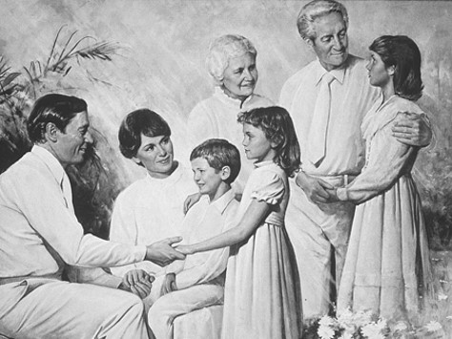
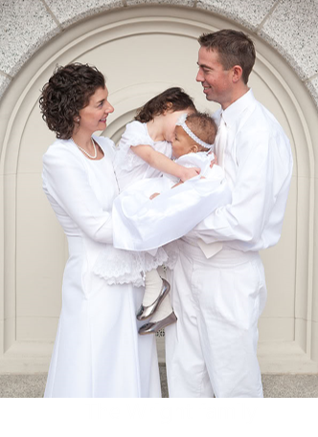
Eternal Increase
Only resurrected and glorified beings can become parents of spirit offspring
Message of First Presidency
“Except a man and his wife enter into an everlasting covenant and be married for eternity, while in this probation, by the power and authority of the Holy Priesthood, they will cease to increase when they die; that is, they will not have any children after the resurrection.
But those who are married by the power and authority of the priesthood in this life, and continue without committing the sin against the Holy Ghost, will continue to increase and have children in the celestial glory.” HC
D&C 131:1-4

Slide 10
Doctrinal Mastery
In the celestial glory there are three heavens or degrees;
And in order to obtain the highest, a man must enter into this order of the priesthood [meaning the new and everlasting covenant of marriage];
And if he does not, he cannot obtain it.
He may enter into the other, but that is the end of his kingdom; he cannot have an increase.
D&C 131:1-4

Slide 11
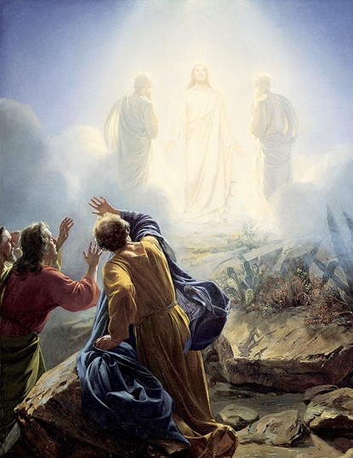
More Sure Word of Prophecy
May 17, 1843
“Those members of the Church who devote themselves wholly to righteousness, living by every word that proceedeth forth from the mouth of God, make their calling and election sure.
That is, they receive the more sure word of prophecy, which means that the Lord seals their exaltation upon them while they are yet in this life.
Peter summarized the course of righteousness which the saints must pursue to make their calling and election sure and then (referring to his experience on the Mount of Transfiguration with James and John) said that those three had received this more sure word of prophecy. (2 Pet. 1.) …
D&C 131:5 Elder Bruce R. McConkie

Slide 12
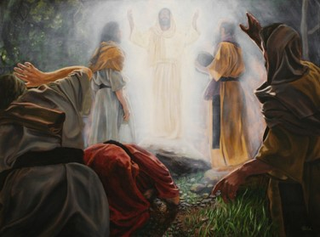
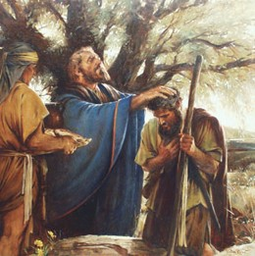
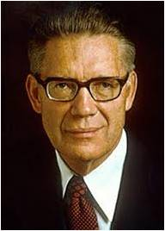
Alma is Promised Eternal Life
“Those so favored of the Lord are sealed up against all manner of sin and blasphemy except the blasphemy against the Holy Ghost and the shedding of innocent blood. That is, their exaltation is assured; their calling and election is made sure, because they have obeyed the fulness of God’s laws and have overcome the world.”
Thou art my servant; and I covenant with thee that thou shalt have eternal life; and thou shalt serve me and go forth in my name, and shalt gather together my sheep.
Mosiah 26:20
D&C 131:5 Elder Bruce R. McConkie

Slide 13


Ignorance
Lack of knowledge or information.
What might prevent someone from receiving eternal life?
“A man is saved no faster than he gets knowledge, for if he does not get knowledge, he will be brought into captivity by some evil power in the other world, as evil spirits will have more knowledge, and consequently more power than many men who are on the earth. Hence it needs revelation to assist us, and give us knowledge of the things of God.”
HC
D&C 131:6

Slide 14
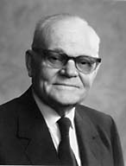
“Knowledge of ‘the only true God, and Jesus Christ’ is the most important knowledge in the universe; it is the knowledge without which the Prophet Joseph Smith said no man could be saved. The lack of it is the ignorance referred to in the revelation wherein it is written: ‘It is impossible for a man to be saved in ignorance.’”
Knowledge
Ignorance
And this is life eternal, that they might know thee the only true God, and Jesus Christ, whom thou hast sent.
John 17:3
D&C 131:6 President Marion G. Romney

Slide 15

Spirit Matter More Fine and Pure
Nothing is made out of nothing
“All material organization in our world is produced from the earth, or from its own elements, as we daily witness while there is not a single instance of a thing, or being, produced from nothing, so far as has come within the sphere of man’s observation.
All creations are composed of matter, but spirit matter is “more fine or pure.
D&C 131:7-8

Slide 16
Sources:
Videos:
“Eternal Marriage, an Apostolic Perspective” (5:26),
Enduring Love (4:16)
Knowledge of God and Jesus Christ (0:40)
The Glory of God is Intelligence (3:17)
Elder David A. Bednar (“Marriage Is Essential to His Eternal Plan,” Ensign, June 2006, 83–84; boldface and italics removed).
True to the Faith: A Gospel Reference [2004], 99.
History of the Church, 5:391; 4:588;
see also Smith, Teachings, pp. 300–301.
Joseph F. Smith, Anthon H. Lund, and Charles W. Penrose Messages of the First Presidency,5:34 in 1910
Presentation by ©http://fashionsbylynda.com/blog/
Elder Bruce R. McConkie Mormon Doctrine, pp. 109–10
President Marion G. Romney (“Except a Man Be Born Again,” Ensign, Nov. 1981, 14).
Presentation by ©http://fashionsbylynda.com/blog/

Slide 17
William H. Clayton (July 17, 1814 – December 4, 1879) was an early leader in the Church of Jesus Christ of Latter Day Saints and acted as a clerk and scribe to the Mormon religious leader Joseph Smith. Clayton, born in England, is recognized as an American pioneer journalist, scribe, inventor, lyricist and musician.
Clayton was born in Penwortham, Lancashire, England, the son of Thomas Clayton and Ann Critchley. He was the eldest of fourteen children. He married Ruth Moon on October 9, 1836.
In 1836, Clayton investigated the Church of the Latter Day Saints. Taught by church apostles Heber C. Kimball and Orson Hyde, Clayton was baptized October 21, 1837; ordained a priest in December; and a high priest on April 1, 1838. Clayton's parents and siblings also joined the church. Clayton put aside his employment as a factory clerk to devote his time to missionary service in England, and was successful in founding a branch of the church in Manchester. In 1838, he served as second counselor to the British mission president Joseph Fielding, with Willard Richards as first counselor.
In September 1840, Clayton led a group of British converts and emigrated to the United States. He and his family first attempted to farm in Iowa Territory, then settled in the predominantly Latter Day Saint community of Nauvoo, Illinois. There he acted as a clerk and scribe to Joseph Smith. In an 1840 letter, now held in archives of The Church of Jesus Christ of Latter-day Saints (LDS Church), Clayton wrote to church members in Manchester about interacting with Smith.
Early in February 1846, Clayton left Nauvoo with the first Latter Day Saint group in their exodus to the West. He spent the winter of 1846-47 at Winter Quarters, Nebraska. The following year, Clayton was a member of the initial vanguard company that crossed the plains to select a western site for Mormon colonization. He acted as recording scribe for Brigham Young, President of the LDS Quorum of the Twelve Apostles, during the journey. The group traveled along the Platte River, into present day Wyoming territory and crossed the continental divide, ultimately reaching the Great Salt Lake Valley in modern Utah.
Clayton's pioneer journal, later published, is the most well-known account of the expedition. He noted that land in the Salt Lake valley would be easy to clear as it had limited timber, and expressed concern over the apparent scarcity of rainfall. He later prepared and published The Latter-day Saints' Emigrants' Guide, a meticulous description of the route from Winter Quarters to Salt Lake City, with suggestions for camping places. Using his odometer, the guide had the most accurate distances of the day. It was a valuable guide for Mormon migrants, but was also used by pioneers bound for the Oregon and California territories.
In April 1846, while camped near Locust Creek on the plains of Iowa, Clayton wrote the words to the popular LDS hymn, now known as "Come, Come, Ye Saints" which is sung to the music of a traditional English song, "All is Well." The hymn was in response to good news from Mormons still living in Nauvoo.
Some of Clayton's other poems have also been put to music, including "When First the Glorious Light of Truth", also used as a hymn by the LDS Church.
Clayton is credited with inventing a version of the modern odometer, during this trip across the plains from Missouri to Utah, with the help of Apostle and mathematician Orson Pratt. He was assigned to record the number of miles the company traveled each day. This was accomplished by tying a red flag onto one of the wagon wheels, and counting the revolutions. After three weeks, Clayton tired of personally counting the revolutions of a wagon wheel and computing the day's distance by multiplying the count by the wheel's circumference. After consulting with Pratt, he developed a design consisting of a set of wooden cog wheels attached to the hub of a wagon wheel, with the mechanism "counting" or recording by position the revolutions of the wheel. The apparatus was built by the company's carpenter Appleton Milo Harmon. Clayton's journal records: "About noon today Brother Appleton Harmon completed the machinery on the wagon called a 'roadometer' by adding a wheel to revolve once in ten miles, showing each mile and also each quarter mile we travel, and then casing the whole over so as to secure it from the weather." The "roadometer" was first used on the morning of May 12, 1847.
Once settled in Utah, Clayton continued to help maintain church records as well as participating in various public and private business activities. He became an auditor for the Territory of Utah, as well as recorder of marks and brands, holding both positions until his death. He also worked as treasurer of the Deseret Telegraph Company and as secretary of Zion's Co-operative Mercantile Institution (ZCMI), a church based cooperative business enterprise. Private ventures included collecting debts, filing land claims, acting as a legal advocate, lending money, merchandising, farming, and mining speculation.
Clayton was active in cultural activities in the Salt Lake Valley, particularly those associated with music. He died in Salt Lake City on December 4, 1879. He was buried at Salt Lake City Cemetery.
Wikipedia

Slide 18
Benjamin Franklin Johnson (July 28, 1818 – November 18, 1905) was an early member of The Church of Jesus Christ of Latter-day Saints and a brickmaker, merchant, tavern keeper, leatherworker, farmer, nurseryman, and beekeeper. Born to Ezekiel Johnson and Julia Hills at Pomfret, New York, he moved to Kirtland, Ohio in 1833. He married Melissa Bloomfield LeBaron on Christmas Day, December 25, 1841.
Johnson was baptized into the LDS church at Kirtland by Lyman E. Johnson in the spring of 1835. Heber C. Kimball ordained him an elder March 10, 1839 at Far West, Missouri and John Smith ordained him a high priest in 1843 at Ramus, Illinois. He served as a missionary for his new faith to the eastern United States and Upper Canada between 1840 and 1842. He was appointed to Joseph Smith’s Council of Fifty in 1843.
In 1838 he moved to Adam-ondi-Ahman, Missouri. He moved to Springfield, Illinois in 1839, Ramus (later Webster) in 1842, Nauvoo in 1845, and Bonaparte, Iowa Territory in 1846. In 1848 he arrived in the Salt Lake Valley and served in the Utah territorial legislature from 1855 to 1867. Johnson left Utah for the Arizona Territory in 1882, settling in Tempe before going to Colonia Diaz, Chihuahua, Mexico in 1890 and returning to Arizona in 1892. He died at Mesa.
Johnson was an early member of The Church of Jesus Christ of Latter-day Saints, and a member of the Council of Fifty and a formerly private secretary to Joseph Smith. He also served fourteen terms in the Utah State Legislature Wikipedia.
Benjamin F. Johnson (1818–69) was a close friend of the Prophet Joseph Smith. He served for a time as the Prophet’s private secretary. He was one of the original pioneers who entered the Salt Lake Valley on 22 October 1848. He later served as a patriarch.
Church History In The Fulness Of Times Student Manual, (2003), 286–296 Chapter 23
Eternal Progression:
On 30 June 1916, the First Presidency of the Church (Joseph F. Smith, Anthon H. Lund, and Charles W. Penrose) declared: “So far as the stages of eternal progression and attainment have been made known through divine revelation, we are to understand that only resurrected and glorified beings can become parents of spirit offspring. Only such exalted souls have reached maturity in the appointed course of eternal life; and the spirits born to them in the eternal worlds will pass in due sequence through the several stages or estates by which the glorified parents have attained exaltation.” (In Clark, Messages of the First Presidency,5:34.)
Eternal Increase:
President Spencer W. Kimball taught that the right to eternal increase will depend directly on how individuals keep the marriage covenant in this life:
“One young man said that he expected to reach exaltation in the celestial kingdom as one of the Lord’s messengers, without having to marry. He does not understand. No one who rejects the covenant of celestial marriage can reach exaltation in the eternal kingdom of God.
“‘In the celestial glory there are three heavens or degrees;
"‘And in order to obtain the highest, a man must enter into this order of the priesthood [meaning the new and everlasting covenant of marriage];
“‘And if he does not, he cannot obtain it.
“‘He may enter into the other, but that is the end of his kingdom; he cannot have an increase.’ (D&C 131:1–4.)
“He cannot have an increase! He cannot have exaltation!
“The Lord says further in the 132nd section of the Doctrine and Covenants:
“‘No one can reject this covenant and be permitted to enter into my glory’ (D&C 132:4).
“No one! It matters not how righteous they may have been, how intelligent or how well trained they are. No one will enter this highest glory unless he enters into the covenant, and this means the new and everlasting covenant of marriage.” (“The Importance of Celestial Marriage,” Ensign, Oct. 1979, pp. 5–6.)
Celestial Marriage:
Elder George Q. Cannon taught: “We believe that when a man and woman are united as husband and wife, and they love each other, their hearts and feelings are one, that that love is as enduring as eternity itself, and that when death overtakes them it will neither extinguish nor cool that love, but that it will brighten and kindle it to a purer flame, and that it will endure through eternity; and that if we have offspring they will be with us and our mutual associations will be one of the chief joys of the heaven to which we are hastening. … God has restored the everlasting priesthood, by which ties can be formed, consecrated and consummated, which shall be as enduring as we ourselves are enduring, that is, as our spiritual nature; and husbands and wives will be united together, and they and their children will dwell and associate together eternally, and this, as I have said, will constitute one of the chief joys of heaven; and we look forward to it with delightful anticipations.” (In Journal of Discourses, 14:320–21; see also Notes and Commentary for D&C 22:1; 132:13–18.)

