Slide 1

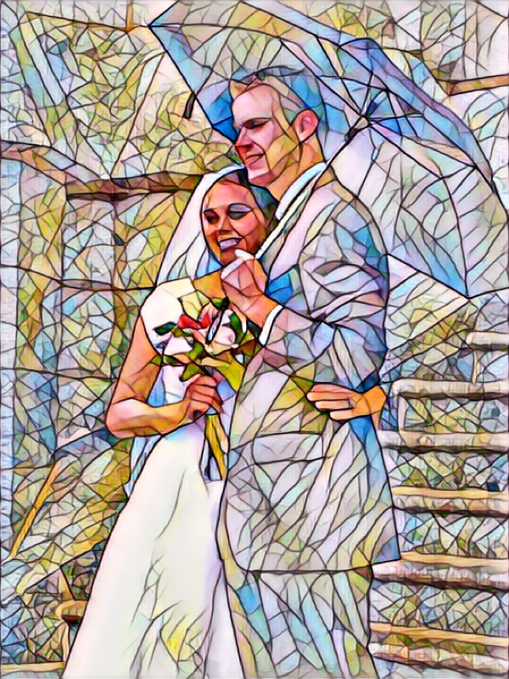
The New And Everlasting Covenant
Doctrine and Covenants 132:3-33
And the Lord God said, It is not good that the man should be alone; I will make him an help meet for him. Genesis 2:18
Presentation by ©http://fashionsbylynda.com/blog/

Slide 2

Eternal Marriage
What will you do, beginning today, to prepare yourself to enter the temple and be married for time and all eternity?
Why is eternal marriage important to you?
What blessings can come in this life to those who obey God’s law to be sealed in the temple?
Therefore shall a man leave his father and his mother, and shall cleave unto his wife: and they shall be one flesh.
Genesis 2:24

Slide 3
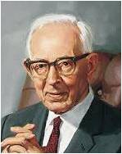
The New And Everlasting Covenant
“Now there is a clear-cut definition in detail of the new and everlasting covenant. It is everything—the fulness of the gospel. So marriage properly performed, baptism, ordination to the priesthood, everything else—every contract, every obligation, every performance that pertains to the gospel of Jesus Christ, which is sealed by the Holy Spirit of promise according to his law here given, is a part of the new and everlasting covenant”
Joseph Fielding Smith

Slide 4
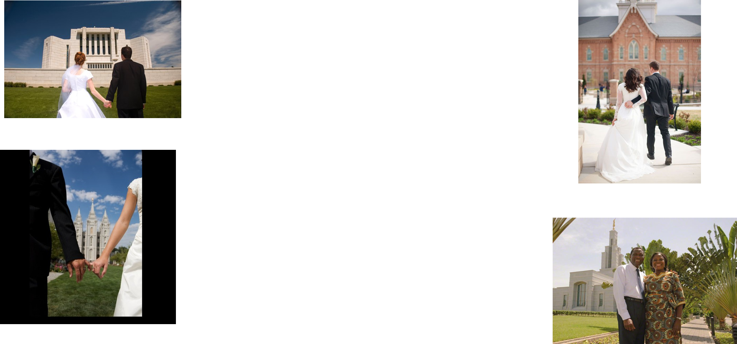
A Common Goal For Latter-day Saints
In “The Family: A Proclamation to the World,” the First Presidency and Quorum of the Twelve Apostles proclaim that “marriage between a man and a woman is ordained of God and that the family is central to the Creator’s plan for the eternal destiny of His children.” When a man and woman are married in the temple, their family can be together forever.

Slide 5

Rejection of…
What is the result of rejecting the new and everlasting covenant?
damned means that a person is stopped in his or her eternal progression
D&C 132:3-5

Slide 6
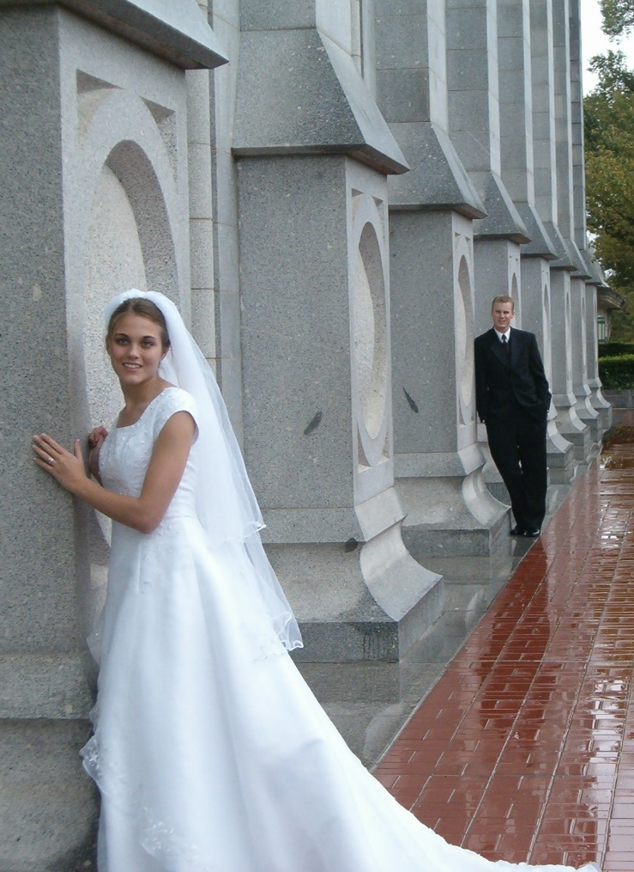
Promises of…
What do we receive if we are faithful in the new and everlasting covenant?
receiving “the fulness of [the Lord’s] glory.”)
D&C 132:6

Slide 7

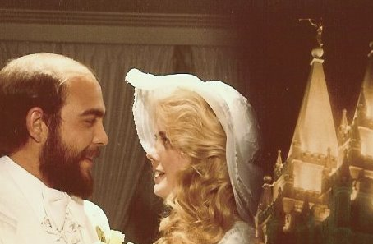
Manmade Contracts
What happens to manmade contracts?
They end at death
What two things must happen for covenants to be binding after we die?
They must be made through priesthood authority, and they must be “entered into and sealed by the Holy Spirit of promise.”
D&C 132:7

Slide 8
The Holy Ghost is the Holy Spirit of Promise
The Holy Spirit of Promise witnesses to the Father that the saving ordinances have been performed properly and that the covenants associated with them have been kept”
Guide to the Scriptures
Unless a covenant is made through the proper priesthood authority and sealed by the Holy Spirit of Promise, it will end at death
When a covenant is made through the proper priesthood authority and is sealed by the Holy Spirit of Promise, it will last forever
D&C 132:7

Slide 9
Conditions the Lord Set
The Lord declared that everything He establishes will remain forever but that everything else will eventually be destroyed
Question 1:
Will I accept of an offering that is not made in my name?
Question 2:
Will I receive that…which I have not appointed?
Question 3:
Will I appoint unto you anything that did not accord with the laws and ordinances of the gospel as they have existed since before the world was created?
Were He to do so, He would negate the purpose of priesthood authority. Priesthood authority is either necessary or it is not, we cannot have it both ways
To respond in the affirmative would be to liken the system of salvation to a flea market where we barter and trade for blessings of salvation
If God were at liberty to change the terms that constitute the covenant of salvation as he may choose, we would be without any sure knowledge that the course we were following was approved by Him.
“Only the knowledge that God is constant, that he changes not, that all principles that flow from Him are everlastingly the same, enables us to exercise faith in Him. If God is not God of order, he is no God at all.”
D&C 132:8-14 McConkie and Ostler

Slide 10
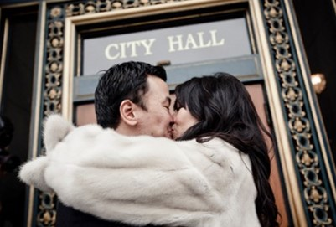

“Till Death Do Us Part”
Example 1: A man and woman fall in love, keep the law of chastity, and are happily married by a local government leader. They are not sealed in a temple. Their marriage ceremony includes the words “till death do you part.” A few years later, the husband is killed in an accident.
What truths taught in Doctrine and Covenants 132:15–17 apply?
Example 2: A man and woman are married. They promise one another that they will always love each other and that they will always be together, but they are not sealed in a temple. They believe that because of their love, God will allow them to be together forever.
What truths taught in Doctrine and Covenants 132:18 apply?
Their marriage will not continue after they die.
The husband and wife are no longer married.
D&C 132:15

Slide 11
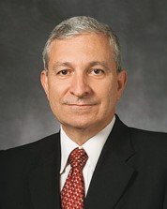
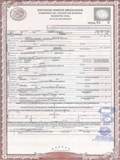
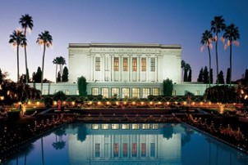
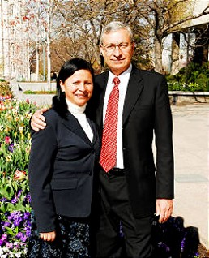
For All Time and All Eternity
“When I returned from my mission, I met a beautiful young woman. … She captivated me from the first moment I saw her.
“My wife had set the goal to get married in the temple, although back then the nearest temple required a trip of over 4,000 miles (6,400 km).
“Our civil marriage ceremony was both happy and sad, for we were married with an expiration date.
The officer pronounced the words ‘And now I declare you husband and wife,’ but immediately after, he said, ‘until death do you part.’
“So with sacrifice we set out to purchase a one-way ticket to the Mesa Arizona Temple.
“In the temple, as we were kneeling down at the altar, an authorized servant pronounced the words I longed for, which declared us husband and wife for time and for all eternity”
Elder Enrique R. Falabella
D&C 132:19-33

Slide 12
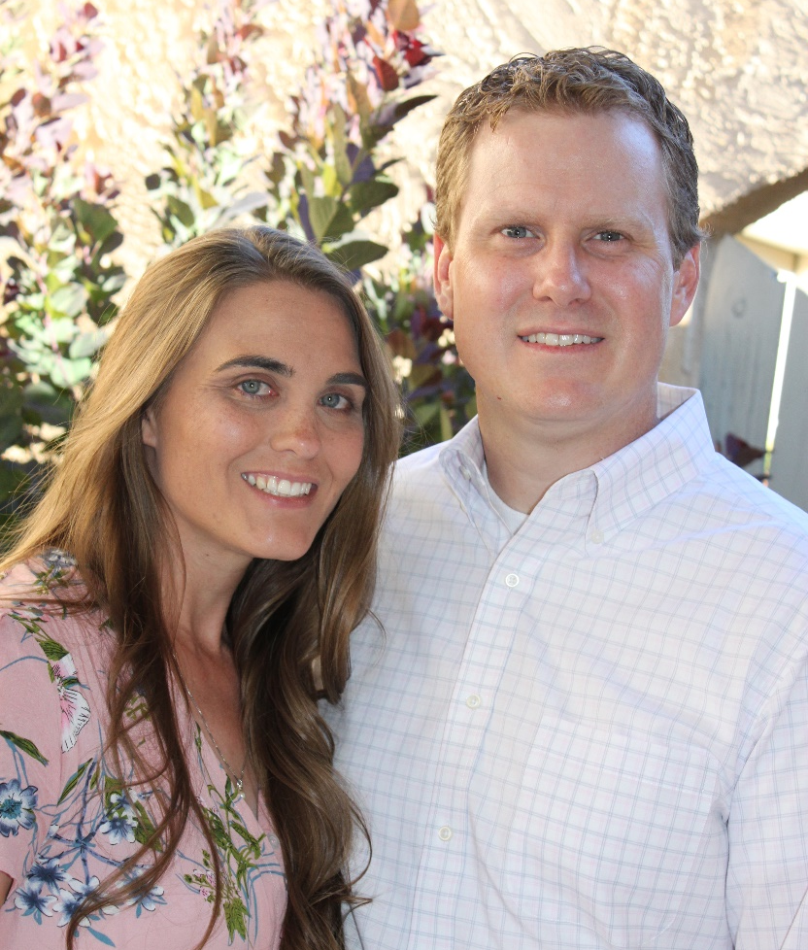
For All Time and All Eternity
Abide in my covenant--to accept or continue,
Abide in my covenant—to remain true to the Lord’s covenant and law
Promises that if a man and woman marry in “the new and everlasting covenant” and “it is sealed unto them by the Holy Spirit of promise,” then they “shall come forth in the first resurrection; and … inherit thrones, kingdoms, principalities, and powers,”
As long as they “abide in [the] covenant, and commit no murder whereby to shed innocent blood.
A continuation of the seeds forever and ever--and “they continue”-- refer to the promise that our families and our posterity can continue throughout eternity.
D&C 132:19-21

Slide 13

If…Then
If a man and a woman abide in the new and everlasting covenant of marriage, then they will receive exaltation and glory.
If a man and a woman abide in the new and everlasting covenant of marriage, then they will have an eternal increase of posterity.
If a man and a woman abide in the new and everlasting covenant of marriage, then their marriage will be in force through all eternity.
If a man and a woman abide in the new and everlasting covenant of marriage, then they will become like God.
D&C 132:19-21

Slide 14

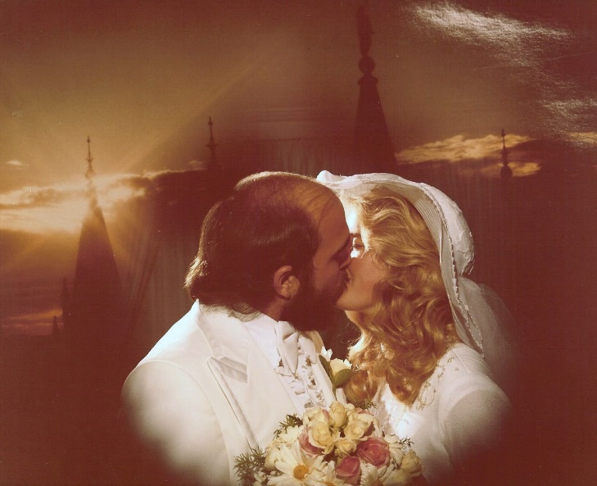
Last Example
Example 3: A young man and a young woman are sealed in a holy temple by priesthood authority. They both live faithfully and keep their covenants.
What truths taught in Doctrine and Covenants 132:19–21 apply after they die?
Their marriage will continue forever. They will become like their Father in Heaven and will be blessed with glory, exaltation, and an eternal family.
Do you think once you are married in the temple you will automatically be saved and have eternal life with your partner?
What must you do to retain those celestial blessings?
By being obedient to all the ordinances of salvation, being virtuous and worthy, loving one another, working together to be good parents, rearing children in love and righteousness, forgiving one another of human mistakes, and returning to the temple together regularly.
D&C 132:19-21

Slide 15

Broad and Wide
Enter ye in at the strait gate: for wide is the gate, and broad is the way, that leadeth to destruction, and many there be which go in thereat: Matthew 7:13
Most people want more latitude than the narrow road can give. Almost all failure begins by merely broadening the way.
Because the road leading to death is broad enough to permit many forbidden activities, many travelers never arrive at their desired destinations.
No one ever leaves the success highway at right angles; instead of acknowledging that they are stepping out of bounds, they try to keep in good standing with themselves and make things appear legal to others by merely broadening the way.
“Everyone wants to be successful and happy, and yet many fall down. The primary reason for failure is the natural tendency to want a broader road than any real success will permit. The broad road leading to destruction maintains its popularity because it is easier to follow.”
D&C 132:22-25 Excerpts from Elder Sterling W. Sill

Slide 16

Narrow and Exact
One leads to exaltation. A narrow or exacting, allowing for no wandering off course.
Because strait is the gate, and narrow is the way, which leadeth unto life, and few there be that find it.
Matthew 7:13-14
This narrow-road concept—with the exact meaning that Jesus attached to it in a spiritual sense—is also important for reaching high objectives in every other area of pursuit, whether it be intellectual, social, physical, or financial.
The road to every success and every happiness is narrow; we must keep ourselves within its bounds; and we must make certain that the road itself leads to the right destination.
D&C 132:22-25 Excerpts from Elder Sterling W. Sill

Slide 17
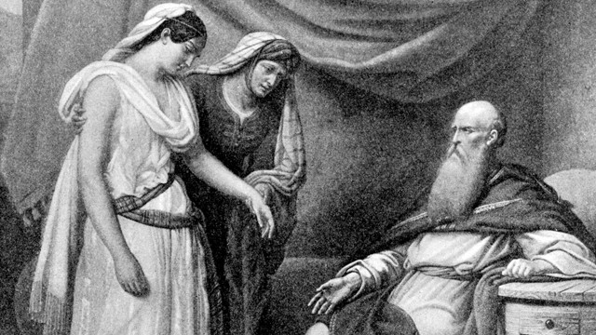
Abraham
In these verses the Lord answers the Prophet’s original question about whether Abraham and the other early patriarchs were justified in having plural wives.
The Lord began by saying that Abraham has now entered his exaltation because he faithfully received the promises and commandments of the Lord. The same promises are offered to modern Saints, and the Lord commands that they too should “do the works of Abraham.”
This is not a commandment to engage in plural marriage but rather a commandment for the Saints to receive the covenants and commandments of God in the same faith and righteousness as Abraham did.
D&C 132:29-33 Student Manual

Slide 18
Sources:
Videos:
Holy Spirit of Promise (0:53)
For All Eternity (1:11)
Hyrum M. Smith and Janne M. Sjodahl Doctrine and Covenants Commentary pg. 821
Official Declaration 1 Manifesto Doctrine and Covenants Student Manual, 2002
Presentation by ©http://fashionsbylynda.com/blog/
Joseph Fielding Smith (Doctrines of Salvation, comp. Bruce R. McConkie, 3 vols. [1954–56], 1:158; italics removed).
Joseph Fielding McConkie and Craig J. Ostler Revelations of the Restoration pg. 1061
Elder Enrique R. Falabella (“The Home: The School of Life,” Ensign or Liahona, May 2013, 102).
Elder Sterling W. Sill The Strait Gate July 1980 Ensign
Doctrine and Covenants Student Manual Religion 324-325 Section 132
Presentation by ©http://fashionsbylynda.com/blog/

Slide 19
Traditional Wedding Vows:
I, (name), take you, (name), to be my [opt: lawfully wedded] (husband/wife), my constant friend, my faithful partner and my love from this day forward. In the presence of God, our family and friends, I offer you my solemn vow to be your faithful partner in sickness and in health, in good times and in bad, and in joy as well as in sorrow. I promise to love you unconditionally, to support you in your goals, to honor and respect you, to laugh with you and cry with you, and to cherish you for as long as we both shall live.
http://christianity.about.com/od/christianweddingelements/qt/weddingvows.htm
Traditional Roman Catholic:
Priest: "Do you take ___ as your lawful wife/husband, to have and to hold, from this day forward, for better or for worse, for richer or for poorer, in sickness and in health, to love and cherish until death do you part?"
Bride/Groom: "I do" Bride/Groom: "I take this ring as a sign of my love and faithfulness in the name of the father, the son and the holy spirit." "
Or:
Priest: "___, will you take ___ here present, for your lawful wedded wife/husband according to the rite of our Holy Mother, the Catholic Church?" ("I will")
Bride/Groom Repeat: "I, ___ take you, ___ for my wife/husband, to have and to hold, from this day forward, for better, for worse, for richer, for poorer, in sickness and in health, until death do us part."
Bride/Groom: "With this ring I thee wed, and pledge thee my troth?”
- See more at: http://www.weddingclipart.com/guide/wedding-vows/Catholic-Wedding-Vows.html#sthash.QkEERoYL.dpuf
Elder Enrique R. Falabella
First Quorum of the Seventy Elder Enrique R. Falabella was called to serve as a member of the First Quorum of the Seventy of The Church of Jesus Christ of Latter-day Saints on March 31, 2007, at age 56. He served previously as an Area Seventy in the Central America Area and as a member of the Fourth Quorum of the Seventy from April 1997 to August 2003. As an Area Seventy he served as first and second counselor in the Central America Area, and after his call to the First Quorum he continued to serve in the Area Presidency, most recently as president. He is currently serving at Church headquarters as an area assistant to the Utah areas.
Prior to his call as a General Authority, Elder Falabella served in numerous Church callings over the years, including full-time missionary in Central America during 1970-1972, stake mission president, bishop, and stake president. He served ten years as a regional representative in Guatemala and Costa Rica and two years as an Area Authority.
Elder Falabella was educated in Guatemala, earning a degree in agronomy from the Universidad de San Carlos de Guatemala in 1975. He later studied marketing at the Universidad de Costa Rica. He worked for Bayer for a number of years, and at the time of his call to full-time Church service, was country manager of Bayer in Guatemala, El Salvador, and Belize.
Enrique Rienzi Falabella Arellano was born in Guatemala City, Guatemala, in May of 1950. He is the son of Udine Falabella, one of the pioneers of the Church in Guatemala. He married Blanca Lidia Sanchez in 1975. They are the parents of five children and have ten grandchildren.
General Authorities and General Officers—Elder Enrique R. Falabella
Temple Marriage Are you Safe:
President Harold B. Lee taught: “Some folks have the mistaken notion that if somehow, by hook or crook, they can get into the House of the Lord and be married they are assured of exaltation regardless of what they do, and they’ll quote the 132 Section, the 26th verse. But that isn’t what the Lord means. The Lord does assure an exaltation to those who make mistakes, if they repent.” (Cram for Life’s Final Examination, Brigham Young University Speeches of the Year [Provo, 5 Jan. 1954], p. 7.)
Abraham, an example:
Spencer W. Kimball said:
“Abraham was true with God in all respects. Oft cited is the instance when Abraham gave to God ‘tithes of all.’ Do you think it was any easier for Abraham to be righteous than it is for you? Do you inwardly suspect that Abraham was given a little extra help by the Lord so that he could become a great and righteous man, or do you feel that we can all become as Abraham if we will learn to put God first in our lives? I testify to you that we can become as Abraham, who now, as a result of his valiance, ‘hath entered into his exaltation and sitteth upon his throne.’ (D&C 132:29.) Is such exaltation a blessing reserved only for General Authorities, or stake presidents, or quorum presidents, or bishops? It is not. It is a blessing reserved for all who will prepare themselves by forsaking their sins, by truly receiving the Holy Ghost into their lives, and by following the example Abraham has set.
“If members of the Church could only have such integrity, such obedience, such revelation, such faith, such service as Abraham had! If parents would seek the blessings Abraham sought, they could also receive such revelation, covenants, promises, and eternal rewards as Abraham received.” (“The Example of Abraham,” Ensign, June 1975, pp. 6–7.)

