Slide 1
Doctrine and Covenants 133:36-74
Coming Down From God
But in those days, after that tribulation, the sun shall be darkened, and the moon shall not give her light, And the stars of heaven shall fall, and the powers that are in heaven shall be shaken.
And then shall they see the Son of man coming in the clouds with great power and glory.
Mark 13:24-26
Presentation by http://fashionsbylynda.com/blog/

Slide 2

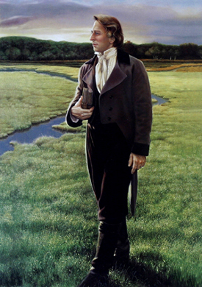
Background
November 3, 1831
“At this time there were many things which the Elders desired to know relative to preaching the Gospel to the inhabitants of the earth, and concerning the gathering; and in order to walk by the true light, and be instructed from on high, on the 3rd of November 1831, I inquired of the Lord and received the following important revelation.”
Joseph Smith—headline to D&C 133
This section was first added to the Book of Doctrine and Covenants as an appendix and was subsequently assigned a section number.

Slide 3
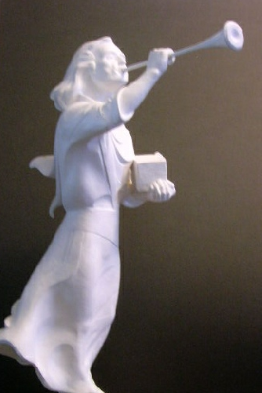
Mighty Angels Flying
And I saw another angel fly in the midst of heaven, having the everlasting gospel to preach unto them that dwell on the earth, and to every nation, and kindred, and tongue, and people.
Revelation 14:6
“This Church is the only Church upon the face of the earth who has claimed that angels from heaven have restored the everlasting gospel on the earth.”
The angels will announce that John the Revelator’s prophecy has been fulfilled
“These verses confirm that it was Moroni and the Book of Mormon of which John wrote.”
The Angel Moroni invites all to worship God
D&C 133:36 McConkie and Ostler

Slide 4
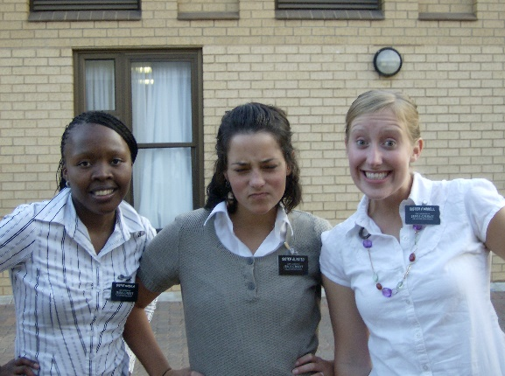
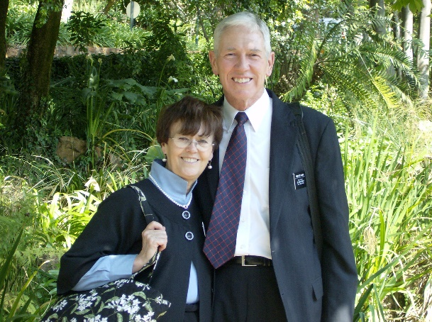
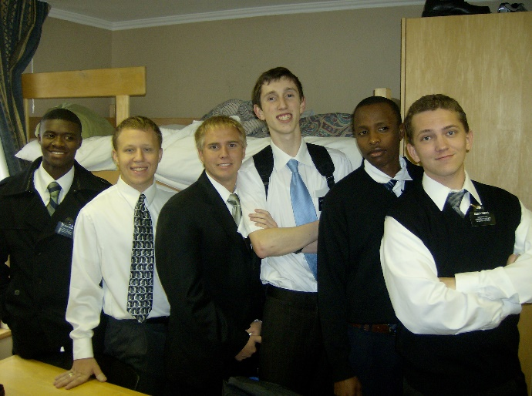

The Servants Who Preach
He is also sending His servants to preach the gospel to all people
Who are the servants of God who will be preaching the message of the restored gospel?
All members of the Church are servants of God who have the responsibility to share the gospel with others.
As servants of God, we can help others prepare for the Second Coming by sharing the gospel with them
D&C 133:37

Slide 5
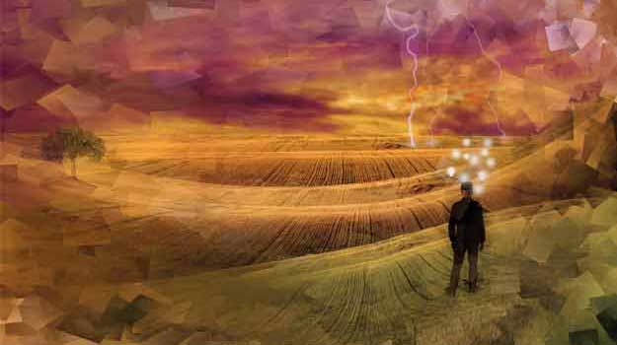
His Judgement is Come
The Moment of Life or Death
Saying with a loud voice, Fear God, and give glory to him; for the hour of his judgment is come: and worship him that made heaven, and earth, and the sea, and the fountains of waters.
Revelation 14:7
We will be judged according to our thoughts, words, deeds, and the desires of our hearts
For our words will condemn us, yea, all our works will condemn us; we shall not be found spotless; and our thoughts will also condemn us; and in this awful state we shall not dare to look up to our God; and we would fain be glad if we could command the rocks and the mountains to fall upon us to hide us from his presence.
Alma 12:14
D&C 133:38

Slide 6
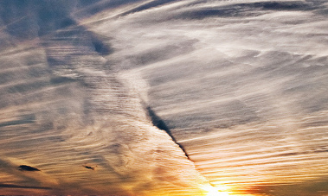

Calling Upon the Lord
Rend the Heavens—tear the veil so that God can be seen McConkie and Ostler
Prayer is a supernal gift of our Father in Heaven to every soul. Think of it: the absolute Supreme Being, the most all-knowing, all-seeing, all-powerful personage, encourages you and me, as insignificant as we are, to converse with Him as our Father. Actually, because He knows how desperately we need His guidance, He commands.”
Elder Richard G. Scott
And again, I command thee that thou shalt pray vocally as well as in thy heart; yea, before the world as well as in secret, in public as well as in private.
D&C 19:28
The servants will pray for the Savior’s return
D&C 133:39-40

Slide 7
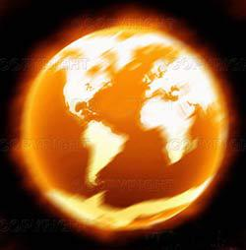

Those Who Wait
“To any of you who are troubled about the future …
“God expects you to have enough faith and determination and enough trust in Him to keep moving, keep living, keep rejoicing. In fact, He expects you not simply to face the future (that sounds pretty grim and stoic);
He expects you to embrace and shape the future—to love it and rejoice in it and delight in your opportunities.
Melting fire—a fire of such heat that it melts the very elements of the earth
McConkie and Ostler
“God is anxiously waiting for the chance to answer your prayers and fulfill your dreams, just as He always has.
But He can’t if you don’t pray, and He can’t if you don’t dream. In short, He can’t if you don’t believe.”
D&C 133:41-45 Elder Jeffrey R. Holland

Slide 8
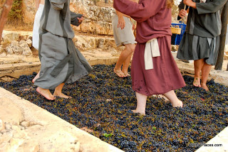
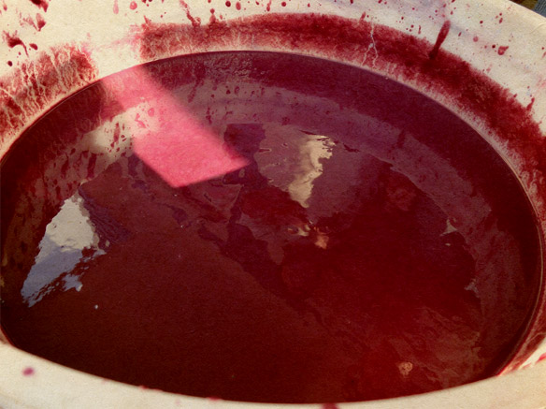
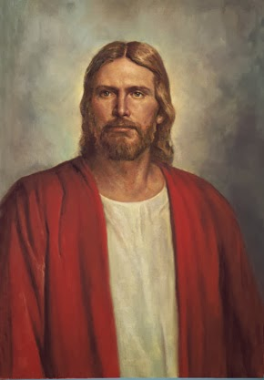
The Color of Red
“In ancient times in some parts of the world, people used to squeeze the juice out of the grapes by placing the grapes in a wine vat and then stomping on them. Naturally, the clothes of those persons who ‘treadeth in the wine-vat’ were soon stained with the grape juice and became the same color.
When the Savior appears in the last days, his garments will be red.”
Ludlow
Wherefore art thou red in thine apparel, and thy garments like him that treadeth in the winefat?
Isaiah 63:2
Wine in Doctrine and Covenants 133:48–51, as in the sacrament, suggests blood, both Christ’s blood when He worked out the Atonement alone, and the blood of vengeance on the wicked at the Second Coming.
Student Manual
The wicked who refuse to repent must suffer the demands of justice and will not be able to abide the day of the Second Coming.
The red color of the Lord’s garments represents the blood of the wicked who will be destroyed when justice is poured out upon them at the Second Coming
D&C 133:46-48

Slide 9
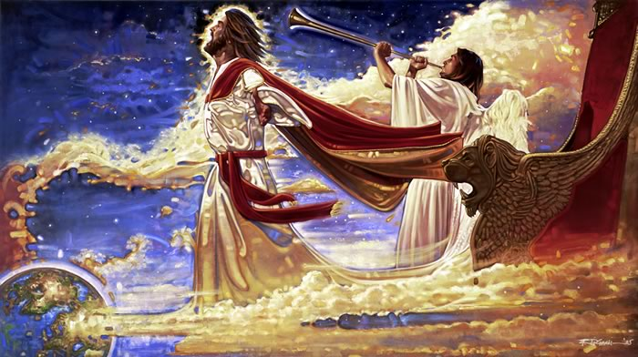
Year of My Redeemed
Describing the time of Christ’s return and ushering in of His Millennial kingdom
In all their affliction he was afflicted, and the angel of his presence saved them: in his love and in his pity here deemed them; and he bare them, and carried them all the days of old.
Isaiah 63:9
D&C 133:52-53

Slide 10
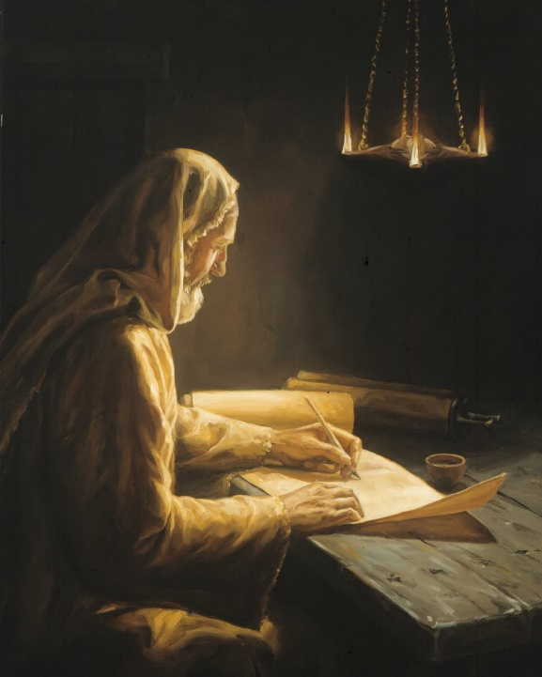
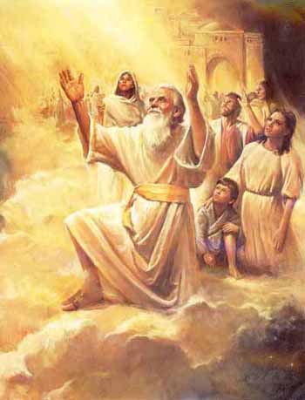
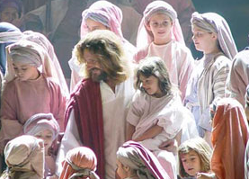
The Righteous Who Lived and Died
The righteous who lived before Jesus Christ and have already been resurrected will come with Him in His glory.
The righteous who lived and died after Jesus Christ will be resurrected and come forth to join the Savior and those with Him.
This includes our righteous family members who have died.
The righteous who still live on the earth will be “caught up” to meet the Savior.
Then we which are alive and remain shall be caught up together with them in the clouds, to meet the Lord in the air: and so shall we ever be with the Lord.
1 Thessalonian 4:7
Wherefore, children shall grow up until they become old; old men shall die; but they shall not sleep in the dust, but they shall be changed in the twinkling of an eye.
D&C 63:51
“Enoch, Moses, and Elijah—translated beings—did not taste of death. “Nonetheless (they)died that they might be resurrected with Christ. Their death and resurrection must have been a change that occurred in the twinkling of an eye.”
McConkie and Ostler
D&C 133:54-55

Slide 11
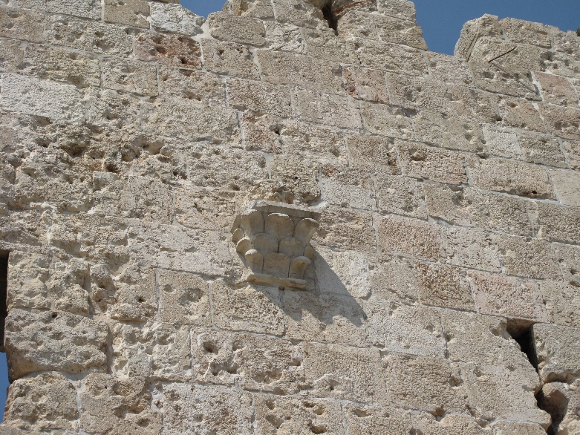
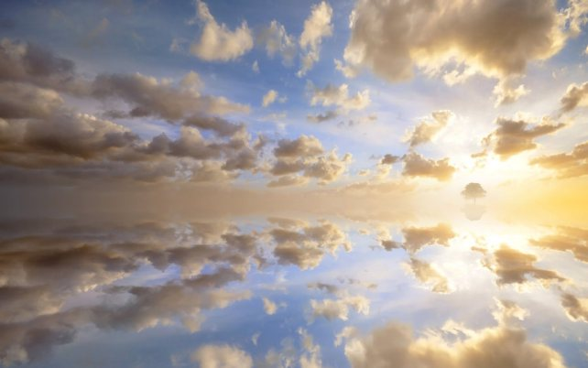
Graves Open
“As all who were in the graves who were worthy of a celestial resurrection, so once again at the time of His return those worthy of a celestial resurrection will be called forth to join Him.”
“Those in Mount Zion, or the Jerusalem of old, will b called forth, first and then those in the New Jerusalem, each when He makes His appearance to them.”
“Caught Up”-- Figuratively
“It is expressly asserted that many graves shall yield up their dead at the time of Christ’s advent in glory, and the just who have slept, together with many who have not died, will be caught up to meet the Lord.”
Elder James E. Talmage
For if we believe that Jesus died and rose again, even so them also which sleep in Jesus will God bring with him.
For this we say unto you by the word of the Lord, that we which are alive and remain unto the coming of the Lord shall not prevent them which are asleep.
For the Lord himself shall descend from heaven with a shout, with the voice of the archangel, and with the trumpof God: and the dead in Christ shall rise first:
1 Thessalonians 4:14-16
D&C 133:56 McConkie and Ostler

Slide 12
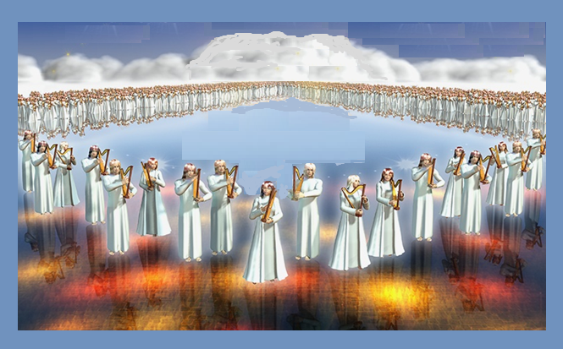
Song of the Lamb
Revelation 5:9-13; D&C 84:99-102
“In honor of the Lamb, a great choir of 100,000,000 voices of the redeemed shall sing this new song.”
D&C 133:57

Slide 13
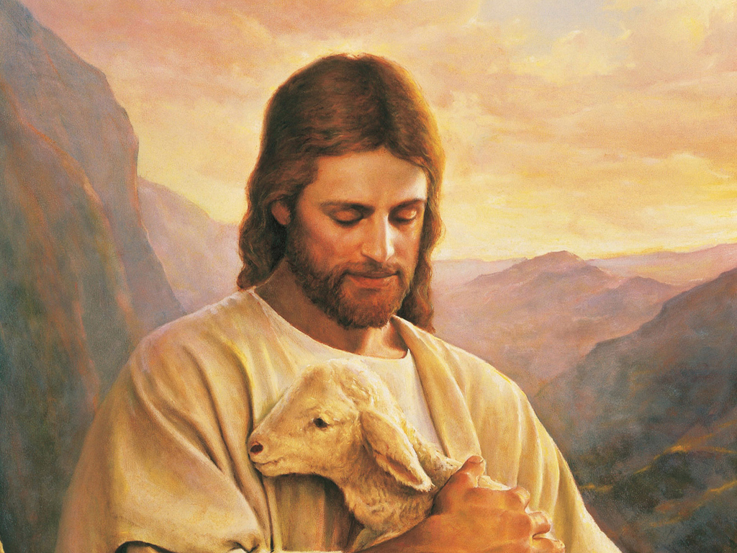
Gospel—One in the Same
“The fullness of the gospel and the everlasting covenant are one and the same.
There is no gospel without covenants and there are no covenants (with the Lord) without the gospel.
A covenant people are and must always be a people who have and live the gospel of Jesus Christ.”
McConkie and Ostler
D&C 133:57

Slide 14

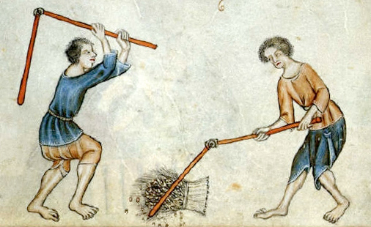
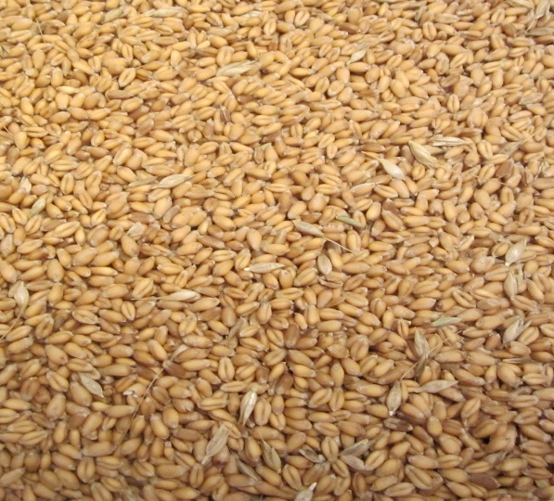
The Earth Shall Thrash
“This expression [thrash or thresh the nations] is found in Habakkuk 3:12.
Threshing, in olden times, was done by treading out the grain on a threshing-floor.
The going forth of the messengers of the gospel among the nations is like trampling the wheat sheaves on the hard floor.
The valuable kernels are carefully gathered up; the straw is left.”
Smith and Sjodahl
D&C 133:57

Slide 15
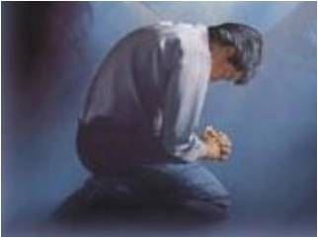

Repentance
Without repentance, there is no real progress or improvement in life.
Pretending there is no sin does not lessen its burden and pain.
Suffering for sin does not by itself change anything for the better.
The invitation to repent is an expression of love.
Those who repent and sanctify themselves will receive eternal life
Repentance means striving to change.
Repentance means not only abandoning sin but also committing to obedience.
Repentance requires a seriousness of purpose and a willingness to persevere, even through pain.
Whatever the cost of repentance, it is swallowed up in the joy of forgiveness.
D&C 133:62

Slide 16
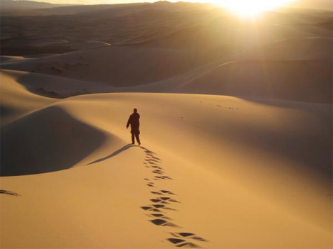
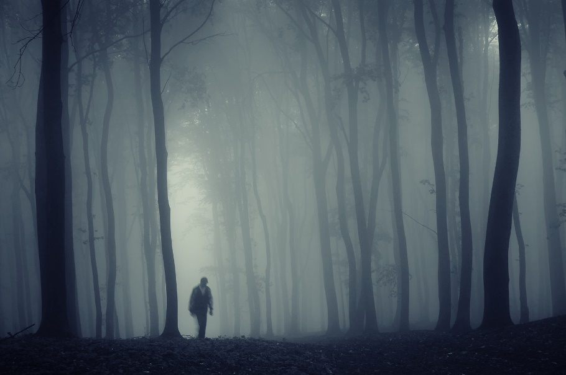
Cut Off
Latter-day revelation speaks of hell in at least two senses. First, it is the temporary abode in the spirit world for those who were disobedient in mortality.
In this sense, hell has an end.
The spirits there will be taught the gospel, and sometime following their repentance they will be resurrected to a degree of glory of which they are worthy.
Those who will not repent, but are nevertheless not sons of perdition, will remain in hell throughout the Millennium.
After these thousand years of torment, they will be resurrected to a telestial glory.
D&C 133:63-74 Bible Dictionary

Slide 17
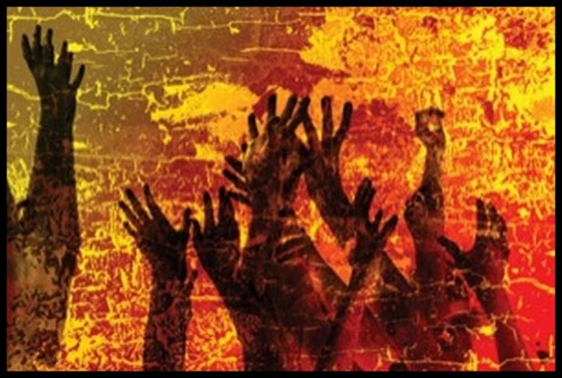
Delivered Into Darkness
Second, it is the permanent location of those who are not redeemed by the atonement of Jesus Christ. In this sense, hell is permanent.
It is for those who are found “filthy still”
This is the place where Satan, his angels, and the sons of perdition—those who have denied the Son after the Father has revealed him—will dwell eternally.
The sons of perdition who deny the Son after the Father has revealed him.
he saves all except them— everlasting, endless eternal punishment-- to reign with the devil and his angels –torment
No man knows how long or where this torment will take place, only to those who are Sons of Perdition.
D&C 76:43-46
That which breaketh a law, and abideth not by law, but seeketh to become a law unto itself, and willeth to abide in sin, and altogether abideth in sin, cannot be sanctified by law, neither by mercy, justice, nor judgment. Therefore, they must remain filthy still.
D&C 88:35
D&C 133:63-74

Slide 18
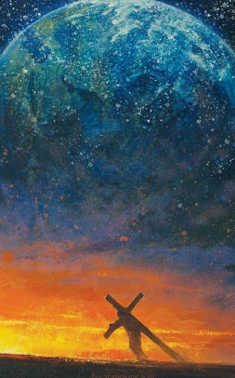
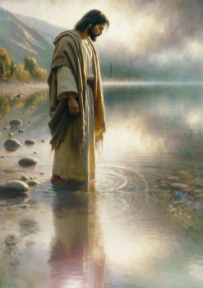
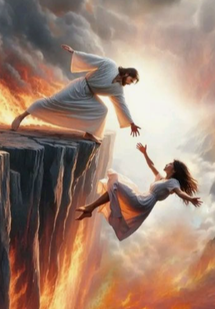
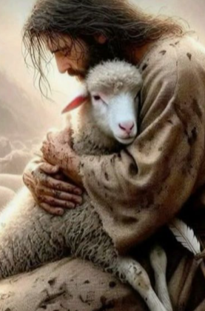
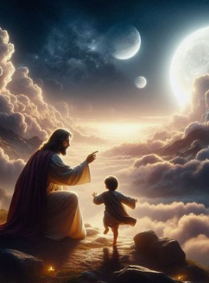
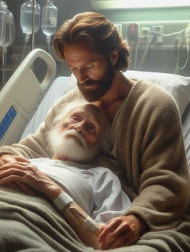
Jesus Christ …
D&C 133:53
D&C 133:44-45, 50-51
D&C 133:47
D&C 133:45
D&C 133:52
D&C 133:53
…is mighty to save
…bears our burdens, carries us, and redeems us because of His love for us
…is just and powerful
…demonstrates loving kindness and goodness
…rewards those who wait for Him
…understands our afflictions

Slide 19
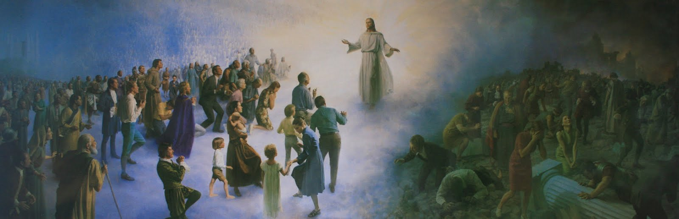
The Second Coming of Jesus Christ will be a sweet and wonderful experience for some and a dreadful experience for others

Slide 20
Sources:
Videos:
Terror, Triumph, and a Wedding Feast (:51)
You Are Needed in the Lord’s Service (2:00)
Wine Press (4:00)
Elder Richard G. Scott Using the Supernal Gift of Prayer April 2007
Elder Jeffrey R. Holland Terror, Triumph, and a Wedding Feast [Church Educational System devotional, Sept. 12, 2004], 3,speeches.byu.edu).
Joseph Fielding McConkie and Craig J. Ostler Revelations of the Restoration pg. 1117-1119
(Ludlow, Companion, 1:678.)
Doctrine and Covenants Student Manual Religion 324-325 Section 133
Presentation by ©http://fashionsbylynda.com/blog/
Smith and Sjodahl, Commentary, p. 186
D. Todd Christofferson The Divine Gift of Repentance October 2011 Gen.Conf.
Presentation by ©http://fashionsbylynda.com/blog/

Slide 21
The Effects of the Fullness of God’s Glory | Scripture
Mountains will flow down at His presence | D&C 133:40, 44; Micah 1:4
The waters on the earth will boil | D&C 133:41
All nations will tremble at His presence | D&C 133:42
The sun will hide, the moon will withhold its light, and the stars will be hurled from their places | D&C 133:49
The wicked will be burned by the brightness or fire of the glory of the Lord | Malachi 4:1–3; 2 Thessalonians 2:8
Others Rose from the Dead “Not only did Christ rise from the dead at that time, but others were seen who had risen from their graves—righteous men and women who died before Christ, and who had the privilege of rising with him. I do not believe that the resurrection then was a general one; I believe it extended to those only who, while upon earth, had proved themselves willing to do all for the kingdom of God, and to whom neither property, honor, nor life itself had been too dear to keep them from carrying out the purposes of God.”
Anthon H. Lund, in Conference Report, Apr. 1904, p. 6

