Slide 1

Doctrine and Covenants 134
Government and the Laws of the Church
As Free, and not using your liberty for a cloak of maliciousness, but as the servants of God. Honour all men. Love the brotherhood. Fear God. Honour the king.
1 Peter 2:16-17
Presentation by ©http://fashionsbylynda.com/blog/

Slide 2
Freedom of Religion
In the 1830s, Church members were facing persecution, in part for the false perception that they would disregard government laws in the name of religion.
Church leaders wrote a declaration of belief now known as Doctrine and Covenants for the Saints to commit to follow the laws of the land along with exercising freedom of religion.

Slide 3
Background
A general assembly of The Church of Jesus Christ of Latter-day Saints was held at Kirtland, Ohio, on 17 August 1835 to formally accept the collection of revelations to be published as the first edition of the Doctrine and Covenants.
“Elder William W. Phelps arose and read an article prepared by Oliver Cowdery, on marriage.
This was one vote ordered to be published also in the volume with the revelations.
They unanimously accepted the revelations
Then President Oliver Cowdery arose and read an article, ‘Of Governments and Laws in General,’ and this likewise was ordered by vote to be published with the book of revelations. Neither of these articles was a revelation to the Church.”
(Smith, Church History and Modern Revelation, 2:30.)

Slide 4
The Article
The article on government was included in that edition of the Doctrine and Covenants as a statement of belief and as a rebuttal to accusations against the Saints.
“The reason for the article on ‘Government and Laws in General,’ is explained in the fact that the Latter-day Saints had been accused by their bitter enemies, both in Missouri and in other places, as being opposed to law and order. They had been portrayed as setting up laws in conflict with the laws of the country.”
This declaration of belief has been included in editions of the Doctrine and Covenants since its proposal in 1835.
When it was read and voted on, “the Prophet Joseph Smith and his second counselor, Frederick G. Williams, were in Canada on a missionary journey, and the Prophet did not return to Kirtland until Sunday, August 23rd, one week after the Assembly had been held.
Since the Assembly had voted to have [the articles on government and marriage] published in the Doctrine and Covenants, the Prophet accepted the decision and permitted this to be done.
(Smith, Church History and Modern Revelation, 2:30–31.)

Slide 5
Not a Revelation
“It should be noted that in the minutes, and also in the introduction to this article on government, the brethren were careful to state that this declaration was accepted as the belief, or ‘opinion’ of the officers of the Church, and not as a revelation, and therefore does not hold the same place in the doctrines of the Church as do the revelations.”
(Smith and Sjodahl, Commentary, p. 852.)

Slide 6
For the Benefit of Mankind
Governments were instituted by God for the benefit of mankind.
Government officials are accountable to God to act for the good and safety of society.
In what ways can government leaders act for the good and safety of society?
D&C 134:1

Slide 7
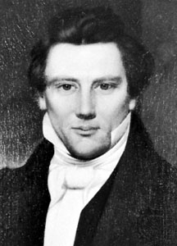
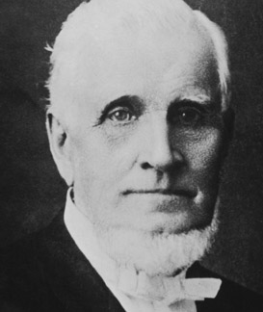
Accountable To God
“We need not doubt the wisdom and intelligence of the Great Jehovah; He will award judgment or mercy to all nations according to their several deserts, their means of obtaining intelligence, the laws by which they are governed, the facilities afforded them of obtaining correct information, and His inscrutable designs in relation to the human family.” Joseph Smith
“If for every word and secret act all men shall be brought to judgment, how much more will the public acts of public men be brought into account before God and before the holy priesthood.” President John Taylor
D&C 134:1

Slide 8
Protection
inviolate -- safe, or not violated.
The free exercise of conscience, the right and control of property, and the protection of life.
“Life, liberty, [and] property [are] mankind’s three great rights” President Ezra Taft Benson
D&C 134:2

Slide 9
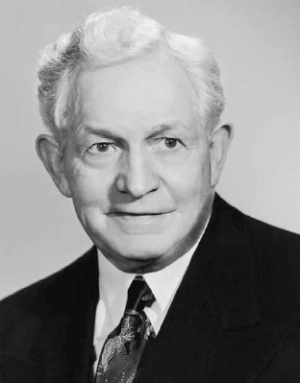
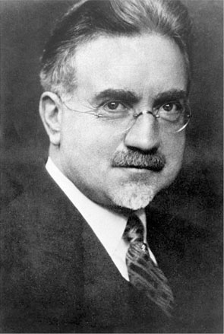
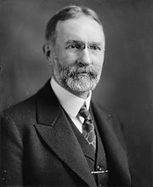
Three Rights = One Right
“Free agency is fundamental as a law of human conduct. Men have the right to obey or disobey the law as they please, and take the consequences. That is fundamental and lies at the bottom of all Latter-day Saint thinking.”
John A. Widtsoe
President David O. McKay cited George Sutherland, who became a United States Supreme Court Justice:
“‘The individual … has three great rights, equally sacred from arbitrary interference: the right to his life, the right to his liberty, and the right to his property.
The three rights are so bound together as to be essentially one right. To give a man his life, but deny him his liberty, is to take from him all that makes life
worth living. To give him liberty, but take from
him the property which is the fruit and badge
of his liberty, is to still leave him a slave.’ Sutherland
D&C 134:2

Slide 10
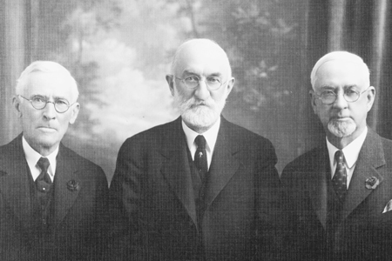
Choose Just and Wise Civic Leaders
“Laws which are enacted for the protection of society have no value except when they are administered in righteousness and justice, and they cannot be so administered in righteousness and justice, if dishonest men occupy administrative offices.
“The Lord says ‘When the wicked rule, the people mourn.’ Wise men, good men, patriotic men are to be found in all communities, in all political parties, among all creeds. None but such men should be chosen. …
Presidents Anthony W. Ivins, Heber J. Grant, and Charles W. Nibley
“Without beneficent laws, righteously administered, the foundations of civilization crumble, anarchy reigns, decay and dissolution follow.
“We call upon all members of The Church of Jesus Christ of Latter-day Saints throughout the world to honor the laws of God, and obey and uphold the law of the land; and we appeal to good men and women everywhere, regardless of creed, party affiliation, race or condition to join with us in an effort to put into operation the words of Lincoln, the great emancipator, that our country may continue to be a light to the world, a loyal, law-abiding, God-fearing nation.”
D&C 134:3

Slide 11
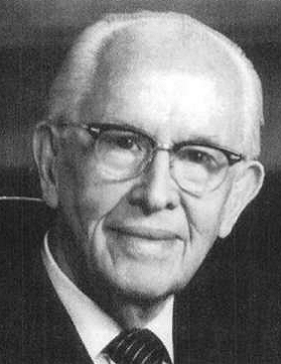
The Lord’s Standard
“First, is the proposal, the policy or the idea being promoted, right as measured by the Gospel of Jesus Christ? …
Measuring all proposals having to do with our national or local welfare-- President Ezra Taft Benson
“Third, … is it right as measured by the counsel of the living oracles of God? …
“Second, is it right as measured by the Lord’s standard of constitutional government? … The Lord’s standard is a safe guide.
“Fourth, what will be the effect upon the morale and the character of the people if this or that policy is adopted?”
D&C 134:3

Slide 12
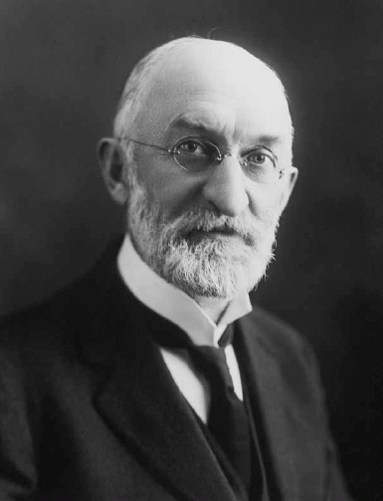
Held Accountable
Readily brought to yield, submit, or cooperate
amenable means accountable and that a civil magistrate is a public official who administers the law.
‘We claim the privilege of worshiping Almighty God according to the dictates of our own conscience; and allow all men the same privilege, let them worship how, where, or what they may.’
Article of Faith 1:11
“But we claim absolutely no right, no prerogative whatever, to interfere with any other people.”
President Heber J. Grant
There should be no mingling of religious influence with civil governments.” (Joseph Smith, p. 215.)
D&C 134:4

Slide 13
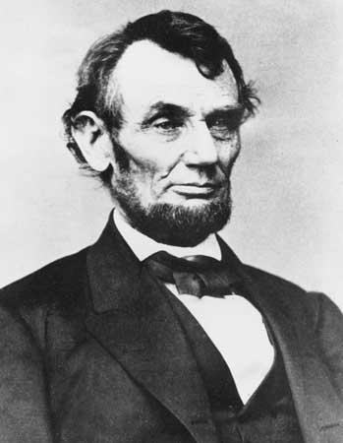
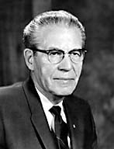
Sustain and Uphold
We believe in being subject to kings, presidents, rulers, and magistrates, in obeying, honoring, and sustaining the law.”
Article of Faith 1:12
“To sustain signifies to hold up; to keep from falling. To sustain the law, therefore, is to refrain from saying or doing anything which will weaken it or make it ineffective.
“We obey law from a sense of right.
“We honor law because of its necessity and strength to society.
“Abraham Lincoln once observed: ‘Bad laws, if they exist, should be repealed as soon as possible; still, while they continue in force, they should be religiously observed.’
“There is no reason or justification for men to disregard or break the law or try to take it into their own hands.”
President Eldon N. Tanner
D&C 134:5

Slide 14
Respecting Divine and Human Laws
Inalienable
Something that cannot be taken away
Sedition
Rebellion against government
Deference
Supplanted
Compliance or submission
Anarchy
Replaced
Lawlessness- the absence of rules and government or rebellion against rules and government
D&C 134:6

Slide 15
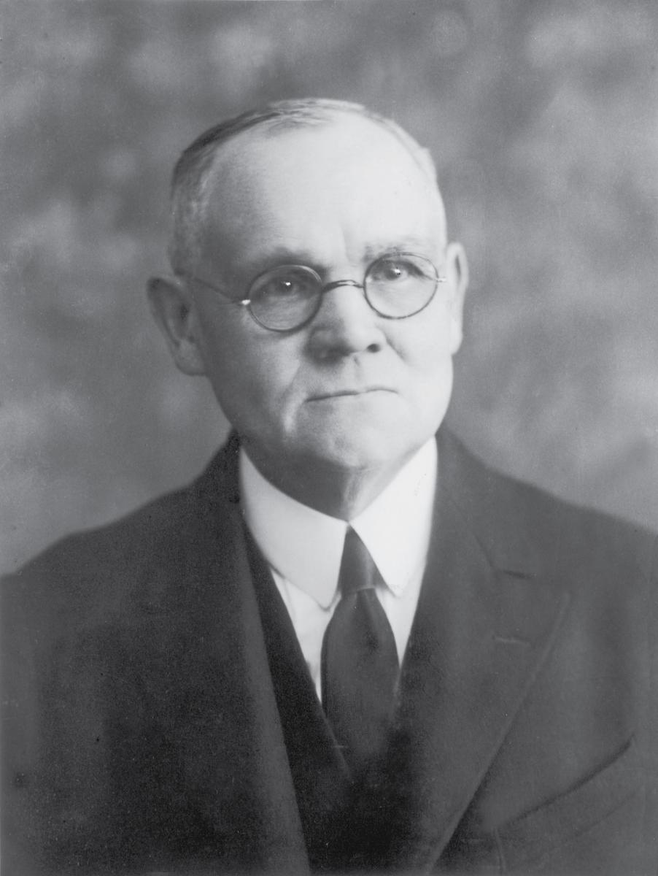
Live According to the Law
“Now, the Lord has provided that those in his Church shall live according to the law, and he makes a distinction between the law pertaining to the Church and what we call the secular law, or the law of the land, but he requires obedience to each.
“My love for my brother in this Church does not mean that I am to … stand between him and righteous judgment.
“This Church is no organization like that of the secret combinations of old, which the Lord hath said he hates, the members of which were pledged, and bound by oath that they would cover up one another’s crimes, that they would justify one another in theft and murder and in all things that were unclean.
“It is no such organization at all. It would not be of God if it were.”
D&C 134:8 Elder James E. Talmage

Slide 16
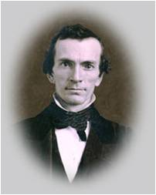
Protection of Religious Observances
Oliver Cowdery wrote that governments should establish laws that protect religious observance but that they should not favor one religion over another.
In addition, he wrote that religious societies have a right to punish their disorderly members by excommunicating them or withdrawing their fellowship from them but that such societies do not have authority to make judgments or inflict punishments that would take their members’ property or harm them physically.
D&C 134:7, 9-10

Slide 17
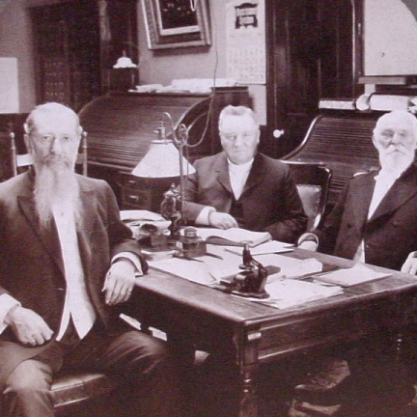
Separation of Church and State
1907
The Church upholds the principle laid down by the Constitution of the United States that religion and government should be kept separate.
“The Church of Jesus Christ of Latter-day Saints holds to the doctrine of the separation of church and state; the non-interference of church authority in political matters; and the absolute freedom and independence of the individual in the performance of his political duties. …
“We declare that from principle and policy, we favor:
“The absolute separation of church and state;
“No domination of the state by the church;
“No church interference with the functions of the state;
“No state interference with the functions of the church, or with the free exercise of religion;
“The absolute freedom of the individual from the domination of ecclesiastical authority in political affairs;
“The equality of all churches before the law.”
D&C 134:9 Joseph F. Smith, John R. Winder and Anthon H. Lund

Slide 18
Redress—To Make Something Right
Citizens should be allowed to ask their government for “redress” if they have been wronged.
This verse includes a declaration that citizens are justified in defending themselves and others when there is an urgent need and the government is unable to help.
D&C 134:11

Slide 19
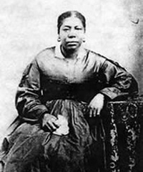
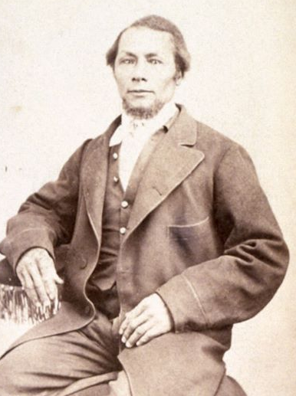
When Slavery Was Tolerated
Although the Church teaches that slavery is wrong and counter to the fundamental rights of an individual, the Prophet Joseph Smith taught that when slavery is tolerated by a government, it is not the Church’s position to try to overthrow that established order:
“It should be the duty of an Elder, when he enters into a house, to salute the master of that house, and if he gain his consent, then he may preach to all that are in that house; but if he gain not his consent, let him not go unto his slaves, or servants, but let the responsibility be upon the head of the master of that house, and the consequences thereof, and the guilt of that house is no longer upon his skirts. … But if the master of that house give consent, the Elder may preach to his family, his wife, his children and his servants, his man-servants, or his maid-servants, or his slaves.” HC
Jane Elizabeth Manning James
Isaac James
D&C 134:12

Slide 20
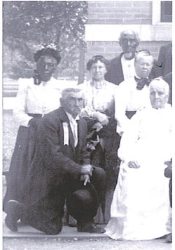
The Issue of Slavery
In 1834, when this statement was written, the Saints in Missouri were often accused by their enemies of seeking to overthrow slavery.
Since Missouri entered the Union as a slave state, this question inflamed the Missourians and doubtless contributed to the spirit of persecution and violence against the Saints. Doctrine and Covenants 134:12 was a reply to these accusations.
“Today, the church disavows the theories advanced in the past that black skin is a sign of divine disfavor or curse, or that it reflects actions in a premortal life; that mixed-race marriages are a sin; or that blacks or people of any other race or ethnicity are inferior in any way to anyone else,” the church statement says. “Church leaders today unequivocally condemn all racism, past and present, in any form.” (Race and the Priesthood)
D&C 134:12

Slide 21
Sources:
President Ezra Taft Benson [“Our Divine Constitution,” Ensign, Nov. 1987, 4].)
Joseph Smith (History of the Church, 4:596).
President John Taylor (in Journal of Discourses, 20:42–43).
John A. Widtsoe (Message of the Doctrine and Covenants, p. 154.)
President David O. McKay from George Sutherland’s speech before the
New York State Bar Association, January 21, 1921.)” (In Conference Report, Oct. 1962, p. 6.)
(Sustaining the Law: In Conference Report, Apr. 1937, p. 28.)
Ivins, Grant, and Nibley In Conference Report, Oct. 1928, p. 16
Presentation by ©http://fashionsbylynda.com/blog/
President Ezra Taft Benson(In Our Prophets and Principles, pp. 69–70.)
President Heber J. Grant (In Conference Report, Apr. 1921, p. 203.)
President N. Eldon Tanner (In Conference Report, Oct. 1975, p. 126; or Ensign, Nov. 1975, p. 83.)
Elder James E. Talmage (In Conference Report, Oct. 1920, p. 63.)
The First Presidency (Joseph F. Smith, John R. Winder, and Anthon H. Lund) stated the following in 1907: (In Clark, Messages of the First Presidency, 4:153.)
Prophet Joseph Smith (History of the Church,2:263.)
“Race and the Priesthood” https://www.lds.org/topics/race-and-the-priesthood?lang=eng
https://youtu.be/sf6HxXkoPUU Jane Manning James: An Independent Mind
We Are Bound to Sustain the Law(1:08)
What Is Religious Freedom? (4:24)
Preserving Religious Freedom(8:44)
Presentation by ©http://fashionsbylynda.com/blog/

Slide 22
Anarchy:
Elder Erastus Snow explained: “Anarchy—shall I say, is the worst of all governments? No: Anarchy is the absence of all government; it is the antipodes [opposite] of order; it is the acme of confusion; it is the result of unbridled license, the antipodes of true liberty. The Apostle Paul says truly: ‘For there is no power but of God: the powers that be are ordained of God.’ At first this is a startling statement. Even the monopoly of the one-man-power as in Russia [the Czar], or the monopoly of the aristocracy as in other parts of Europe, or the imbecility and sometimes stupidity of a republic like our own, is far better than no government at all. And for this reason, says the Apostle Paul, ‘The powers are ordained of God,’ not that they are always the best forms of government for the people, or that they afford liberty and freedom to mankind but that any and all forms of government are better than none at all, having a tendency as they do to restrain the passions of human nature and to curb them, and to establish and maintain order to a greater or less degree. One monopoly is better than many; and the oppression of a king is tolerable, but the oppression of a mob, where every man is a law to himself and his own right arm, is his power to enforce his own will, is the worst form of government.” (In Journal of Discourses, 22:151.)
George Sutherland was born in Stony Stratford, Buckinghamshire, England, to a Scottish father, Alexander George Sutherland, and an English mother, Frances, née Slater. A recent convert to The Church of Jesus Christ of Latter-day Saints (LDS Church), Alexander Sutherland moved the family to Utah Territory in the summer of 1863. Initially Alexander Sutherland settled his family in Springville, Utah, but moved to Montana and prospected for a few years before moving his family back to Utah Territory in 1869, where he pursued a number of different occupations.
At the age of twelve, the need to help his family financially forced Sutherland to leave school and take a job, first as a clerk in a clothing store, then as an agent of the Wells Fargo Company. Yet Sutherland aspired to a higher education, and in 1879 had saved enough to attend Brigham Young Academy. There he studied under Karl G. Maeser, who proved an important influence in his intellectual development, most notably by introducing Sutherland to the ideas of Herbert Spencer, which would form an enduring part of Sutherland's philosophy. After graduating in 1881, Sutherland worked for the Rio Grande Western Railroad for a little over a year before moving to Michigan to enroll in the University of Michigan Law School, where he was a student of Thomas M. Cooley.
Sutherland left school before earning his law degree. After admission to the Michigan bar, he married Rosamond Lee in 1883; their marriage proved a happy one, and produced two daughters and a son. After his marriage, Sutherland moved back to Utah Territory, where he joined his father (who had also become a lawyer) in a partnership in Provo. In 1886, they dissolved their partnership and Sutherland formed a new one with Samuel Thurman, a future chief justice of the Utah Supreme Court. After running unsuccessfully as the Liberal Party candidate for mayor of Provo, Sutherland moved to Salt Lake City in 1893. There he joined one of the state's leading law firms, and the following year was one of the organizers of the Utah State Bar Association. In 1896 he was elected as a Republican to the newly created Utah State Senate, where he served as chairman of the senate's Judiciary Committee and sponsored legislation granting powers of eminent domain to mining and irrigation companies.
On September 5, 1922, Sutherland was nominated by President Warren G. Harding to the Associate Justice seat on the Supreme Court of the United States vacated by John Hessin Clarke. Sutherland was confirmed by the United States Senate on September 5, 1922, and received his commission the same day.
While vacationing with his wife at a resort in Stockbridge, Massachusetts, Sutherland suffered a severe heart attack on the afternoon of July 17, 1942. He died in his sleep some time between 4:00 AM and 9:30 AM on July 18, his wife by his side. They had celebrated their 59th wedding anniversary just 29 days before
D&C 134:3 A republic is a government in which the people elect leaders to represent them and that a sovereign is a supreme ruler, such as a king or queen
President N. Eldon Tanner taught:
“There are many who question the constitutionality of certain acts passed by their respective governments, even though such laws have been established by the highest courts in the land as being constitutional, and they feel to defy and disobey the law.
“Abraham Lincoln once observed: ‘Bad laws, if they exist, should be repealed as soon as possible; still, while they continue in force, they should be religiously observed.’
“This is the attitude of the Church in regard to law observance. …
“There is no reason or justification for men to disregard or break the law or try to take it into their own hands.
“It is the duty of citizens of any country to remember that they have individual responsibilities, and that they must operate within the law of the country in which they have chosen to live.” (In Conference Report, Oct. 1975, p. 126; or Ensign, Nov. 1975, p. 83.)

Slide 23
Those who are rebellious towards the laws of the Land:
President Joseph Fielding Smith likewise said: “No member of the Church can be accepted as in good standing whose way of life is one of rebellion against the established order of decency and obedience to law. We cannot be in rebellion against the law and be in harmony with the Lord, for he has commanded us to ‘be subject to the powers that be, until he reigns whose right it is to reign. …’ (D&C 58:22.) And one of these days he is going to come.” (In Conference Report, Apr. 1971, p. 48; or Ensign, June 1971, p. 50.)
The exception to this principle would be when the Lord directs His people through His prophets to take an opposing stand to government. Otherwise they recognize the established authority of government.
President Wilford Woodruff said “God will bless no king, no emperor and no president who will not give unto his subjects the rights and privileges in their relationship to God which the Father Himself has given unto them. Whenever these subjects are deprived of their rights, those who preside over them are held responsible.” (Deseret Weekly News, 19 Apr. 1890, p. 561.)
Sustaining and upholding the laws:
President Howard W. Hunter made the following declarations:
“We are charged with the duty of sustaining and upholding the laws of the land. It is dishonest to intentionally violate the law. It doesn’t make any difference how one may feel personally about the fairness or justness of the rules which have been established by society, one’s duty is to respect and sustain the law” (in The Teachings of Howard W. Hunter, ed. Clyde J. Williams [1997], 164).
“The sovereign laws of the state must be sustained, and persons living under those laws must obey them for the good of the whole. In this regard The Church of Jesus Christ of Latter-day Saints takes a strong position. One of the fundamental tenets of its faith is clearly stated in these words: ‘We believe in being subject to kings, presidents, rulers, and magistrates, in obeying, honoring, and sustaining the law’ [Articles of Faith 1:12]” (The Teachings of Howard W. Hunter, 165).
Jane Elizabeth Manning James worked and lived in Joseph Smith’s home. Lucy Mack Smith entrusted her to handle a bundle of clothing belonging to Joseph Smith that had the Urim and Thummim in them. Jane and her sister Abigail went to look for work in Burlington when Joseph Smith was martyred. After her return she worked and lived in Brigham Young’s household. She married Isaac James. Her and her family arrived in Salt Lake on September 19, 1847. They were not the first African Americans to enter into the valley, but they were the first “free blacks.”
for more: http://books.google.com/books?id=uwKuLlDDT-wC&pg=PA144&lpg=PA144#v=onepage&q&f=false

