Slide 1
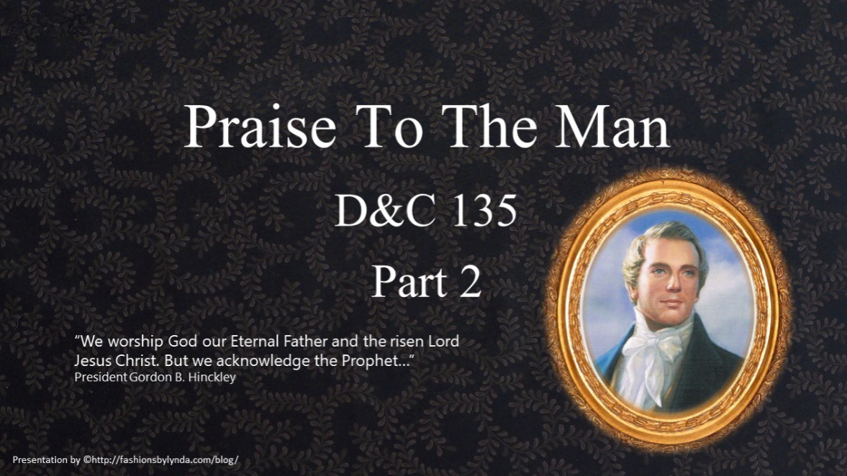

Slide 2

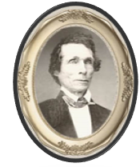
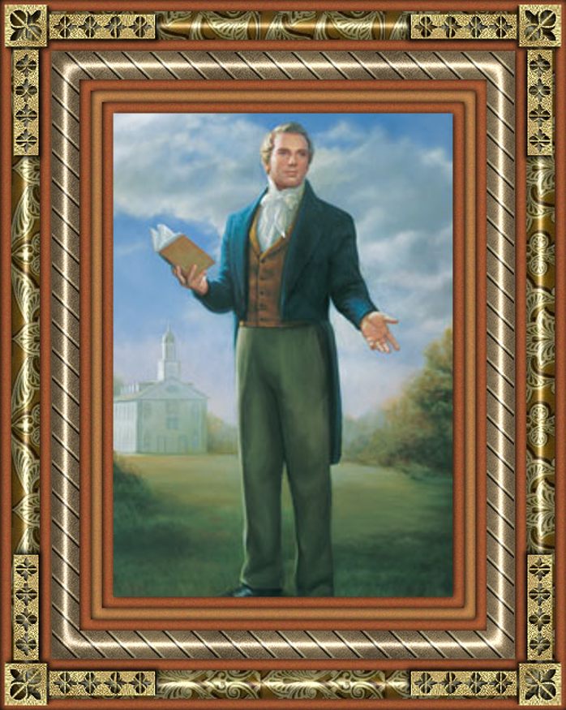
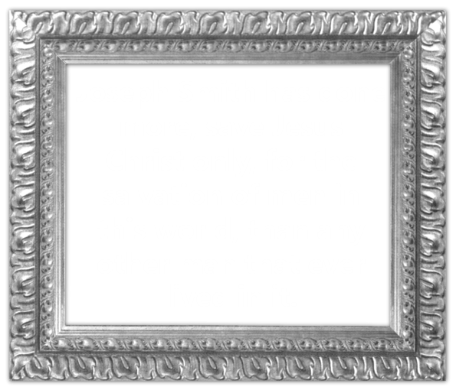
In Memory of Joseph Smith
W. W. Phelps wrote the words of the hymn, Praise to the Man, in memory of the Prophet Joseph Smith shortly after the martyrdom.

Slide 3

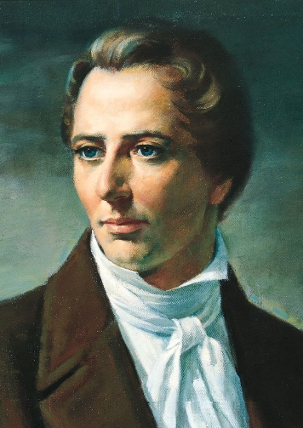
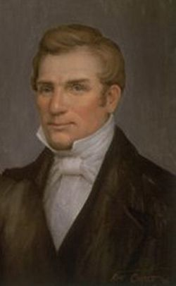
In Short 20 Years
Joseph Smith has brought forth the Book of Mormon
He has received revelations and commandments
He translated it by the gift and power of God
He has sent the fullness of the everlasting gospel
He had it published on two continents
He gathered many thousands of Latter-day Saints
He founded a great city, Nauvoo, which left a legacy
He lived a great life and died great in the eyes of God and his people
It has given instruction for the benefit of everyone
He sealed his mission and works with his blood
D&C 135:3

Slide 4
Doctrinal Mastery
Joseph Smith, the Prophet and Seer of the Lord, has done more, save Jesus only, for the salvation of men in this world, than any other man that ever lived in it. In the short space of twenty years, he has brought forth the Book of Mormon, which he translated by the gift and power of God, and has been the means of publishing it on two continents; has sent the fulness of the everlasting gospel, which it contained, to the four quarters of the earth; has brought forth the revelations and commandments which compose this book of Doctrine and Covenants, and many other wise documents and instructions for the benefit of the children of men; gathered many thousands of the Latter-day Saints, founded a great city, and left a fame and name that cannot be slain. He lived great, and he died great in the eyes of God and his people; and like most of the Lord’s anointed in ancient times, has sealed his mission and his works with his own blood; and so has his brother Hyrum. In life they were not divided, and in death they were not separated!
D&C 135:3

Slide 5
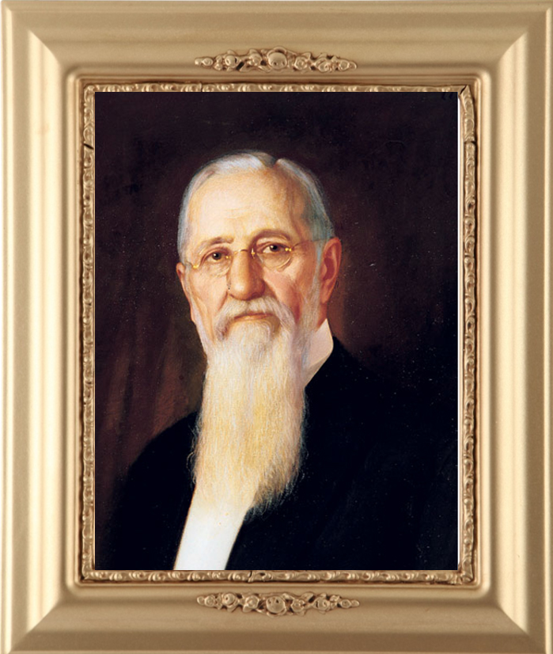
“The work in which Joseph Smith was engaged was not confined to this life alone, but it pertains as well to the life to come, and to the life that has been. In other words, it relates to those who have lived upon the earth, to those who are living and to those who shall come after us. It is not something which relates to man only while he tabernacles in the flesh, but to the whole human family from eternity to eternity.”
President Joseph F. Smith

Slide 6
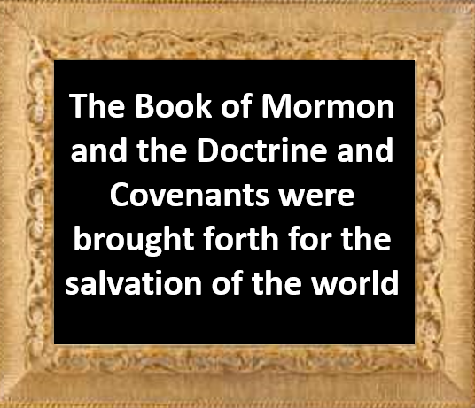
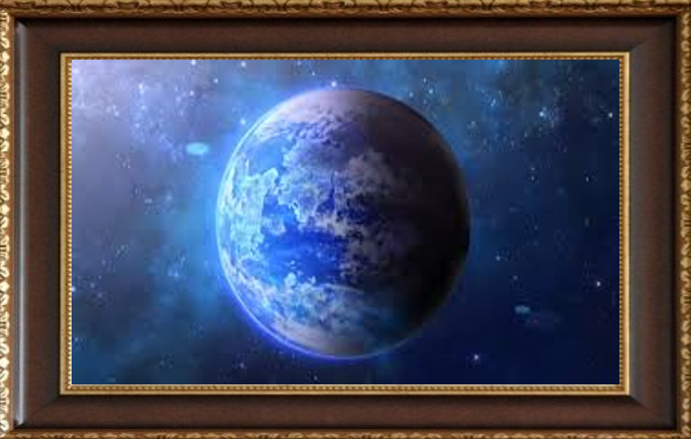
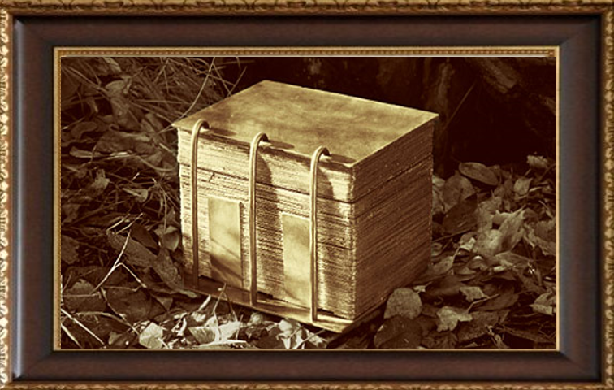
Why Was the Book of Mormon Brought Forth?
D&C 135:6

Slide 7
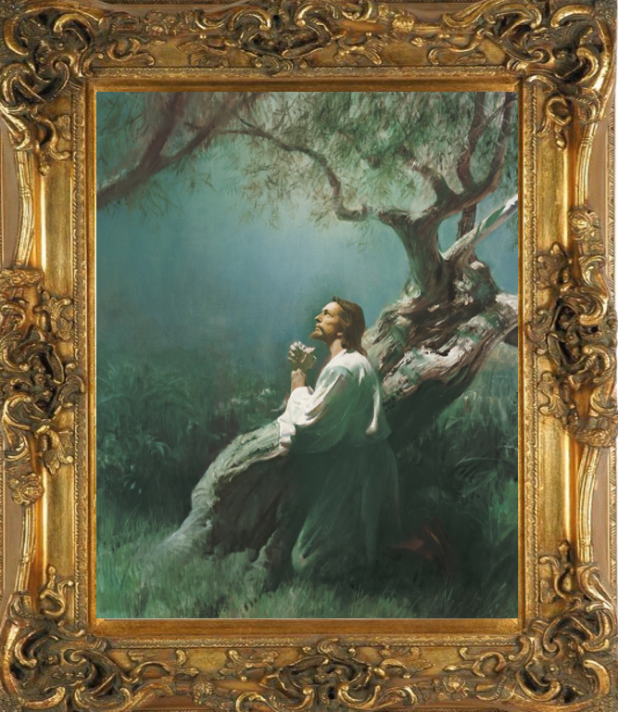
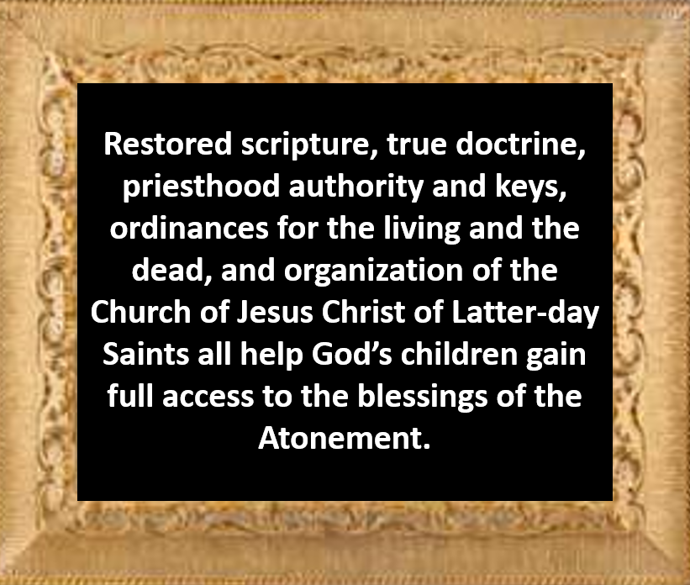
Blessings of the Atonement

Slide 8
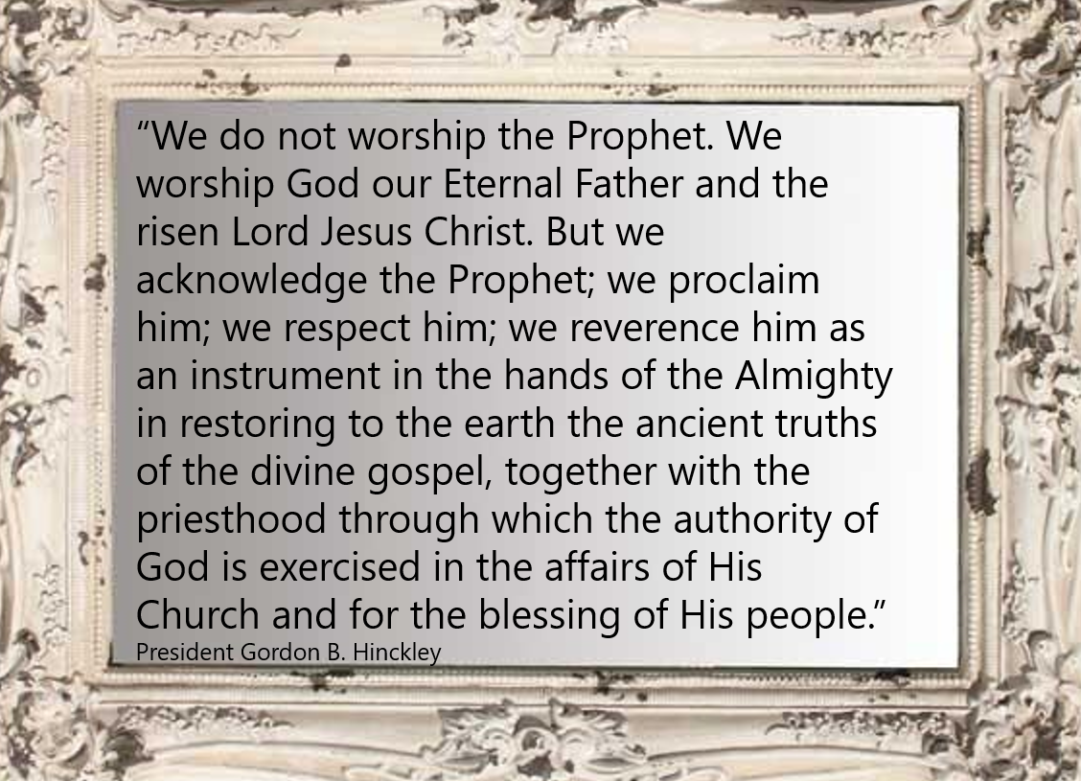
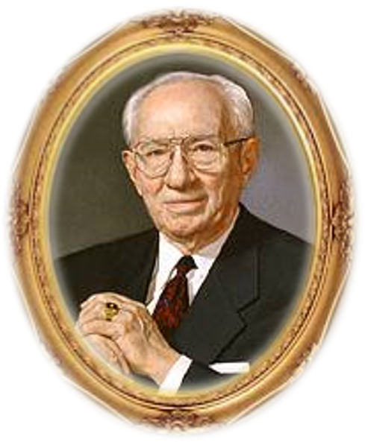

Slide 9
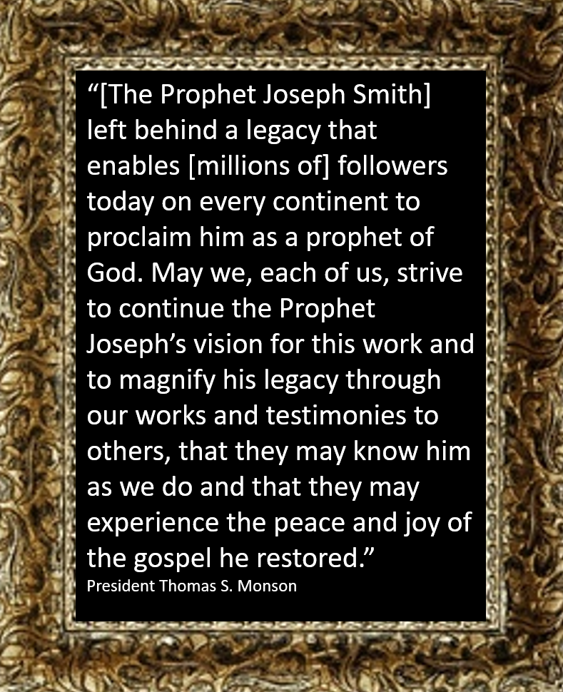
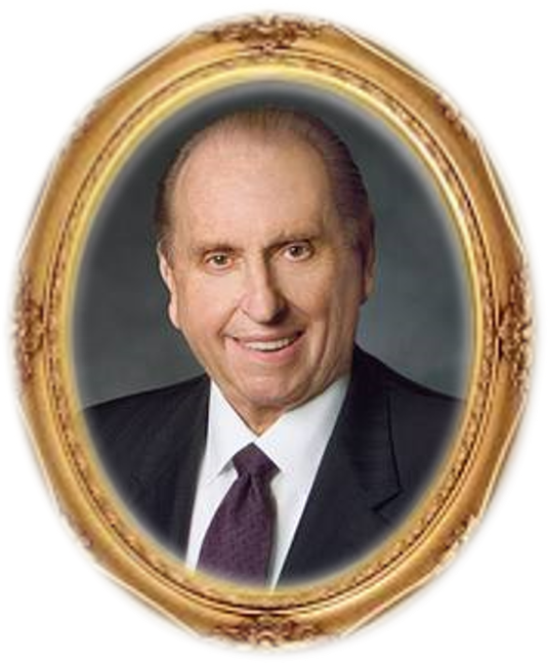
D&C 135:6

Slide 10
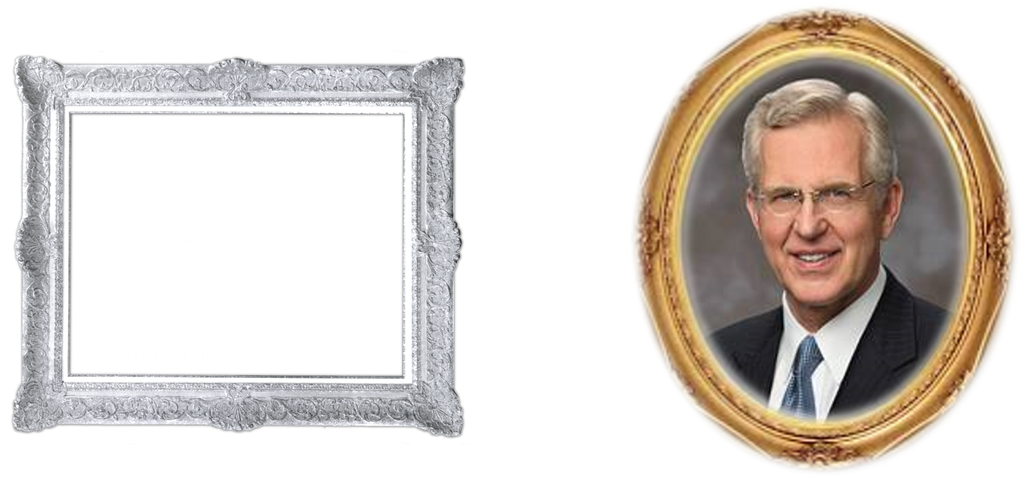

Slide 11
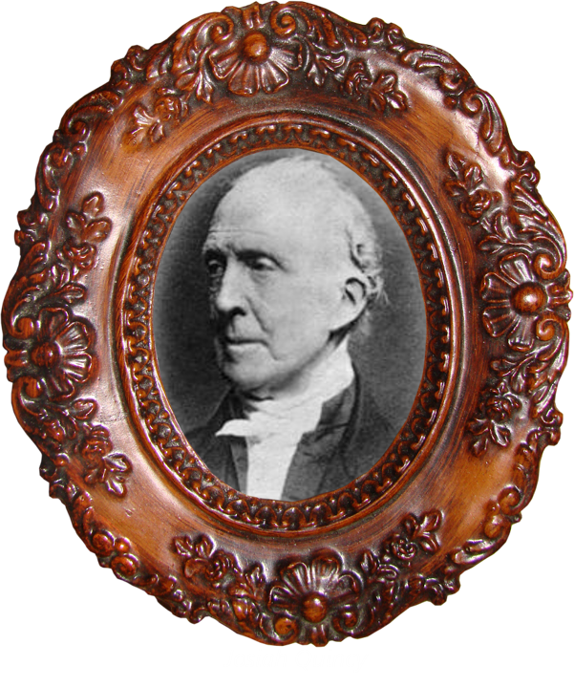
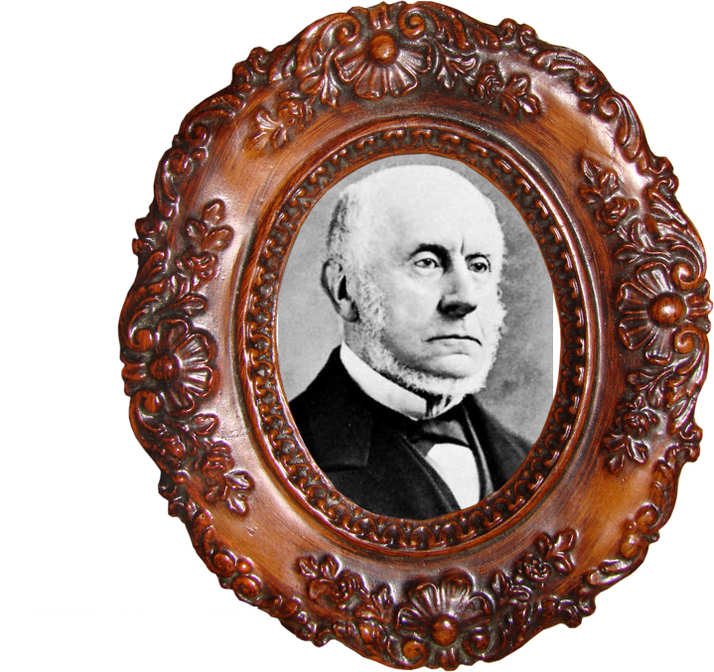
In the spring of 1844, Josiah Quincy, former mayor of Boston, Massachusetts, and then president of Harvard University, along with his cousin Charles Francis Adams, son of former United States President John Quincy Adams, visited Nauvoo. They spent a day with the Prophet Joseph Smith. Years later, Josiah Quincy wrote of his experience:
“It is by no means improbable that some future text-book, for the use of generations yet unborn, will contain a question something like this: What historical American of the nineteenth century has exerted the most powerful influence upon the destinies of his countrymen? And it is by no means impossible that the answer to that interrogatory may be thus written.”
Josiah Quincy

Slide 12

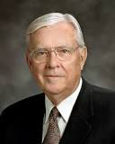
We should always remember the price Joseph and Hyrum Smith paid, along with so many other faithful men, women, and children, to establish the Church so you and I could enjoy the many blessings and all of these revealed truths we have today. Their faithfulness should never be forgotten!
M. Russell Ballard

Slide 13
Sources:
Video:
Joseph Smith—Prophet of the Restoration (13:09)
President Joseph F. Smith (Gospel Doctrine, 5th ed. [1939], 481).
Spencer W. Kimball (“Joseph Smith Jr.—Prophet of God, Mighty Servant,” Ensign, Dec. 2005, 4).
Presentation by ©http://fashionsbylynda.com/blog/
President Thomas S. Monson (“Brother Joseph,” Church News, Dec. 31, 2005, 4).
Elder D. Todd Christofferson (“Born Again,” Ensign or Liahona, May 2008, 79; italics added).
Joseph Smith, the Mormon prophet” (Figures of the Past: From the Leaves of Old Journals [1888], 376).
M. Russell Ballard, “Shall We Not Go On in So Great a Cause?,” Ensign or Liahona, May 2020, 11)
Presentation by ©http://fashionsbylynda.com/blog/

