Slide 1

Succession in the Presidency
1844
Presentation by ©http://fashionsbylynda.com/blog/

Slide 2
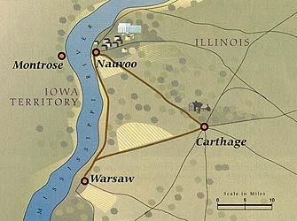
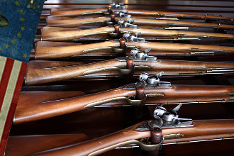
Aftermath of the Carthage Tragedy
“The sun rose on as strange a scene as the broad Hancock prairies had ever witnessed. At the three corner of a triangle eighteen miles asunder, stood a smitten city [Nauvoo], and two almost deserted villages, [Warsaw and Carthage], with here and there a group of questioning men, anxious to hear the news of the night. Toward the two villages the more courageous ones were returning to find their several abodes unsacked and untouched…All knew that a great crime had been committed, by whom they knew
not; and they knew not how,
upon whom, where, or in what
manner retribution might fall.”
Mr. Gregg
In Nauvoo there was a trained militia numbering about 4,000 men. Although the state arms had been confiscated the Saints had their own arms.
They could have swept Hancock County in revenge…But they did not do that.
They remained true to their pledged word to Governor Ford, and to the instructions of their Prophet.

Slide 3
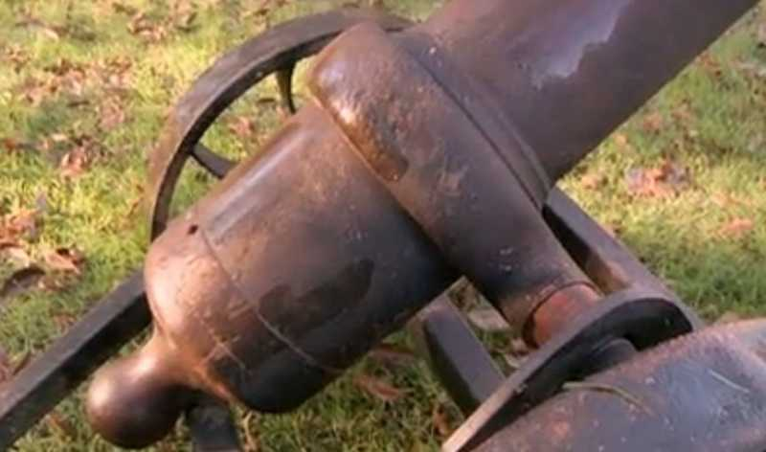
Note To The Saints
The bodies of Joseph and Hyrum Smith were removed to the Hamilton Hotel, and also Elder Taylor who was suffering from bullet wounds.
A note, carried by Arza Adams to the Saints in Nauvoo:
“Carhage Jail..
8 o’clock, 5 min., p.m...June 27
Joseph and Hyrum are dead. Taylor wounded, not badly. I am well. Our guard was forced as we believe, by a band of Missourians from 100 to 200. The job was done in an instant, and the party fled towards Nauvoo instantly. This is as I believe it. The citizens here are afraid of the “Mormons” attacking them; I promise them no.
W. Richards
“N.B.—The citizens promise us protection. Alarm guns have been fired.”
John Taylor
Alarm guns—cannons:
They were the signal agreed upon to announce the death of the prisoners.
Upon hearing that the cannons were fired Gov. Ford’s hastened his departure from Nauvoo
B.H. Roberts

Slide 4

Rumors and False Reports
Rumor:
Upon hearing a cannon fired a merchant of Warsaw rode directly to Quincy and reported that Joseph and Hyrum Smith and those who were with them in jail were killed; that they [the prisoners] were attempting to break jail and were all killed by the guard.
False Report:
By Josiah B. Conyer, M.D.
At the time the two Smiths were murdered “certain individual were dispatched from Carthage and Warsaw to Quincy, in order to make a false report…that the attack had been made by the “Mormons,’ and they expected that these two places were then burnt to ashes, and Governor Ford and his detachment murdered.”
B.H. Roberts

Slide 5
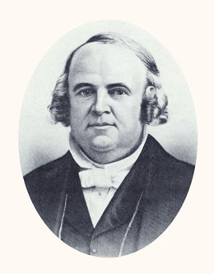
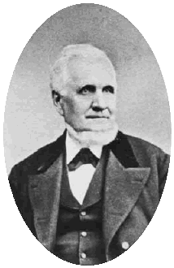
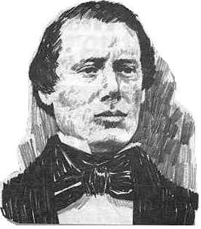
The Second Note
“12 o’clock at night. 27th of June.
Carthage, Hamilton’s Tavern.
To Mrs. Emma Smith and Major-General Dunham, &c.
The governor has just arrive; says all things shall be inquired into, and right measures taken.
I say to all the citizens of Nauvoo, my brethren, be still, and know that God reigns. Don’t rush out of the city—don’t rush to Carthage—stay at home, and be prepared for an attack from Missouri mobbers. The governor will render every assistance possible—has set out orders for troops. Joseph and Hyrum are dead. We will prepare to move the bodies as soon as possible.
The people of the county are greatly excited, and fear the ‘Mormons’ will come out and take vengeance. I have pledged my word the ‘Mormons’ will stay home as soon as they are informed, and no violence will be on their part, and say to my brethren in Nauvoo, in the name of the Lord, be still, be patient: only let such friends as choose come here to see the bodies. Mr. Taylor’s wounds are dressed and not serious. I am sound.
Willard Richards
John Taylor
Samuel H. Smith
B.H. Roberts

Slide 6
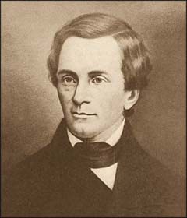
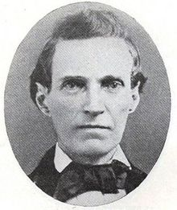
Notes to the Saints
“Defend yourselves until protection can be furnished necessary, June 27th, 1844”
Signed
Thomas Ford
Governor and Commander-in-Chief.”
Thomas Ford
To which was appended this note:
“Mr. Orson Spencer,
Dear Sir;--Please deliberate on this matter—prudence may obviate material destruction. I was at my residence when this horrible crime was committed. It will be condemned by three-fourths of the citizens of the county. Be quiet, or you will be attacked from Missouri.
M.R. Deming.” (Times and Season, vol. V. no 12 July 1st, 1844 p. 560-1.)
B.H. Roberts
Orson Spencer

Slide 7
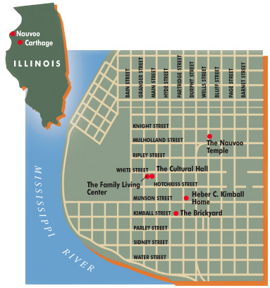
Bodies Taken to Nauvoo
Thousands of Saints gathered on Mullholland street about a mile east of the temple
Major General Jonathan Dunham and the staff, and other officers of the legion move through the procession to the Nauvoo Mansion where the bodies were given into the care of their families
Addresses were given by , Messrs, Reid, Wood, W.W. Phelps, Stephen Markham, and Dr. Willard Richards.
Richards admonished again to keep peace…that he had pledged his honor and life for their good conduct
The people then—”with one united voice resolved to trust to the law for a remedy of such a high-handed assassination, and when that failed, to call upon God to avenge them of their wrongs.”
B.H. Roberts

Slide 8
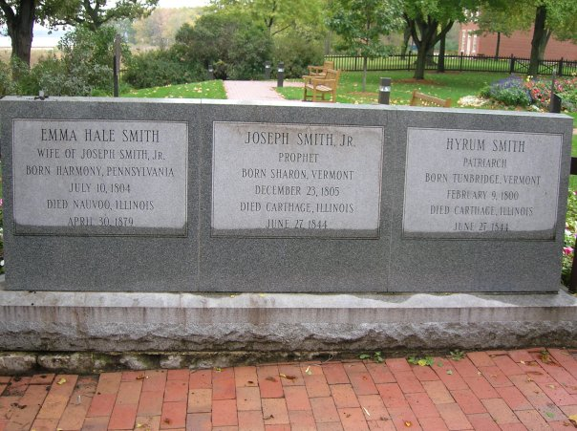
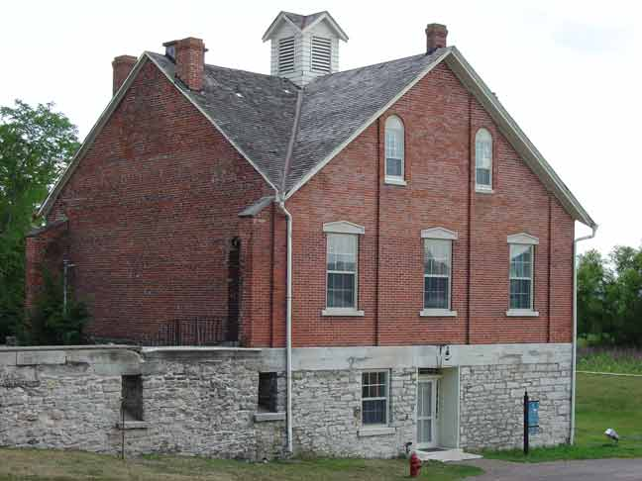
Burial
“They lived for glory; they died for glory; and glory is their eternal reward. From age to age shall their names go down to posterity as gems for the sanctified.”
D&C 135:6
June 29, 1844—the bodies were viewed from eight o’clock till five in the afternoon.
The coffins with the bodies were removed from the outer boxes which were then filled with bags of sand and taken to the cemetery where they were deposited with the usual burial ceremonies.
About midnight the bodies were taken by a few trusted friends and buried in the basement of the then building Nauvoo House.
They remained there until the fall when they were removed at the request of Emma Smith to a spot near the Nauvoo Mansion overlooking the Mississippi.
“In life they were not divided; in death they were not separated.”
B.H. Roberts

Slide 9
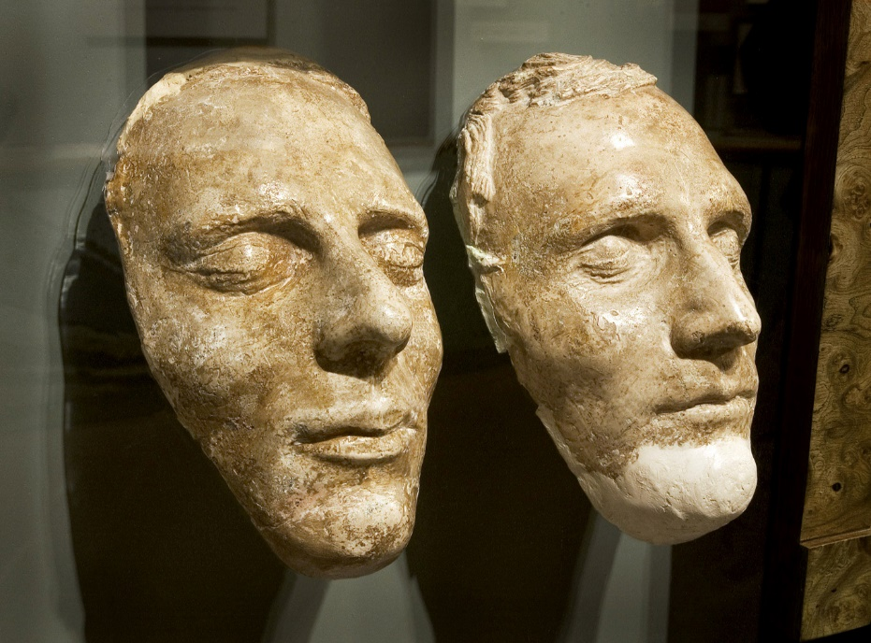
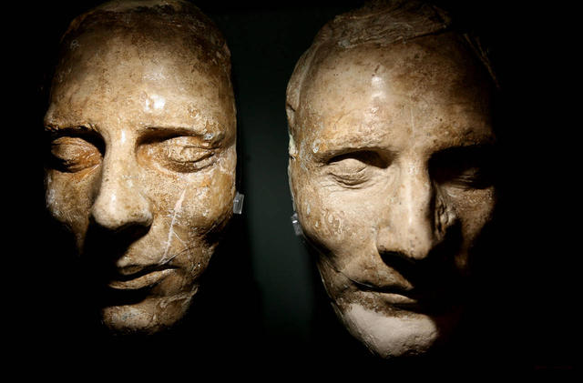
Masks of Joseph and Hyrum Smith
These original plaster impressions were made following Joseph and Hyrum’s death for Church members to preserve the memory of their physical appearance…donated as a gift to the Church by the Willard C. Wood Family
Joseph (left) Hyrum (right)
George Cannon (father of future Church leader George Q. Cannon) cast the death masks of Joseph and Hyrum Smith, and Philo Dibble (who married widow Smith) kept the masks safe for forty-one years.
If you look closely, you can see the wound where a bullet struck Hyrum on the left side of his nose.
The white patches on the casts indicate areas where they have been repaired in recent years.
B.H. Roberts

Slide 10
When the current President of the Church dies, who will become the next President of the Church?
How will he be chosen?
How does the President of the Church receive the priesthood authority necessary to preside over the Church?

Slide 11
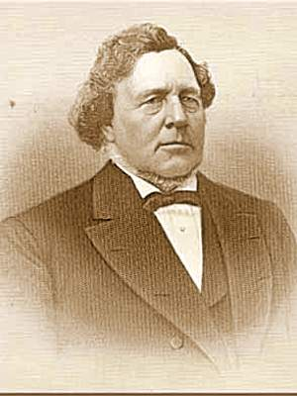
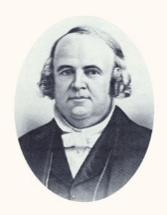
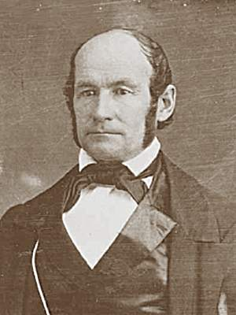
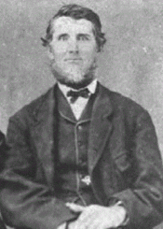
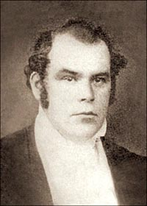
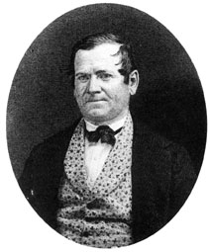
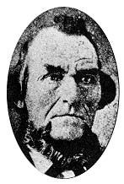
Where Were The Twelve?
1844
Elder Richards directed the Church until the Twelve returned.
They All Returned to Nauvoo by August 6th
Elders Heber C. Kimball and Lyman Wight were traveling between Philadelphia and New York City when Elder Kimball felt mournful, as if he had just lost a friend.
George A. Smith was in Michigan and was plagued with a depressed spirit and foreboding thoughts all day long. “Once it seemed to him that some fiend whispered in his ear, ‘Joseph and Hyrum are dead; ain’t you glad of it”
John Taylor—wounded-- returned to Nauvoo July 2nd
In Boston, Brigham Young, Wilford Woodruff, and Orson Pratt learned of the deaths on July 9th
Orson Hyde was examining maps in the hall rented by the Church in Boston when he felt a heavy and sorrowful spirit come upon him.
Two days before the Martyrdom, Parley P. Pratt was moved upon the Spirit to start home from New York State and met his brother William on a canal boat on the day of the tragedy.
Parley was the first Apostle outside of Nauvoo to learn of the deaths on a steamboat headed across the Great Lakes toward Chicago.
Samuel H. Smith who fled to the scene of his brothers’ deaths contracted a serious fever and died on July 30th.
Student Manual

Slide 12
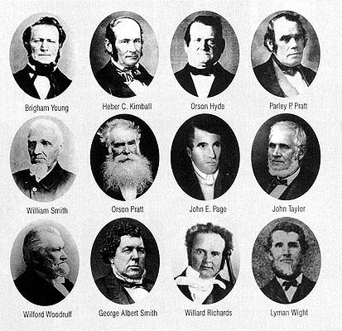
Priesthood Keys and Power of the Priesthood
Orson Hyde later reported that Joseph Smith gave the Quorum of the Twelve the final priesthood key in early 1844
At left are the members of the Quorum of the Twelve Apostles at the death of the Prophet Joseph Smith.
Brigham Young, Heber C. Kimball, Orson Hyde, Parley P. Pratt, William Smith, Orson Pratt, John E. Page, John Taylor, Wilford Woodruff, George Albert Smith, Willard Richards, Lyman Wight
The Twelve were “ordained and anointed to bear … the keys of the Kingdom of God in all the world. … The keys of the Kingdom are with them [the Quorum of the Twelve Apostles], and they can manage the affairs of the Church and direct all things aright.”
President Brigham Young, August 8, 1844
Brent L. Top and Lawrence R. Flake

Slide 13
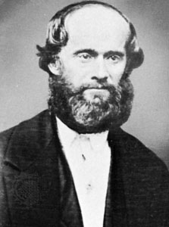
Claims To Be The Next Prophet
James Strang
He, who had been baptized in February 1844 in the font of the unfinished temple of Nauvoo, was exploring a possible location for the Saints in Wisconsin in the spring of 1844.
After the martyrdom, he claimed to have received a letter on July 9th from Joseph Smith, written on June 18th , stating that he had been appointed to be Joseph’s successor.
James Strang’s letter, which he showed to members of the Church, appeared to have Joseph Smith’s signature.
James Strang claimed to be the next prophet and announced his position at a conference of the Church in Michigan on August 5, 1844.
Strang then translated an “ancient” record which he unearthed at the foot of an oak tree, announced a visitation from an angel who “anointed” him, published a periodical aimed at persuading the Saints to abandon Brigham Young, and sent out missionaries who converted both some sincere believers and some dissatisfied former Church officials, including John C. Bennett, John E. Page, and William Smith.
Since the letter was hand printed and differed markedly from Joseph Smith’s usual style, Strang was excommunicated, first at an elders conference in Florence, Michigan, and again by the Twelve in Nauvoo.
He moved his organization to Beaver Island in Lake Michigan in 1847, had himself crowned “king of the Kingdom” in 1850, and was murdered by disaffected followers in 1856

Slide 14
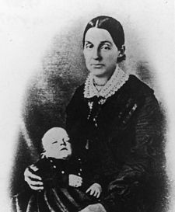
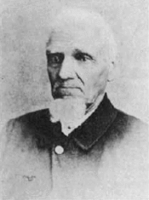
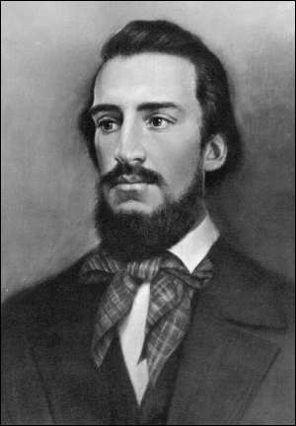
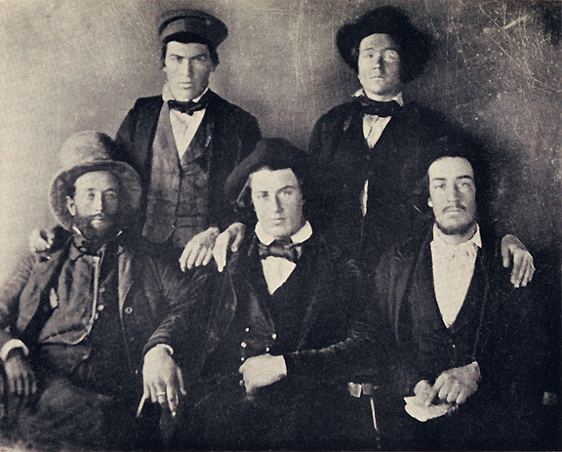
Claims To Be The Next Prophet
Some of Joseph Smith’s own family did not follow the Twelve.
The prophet’s widow, Emma, could not be reconciled with the Twelve on economic and theological matters.
William Smith returned to Nauvoo from the East, and he was ordained Church Patriarch to replace Hyrum.
After a few months, he advanced his own claims to be Church leader.
He was consequently excommunicated.
He had a short association with Strang where he taught that Joseph Smith’s eldest son should, by right of lineage, inherit the presidency and that he, William, was to be guardian and president pro tem until Joseph III was of age.
Gradually in 1850 a “new organization gradually emerged.
In 1860 leaders of the new organization (among them William Marks) formed the Reorganized Church of Jesus Christ of Latter-Day Saints and succeeded in naming Joseph Smith III to be its president. Eventually it established it headquarters in Independence, Missouri.
Emma’s Sons and 2nd husband, Lewis Crum Bidamon, married Dec. 23, 1847
Student Manual

Slide 15
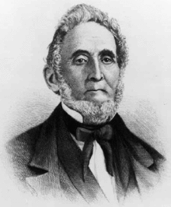
Claims To Be The Next Prophet
Sidney Rigdon, the only surviving member of the First Presidency
“In this I have discharged my duty, and done what God has commanded me,”…and the people can please themselves whether they accept me or not.”
Millennial Star vol. XXC. P. 215
He arrived in Nauvoo on August 3, 1844
There was a council meeting held with three members of the apostles’ quorum, but he failed to attend the meeting.
Sunday the 4th he spoke at an assembly of saints relating a vision he had received while in Pittsburg concerning the situation of the church which led him to advocate the appointment of “a guardian”.
August 7th he held another meeting for the purpose of appointing a “guardian” for the church
August 8th He spoke without interruption for 1 ½ hours that he was sent from God, but he failed to convince the Saints
“I have been ordained a spokesman to Joseph, and I must … see that the church is governed in a proper manner. Joseph sustains the same relationship to this church as he has always done. No man can be the successor of Joseph.” Sidney Rigdon
B.H. Roberts pgs. 414-415 B. Top and L. Flake

Slide 16
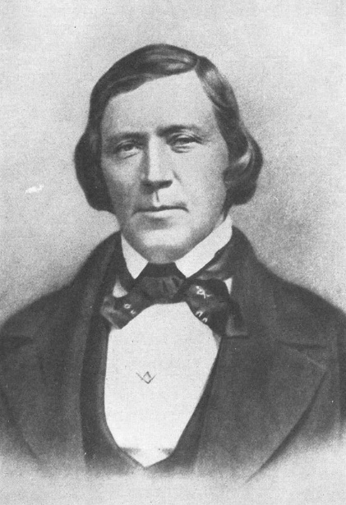
Brigham’s Response to Sidney Rigdon
“I do not care who leads the church, … but one thing I must know, and that is what God says about it. I have the keys and the means of obtaining the mind of God on the subject. …
“Joseph conferred upon our heads [referring to the Quorum of the Twelve] all the keys and powers belonging to the Apostleship which he himself held before he was taken away. …
The Apostles hold all the keys of the priesthood necessary to preside over the Church
“How often has Joseph said to the Twelve, ‘I have laid the foundation and you must build thereon, for upon your shoulders the kingdom rests’” HC

Slide 17
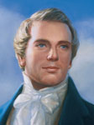
Death of the President
“The Twelve are not subject to any other than the first Presidency, … ‘and where I am not, there is no First Presidency over the Twelve.’”
--January 1836 Joseph Smith
When the President of the Church dies, the First Presidency is dissolved and the Quorum of the Twelve Apostles becomes the presiding quorum.
When the President of the Church dies, the counselors in the First Presidency take their places once again as members of the Quorum of the Twelve Apostles, based on their seniority in the Quorum.
When the Quorum was first formed in 1835, seniority was decided by age. Now seniority is determined by the date a man becomes a member of the Quorum of the Twelve.

Slide 18
When the President of the Church dies, the First Presidency is dissolved, and the Quorum of the Twelve Apostles becomes the presiding quorum under the direction of the senior Apostle

Slide 19
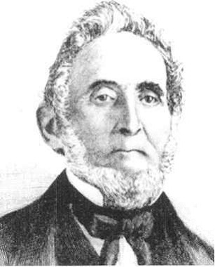
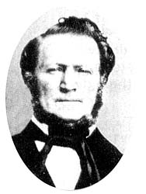
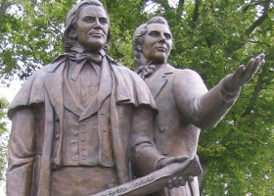
The Mantle Falls on Brigham Young
August 8, 1844
Sidney Rigdon took his position in a wagon behind the assembled congregation so the people could better hear his voice…because the wind was blowing toward the stand.
President Brigham Young and other Church leaders came and sat on the stand opposite where Sidney Rigdon was speaking. The wind had died down by this point.
Brigham Young spoke briefly and said that he would have preferred to come back to Nauvoo to mourn for the Prophet than to have to appoint a new leader. He announced that an assembly of leaders and members would be held later that day at 2:00 p.m.
Several members of the Church later testified that as Brigham Young spoke, they saw his appearance change and heard his voice change, and he took on the appearance and voice of the Prophet Joseph Smith. This miraculous event helped many of the Saints know that the Lord wanted Brigham Young to lead the Church.

Slide 20
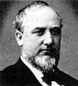
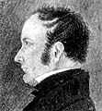
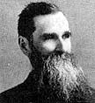
Witnesses to the Transfiguration
August 8, 1844
Benjamin F. Johnson, a 26-year-old member of the Church who was present that day, later recalled that as President Young spoke,
“I jumped upon my feet, for in every possible degree it was Joseph’s voice, and his person, in look, attitude, dress and appearance was Joseph himself, personified; and I knew in a moment the spirit and mantle of Joseph was upon him.”
Joseph Fielding
“The Saints soon began to see how things were…
They also saw “that the 12 must now hold the Keys of Power and Authority according to the Revelation which says the 12 are equal with the First Presidency. … It was now no hard thing determining who should lead the Church.”
George Q. Cannon (age 15)
“If Joseph had risen from the dead and again spoken in their hearing, the effect could not have been more startling than it was to many present at that meeting; it was the voice of Joseph himself; and not only was it the voice of Joseph which was heard, but it seemed in the eyes of the people as if it were the very person of Joseph which stood before them. A more wonderful and miraculous event than was wrought that day in the presence of that congregation we never heard of. The Lord gave his people a testimony that left no room for doubt as to who was the man chosen to lead them.”
B. Top and L. Flake

Slide 21
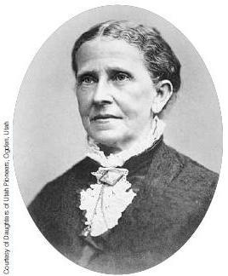
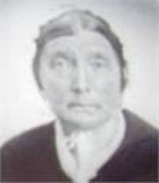
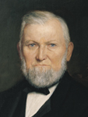
Witnesses to the Transfiguration
August 8, 1844
Jane Snyder Richards
After his [Joseph’s] tragic death I attended the meeting at which President Brigham Young addressed the Saints, and saw his face illuminated and appear as the face of Joseph while the voice of Joseph seemed to address the people through the mouth of Brigham. I can never forget the divine thrill that passed through the audience on that occasion and the impression that the appearance and voice of Joseph produced upon his hearers.
Wilford Woodruff wrote, “If I had not seen him with my own eyes, there is no one that could have convinced me that it was not Joseph Smith, and anyone can testify to this who was acquainted with these two men”
Bowen, Cynthia Harrington Durphy/Durfey (age 32)
“While at the prayer meeting that was called after hearing Sydney Rigdon speak an event that gave me great strength took place. Brigham Young stood before us and as I listened to him, his countenance changed & I saw the prophet Joseph Smith & heard his voice speaking as well & I knew who was to be the next prophet of the Lord & who was to lead the Saints.”
BYU Studies

Slide 22
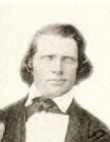
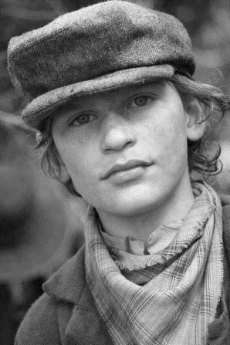
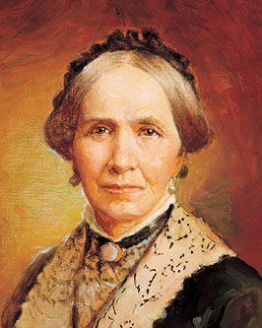
Witnesses to the Transfiguration
August 8, 1844
Zina Diantha Huntington (age 23)
“When I approached the stand (on the occasion when Sidney Rigdon was striving for the guardianship of the Church), President Young was speaking. It was the voice of Joseph Smith-not that of Brigham Young. His very person was changed. The mantle was truly given to another. There was no doubting this in the minds of that vast assembly. All witnessed the transfiguration, and even to-day thousands bear testimony thereof. I closed my eyes. I could have exclaimed, I know that is Joseph Smiths voice!
Yet I knew he had gone. But the
same spirit was with the people;
the comforter remained."
Cox, Elias (age 9)
“I heard Brother Brigham speak and that is the first time that I ever saw two men look and sound so much alike in all my life. And after he had sat down, I wondered where Joseph had gone.”
Robert Taylor Burton (age 22)
“At that time I was not acquainted with President Young, but his voice, manner, expression, and in fact, his personal appearance was so strikingly that of the martyred Prophet, that I rose from my seat, as did hundreds of others, to look at the Prophet Joseph Smith Jr. The likeness was so marked that I could hardly make myself believe that the Prophet had not himself returned; not that there was a resemblance between the two men.”
Unknown boy
BYU Studies

Slide 23
Witnesses to the Transfiguration
August 8, 1844
The Saints overwhelmingly accepted the Twelve, with Brigham Young as President of the Church. The minutes of the special conference recorded that almost every hand was raised when President Young asked: “Does the church want, and is it their only desire to sustain the Twelve as the First Presidency of this people? … All that are in favor of this, … manifest it by holding up the right hand.”
The cloud of gloom and uncertainty that had been over the Saints was removed, and in its place came confidence, renewed dedication, and almost universal support of the Quorum of the Twelve and President Young as their head.
B. Top and L. Flake

Slide 24
Through the Holy Ghost, we can receive a witness that those who lead the Church have been called of God
B. Top and L. Flake

Slide 25
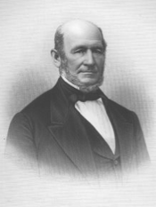
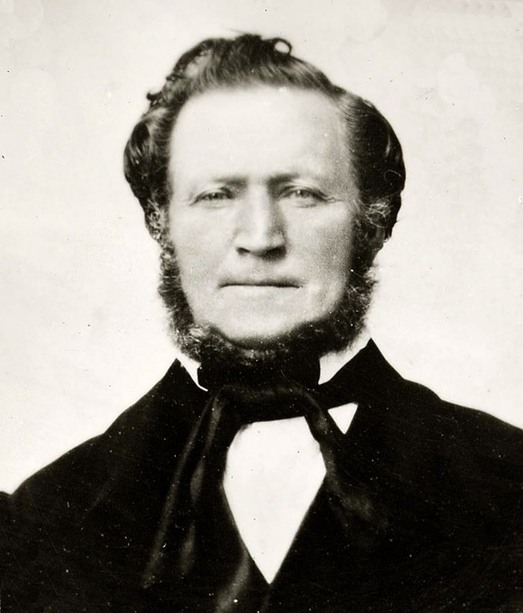
Reorganization of the Presidency
1847
Heber C. Kimball 1st Counselor
Willard Richards 2nd Counselor
President of the Church
Brigham Young
More than two years after the martyrdom—Brigham Young was inspired to reorganize the First Presidency rather than continue to lead the Church as President of the Quorum of the Twelve Apostles.

Slide 26
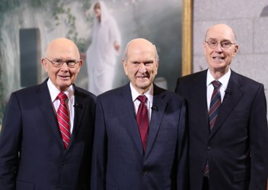
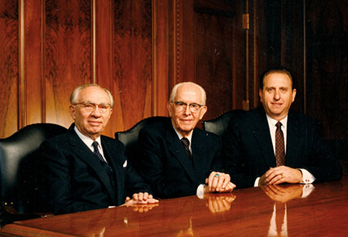
Succession
Succession in the Presidency of the Church has been established by the Lord. The Church is never without inspired leadership, and there is no reason for speculation or controversy over who will become the next President of the Church.
“God knows all things, the end from the beginning, and no man becomes president of the church of Jesus Christ by accident, or remains there by chance, or is called home by happenstance.”
President Ezra Taft Benson

Slide 27
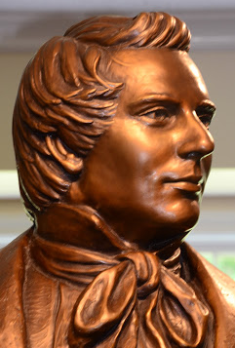
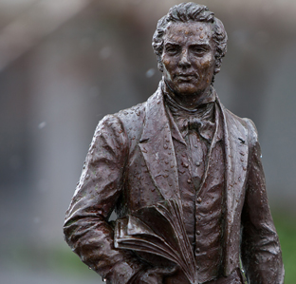
March 1844
“He stood for some three hours in a room delivering to us his last lecture. The room was filled as with consuming fire. His face was as clear as amber; his words were like vivid lightning to us. They penetrated every part of our bodies from the crown of our head to the soles of our feet.
He said, ‘Brethren, the Lord Almighty has sealed upon my head every Priesthood, every key, every power, every principle that belongs to the last dispensation of the fulness of times, and to the building up of the kingdom of God. I have sealed upon your heads all those principles, Priesthood, apostleship, and keys of the kingdom of God, and now you have got to round up your shoulders and bear off this kingdom or you will be damned.’”
Wilford Woodruff

Slide 28
Sources:
Videos:
Succession in the Presidency (2:13)
The President of the Church(1:40)
Mr. Gregg—History of Hancock county, p. 323 In B.H. Roberts A Comprehensive History of the Church Vol. 2 pg. 288-292
Brent L. Top and Lawrence R. Flake The Kingdom of God Will Roll On: Succession in the Presidency August 1996 Ensign
Presentation by ©http://fashionsbylynda.com/blog/
Russell R. Rich Nineteenth-Century Break-offs 1979 Ensign
History of the Church, 7:230; 2:374
Student Manual Church History in the Fulness of Times Chapter 23
Other Witnesses to the Transformation of Brigham Young August 8, 1844 "Appendix I: Firsthand Testimonies," BYU Studies, vol. 36 (1996-97), Number 4--1996-97 http://scottwoodward.org/brighamyoung_transfiguration.html
President Ezra Taft Benson (“Jesus Christ—Gifts and Expectations,” New Era, May 1975, 16–17).
President Wilford Woodruff (Teachings of Presidents of the Church: Wilford Woodruff [2004], xxxii).
Break off Groups from Church
https://www.lds.org/ensign/1979/09/nineteenth-century-break-offs?lang=eng&query=james+strang
Presentation by ©http://fashionsbylynda.com/blog/

Slide 29
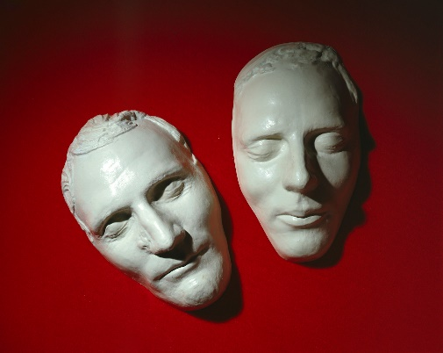
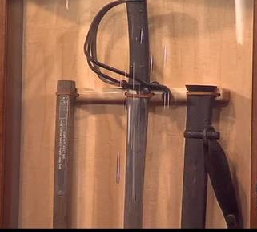
Death Masks:
The tradition of making death masks dates back to ancient Egypt, when the masks were served as aids to portrait sculptors.2 By the Middle Ages, death masks were created as both a memento of the person and as a model from which sculptures and paintings of the person could be made.3 Although the tradition of making death masks is not well known today, it remained popular through the 19th century and into the 20th, in part because of the practice of phrenology,4 or the study of a person’s head to determine that person’s character and attributes.5 Some famous people, including Abraham Lincoln, also sat for life masks, or casts of their faces made while they were still living.6
Because the masks of Joseph and Hyrum were made within 24 hours after death and because both men were healthy and strong, there is very little post-death distortion to their facial features. As early as 1850, casts of the death masks were used to create a bust of Joseph Smith. Later artists have followed suit, using the death masks to guide them in their work.
Museum Treasures
https://history.lds.org/article/museum-treasures-joseph-and-hyrum-death-masks?lang=eng
Afterwards the death masks came into the possession of an early Church member by the name of Philo Dibble. During the 1850's - 1860's he traveled around Utah and the West with kind of a traveling museum with various artifacts including the death masks of Joseph and Hyrum.
Harrie Brown of Logan, Utah purchased the death masks from the Dibble family in November of 1885. In 1936, Wilford Wood of Wood's Cross, Utah purchased the death masks, and kept them his personal church history museum in Wood's Cross, Utah.
Steve Glenn who owns Mormon Art, in Provo, Utah, knew the Wood family and received permission to make a mold of the death masks. He made copies of the death masks and gave them to the First Presidency and the Twelve Apostles and other key individuals over the next several years.
About 1980 the daughters of Wilford Wood, Leila Wood and Mary Wood Cannon generously gave the original death masks to the church Museum. Steve Glenn, knowing my personal love for the Smith Family gave me the death mask mold and I believe made another copy of the mold. He instructed me to make copies of the masks for whoever I felt prompted to share them with. A stipulations was given that they would never be sold - for this would be considered against the spirit in which the mold of the death masks were allowed to be made.
To the best of my knowledge, this statement is correct about the death masks
Wayne J. Lewis
The Joseph Smith and Emma Hale Smith Historical Society
https://www.josephsmithjr.org/index.php/history/joseph-smith-jr/202-joseph-and-hyrum-death-masks
Casket Cane:
Porter Rockwell, Joseph Bates Noble, and other bodyguards risked their lives to recover the martyred bodies of Joseph and Hyrum Smith. After the funeral, Emma Smith took the head casket and cut it into 12 pieces to give to those who recovered the bodies and other upstanding individuals. This casket cane is one of 11 that represents the 12 tribes of Israel. It is over 165 years old. This caket cane was owned by Joseph Smith's Bishop, bodyguard, and best friend, Joseph Bates Noble, and was hidden away in the Noble's West Bountiful home for more than 165 years before it was shown to the public in 2009. It turns out Joseph and Hyrum weren't buried in the original oak casket. Their bodies were removed and replaced with sandbags in order to prevent the mob from defacing the bodies. Replacement casket's were used to bury the bodies in to keep the bodies safe and hidden from the mob.
http://www.good4utah.com/story/d/story/the-casket-cane-of-joseph-smith/22590/26m-MRgk00mc55OpkDv9pg

Slide 30
Wycam (or Wycom) Clark is a name known to few and then only because he has the dubious distinction of apparently founding the first opposition church. Baptized in Kirtland in about 1830, he left the Church, probably in 1831, to organize the “Pure Church of Christ.” Its six members held a few meetings, but the organization soon disintegrated.
Warren Parrish had been a loyal missionary and the Prophet’s faithful scribe, but when the Kirtland Safety Society, a banking institution, failed, he with others questioned whether Joseph Smith could still be inspired of God. Warren Parrish had previously repented of serious transgression; but as cashier of the Kirtland Safety Society, he embezzled more than $25,000 of its funds (which embezzlement contributed to the failure of the Society) and “began to discover that there was ‘great iniquity’ in the church.” He led a group of about thirty men, all former elders, in founding the “Church of Christ”; the group had previously tried to install David Whitmer as their president. They stayed behind when most of the members moved to Missouri, and soon disintegrated.
https://www.lds.org/ensign/1979/09/nineteenth-century-break-offs?lang=eng&query=james+strang
William Smith, the last surviving brother of the Prophet, led an equally erratic career. Ordained one of the original apostles, he was suspended two or three times because of his behavior. After his brothers’ deaths, he alternately supported and criticized the Twelve, joining, not particularly peacefully, first with the Strangites and then with the Reorganized Church after his excommunication in 1845. He apparently aspired to power and never succeeded in obtaining it. He wanted Joseph Smith III to succeed. They did in the “Reorganized Church of Jesus Christ of Latter-Day Saints in 1860.
William Law spearheaded dissension from within at a critical time. In the spring of 1844, persecution by Illinois neighbors was severe, but when influential deserters threw their weight behind the anti-Mormon movement, they not only precipitated the second major crisis in the Church but indirectly brought about the death of Joseph Smith.
On 18 April 1844, Law and a number of other conspirators were excommunicated. The next month, the group of excommunicates appointed Law to succeed Joseph Smith, the “fallen prophet.” They canvassed Nauvoo for new members, but the group disintegrated soon after the death of Joseph Smith
A few break offs from the Church of Jesus Christ of Latter-day Saints.
William E. McLellin, one of the original twelve apostles, was excommunicated at Far West in 1838 and became an active persecutor of the Saints. He also probably holds the record for involvement in other factions of the Church since, at one time or other, he belonged to break-offs founded by Warren Parrish, George Hinkle, Sidney Rigdon, William Law, and James Jesse Strang—whom he tried to oust from leadership. He founded a church of his own, then affiliated with the Church of Christ—Temple Lot, and died unaffiliated with any in 1883
Sidney Rigdon moved to Pittsburgh, then to Greencastle, Pennsylvania, where he published a paper and organized his own church, sent out missionaries, and tried to organize a United Order. By 1847, however, he had only a handful of followers left, although some of them began a second organization in Iowa in 1869 that attracted possibly twenty families at its peak. Rigdon, who was living near his married children in Friendship, New York, never moved to Iowa although he corresponded with this group. He died 14 July 1876
Jesse Strang moved his organization to Beaver Island in Lake Michigan in 1847, had himself crowned king in 1850, began practicing plural marriage, and was fatally wounded on 16 June 1856 by two men who took refuge with Strang’s enemies and were never tried for their crime.
After his death, his approximately 2,600 followers were forcibly removed from Beaver Island. Five of Strang’s twelve apostles spent the night of 19 February 1857 praying for guidance, but received no answer about a successor. The church dwindled rapidly.

Slide 31
June 27, 1844 | Joseph and Hyrum Smith are martyred.
June 29, 1844 | Public viewing of the bodies of Joseph and Hyrum Smith.
June 27–July 7, 1844 | Willard Richards and the injured John Taylor are the only Apostles in Nauvoo.
July 8, 1844 | Parley P. Pratt returns to Nauvoo and helps Willard Richards and John Taylor keep order in the Church.
August 3, 1844 | Sidney Rigdon arrives in Nauvoo from Pittsburgh, Pennsylvania.
August 4, 1844 | Sidney Rigdon tells a group of Saints that he should be the guardian of the Church and wants a special meeting to be called on August 6 to ratify his appointment. The meeting is actually held on Thursday, August 8.
August 6, 1844 | Most of the rest of the Apostles, including Brigham Young, return to Nauvoo from their missions.
August 7, 1844 | In the morning, the Apostles meet together in the home of the injured John Taylor. At an afternoon meeting of the Apostles, high council, and high priests, Sidney Rigdon again claims he should be the guardian of the Church. Brigham Young states that he [Brigham Young] holds the keys and wants to do the Lord’s will in the matter.
August 8, 1844 | During a 10:00 a.m. meeting, Sidney Rigdon speaks for an hour and a half to thousands of assembled Saints explaining why he should be the guardian. Brigham Young also speaks and calls for the Saints to gather again for a meeting at 2:00 p.m. During both meetings, many Saints witness Brigham Young appear and sound like Joseph Smith. During the 2:00 p.m. meeting, the Saints sustain Brigham Young and the Twelve Apostles as the Church’s leaders. Many members of the Church witness the mantle of the Prophet Joseph Smith fall upon Brigham Young, who temporarily appears and sounds like Joseph Smith.
1844 Timeline succession in the Presidency after the martyrdom of Joseph Smith

Slide 32
Where the Twelve Were At the Time of the Martyrdom:
Parley P. Pratt was the first Apostle outside of Nauvoo to learn of the Martyrdom. He was on a steamboat headed across the Great Lakes toward Chicago. At a landing in Wisconsin, boarding passengers brought news of the Carthage murders. There was great excitement on board, and many passengers taunted him, asking what the Mormons would do now. He replied that “they would continue their mission and spread the work he [Joseph Smith] had restored, in all the world. Observing that nearly all the prophets and Apostles who were before him had been killed, and also the Saviour of the world, and yet their death did not alter the truth nor hinder its final triumph.”
In sorrow Elder Pratt walked 105 miles across the plains of Illinois, hardly able to eat or sleep, wondering how he should “meet the entire community bowed down with grief and unutterable sorrow.” He prayed for assistance. “On a sudden the Spirit of God came upon me, and filled my heart with joy and gladness indescribable; and while the spirit of revelation glowed in my bosom with as visible a warmth and gladness as if it were fire. The Spirit said unto me: … ‘Go and say unto my people in Nauvoo, that they shall continue to pursue their daily duties and take care of themselves, and make no movement in Church government to reorganize or alter anything until the return of the remainder of the Quorum of the Twelve Apostles. But exhort them that they continue to build the House of the Lord which I have commanded them to build in Nauvoo.’” Arriving in Nauvoo on 8 July, Parley helped Elders Richards and Taylor keep order in the stricken community.
George A. Smith learned of the Martyrdom from a newspaper account in Michigan on 13 July. At first he thought it a hoax, but when the report was confirmed, he hastened home with his three missionary companions. Overcome by worry and fatigue, he broke out in hives over his entire body. He could not even eat, but he traveled on, arriving in Nauvoo on 27 July. Soon he was meeting in council with the three Apostles already there.
In Boston rumors of Joseph Smith’s death began on 9 July. During the week before confirmation came from family letters and more complete newspaper accounts, Brigham Young, Wilford Woodruff, and Orson Pratt struggled within themselves about what the terrible news meant. Brigham recorded in his journal, “The first thing which I thought of was, whether Joseph had taken the keys of the kingdom with him from the earth; brother Orson Pratt sat on my left; we were both leaning back on our chairs. Bringing my hand down on my knee, I said the keys of the kingdom are right here with the Church.”
Brigham Young, Heber C. Kimball, Orson Pratt, Wilford Woodruff, and Lyman Wight contacted each other, joined together, and hastened home by railway, stagecoach, boat, and buggy. Subsequent events proved the wisdom of their haste. They arrived in Nauvoo the evening of 6 August. Wilford Woodruff recorded his feelings:
“When we landed in the city there was a deep gloom seemed to rest over the City of Nauvoo which we never experienced before.
“… We were received with gladness by the Saints throughout the city. They felt like sheep without a shepherd, as being without a father, as their head had been taken away.”
Chapter Twenty-Three: The Twelve to Bear Off the Kingdom
Church History In The Fulness Of Times Student Manual, (2003), 286–296
Those Left Behind:
Emma would pass away at the Riverside Mansion in Nauvoo in the early morning hours of April 30, 1879, raising herself and extending her left arm with the words, "Joseph! Yes, yes, I'm coming."
David (born November 17, 1844) would die at the Northern Illinois Hospital and Asylum for the Insane at Elgin, Illinois, August 29, 1904.
Alexander (born June 2, 1838) died on August 12, 1909, in the Mansion House during a visit to Nauvoo.
Joseph III, (born November 6, 1832) president of the Reorganized Church of Jesus Christ of Latter Day Saints, died December 10, 1914, at Independence,Latter-Dayi.
"My mother," he wrote,
. . . endeared herself to the entire community. To those within her reach she had ever been an unfailing source of comfort and assistance in all the varied troubles to which ordinary households are subject. As the long stream of people passed by her bier, there was often noted the silent gaze of sorrow, the gently falling tears, or the touch of living hands upon those folded in death, all mute testimonies of the love and appreciation which had been cherished for her in the hearts of her friends and neighbors. [Joseph Smith III and the Restoration, p. 284]
http://www.rickgrunder.com/Manuscripts%20for%20Sale/SmithLetters/emmasons.htm#emmacherish

