Slide 1
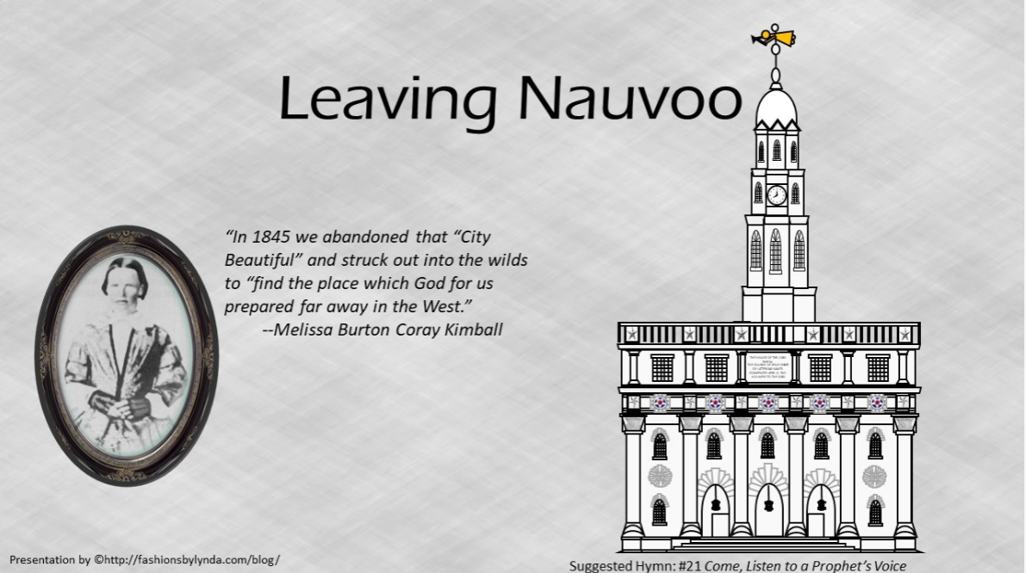

Slide 2

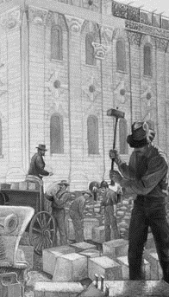
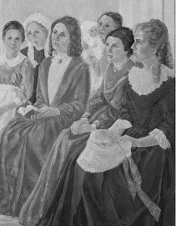
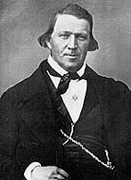
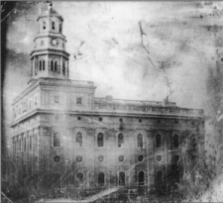
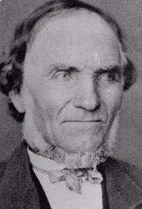
Completing the Temple
October 1844 general conference
President Brigham Young asked the Saints to give their tithes and offerings to build the temple. In response, each Relief Society sister contributed a penny a week for building supplies.
Many men tithed their time by working on the temple one day out of every ten.
Others gave more than one-tenth of their means.
Joseph Toronto gave Brigham Young $2,500 in gold and said he wanted to give all that he had to build the kingdom of God.
Receiving temple ordinances is worth all our righteous effort and sacrifice
Student Manual

Slide 3
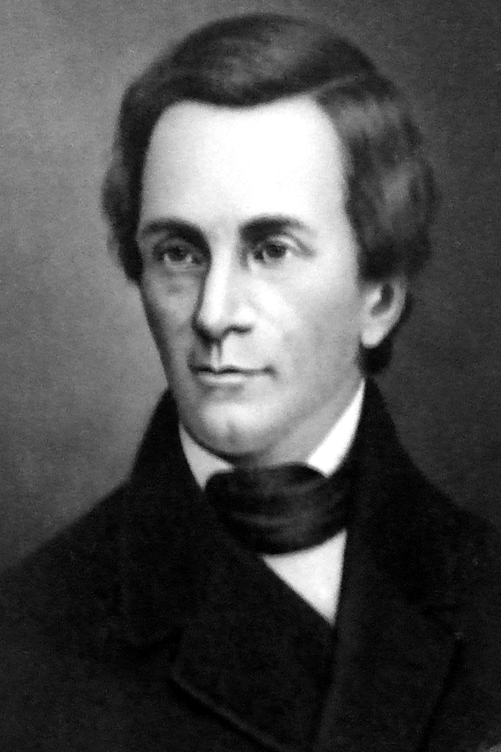
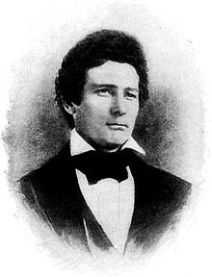
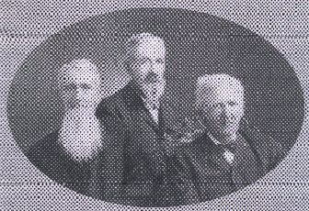
The Great Wolf Hunt
Many enemies of the Church thought that once Joseph Smith was killed, the Church would collapse. However, when the Church continued to grow and flourish, enemies of the Church intensified their efforts to drive the Saints from Illinois.
Upon hearing of this, Governor Thomas Ford of Illinois sent General John Hardin of the state militia to the county to keep the peace.
In September 1844, Colonel Levi Williams, one of those later indicted for the murders of Joseph and Hyrum Smith, organized a major military campaign to force the Latter-day Saints out of Illinois. It was advertised as “a great wolf hunt in Hancock County”
A year later, in September 1845, Colonel Williams led a mob of 300 men who raided Latter-day Saints’ settlements in outlying areas, burning many unprotected homes, farm buildings, mills, and grain stacks.
In mid-September, President Brigham Young asked for volunteers to rescue those Saints
David E. Miller and Della S. Miller

Slide 4
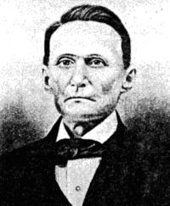
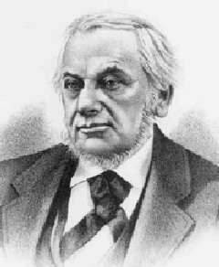
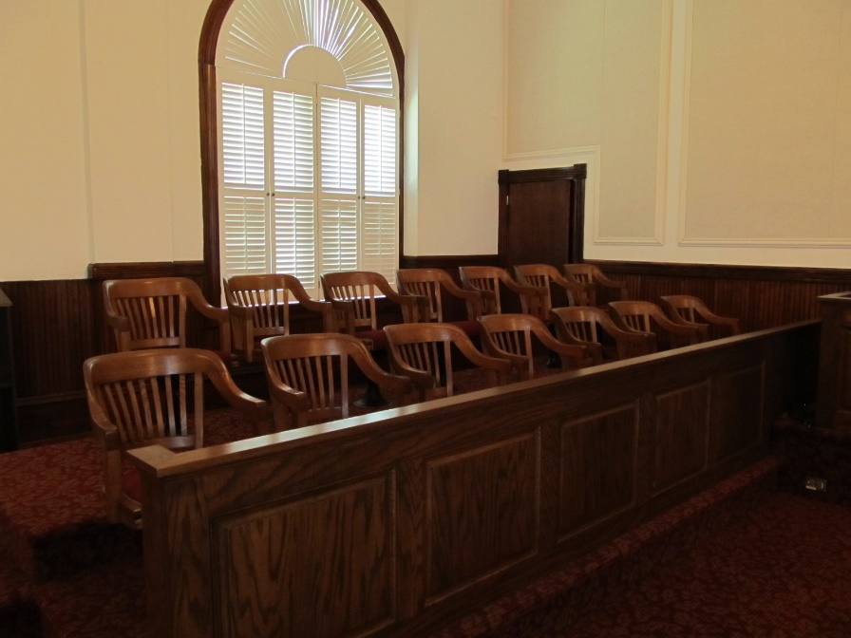
The Trial
May 1845 when nine men were finally brought to trial in Carthage for the murder of Joseph Smith. Five of them were prominent citizens: Mark Aldrich, land promoter; Jacob C. Davis, state senator; William A. Grover, captain of the Warsaw militia; Thomas C. Sharp, newspaper editor; and Levi Williams, colonel in the fifty-ninth regiment of the state militia.
Mark Aldrich
Thomas C. Sharp
The trial lasted for two weeks, an unusually long time for that era. Prosecution witnesses gave contradictory evidence, while defense attorneys argued persuasively before a non-Mormon jury that Joseph Smith was killed in response to the popular will of the people. Therefore, they asserted that no specific person or group could be held responsible. The defendants were acquitted.
A separate trial scheduled for 24 June for the murder of Hyrum Smith was not held because the prosecutors did not appear.
Student Manual

Slide 5

Anti-Mormon Articles
Thomas Sharp unleashed a new anti-Mormon volley in the Warsaw Signal in the summer of 1845. He opposed Latter-day Saint officeholders in the county and reopened the debate over Mormon political activity.
THE TEMPLE. -- The last Neighbor announces the fact, that the last shingle has been laid on the Temple. This building has been progressing for five years, and the Saints boast that it has cost $500,000, yet as an architectural burlesque they have covered the structure with oak shingles. It seems to have been a part of their policy to use no material in their building, except such as could be conveniently stolen from the neighboring Gentiles. Oak shingles on a building that cost $500,000, look very much like Corinthian pillars to a pig sty.
Thomas C. Sharp
Student Manual

Slide 6
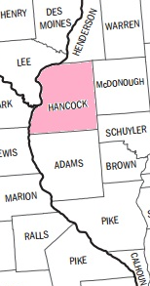
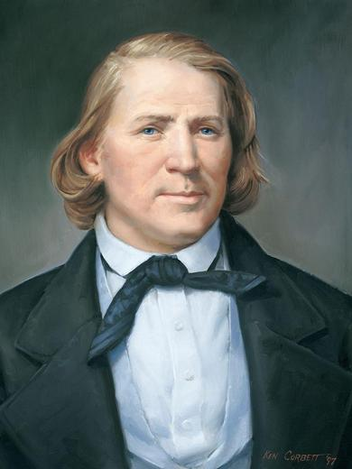
Asking for Volunteers
In mid-September, President Brigham Young asked for volunteers to rescue those Saints
The Saints in Nauvoo prepared 134 wagons to bring the families in the outlying settlements (Hancock County and north Adams County) safely to Nauvoo.
“Let the fire of the covenant which you made in the House of the Lord, burn in your hearts, like flame unquenchable, till you … have searched out every man … who [is able to leave], and impart the fire to his soul, till he shall rise up … and go straitway, and bring a load of the poor from Nauvoo. …
“… This is a day of action”
Brigham Young
Student Manual

Slide 7
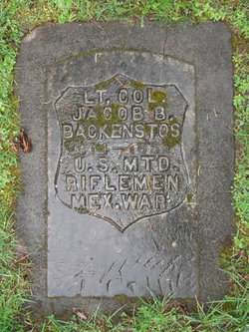
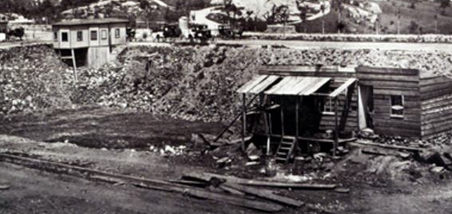
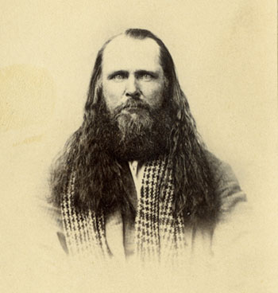
Jacob Backenstos--Sheriff
The sheriff of Hancock County, Jacob Backenstos, a friend of the Latter-day Saints, endeavored to preserve order, but citizens in Warsaw refused to join a posse he tried to organize.
After he drove off the mob with a posse made up of ex-members of the Nauvoo Legion, his life was threatened by the non-Mormons of Hancock County, and he fled.
Frank Worrell, who had supervised the guard at Carthage the day of the Martyrdom, led the chase after Backenstos..
Near the railroad shanties north of Warsaw, Backenstos overtook several members of the Church and immediately deputized them.
When Worrell raised his gun to fire at the sheriff, deputy Porter Rockwell took aim with his rifle and mortally wounded Worrell.
This intensified hostilities in Hancock County, and with civil war imminent, citizens in Quincy, Illinois, and Lee County, Iowa, asked Church members to move from Illinois.
On 24 September 1845 the Quorum of the Twelve Apostles promised that the Church would leave the following spring.
Student Manual

Slide 8
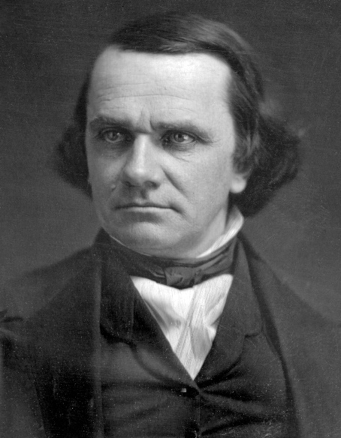
Civil Unrest
Governor Ford dispatched four hundred militia troops under the direction of General Hardin and three other prominent citizens, including Congressman Stephen A. Douglas, to act as an independent police force during this period of civil unrest.
Gov. Ford
The depredations ended, and peace was restored temporarily. Acting as the governor’s on-the-spot advisory committee, the four leaders investigated the circumstances and learned that the anti-Mormons had initiated the conflict with their raids.
They also recognized that there would be no peace in Hancock County until the Mormons left Illinois.
Stephen A. Douglas
General Hardin
Congressman Douglas was an advocate of manifest destiny—a philosophy advocating the growth of the United States completely across the continent. He counseled Church leaders to find a place to settle in the West and promised to use his influence in assisting their move.
Trustees of the Church would stay in Nauvoo to sell any remaining property
Student Manual

Slide 9
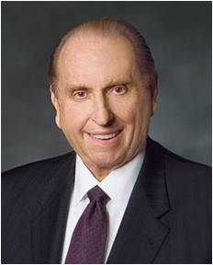
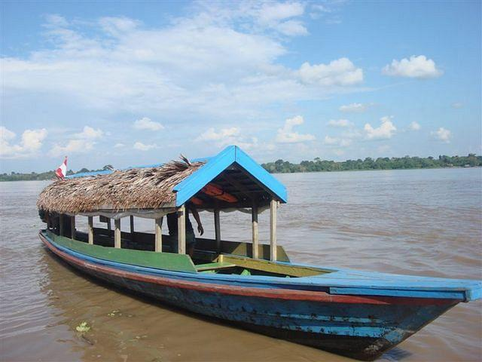

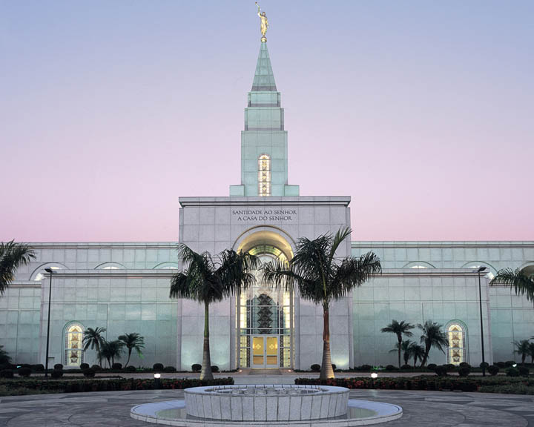
Sacrifices
Those faithful Saints journeyed by boat for four days on the Amazon River and its tributaries. After completing this journey by water, they boarded buses for another three days of travel—over bumpy roads, with very little to eat, and with nowhere comfortable to sleep.
“Many years ago, I read of a group of over a hundred members who left Manaus, located in the heart of the Amazon rain forest, to travel to what was then the closest temple, located in São Paulo, Brazil—nearly 2,500 miles (4,000 km) from Manaus.
After seven days and nights, they arrived at the temple in São Paulo, where ordinances eternal in nature were performed. Of course, their return journey was just as difficult. However, they had received the ordinances and blessings of the temple, and although their purses were empty, they themselves were filled with the spirit of the temple and with gratitude for the blessings they had received.”
President Thomas S. Monson

Slide 10
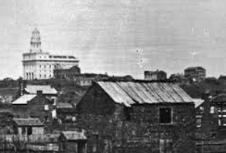
The Finished Temple
Church leaders dedicated rooms in the temple as they were completed so that ordinance work could begin as early as possible. The attic of the temple was dedicated for ordinance work on November 30, 1845. The Saints began receiving their endowments on the evening of December 10, with endowment sessions continuing until 3:00 a.m. on December 11
By the end of 1845, over 1,000 members had received temple ordinances. In January 1846, President Brigham Young recorded, “Such has been the anxiety manifested by the saints to receive the ordinances [of the Temple], and such the anxiety on our part to administer to them, that I have given myself up entirely to the work of the Lord in the Temple night and day, not taking more than four hours sleep, upon an average, per day, and going home but once a week” HC
Many men and women contributed by washing the temple clothing each night so the work could continue the next morning without delay.
Student Manual

Slide 11
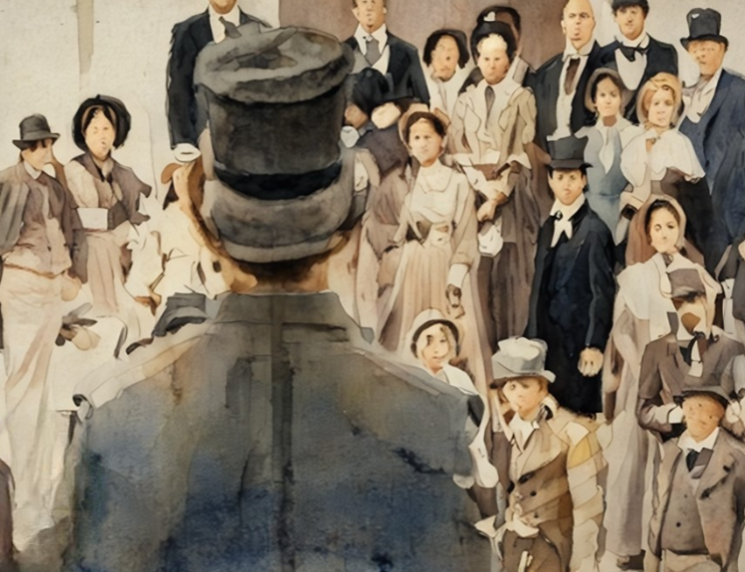
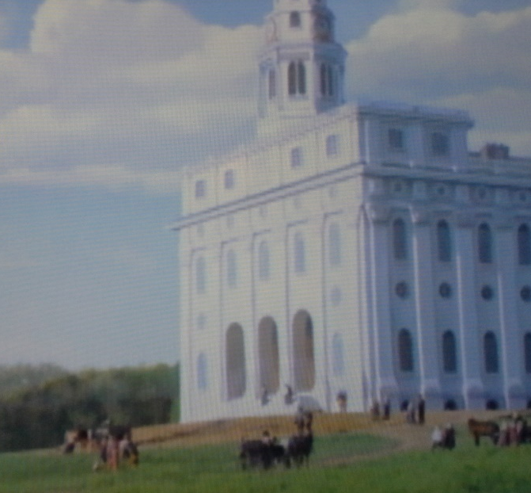
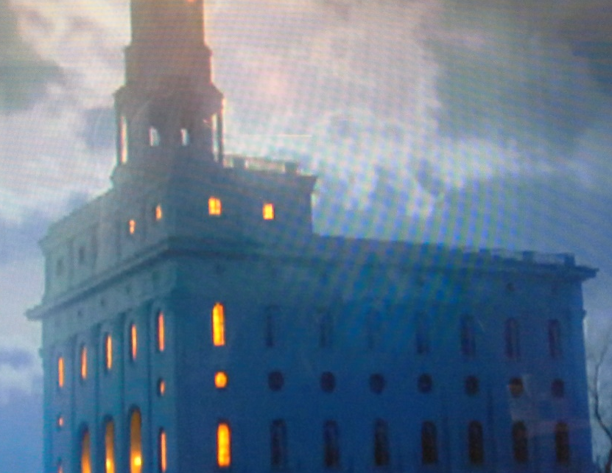
Receiving Endowments
On February 3, 1846, President Young left the temple so he could prepare to leave Nauvoo the next day. But as he walked outside, he saw a large group of people who were still waiting to receive their endowments.
Feeling compassion for his fellow Saints, he returned to the temple to serve them.
He was not able to leave Nauvoo until two weeks later. Temple records show that 5,615 Saints were endowed before going west.
Student Manual

Slide 12
Our Efforts and Sacrifices
What efforts and sacrifices do we have to make to receive temple ordinances?
Why do you think receiving the ordinances of the temple is worth working hard and making sacrifices?
What do you need to do so you can receive temple ordinances? (What do you need to stop or start doing?)

Slide 13
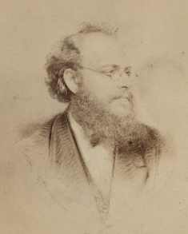
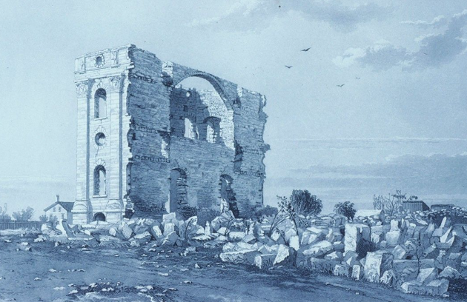
Aftermath in Nauvoo
Only four years after the Nauvoo Temple was dedicated, it lay in ruins. In October 1848, arsonists’ fire left only the limestone outer walls intact.
In May 1850, a tornado toppled the north wall and weakened two others. Local citizens dismantled these walls as a matter of public safety.
By the time London-trained artist Frederick Piercy traveled through Nauvoo in 1853, only the building’s crumbling facade remained.
Piercy wrote, “The first objects I saw in approaching the city were the remains of what was once the Temple, situated on the highest eminence of the city.”₁ He drew this image of the ruined temple, which was later engraved and included with engravings of scenes from the pioneer trail in his book Route from Liverpool to the Great Salt Lake Valley, published in 1855.

Slide 14
Sources:
Videos:
From Manaus to São Paulo (1:28)
Endowed with Power (12:17)
Church History in the Fulness of Times Student Manual, 2nd ed. [Church Educational System manual, 2003], 302-304; Our Heritage [1996], 59–60.)
Brigham Young (Journal History of The Church of Jesus Christ of Latter-day Saints, Sept. 28, 1846, 5–6, Church History Library, Salt Lake City).
Presentation by ©http://fashionsbylynda.com/blog/
David E. Miller and Della S. Miller, Nauvoo: The City of Joseph [1974], 186).
Warsaw Signal--http://www.sidneyrigdon.com/dbroadhu/il/sign1845.htm
President Thomas S. Monson (“The Holy Temple—a Beacon to the World,” Ensign or Liahona, May 2011, 91).
History of the Church,7:567
Frederick Piercy: https://history.churchofjesuschrist.org/content/museum/museum-treasures-nauvoo-temple-in-ruins-lithograph?lang=eng
Presentation by ©http://fashionsbylynda.com/blog/

Slide 15
Joseph Toronto--excerpts
--Giuseppe Efisio Taranto’ was born June 25, 1816, in Cagliari, a fishing town on the southern shore of the island of Sardinia in the Mediterranean Sea. He was the first son and third of seven children of Francesco Matteo Antonio Taranto and Angela Maria Fazio.
For the first thirty years of his life Giuseppe followed his father’s footsteps and was intimately involved with the life of the sea as a fisherman and sailor. His travels with the shipping business brought him to New Orleans where he lived and worked for a time, and subsequently to two other bustling American seaports, New York and Boston.
One time as he sailed towards New York, he became fearful that someone in the city might steal the money he had been saving for some time to take back to his family in Palermo. That night as he slept, he had a dream in which a man told him to take the money to “Mormon Brigham” and he would be blessed. When he arrived in New York, he began to inquire about “Mormon Brigham,” but no one seemed to know him. From New York Giuseppe went to Boston.
He gave up his job with the Italian shipping firm and purchased a small boat of his own. He made a living by buying fruits and vegetables from the wholesale vendors in Boston and then selling them to the large ships at anchor in the harbor. It was during his stay in Boston that Giuseppe first heard the Mormon missionaries preaching the Gospel as restored through Joseph Smith only a few years before. In the fall of 1843 at the age of 27, he was baptized by Elder George B. Wallace. It is believed that Giuseppe Efisio Taranto thus became the first native Italian and the first Catholic to join the Church of Jesus Christ of Latter-Day Saints in this dispensation.
After his baptism, Giuseppe was counseled to join the other members of the Church gathering in Nauvoo. One day, while transporting a load of fruits and vegetables in Boston harbor, his boat collided with a larger vessel and was capsized. He lost his cargo of goods and nearly lost his life by drowning.
One of the ironies in Joseph’s life is that he spent much of his life on the water and was skilled as a seaman, yet he never learned to swim. As a result he had at least two near-drowning experiences: this one in Boston harbor, and another in the Great Salt Lake. It was a terrifying and traumatic event for him, one which became a turning point in his life. This accident made him feel that he should now heed his church leader’s counsel to go to Nauvoo with the saints. So it was that in the spring of 1845 he sold his boat and his business and headed to the western frontiers of the United States.
It must have been approximately at this time that Giuseppe began to be called permanently by his English name, Joseph, and that his last name became anglicized to the “Toronto” we have today.
on May 24, 1845 at 6:00 a.m., the capstone was laid amid the general rejoicing and shouts of hosanna from the assembled thousands of saints. Joseph Toronto arrived in Nauvoo not long after the capstone laying ceremony.
Joseph was in attendance at that Sabbath meeting and heard the President’s fervent appeal to the membership of the Church. The newly-arrived convert from Sicily was deeply moved, and he determined to do whatever he could to help move the work along. The next afternoon, Monday, July 7, Pres. Brigham Young (according to his diary account) “had an interview with Bro. Joseph Toronto.” His journal entry for the next day, Tuesday the 8th, states: “went and lay at the feet of the Bishops Whitney and Miller $2600 in gold that I had received of Brother Toronto.” When the manuscript history was compiled in the 1850’s, the account read as follows: “Brother Joseph Toronto handed to me $2500 in gold and said he wanted to give himself and all he had to the up building of the church and kingdom of God; he said he should henceforth look to me for protection and counsel. I laid the money at the feet of the bishops.”
Joseph was in the emigration from Illinois to Utah which took place the next year, 1848. His name appears in the 1st Division (with Brigham Young, General Superintendent and Leader, and Daniel H. Wells, Aide-de-Camp).
on Friday October 19, 1849, Joseph Toronto and Lorenzo Snow left Great Salt Lake Valley in company with 35 other men, mostly missionaries destined for different mission fields. This was the first company of missionaries to have left the Valley to preach the Gospel abroad. Joseph Toronto no doubt shared these sentiments to a degree, but for him, the “land of strangers” was his homeland where he would be reunited with family and friends, and the “jargon of Babal” was his native tongue which would sound like music to his ears.
Elder Snow, Elder T.B.H. Stenhouse and Elder Toronto were the first elders of the L.D.S. Church to set foot on Italian soil as missionaries of the restored Gospel of Christ.
Joseph and Ellenore Jones (She was baptized on May 18, 1847, but her sister, Jane, was the only other member of the family to join the Church with her) were married in the fall of 1853.
He died at the age of 67 in Salt Lake City, Utah
See more : http://www.josephtoronto.org/?p=474#joseph

Slide 16
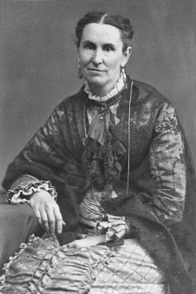
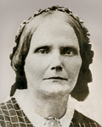
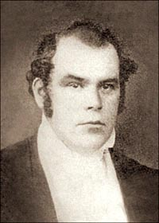
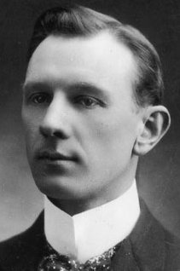
Jacob Backenstos:
Son of Jacob Backenstos (June 2, 1776) and Margretha Theis (about 1796); born in Dauphin County, Pennsylvania. Married Sarah Lavina Lee, niece of Robert E. Lee in 1836 and was living in Sangamon County, Illinois by 1840. Member of Lutheran Reformed Church Clerk of the Hancock County, Illinois circuit court, 1843 to 1845 and was elected to the Illinois legislature, 1844, and Sheriff of Hancock County in 1845 where he defended the rights of the Mormons from mob-violence. He became an army officer in 1846 and participated in the war with Mexico as a Lieutenant Colonel of the 2nd Brigade, Illinois Mounted Rifles and was wounded in the battle of Chapultepec. In 1849 he traveled to Oregon with the Mounted Rifles, resigning in 1851. He was living in Oregon City, Clackamas County in 1850 and later committed suicide by drowning himself in the Willamette River near Portland. Originally buried at Saint Marys Cemetery later reinterred at Mount Calvary.
In summing up the efforts of Backenstos and Babbitt, Brigham Young wrote: "Mr. Backenstos had appealed to the sense of justice, equal rights, patriotism and humanity possessed by the members of the House of Representatives in vain. His colleague Mr. Babbitt and himself had done their duty." (HC 7:368.) Find a Grave
Colonel Thomas L. Kane visited Nauvoo and described the abandoned city: “The town lay as in a dream, under some deadening spell of loneliness, from which I almost feared to wake it. For plainly it had not slept long. There was not grass growing up in the paved ways. Rains had not entirely washed away the prints of dusty footsteps. …(The Mormons: A Discourse Delivered before the Historical Society of Pennsylvania, March 26, 1850[1850], 4–5).
Helen Mar Whitney wrote that it was only “through the united faith and prayers of the faithful few” that the Saints “were permitted to remain there long enough to finish that Temple” (“Scenes in Nauvoo after the Martyrdom of the Prophet and Patriarch,”Woman’s Exponent, Apr. 15, 1883, 170). (Photograph of Nauvoo Temple detail by Welden C. Andersen.)
Sarah Rich expressed the feelings of nearly all the recently endowed Saints when she wrote: “If it had not been for the faith and knowledge that was bestowed upon us in that temple by the influence and help of the Spirit of the Lord our journey would have been like one taking a leap in the dark” (Reminiscences). (Photograph by Welden C. Andersen.)
Joseph F. Smith—leaving Nauvoo
In the fall of 1846. Among them were young Joseph F. Smith and his mother, Mary. Joseph wrote: “My mother and her family were compelled to take all that they could move out of the house—their bedding, their clothing, the little food they possessed, leaving the furniture and everything else standing in the house, and fled across the river, where we camped without tent or shelter until the war was over. The city was conquered” (Gospel Doctrine, 5th ed. [1939], 500).
Parley P. Pratt—leaving Nauvoo
“Our houses, our farms, this Temple and all we leave will be a monument to those who may visit the place of our industry, diligence and virtue,”
“There is no sacrifice required at the hands of the people of God but shall be rewarded to them an hundred fold, in time or eternity” (in James R. Clark, comp., Messages of the First Presidency, 6 vols. [1965–75], 1:283). (Seventies Hall, by Al Rounds, may not be copied.)
Young Joseph F. Smith, who fled Nauvoo in September 1846, witnessed the first exodus in February: “The [Mississippi] river froze within a day or two, … which enabled them to cross as they did, and thus the first real marvel and manifestation of the mercy and the power of God was manifest” (Gospel Doctrine, 5th ed. [1939], 499). (Farewell Nauvoo: The Exodus Begins, by Frank Thomas.)

Slide 17
Those Indicted for the murders of Joseph and Hyrum Smith:
In October 1844, a Hancock County grand jury indicted nine men for the murders of Joseph and Hyrum Smith. Four men fled the county and were never arrested:
John Wills, William Voras, and two men with unknown first names, Gallaher and Allen.
A witness to the murders, Jeremiah Willey, said that Wills, Gallaher, and Voras were among the men that broke into the Smiths' room and that Gallaher shot Joseph Smith in the back as he ran to the window.
Wills, Gallaher, and Voras all received wounds when they were shot through the cell door by Joseph Smith.
http://law2.umkc.edu/faculty/projects/ftrials/carthage/defendantsbios.html
Levi Williams
Colonel and commanding officer of the 59th Regiment of the Illinois Militia
Age at indictment: 34
Levi Williams and his wife moved from New York to Green Plains, Illinois, in the early 1830s, where the couple raised their five children. Williams farmed, worked as a cooper, and served as a part-time Baptist minister. He rose through the ranks of the Illinois militia and assumed the position of commanding officer of the 59th Regiment in 1840. Williams used his position in the militia to make life difficult for Mormons. In December 1843, he led a mob that kidnapped a Mormon and his son at gunpoint, bound them in chains, and carried them across the river to Missouri, where they were briefly held on charges of horse theft. On June 19, 1844, Williams ordered the tar and feathering of a militia officer who refused a request of a constable to join a posse that was traveling to Nauvoo to attempt to arrest Joseph Smith. Williams reportedly said after Smith's murder, that Mormon domination of Hancock County meant "the old settlers had no chance, and that [murder] was the only way to get rid of them." At the 1845 trial, the prosecution presented no evidence that Williams actually fired a bullet at the Smiths, but two witnesses testified that Williams asked for militia volunteers to go to Carthage, where the Smiths were imprisoned. Williams, according to witnesses, was among the 100 or so men present at the jail when the Smiths were murdered. According to the account of William Daniels, Williams gave the order to charge the jail: "Col. Williams shouted out, 'Rush in!—there’s no danger boys—all is right!'”
Mark Aldrich
Land developer and Commander of the Warsaw Independent Battalion (a two-company battalion attached to the 59th Regiment)
Age at indictment: 42
Mark Aldrich, the oldest of the Carthage defendants, was a founder of Warsaw, a Whig Party member of the Illinois State Legislature, and--after the Carthage trial--the first American mayor of Tucson, Arizona. Aldrich moved to Hancock County from New York in 1832 and quickly established himself as one of the early developers in the area. Aldrich and Smith became involved in a land dispute in 1841-42 after 204 English immigrant Mormons moved on to rented land just south of Warsaw owned by Aldrich. When Aldrich raised the rent and imposed certain restrictions objectionable to Smith, the Mormons left for Nauvoo, a move that forced Aldrich to file for bankruptcy in March 1842. Anti-Mormon antipathy in Warsaw also was a factor in the decision to leave Aldrich's property. It is believed that the land controversy turned Aldrich into an outspoken opponent of the presence of Mormons in Hancock County. Witnesses at the 1845 trial placed Aldrich at a railroad shanty where volunteers were recruited to march to the Carthage jail. There he reportedly spoke in favor of ridding Hancock County of the Smiths, and then set off with the mob. The jury acquitted Aldrich along with the other defendants.
Jacob C. Davis
State senator and commander of the Warsaw Cadets
Age at indictment: 31
After attending William and Mary College in Virginia, Davis moved to Warsaw in 1838, where he studied law and served as Hancock County circuit clerk before being elected (with Mormon support) to the Illinois Senate in 1842. In 1844, Davis sought the Democratic nomination for a seat in Congress, but failed to win Mormon backing for his bid and thus lost the race. It is believed that the failure of the Mormons to support his campaign for Congress might have led to Davis becoming an outspoken opponent of the presence of the Latter Day Saints in Hancock County. According to prosecution witness William Daniels, Davis agreed with other conspirators the night before the murders that the Smiths should be killed. When asked by Thomas Sharp to join the march to the Carthage jail, however, Davis refused and (according to Daniels) was called a "damned coward." At the 1845 trial, Prosecutor Lamborn effectively dropped charges against Davis. Lamborn told the jury, "I have no doubt in my own mind, not a particle, that Davis cooperated in the murder, but there is no legal evidence to convict him."
Biographical sketches of the five defendants in the Carthage Conspiracy trial of 1845 are drawn largely from Carthage Conspiracy: The Trial of the Accused Assassins of Joseph Smith, by Dallin H. Oaks and Marvin S. Hill (University of Illinois Press, 1979).

Slide 18
Thomas C. Sharp
Publisher of the Warsaw Signal, a leading anti-Mormon newspaper
Age at indictment: 31
"Old Tom Sharp," as he was called by Mormons, was the most prominent of the five defendants. Sharp's anti-Mormon views, published in his Warsaw Signal newspaper, helped turn much of Hancock County's non-Mormon population against the Smiths. After graduating from Dickinson College in Pennsylvania and studying law, Sharp moved to Warsaw in 1840. After a year or so of largely unsuccessful law practice, Sharp turned to editorializing against Mormon power in Hancock County. After the destruction of the Nauvoo Expositor, Sharp called for revenge: "War and extermination is inevitable!...We have no time for comment, every man will make his own. Let it be made with powder and ball!!!" Evidence at the trial showed Sharp spoke at the railroad shanty in favor of an attack on the jail and made no effort "to inform the Carthage Greys that a mob was coming." Witness William Daniels testified that Sharp's speech "pointed to the necessity of killing the Smiths to get rid of the Mormons." After the murders, Sharp defended them in the Warsaw Signal calling them an "execution" supported by "some of our most respectable citizens. "Sharp fled to Missouri after a reward was posted for his arrest, but surrendered to Illinois authorities on October 1, 1844. Following his acquittal at the Carthage trial, Sharp served as mayor of Warsaw, Hancock County judge, and as a school principal.
William N. Grover
Captain of the Warsaw Rifle Company
Age at indictment: 26
William Grover, married but childless, practiced law in Warsaw. He was elected justice of the peace in 1843. In his summation for the prosecution, Josiah Lamborn conceded that the state had failed to produce sufficient evidence to convict Grover. Lamborn told the jury: "Nor is there evidence to convict Captain Grover, although I verily believe he was at the jail with a gun." Lamborn's concession was surprising in view of the fact that testimony indicated Grover was among the mob that marched to the Carthage jail and that Grover had later bragged that he had killed Joseph Smith. After his acquittal, Grover moved to Missouri and, in 1863, was appointed U. S. Attorney for the Eastern District of Missouri.

