Slide 1
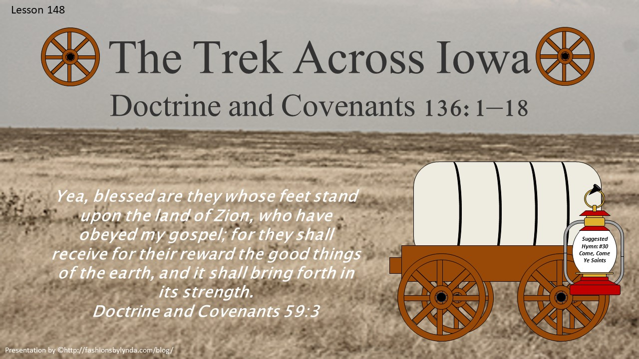

Slide 2

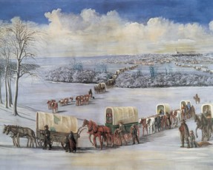
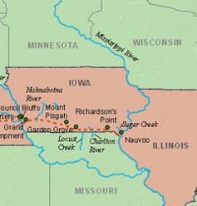
The Trek Across Iowa
In February 1846, the Saints began leaving Nauvoo and traveling west across the territory of Iowa
Brigham Young received the revelation recorded in Doctrine and Covenants 136 at Winter Quarters, Nebraska, in January 1847.

Slide 3
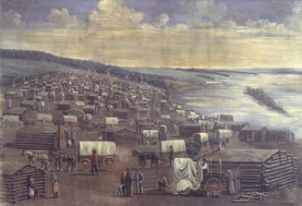
An Act of Faith
“Leaving Nauvoo was an act of faith for the Saints. They departed without knowing exactly where they were going or when they would arrive at a place to settle. They only knew that they were on the verge of being driven out of Illinois by their enemies and that their leaders had received revelation to locate a refuge somewhere in the Rocky Mountains.”
Student Manual
We exercise faith when we follow the counsel and direction of our Church leaders

Slide 4

What is a Pioneer?
“A dictionary defines a pioneer as ‘one who goes before to prepare or open up the way for others to follow’ [Oxford English Dictionary, 2nd ed. (1989), “pioneer”].
Can we somehow muster the courage and steadfastness of purpose that characterized the pioneers of a former generation? Can you and I, in actual fact, be pioneers?
“I know we can be. Oh, how the world needs pioneers today!”

Slide 5
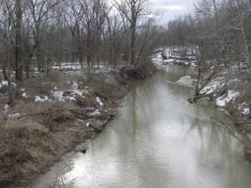
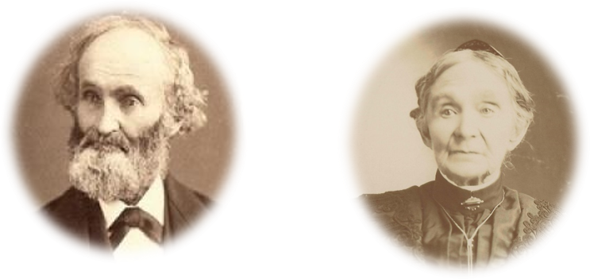
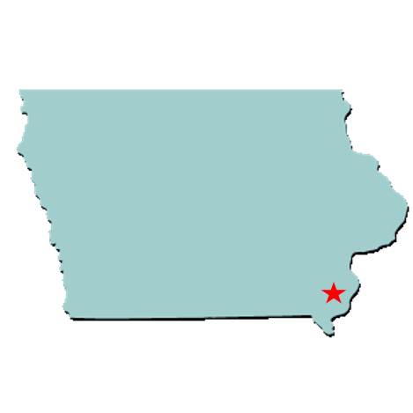
John and Jane (Ives) Pack
“On the 8th of February 1846 we left Nauvoo, crossed the Mississippi River and camped on Sugar Creek with many of our brothers and sisters who had left Nauvoo about that time. We had no shelter but our wagons in the dead of winter. We stayed there until the first day of March.”—Jane Ives Pack
After leaving Nauvoo, Illinois, on Feb. 15, 1846. Brigham Young with his wagons and family continued on for about seven miles and joined those camped at Sugar Creek in the Iowa Territory. The idea was to assemble and organize the members of The Church of Jesus Christ of Latter-day Saints there before continuing west.
An advance company was sent ahead to build roads and bridges and gather firewood. Some 500 wagons of Brigham Young’s Camp of Israel followed two weeks later, leaving Sugar Creek on March 1, 1846.
Deseret News and Family Search

Slide 6
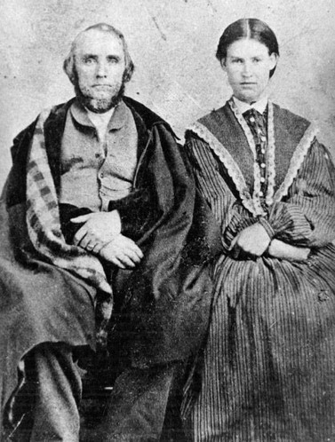
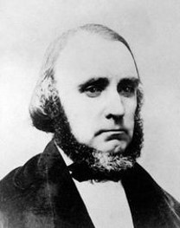
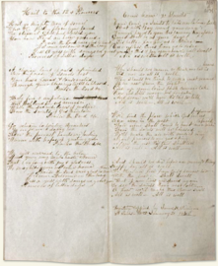

William Clayton
“William Clayton was called to be in one of the first groups to leave Nauvoo and left his wife, Diantha, with her parents, only a month away from delivering her first child.
Slogging through muddy roads and camping in cold tents wore his nerves thin as he worried about Diantha’s well-being.
Two months later, he still did not know if she had delivered [her baby] safely but finally received the joyful word that a ‘fine fat boy’ had been born.
Almost as soon as he heard the news, William sat down and wrote a song that not only had special meaning to him but would become an anthem of inspiration and gratitude to Church members for generations.
The song was ‘Come, Come, Ye Saints’”
Our Heritage

Slide 7
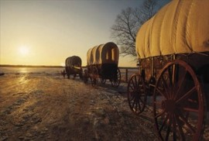
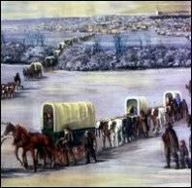
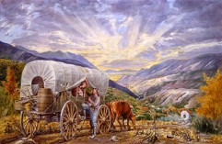
Come, Come Ye Saints
1. Come, come, ye Saints, no toil nor labor fear; But with joy wend your way. Though hard to you this journey may appear, Grace shall be as your day. 'Tis better far for us to strive Our useless cares from us to drive; Do this, and joy your hearts will swell— All is well! All is well!
2. Why should we mourn or think our lot is hard? 'Tis not so; all is right. Why should we think to earn a great reward If we now shun the fight? Gird up your loins; fresh courage take. Our God will never us forsake; And soon we'll have this tale to tell— All is well! All is well!
3. We'll find the place which God for us prepared, Far away in the West, Where none shall come to hurt or make afraid; There the Saints will be blessed. We'll make the air with music ring, Shout praises to our God and King; Above the rest these words we'll tell— All is well! All is well!

Slide 8
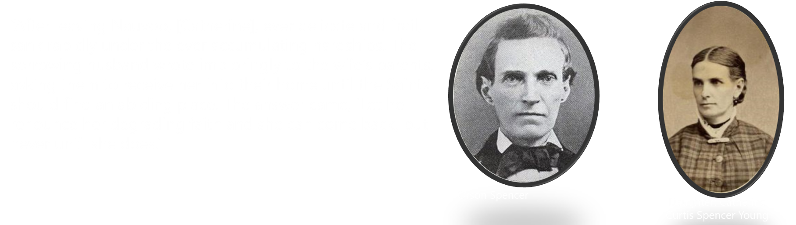
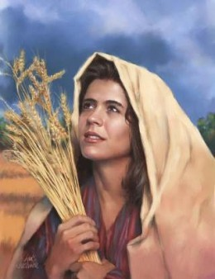
Orson and Catherine Spencer
“When the letter was read to her, she asked her husband to get his Bible and to turn to the book of Ruth and read the first chapter, sixteenth and seventeenth verses: ‘Entreat me not to leave thee or to return from following after thee; for whither thou goest I will go, and where thou lodgest I will lodge. Thy people shall be my people and thy God my God.’”
Catherine Spencer died shortly thereafter.

Slide 9
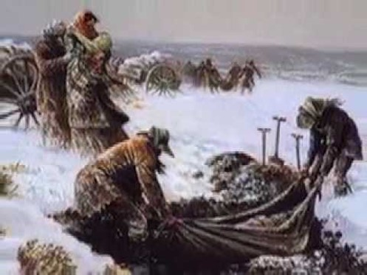
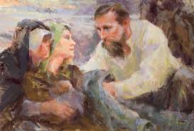
4. And should we die before our journey's through, Happy day! All is well! We then are free from toil and sorrow, too; With the just we shall dwell! But if our lives are spared again To see the Saints their rest obtain, Oh, how we'll make this chorus swell— All is well! All is well!

Slide 10
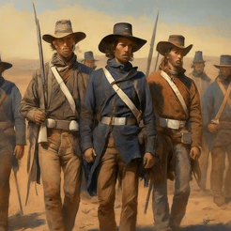
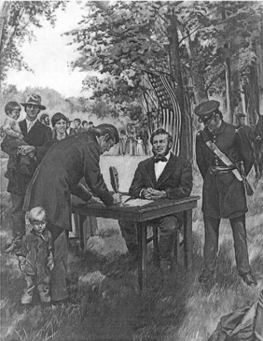
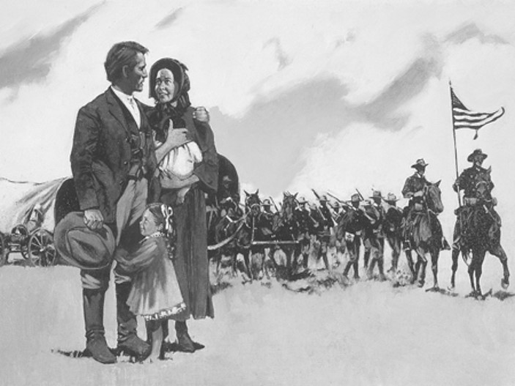
Into the Service
Because of excessive rain and insufficient supplies, the Saints who left Nauvoo in February 1846 spent four months making the 300-mile journey across Iowa.
The group’s pace was slowed because of these conditions and because they lost the services of more than 500 able-bodied Latter-day Saint men.
These men, who became known as the Mormon Battalion, had heeded the call of President Brigham Young to enlist in the United States Army to earn money to help poor Church members make the journey west. This sacrifice helped in many ways, but it also left many families without husbands and fathers for part of the journey.
D&C 136:8

Slide 11
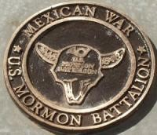
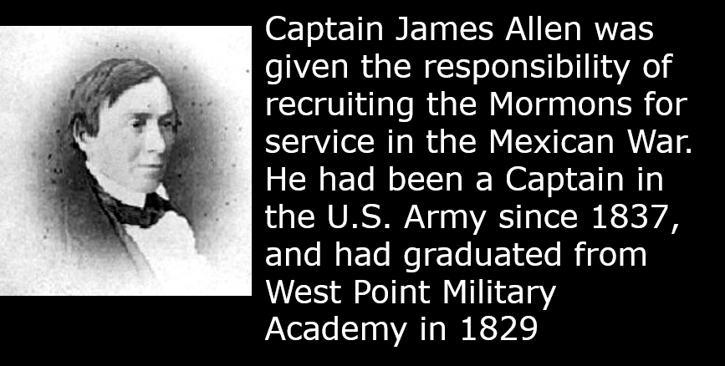
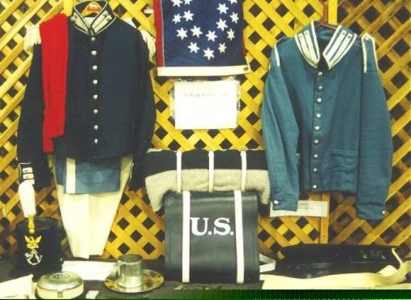
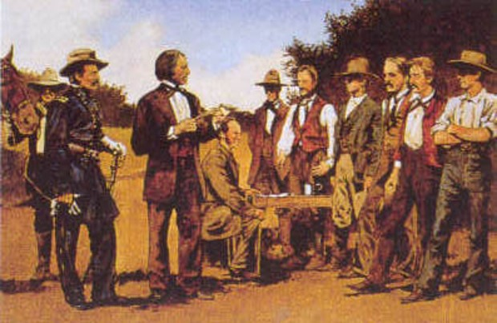
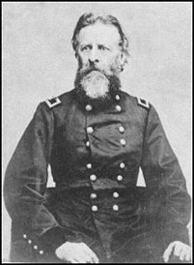
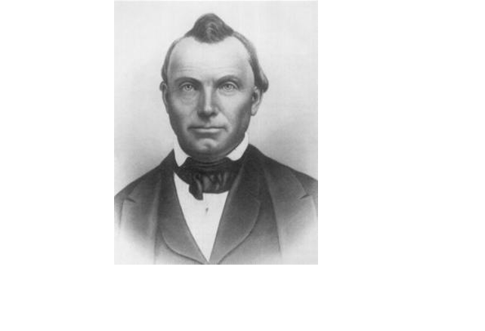
Mormon Battalion
The Mormon Battalion was commanded by Col. Philip St. George Cooke
D&C 136:8

Slide 12
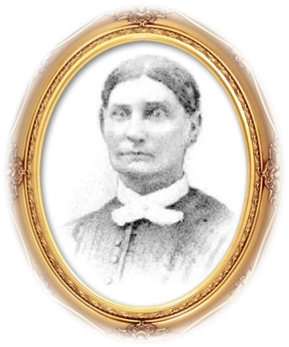
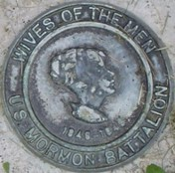
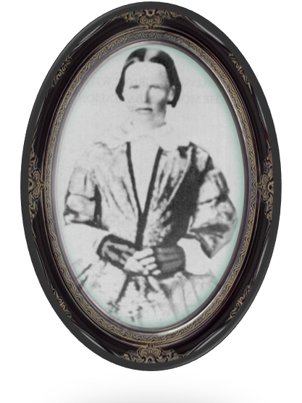
Mormon Battalion Women
The women served as nurses, laundresses, and companions to their husbands during the long march. Only four women accompanied the battalion all the way to California; the rest became part of the battalion sick detachment and spent the winter at Fort Pueblo, Colorado.
All the women suffered the hardships of the march—shortage of food, water, clothing, and the comforts they had left behind.
At least two who marched to California, Melissa Burton Cory and Lydia Edmunds Hunter, were pregnant.
Susannah Smith Adams with husband Orson Bennett Adams in Company C
“William joined the Battalion. So did I. I could not see ‘why women must always stay behind and worry about their husbands when they could just as well march beside them.’”
—Melissa Burton Coray
The other women: Phebe Brown, Susan Davis and Nancy Davis.

Slide 13
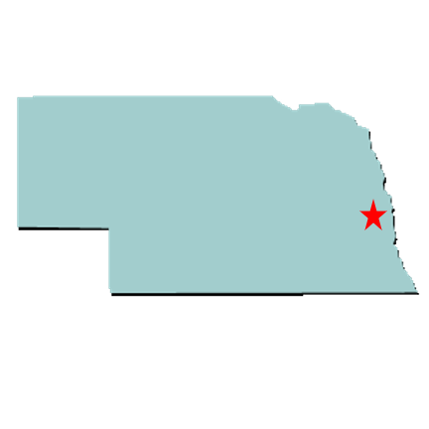
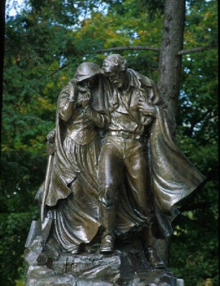
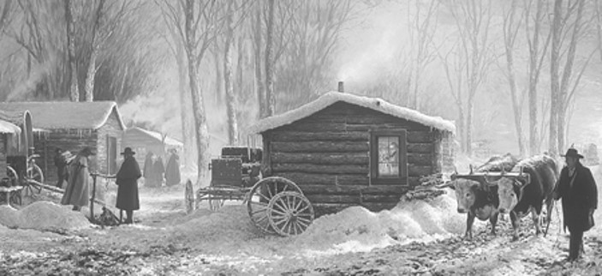
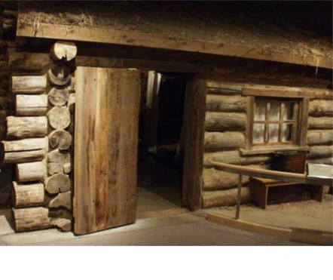
Winter Quarters
Church leaders decided not to continue west to the Rocky Mountains until the spring of 1847.
They counseled the Saints to settle for the winter. One of the largest settlements, Winter Quarters, was located on the west side of the Missouri River, in the modern-day state of Nebraska.
Many of the Saints lived in log houses and in dugouts made of willows and dirt. Many people were inadequately sheltered from the cold weather. Diseases such as malaria, pneumonia, tuberculosis, cholera, and scurvy resulted in widespread suffering and death. More than seven hundred people died in the camps by the end of the first winter.
Student Manual

Slide 14
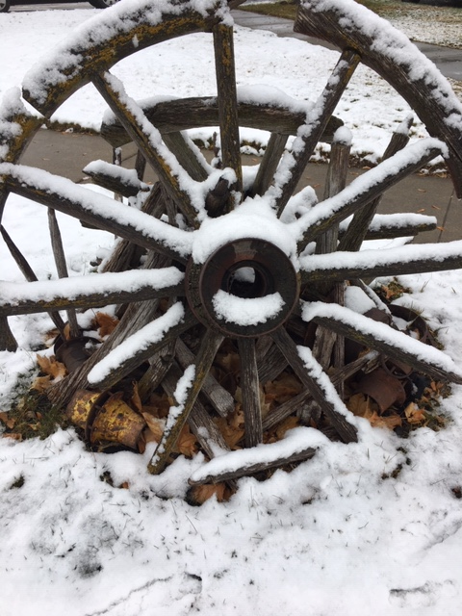
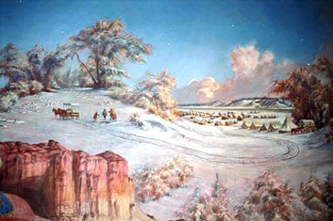
Winter Quarters
The favored spot, covering between 600 and 800 acres of bench land sloping toward the river, was drained on the north and south by two creeks and bounded on the north and west with high bluffs. Benefits of the new site were its natural defense, seclusion from strong prairie winds, and proximity to good streams. With official selection of the site by the Twelve Apostles on 11 September 1846, Nebraska’s first city was born.
Student Manual

Slide 15
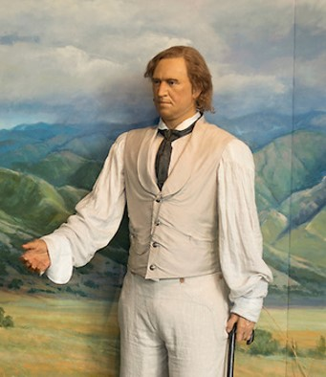
Camp of Israel
The Lord did not fail them in this hour of distress and gave this revelation to President Brigham Young to guide them in their journeyings and admonishing them to keep His commandments.
All the members of the Church were to be organized in companies and were required to keep the commandments faithfully that they might have the guidance of His Spirit with them in all their trying circumstances.
The Lord organizes His Saints into groups so that each person can be guided and cared for
These companies were to be on the order followed by Zion’s Camp in their remarkable march from Kirtland to Missouri, with captains, over hundreds, fifties and tens and all under the direction of the council of Apostles.”
Smith and Sjodahl
D&C 136:1-3

Slide 16
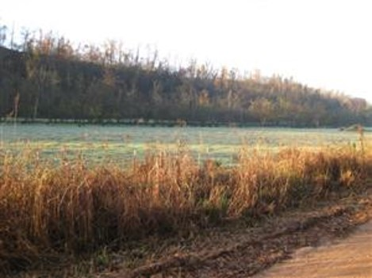
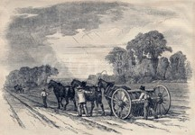
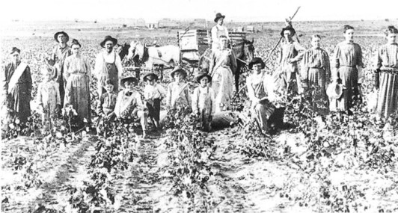
Walk By Covenant
“… it was necessary that they provide themselves the best they could with teams, clothing and provisions, for the journey was a difficult one.
Some members of necessity would be left behind until such time as they could be prepared.
The officers of the companies were to decide who might go and who would better remain behind until a more suitable day. These who were to remain were to put in crops and wait until the coming harvest.
Each company was to bear an equal proportion of the means for the benefit of all.
Those who had substance were to share with those who were destitute, in the true spirit of charity and faith.
D&C 136:4-11 Smith and Sjodahl

Slide 17
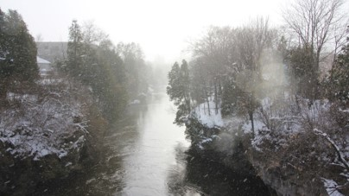
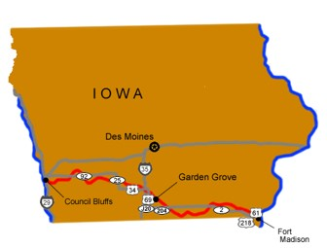
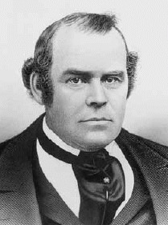
Prepare For…
Pioneer: One who goes before to prepare or open up the way for others to follow
President Young called upon the Latter-day Saints “to unite with us in the principles of self preservation” so that the camps could be made as self-sufficient as possible.
The Lord will bless us when we help others in need and prepare the way for them
“All things being harmonized and put in order, the camps moved on. Arriving at a place on a branch of Grand River we encamped for a while, having travelled much in the midst of great and continued rains, mud and mire. Here we enclosed and planted a public farm of many hundred acres and commenced settlement, for the good of some who were to tarry and of those who should follow us from Nauvoo. We called the place ‘Garden Grove’” Parley P. Pratt
D&C 136:7

Slide 18
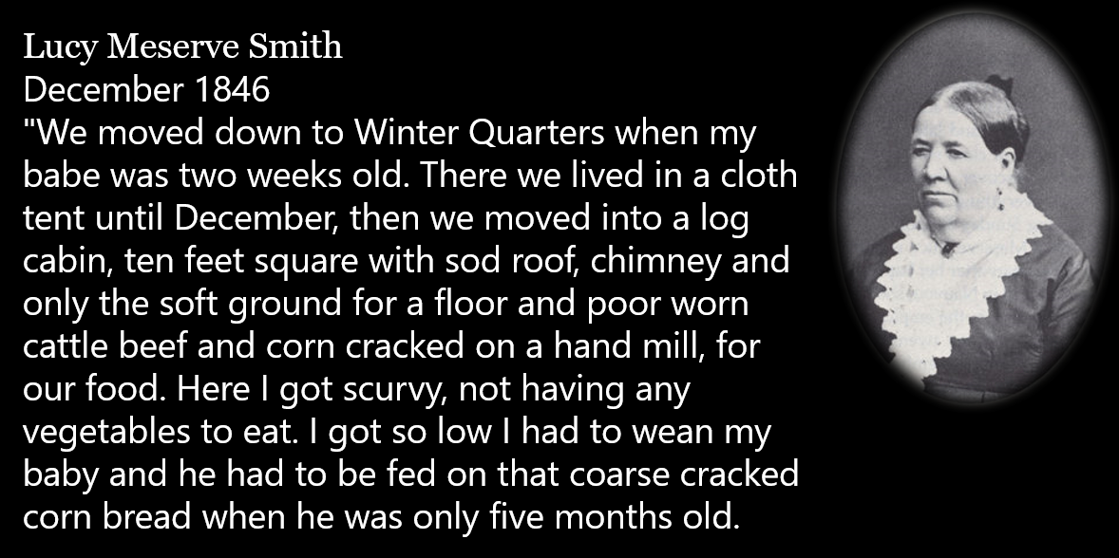

Other Accounts of Winter Quarters

Slide 19
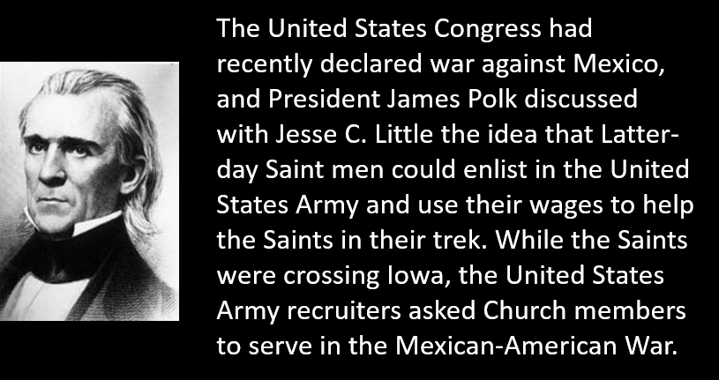
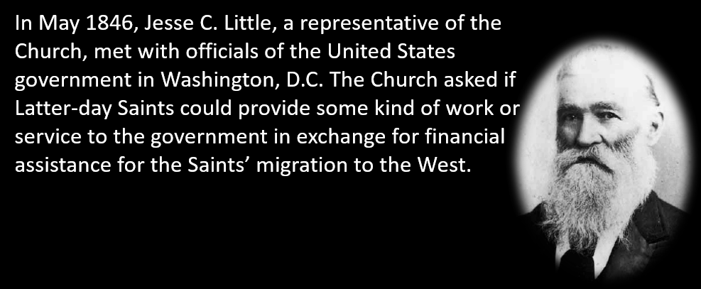
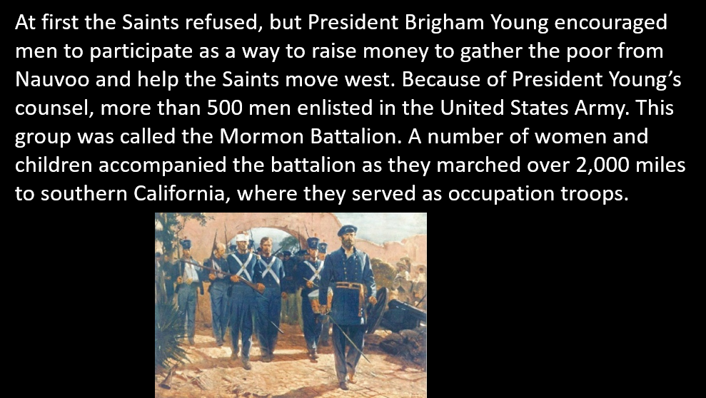
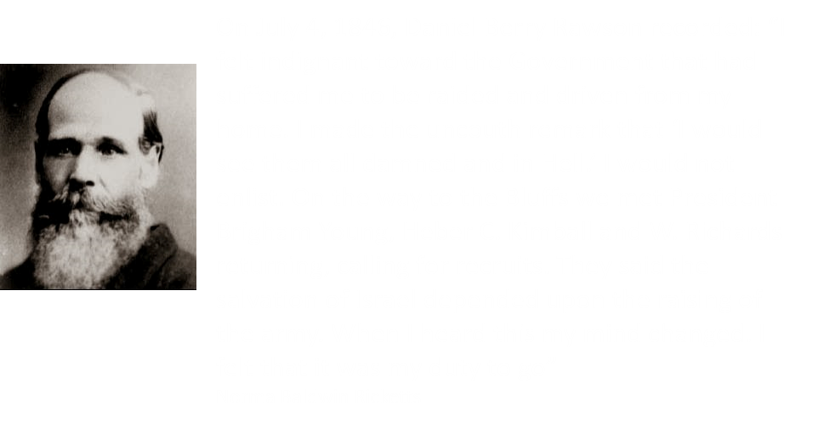
United States Declares War on Mexico

Slide 20
Sources:
Videos:
Mormon Tabernacle Choir Pioneer Day Concert (7:27)
Ministry of Brigham Young: A Visionary Leader (1:43)
Our Pioneer Legacy (1:18)
“Watched Over by God: Elizabeth Panting’s Journey to Zion” from time code 7:47 to 11:16
Church History in the Fulness of Times Student Manual, 2nd ed. [Church Educational System manual, 2003], 309, 319-320
President Thomas S. Monson . (“The World Needs Pioneers Today,” Ensign, July 2013, 5).
Our Heritage: A Brief History of the Church of Jesus Christ of Latter-day Saints [1996], 71-72.
Presentation by ©http://fashionsbylynda.com/blog/
Orson and Catherine Spencer (Memoirs of John R. Young: Utah Pioneer 1847 [1920], 17–18).
Deseret News http://www.deseretnews.com/article/865622128/Picturing-history-Sugar-Creek-first-campsite-west-of-Nauvoo.html?pg=all
http://www.mormonbattalion.com/mormon_battalion_association/mormon_battalion_roster/mormon_battalion_roster.html
Hyrum M. Smith and Janne M. Sjodahl Doctrine and Covenants Commentary page 857-859
(Thomas Bullock, as quoted in Richard E. Bennett, Mormons at the Missouri, 1846-1852: "And Should We Die . . . " [1987], 80-81).
"Origional Historical Narrative of Lucy Meserve Smith: 14 Aug. 1884–1889" typescript, Family and Church History Department Archives, The Church of Jesus Christ of Latter-day Stainst, 7–8).
Elder Parley P. Pratt (Autobiography of Parley P. Pratt, ed. Parley P. Pratt Jr. [1938], 342).
Norma Baldwin Ricketts, The Mormon Battalion [1996], 13).
Presentation by ©http://fashionsbylynda.com/blog/

Slide 21
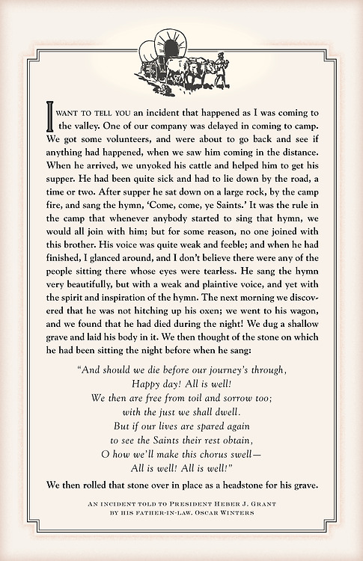
CATHARINE CURTIS SPENCER Written by Thomas S. Monson (Catharine Curtis Spencer was born on March 21, 1811 in New York and died on March 12, 1846. Her parents were Samuel Allen Curtis and Patience Smith. She married Orson Spencer on April 13, 1830.) I think also of an account I read about a sweet lady, the wife of one of our early pioneers. Her name was Catharine Curtis Spencer. She was married to Orson Spencer, a sensitive, well-educated man. Catharine had been reared in Boston and was cultured and refined. She had six children. Her delicate health declined from exposure and hardships after her family was forced to leave Nauvoo. Elder Spencer wrote to her parents and asked if she could return to live with them while he established a home for his family in the West. Their reply: “Let her renounce her degrading faith, and she can come back—but never until she does.” Sister Spencer would not renounce her faith. When her parents’ letter was read to her, she asked her husband to get his Bible and read to her from the book of Ruth as follows: “Intreat me not to leave thee, or to return from following after thee: for whither thou goest, I will go; and where thou lodgest, I will lodge: thy people shall be my people, and thy God my God.” Outside the storm raged, the wagon covers leaked, and friends held milk pans over Sister Spencer’s head to keep her dry. In these conditions, and without a word of complaint, she closed her eyes as her spirit left her mortal body. Catherine was not yet 35 years old and left behind her six children, all under the age of fifteen. The thermometer had been below zero for ten days. During this time, she would cheer her little innocents with the songs of Zion. She told her children how she wanted them to live and conduct themselves when they became motherless and pilgrims in a strange land. A few days before she died, she told her husband, “A heavenly messenger has appeared to me tonight and told me that I had done and suffered enough, and that he had now come to convey me to a mansion of gold.” She died charging her children to obey the Gospel. This is the spirit of serving God. This is the spirit of putting Him first in our lives. Though we may not necessarily forfeit our lives in service to our God, we can certainly demonstrate our love for Him by how well we serve Him. He who hears our silent prayers, He who observes our unheralded acts will reward us openly when the need comes. (Taken from the January 1998 Ensign, “How Do We Show our Love?” by Thomas S. Monson.)

Slide 22
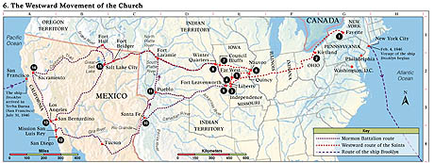
Fayette The Prophet Joseph Smith left Fayette for Kirtland, Ohio, in January 1831. The three New York branches (Fayette, Colesville, and Manchester) followed in April and May 1831 under the Lord’s command to gather (see D&C 37–38).
Kirtland The headquarters of the Church was primarily in Kirtland from 1831 to 1838.
Independence The Lord identified Independence (in Jackson County, Missouri) as the center place of Zion in July 1831 (see D&C 57:3). Mobs forced the Saints out of Jackson County in November 1833.
Liberty The Saints from Jackson County gathered in Clay County from 1833 to 1836, when they were again required to leave. The Prophet Joseph Smith and five others were unjustly imprisoned here from December 1838 to April 1839.
5. Far West A refuge was established here for the Saints 1836–38. It was the headquarters of the Church in 1838. In 1838–39 the Saints were forced to flee to Illinois.
6. Nauvoo The headquarters of the Church 1839–46. After the martyrdom of the Prophet and his brother Hyrum, the Saints moved west.
7. Council Bluffs The pioneers arrived here June 1846. Members of the Mormon Battalion departed on July 21, 1846, under James Allen’s leadership.
8. Winter Quarters Important temporary settlement, 1846–48. The vanguard company under the direction of President Brigham Young departed for the West April 1847.
9. Fort Leavenworth The Mormon Battalion was outfitted here before starting the march west in August 1846.
10. Santa Fe Philip Cooke commanded the Mormon Battalion as it marched from here October 19, 1846.
Pueblo Three sick detachments of the Mormon Battalion were ordered to Pueblo to recuperate, where they spent the winter of 1846–47 with Saints from Mississippi. These parties entered the Salt Lake Valley in July 1847.
11. San Diego The Mormon Battalion completed its 2,000-mile (3,200-kilometer) march here on January 29, 1847.
12. Los Angeles The Mormon Battalion was discharged here July 16, 1847.
13. Sacramento Some discharged battalion members worked here and at Sutter’s Mill farther east on the American River. They were present when gold was discovered in January 1848.
14. Salt Lake City Headquarters of the Church from 1847 to the present. Brigham Young arrived in the Salt Lake Valley on July 24, 1847.

Slide 23
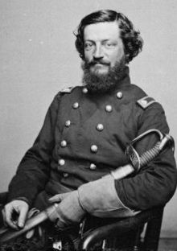

Mormon Battalion Women:
Lydia Hunter gave birth to the first white child born in California and then died from the effects of childbirth, Melissa Corey gave birth to a baby who died at birth. Susan and Phebe reenlisted with their husbands and helped build San Diego. Susan returned to the valley with the first wagon train that came up through the southern Utah trail. Phebe went with her husband Ebenezer Brown to the gold fields and panned gold and worked until 1849 when she rode a mule back to the Salt Lake Valley. She and Ebenezer were the first to make their home in the Draper area. Draper was named after her brother who was the first presiding elder in Draper. It was called South Willow Creek before that.Phebe's life demonstrated her great faith in the Lord and her willingness, at the age of 49 to accompany her husband in the Mormon Battalion trek. Certainly, these women should have equal recognition with the men. Phebe was the oldest but probably the strongest of the four women and her maturity would suggest that she helped the others to carry on in the face of adversity, even nursing them when they were ill. Some of the journals noted that Phebe was kind to the soldiers and helped them, making the journey easier.
Winter Quarters (today’s north Omaha, Nebraska) was soon divided into five-acre blocks measuring 380 feet by 660 feet. The city plat initially called for 41 blocks, 16 named streets, and 594 lots, each measuring 72 feet by 165 feet. A block could accommodate 20 houses and a population of 150 to 300 people. Houses were built on the outside of each block, with gardening areas reserved for the inside of the block. Wells were dug, wide streets laid out, bridges built across streams, and a large stockyard sectioned off south of the city for cattle.
Margaret Phelps another witness to Winter Quarters life
Winter 1846–1847
"Winter [1846–1847] found me bed-ridden, destitute, in a wretched hovel which was built upon a hillside; the season was one of constant rain; the situation of the hovel and its openness, gave free access to piercing winds and water flowed over the dirt floor, converting it into mud two or three inches deep; no wood but what my little ones picked up around the fences, so green it filled the room with smoke; the rain dropping and wetting the bed which I was powerless to leave" (Margaret Phelps, as quoted in Richard E. Bennett, Mormons at the Missouri, 1846-1852: "And Should We Die
To the Women of the Mormon Battalion:
“They had been bred to other lives. Before their flight, they had sold their watches and trinkets as the most available resource for raising ready money; and . . . [even though they] were without earrings, finger rings, chains, or broaches . . . they lacked nothing most becoming the attire of decorous maidens. They neatly darned white stockings, and clean, bright petticoats, the artistically clear-starched collar and chemisette, the something faded, only because too well-washed, lawn or gingham gown, that fit modestly to the waist of the pretty wearer—these, if any of them spoke of poverty, spoke of a poverty that had known its better days.” -- Colonel Thomas L. Kane
BYU studies--Author: Carl V. Larson, Shirley N. Maynes
Colonel Thomas L. Kane
Daniel Coon Davis Company E wife Susan Davis

