Slide 1
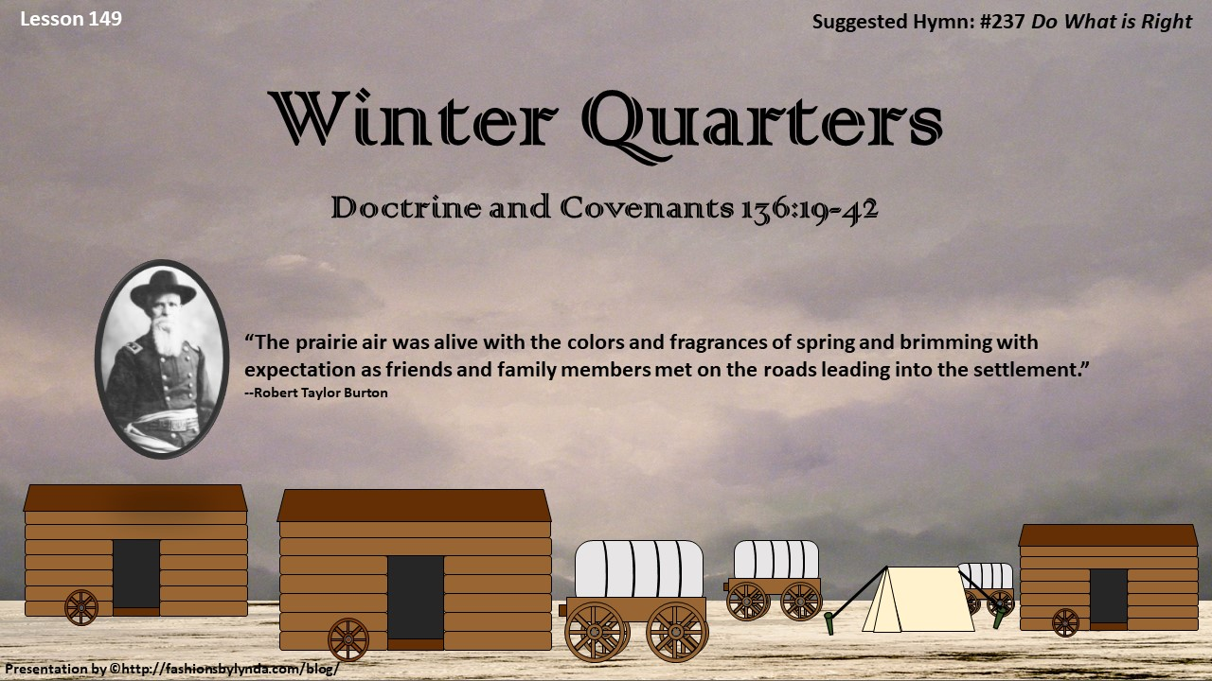

Slide 2

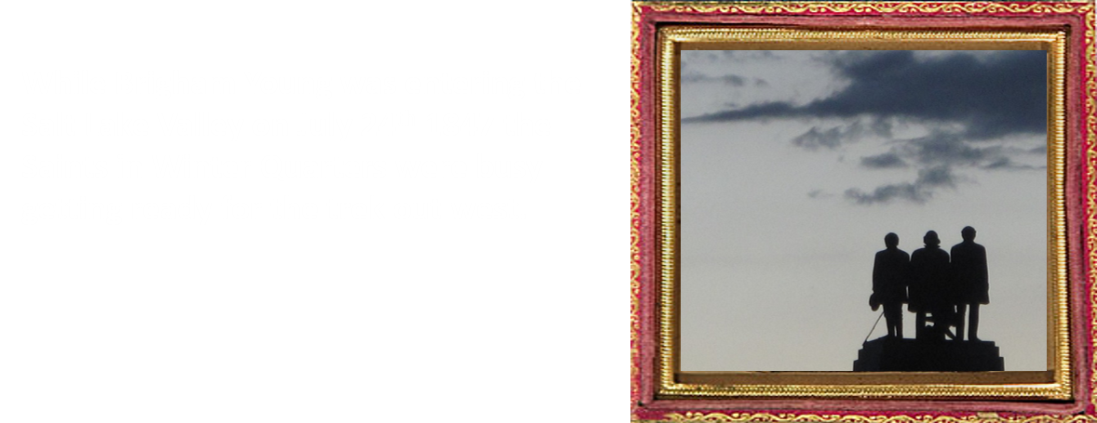
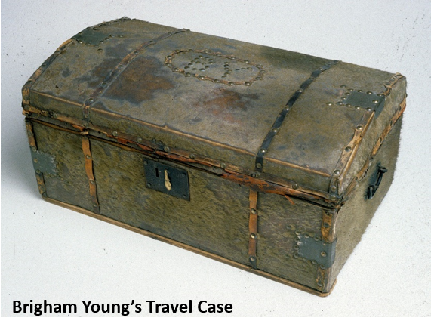
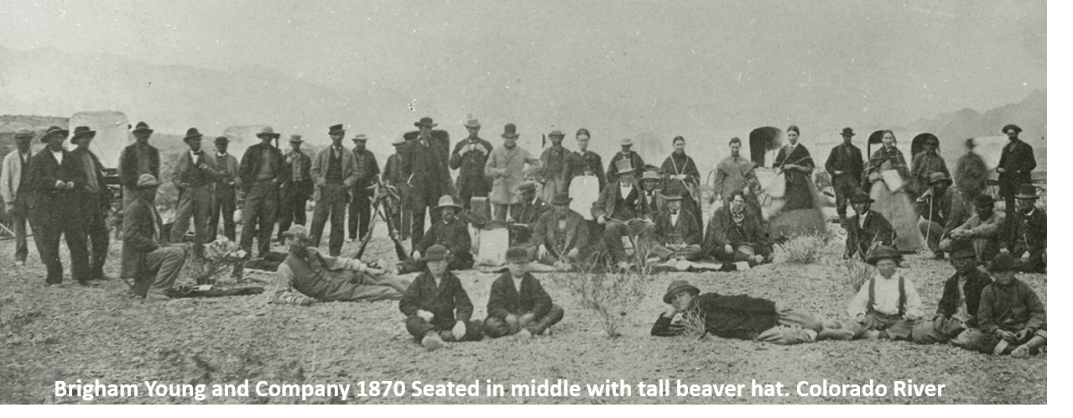
Brigham Young spent long enough in Salt Lake to set the motions in the plan for a settlement.
By August 26, 1847 he was leading 107 men—some pioneer companies and some Mormon Battalion veterans back to Winter Quarter to get their families.
The next exodus from Winter Quarters would be the last journey Brigham Young took, while making preparations for 2,500 families to cross the plains into the Salt Lake Valley
—Robert Taylor Burton

Slide 3
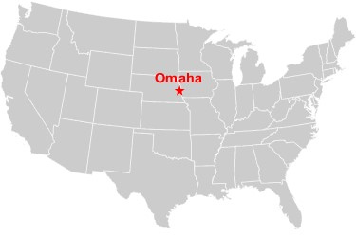
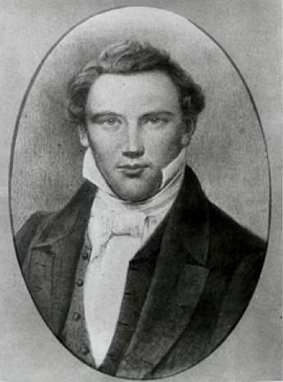
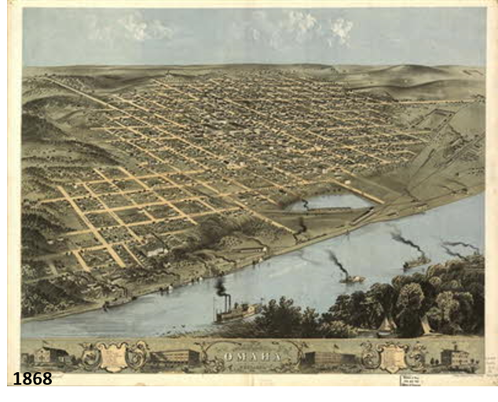
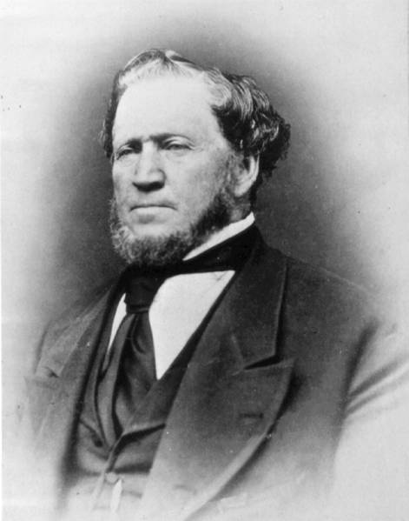
Making A Temporary Home
In the autumn of 1846 fifteen thousand exiled Latter-day Saints made temporary homes known as Winter Quarters of the Camp of Israel, on the banks of the Missouri River in the Omaha Nation, where Omaha and Council Bluffs now stand
Before Joseph Smith’s death he told them that they would only find peace in the Rocky Mountains.
“The Word and Will of God concerning the Camp of Israel” is the revelation given to Brigham Young in Section 136
McConkie and Ostler

Slide 4
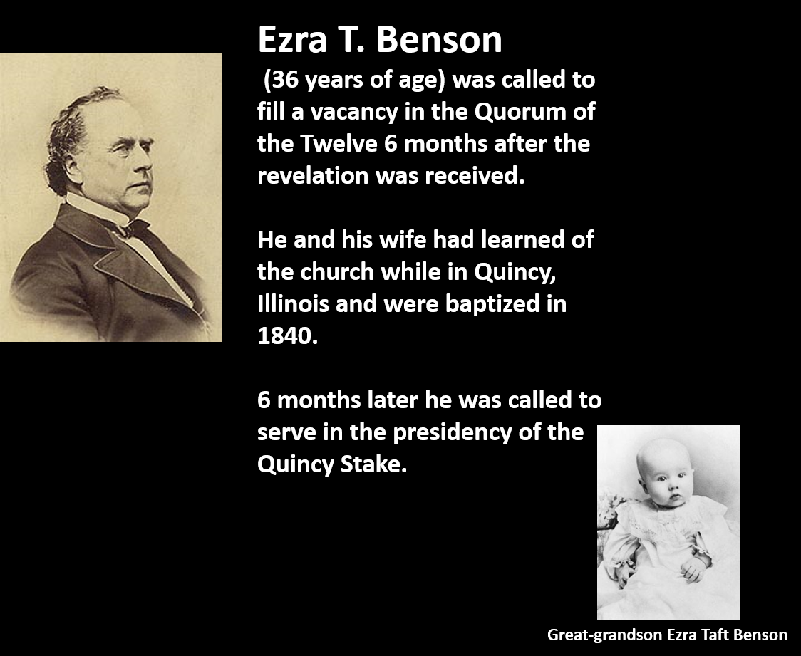
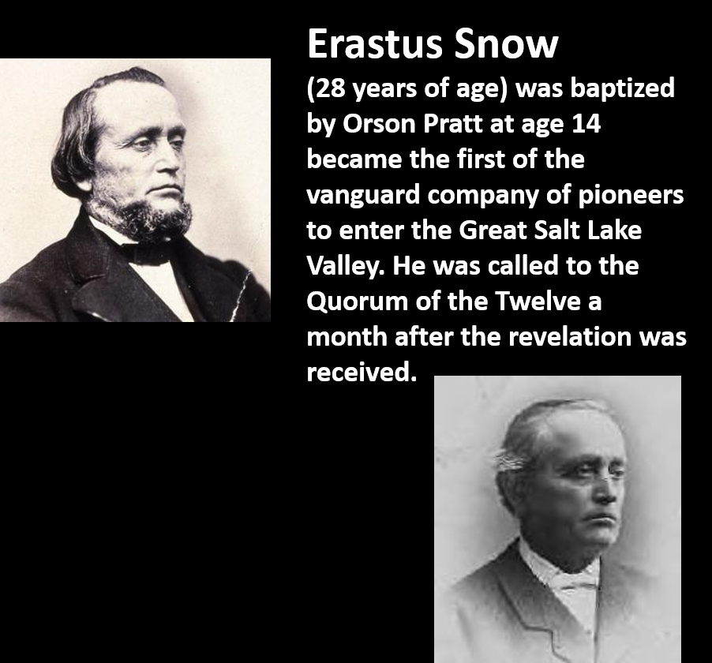
Ezra T. Benson and Erastus Snow
D&C 136:12 McConkie and Ostler

Slide 5
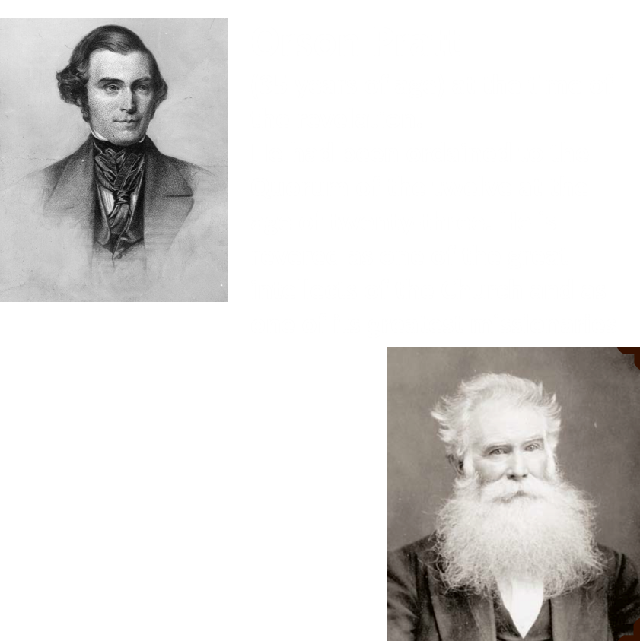
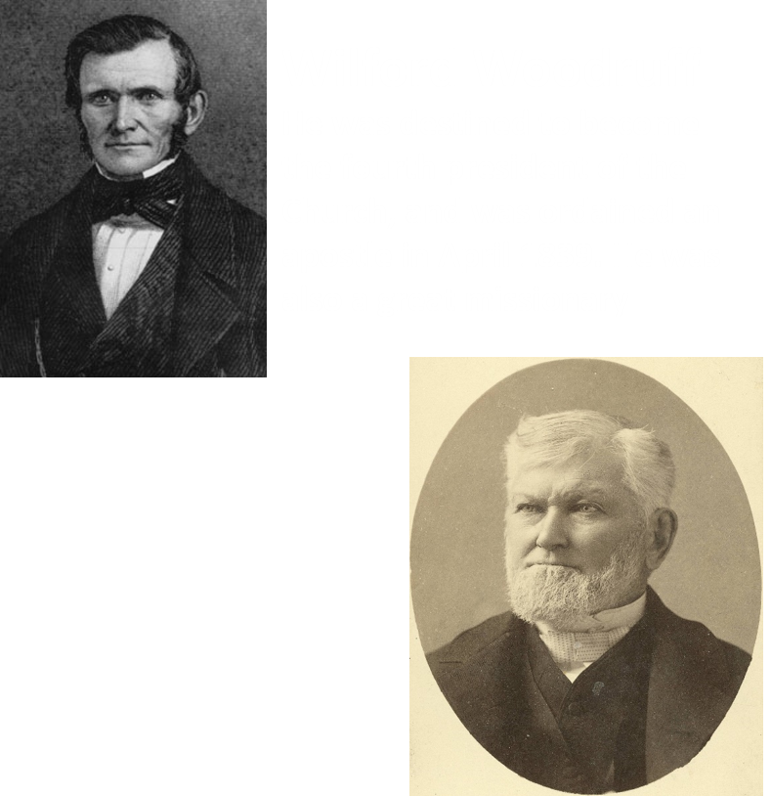
Orson Pratt and Wilford Woodruff
D&C 136:13 McConkie and Ostler

Slide 6
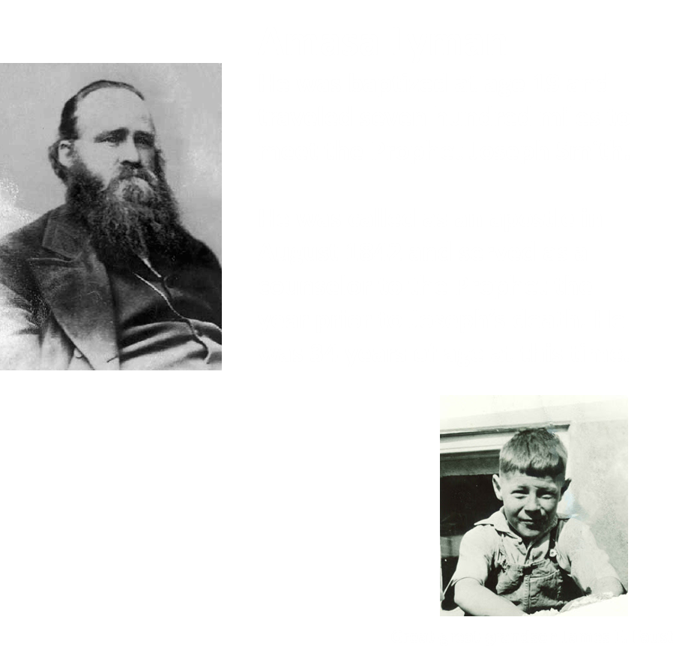
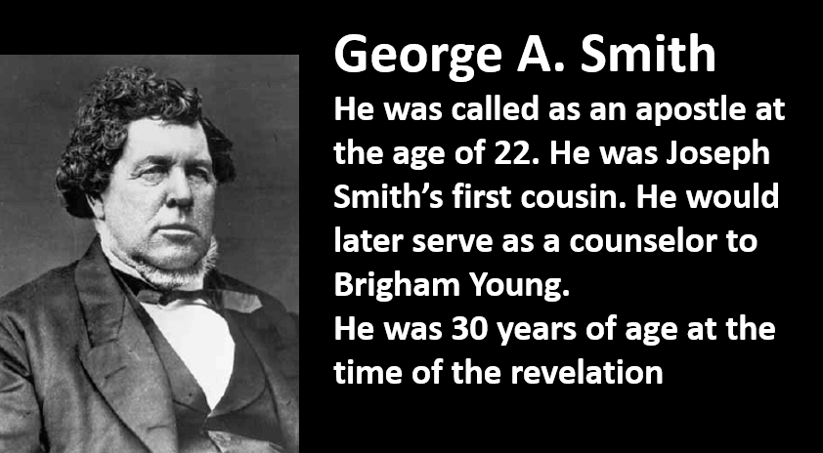
Amasa Lyman and George A. Smith
D&C 136:14 McConkie and Ostler

Slide 7



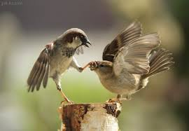



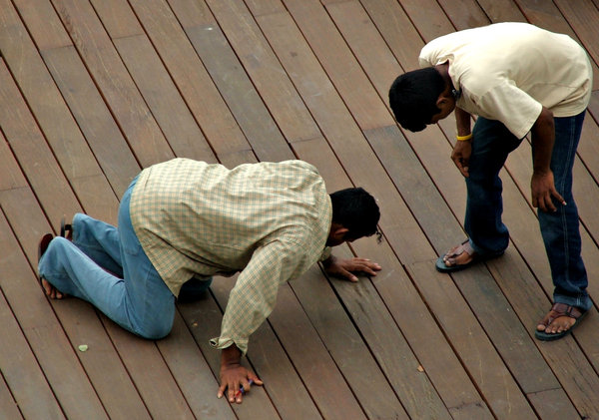
The Lord’s Direction
Seek to build yourself up
Keep yourself away from evil
Keep all your promises
Do not argue of quarrel with each other
Edify one another
Help those who have lost something…could be a spiritual loss also
If you borrow something return it in the same condition you borrowed it
Use what you have
D&C 136:19-27

Slide 8

A Need For Directions
What direction did you see that would help the Saints travel and work together?
How can you apply this direction as you interact and work with other people?
What are the consequences when people disobey this counsel?
D&C 136:19-27

Slide 9

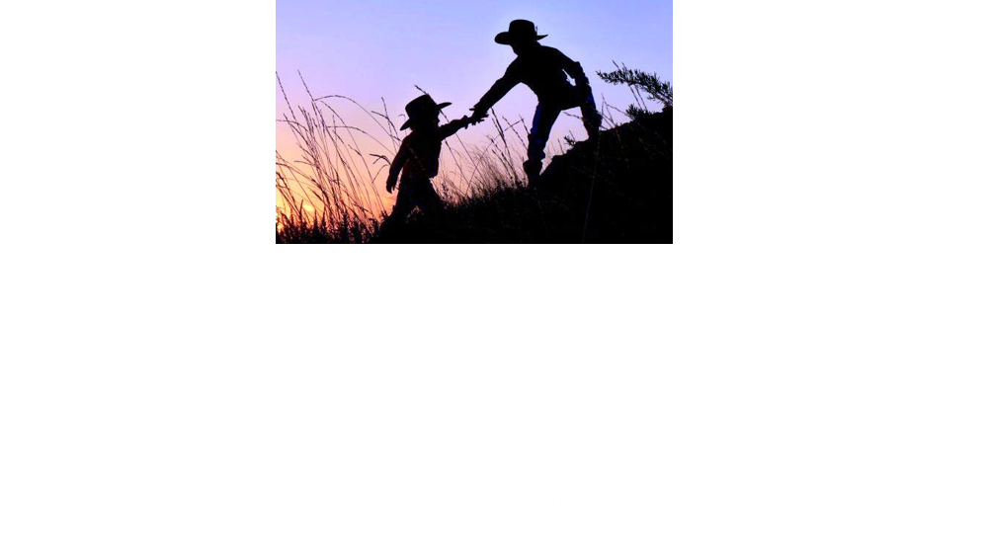
Cease Drunkenness And Edify
The Saints progressed gradually in their observance of the Word of Wisdom.
When the revelation in Doctrine and Covenants 136 was given, the Latter-day Saints were not prohibited from consuming all alcoholic drinks as we are today.
D&C 136:23-24

Slide 10
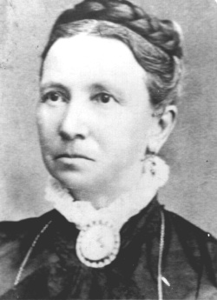
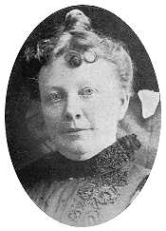
Character of the Saints
Mary Ann Weston Maughan wrote:
“We were called to bury two of our company who died this morning of cholera, a man named Brown and a child.
There are more sick in camp. Have been in sight of the Platte River all day.
Traveled 15 miles, camped on Salt Creek. Soon some of our company came up with another child dead.
They buried it at twilight on the bank of the creek.
There are more sick.
It makes us feel sad thus to bury our friends by the way. Weather very hot.”
Clarissa Young Spencer (Brigham Young’s daughter) wrote:
“One of Father’s most outstanding qualities as a leader was the manner in which he looked after the temporal and social welfare of his people along with guiding them in their spiritual needs. On the great trek across the plains when everyone but the most feeble walked the greater part of the way, the Saints would be gathered around the campfire for evening entertainment, if the weather was at all favorable. There songs would be sung, music played by the fiddlers, and the men and women would forget the weariness of walking fifteen miles or so over a trackless desert while they joined in dancing the quadrille. It was his way of keeping up ‘morale’ before such a word was ever coined”

Slide 11

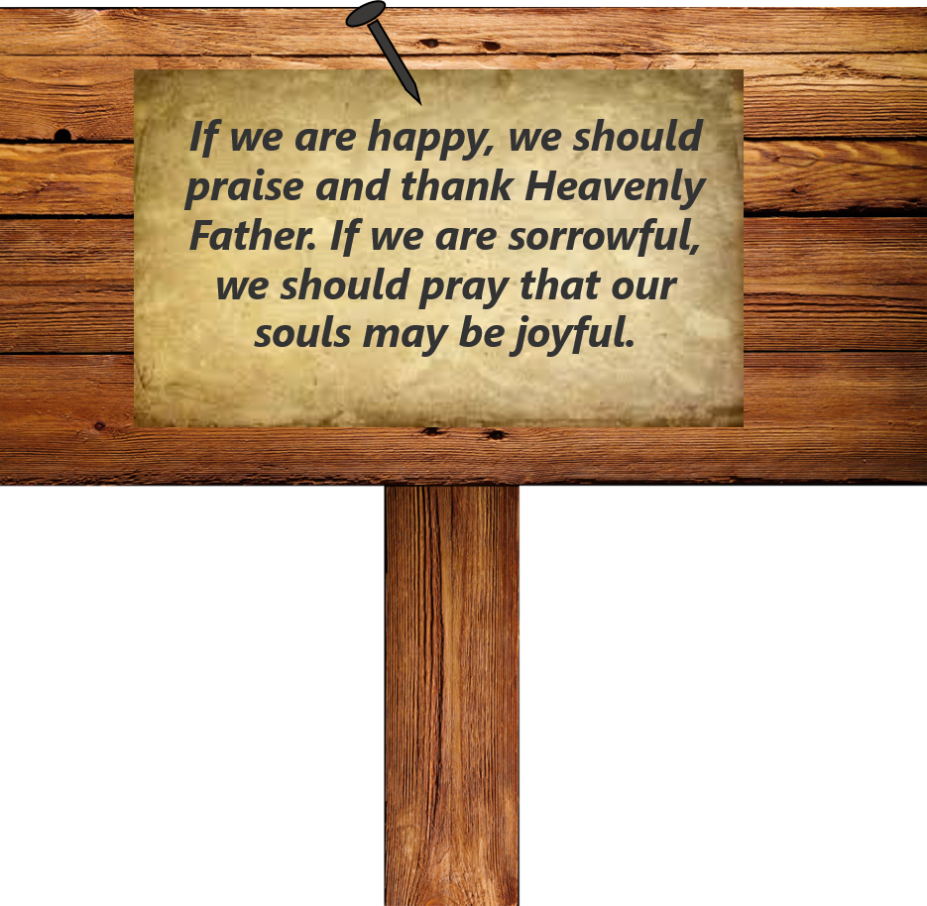

Slide 12

Must Be Tried
Suffering and trials are essential to the eternal welfare of man.
Those who seek a place in the celestial kingdom in exaltation may be called upon to pass through tribulation
D&C 136:31

Slide 13

Recently I came across a question from a friend concerning hardships in life. The question was, “If there is a God, why do bad things happen to good people? Why does God just let this happen?”.
This question stumped me for a while because I knew that God loved us, but if he did, why would he just let his children suffer?
First, God all gave us agency to choose what we would do in our lives. Agency is literally our God-given right that if used right can be an amazing gift, but if used wrong our worst nightmare. A lot of the catastrophes and heartaches come from the poor decisions of ourselves and others. God can not take away that agency from us, because its not God’s job to make choices for us.
What I’ve found is that all because you feel alone doesn’t mean you are alone… I know God can touch everyone if they are willing to simply ask for His help and guidance.
I know God loves his children so he places trials in their lives because he knows it will make them stronger. We can all benefit from these experiences no matter how much the pain. All along the way God is your biggest fan and is waiting for you to ask for help.
Second, we are here because life is full of trials and God gives us some of those trials to make us stronger.
Overcoming Trials
Posted on August 13, 2012 by Jackson

Slide 14
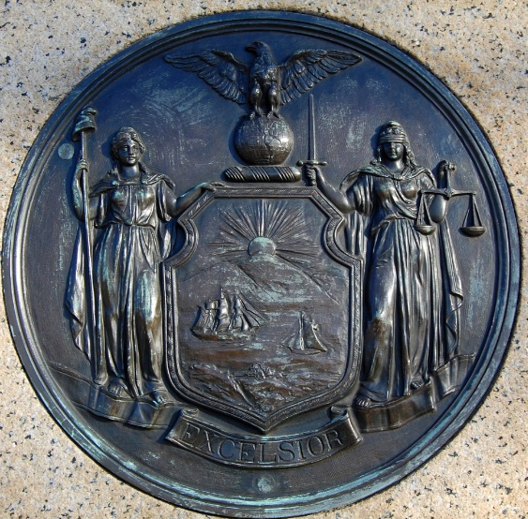
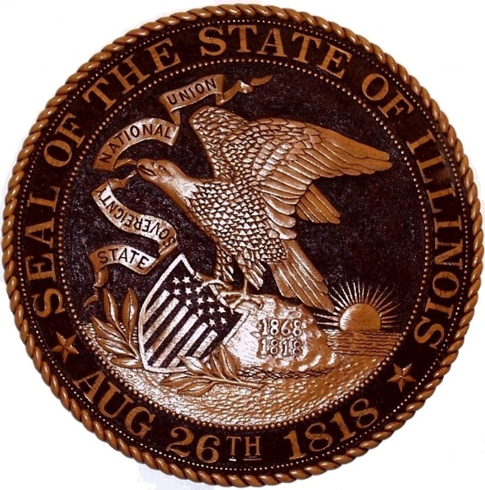
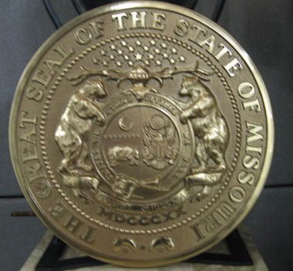

Nations Have Rejected the Prophet
“The Lord declares that the nation rejected the prophets and permitted the saints to be driven out, and by doing so there would come upon them calamity and sorrow. The blood of Joseph and Hyrum Smith and the others who had been slain for the Gospel’s sake cried to the Lord from the ground against them.
The Prophet laid a foundation upon which all men could build…
While many marveled that the Lord would permit his enemies to slay his servant, yet it was needful that he seal his testimony with his blood “that he might be honored and the wicked be condemned.”
D&C 136:34-42 Smith and Sjodahl

Slide 15
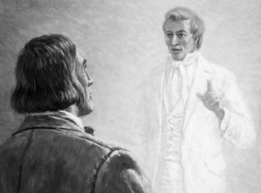
Fear Not Thine Enemies
Joseph Smith appeared to Brigham Young in a dream
“Tell the people to be humble and faithful, and be sure to keep the spirit of the Lord and it will lead them right. Be careful and not turn away the small still voice; it will teach you what to do and where to go; it will yield the fruits of the kingdom.
Tell the brethren to keep their hearts open to conviction, so that when the Holy Ghost comes to them, their hearts will be ready to receive it.
They can tell the Spirit of the Lord from all other spirits; it will whisper peace and joy to their souls; it will take malice, hatred, strife and all evil from their hearts; and their whole desire will be to do good, bring forth righteousness and build up the kingdom of God.
Tell the brethren if they will follow the spirit of the Lord they will go right. Be sure to tell the people to keep the Spirit of the Lord; and if they will, they will find themselves just as they were organized by our Father in Heaven before they came into the world. …
“Tell the people to be sure to keep the Spirit of the Lord and follow it, and it will lead them just right.”
D&C 136:33 Brigham Young

Slide 16


If we are diligent in keeping the Lord’s commandments, then the Lord’s judgments will not come upon us, our faith will be strong, and our enemies will not triumph over us

Slide 17
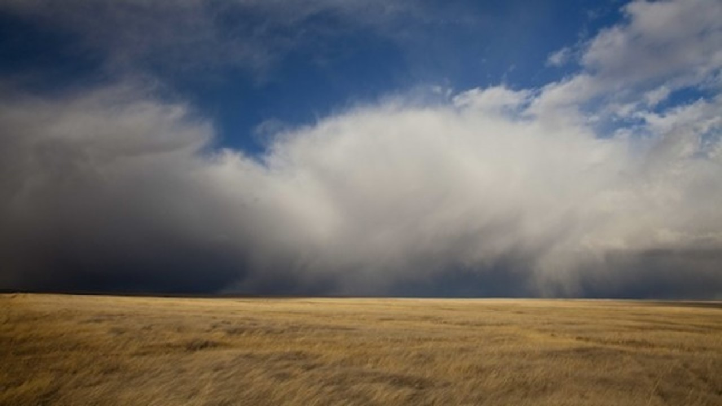
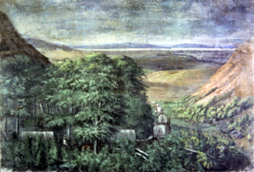
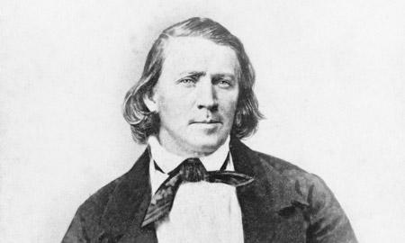
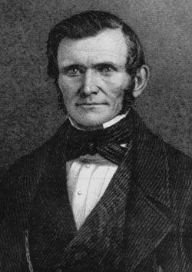
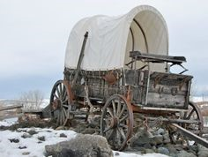
Keeping the Lord’s Commandment
The first group of pioneers left Winter Quarters on April 5, 1847. They traveled more than 1,000 miles and arrived in the Salt Lake Valley in late July 1847.
On July 24, 1847, President Brigham Young entered the valley and received confirmation that the Saints had found their new home. He was riding in the back of Wilford Woodruff’s wagon at the time because he was sick with a fever.
“When we came … into full view of the valley, I turned the side of my carriage around, open to the west, and President Young arose from his bed and took a survey of the country. While gazing upon the scene before us, he was enwrapped in vision for several minutes. He had seen the valley before in vision, and upon this occasion he saw the future glory of Zion and of Israel. … When the vision had passed, he said, ‘It is enough. This is the right place. Drive on.’”
Wilford Woodruff

Slide 18
Sources:
Videos:
Edifying Words (1:12)
Teachings of Brigham Young: Hard Work, Sacrifice, Obedience(1:27)
The Life Story of Robert Taylor Burton by Jane Burton Seegmiller pgs. 83-85
Joseph Fielding McConkie and Craig J. Ostler Revelations of the Restoration pg.1131-1135
Mary Ann Weston Maughan journal, 3 vols., June 21, 1850, 2:1, Family History Library, Salt Lake City; spelling, capitalization, and punctuation modernized.
Presentation by ©http://fashionsbylynda.com/blog/
Clarrisa Young Spencer (with Mabel Harmer, One Who Was Valiant[1940], 162).
Hyrum M. Smith and Janne M. Sjodahl Doctrine and Covenants Commentary pg. 861
Wilford Woodruff (Teachings of Presidents of the Church: Wilford Woodruff [2004], 146).
Brigham Young Manuscript History of Brigham Young, 1846–1847, comp. Elden J. Watson [1971], 529–30).
Presentation by ©http://fashionsbylynda.com/blog/

Slide 19
Drunkenness and the Word of Wisdom:
Some of the pioneer Saints used substances that are prohibited by the Word of Wisdom, such as alcohol and tobacco. The Lord did not initially give the Word of Wisdom to the Saints as a commandment (see D&C 89:2). President Joseph F. Smith explained:
“If [the Word of Wisdom] had been given as a commandment it would have brought every man, addicted to the use of these noxious things, under condemnation; so the Lord was merciful and gave them a chance to overcome, before He brought them under the law” (in Conference Report, Oct. 1913, 14).
With this in mind, we should be careful not to judge some of the early Church leaders and members who used substances that are prohibited in the Word of Wisdom. Throughout the early history of the Church, leaders invited the Saints to more fully live the Word of Wisdom. In a general conference in September 1851, Brigham Young called on members to formally covenant to abstain from tea, coffee, tobacco, whiskey, and “all things mentioned in the Word of Wisdom” (see “Minutes of the General Conference,” Millennial Star, Feb. 1, 1852, 35). In 1919, the First Presidency, under President Heber J. Grant, made the observance of the Word of Wisdom a requirement for receiving a temple recommend (see James R. Clark, comp., Messages of the First Presidency of The Church of Jesus Christ of Latter-day Saints,6 vols. [1965–75], 5:163). The Word of Wisdom continues to be an important commandment today, and obeying it is a prerequisite for baptism, temple attendance, missionary service, and other worthy service in the Church.
Charles W. Penrose On Joseph Smith and Hyrum Smith
When the Prophet Joseph and his brother Hyrum were slain for the testimony of Jesus it was in the providence of god; it was with His permission,. They went to open the door of the kingdom in the spirit world, and thus a marvelous work and a wonder has begun there also.
When we get there we will find out the magnitude of it; for we will see that the Elders of Zion who have tabernacle in the flesh are laboring there, under the direction of him who holds the keys of the last dispensation, and the gospel is being preached to millions upon millions of spirits, and a far greater work is to be accomplished there than among men in the flesh.: (Conference Report, April 1902, 52-53).
Appearing to Brigham Young:
On another occasion, before the Saints left Nauvoo, the Prophet Joseph Smith appeared in a vision to President Young and showed him where to build a community in the Salt Lake Valley. President George A. Smith of the Quorum of the Twelve recounted:
“[He saw] a vision of Joseph Smith, who shewed him the mountain that we now call Ensign Peak, immediately north of Salt Lake City, and there was an ensign fell upon that peak, and Joseph said ‘Build under the point where the colors fall and you will prosper and have peace’” (“Historical Discourse,” Deseret News, Jun. 30, 1869, 248).

