Slide 1
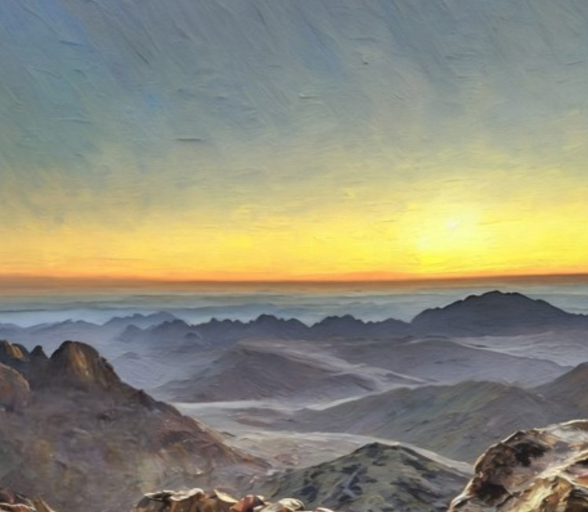
Pioneers in Every Land
Presentation by http://fashionsbylynda.com/blog/

Slide 2

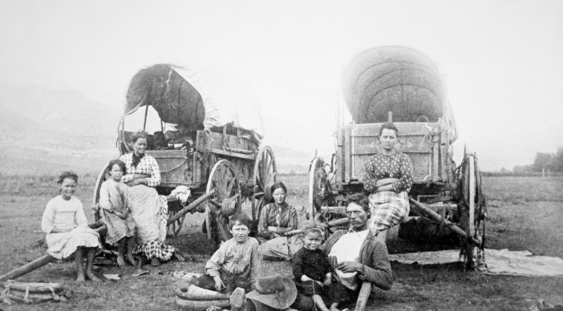
Pioneers
From 1847 to 1868, thousands of pioneers demonstrated great faith in Jesus Christ as they traveled by wagon or handcart to gather with the Saints in the Salt Lake Valley.
Today, pioneers from all around the world continue to demonstrate great faith as they gather with the Saints wherever they live.

Slide 3
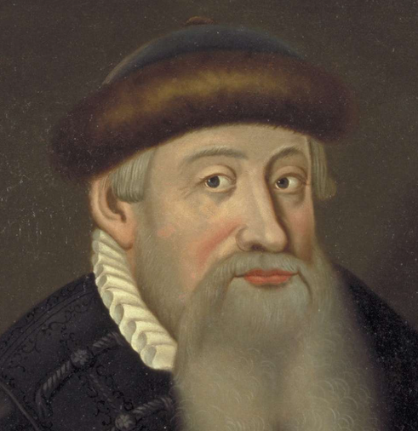
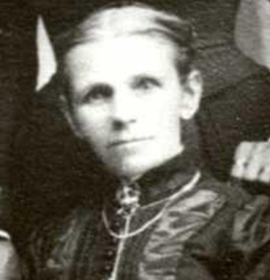
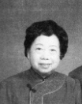
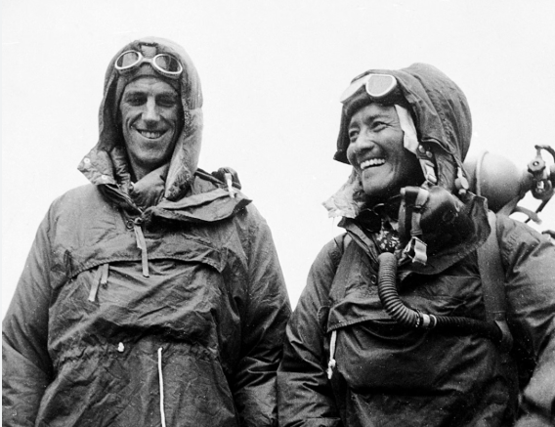
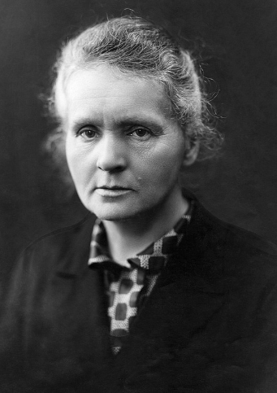
People and Their Accomplishments
Johnnes Gutenberg
A. First Relief Society president in Taiwan
B. First woman to win a Nobel Prize, awarded for her research on radiation
Elizabeth Jackson
Chen Lin Shuliang
C. Invented the printing press
Edmund Hillary and Tenzing Norgay
D. First to climb to the summit of Mount Everest
Marie Curie
What Do These People Have In Common?
E. Traveled by handcart to the Salt Lake Valley

Slide 4
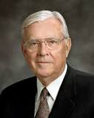
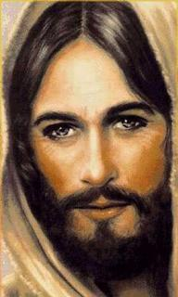
Ultimate Pioneer
Our Savior, Jesus Christ, is the ultimate pioneer in preparing the way. Indeed, He is “the way” for the plan of salvation to be accomplished so that we can repent and, through faith in Him, return to our Heavenly Father.
M. Russell Ballard
Wherefore, after he was baptized with water the Holy Ghost descended upon him in the form of a dove.
And again, it showeth unto the children of men the straitness of the path, and the narrowness of the gate, by which they should enter, he having set the example before them.
2 Nephi 31:8-9
For I have given you an example, that ye should do as I have done to you.
John 13:15
Jesus saith unto him, I am the way, the truth, and the life: no man cometh unto the Father, but by me.
John 14:6
And if Christ had not risen from the dead, or have broken the bands of death that the grave should have no victory, and that death should have no sting, there could have been no resurrection.
Mosiah 16:7

Slide 5

Do you feel like you are leaving an example you want others to follow?
What excites you about being a pioneer?
What makes you nervous?
How do you feel Jesus Christ can help you be a pioneer for others?

Slide 6
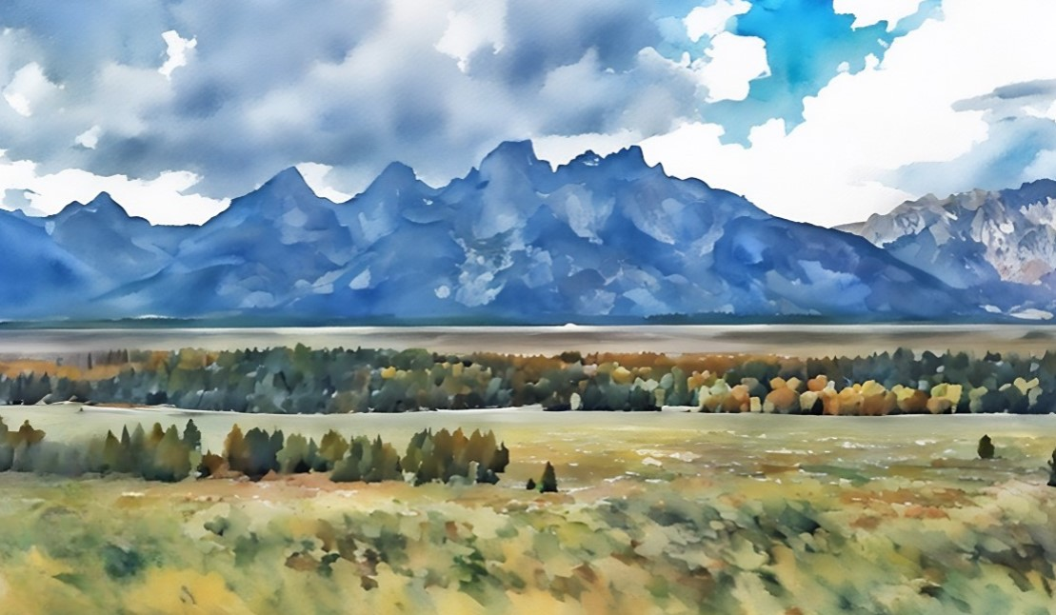
After many companies had traveled to Salt Lake City in wagons, typically pulled by oxen, Brigham Young encouraged Saints to use handcarts. Pioneers pulled handcarts themselves enabling cheaper and faster travel. Only 10 of the more than 350 emigrating companies traveled by handcart.
Though most of the handcart companies made the journey without major problems, winter storms in 1856 caused the Willie and Martin handcart companies to be stranded along the trail.
Many lost their lives due to starvation and extreme temperatures. Rescue efforts made by Church members in Utah provided needed supplies and helped the travelers complete their journey, saving over 1,200 lives.
Church History Topics

Slide 7
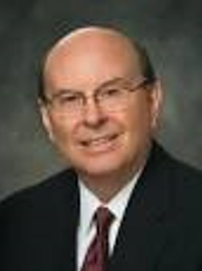
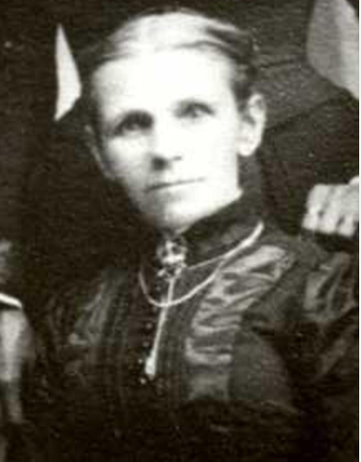
Elizabeth Jackson
I am moved by the account of Elizabeth Jackson, whose husband Aaron died after the last crossing of the Platte River with the Martin handcart company.
She wrote:
“I will not attempt to describe my feelings at finding myself thus left a widow with three children, under such excruciating circumstances. … I believe … that my sufferings for the Gospel’s sake will be sanctified unto me for my good. …
“I [appealed] to the Lord, … He who had promised to be a husband to the widow, and a father to the fatherless. I appealed to him and he came to my aid.”
Elizabeth said she was writing the history on behalf of those who passed through like scenes with the hope that posterity would be willing to suffer and sacrifice all things for the kingdom of God.
Quentin L. Cook

Slide 8
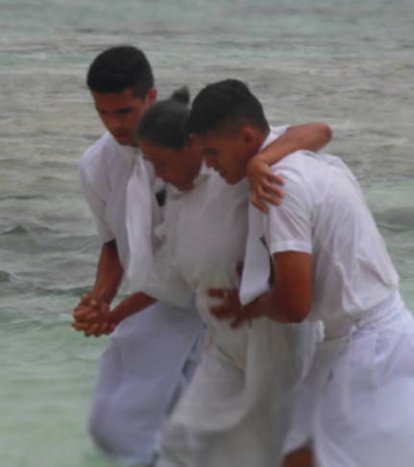
American Samoa
Leva ‘aia Levao lived with severe health problems. In 2015 she developed boils on her eyes. The boils were healed after missionaries gave her a priesthood blessing. They began reading the Book of Mormon with her.
Some people in the island’s small community were unhappy to see Levao considering a new religion. They mocked her efforts and belittled her. Still, she remained firm and was soon baptized.
Her husband, Tui, and her three children soon followed her into the faith, and Levao later served in her branch as Relief Society president. Others, influenced by her example of dedication, called her the heart of the Church on Olosega.

Slide 9
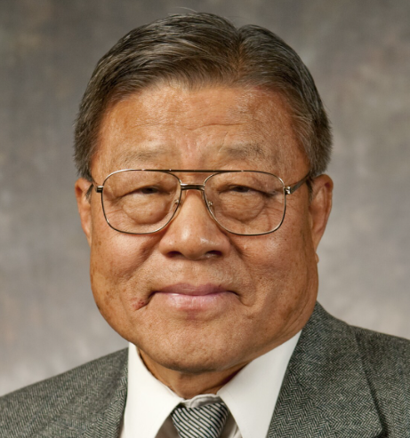

South Korea
Choi Dong Sull was a Presbyterian minister who felt it was his responsibility to protect members of his congregation from The Church of Jesus Christ of Latter-day Saints. However, he began meeting with missionaries and finding clarity to doctrinal issues that had troubled him. He knew his new convictions would require a career change and jeopardize his relationship with his father, who was chairman of the Presbyterian Church of Korea at the time.
Dong Sull chose to be baptized in the Han River. “I wanted my baptism to be an experience as much like Jesus Christ’s as possible,” he explained.
On the foggy morning of September 5, 1981, the water of the Han River was cold, but when he came up out of the water, Dong Sull described an inner warmth. “Now I belong to God’s true Church,” he said. “I shall never again be truly cold.” Two weeks later, his wife and two sons were also baptized—this time in a warm meetinghouse. Joining the Church didn’t make life easy for Dong Sull and his family, but it made new blessings possible. “The persecutions and sufferings … after my baptism are beyond my ability to tell,” said Dong Sull. “We lost much in the process [of joining the Church], yet we have gained more than we ever dreamed of.”

Slide 10
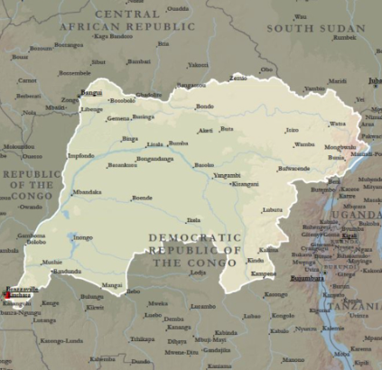
Côte d’Ivoire
Lydie Zebo Bahie was the last child of her family living at home when both her parents died. This loss led to severe depression. Her nephew, Faet Nadege, introduced her to The Church of Jesus Christ of Latter-day Saints.
When she went to church for the first time, Lydie felt great love from the sisters of the Relief Society and Young Women organizations. Though she had stopped reading during her period of depression, she found herself able to focus once again as she studied the Book of Mormon. She was baptized on November 18, 1995.
Not long after her baptism, she received an opportunity to return the love that had been shown to her by serving in the Relief Society and Young Women organizations. She also served as a branch missionary, inviting others to discover the same fellowship and peace she had recently found. “All of these callings strengthened me and helped me progress, both spiritually and mentally,” Lydie said.
Lydie became one of the first sister missionaries to serve in the Democratic Republic of the Congo Kinshasa Mission.

Slide 11

Insert Your Own Pioneer Story

Slide 12
Sources:
Video: “Special Witnesses of Christ—Elder Ronald A. Rasband” (5:09),
M. Russell Ballard, “Follow Jesus Christ with Footsteps of Faith,” Liahona, Nov. 2022, 35)
Presentation by http://fashionsbylynda.com/blog/
Church History Topics, “Handcart Companies,” ChurchofJesusChrist.org/study/history/topics
Quentin L. Cook, “LDS Women Are Incredible!,” Ensign or Liahona, May 2011, 18
Presentation by http://fashionsbylynda.com/blog/

Slide 13
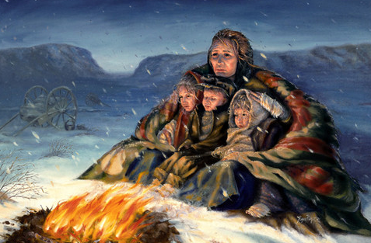
Elizabeth H. Jackson: Pioneer Mother
Megan Rieker
Oil on panel
After reading journal accounts of the Martin Handcart Company, the artist was impressed to do this painting of Elizabeth Horrocks Jackson Kingsfield, who wrote: "A few days after the death of my husband, the male members of the company had become reduced in number by death and sickness . . . There were not sufficient men with strength enough to raise the poles and pitch the tents. The result was that we camped out with nothing but the vault of Heaven for a roof and the stars for companions. . . .The night was bitterly cold. I sat down on a rock with one child in my lap and one on each side of me. In that condition I remained until morning. . . . In my dream, my husband stood by me and said, ‘Cheer up, Elizabeth, deliverance is at hand.’" The next day they were found by the rescue team.
Elizabeth H. Jackson: Pioneer Mother - Megan Rieker, 2001

