Slide 1
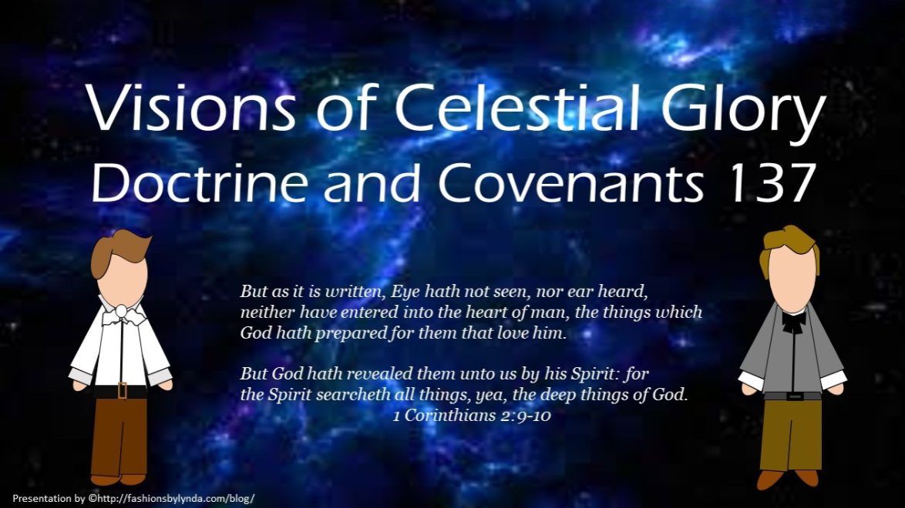

Slide 2

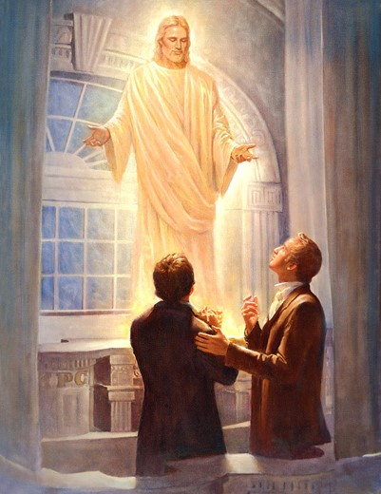
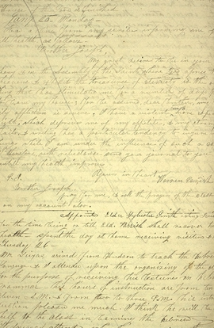
Background
Recap
Throughout his life, Joseph experienced even more loss with his wife Emma, as they buried four of their six infant children.
On January 21, 1836, the Prophet Joseph Smith met in an upper room of the nearly completed Kirtland Temple with his counselors in the First Presidency, the bishoprics from Kirtland and Missouri, his father, and his scribe.
These men had gathered for the administration of ordinances in preparation for the dedication of the temple.
On this occasion the Prophet saw a vision of the celestial kingdom and heard the Lord declare how He will judge those who die without a knowledge of the gospel.
Warren Parrish, Joseph Smith’s scribe at the time, recorded the vision in the Prophet’s journal. Part of the record of the vision was later included in the Doctrine and Covenants as section 137.
Joseph Smith

Slide 3
Warren Parrish
He was born January 10, trial, in Mendon, New York
He married Elizabeth Patten, the sister of David W. Patten
He was baptized by Brigham Young along with some of David W. Patten’s family around May 20, 1833
In September of 1834 he and his brother-in-law David W. Patten went on a mission to upper Missouri and baptized 20 people
He volunteered for Zion’s Camp in 1834 and was called to be a Seventy in 1835
He was a scribe for Joseph Smith
In 1836 he, David W. Patten, and Wilford Woodruff were arrested in Tennessee on a complaint by a Methodist Minister. There was a mock trial, and they were released later with fines
He became the treasurer in the Kirtland Safety Society, but the failure of the bank caused a rift between him and church leaders. He, along with other dissenters, left the Church
He stayed in Kirtland and formed a short-lived church call the Church of Christ, and in 1838 the dissenters took control of the Kirtland Temple as the Saints left for Far West, Missouri
After his church dissolved, he left Kirtland and became a Baptist Minister in 1844
In 1850 he moved to Mendon, New York, and in 1870 he moved to Emporia, Kansas and died in 1877
Wikipedia

Slide 4
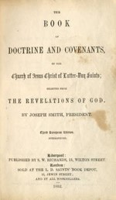
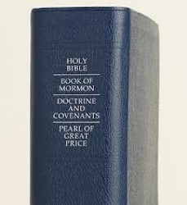
The Vision
The vision of the celestial kingdom, which is now Doctrine and Covenants 137, was not part of the standard works until 1976.
During the April general conference of that year, the Church voted to accept this vision and the vision of the redemption of the dead (D&C 138) as scripture.
These revelations were originally placed in the Pearl of Great Price. However, the First Presidency and the Quorum of the Twelve later decided to move them to the new edition of the Doctrine and Covenants as sections 137 and 138.
D&C 137:1-4

Slide 5
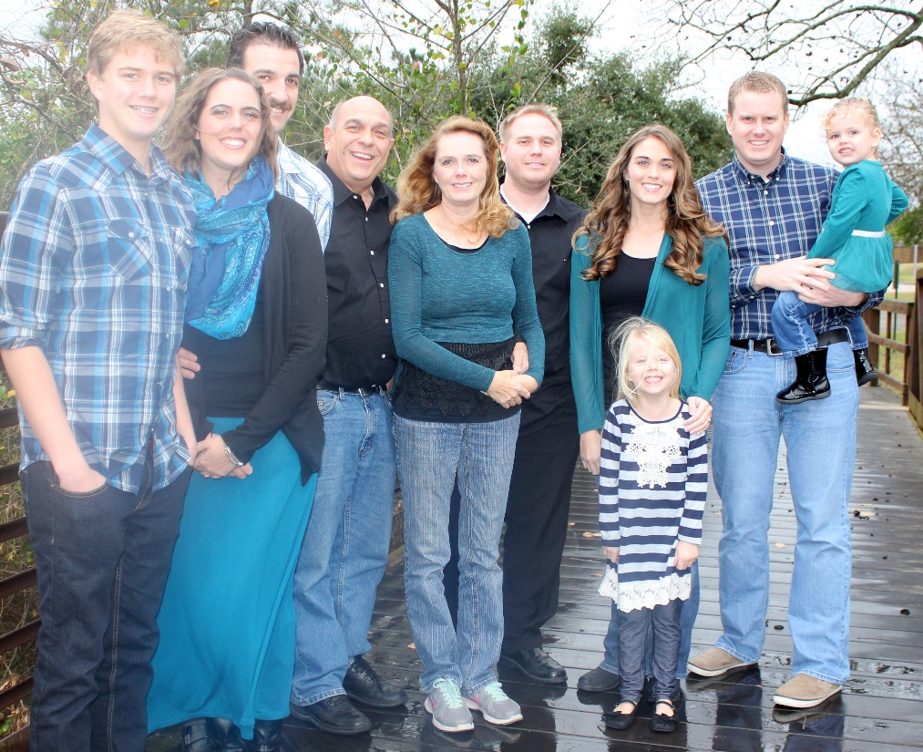
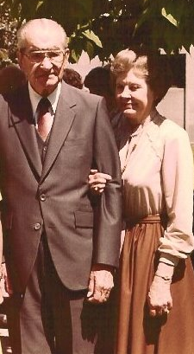
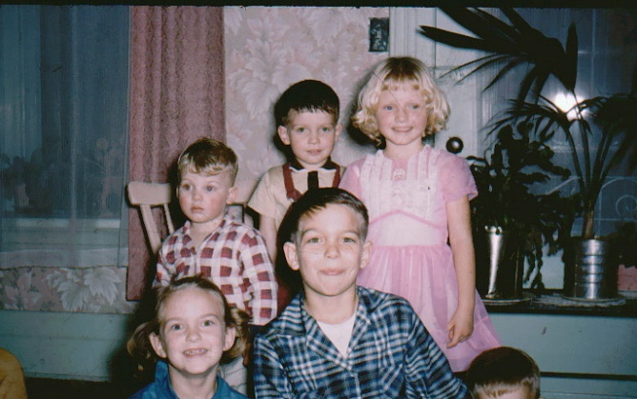
The Important People in Your Life
Who are they?
Why would it be important to you to know that the people you love will have the opportunity to live in the celestial kingdom?

Slide 6
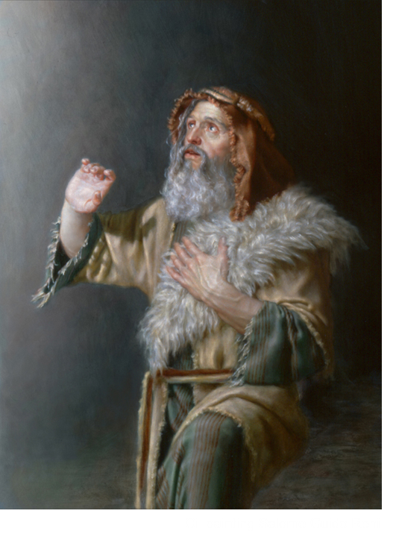
Spiritual Eyes
“Mine own eyes have beheld God; but not my natural, but my spiritual eyes”
Moses 1:11
“,,,discerned them by the spirit of God“
Moses 1:28
“…things which were not visible to the natural eye”
Moses 6:36
D&C 137:1-4

Slide 7
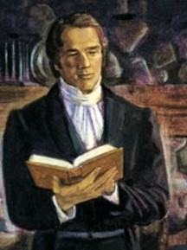

The View of the Lord
“…by the power of the Spirit our eyes were opened and our understandings were enlightened, so as to see and understand the things of God” (D&C 76:12)
When the Lord gives revelations to His children He communicates through the power of the Holy Ghost to their spirit
“All things whatsoever God in his infinite wisdom has seen and proper to reveal to us, while we are dwelling in mortality, in regard to our mortal bodies, are revealed to us in the abstract, and independent of affinity of this mortal tabernacle, but are revealed to our spirits precisely as though we had no bodies at all; and those revelations which will save our spirits will save our bodies.
God reveals them to us in view of no eternal dissolution of the body, or tabernacle.” Joseph Smith
D&C 137:1-4

Slide 8

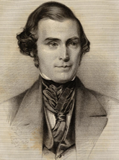
Heavens Opened To Us
“When [the light] first came upon him, it produced a peculiar sensation throughout his whole system; and, immediately, his mind was caught away from the natural objects with which he was surrounded; and he was enwrapped in a heavenly vision”
Elder Orson Pratt
When the Lord gives such revelations to His children, they become enveloped in the Spirit and filled with His glory to such an extent that they become oblivious to the things of the natural world.
Student Manual
D&C 137:1-4

Slide 9


Our God is a Consuming Fire
Hebrews 12:29
The Prophet Joseph Smith in his account of the First Vision wrote that God’s “brightness and glory defy all description” (JS—H 1:17).
He also taught that “God Almighty Himself dwells in eternal fire; flesh and blood cannot go there, for all corruption is devoured by the fire.
“… Immortality dwells in everlasting burnings.”
Joseph Smith
“God is full of energy, and should we mortals stand in his presence, unless his spirit was upon us to protect us we would be consumed. That is how much energy there is in a celestial body.”
President Joseph Fielding Smith
D&C 137:2-3

Slide 10
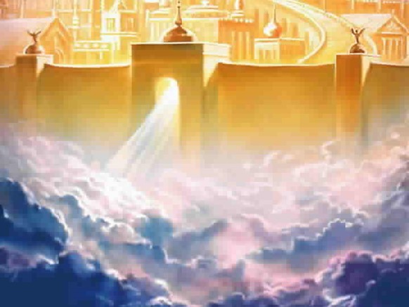
Paved With Gold
And the twelve gates were twelve pearls; every several gate was of one pearl: and the street of the city was pure gold, as it were transparent glass.
Revelation 21:21
And the building of the wall of it was of jasper: and the city was pure gold, like unto clear glass.
Revelation 21:18
D&C 137:4

Slide 11
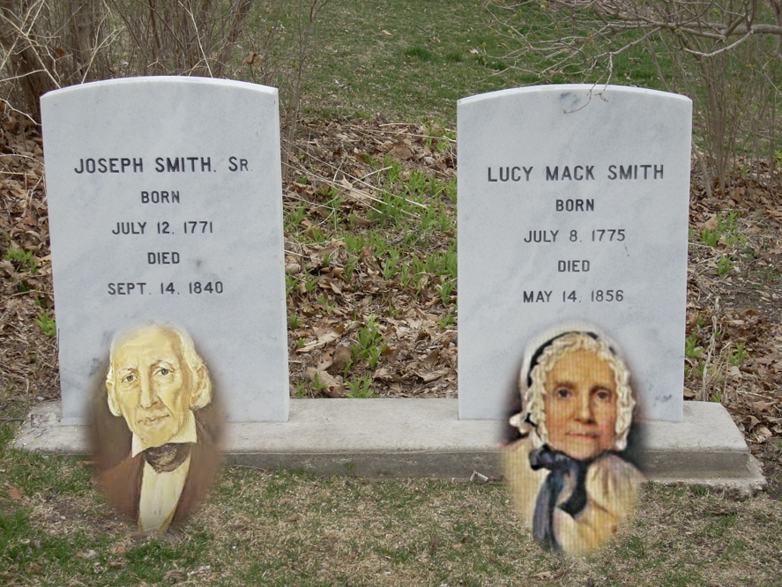
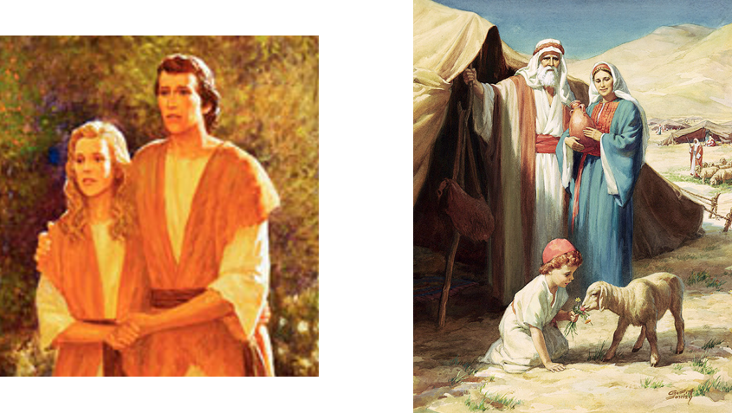
Joseph’s Vision
Joseph’s father and mother were still alive at this time; in fact, his father was in the room with him at the time of this vision. This indicates that this vision was not of those who were already in the celestial kingdom but of those who would eventually be there. (see Historical Background for D&C 137).
D&C 137:5

Slide 12
Alvin Smith
He was born February 11, 1798 (or 1799) at Tunbridge, Orange County, Vermont
He was the oldest son of Joseph and Lucy Smith
He had a strong work ethic and was a great help to his family in their years of financial struggle
He helped build their home, across the street from their log cabin, in Palmyra
He encouraged Joseph Smith Jr., his younger brother, to continue on the Restoration
He became seriously ill in November 1823 and died of mercury poisoning from calomel, which had been administered to cure a case of “bilious colic” and died Nov. 19, 1823
On Jan. 21, 1836, the Prophet Joseph beheld his brother once again in the celestial kingdom (D&C 137:5-9)
Who’s Who

Slide 13
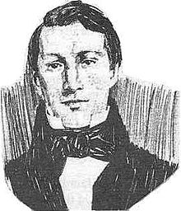
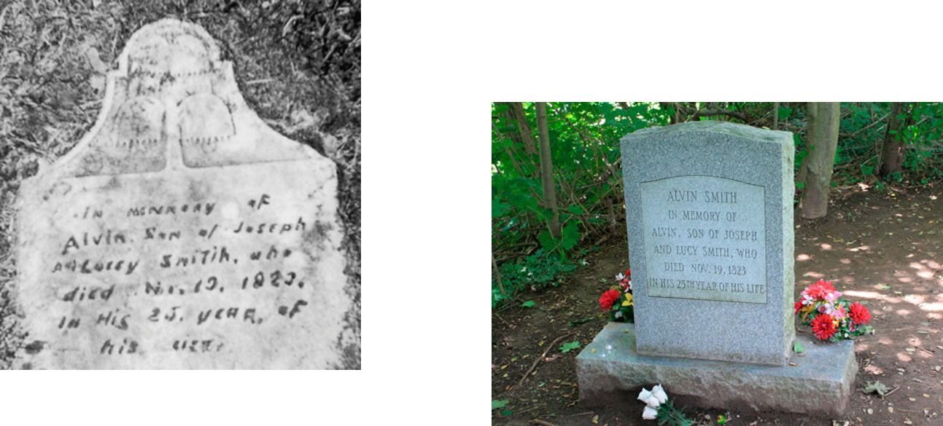
A Love For His Brother
In 1823, the sudden death of Alvin, the oldest son, devastated the Smith family. The family asked a local minister to officiate at Alvin’s funeral. As Alvin had not been a baptized member of the minister’s congregation, the clergyman claimed that Alvin could not be saved. Joseph’s brother William later said, “[The minister] … intimated very strongly that [Alvin] had gone to hell, for Alvin was not a church member”
Teachings of Presidents of the Church
The Lord has provided the means for Alvin Smith and others who would have received the gospel with all their hearts if they had been permitted to tarry to enjoy a fulness of His blessings in the eternal worlds
D&C 137:5-8

Slide 14
Without Knowledge of the Gospel
Else what shall they do which are baptized for the dead, if the dead rise not at all? why are they then baptized for the dead?
1 Corinthians 15:29
Baptisms for the Dead—
This practice has been restored with the establishment of The Church of Jesus Christ of Latter-day Saints. The Prophet Joseph Smith first taught about the ordinance of baptism for the dead during a funeral sermon in August 1840. He read much of 1 Corinthians 15, including verse 29, and announced that the Lord would permit Church members to be baptized in behalf of their friends and relatives who had departed this life. He told them “the plan of salvation was calculated to save all who were willing to obey the requirements of the law of God”
HC
All people who die without a knowledge of the gospel, who would have received it, will inherit the celestial kingdom
D&C 137:7-8

Slide 15

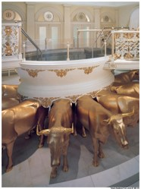
Baptisms For The Dead
Because all who have lived on the earth have not had the opportunity to be baptized by proper authority during life on earth, baptisms may be performed by proxy, meaning a living person may be baptized in behalf of a deceased person. Baptisms for the dead are performed by Church members in temples throughout the world.
People have occasionally wondered if the mortal remains of the deceased are somehow disturbed in this process; they are not. The person acting as a proxy uses only the name of the deceased.
To prevent duplication the Church keeps a record of the deceased persons who have been baptized. Some have misunderstood that when baptisms for the dead are performed the names of deceased persons are being added to the membership records of the Church.
This is not the case.
Why do Mormons perform baptisms for the dead? Mormon.org

Slide 16

True Desires Of Our Hearts
The true desire of our heart determines our future. If we have had the opportunity to hear the gospel, our obedience to it demonstrates our true desire. If not, our desire will determine whether we accept it when we are given the opportunity, either in this life or the spirit world.
All whose hearts are right will receive and live the gospel whenever they have the opportunity and will be “heirs of the celestial kingdom of God”.
Vicarious ordinance work is performed in the temple for those like Alvin Smith who did not have the opportunity to receive the ordinances of the gospel in mortality.
Heavenly Father provides the way for all His children to receive salvation
D&C 137:7-9 Student Manual

Slide 17
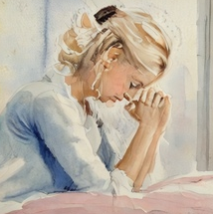
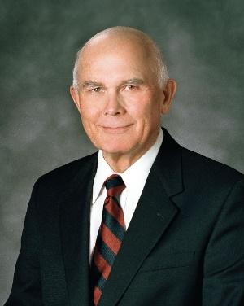

“Are we sure to be guiltless under the law of God if we merely refrain from evil acts? What if we entertain evil thoughts and desires?
“Will hateful feelings go unnoticed in the day of judgment? Will envy? Will covetousness? …
Our answers to such questions illustrate what we might call the bad news, that we can sin without overt acts, merely by our feelings and the desires of our hearts.”
“There is also good news. Under the law of God, we can be rewarded for righteousness even where we are unable to perform the acts that are usually associated with such blessings.”
“When someone wanted to do something for my father-in-law but was prevented by circumstances, he would say, ‘Thank you. I will take the good will for the deed.’ Similarly, I believe that our Father in Heaven will receive the true desires of our hearts as a substitute for actions that are genuinely impossible.”
The Lord will judge each of us by our works and the desires of our hearts
D&C 137:7-9 Elder Dallin H. Oaks

Slide 18
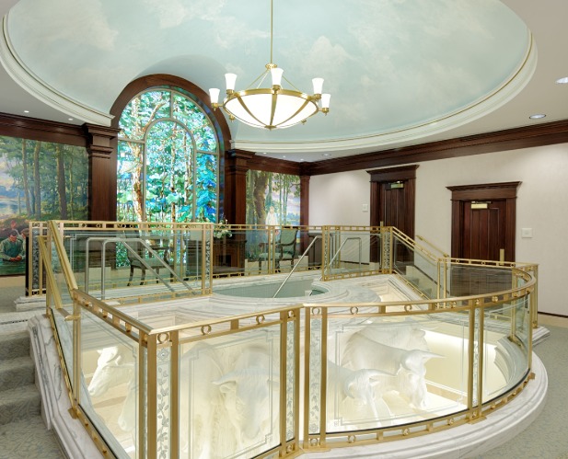
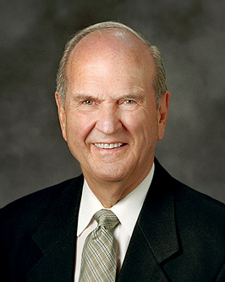
For for this cause was the gospel preached also to them that are dead, that they might be judged according to men in the flesh, but live according to God in the spirit.
1 Peter 4:6
And these are those who have part in the first resurrection; and these are they that have died before Christ came, in their ignorance, not having salvation declared unto them. And thus the Lord bringeth about the restoration of these; and they have a part in the first resurrection, or have eternal life, being redeemed by the Lord.
Mosiah 15:45
Mercifully, God’s great plan of happiness and its eternal blessings can be extended to those who did not have the opportunity to hear the gospel in mortality.
Temple ordinances can be done vicariously for them.
Russell M. Nelson
D&C 137:7-8

Slide 19
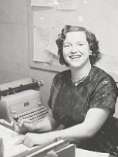
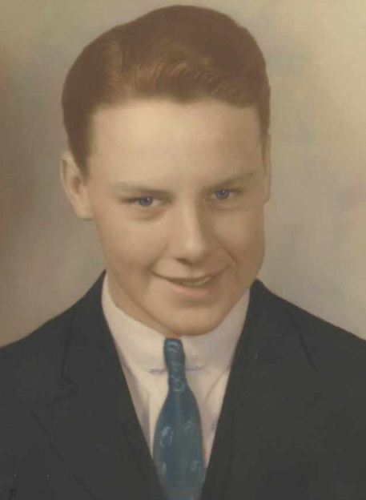
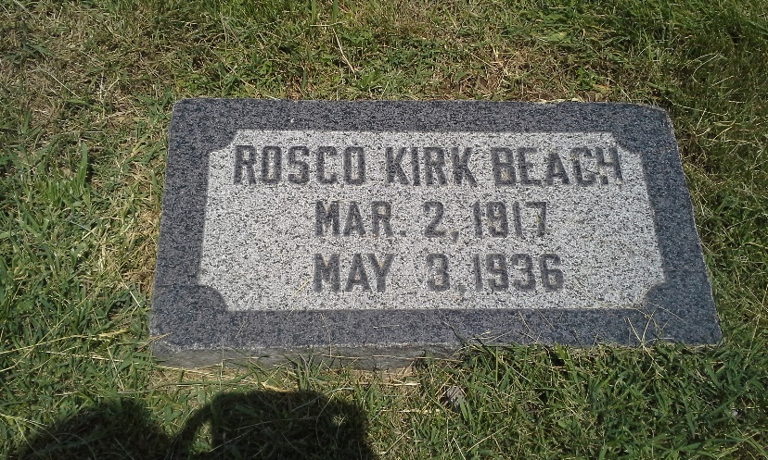
All Who Are Worthy
What about those who are not able to marry in this life or those who cannot be sealed to their parents in this life?
We know that the Lord will judge each of us according to the desires of our hearts, as well as our works, and that the blessings of exaltation will be given to all who are worthy. Russell M. Nelson
D&C 137:7-8

Slide 20
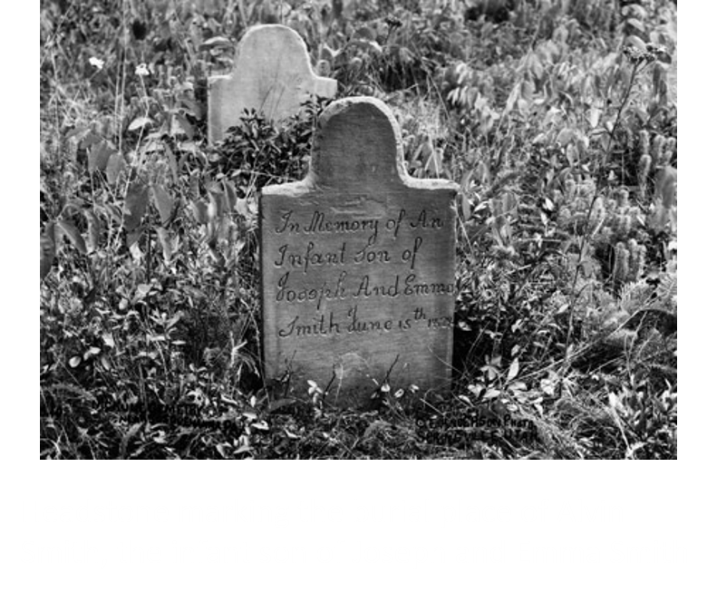
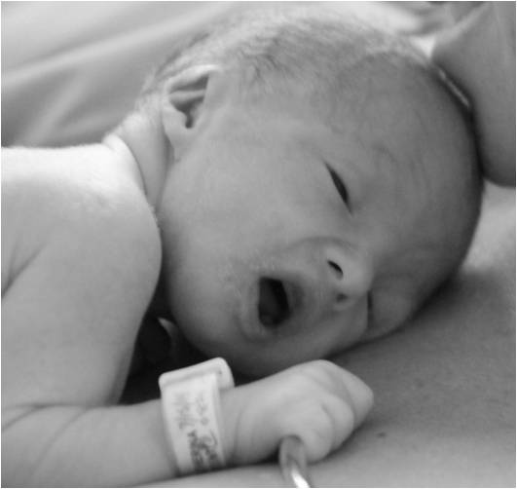
Children Are Saved
“The Lord will grant unto these children the privilege of all the sealing blessings which pertain to the exaltation.
“We were all mature spirits before we were born, and the bodies of little children will grow after the resurrection to the full stature of the spirit, and all the blessings will be theirs through their obedience, the same as if they had lived to maturity and received them on the earth.”
Joseph Fielding Smith
All children who die before they become accountable will be saved in the celestial kingdom
D&C 137:10

Slide 21
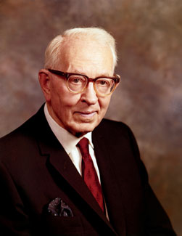
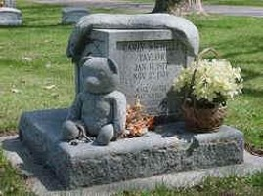
What will happen to children in the Resurrection?
“Joseph Smith taught the doctrine that the infant child that was laid away in death would come up in the resurrection as a child; and, pointing to the mother of a lifeless child, he said to her:
‘You will have the joy, the pleasure, and satisfaction of nurturing this child, after its resurrection, until it reaches the full stature of its spirit.’
There is restitution, there is growth, there is development, after the resurrection from death. I love this truth.
It speaks volumes of happiness, of joy and gratitude to my soul. Thank the Lord he has revealed these principles to us.”
Will children who die before the years of accountability ever be tested in the way that other mortals are tested?
“Satan cannot tempt little children in this life, nor in the spirit world, nor after their resurrection. Little children who die before reaching the years of accountability will not be tempted.”
D&C 137:10 Joseph Fielding Smith

Slide 22
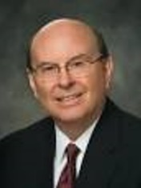
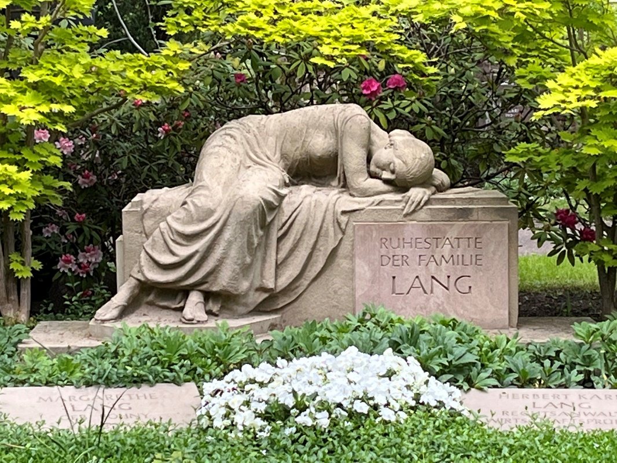
False Traditions
At the time Joseph Smith received revelations and organized the Church, the vast majority of churches taught that the Savior’s Atonement would not bring about the salvation of most of mankind.
The common precept was that a few would be saved and the overwhelming majority would be doomed to endless tortures of the most awful and unspeakable intensity.
The marvelous doctrine revealed to the Prophet Joseph unveiled to us a plan of salvation that is applicable to all mankind, including those who do not hear of Christ in this life, children who die before the age of accountability, and those who have no understanding.
Quentin L. Cook
D&C 29:46-50; D&C 137:7-10

Slide 23
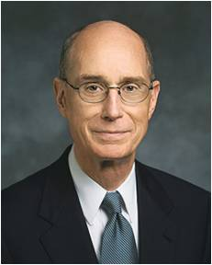
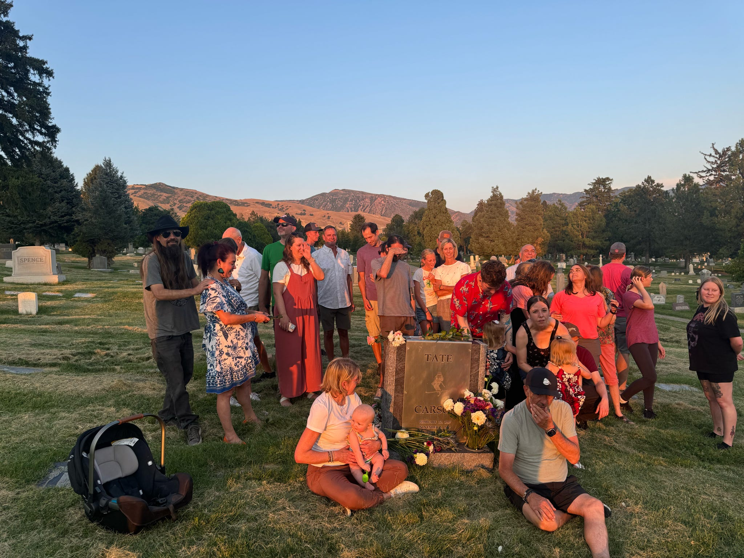
All Families Are At the Heart of His Plan
… Our Heavenly Father is anxious to gather and bless all of His family.
While He knows that not all of them will choose to be gathered, His plan gives each of His children the opportunity to accept or reject His invitation. And families are at the heart of this plan.
Henry B. Eyring
D&C 29:46-50; D&C 137:7-10

Slide 24
Sources:
Video:
Glad Tidings: The History of Baptisms for the Dead (6:55)
Little Children Are Innocent (1:26)
“Ministry of Joseph Smith: Temples” (2:19).
“If We Are Well Prepared, Death Brings No Terror” (1:10)
“Rise” (1:42).
Joseph Smith (History of the Church, 2:379–80.) (Journal History of the Church, 15 Aug. 1840).
Joseph Smith (Teachings, p. 355; 367)
Even though Warren Parrish’s name is not mentioned in the Doctrine and Covenants…I felt it noteworthy to include his name in the Bio-sketches after all he did contribute much to the converting of many Saints
Elder Orson Pratt (in James B. Allen, “Eight Contemporary Accounts of Joseph Smith’s First Vision: What Do We Learn from Them?” Improvement Era, Apr. 1970, p. 10).
Teachings of Presidents of the Church: Joseph Smith [2007], 401–3).
Doctrine and Covenants Student Manual Religion 324-325 Section 137
Church News, 2 June 1979, p. 3
Presentation by ©http://fashionsbylynda.com/blog/
President Joseph Fielding Smith Seek Ye Earnestly, p. 275.
(Children) Doctrines of Salvation, 2:54, 57; Gospel Doctrine, pp. 455–56
Doctrine and Covenants Who’s Who by Ed J. Pinegar and Richard J. Allen pg. 132
Additional Information on Alvin Smith: The Alvin Smith Story: Fact and Fiction by Richard Lloyd Anderson Ensign Aug. 1987
Elder Dallin H. Oaks (“The Desires of Our Hearts,” Ensign, June 1986, 66).
Russell M. Nelson, “Celestial Marriage,” Ensign or Liahona, Nov. 2008, 94; “Salvation and Exaltation,” Ensign or Liahona, May 2008, 10
Quentin L. Cook, “Our Father’s Plan—Big Enough for All His Children,” Ensign or Liahona, May 2009, 36–37)
Henry B. Eyring, “Gathering the Family of God,” Ensign or Liahona, May 2017, 20–21
Presentation by ©http://fashionsbylynda.com/blog/

Slide 25
The status of children who die before the age of accountability.
Are they automatically saved? Elder Bruce R. McConkie wrote: “To this question the answer is a thunderous yes, which echoes and re-echoes from one end of heaven to the other. Jesus taught it to his disciples. Mormon said it over and over again. Many of the prophets have spoken about it, and it is implicit in the whole plan of salvation. If it were not so the redemption would not be infinite in its application. And so, as we would expect, Joseph Smith’s Vision of the Celestial Kingdom contains this statement: ‘And I also beheld that all children who die before they arrive at the years of accountability are saved in the celestial kingdom of heaven.’ [D&C 137:10.]
“It is sometimes asked if this applies to children of all races, and of course the answer is that when the revelation says all children it means all children. There is no restriction as to race, kindred, or tongue. Little children are little children and they are all alive in Christ, and all are saved by him, through and because of the atonement. …
“They are saved through the atonement and because they are free from sin. They come from God in purity; no sin or taint attaches to them in this life; and they return in purity to their Maker. Accountable persons must become pure through repentance and baptism and obedience. Those who are not accountable for sins never fall spiritually and need not be redeemed from a spiritual fall which they never experienced. Hence the expression that little children are alive in Christ. …
“Truly it is one of the sweetest and most soul-satisfying doctrines of the gospel! It is also one of the great evidences of the divine mission of the Prophet Joseph Smith. In his day the fiery evangelists of Christendom were thundering from their pulpits that the road to hell is paved with the skulls of infants not a span long because careless parents had neglected to have their offspring baptized. Joseph Smith’s statements, as recorded in the Book of Mormon and latter-day revelation, came as a refreshing breeze of pure truth: little children shall be saved. Thanks be to God for the revelations of his mind where these innocent and pure souls are concerned!” (“The Salvation of Little Children,” Ensign, Apr. 1977, pp. 4, 7.)
President Joseph Fielding Smith added: (Children)
“The Lord will grant unto these children the privilege of all the sealing blessings which pertain to the exaltation.
“We were all mature spirits before we were born, and the bodies of little children will grow after the resurrection to the full stature of the spirit, and all the blessings will be theirs through their obedience, the same as if they had lived to maturity and received them on the earth.
“The Lord is just and will not deprive any person of a blessing, simply because he dies before that blessing can be received. It would be manifestly unfair to deprive a little child of the privilege of receiving all the blessings of exaltation in the world to come simply because it died in infancy. …
“Children who die in childhood will not be deprived of any blessing. When they grow, after the resurrection, to the full maturity of the spirit, they will be entitled to all the blessings which they would have been entitled to had they been privileged to tarry here and receive them.” (Doctrines of Salvation, 2:54; see also Mosiah 15:25.)
Why do some children die and others live? Are those who die better off than those who remain in mortality? Elder McConkie wrote:
“We may rest assured that all things are controlled and governed by Him whose spirit children we are. He knows the end from the beginning, and he provides for each of us the testings and trials which he knows we need. President Joseph Fielding Smith once told me that we must assume that the Lord knows and arranges beforehand who shall be taken in infancy and who shall remain on earth to undergo whatever tests are needed in their cases. This accords with Joseph Smith’s statement: ‘The Lord takes many away, even in infancy, that they may escape the envy of man, and the sorrows and evils of this present world; they were too pure, too lovely, to live on earth.’ (Teachings, pp. 196–97.) It is implicit in the whole scheme of things that those of us who have arrived at the years of accountability need the tests and trials to which we are subject and that our problem is to overcome the world and attain that spotless and pure state which little children already possess.” (“Salvation of Little Children,” p. 6.)

