Slide 1
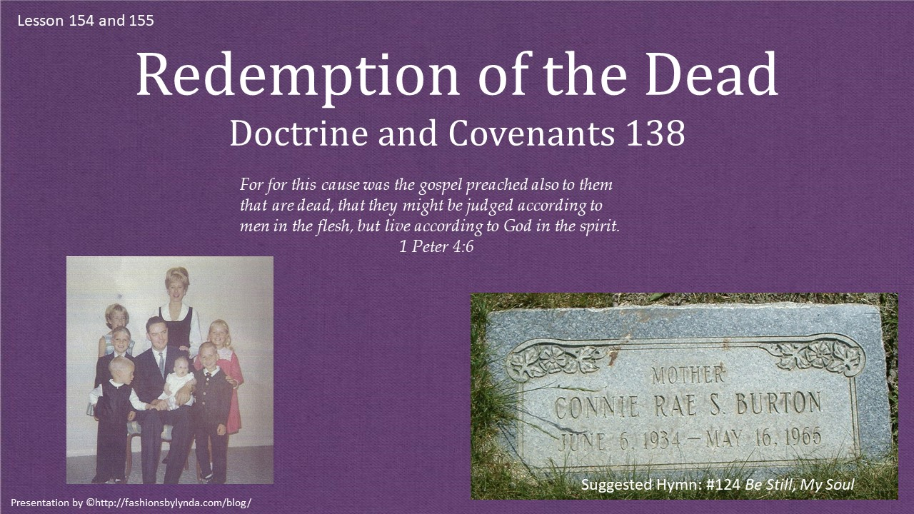

Slide 2

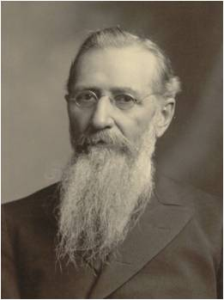
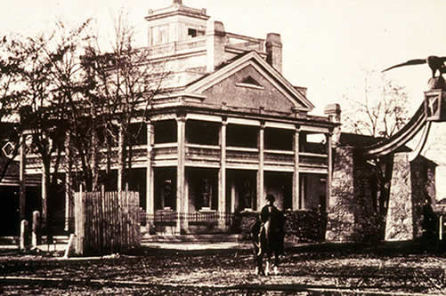
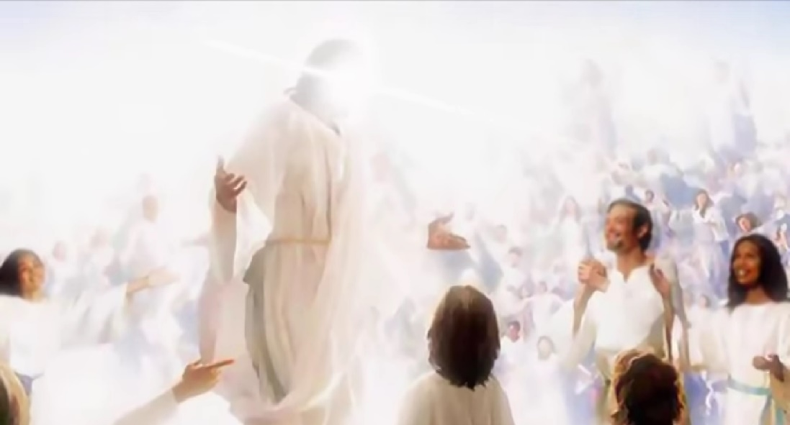
The Vision
On October 3, 1918, in the Beehive House in Salt Lake City (the home where President Brigham Young had lived when he was President of the Church), President Joseph F. Smith received the vision recorded in Doctrine and Covenants 138.
In this vision President Smith saw the Savior, between the time of His death and the time of His Resurrection, minister to righteous spirits in paradise who had been awaiting deliverance from the bands of death.

Slide 3
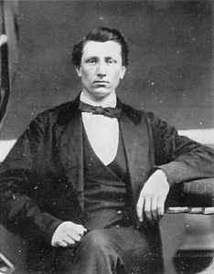
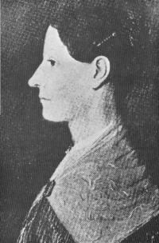
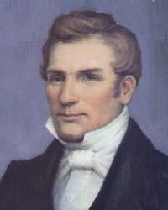
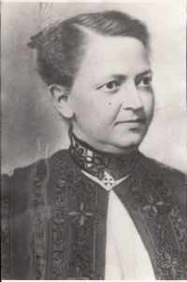
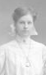
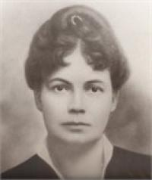
The Death of Loved Ones
Joseph was 5 when his father, Hyrum was martyred along with his uncle Joseph Smith
His mother, Mary Fielding Smith, died when he was 13.
Joseph F. Smith
His first child, Mercy Josephine died before her third birthday, in 1870
His daughter, Zina Smith Greenwell died in Oct. 1915 at age 25
His wife Sarah Richards Smith died in 1915
Sara Elizabeth Bowmen Smith, wife of Hyrum M. Smith, died during childbirth in 1918
George S. Tate

Slide 4
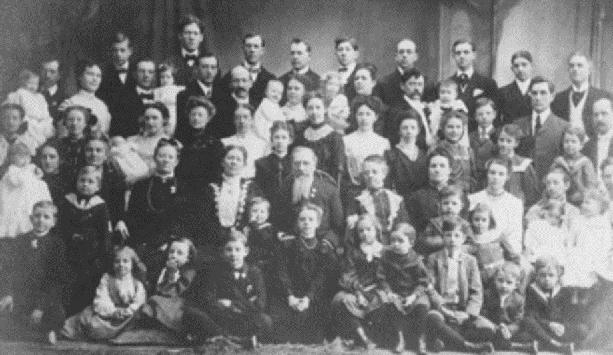
Joseph F. Smith’s Family
Of his 44 children, 13 had died, many in their childhood. President Joseph F. Smith’s expressions of grief over the death of each in his journal, letters, and commemorative poems are touching from first to last.

Slide 5
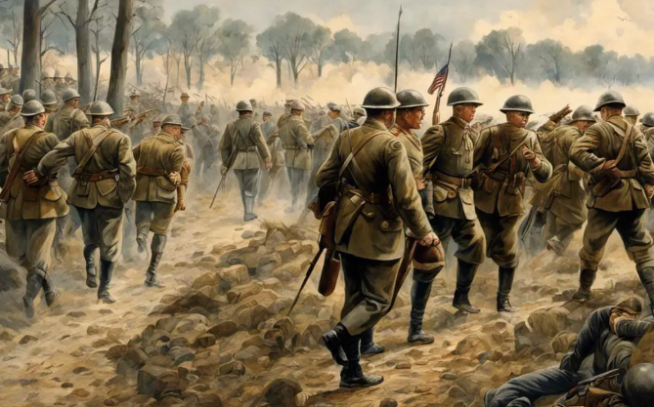
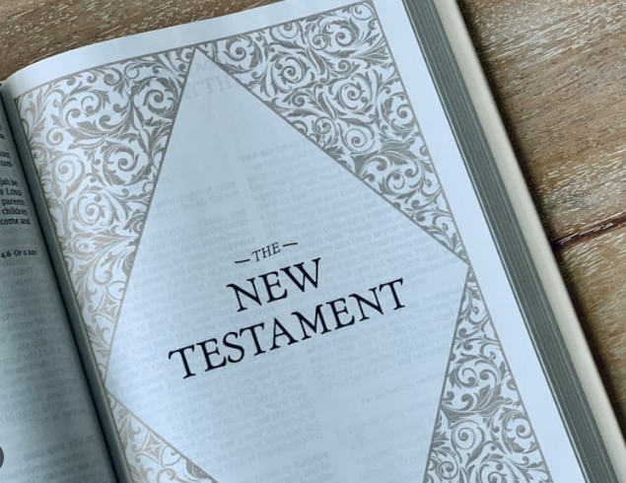
Seeking Comfort
Grieving the deaths of beloved family members and mourning the devastation caused by World War I and the global flu pandemic, President Joseph F. Smith sought comfort in the scriptures. (1 Peter 3-4)
He received a glorious vision of the Savior’s ministering efforts in the spirit world between His death and Resurrection. President Smith’s vision is now Doctrine and Covenants 138.

Slide 6
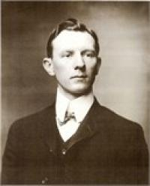
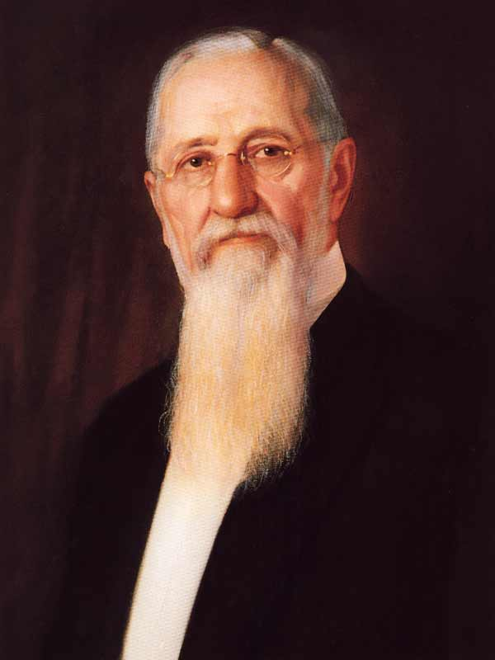
Death
What happens to our spirits and bodies when we die?
Where do our spirits go?
Hyrum Mack Smith
Joseph F. Smith had been ill for the 5 months before General Conference in October of 1918
In January of 1918 he experienced the untimely loss of his son Hyrum Mack Smith at age 45, of a ruptured appendix.
The 6th President of the Church now ponders the meaning of life and death.

Slide 7
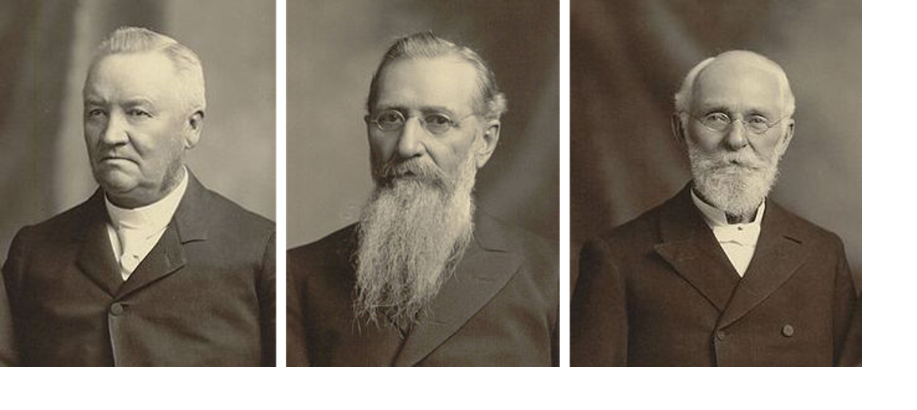
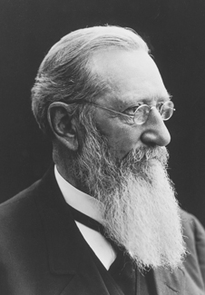
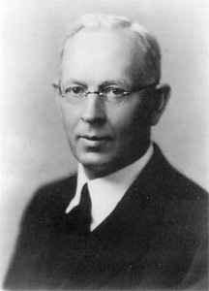
Written and Added
Shortly after the October 1918 general conference his son, Joseph Fielding Smith, took it in dictation.
It was approved by President Smith’s counselors, the Quorum of the Twelve Apostles, and the Church Patriarch on October 31.
During April conference of 1976 it was accepted as scripture and approved for publication in the Pearl of Great Price.
In June 1979 the First Presidency announced that it would become section 138 of the Doctrine and Covenants.
Student Manual

Slide 8
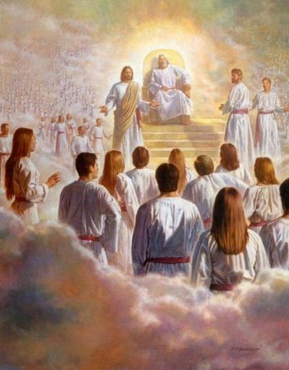
All Mankind Might Be Saved
By the grace of the Father we were born as His spirit offspring, given the gift of agency, and provided with a plan whereby we might obtain the fullness of all that He has.
By the grace of Christ, we can obtain a remission of sins, be resurrected, and return to the presence of our Father.
Through the Atonement of Jesus Christ and by obedience to the principles of the gospel, all mankind may be saved
D&C 138:1-4

Slide 9
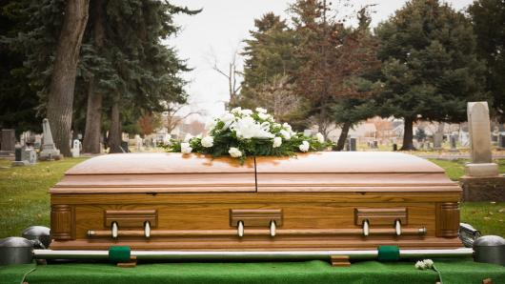
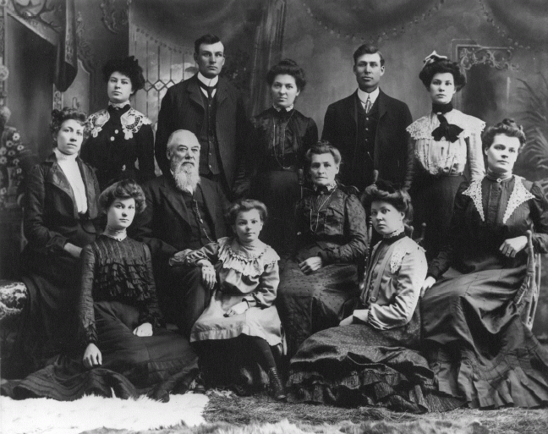
Those Who Die Before
What becomes of those who died without the opportunity to accept Christ?
Our Father in Heaven’s prophets have told us that missionaries will be sent from among the righteous in the spirit world to teach the gospel to all the spirits of the dead people.
Many will accept the gospel and repent. Necessary saving ordinances will be done for them by living persons in our Father in Heaven’s temples.
Relatives or other members of the Church do these ordinances for them.
Then they will be able to leave the spirit prison.
In this way, our Father in Heaven provides opportunity for all His children to receive the blessings of the gospel no matter when they lived on the earth.
Samuel R. Parkinson Family
D&C 138:5-10 Gospel Fundamentals

Slide 10


Ponder
Behold, I would exhort you that when ye shall read these things, if it be wisdom in God that ye should read them, that ye would remember how merciful the Lord hath been unto the children of men, from the creation of Adam even down until the time that ye shall receive these things, and ponder it in your hearts.
And when ye shall receive these things, I would exhort you that ye would ask God, the Eternal Father, in the name of Christ, if these things are not true; and if ye shall ask with a sincere heart, with real intent, having faith in Christ, he will manifest the truth of it unto you, by the power of the Holy Ghost.
And by the power of the Holy Ghost ye may know the truth of all things.
D&C 138:11 Moroni 10:3-5

Slide 11
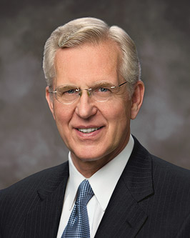
“When I say ‘study,’ I mean something more than reading. … I see you sometimes reading a few verses, stopping to ponder them, carefully reading the verses again, and as you think about what they mean, praying for understanding, asking questions in your mind, waiting for spiritual impressions, and writing down the impressions and insights that come so you can remember and learn more.”
Elder D. Todd Christofferson
D&C 138:11

Slide 12
Spirit Body
Spirit beings have the same bodily form as mortals except that the spirit body is in perfect form (read Ether 3:16).
Spirits carry with them from earth their attitudes of devotion or antagonism toward things of righteousness. (read Alma 34:34).
They have the same appetites and desires that they had when they lived on earth.
All spirits are in adult form.
They were adults before their mortal existence, and they are in adult form after death, even if they die as infants or children.
Gospel Principles

Slide 13
Paradise vs Prison
By which also he [Christ] went and preached unto the spirits in prison;
1 Peter 3:18
Spirit Paradise
Spirit Prison
In the spirit prison are the spirits of those who have not yet received the gospel of Jesus Christ. These spirits have agency and may be enticed by both good and evil. If they accept the gospel and the ordinances performed for them in the temples, they may leave the spirit prison and dwell in paradise.
The spirits of those who are righteous are received into a state of happiness, which is called paradise, a state of rest, a state of peace, where they shall rest from all their troubles and from all care, and sorrow.
D&C 138:12-15, 20-22, and Gospel Principles

Slide 14
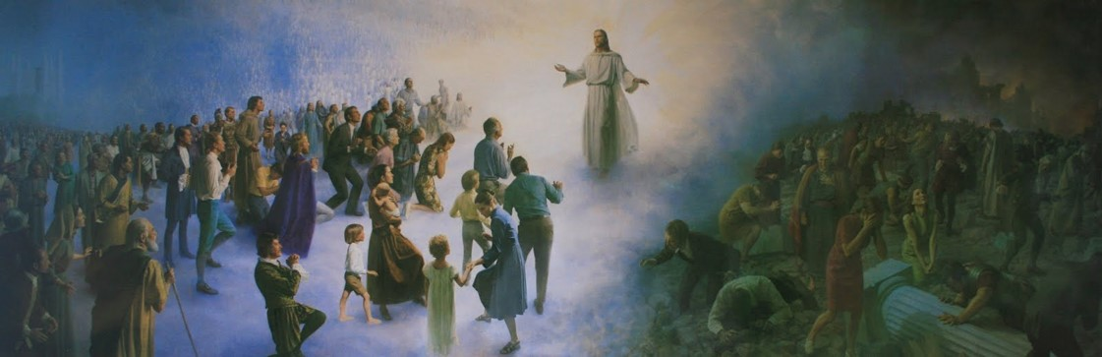
Separation
The spirits are classified according to the purity of their lives and their obedience to the will of the Lord while on earth.
The righteous and the wicked are separated, but the spirits may progress as they learn gospel principles and live in accordance with them. The spirits in paradise can teach the spirits in prison
Read: 1 Nephi 15:28-30
D&C 138:12-15, 20-22 and Gospel Principles

Slide 15
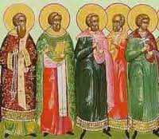

The Future
In his vision President Smith saw “an innumerable company” of spirits who “had departed the mortal life, firm in the hope of a glorious resurrection.”
These were celestial heirs who had lived on the earth from the time of Adam until Christ came. Great multitudes of people born after that time will qualify for the celestial glory through their faithfulness in this life or in the spirit world.
In addition, there will be the millions of children who died before they reached the age of accountability.
D&C 138:12-14

Slide 16

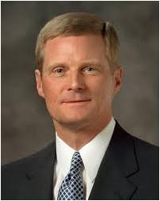
Joy and Gladness
O how great the plan of our God! For on the other hand, the paradise of God must deliver up the spirits of the righteous, and the grave deliver up the body of the righteous; and the spirit and the body is restored to itself again, and all men become incorruptible, and immortal, and they are living souls, having a perfect knowledge like unto us in the flesh, save it be that our knowledge shall be perfect.
2 Nephi 9:13
“…our gospel perspective helps us to understand that joy is more than a fleeting feeling or emotion; rather, it is a spiritual gift and a state of being and becoming.”
D&C 138:12-14
Elder David A. Bednar

Slide 17
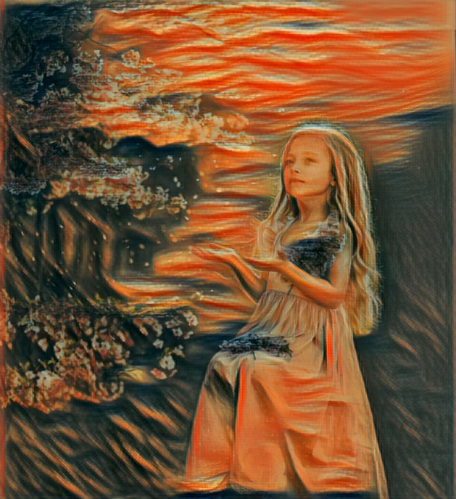

Joy VS Fun
Joy
Spiritual
Enduring
Deep and Rich
Whole and Complete
Pertains to Mortality and Eternity
Fun
Temporal
Temporary
Shallow
Partial
Pertains only to mortality
D&C 138:12-14
Elder David A. Bednar

Slide 18
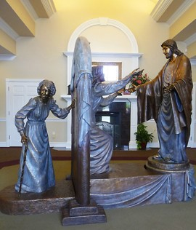
Returning Safely Home
“Our physical bodies make possible a breadth, a depth, and an intensity of experience that simply could not be obtained in our premortal existence.
Thus, our relationships with other people, our capacity to recognize and act in accordance with truth, and our ability to obey the principles and ordinances of the gospel of Jesus Christ are amplified through our physical bodies. …
“The Father’s plan is designed to provide direction for His children, to help them become happy, and to bring them safely home to Him with resurrected, exalted bodies.”
Elder David A. Bednar
D&C 138:14-17, 51

Slide 19
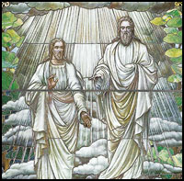
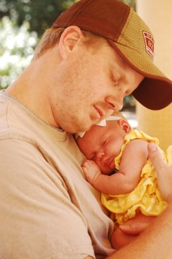

Physical and Spiritual Bodies
Heavenly Father has a physical body of flesh and bones.
When our spirits and bodies are separated, we are unlike Him and cannot receive a fulness of joy.
The Father has a body of flesh and bones as tangible as man’s; the Son also; but the Holy Ghost has not a body of flesh and bones, but is a personage of Spirit. Were it not so, the Holy Ghost could not dwell in us.
D&C 130:22
For man is spirit. The elements are eternal, and spirit and element, inseparably connected, receive a fulness of joy;
And when separated, man cannot receive a fulness of joy. D&C 93:33-34
When are our spirits and bodies inseparably connected?
When we are resurrected—we can eventually become like our Heavenly Father and have a fulness of joy.
D&C 138:14-17, 50

Slide 20
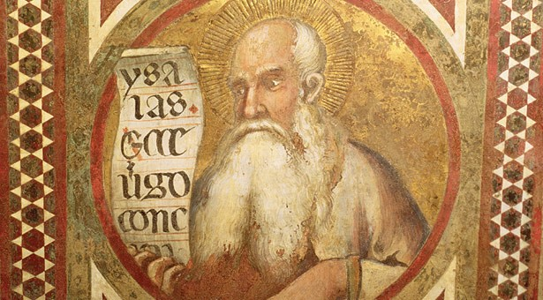
Preaching The Everlasting Gospel
The Spirit of the Lord God is upon me; because the Lord hath anointed me to preach good tidings unto the meek; he hath sent me to bind up the brokenhearted, to proclaim liberty to the captives, and the opening of the prison to them that are bound;
Isaiah 61:1
Christ chose simply to teach the “everlasting gospel.” To the likes of Adam, Enoch, Isaiah, Jeremiah, Nephi, Jacob, and Alma, he taught the doctrine of “resurrection and the redemption of mankind from the fall.”
McConkie and Ostler
D&C 138:18-19, 36, 38

Slide 21
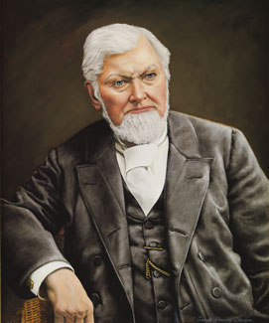
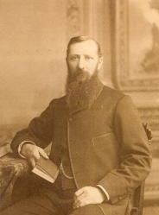
Carry The Message To The Dead
“Every Apostle, every Seventy, every Elder, etc., who has died in the faith, as soon as he passes to the other side of the veil, enters into the work of the ministry, and there is a thousand times more to preach to there than there is here. … They have work on the other side of the veil; and they want men, and they call them.”
President Wilford Woodruff
“Those who have passed away in this dispensation … are preaching that same gospel that they lived and preached here, to those who are in darkness in the spirit world and who had not had the privilege before they went. The gospel must be preached to them. We are not perfect without them—they cannot be perfect without us.”
Joseph F. Smith
D&C 138:37

Slide 22
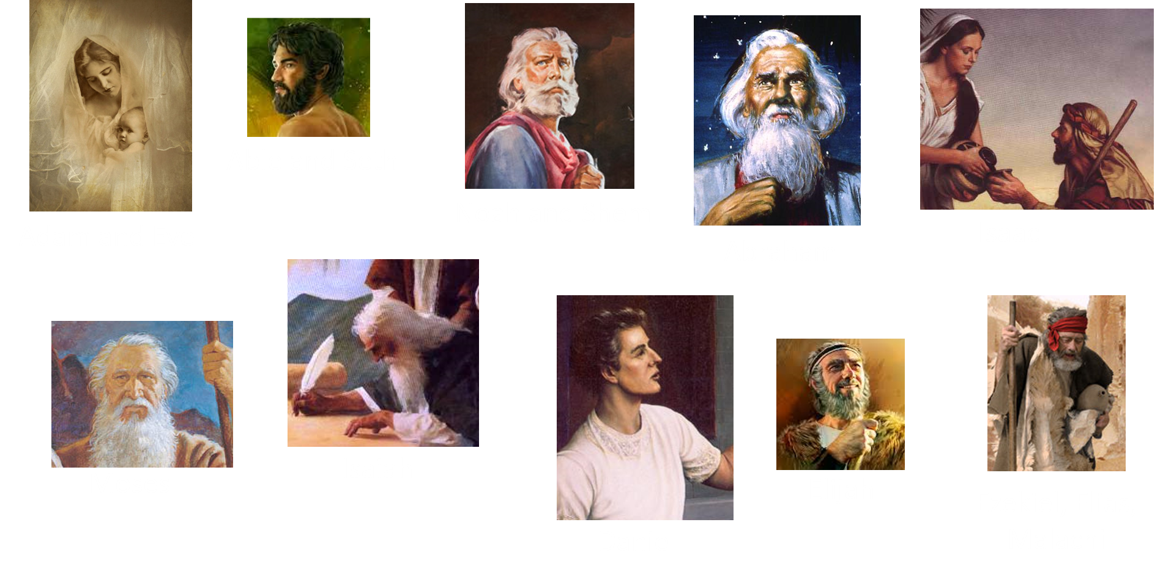
The Great and Marvelous Ones
D&C 138:39-47

Slide 23
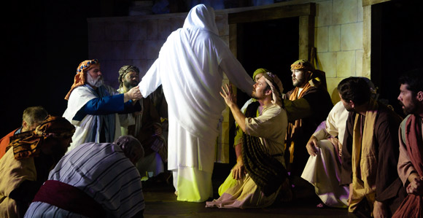
Appearance To The Righteous
Among the disembodied spirits, only those who had proven themselves true and faithful, only those who had complied with the laws and ordinances of the gospel while in the flesh, were among those assembled to greet Christ and to be taught by him.
The resurrected Christ did not appear to Caiaphas and the Sanhedrin or to the Jews who jeered and rejected him or to the soldiers who mocked and ridiculed him, Rather, he appeared to his humble followers.
After that, he was seen of above five hundred brethren at once; of whom the greater part remain unto this present, but some are fallen asleep.
1 Corinthians 15:6
D&C 138:20-24, 50

Slide 24
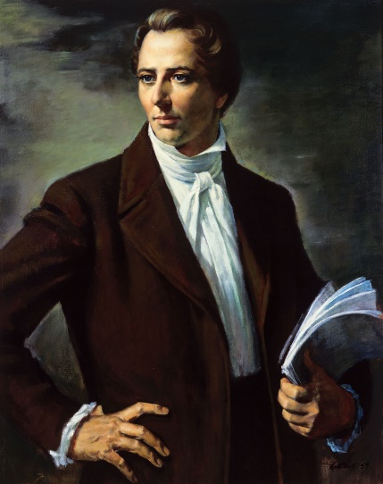
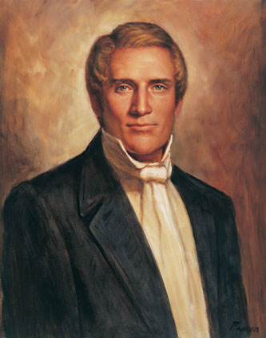
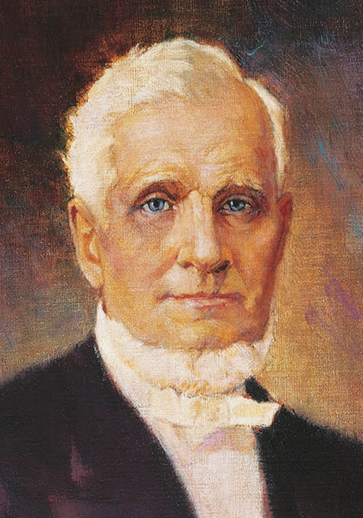
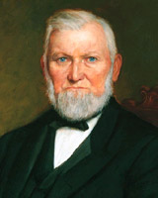
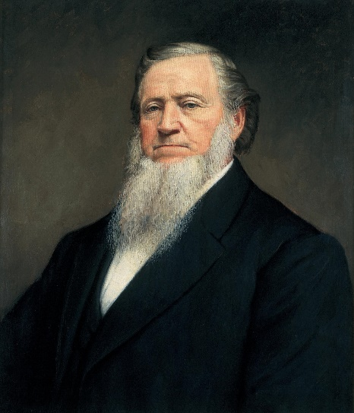
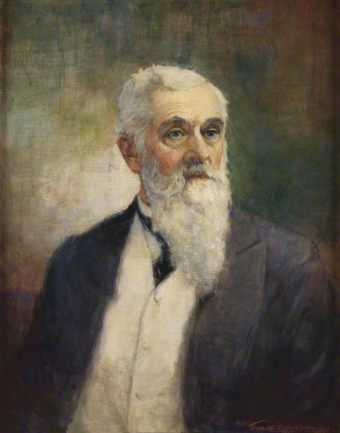
The Noble Who Have Gone
Joseph Smith
1844
Hyrum Smith
1844
John Taylor
1887
Wilford Woodruff
1898
Brigham Young
1877
Lorenzo Snow
1901
D&C 138:53

Slide 25
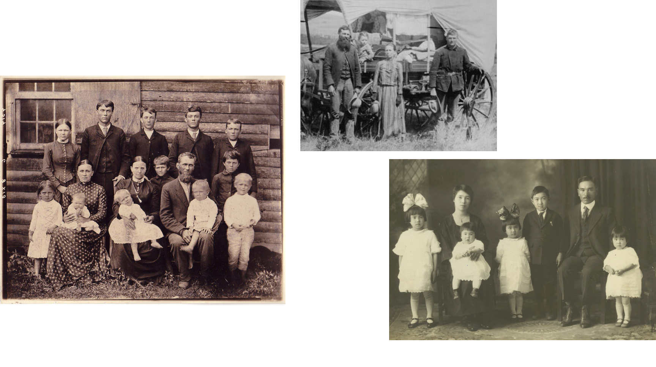
Those Who Have Gone Before
D&C 138:57

Slide 26

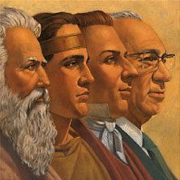
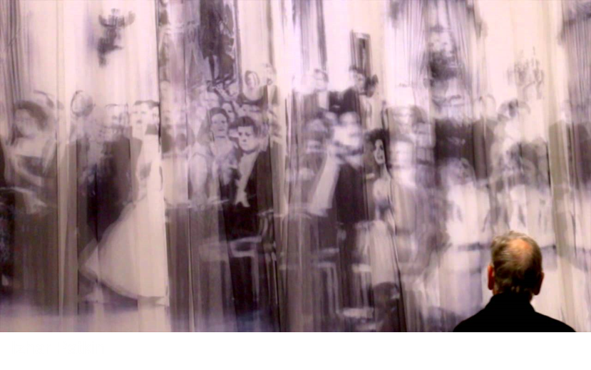
In the Presence of the Divine
“We Are in the Presence of Heavenly Beings.”
“Sometimes the Lord expands our vision from this point of view and this side of the veil, so that we feel and seem to realize that we can look beyond the thin veil which separates us from that other sphere.
“If we can see, by the enlightening influence of the Spirit of God and through the words that have been spoken by the holy prophets of God, beyond the veil that separates us from the spirit world, surely those who have passed beyond can see more clearly through the veil back here to us than it is possible for us to see to them from our sphere of action.”
Joseph F. Smith

Slide 27
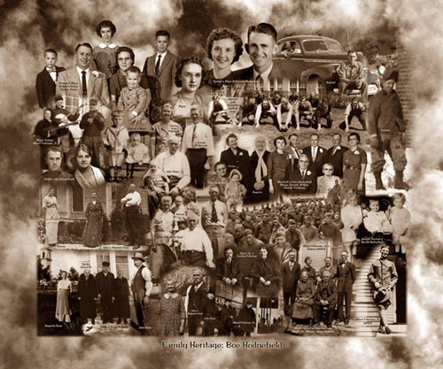
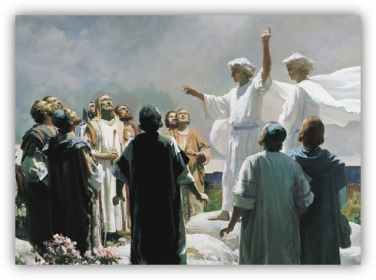
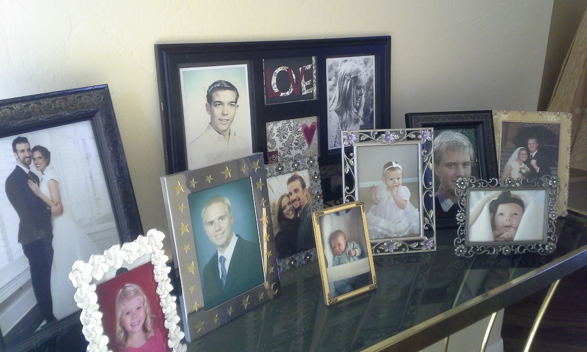
“I believe we move and have our being in the presence of heavenly messengers and of heavenly beings.
“We are not separate from them. We begin to realize, more and more fully, as we become acquainted with the principles of the gospel, as they have been revealed anew in this dispensation, that we are closely related to our kindred, to our ancestors, to our friends and associates and co-laborers who have preceded us into the spirit world.
“We can not forget them; we do not cease to love them; we always hold them in our hearts, in memory, and thus we are associated and united to them by ties that we can not break, that we can not dissolve or free ourselves from.”
Joseph F. Smith

Slide 28


“If this is the case with us in our finite condition, surrounded by our mortal weaknesses, short-sightedness, lack of inspiration and wisdom, from time to time, how much more certain it is and reasonable and consistent to believe that those who have been faithful,…
…who have gone beyond and are still engaged in the work for the salvation of the souls of men, the opening of the prison doors to them that are bound, and proclaiming liberty to the captives, can see us better than we can see them; that they know us better than we know them.”
Joseph F. Smith

Slide 29
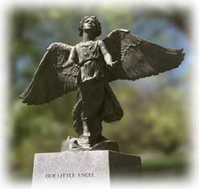

The Christmas Box Angel
“They have advanced; we are advancing; we are growing as they have grown; we are reaching the goal that they have attained unto; and therefore, I claim that we live in their presence, they see us, they are solicitous for our welfare, they love us now more than ever.
“For now they see the dangers that beset us; they can comprehend, better than ever before, the weaknesses that are liable to mislead us into dark and forbidden paths.
They see the temptations and the evils that beset us in life and the proneness of mortal beings to yield to temptation and to wrong doing; hence their solicitude for us, and their love for us, and their desire for our well being, must be greater than that which we feel for ourselves.”
Joseph F. Smith

Slide 30
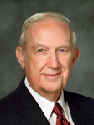
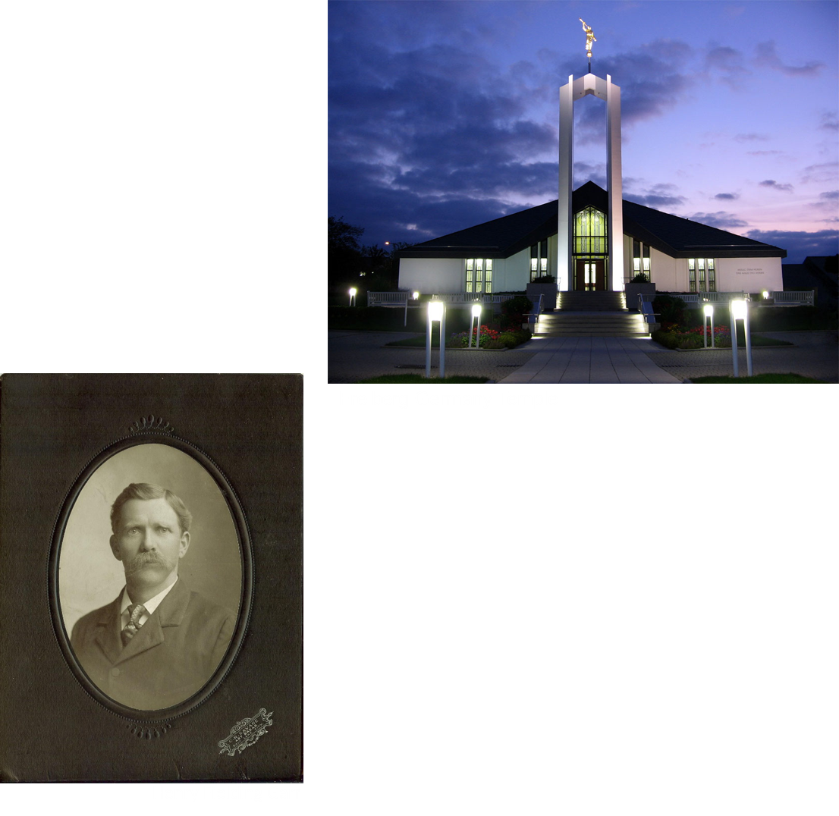
“Any work you do in the temple is time well spent, but receiving ordinances vicariously for one of your own ancestors will make the
time in the temple more
sacred, and even greater
blessings will be received.”
Elder Richard G. Scott

Slide 31
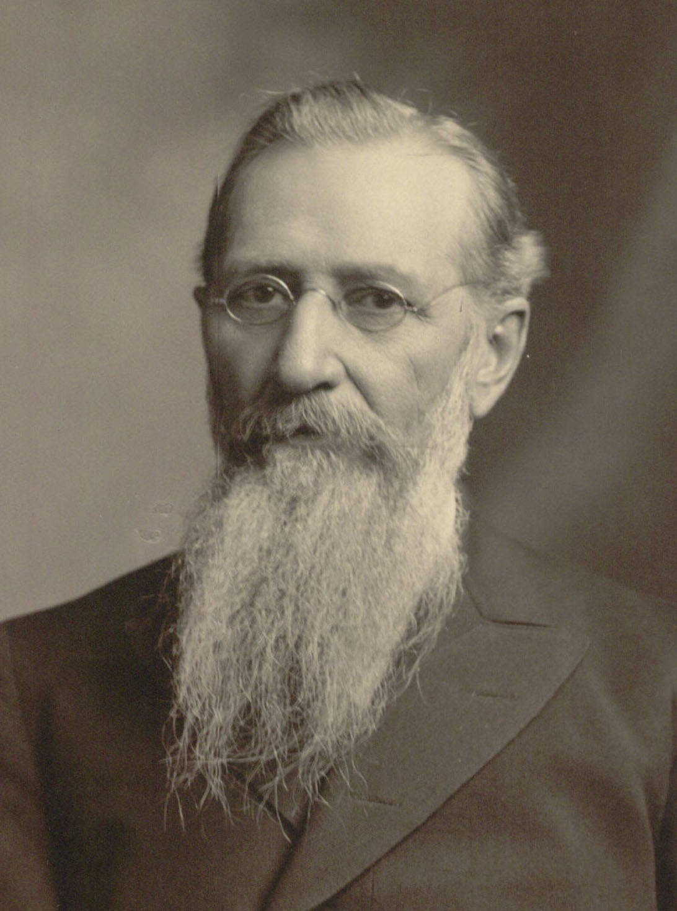
Thus was the vision of the redemption of the dead revealed to me, and I bear record, and I know that this record is true, through the blessing of our Lord and Savior, Jesus Christ, even so. Amen.
D&C 138:60

Slide 32


In Memory of:
Carson Lee Tate
February 22, 1997-November 5, 2017
Carson our dear grandson, son, brother, nephew and friend; you will be sorely missed by all who know and love you. It feels as though a part of us is missing. Fly high into God's open arms and find peace and joy with him. May God bless and keep you. May your memory be eternal.

Slide 33
Sources:
Videos:
The Lord Speaks through the Scriptures (2:11)
To This End Was I Born (27:11)
A Visit from Father (3:20)
“Ministry of Joseph F. Smith: A Vision of the Redemption of the Dead” (3:06).
George S. Tate I Saw the Hosts of the Dead December 2009 Ensign
Gospel Fundamentals Chapter 35: Life After Death
Elder D. Todd Christofferson (“When Thou Art Converted,” Ensign or Liahona, May 2004, 11).
Elder David A. Bednar (“We Believe in Being Chaste,” Ensign or Liahona, May 2013, 41, 43).
Joseph Fielding McConkie and Craig J. Ostler Revelations of the Restoration pg. 1147
President Wilford Woodruff (In Journal of Discourses, 22:334.)
Joseph F. Smith Improvement Era 19:646-652, May, 1916.
Presentation by ©http://fashionsbylynda.com/blog/
Gospel Principles Chapter 41The Postmortal Spirit World (see also: Teachings of Presidents of the Church: Joseph F. Smith[1998], 131–32).
Elder Richard G. Scott (“The Joy of Redeeming the Dead,” Ensign or Liahona, Nov. 2012, 93–94).
Elder David A. Bednar “That we Might Have Joy” December 4, 2018 BYU Devotional: https://speeches.byu.edu/talks/david-a-bednar/that-they-might-have-joy/
Presentation by ©http://fashionsbylynda.com/blog/

Slide 34
Joseph F. Smith
“As most of you, I suppose, are aware, I have been undergoing a siege of very serious illness for the last five months. It would be impossible for me, on this occasion, to occupy sufficient time to express the desires of my heart and my feelings, as I would desire to express them to you, but I felt that it was my duty, if possible, to be present. …
“… Although somewhat weakened in body, my mind is clear with reference to my duty, and with reference to the duties and responsibilities that rest upon the Latter-day Saints; and I am ever anxious for the progress of the work of the Lord, for the prosperity of the people of the Church of Jesus Christ of Latter-day Saints throughout the world. …
“I will not, I dare not, attempt to enter upon many things that are resting upon my mind this morning, and I shall postpone until some future time, the Lord being willing, my attempt to tell you some of the things that are in my mind, and that dwell in my heart. I have not lived alone these five months. I have dwelt in the spirit of prayer, of supplication, of faith and of determination; and I have had my communication with the Spirit of the Lord continuously.” (In Conference Report, Oct. 1918, p. 2.)
Flu Epidemic of 1918:
Many more deaths were soon to follow, unrelated to battle. There were so many, in fact, that the horrific losses of the previous four years of war would be multiplied several times within a short period by the pandemic of 1918. The new killer was a flu virus more virulent than any ever known, the cause of the pandemic of 1918. In the United States alone, the month of October 1918—the period between the vision of October 3 and its formal acceptance on October 31—was the deadliest month in the nation’s history.
Although Utah was less devastated than were the larger urban areas, by October 9 cases of the flu had grown so alarmingly that the order was given to cease all public gatherings.
The Armistice was declared on November 11. A few days later, on November 19, just after his 80th birthday, President Smith died. Because of the pandemic, no public funeral services were held. A month later, with the flu still raging, Church leaders designated December 22 as a day of fasting “for the arrest and speedy suppression by Divine Power of the desolating scourge that is passing over the earth.” ⁸ Shortly thereafter the pandemic seemed to have passed its crest, and the decision was made to resume church services on January 5. But a further wave of the epidemic in the spring caused the April general conference to be postponed until June.
In the United States, the average life expectancy dropped by 12 years between 1917 and 1918. Worldwide, the death toll was staggering: at least 50 million. ⁹ According to historian Alfred Crosby, “Nothing else—no infection, no war, no famine—has ever killed so many in as short a period.” George S. Tate Ensign Dec 2009
Hyrum Mack Smith (March 21, 1872 – January 23, 1918) was a member of the Quorum of the Twelve Apostles of The Church of Jesus Christ of Latter-day Saints (LDS Church).
Smith was born in Salt Lake City, Utah Territory, the eldest son of church apostle and future church president Joseph F. Smith and Edna Lambson. Smith was named after his paternal grandfather Hyrum Smith, who was the elder brother of LDS Church founder Joseph Smith and a prominent leader of the early church.
Smith attended Latter-day Saint College, from which he graduated in 1894. On November 15, 1895, he married Ida Elizabeth Bowman and the next day left her behind in Utah to serve a mission in Great Britain. From October 1896 until February 1898, Smith presided over the Newcastle Conference.
After returning from his mission, Smith worked at ZCMI while also serving as a part-time missionary in Salt Lake City.
Smith was ordained an apostle of the church on October 24, 1901, at the age of 29, by his father, who was president of the church. Smith was the first apostle of the church ordained in the 20th century.
In 1913, Smith was called as the president of the European Mission of the church. He served in this capacity until 1916, when the activities of the mission were suspended due to World War I.
Smith and his wife had five children, one of whom was Joseph Fielding Smith, who became presiding patriarch of the church. Another of Smith's children was Geraldine Smith, the mother of M. Russell Ballard, and apostle of the LDS Church.
Smith wrote a commentary on the Doctrine and Covenants with Janne M. Sjödahl.
Smith died in Salt Lake City from a ruptured appendix at the age of 45. He was buried at Salt Lake City Cemetery. Wikipedia

Slide 35
President Smith wrote the following in a letter to his wife Edna when his firstborn child, Mercy Josephine, died when she was not quite three years old.
“I scarcely dare to trust myself to write, even now my heart aches, and my mind is all chaos; if I should murmur, may God forgive me, my soul has been and is tried with poignant grief, my heart is bruised and wrenched almost asunder. I am desolate, my home seems desolate and almost dreary, yet here are my family and my little babe; yet I cannot help but feel that the tenderest, sweetest and yet the strongest cord that bound me to home and earth is severed, my babe, my own sweet Dodo is gone! I can scarcely believe it and my heart asks, can it be? I look in vain, I listen, no sound, I wander through the rooms, all are vacant, lonely, desolate, deserted. I look down the garden walk, peer around the house, look here and there for a glimpse of a little golden, sunny head and rosy cheeks, but no, alas, no pattering little footsteps. No beaming little black eyes sparkling with love for papa; no sweet little enquiring voice asking a thousand questions, and telling pretty little things, prattling merrily, no soft little dimpled hands clasping me around the neck, no sweet rosy lips returning in childish innocence my fond embrace and kisses, but a vacant little chair. Her little toys concealed, her clothes put by, and only the one desolate thought forcing its crushing leaden weight upon my heart—she is not here, she is gone! But will she not come back? She cannot leave me long, where is she? I am almost wild, and O God only knows how much I loved my girl, and she the light and the joy of my heart.
“The morning before she died, after being up with her all night, for I watched her every night, I said to her, ‘My little pet did not sleep all night.’ She shook her head and replied, ‘I’ll sleep today, papa.’ Oh! how those little words shot through my heart. I knew though I would not believe, it was another voice, that it meant the sleep of death and she did sleep. And, Oh! the light of my heart went out. The image of heaven graven in my soul was almost departed” (in Joseph Fielding Smith, Life of Joseph F. Smith[1938], 455–56).
Those who obtain their exaltation will have the privilege of having spirit children in the eternities.
To receive this blessing, they must have resurrected, glorified bodies.
Elder Melvin J. Ballard taught:
“Those who are denied endless increase cannot be what God is because that, in connection with other things, makes Him God. …
“… through the righteousness and faithfulness of men and women who keep the commandments of God they will come forth with celestial bodies, fitted and prepared to enter into their great, high and eternal glory in the celestial kingdom of God; and unto them, through their preparation, there will come spirit children. …
“… When the power of endless increase shall come to us, and our offspring grow and multiply through ages that shall come, they will be in due time, as we have been, provided with an earth like this wherein they too may obtain earthly bodies and pass through all the experiences through which we have passed. … We shall stand in our relationship to them as God our Eternal Father does to us, and thereby this is the most glorious and wonderful privilege that ever will come to any of the sons and daughters of God.” (Melvin J. Ballard, pp. 211–12.)

Slide 36
Joseph F. Smith on those who have passed away:
“Now, among all these millions of spirits that have lived on the earth and have passed away, from generation to generation, since the beginning of the world, without knowledge of the gospel—among them you may count that at least one-half are women. Who is going to preach the gospel to the women? Who is going to carry the testimony of Jesus Christ to the hearts of the women who have passed away without a knowledge of the gospel? Well, to my mind it is a simple thing. These good sisters who have been set apart, ordained to the work, called to it, authorized by the authority of the Holy Priesthood to minister for their sex, in the House of God for the living and for the dead, will be fully authorized and empowered to preach the gospel and minister to the women while the Elders and Prophets are preaching it to the men. … Those who are authorized to preach the gospel here and are appointed here to do that work will not be idle after they have passed away, but will continue to exercise the rights that they obtain here under the Priesthood of the Son of God to minister for the salvation of those who have died without a knowledge of the truth.” (Gospel Doctrine, pp. 460–61.)
Spirits of the Wicked when they die:
“And then shall it come to pass, that the spirits of the wicked, yea, who are evil—for behold, they have no part nor portion of the Spirit of the Lord; for behold, they chose evil works rather than good; therefore the spirit of the devil did enter into them, and take possession of their house—and these shall be cast out into outer darkness; there shall be weeping, and wailing, and gnashing of teeth, and this because of their own iniquity, being led captive by the will of the devil.
Spirit Prison:
Also in the spirit prison are those who rejected the gospel after it was preached to them either on earth or in the spirit prison. These spirits suffer in a condition known as hell. They have removed themselves from the mercy of Jesus Christ, who said, “Behold, I, God, have suffered these things for all, that they might not suffer if they would repent; but if they would not repent they must suffer even as I; which suffering caused myself, even God, the greatest of all, to tremble because of pain, and to bleed at every pore, and to suffer both body and spirit” (D&C 19:16–18). After suffering for their sins, they will be allowed, through the Atonement of Jesus Christ, to inherit the lowest degree of glory, which is the telestial kingdom.
The Christmas Box Angel Statue was introduced to the world in the book The Christmas Box, a worldwide bestseller and hit television movie by author Richard Paul Evans. In the book, a woman mourns the loss of her child at the base of an angel monument. Though the story is mostly fiction, the angel monument once existed but is speculated to have been destroyed. The new angel statue was commissioned by Richard Paul Evans, in response to reports that grieving parents were seeking out the angel as a place to grieve and heal. The monument was dedicated on December 6, 1994-corresponding with the date of the child’s death in The Christmas Box.
The Christmas Box Angel Statue is dedicated to all parents who have lost a child.
The original angel monument as referred to in the book no longer exists at the Salt Lake City Cemetery, but was located in the area north of the cemetery office. It was an actual gravestone for a child with the words "Our Little Angel" inscribed on the headstone. The headstone wCemetery butyed approximately 1984.
Search your ancestors:
“Do you young people want a sure way to eliminate the influence of the adversary in your life? Immerse yourself in searching for your ancestors, prepare their names for the sacred vicarious ordinances available in the temple, and then go to the temple to stand as proxy for them to receive the ordinances of baptism and the gift of the Holy Ghost. As you grow older, you will be able to participate in receiving the other ordinances as well. I can think of no greater protection from the influence of the adversary in your life” Elder Richard G. Scott (“The Joy of Redeeming the Dead,” Ensign or Liahona, Nov. 2012, 94).

