Slide 1
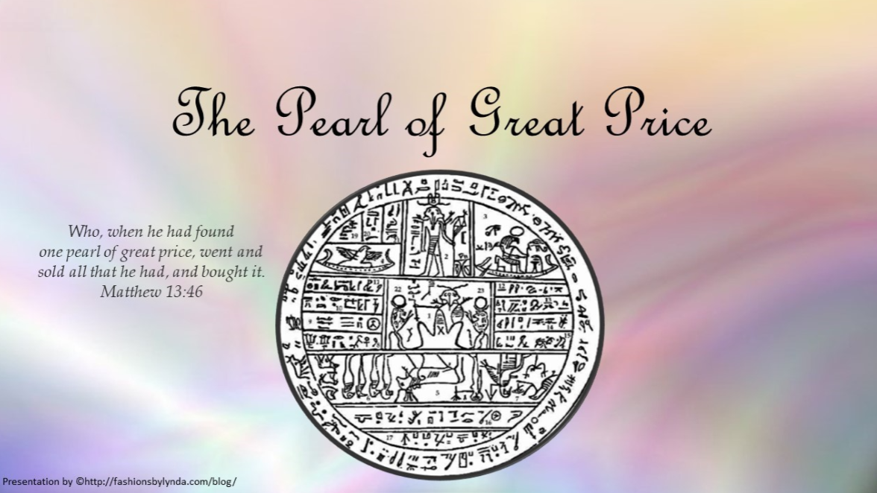

Slide 2

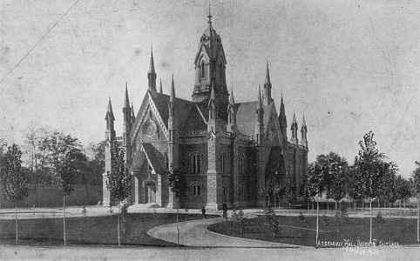

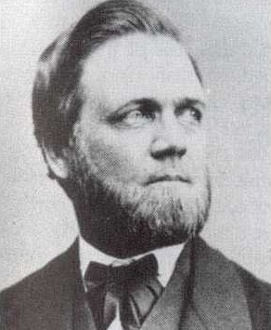
The Pearl of Great Price
In 1851, Elder Franklin D. Richards, a member of the Quorum of the Twelve Apostles and the president of the British Mission, published several revelations, translations, and writings of Joseph Smith and called the collection the Pearl of Great Price.
Assembly Hall 1888—finished in 1880
During a general conference of the Church in October 1880, the Church accepted the Pearl of Great Price as scripture—part of the standard works.
“The Pearl of Great Price is a selection of choice materials touching many significant aspects of the faith and doctrine of The Church of Jesus Christ of Latter-day Saints”
Introduction to the Pearl of Great Price

Slide 3

Origin of the Name
A pearl is produced inside an oyster as the oyster responds to the irritation of foreign matter, such as a grain of sand. The oyster produces a substance to surround the grain, which eventually forms a pearl. Natural pearls are rare and are considered precious.

Slide 4
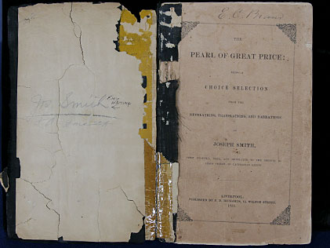
Purpose of the Articles
To make more readily accessible some important articles that had had limited circulation in the time of Joseph Smith.
As Church membership increased throughout Europe and America, there was a need to make these items available.
The Pearl of Great Price received wide use and subsequently became a standard work of the Church by action of the First Presidency and the general conference in Salt Lake City on October 10, 1880.

Slide 5
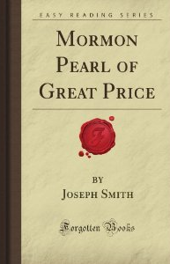
What is in the Book?
The Book of Moses or Selections from the Book of Moses consists of several revelations given to Joseph Smith while he was revising the Bible under inspiration, beginning in June 1830.
The Book of Abraham contains writings of Abraham, and it is a translation from some Egyptian papyri that the Church obtained in 1835. It includes a record of the life of the patriarch Abraham and also a description of the creation of the world that is similar to that recorded in Genesis and in the Book of Moses.
Joseph Smith-Matthew is an extract from the testimony of Matthew taken from Joseph Smith's translation of the Bible.
Joseph Smith-History includes excerpts from Joseph Smith's official testimony and history, which he prepared in 1838.
The Articles of Faith of The Church of Jesus Christ of Latter-day Saints include thirteen untitled statements previously published in the Times and Seasons in March 1842.
Mormonwiki

Slide 6

Revisions
Several revisions have been made in the contents as the needs of the Church have required.
1878
1902
1921
1976
1979
Certain parts of Pearl of Great Price that were duplicated and published in D&C were omitted and Arrangements into chapters and verse, with footnotes
Double-column pages with index
Two items of revelation were added
The items removed were placed in
D&C 137 and 138
Portions of Book of Moses not contained in first edition were added

Slide 7
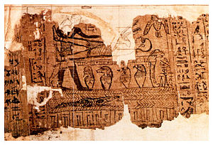
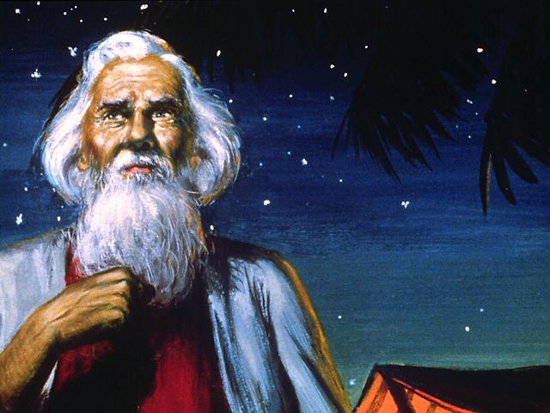
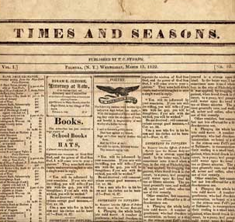
Book of Abraham
Joseph Smith began the translation in 1835 after obtaining some Egyptian papyri.
The Book of Abraham. An inspired translation of the writings of Abraham.
The translation was published serially in the Times and Seasons beginning March 1, 1842, at Nauvoo, Illinois.

Slide 8
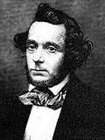
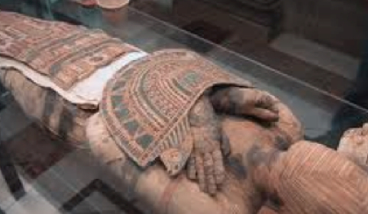
Egyptian Mummies
“On 3 July 1835 a man named Michael Chandler brought four Egyptian mummies and several papyrus scrolls of ancient Egyptian writings to Kirtland, Ohio. The mummies and papyri had been discovered in Egypt several years earlier by Antonio Lebolo.
Antonio Lebolo.
Kirtland was one of many stops in the eastern United States for Chandler’s mummy exhibition. Chandler was offering the mummies and rolls of papyrus for sale and, at the urging of the Prophet Joseph Smith, several members of the Church donated money to purchase them. In a statement dated 5 July 1835, Joseph Smith, declaring the importance of these ancient Egyptian writings, recorded: ‘I commenced the translation of some of the characters or hieroglyphics, and much to our joy found that one of the rolls contained the writings of Abraham. …
History of the Church

Slide 9
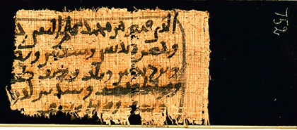
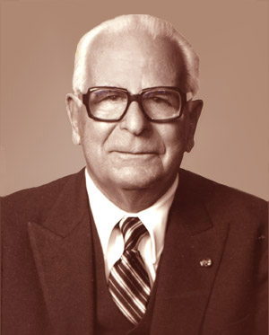
Egyptian Papyrus
These records had been acquired in 1835 when the Church purchased several rolls of ancient Egyptian papyrus from Michael Chandler.
In 1967 eleven fragments of the Joseph Smith papyri were rediscovered by Doctor Aziz S. Atiya, in the New York Metropolitan Museum of Art. Studies of them have confirmed that they are mainly ancient Egyptian funerary texts of the sort commonly buried with royalty and nobility and designed to guide them through their eternal journeyings. This has renewed the question about the connection between the records and the book of Abraham.
Joseph Smith did not explain the
method of translating the book of
Abraham, just as he did not explain
fully how the Book of Mormon was
translated. Nevertheless, like the
Book of Mormon, the book of
Abraham is its own evidence that
it came about through the gift and
power of God.
Extracts from the book of Abraham appeared first in the Times and Seasons and in the Millennial Star in the summer of 1842. Joseph Smith indicated that more would be forthcoming, but he was unable to continue the translation after 1842. What the Church received—five chapters of the book of Abraham in the Pearl of Great Price—is only a portion of the original record.

Slide 10
An Interview
Why did Joseph Smith say he had translated the writings of Abraham even though the manuscripts do not date from Abraham’s time?
“The Prophet Joseph Smith never claimed the papyri were indeed the writings of Abraham. He said the book of Abraham was “a translation of some ancient Records that have fallen into our hands, from the Catacombs of Egypt, purporting to be the writings of Abraham, while he was in Egypt.”
Times and Seasons
“In 1966 eleven fragments of papyri once possessed by the Prophet Joseph Smith were discovered in the Metropolitan Museum of Art in New York City. They were given to the Church and have been analyzed by scholars who date them between about 100 B.C. and A.D. 100. A common objection to the authenticity of the book of Abraham is that the manuscripts are not old enough to have been written by Abraham, who lived almost two thousand years before Christ. Joseph Smith never claimed that the papyri were autographic (written by Abraham himself), nor that they dated from the time of Abraham. It is common to refer to an author’s works as ‘his’ writings, whether he penned them himself, dictated them to others, or others copied his writings later.”
(The Pearl of Great Price Student Manual, 28).

Slide 11
What did Joseph Smith do with his translation?
“The book of Abraham was originally published a few excerpts at a time in Times and Seasons, a Church publication, beginning in March 1842 at Nauvoo, Illinois (see [the introduction] at the beginning of the Pearl of Great Price). The Prophet Joseph Smith indicated that he would publish more of the book of Abraham later, but he was martyred before he was able to do so. Concerning the potential length of the completed translation, Oliver Cowdery once said that ‘volumes’ would be necessary to contain it.”
Messenger and Advocate,Dec. 1835, 236).
“In addition to hieroglyphic writings, the manuscript also contained Egyptian drawings. On 23 February 1842, the Prophet Joseph Smith asked Reuben Hedlock, a professional wood engraver and member of the Church, to prepare woodcuts of three of those drawings so they could be printed. Hedlock finished the engravings in one week, and Joseph Smith published the copies (facsimiles) along with the book of Abraham. Joseph Smith’s explanations of the drawings accompany the facsimiles.”
(The Pearl of Great Price Student Manual, 28–29).

Slide 12
What happened to the mummies and the papyri?
“After the death of the Prophet Joseph Smith, the four mummies and the papyri became the property of Joseph’s widowed mother, Lucy Mack Smith” (The Pearl of Great Price Student Manual, 29). After Lucy Mack Smith died, the collection was sold to a man named Abel Combs. The collection may have been sold by Joseph Smith’s wife Emma, or it may have been sold by his brother William. Mr. Combs sold some of the collection to a museum in St. Louis, Missouri. He retained other portions and later gave some of them away.”
(See The Pearl of Great Price Student Manual, 29; H. Donl Peterson, The Story of the Book of Abraham: Mummies, Manuscripts, and Mormonism [1995], 204–9, 257.)
“Several theories have been offered regarding what happened … to the mummies and the papyri. It appears that at least two of the mummies were burned in the great Chicago fire of 1871.”
(see B. H. Roberts, New Witnesses for God, 3 vols. [1909–11], 2:380–382).

Slide 13
“In the early spring of 1966, Dr. Aziz S. Atiya, a University of Utah professor, [brought to the attention of the Church several fragments of the Joseph Smith papyri that were located] at the Metropolitan Museum of Art in New York City. These fragments were presented to the Church by the director of the museum on 27 November 1967. The current whereabouts of the other mummies and the other portions of the papyri are unknown.
Studies in Scripture

Slide 14
“The Prophet Joseph Smith never communicated his method of translating these records. As with all other scriptures, a testimony of the truthfulness of these writings is primarily a matter of faith. The greatest evidence of the truthfulness of the book of Abraham is not found in an analysis of physical evidence nor historical background, but in prayerful consideration of its content and power”
Although we do not know the exact method Joseph Smith used to translate the writings, we do know that he translated the book of Abraham by the gift and power of God.
The Pearl of Great Price Student Manual, 28

Slide 15

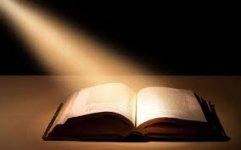
Book of Matthew
Joseph Smith—Matthew. An extract from the testimony of Matthew in Joseph Smith’s translation of the Bible (see Doctrine and Covenants 45:60–61 for the divine injunction to begin the translation of the New Testament).

Slide 16


Joseph Smith History
Joseph Smith—History. Excerpts from Joseph Smith’s official testimony and history, which he and his scribes prepared in 1838–1839 and which was published serially in the Times and Seasons in Nauvoo, Illinois, beginning on March 15, 1842.

Slide 17
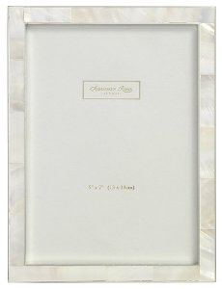
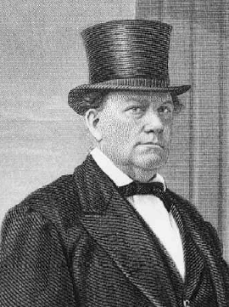
Articles of Faith
Joseph Smith wrote a letter to John Wentworth, editor and proprietor of the Chicago Democrat, an Illinois newspaper. In the letter the Prophet Joseph Smith gave an account of the doctrines and history of the Latter-day Saints. The Articles of Faith were a part of that letter. For the text of the entire letter.
The Articles of Faith of The Church of Jesus Christ of Latter-day Saints. A statement by Joseph Smith published in the Times and Seasons March 1, 1842, in company with a short history of the Church that was popularly known as the Wentworth Letter.
Ensign July 2002

Slide 18
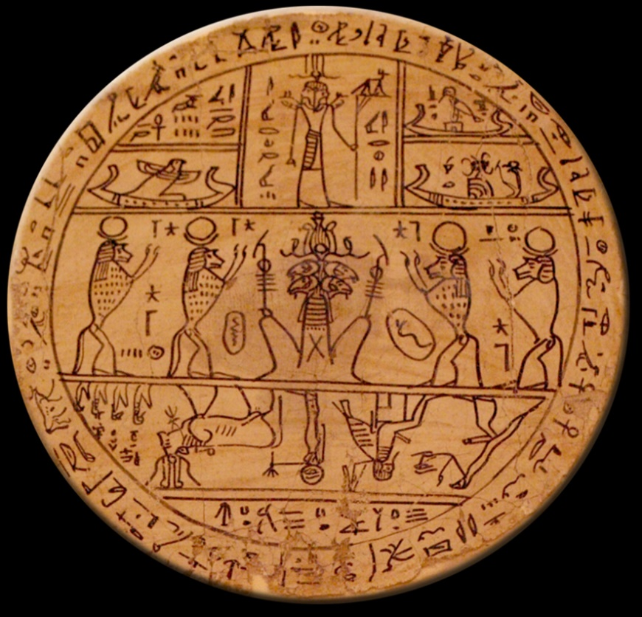
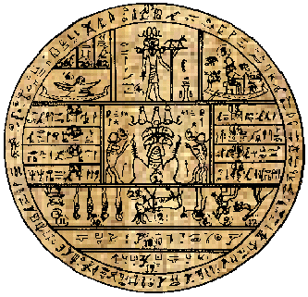
The Pearl of Great Price is evidence that Joseph Smith was a prophet, seer, and revelator
Hypocephalus of B’nai-Amen
A hypocephalus similar to one originally in the Smith collection, but now lost.

Slide 19
Sources:
Video:
The Doctrines and Principles Contained in the Articles of Faith (2:47)
First Vision Accounts: Joseph Smith, “Church History,” 1 March 1842 (Wentworth Letter) (2:37)
Introduction to the Pearl of Great Price
http://nephicode.blogspot.com/2013/02/the-book-of-abraham-and-facsimile-image.html
Church History in the Fulness of Time Student Manual Chapter 20
Presentation by ©http://fashionsbylynda.com/blog/
History of the Church, 2:236)” (The Pearl of Great Price Student Manual [Church Educational System manual, 2000], 28).
History of the scriptures:
https://www.lds.org/scriptures/pgp/introduction?lang=eng https://tech.lds.org/blog/606-the-history-of-ldsorg-shows-gods-hands-part-2
(Times and Seasons, Mar. 1, 1842, 704).
[see H. Donl Peterson, “Some Joseph Smith Papyri Rediscovered (1967),” in Studies in Scripture, Volume Two: The Pearl of Great Price, ed. Robert L. Millett and Kent P. Jackson (1985), 183–85]” (The Pearl of Great Price Student Manual, 29).
Studies in Scripture, Volume Two: The Pearl of Great Price, ed. Robert L. Millett and Kent P. Jackson (1985), 183–85]” (The Pearl of Great Price Student Manual, 29).
“The Wentworth Letter,” Ensign, July 2002, 26–32
Presentation by ©http://fashionsbylynda.com/blog/

Slide 20
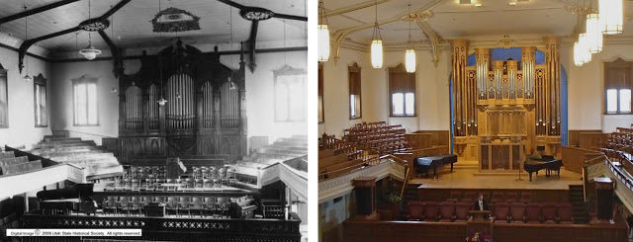
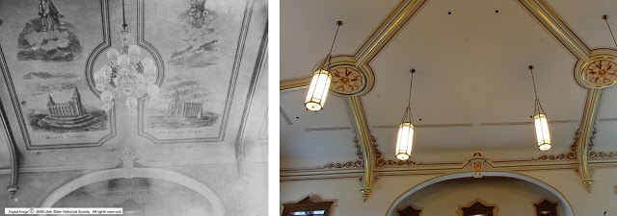
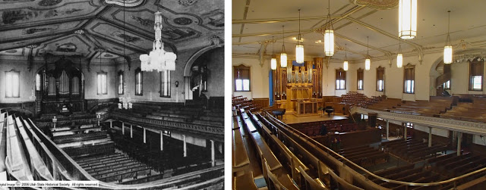
The Assembly Hall (c. 1888), on Temple Square in Salt Lake City, has been used for over a century for Church meetings, conferences, firesides, public lectures, and concerts. Photographer: C. R. Savage.
Finding ample meeting space was a constant struggle for the early members of The Church of Jesus Christ of Latter-Day Saints (also referred to as the LDS or Mormon church). After building multiple tabernacles and boweries, the pioneers finally constructed the Tabernacle which currently sits on Temple Square in Salt Lake City. The Tabernacle could not be adequately heated during the winter and consequently in 1877 the old (or adobe) tabernacle was demolished Consequently, construct the Assembly Hall.
The Assembly Hall was built mostly using left over granite from the Salt Lake Temple. Unlike the Temple, the granite for the Assembly Hall was not finished nor polished which gives it a rougher, gray appearance. Construction continued for 3 years, and the building was dedicated in 1882.
During construction, the building was often referred to as the "new tabernacle." Then president of the LDS church John Taylor corrected the confusion by naming it the "Salt Lake Assembly Hall" in 1879. Every member of the Latter-day Saint community was asked to contribute the equivalent of one day's pay or one day's labor to the construction of the building. The building originally was meant to hold around 3,000, but it currently only sits around 1,400, less that the old, adobe tabernacle that was razed. People from Provo may recognize the building because the Assembly Hall was used as a blueprint for later construction of the Provo Tabernacle.
The building has several architectural features that I have found confusing, one being the prominent star of David over the entrance. The year the building was finished, 1880, was the "jubilee year," or 50th anniversary of the founding of the LDS church. Consequently builders decided to incorporate the star in reference to the Israelite jubilee celebrations in the Old Testament. An additional oddity are the spires, several of which are truncated. These spires previously served as chimneys. Finally, I have often wondered about the incorporation of the large flowers around the ceiling. These flowers are sego lilies, the Utah state flower and an important food source for early pioneers. Murals of important figures and locations in the LDS church were previously painted on the ceiling, although these have since been removed.
Extensive renovations occurred between 1979 and 1983, which mainly consisted of making the building and its roof more structurally sound. Like the Tabernacle, the Assembly Hall has mainly served as a meeting hall and a location for musical concerts. It still fulfills that purpose today, serving as the location for the Temple Square Concert Series, meetings, and overflow for General Conference, a bi-annual LDS meeting.
http://utahspresenthistory.blogspot.com/2013/07/salt-lake-assembly-hall-at-temple-square.html

Slide 21
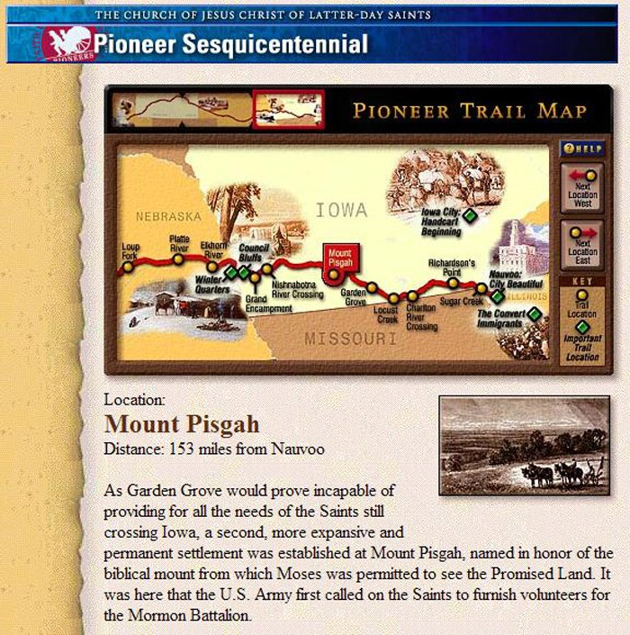
Wentworth Letters:
The Prophet was occasionally called on to explain the teachings and practices of Mormonism to outsiders. A significant example was the Wentworth Letter. In the spring of 1842, John Wentworth, editor of the Chicago Democrat, asked Joseph Smith to provide him with a sketch of “the rise, progress, persecution, and faith of the Latter-Day Saints.” Wentworth was originally from New Hampshire and desired this information to help in the compilation of a history of his native state, which was being written by his friend George Barstow. Joseph complied with this request and sent Wentworth a multi-page document containing an account of many of the early events in the history of the Restoration, including the First Vision and the coming forth of the Book of Mormon. The document also contained thirteen statements outlining Latter-day Saint beliefs, which have come to be known as the Articles of Faith. Barstow did publish his history, but the Wentworth Letter was not included, nor was anything about the Mormons.
Wentworth did not publish this document in the
Chicago Democrat, nor did it ever appear in any history of New Hampshire. But the Church’s newspaper, Times and Seasons, published it in March 1842, and it has become one of the most important statements of inspiration, history, and doctrine for the Church. The Articles of Faith were written for non-Mormons and were never intended to be a complete summary of gospel principles and practices. They do, however, provide a clear statement about the unique beliefs of the Latter-day Saints. Each article is a positive statement of the differences between Mormonism and the sectarian beliefs of other denominations.
In 1851 the Articles of Faith were included in the first edition of the Pearl of Great Price published in the British Mission. After the Pearl of Great Price was revised in 1878 and canonized in 1880, the Articles of Faith became official doctrine of the Church.
LDS Website:
By April of 1997 content was added to celebrate the pioneer sesquicentennial, including an interactive map. Until it was taken down in 2012, this was the oldest content on the website.

Slide 22
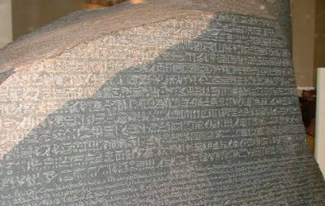
Several papyri and eleven mummies were discovered near the ancient Egyptian city of Thebes by Antonio Lebolo between 1818 and 1822, and around 1830, he arranged to have them sold. The mummies were shipped to Lebolo's nephew, Michael Chandler, in New York, in 1833. He spent two years touring the eastern United States, displaying and selling most of the mummies. In July 1835, Chandler brought the remaining four mummies and associated papyri to Kirtland, Ohio.
Even though the Rosetta Stone had been deciphered by Jean-Francois Champollion in 1822, the ability to read Egyptian was not well developed until the 1850s. Chandler asked Joseph Smith to look at the scrolls and give some insight into what was written on them because of his notoriety and claim to have translated the plates of the Book of Mormon. After examining the scrolls, Joseph, Simeon Andrews and Joseph Coe purchased the four mummies and at least five papyrus documents for $2,400.
With W.W. Phelps and Oliver Cowdery as scribes, Joseph translated some of the characters and hieroglyphics, and “much to our joy found that one of the rolls contained the writings of Abraham, another the writings of Joseph of Egypt.” He also said that “a more full account of which will appear in its place, as I proceed to examine or unfold them,” which was mostly translated in July and November of 1835, with some minor revisions in March 1842. Beginning October 1st of that year, Joseph had begun translating an alphabet to the Book of Abraham, and arranging a grammar of the Egyptian language as practiced by the ancients, which became known as the Kirtland Egyptian Alphabet and Grammar or the Kirtland Egyptian Papers. Also that year, the complete work was published serially in the Times and Seasons, and later canonized by the Church in 1880 as part of the Pearl of Great Price.
One of the outstanding doctrinal tenets in Abraham’s writing was the concept of God organizing eternal, pre-existing elements to create the universe instead of creating it ex nihilo (out of nothing), which was, and still is, most of the world’s view of the Creation. The papyri were thought lost in the 1871 Great Chicago Fire, but turned up in 1966 in several fragments found in the archives of the Metropolitan Museum of Art in New York, and in Church archives.
Critics of the Church and Egyptologists claim, upon examination of the papyri fragments, that the interpretation of the text bears no resemblance to the interpretation given by Joseph Smith, saying, in part, that Facsimile 1 is nothing more than common Egyptian funerary text, dating to about the first century B.C.
However, if you examine the Book of Abraham, you will notice a rather peculiar circumstance for what some allege to be an Egyptian work—that is, Egyptian elements are both limited and casually used, and found almost solely in the facsimiles. Yet, you would expect to find such Egyptian ideas to permeate such a pagan document if it were “merely an Egyptian funerary.” Take, for instance, the bizarre names in the explanation of Facsimile 1.2—which, for the most part, are a recognizable form of Hebrew, though they may be Hebrew adaptations of Egyptian words, as in the case of "Pharaoh." Likewise, Kolob is undoubtedly a rendering of Hebrew terminology. When these mysterious words are viewed in light of their Jewish origins, their significance becomes apparent, as do other curious components of the Book of Abraham.
Nephicode blogspot
The stone of black granite, bearing three inscriptions found at Rosetta, and is a fragment of a larger stele. The stone weighs 1700 pounds and is 45" by 28.5" and 11" thick, and contains a decree passed by a council of priests in 196 B.C., affirming the royal cult of the 13-year-old Ptolemy V on the first anniversary of his coronation. It was written in two languages, Egyptian and Greek, using three scripts (hieroglyphic, demotic and Greek), making its interpretation possible and opening the door to understanding Egyptian hieroglyphic writing for the first time since 400 A.D.
The Rosetta Stone was first discovered in 1799 during Napoleon's campaign in Egypt to protect French trading interests. When the war was lost to the English, the stone passed into British hands, and ended up in the New York Metropolitan Museum
The fact is, the Book of Abraham is an inspired document of the ancient prophet’s knowledge and understanding, his experiences as a youth, and the teachings the Lord inspired him to understand and write down. The exact details of how the Spirit worked on Joseph to interpret the papyri is unknown, and ultimately, unimportant—what is important is that we have that information that is critically important in understanding some of the deeper doctrines of God and those tenets we now have that helps us better understand the Universe and God’s working upon it.

Slide 23
Book of Mormon 1st European Edition
King James Bible
Oxford Edition
Book of Mormon 2nd Edition
Doctrine and Covenants 1st European Edition
Doctrine and Covenants
Orson Pratt Revision
Book of Commandments
1611
1830
1835
1840
1844
1851
1878
1769
1833
1837
1841
1845
1876
Doctrine and Covenants 1st Edition
Doctrine and Covenants 2nd Edition
King James Bible
1st Edition
Book of Mormon 1st Edition
And Joseph Smith’s Translation of the Bible
Book of Mormon 3rd Edition
Pearl of Great Price
Liverpool Edition
Pearl of Great Price
Utah Edition
History Timeline of Latter-day Saint Scriptures

Slide 24

Book of Mormon
Apostles Revision
First Radio Broadcast by Heber J. Grant
Broadcast of General Conference via Satellite
1st General Conference Broadcast outside of Utah (Radio and TV)
First Live Broadcast of General Conference via internet
Introduction to LDS Tools
1879
1921
1924
1952
1981
1997
2013
1920
1922
1941
1979
1996
1999
Standard Works
Scripture Publication Committee
Triple Combination Scripture Publication Committee
First Official Website of the Church
First General Conference Broadcast (Radio)
Weekly Broadcast began in July
Book of Mormon and Doctrine and Covenants
Orson Pratt Revision
Doctrine and Covenants
Apostles Revision
Priesthood Session carried via telephone to Stake Centers
Throughout the history of The Church of Jesus Christ of Latter-day Saints, leaders and members have reverenced the text of the scriptures and deepened their understanding by using study aids such as dictionaries, cross-references, and the historical information given in chapter and section headings. The scriptures as we know them today have undergone careful revisions and subtle improvements, introduced gradually through numerous editions.

