Slide 1
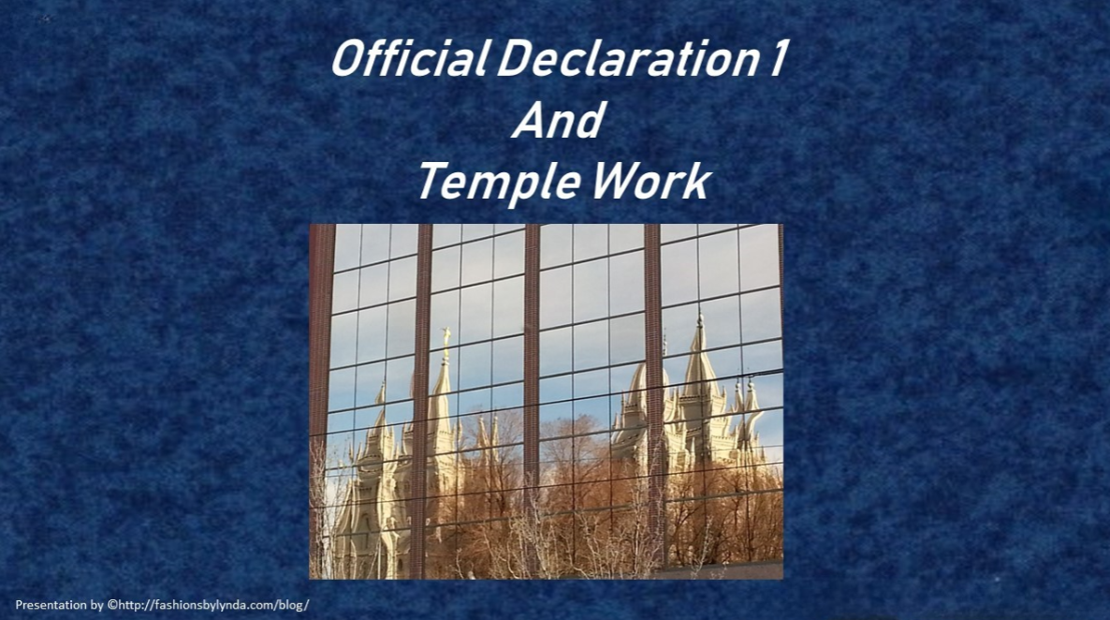

Slide 2

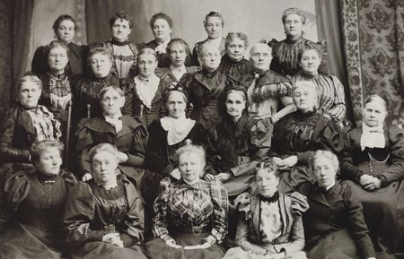
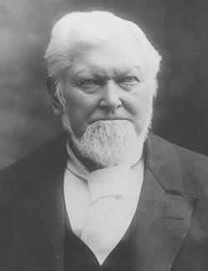
Practice of Plural Marriage
After the Prophet Joseph Smith received revelation directing him to teach the principle of plural marriage, some Church members began practicing plural marriage under his direction in the early 1840’s.
“After receiving revelation, President Wilford Woodruff issued the … Manifesto [Official Declaration 1], which was accepted by the Church as authoritative and binding on October 6, 1890. This led to the end of the practice of plural marriage in the Church.”

Slide 3
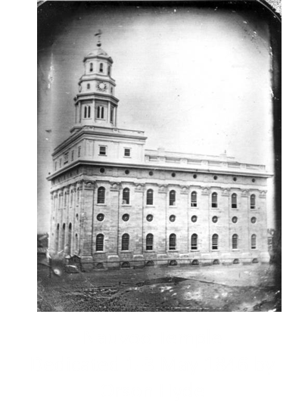
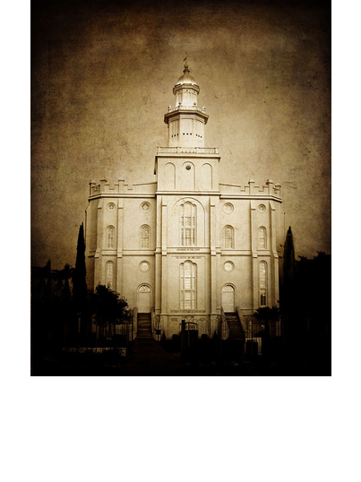
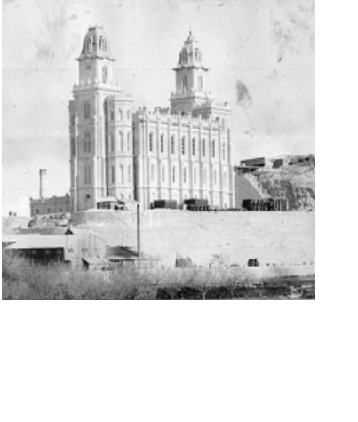
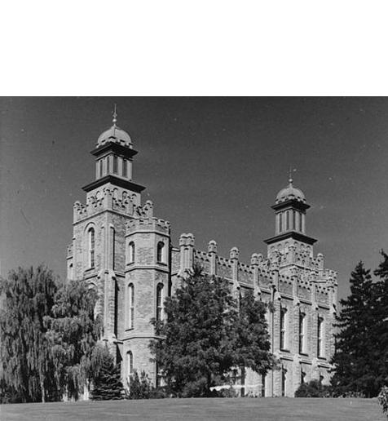
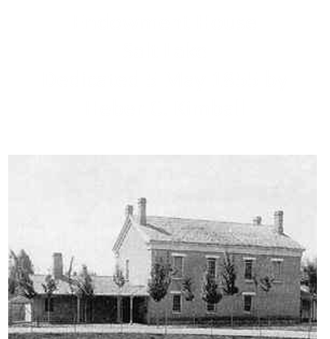
First Temples
Even while the Saints experienced opposition, they worked diligently to build temples, where they received saving ordinances for themselves and for the dead. They built and dedicated five temples between 1846 and 1893.

Slide 4
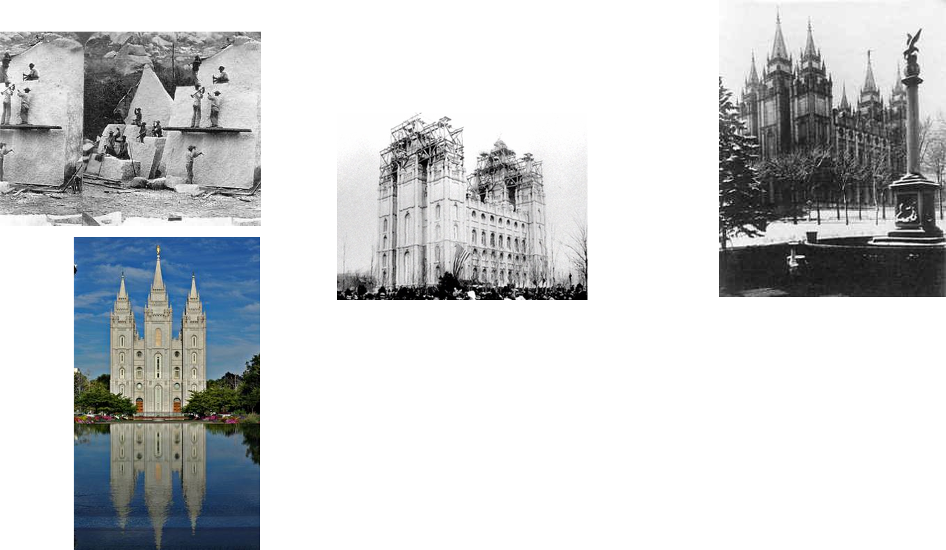
The 5th Temple
Salt Lake Temple
Dedicated 6-24 April 1893 by Wilford Woodruff
SYMBOLISM. Notable among all LDS temples, the Salt Lake Temple includes significant symbolism in its architecture. The six major towers and finial spires signify the restoration of priesthood authority. Earth stones, sun stones, moon stones, star stones, cloud stones penetrated with rays of light, the all-seeing eye, the clasped hands, Ursa Major pointing to the North Star, and the inscriptions "The House of the Lord" and "I Am Alpha and Omega" all appear on its exterior.

Slide 5
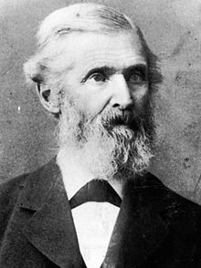
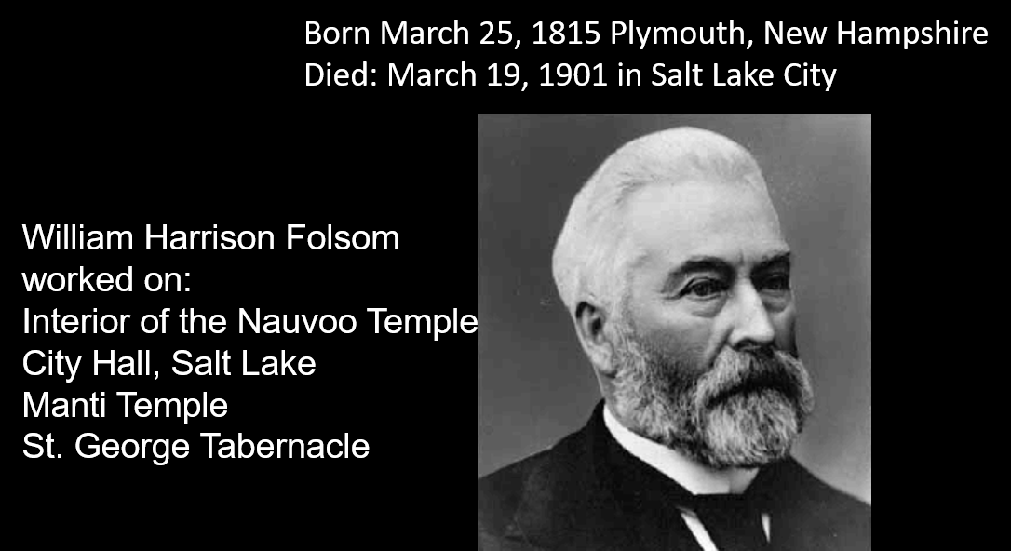
The Architects
Born June 5, 1810 in Providence, Rhode Island
Died: October 16, 1887 (age 77) in Salt Lake City, Utah
The architect did not live to see the completion of the beautiful Salt Lake Temple
Truman Osborn Angell designed the Salt Lake Temple, the Lion House, the Beehive House, the Utah Territorial Statehouse, the St. George Utah Temple, and Logan Temple
Both men work and designed many historical buildings in Utah

Slide 6
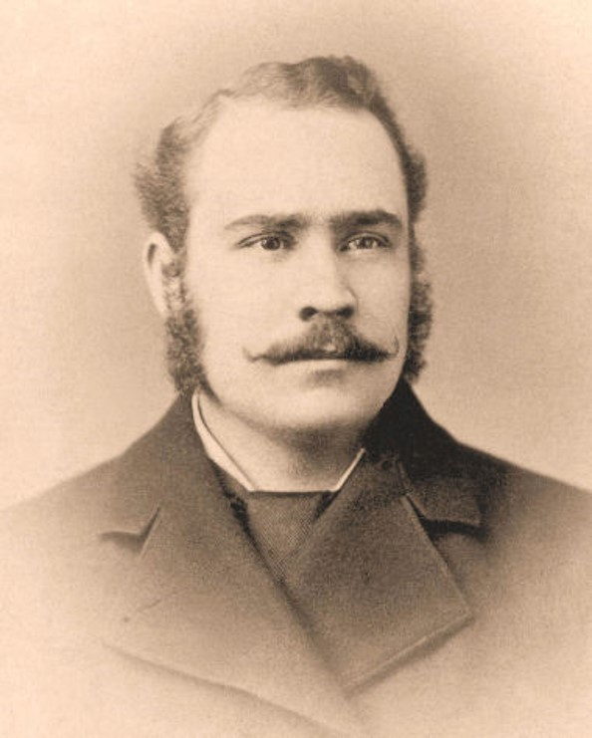
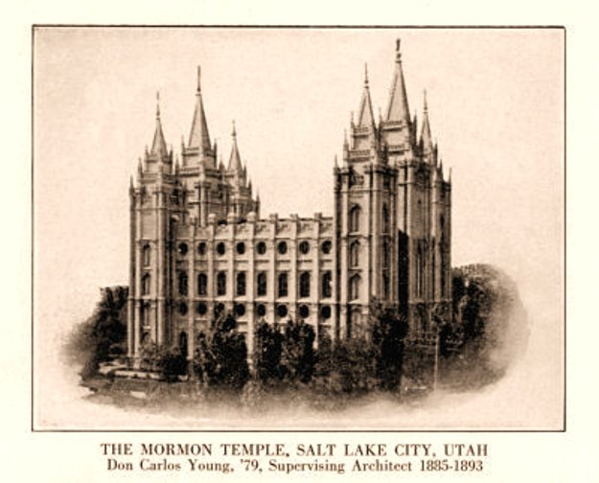
The Architects
Don Carlos Young, Jr. was born August 5, 1882 and died on December 8, 1960, both events in Salt Lake City, Utah.
The Salt Lake City Temple, considered a fine example of Romanesque Gothic architecture, was started by Truman O. Angell on April 6, 1853. Mr. Angell did not live to see his work completed and his assistant, Joseph Don Carlos Young, son of Brigham Young and architect of the Brigham Young Academy building, finished the project on April 6, 1893.
http://abc.eznettools.net/byhigh/History/Young/JosDonCarlosSr.html

Slide 7
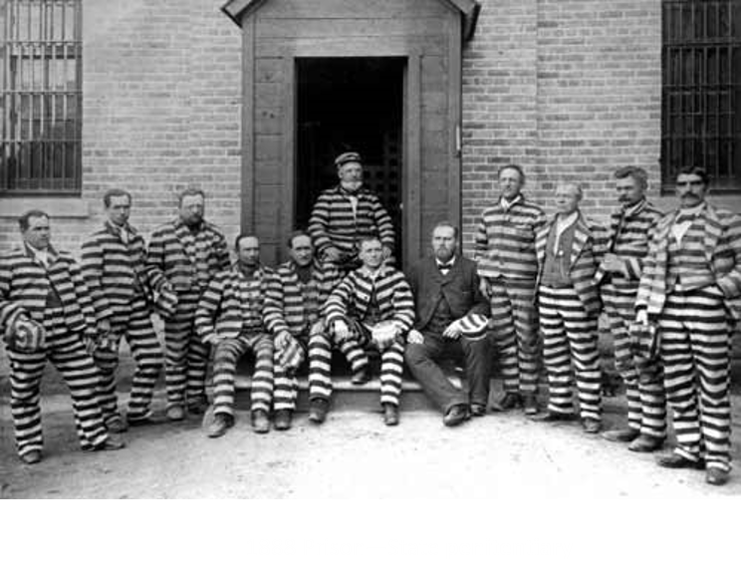
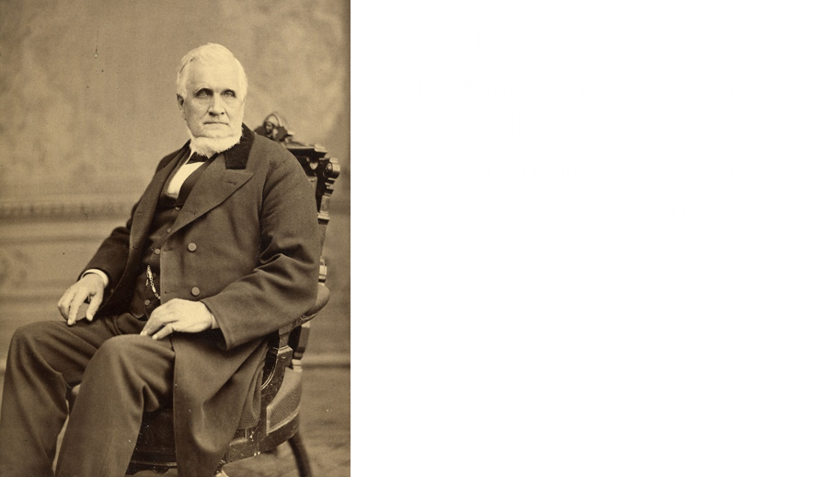
Those Arrested For Polygamy
Many Latter-day Saint men were arrested and imprisoned because they continued to obey the commandment to practice plural marriage after the United States government passed laws making the practice illegal. Some women were arrested as well, usually because they would not reveal the locations of their husbands, who had gone into hiding to avoid arrest.
Perhaps more serious than the imprisonment of individuals, the acts threatened to bankrupt the LDS church and polygamy was preventing Utah from becoming a state.

Slide 8
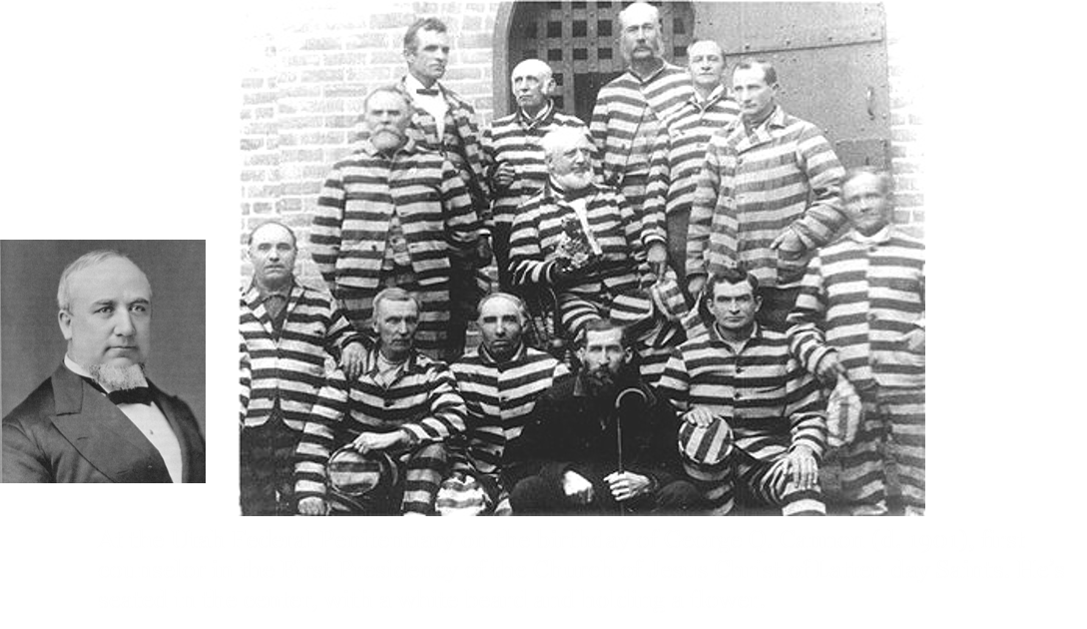
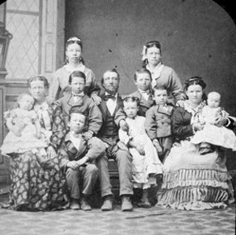
The Laws after 1852
These laws ultimately led to the arrest and imprisonment of men who had more than one wife. These men were denied “the right to vote, the right to privacy in their homes, and the enjoyment of other civil liberties.”
Our Heritage
By 1890, hundreds of faithful Latter-day Saints had served time in prison. Others went into hiding to avoid arrest and imprisonment. In these conditions, many families suffered from stress, grief, poverty, and hunger.

Slide 9
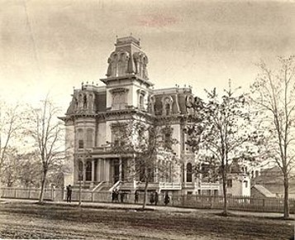
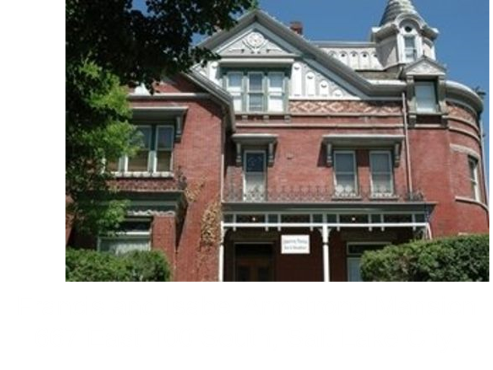
Places of Hiding
In the early days of the LDS church, early church leaders would often have death threats on their life. Because the Armstrong's were such great friends with the church leaders, they would harbor them from danger in their secret attic room.
The Gardo House was a rendezvous where the brethren and sisters on the underground would often come in the night to meet their loved ones. . . . Samuel Sudbury, a mysterious man, was custodian of the Gardo House and was ever on the alert for the approach of marshals and deputies searching for polygamists. It was the rule that the Gardo House was to be closed at 10 p.m. without exception, and no stranger was permitted after that hour.

Slide 10
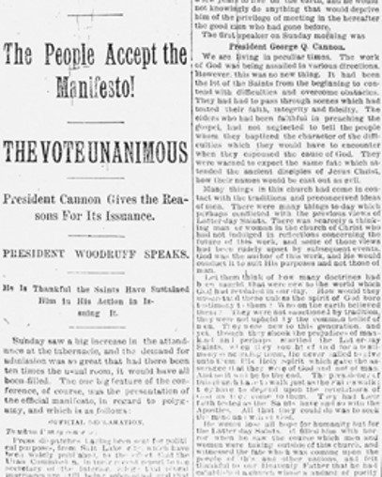
Manifesto—Official Declaration 1
“I hereby announce that all such marriages are prohibited, and if any officer or member of the Church shall assume to solemnize or enter into any such marriage he will be deemed in transgression against the Church and will be liable to be dealt with, according to the rules and regulations thereof, and excommunicated therefrom.” (In Conference Report, Apr. 1904, p. 75.)
The Lord will never permit the President of the Church to lead the Church astray
Excerpts from Official Declaration

Slide 11
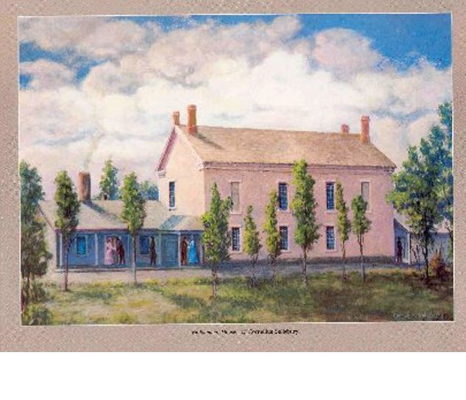
“I Wrote What the Lord Told Me to Write”
“We are not teaching polygamy or plural marriage, nor permitting any person to enter into its practice, and I deny that either forty or any other number of plural marriages have during that period been solemnized in our Temples or in any other place in the Territory.”
“Which is the wisest course for the Latter-day Saints to pursue—to continue to attempt to practice plural marriage, with the laws of the nation against it and the opposition of sixty millions of people, and at the cost of the confiscation and loss of all the Temples, and the stopping of all the ordinances therein, both for the living and the dead, and the imprisonment of the First Presidency and Twelve and the heads of families in the Church, and the confiscation of personal property of the people (all of which of themselves would stop the practice); or, after doing and suffering what we have through our adherence to this principle to cease the practice and submit to the law, and through doing so leave the Prophets, Apostles and fathers at home, so that they can instruct the people and attend to the duties of the Church, and also leave the Temples in the hands of the Saints, so that they can attend to the ordinances of the Gospel, both for the living and the dead?”
Excerpts from Official Declaration

Slide 12
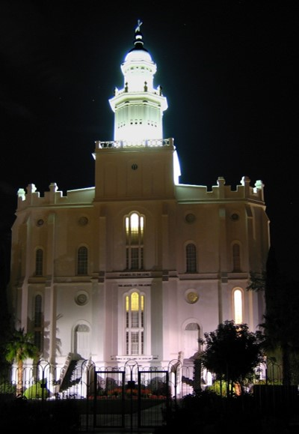
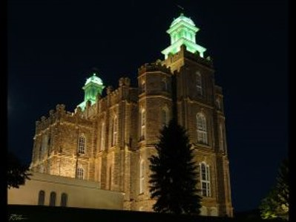
“The Lord Showed Me in a Vision”
“The Lord showed me by vision and revelation exactly what would take place if we did not stop this practice. If we had not stopped it, you would have had no use for … any of the men in this temple at Logan; for all ordinances would be stopped throughout the land of Zion. Confusion would reign throughout Israel, and many men would be made prisoners.”
… I saw exactly what would come to pass if there was not something done. I have had this spirit upon me for a long time. But I want to say this: I should have let all the temples go out of our hands; I should have gone to prison myself, and let every other man go there, had not the God of heaven commanded me to do what I did do; and when the hour came that I was commanded to do that, it was all clear to me. I went before the Lord, and I wrote what the Lord told me to write. …
Excerpts from Official Declaration

Slide 13
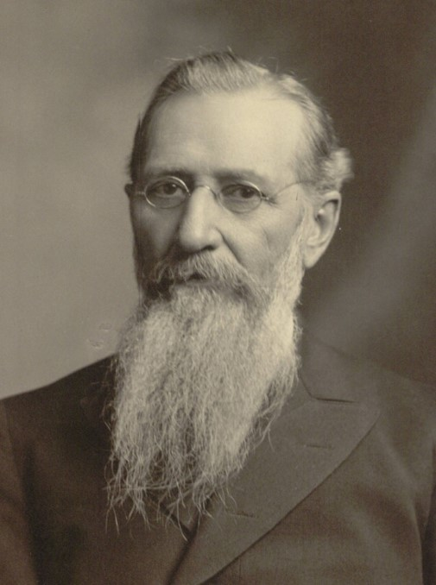
Those Who Entered Into Plural Marriage After Manifesto
“A small number of Latter-day Saints continued to enter into new plural marriages after the Manifesto was given.
In 1904, President Joseph F. Smith announced “that all [plural] marriages are prohibited, and if any officer or member of the Church shall assume to solemnize or enter into any such marriage he will be … excommunicated.”
President Joseph F. Smith
This policy continues today
Excerpts from Official Declaration

Slide 14
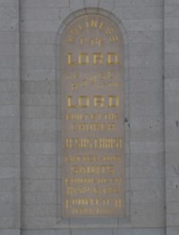
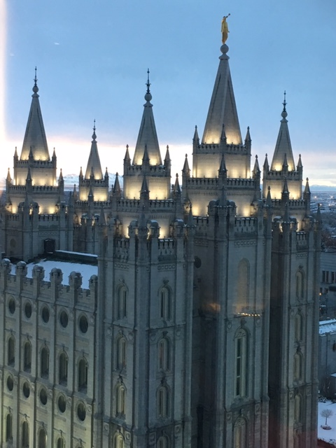
Those Who Entered Into Plural Marriage After Manifesto
After the Manifesto was given, the threat of the federal government confiscating the temples and the property of the Church ended. Without that distraction, the Saints were able to give greater focus to temple work. On April 6, 1893, forty years after the cornerstones of the Salt Lake Temple were laid, President Wilford Woodruff dedicated that temple, bringing the total number of functioning temples to four.
In April 1894, one year after the dedication of the Salt Lake Temple, President Woodruff announced that he had received a revelation. Before this revelation, Church members, acting according to the knowledge they possessed, often had themselves sealed, or “adopted,” to Church leaders, such as Joseph Smith or Brigham Young, rather than to their own parents. But President Woodruff learned by revelation that he should direct the Saints “to trace their genealogies as far as they can, and to be sealed to their fathers and mothers. Have children sealed to their parents, and run this chain through as far as you can get it. … This is the will of the Lord to his people.” President Woodruff
Excerpts from Official Declaration

Slide 15
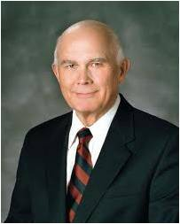
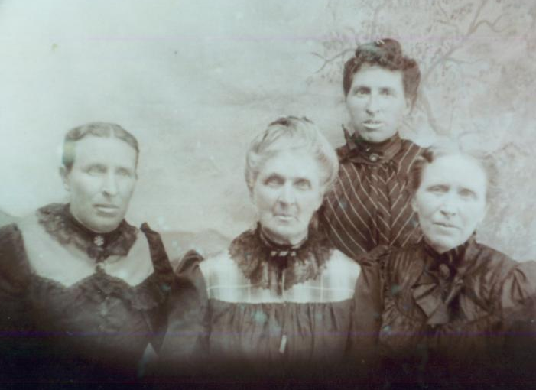
“Polygamy did not end suddenly with the 1890 Manifesto. Polygamous relationships sealed before that revelation was announced continued for a generation.
The performance of polygamous marriages also continued for a time outside the United States, where the application of the Manifesto was uncertain for a season. It appears that polygamous marriages also continued for about a decade in some other areas among leaders and members who took license from the ambiguities and pressures created by this high-level collision between resented laws and revered doctrines. …
“My heart breaks when I read of circumstances in which wives and children were presented with the terrible choice of lying about the whereabouts or existence of a husband or father on the one hand or telling the truth and seeing him go to jail on the other. …
A father in jail took food off the table and fuel from the hearth. Those hard choices involved collisions between such fundamental emotions and needs as a commitment to the truth versus the need for loving companionship and relief from cold and hunger.

Slide 16
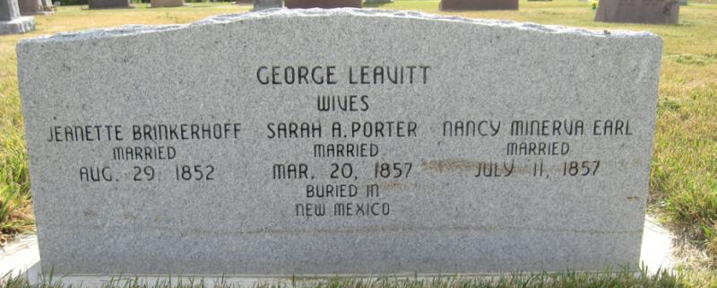
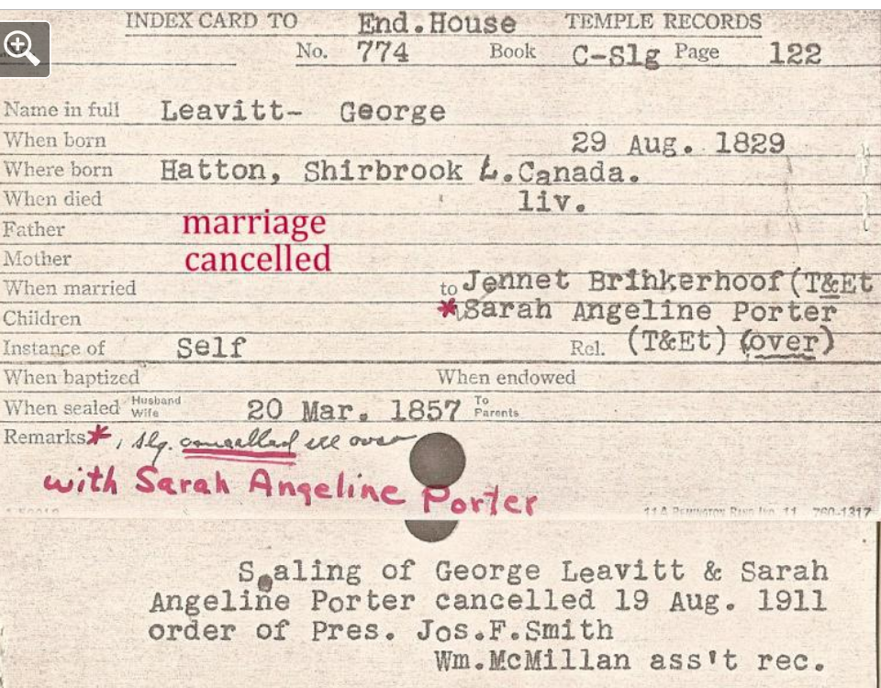
“My heart also goes out to the Church leaders who were squeezed between their devotion to truth and their devotion to their wives and children and to one another. To tell the truth could mean to betray a confidence or a cause or to send a brother to prison. …
“I do not know what to think of all of this, except I am glad I was not faced with the pressures those good people faced. My heart goes out to them for their bravery and their sacrifices, of which I am a direct beneficiary. I will not judge them. That judgment belongs to the Lord, who knows all of the circumstances and the hearts of the actors, a level of comprehension and wisdom not approached by even the most knowledgeable historians.”
Dallin H. Oaks

Slide 17
Sources:
Video:
Only a Stonecutter (15:00)
The Church is On Course (22:36)
Truman O. Angell—Builder of the Kingdom By Shannon W. Ostler February 1987 Ensign
(Our Heritage: A Brief History of The Church of Jesus Christ of Latter-day Saints [1996], 97).
President Joseph F. Smith (in Conference Report, Apr. 1904, 75
Presentation by ©http://fashionsbylynda.com/blog/
President Woodruff (in James R. Clark, comp., Messages of the First Presidency of The Church of Jesus Christ of Latter-day Saints, 6 vols. [1965–75], 3:256–257; see also Teachings of Presidents of the Church: Wilford Woodruff[2004], xxxiii–xxxv).
https://www.lds.org/manual/doctrine-and-covenants-student-manual/official-declarations/official-declaration-1-manifesto?lang=eng
http://www.ldschurchtemples.com/chronological/
http://www.lightplanet.com/mormons/temples/salt_lake_temple_history.html
Dallin H. Oaks (“Gospel Teachings about Lying,” Clark Memorandum [Brigham Young University J. Reuben Clark Law School periodical], Spring 1994, 16–17).
Presentation by ©http://fashionsbylynda.com/blog/

Slide 18
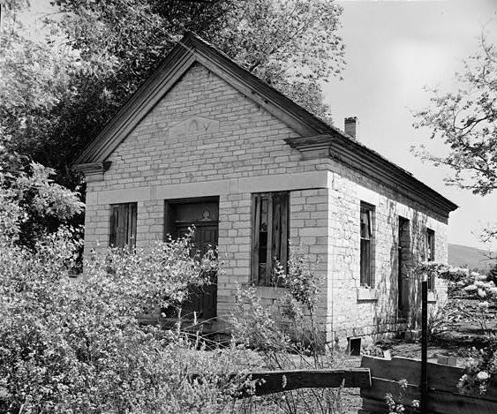
An Endowment house is a building or place where certain temple ordinances may be administered, outside of the temple itself. Moses erected a tabernacle in the wilderness as a "temporary temple"; by analogy, so did the Prophet Joseph Smith. Before the Nauvoo Temple was completed, the large upper room of Joseph Smith's red-brick store building in Nauvoo, Illinois, was used to confer the first temple ordinances on a few leaders of the Church on May 4, 1842, and then on their wives. These ordinances, called endowments, consisted of a course of instruction and rites that included prayers, washings, anointings, and the making of covenants with the Lord Jesus Christ.
The Latter-day Saints occasionally used a mountaintop as their temporary temple, and President Brigham Young dedicated Ensign Peak, a hill just north of Salt Lake City, Utah, as a "natural temple." Though Brigham Young designated a temple site in Salt Lake Valley on July 28, 1847, just four days after his arrival, the temple took forty years to build. In the meantime, the upper floor of the Council House, Salt Lake City's first public building, served 2,222 members of the Church as their Endowment house between February 21, 1851, and May 5, 1855.
A more permanent Endowment house, designed by Truman O. Angell, Church architect, was soon built on the northwest corner of Temple Square. Brigham Young named it "The House of the Lord." It was dedicated on May 5, 1855, by Heber C. Kimball. The main structure was a two-story building 34 feet by 44 feet, with small one-story extensions on both ends. The first floor had a room for washing and anointing, and also "garden," "world," and "terrestrial" rooms. The upper floor was the "celestial room," with an adjacent sealing room.
On the average, 25 to 30 endowments were given daily, for a total of 54,170 in the thirty-four years it was used. And an average of 2,500 marriages were also performed annually. In addition, the Endowment house served as a place for special prayer circles and the setting apart and instruction of newly called missionaries.
As the Salt Lake Temple neared completion, the Endowment house was torn down in November 1889. The Salt Lake Temple was dedicated April 6, 1893. A long-anticipated holy place for temple ordinances was then permanently established in Salt Lake City.
Author: Lamar C. Berrett
BYU Harold B. Lee Library
Other Endowment Houses:
Spring City, Utah

Slide 19
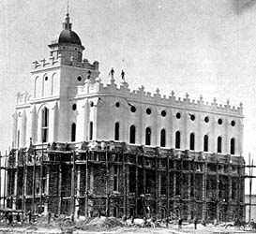
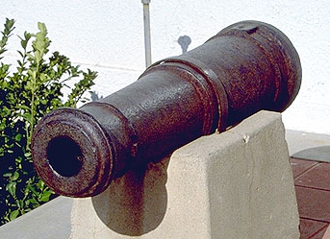
St. George Temple dome:
From his winter home in St. George Brigham Young watched with great satisfaction the progress of the Temple. This stately building rising in the valley was an inspiring sight. The people were relieved to see the Temple nearing its completion and looked forward to its final dedication, April 6, 1877.
As the time drew near and the finishing touches were added, Brigham Young realized something was not right. The tower and dome, just added, simply did not compliment the temple. In his own words, "They are too short and squatty." He suggested an immediate change but the people, worn out after their non-stop effort to build the Temple resisted. Brigham Young, sympathetic, relented. Church leaders and members hailed the Temple as a great monument of its time, praising Brigham Young for his insight as a Prophet and the stalwart people of St. George for their dedication and hard work. Following the dedication Brigham Young returned to his home in Salt Lake City, where he died August 29th 1877 at the age of 76. His objection to the tower and dome was forgotten, as the people began to enjoy their beautiful temple.
All was peaceful in St. George until the night of October 16th 1878. History records a terrible storm of crashing thunder, rain and flashing lightning. Without warning, a tremendous bolt struck and destroyed the Temple tower and dome that Brigham Young had so disliked. When things calmed down the unanimous feeling was that even in death, Brigham Young had his way. The people made the observation out of deepest respect for their late prophet and immediately designed and replaced the tower and dome with the tall, handsome steeple that stands today.
St. George Temple Cannon: Erastus Snow requested Jesse W. Crosby to buy a cannon while he was on a trip to California and bring it back to St. George. He said that he would be paid for it out of the militia funds then the territorial legislature appropriated money. Jessie Crosby paid for the cannon and hauled it back from California, but the governor of the territory refused to sign a bill appropriating any money, so Jesse Crosby didn't get paid.
When Jesse W. Crosby didn't get his pay he had no use for the cannon but he let them go on and use it for an artillery company in St. George. Later when the territorial militia wasn't meeting in St. George any more, Jesse Crosby took the cannon back. When the boggy ground was found on the site of the St. George Temple, The saints brought black volcanic rock from the ridge around the valley. They had no pile driver to drive the rocks down into the bog so they borrowed Jesse Crosby's cannon. The cannon barrel was filled with lead and weighed close to a thousand pounds. With a system of pulleys rigged to teams of horses and fastened to the old cannon, now filled with lead, the pioneer workmen crafted their only "power tool". Over and over they hoisted, then dropped the heavy hammer, until with relentless pounding solid foundation footings were formed.
After they were finished with the cannon, it was left near the temple. In 1883 Jessie Crosby melted the lead out of the cannon. After that the people in St. George took it up above the town and fired it on the 4th and the 24th of July. That practice continued for many years. Today the proud old cannon, mounted on the Temple grounds, has earned a place of peace and honor.
As the volcanic rock was made firm the masons laid up great slabs of sandstone and the foundation began to take shape. The cannon method had worked. The Temple was underway. As the building progressed, seldom were there any less than 100 workers a day at the site. The faithful came from all over, leaving homes before daybreak and walking, sometimes many miles, to work on their beloved Temple. After an amazingly short period of five and a half years, and much back-breaking effort, the Temple was completed and ready for dedication. --http://www.george-and-ann-prior-jarvis.org/html_docs/building_the_temple.html
See also March 1977 Ensign
St. George Temple: One Hundred Years of Service

Slide 20
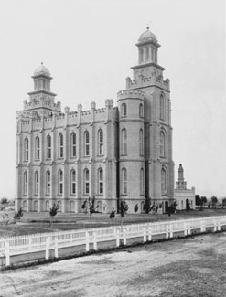
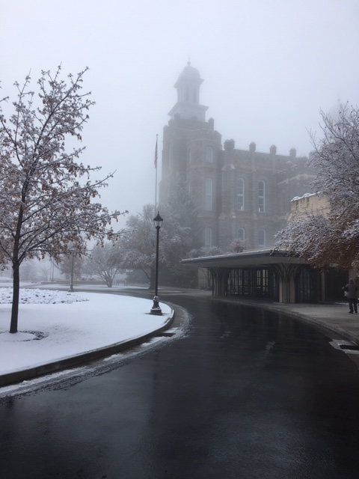
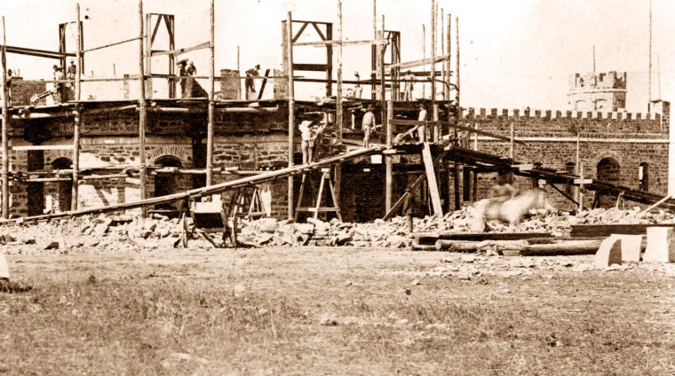
Logan Temple:
The five-story Logan Utah Temple was built entirely by volunteer labor over a seven-year period from 1877 to 1884.
The exterior walls of the Logan Utah Temple were originally painted an off-white color to hide the dark, rough-hewn limestone. In the early 1900s, however, the paint was allowed to weather away, uncovering the beautiful stone that characterizes the temple today.
On the evening of December 4, 1917, fire broke out in the Logan Utah Temple, engulfing the southeast staircase, destroying several windows and paintings, and causing extensive smoke and water damage. The origin of the fire was discovered to be electrical wiring.
The Logan Utah Temple was flood lighted at night for the first time during the month of May 1934 as part of the temple's Golden Jubilee celebration. Everyone entering the valley was astonished by the brilliant spectacle. Thirteen years would pass before the temple was lit again on the temple's 63rd anniversary—this time with an elaborate permanent system.
In the late 1970s, the interior of the Logan Utah Temple was completely gutted and rebuilt. The two-year project replaced the progressive-style ordinance rooms with motion-picture ordinance rooms. President Spencer W. Kimball, who rededicated the completed temple in 1979, regretted the need to reconstruct the interior because of the loss of pioneer craftsmanship.

Slide 21
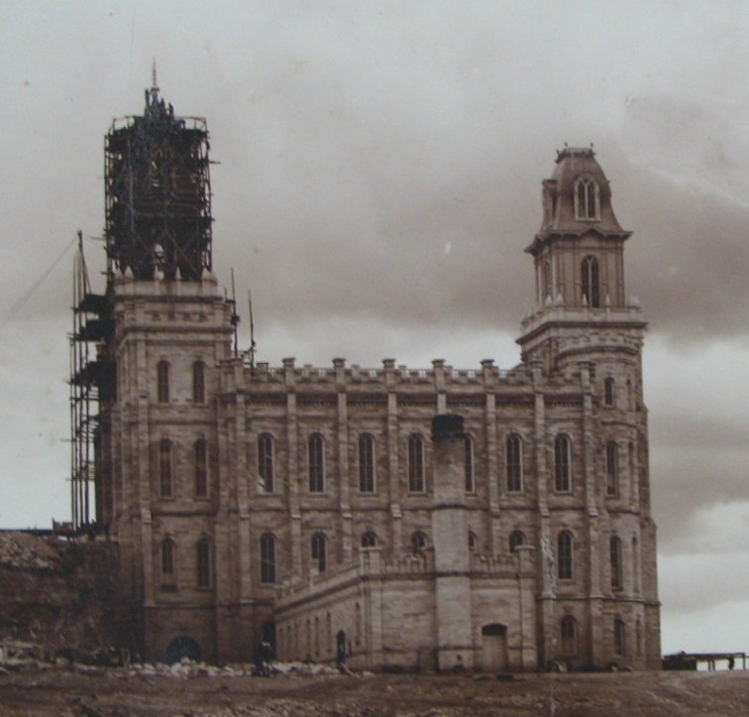
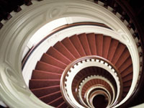
Manti Temple:
It took two long years to prepare the ground for the foundation of the temple. The little gray hill on which the temple was to stand was solid rock; consequently, it was quite a challenge for the Saints to dig their way through it. The workers tunneled twenty to thirty feet into the hill and then dug ten-foot wings at the end, forming a T. They subsequently deposited several hundred pounds of gunpowder in the tunnel, causing an explosion that dislodged twenty-five hundred tons of rock, dirt, and trees that had to be moved away. Some of the rock that was blown out for the foundation can still be seen in Manti today, because many of the settlers used it to build their houses. This “explosion in a tunnel” process was repeated numerous times, and the work progressed rather quickly. The most time-consuming part of the procedure was removing all the debris. When that was done, the ground was ready for laying the cornerstones and the foundation. These were “built of a buff colored white limestone, quarried from near warm springs about a mile south of Manti.”
The immigrants found or made the necessary materials for building very near the site of the temple itself. It was built of white oolite stone from the mountains east of the temple and from a quarry owned by the Parry brothers that was northeast of Ephraim. Victor Rassmussen writes: “The lime for the mortar was obtained by burning lime rock from the hills west of the valley. The sand for the mortar was obtained by crushing limestone quarried from the hill east of the temple. The burning and the crushing of the limestone, as well as much of the carpentry work, were done in a building located at the southwest of the temple hill.”
All of the wood for the temple, except for that used in the staircases, came from locations very near the temple.
The most amazing architecture in the Manti Temple lies in the two circular stairways in the western towers, which wind upward 151 steps. Having no central support, the stairways are two of only three like them in the United States (the other in the Octagon in Washington DC). Standing at the top of the stairs and looking down is like looking into a large well, six stories deep. Not only is the support system of the stairs unique, but so are the railings, spindles, and paneling. Many have commented that the joints on the black walnut railings are so smooth that they cannot be felt.
In the eleven years that the temple was being built, no one died of injuries incurred while working on it.
The Carpet described by Hugh Nibley:
A circle is surrounded by botanical motifs and is circled by small rings. One of these rings instead of a simple circle or ring is an Ankh, or Crux Anasta, the best known of all ancient symbols, as it stands for life. (In the usual salutary title placed after the names of initiates, Ankh, Djed, Seneb, the Ankh symbol represents an umbilical cord and the three words mean health to the naval and marrow to the bones and strength, often in the royal tombs the last of the three is the Was-symbol which means, according to Gardnier, “power in the Priesthood.”) In this drawing the Ankh sign is at the top of the circle. A quarter of the way around, right next to the hole for the screw is the Egyptian Hetepsymbol meaning peace and salvation. On the opposite side of the circle from the Ankh sign is the Shen sign, the personal seal and sign for eternity, one everlasting round.

Slide 22
Private citizens and the government crusaded to end polygamy—mostly through laws. Congress passed a series of laws:
The Morrill Anti-Bigamy Act of 1862 prohibited polygamy in the territories. It also limited the value of the land that the LDS church could own, among other things.
The Poland Act of 1874 took away the LDS church’s power over the territory’s judicial system.
The Edmunds Act of 1882 made polygamy a felony, prohibited “unlawful cohabitation,” and took away polygamists’ right to vote and hold political office.
The Edmunds-Tucker Act of 1887, which abolished women's suffrage in Utah Territory, disincorporated the LDS church, allowed the government to seize church assets, punished offenders with large fines and prison, required wives to testify against husbands, and more.
Elder Dallin H. Oaks-- Article on Polygamy:
Some members of the Church continued to enter into plural marriages after the Manifesto was given in 1890. “Polygamy did not end suddenly with the 1890 Manifesto. Polygamous relationships sealed before that revelation was announced continued for a generation. The performance of polygamous marriages also continued for a time outside the United States, where the application of the Manifesto was uncertain for a season. It appears that polygamous marriages also continued for about a decade in some other areas among leaders and members who took license from the ambiguities and pressures created by this high-level collision between resented laws and revered doctrines. …
“My heart breaks when I read of circumstances in which wives and children were presented with the terrible choice of lying about the whereabouts or existence of a husband or father on the one hand or telling the truth and seeing him go to jail on the other. … A father in jail took food off the table and fuel from the hearth. Those hard choices involved collisions between such fundamental emotions and needs as a commitment to the truth versus the need for loving companionship and relief from cold and hunger.
“My heart also goes out to the Church leaders who were squeezed between their devotion to truth and their devotion to their wives and children and to one another. To tell the truth could mean to betray a confidence or a cause or to send a brother to prison. …
“I do not know what to think of all of this, except I am glad I was not faced with the pressures those good people faced. My heart goes out to them for their bravery and their sacrifices, of which I am a direct beneficiary. I will not judge them. That judgment belongs to the Lord, who knows all of the circumstances and the hearts of the actors, a level of comprehension and wisdom not approached by even the most knowledgeable historians” (“Gospel Teachings about Lying,” Clark Memorandum [Brigham Young University J. Reuben Clark Law School periodical], Spring 1994, 16–17).
Since 1904, the Church has excommunicated any of its members who have performed or entered into plural marriages (see Conference Report, Apr. 1904, 75). In 1998, President Gordon B. Hinckley stated the Church’s position on the practice of plural marriage:
“This Church has nothing whatever to do with those practicing polygamy. … If any of our members are found to be practicing plural marriage, they are excommunicated, the most serious penalty the Church can impose. Not only are those so involved in direct violation of the civil law, they are in violation of the law of this Church” (“What Are People Asking about Us?” Ensign, Nov. 1998, 71).
John Taylor Hiding Place:
“Upon learning of the passage of the law,” President George Q. Cannon wrote to Church attorney Franklin S. Richards, “knowing that he [President Taylor] would be selected as a target for attack, . . . he called his family together and submitted to them a proposition that his wives should each return to her private residence . . . and leave him to live in the Gardo House [Presidential residence].”Ultimately this plan did not work, and John Taylor was forced into hiding.
Monogamy:
“The Bible and the Book of Mormon teach that monogamy is God’s standard for marriage unless He declares otherwise (see2 Samuel 12:7–8 and Jacob 2:27, 30). Following a revelation to Joseph Smith, the practice of plural marriage was instituted among Church members in the early 1840s (see section 132). From the 1860s to the 1880s, the United States government passed laws to make this religious practice illegal. These laws were eventually upheld by the U.S. Supreme Court. After receiving revelation, President Wilford Woodruff issued the following Manifesto, which was accepted by the Church as authoritative and binding on October 6, 1890. This led to the end of the practice of plural marriage in the Church.”

