Slide 1
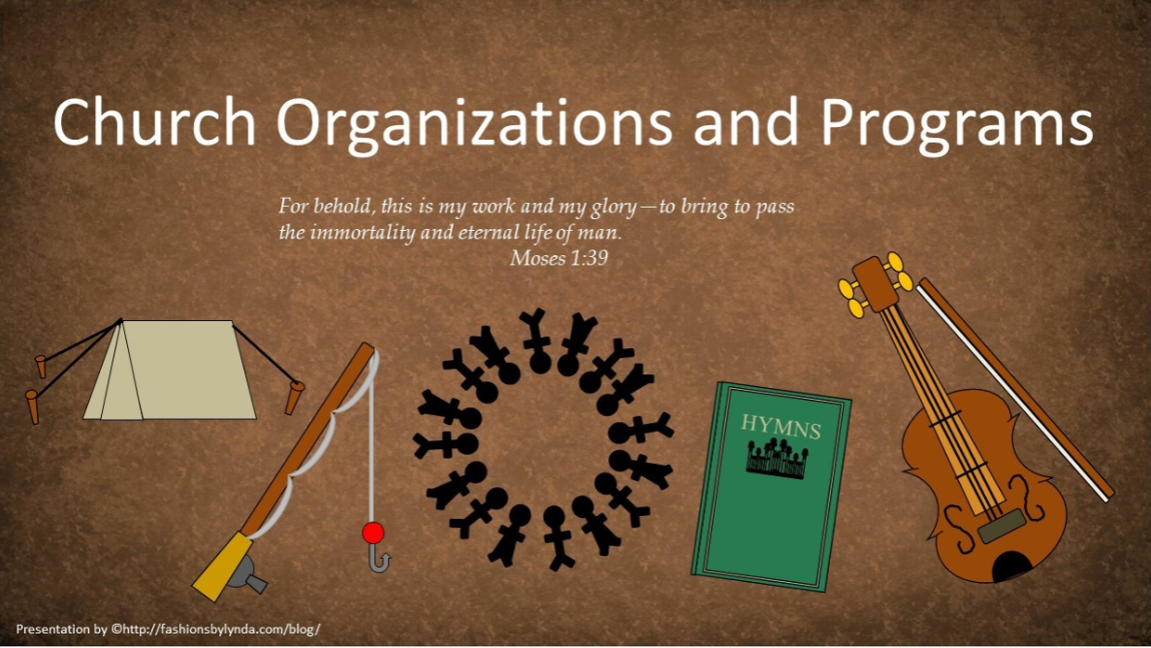

Slide 2

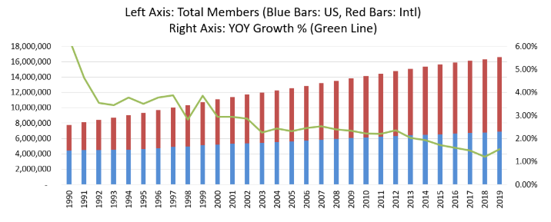
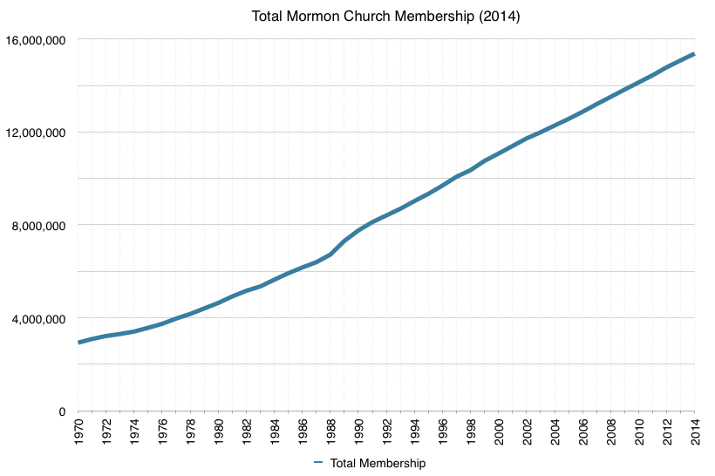
Growth of the Church
As the Church has continued to grow, the Lord has inspired Church leaders and members to implement organizations and programs within the Church to bless the Saints.
When some of these organizations and programs were first established, they were not critically needed, but as the Church has grown they have become crucial in the Lord’s work for the salvation of His children.

Slide 3
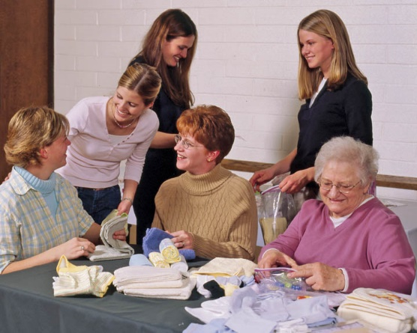
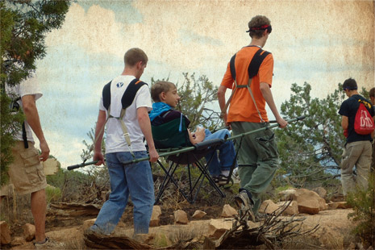
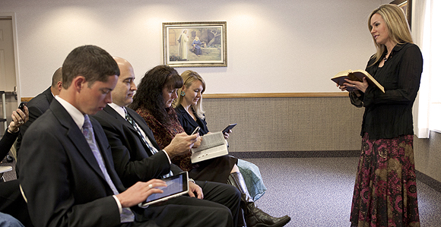

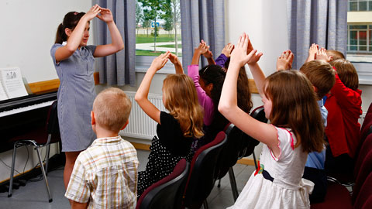
Church Programs
The Church has a number of organizations—called auxiliaries to the priesthood—and other programs that help us progress toward eternal life. Invite students to name some of them.

Slide 4
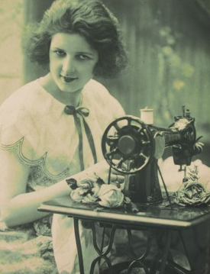
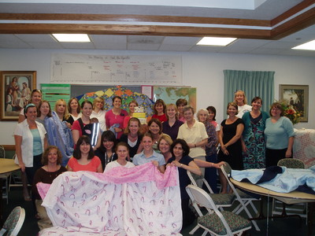
Programs
“These programs were started when they were nice but were not critically needed.
They were granted a season to flourish and to grow into a bulwark (a defensive wall) for the Church.
They now become a godsend for the salvation of modern Israel in a most challenging hour.”
Relief Society sisters in the Windermere Ward, Orlando Florida South Stake,
President Boyd K. Packer (“Teach the Scriptures” [address to CES religious educators, Oct. 14, 1977], 3, LDS.org).

Slide 5
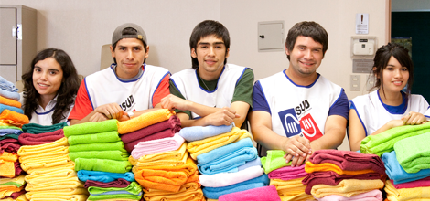

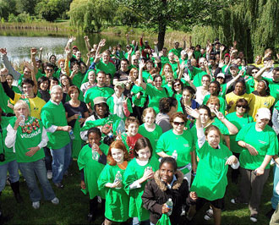
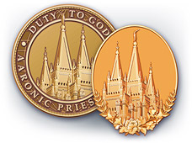
Inspired Programs
The Lord has inspired the many programs and organizations in the Church to prepare us for the challenges of life and to help us progress toward eternal life.
Church humanitarian work primarily helps those in need who are not members of the Church. There are many people in virtually any community in the world who struggle to meet their basic needs. The Church seeks to help as many as possible.
Humanitarian Service lds.org

Slide 6
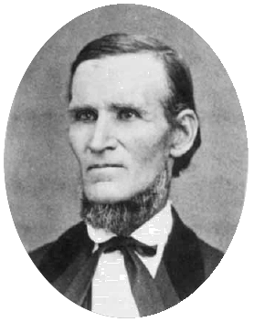
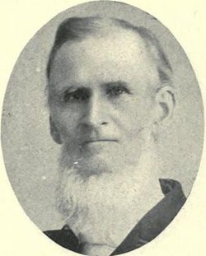
Sunday School
In 1849 a Church member named Richard Ballantyne felt that children needed a place to learn the gospel on the Sabbath day. Saints in Great Britain were already holding Sunday School classes, and Brother Ballantyne started the first Sunday School class in Utah in his Salt Lake City ward in December 1849.
Soon after that, other wards began to adopt the same practice, each using its own curriculum. In 1867, Church leaders formed the Deseret Sunday School Union, which fostered uniformity in curriculum.
By 1870, more than 200 Sunday School classes had been formed. Today, wards and branches have multiple Sunday School classes.
Richard Ballantyne
Courtesy of Daughters of Utah Pioneers, Ogden, Utah

Slide 7
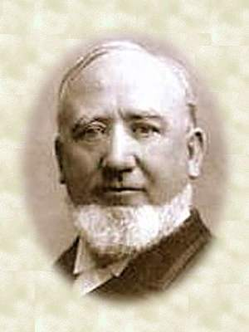
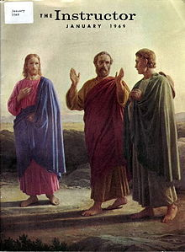
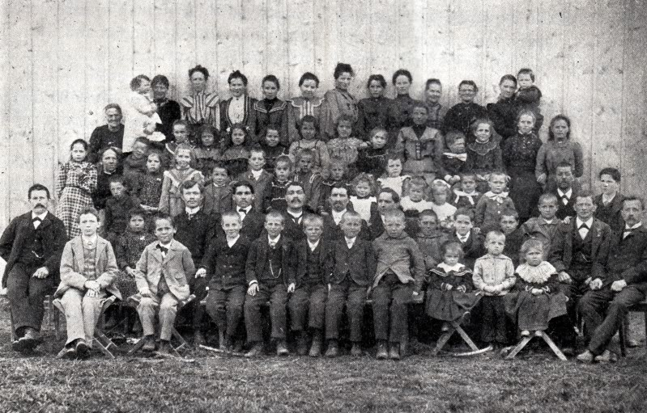
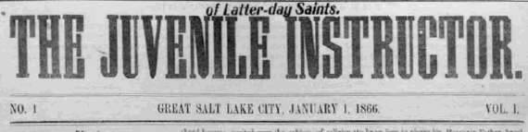
Sunday School Instruction
In 1866 the Juvenile Instructor was edited and published privately by George Q. Cannon for the Sunday School. Later the magazine was published by the Deseret Sunday School Union.
The magazine was called the Juvenile Instructor from 1866 to 1929 and the Instructor from 1930 to 1970.
Thun, Switzerland Sunday School
Church History In The Fulness of Times Student Manual Chapter 32

Slide 8
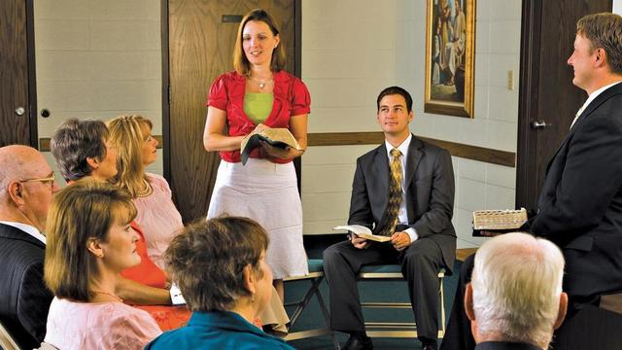
Sunday School Today-2019
The 50-minute Sunday School classes for youth and adults, on the first and third Sundays, focus on a study of the scriptures.
Teaching materials are found in Come, Follow Me—For Sunday School.
This study is aligned with the Primary curriculum and the individuals and family resource.

Slide 9
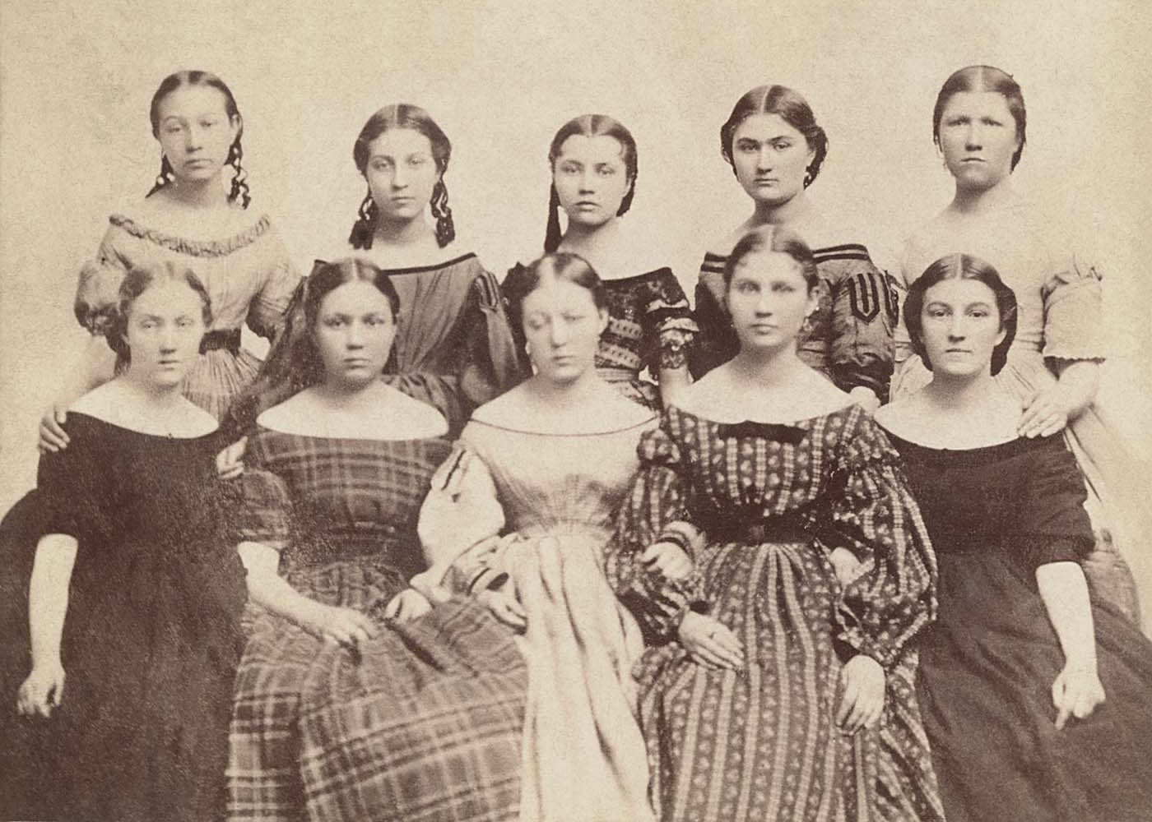
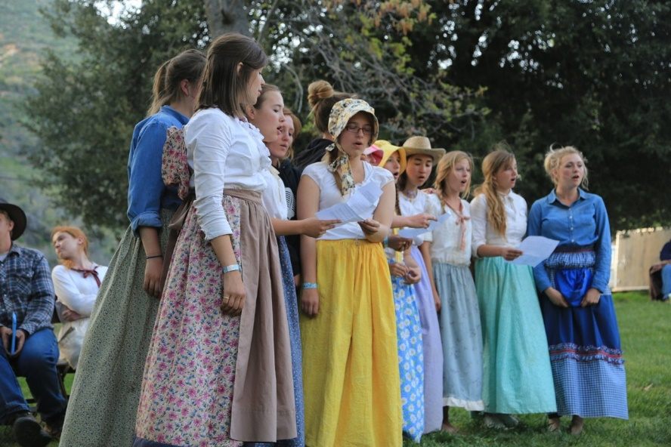
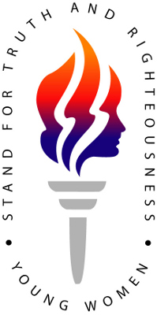
Young Women--YWMIA
President Brigham Young met with his daughters in his home on November 28, 1869, and asked them to be leaders to help their peers gain testimonies of the gospel, be modest in their dress and their actions, and avoid trends and behaviors of the world. In 1870 a formal organization of young women was organized to promote these objectives.
This organization eventually became known as the Young Women’s Mutual Improvement Association (YWMIA), which later changed to Young Women. In the early 1970s, leaders introduced the Personal Progress program. In 1985 they introduced the Young Women values and theme.

Slide 10
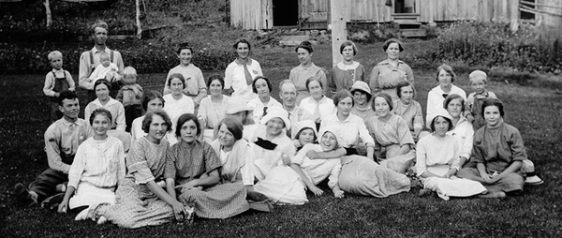
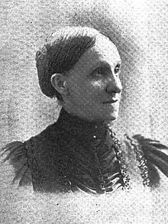
Purpose of Young Women Program
The purpose of the Young Women organization is to help each young woman be worthy to make and keep sacred covenants and receive the ordinances of the temple.
A gathering of the YLMIA in Springdell, Utah in 1914
In 1972, the YWMIA and the YMMIA were combined into a new organization called Aaronic Priesthood MIA Young Women. Leadership of the auxiliary was shared between the presiding bishopric and the general presidency of the Young Women.
This organization was short-lived, however, and the Young Women organization was separated from the Young Men organization and given its current name in 1974. Wikipedia
Anstis Elmina Shepard Taylor
First General Young Woman’s President in 1880

Slide 11
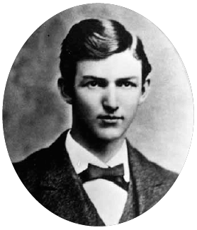
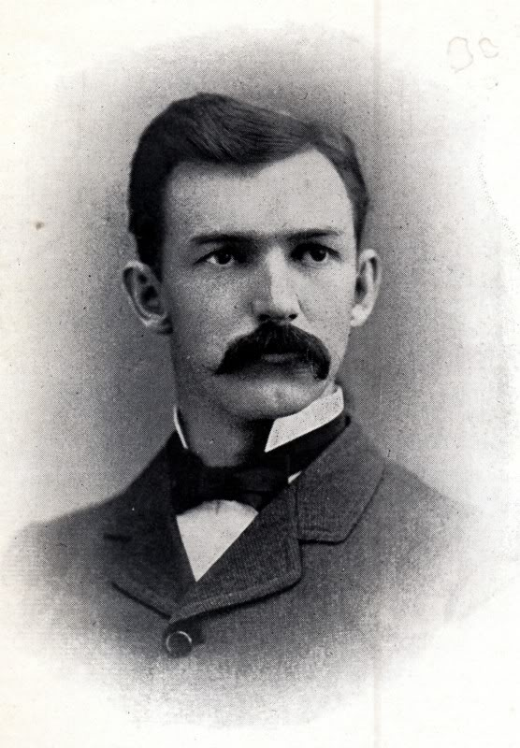
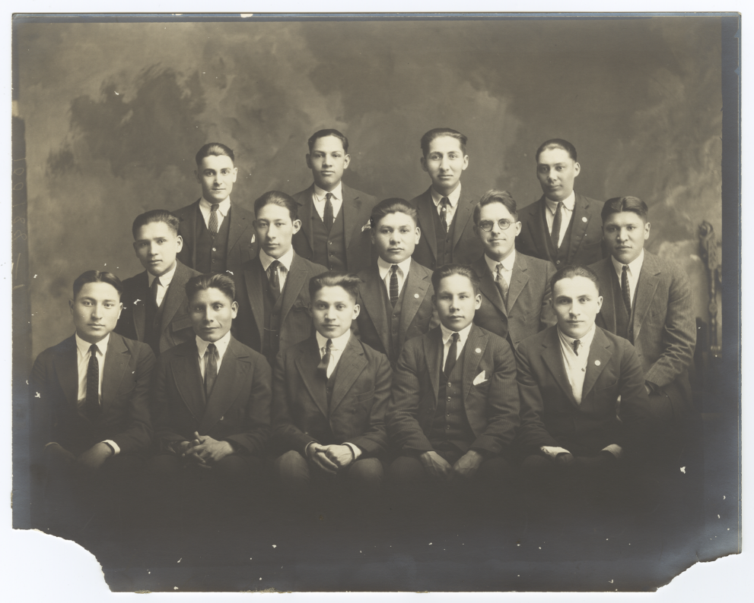
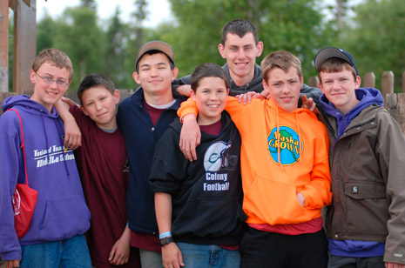
Young Men--YMMIA
The Young Men’s Mutual Improvement Association (YMMIA) was organized on June 10, 1875, under the direction of President Brigham Young.
Junius F. Wells (1854–1930) was born in Salt Lake City. Besides being involved with the organization of the YMMIA and being the editor of the Contributor for thirteen years, he also served two missions for the Church—one from 1872–74 to Great Britain and one in 1875–76 to the eastern United States. In 1921 he was sustained as an assistant Church historian.
This organization was intended to help young men develop spiritually and intellectually as well as provide them with recreational activities.
Church History In The Fulness of Times Student Manual Chapter 32

Slide 12
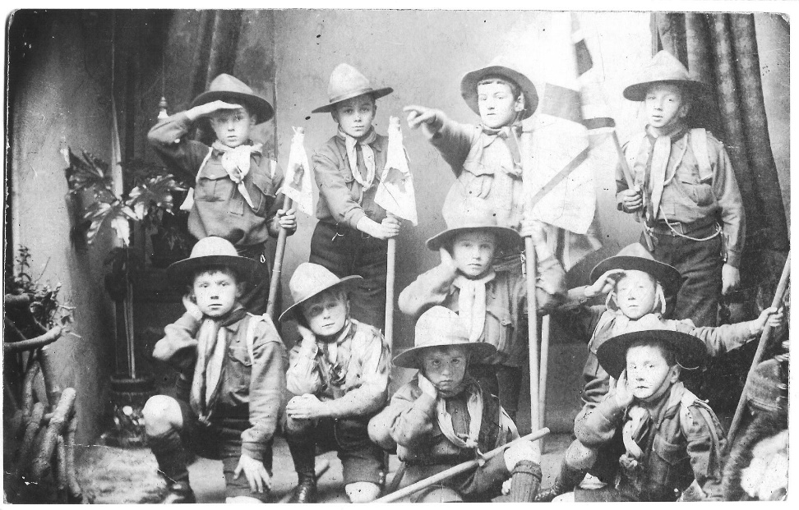
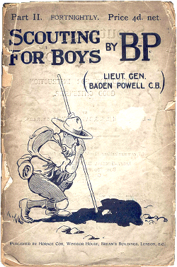
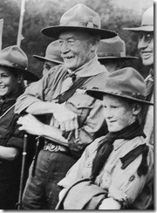
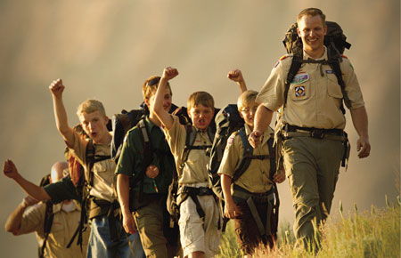

Young Men and the Scouts
In 1913, the Church partnered with Boys Scouts of America in the United States. Internationally, partnerships with other Scouting programs have been formed where possible.
1910
The organization’s name evolved as well, first changing to Aaronic Priesthood–MIA, then Aaronic Priesthood, and then Young Men. In 2001, Church leaders introduced the Duty to God program.
Baden-Powell
2009-2015

Slide 13

Changes for Scouting Programs
Effective December 31, 2019, “The Church will conclude its relationship as a chartered organization with all Scouting programs around the world,”
A new and developing Church activity program for children and youth will “replace all existing activity programs for girls and boys, young women and young men beginning in January 2020,” according to the statement.
Church News May 8, 2018

Slide 14
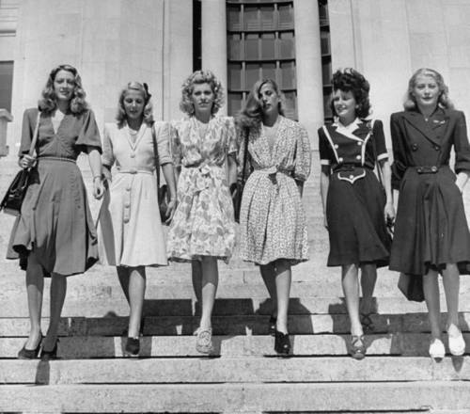
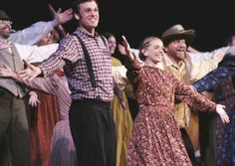
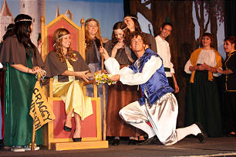
“Trail Shows” Road Shows Created
(Brigham Young) set a precedent when he instructed the Saints traveling across the vast prairie expanses to gather together in the evenings to sing, dance, and entertain each other. He knew that such celebrations could raise the spirits of his people.
Roadshows no longer fall under the jurisdiction of the Young Men or Young Women, but under the local Activities Committee, so they can provide an opportunity for the family to spend more time together.
In the 1930s, leaders gave new emphasis to music, dance, and the performing arts.
They published a recreational song book, and sociable singing became popular.
They sponsored ten-minute musical programs or "road shows" that were locally created and rehearsed and then presented in successive wards in each LDS stake.
“Roadshows are a unique LDS art form, and an exciting showcase for talents. Every would-be composer, choreographer, director, singer, playwright, and dancer has the opportunity to hone skills and try them before the public.”
Pat Davis
Kathleen Lubeck

Slide 15
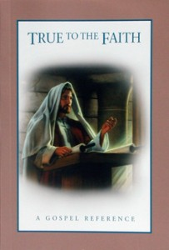
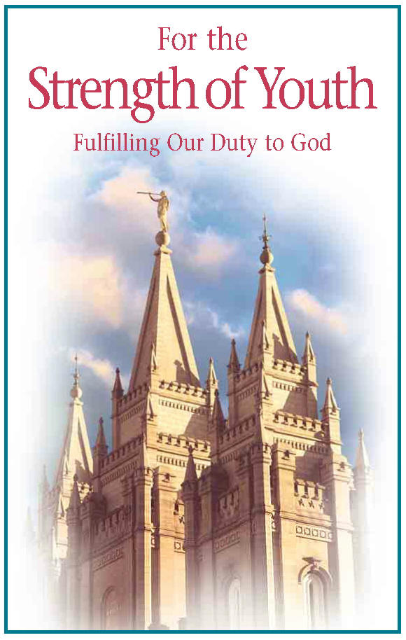
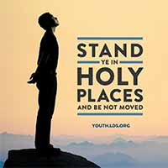



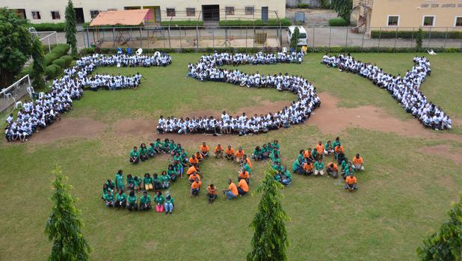
Youth Organization—age 12-18
Youth programs such as Personal Progress and Duty to God encourage youth to be worthy to attend the temple.
These programs are designed to help youth make and keep commitments, thus preparing them to make and keep covenants.
Elaine S. Dalton
LAGOS--Youth and counselors form “FSY” and “2014” to represent the 2014 “For the Strength of Youth” Summit.

Slide 16
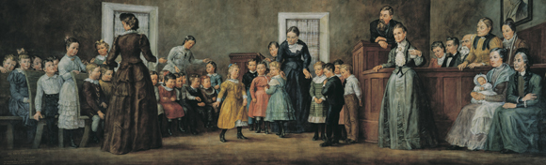
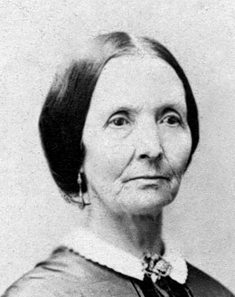
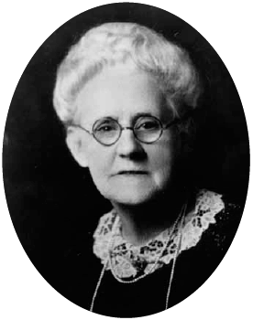
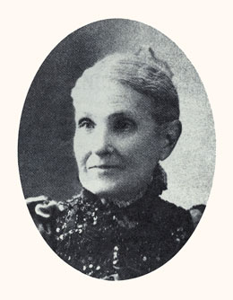
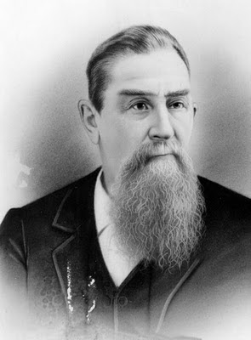
Primary
A mural depicts Bishop John W. Hess, Aurelia S. Rogers, and other leaders at the first meeting of the Farmington Ward Primary Association on August 25, 1878; 215 children between the ages of 6 and 14 attended.
Eliza R. Snow.
Louie B. Felt
Aurelia met with Eliza R. Snow, who at the time was serving as the Relief Society general president, and they obtained permission from President John Taylor to organize a Primary in Farmington, Utah, under the direction of Bishop John Hess.
The first Primary meeting, held on August 25, 1878, consisted of 224 boys and girls. In 1880, a Primary general president, Luie B. Felt, was called, and Primary classes began to be organized in many wards.
Aurelia Spencer Rogers.
In 1877, Aurelia Spencer Rogers “felt strongly that something should be done about the behavior of the neighborhood boys who ran freely through the town day and night.” She felt many of these children were not being taught basic principles and values [to prepare them] in either knowledge or behavior to carry the gospel forward, or even to be good parents or citizens.
Bishop John W. Hess.

Slide 17
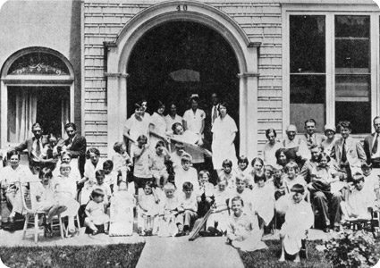
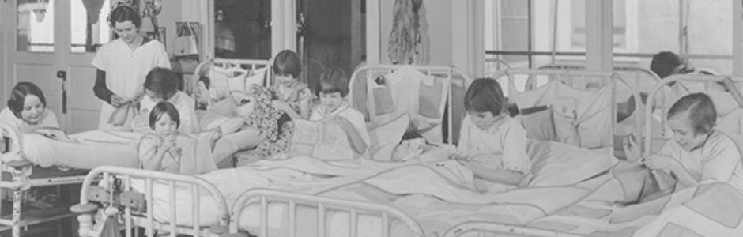
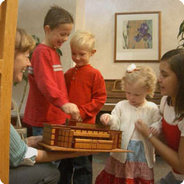

Primary Children’s Hospital
On May 12, 1922, the Primary Association opened its own 35-bed facility in a large old home at 40 West North Temple, across from Salt Lake City's Temple Square. Surgeries were performed at LDS Hospital, and then children convalesced in the Primary facility.
Children with mostly orthopedic and chronic diseases were hospitalized an average of six months. Parents had limited visiting privileges because of the threat of communicable diseases in those pre-antibiotic days.
The hospital was supported by donations of birthday pennies by LDS Primary children, and by an annual Penny Parade held in hundreds of Intermountain area towns and farming districts.
Primary Children's Hospital is not run by the Church today

Slide 18
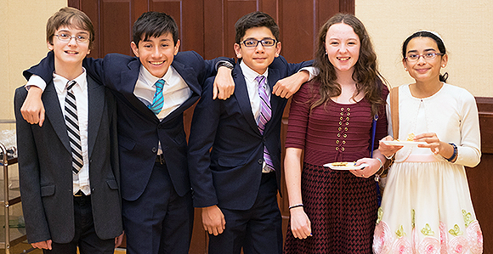
Primary Today
In 2019, children and youth will complete Primary and progress from one class or quorum to the next as age-groups. Worthy young men will be eligible to be ordained to a priesthood office in January of the year they turn 12, 14, and 16. Worthy youth will be eligible to obtain a limited-use temple recommend beginning in January of the year they turn 12.
The Primary Curriculum changed to a new program called, “Come Follow Me”
They are to meet only for 50 minutes with a singing and classes.
Church News December 14, 2018

Slide 19
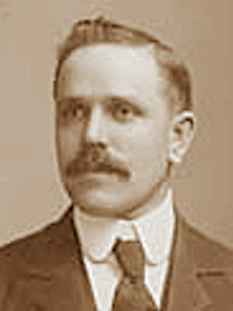
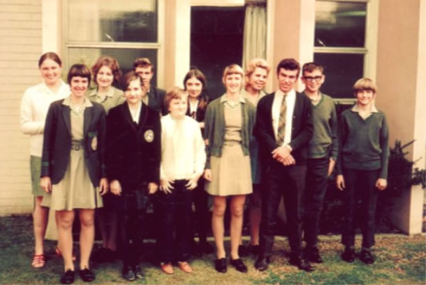

Seminary
In 1888 the Church established a general Board of Education and Church academies and created religion classes to provide a spiritual foundation for secular learning for those who did not attend Church academies.
In 1912 Joseph F. Merrill, a professor and Church member, proposed a plan to allow students in public schools to attend religious classes as part of their school day.
Joseph F. Merrill
1912: The first Seminary class is held at a home near Granite High School in Salt Lake City, Utah. Thomas J. Yates was hired as the first teacher and taught afternoon classes to 70 students.
Mormon mission prep
1950: The early-morning seminary program began in California. The first early-morning seminary classes were taught before school in Church meetinghouses near public schools. Seminary enrollment was 28,677 (world wide). Mormon Prep

Slide 20



Institute of Religion
As the seminary program spread, a similar program was established for college-age youth.
It was named the Latter-day Saint Institute of Religion, and institute classes began in 1926 in Moscow, Idaho.
In the early 1950s an early-morning seminary program began in California, the home-study seminary program began in the 1960s, and seminaries and institutes of religion have continued to expand throughout the world.
Upon returning from a seven-year mission to South Africa, J. Wyley Sessions (pictured here) was sent to Moscow, Idaho, where he started the first LDS Institute of Religion.

Slide 21


Church Schools
When Brigham Young established the academies, he required that each one have at least one woman on its board of trustees. Martha Jane Knowlton Coray (1821-81) was the first woman to serve on the board of trustees of the Brigham Young Academy, which is now called Brigham Young University.
Martha Coray was a mother of twelve children, assayer, herbalist, church worker, prolific writer, and schoolteacher. Her scholarly interests included geology, geography, politics, chemistry, and biblical studies.
Karl G. Maeser (1828–1901), one of the leading educators of the Church, was born, reared, and educated in Germany. While teaching there he met the missionaries and was baptized in 1855 in the Elbe River by Franklin D. Richards. Following the baptism the two men engaged in a conversation through the gifts of tongues and interpretation of tongues.
Brother Maeser came to America in 1857, but did not arrive in Utah until 1860. He became the private tutor of Brigham Young’s family in 1864. In 1888 he was called by the First Presidency to be the first superintendent of all Church schools.

Slide 22





Female Relief Society of Nauvoo
The Prophet Joseph Smith organized the Relief Society on March 17, 1842. He taught that the Relief Society was organized for “the relief of the poor, the destitute, the widow and the orphan, and for the exercise of all benevolent purposes.”
The women in the Church have been taught to live up to their divine potential by fulfilling God's purposes for them. As they come to understand who they really are—God's daughters—they reach their potential as holy women. Established as an integral part of the Restoration of the gospel of Jesus Christ, the Relief Society helps Latter-day Saint women live up to their privilege.
In one of the first meetings of the Female Relief Society of Nauvoo, Joseph Smith admonished the sisters to “live up to [their] privilege.”
Topics Relief Society lds.org

Slide 23




Women Still Met
When the original Nauvoo Relief Society disbanded in 1844, the women stopped formally meeting together. But, the Spirit of Women cannot be hushed. Groups of women still managed to meet. They were still concerned for the poor, for one another, and for the needs of the community.
In 1847, while the Saints gathered in Winter Quarters, there was a profusion of women’s meetings. Eliza reported in her journal on April 1847, “Had a rejoicing time thro’ the outpouring of the spirit of God. All hearts comforted.”
Eliza R. Snow
Patty Bartlett Sessions
Again, in the Salt Lake Valley, when they first arrived, small groups met in private homes. Eliza Snow and Patty Sessions initiated meetings where women presided and conducted business, although there was no formal organization.
The Forgotten Relief Society

Slide 24




Relief Society
1882
The purpose of Relief Society is to help prepare women for the blessings of eternal life by helping them increase faith and personal righteousness, strengthen families and homes, and seek out and help those in need.
Women fulfill these purposes as they seek, receive, and act on personal revelation in their lives.
Relief Society accomplishes the purposes through Sunday gospel instruction, other Relief Society meetings, visiting teaching, and welfare and compassionate service.
Front row, from left, Jane S. Richards, Emmeline Wells;
Middle row, Phoebe Woodruff, Isabelle Horne, Eliza R. Snow, Zina Young, Marinda Hyde;
Back row, Dr. Ellis R. Shipp, Bathsheba W. Smith, Elizabeth Howard, Dr. Romania Pratt Penrose

Slide 25



Mormon Tabernacle Choir
The first version of the Mormon Tabernacle Choir was a small group who sang at a conference in 1847, 29 days after the first pioneers arrived in the Salt Lake Valley.
In 1929, the Choir began broadcasting Music & The Spoken Word on radio. Now the program—carried on over 2,000 radio and television stations and with over 4,000 episodes—is the world’s longest continuing network broadcast.
1920
In 2012 the Choir launched a YouTube channel, enabling more people in countries all over the world to experience the music of the Choir and Orchestra.
Mormon Tabernacle Choir Site
Name change: “The Tabernacle Choir at Temple Square” August 2018

Slide 26


Family Home Evening
In 1909 the Granite Stake in Salt Lake City, Utah, began a weekly home evening program, which President Smith said was inspired.
“Supplements to our teachings and training in the home. Not one child in a hundred would go astray, if the home environment, example, and training, were in harmony with the truth in the Gospel of Christ”
President F. Smith
In 1915 the First Presidency recommended that monthly home evenings be adopted throughout the Church.
“If the Saints obey this counsel [to observe home evenings], we promise that great blessings will result. Love at home and obedience to parents will increase. Faith will be developed in the hearts of the youth of Israel, and they will gain power to combat the evil influence and temptations which beset them.” First Presidency Message

Slide 27





Monday Nights Observed for Family Night
Fifty years later, the Church published manuals for families to use in weekly gospel instruction.
In 1970 Church leaders designated Monday evenings for family home evening and announced that no other Church activities were to be held that night.
Temples are also closed on Mondays
1965
1979-80

Slide 28

The New Home Centered Program-2019
Individual Come, Follow Me
“The new home-centered, Church-supported integrated curriculum has the potential to unleash the power of families,”
President Nelson at the October 2018 general

Slide 29


The Church Organization and Programs
Each Church organization and program originally operated independently.
As the Church expanded dramatically in the 1950s, Church leaders saw a need to evaluate how Church organizations were meeting the Church’s objectives.
They decided to unify and coordinate all Church organizations and programs both in administration and in selecting curriculum.
All Church organizations operate under the direction of priesthood leaders, who hold the keys to preside.

Slide 30

Come Follow Me
Come, Follow Me is designed to help youth leaders pattern their teaching after the Savior’s methods, with the goal of helping youth become more converted to the gospel.
The goal of every gospel teacher﻿—every parent, every formally called teacher, every home teacher and visiting teacher, and every follower of Christ﻿—is to teach the pure doctrine of the gospel, by the Spirit, in order to help God’s children build their faith in the Savior and become more like Him.
Launched in 2013
New Youth Curriculum for 2014

Slide 31

“Correlation is that system of church administration in which we take all the programs of the Church, bring them to one focal point, wrap them in one package, operate them as one program, involve all members of the Church in the operation—and do it all under priesthood direction.”
--Elder Bruce R. McConkie

Slide 32
Sources:
Vision for Women's Organizations (1:25)
Seminary Centennial (4:40)
A Heaven-Inspired Program (3:14)
Seminary Can Change Lives (4:14)
Teaching the Gospel in the Savior’s Way (4:38)
The Forgotten Relief Society http://www.ldswomenofgod.com/the-forgotten-relief-societies/
Fashion from 1869 – Today http://goforwardwithfaith.blogspot.com/2012/03/pageant-of-colors.html
Elaine S. Dalton We Did This for You October 2004 General Conference
Primary (“History of Primary,” lds.org/callings/primary/getting-started/history-of-primary).
Kathleen Lubeck Get That Show on the Road: How to Stage a Roadshow August 1984 Ensign
President F. Smith (“Worship in the Home,” Improvement Era, Dec. 1903
Presentation by http://fashionsbylynda.com/blog/
First Presidency Message in James R. Clark, comp., Messages of the First Presidency of The Church of Jesus Christ of Latter-day Saints, 6 vols. [1965–75], 4:339).
Elder Bruce R. McConkie (Let Every Man Learn His Duty [booklet, 1976], 2).
https://addictionrecovery.lds.org/?lang=eng
Presentation by http://fashionsbylynda.com/blog/

Slide 33
Richard Ballantyne (1817–98) was born and reared in Scotland, where as a young man he was a Sunday School teacher in the Presbyterian Church. At age twenty-five he was baptized a member of the Church. He went to Nauvoo with his mother in 1843.
When asked why he was so involved in the Sunday School he replied: “I was early called to this work by the voice of the spirit, and I have felt many times that I have been ordained to this work before I was born, for even before I joined the Church, I was moved upon to work for the young.”⁴In 1852 he was called on a mission to India, which lasted about three years.
DEATH OF JOHN W. HESS. A noted pioneer, a member of the Mormon Battalion, and a man of unflinching integrity, was President John W. Hess, of Davis Stake, who died in Farmington, on the morning of the 16th. He was the son of Jacob and Elizabeth Foutz Hess, and was born in Franklin County, Pennsylvania, August 24, 1824. He was baptized into the Church with his father's family, in March 1834, in Richland County, Ohio, whither the family had removed in 1832. Then came removals with the Saints to Ray and Caldwell Counties, Missouri, and later to Illinois, and then again to Mt. Pisgah, Iowa. Elder Hess bearing the blunt of the trials, the burdens of the family, and caring for his partly paralyzed father, whose health failed owning to the severe hardship which he passed through. On July 10, 1846, he and his wife having arrived at Council Bluffs, on their westward journey, his father's family remaining at Mt. Pisgah, he enlisted in the Mormon Battalion, in Company E, Captain Daniel C. Davis, his wife Emeline Bigler whom he had married in Nauvoo, November 2, 1845, also enlisting as one of the four women to accompany each company as laundresses. After his return, in 1848, to Mt. Pisgah, he found his father had died June 22, 1846. In the spring of 1849, he arranged for the westward journey, taking him with his father's family, and arriving in Salt Lake Valley July 27, settling shortly thereafter in Farmington.
In March 1865, he was ordained a bishop serving in this capacity for 27 years, until he was ordained, September 22, 1882, counselor to President W. R. Smith, upon whose death he was made President, January 15, 1894. This position he held until his death. He served three terms in the Territorial legislature, in 1858, 1860, 1876; was commander of the Davis County Militia for many years, and a delegate in 1895 to the Omaha Trans-Mississippi Congress. He filled a mission to the Lamanites and to Pennsylvania. On February 8, 1900, he was ordained a patriarch by Elder Francis M. Lyman, and remained an active worker inhis calling to the day of his going to rest. Find a Grave
Sunday School:
In 1866 the Juvenile Instructor was edited and published privately by George Q. Cannon for the Sunday School. Later the magazine was published by the Deseret Sunday School Union. The magazine was called the Juvenile Instructor from 1866 to 1929 and the Instructor from 1930 to 1970.
Sarah Louise ("Louie") Bouton Felt (May 5, 1850 – February 13, 1928) was the first general president of the children's Primary organization of The Church of Jesus Christ of Latter-day Saints (LDS Church) between 1880 and 1925. Louie Bouton was born in South Norwalk, Connecticut, the third child of Joseph Bouton and Mary Rebecca Barto. Her parents had become members of The Church of Jesus Christ of Latter-day Saints several years before Louie's birth. In 1866, the Bouton family travelled to Utah Territory to join the gathering of Latter-day Saints. On the journey to Utah, Louie met Joseph H. Felt. On December 24, 1866, Louie and Joseph Felt were married at Salt Lake City. Joseph Felt was the eldest son of Nathaniel H. Felt.
Louie was not able to have children, and she suffered periods of great loneliness while her husband left Utah to work as a missionary for the church. Later, Louie encouraged her husband to live the Latter-day Saint law of plural marriage. Joseph married Elizabeth Mineer in 1875 and Elizabeth Tidwell in 1881. Louie got along well with Joseph's other wives and found great pleasure in caring for the children of her "sister wives".
During the government attempts to prosecute polygamists, Felt twice left Utah Territory to avoid testifying in court against Joseph. In 1918, 11 years after her husband's death, Felt was described as having been an exemplary wife fulfilling the role of a helpmeet to man.
On June 19, 1880, Felt was selected as the first general president of the Primary by John Taylor, who was then the President of the Quorum of the Twelve Apostles and the acting church president. Felt was set apart by Taylor, who was assisted in the blessing by Eliza R. Snow.
Wikipedia
Aurelia Spencer Rogers (1834–1922). When Aurelia was twelve years old her mother, Catherine, died at Sugar Creek Camp in Iowa. A few months later at Winter Quarters where they had established a temporary home, her father, Orson, was called to serve as the European Mission president. Along with her five brothers and sisters, she crossed the plains two years later and settled in Salt Lake City, where her father joined them in September 1849.
At the age of seventeen Aurelia married Thomas Rogers and moved to Farmington, Utah. There she raised ten children and led an active life. She was the founder of the Primary, and she served on the General Board of the Primary Association from 1893 until her death. She was a delegate to the Woman’s Suffrage Convention in Georgia and the National Council of Women in Washington, D.C., both in 1895. Student Manual

Slide 34
Joseph Francis Merrill was the son of Apostle Marriner W. Merrill and Maria L. Kingsbury, and was born at Richmond, Cache county, Utah, Aug. 24, 1868. He was baptized into the Church July 22, 1877. His first ordination to the Priesthood was to the office of a Teacher, and on Sept. 22, 1889, he was ordained an Elder by his father; he received the Priesthood of a Seventy Sept. 23, 1898, under the hands of then Apostle Heber J. Grant.
Brother Merrill was brought up on his father's farm in Richmond, where he attended the common schools till 1887, when he entered the University of Deseret as a normal student. He graduated from that institution in 1889, and in the fall of the same year he became a student in the University of Michigan, graduating in 1893 with the degree of Bachelor of Science. The summer of 1892 he spent as a student at Cornell University, and in the summer of 1894 he studied at the University of Chicago.
In 1893-95 he was assistant professor of chemistry and physics in the University of Utah. During 1896-97 he studied physics and electrical engineering, in the Johns Hopkins University, Baltimore, Md., and in the University of Chicago. After his return to Utah he resumed teaching again in the University of Utah, and is listed as the Dean of the College of Engineering from 1897-1928; but after being elected Fellow in Physics in the Johns Hopkins University he went east once more and further continued his studies, till 1899, when he took the degree of Doctor of Philosophy from the Johns Hopkins institution. An abstract of his doctorate thesis was published in the "Physical Review" for Feb. 1899. A later article by Dr. Merrill, embodying the results of original research was published in the same journal for March, 1900, an abstract of which article was also published in the "Physikalische Zeitshrift" of Germany. Doctor Merrill also served as professor of physics and electrical engineering in the University of Utah, and also principal of the State School of Mines, a department in the University. Considering the depth of his attainments, it is obvious that he was a master of multi-tasking and pursued numerous endeavors at the same time.
During his stay in Michigan, in 1892-93, he acted as presiding Elder of the "Mormon Colony" at Ann Arbor. In November, 1897, Elder Merrill was chosen as first assistant superintendent of the Y. M. M. I. A. of the Salt Lake Stake of Zion.
He married Annie Laura Hyde, a daughter of Alonzo E. and Annie Taylor Hyde, June 9, 1898, which union was blessed with two children. During 1898-99 Brother Merrill and his wife labored as regularly anointed missionaries in Baltimore. Elder Merrill was looked upon as a conscientious Latter-day Saint and as a scholar of imminent ability.
Elder Merrill served as a member of the General Board of Y. M. M. I. A. from 1927 to 1933
He was ordained an Apostle October 8, 1931 by President Heber J. Grant.at the age of sixty-three. His ordination and placement in the Quorum of the Twelve were occasioned by the death of Elder Orson F. Whitney. One can only imagine the depth of discussions held between himself, and Elders James E. Talmadge, and John A. Widtsoe, contemporaries on the Twelve.
Elder Joseph F. Merrill died Feb. 3, 1952, at Salt Lake City, Utah.
http://www.gapages.com/merrijf1.htm
First Institute, Moscow, Idaho
On April 17, 1928, J. Wyley Sessions was named the first director, and the effort to find land and build moved forward, despite early fears that Sessions was working to move the University of Idaho to Boise.
The land search took a while, and the price was set high — $8,000 for a corner property known as the Deakin homestead then owned by Ella and Arnold Lyon. President Heber J. Grant agreed to pay the inflated, stiff price after the town's Chamber of Commerce had offered to pay two-thirds.
Then when Arthur Price designed the building, he was told by the church's education commissioner — described as the "most economical, conservative General Authority of this dispensation" — that it would be too expensive to build.
President Grant assigned the contractor to build a three-story $60,000 building with a chapel, a baptismal font, a kitchen, a library, three large classrooms, a full basement, a large recreation room, an office and 11 apartments for 22 male students.
It was dedicated on Sept. 26, 1928.
By Sharon Haddock, For the Deseret News
Published: Tuesday, Aug. 24 2010

Slide 35
A Brief History of the LDS Seminary Program
1912: The first Seminary class is held at a home near Granite High School in Salt Lake City, Utah. Thomas J. Yates was hired as the first teacher and taught afternoon classes to 70 students.
1920: Seminary enrollment was 2,982.
1925: Seminary enrollment was 8,527.
1926: President Heber J. Grant initiated “collegiate seminaries” which would later be called LDS Institutes of Religion.
1938: There were ninety-eight functioning seminary programs in the following US states: Arizona, Colorado, Idaho, Nevada, Utah, and Wyoming.
1950: The early-morning seminary program began in California. The first early-morning seminary classes were taught before school in Church meetinghouses near public schools. Seminary enrollment was 28,677.
1962: Early-morning seminary was introduced to Finland and Germany (a total of 34 students) in response to requests for programs outside of the U.S. and Canada.
1967: The first home-study seminary classes begun in scattered rural areas for students are held in Iowa, Indiana, and Illinois.
1975: Seminary enrollment was 183,670.
1980: Sequential Scripture Teaching, the program to use the four books of scripture (Old Testament, New Testament, the Book of Mormon, and the Doctrine and Covenants) for the four years of seminary, was introduced emphasizing the importance of using the scriptures in the lives of students.
2010: Seminary enrollment was 369, 373.
2012: 100 year anniversary of LDS Seminary.
Relief Society in 1882:
With increasing evidence that home care of the sick and injured was no longer adequate, the women of the Relief Society, with the support of the First Presidency, opened Deseret Hospital in Salt Lake City on July 17, 1882. Though Roman Catholics and Episcopalians already sponsored hospitals in Utah, this was the first official endorsement of allopathic medicine by The Church of Jesus Christ of Latter-day Saints (see Medical Practices). A desire to have a place where spiritual ministrations could accompany medical treatment (see Sick, Blessing the) was among the motivations for the institution, and staff members were blessed and set apart by Church leaders for their tasks. The hospital also specialized in obstetrics, both in providing care and in training midwives and others.

Slide 36
Timeline of Presidency of the Young Women
No. | Dates | General President | First Counselor | Second Counselor
1 | 1880–1904 | Elmina Shepard Taylor | Margaret Young Taylor (1880–87) Maria Young Dougall (1887–1904) | Martha H. Tingey
2 | 1905–29 | Martha H. Tingey | Ruth May Fox | Mae Taylor Nystrom (1905–23) Lucy Grant Cannon (1923–29)
3 | 1929–37 | Ruth May Fox | Lucy Grant Cannon | Clarissa A. Beesley
4 | 1937–48 | Lucy Grant Cannon | Helen S. Williams (1937–44) Verna W. Goddard (1944–48) | Verna W. Goddard (1937–44) Lucy T. Andersen (1944–48)
5 | 1948–61 | Bertha S. Reeder | Emily H. Bennett | LaRue C. Longden
6 | 1961–72 | Florence S. Jacobsen | Margaret R. J. Judd | Dorothy P. Holt
7 | 1972–78 | Ruth H. Funk | Hortense H. C. Smith | Ardeth G. Kapp
8 | 1978–84 | Elaine A. Cannon | Arlene B. Darger | Norma B. Smith
9 | 1984–92 | Ardeth G. Kapp | Patricia T. Holland (1984–86) Maurine J. Turley (1986–87) Jayne B. Malan (1987–92) | Maurine J. Turley (1984–86) Jayne B. Malan (1986–87) Elaine L. Jack (1987–90) Janette C. Hales (1990–92)
10 | 1992–97 | Janette C. Hales (name changed to Janette Hales Beckham in 1995) | Virginia H. Pearce | Patricia P. Pinegar (1992–94) Bonnie D. Parkin (1994–97) Carol B. Thomas (1997)
11 | 1997–2002 | Margaret D. Nadauld | Carol B. Thomas | Sharon G. Larsen
12 | 2002–08 | Susan W. Tanner | Julie B. Beck (2002–07) Elaine S. Dalton (2007–08) | Elaine S. Dalton (2002–07) Mary N. Cook (2007–08)
13 | 2008–13 | Elaine S. Dalton | Mary N. Cook | Ann M. Dibb
14 | 2013– | Bonnie L. Oscarson | Carol F. McConkie | Neill F. Marriott

Slide 37









Scouts:
On January 24, 1908, the Boy Scouts movement begins in England with the publication of the first installment of Robert Baden-Powell’s Scouting for Boys. The name Baden-Powell was already well known to many English boys, and thousands of them eagerly bought up the handbook. By the end of April, the serialization of Scouting for Boys was completed, and scores of impromptu Boy Scout troops had sprung up across Britain.
In 1900, Baden-Powell became a national hero in Britain for his 217-day defense of Mafeking in the South African War. Soon after, Aids to Scouting, a military field manual he had written for British soldiers in 1899, caught on with a younger audience. Boys loved the lessons on tracking and observation and organized elaborate games using the book. Hearing this, Baden-Powell decided to write a nonmilitary field manual for adolescents that would also emphasize the importance of morality and good deeds.
First, however, he decided to try out some of his ideas on an actual group of boys. On July 25, 1907, he took a diverse group of 21 adolescents to Brownsea Island in Dorsetshire where they set up camp for a fortnight. With the aid of other instructors, he taught the boys about camping, observation, deduction, woodcraft, boating, lifesaving, patriotism, and chivalry. Many of these lessons were learned through inventive games that were very popular with the boys. The first Boy Scouts meeting was a great success.
With the success of Scouting for Boys, Baden-Powell set up a central Boy Scouts office, which registered new Scouts and designed a uniform. By the end of 1908, there were 60,000 Boy Scouts, and troops began springing up in British Commonwealth countries across the globe. In September 1909, the first national Boy Scout meeting was held at the Crystal Palace in London. Ten thousand Scouts showed up, including a group of uniformed girls who called themselves the Girl Scouts. In 1910, Baden-Powell organized the Girl Guides as a separate organization.
The American version of the Boy Scouts has it origins in an event that occurred in London in 1909. Chicago publisher William Boyce was lost in the fog when a Boy Scout came to his aid. After guiding Boyce to his destination, the boy refused a tip, explaining that as a Boy Scout he would not accept payment for doing a good deed. This anonymous gesture inspired Boyce to organize several regional U.S. youth organizations, specifically the Woodcraft Indians and the Sons of Daniel Boone, into the Boy Scouts of America. Incorporated on February 8, 1910, the movement soon spread throughout the country. In 1912, Juliette Gordon Low founded the Girl Scouts of America in Savannah, Georgia.
In 1916, Baden-Powell organized the Wolf Cubs, which caught on as the Cub Scouts in the United States, for boys under the age of 11. Four years later, the first international Boy Scout Jamboree was held in London, and Baden-Powell was acclaimed Chief Scout of the world. Baden-Powell died in Africa on 8th January 1941 and was burred in Nyeri a town in Kenya.
This Day in History--History Channel
http://www.history.com/this-day-in-history/boy-scouts-movement-begins
First edition 1910
1911
1937
1945
1959
1965
1972-1979
1989-2009

Slide 38
Scouting today
The Church’s long, prolific, and storied relationship with the Boy Scouts of America, stretching back more than a century, is coming to an end.
Effective December 31, 2019, “The Church will conclude its relationship as a chartered organization with all Scouting programs around the world,” according to statement from Mormon Newsroom, released Tuesday, May 8.
A new and developing Church activity program for children and youth will “replace all existing activity programs for girls and boys, young women and young men beginning in January 2020,” according to the statement.
The changes will be effective January 1, 2020. The Church plans to “remain a fully engaged partner in Scouting for boys and young men ages 8–13” through December 31, 2019.
The statement concludes by acknowledging the Church’s rich historical connection with Scouting:
“The Church honors Scouting organizations for their continued goal to develop character and instill values in youth. The lives of hundreds of thousands of young men, along with their families and communities, have been blessed by Scouting organizations worldwide.”
For further information:
https://www.churchofjesuschrist.org/church/news/church-to-end-relationship-with-scouting-announces-new-activity-program-for-children-and-youth?lang=eng

Slide 39

The first For The Strength of Youth pamphlet was printed in 1965.
In a recent post, frequent commenter Ardis noted her experience with the standards of the church that have been pushing similar themes since the mid-1960s. This reminded me of a post I did elsewhere noting some of the “timeless standards” from the 1965 pamphlet.
There is a new trend in the church to elevate the For the Strength of Youth standards to something that should be applied to all members, not just the youth.
I’ve experienced first hand and heard online from others that local wards have reviewed the For the Strength of Youth pamphlet and standards with the adults, explaining that it applies to them as well.
By Common Consent JULY 12, 2013 BY ANGELA C
http://bycommonconsent.com/2013/07/12/for-the-strength-of-youth/

Slide 40
Forgotten Relief Societies Continued Article:
The Female Council of Health was formed in 1851, separate from the group that included men, because there were certain subjects women felt uncomfortable discussing in front of the men. Here midwives would discuss health issues. Soon, a variety of women were interested in the subject, and in bettering the community. The group met twice a month in the Old Tabernacle where they enjoyed a social and spiritual interchange and set goals in providing health needs for the poor.
Women were always at work as well, the Thirteenth Ward women entered into a covenant: “That we speak no evil of each other nor of the authorities of the Church but endeavor by means in our power to cultivate a spirit of union, humanity, and love.” It is so interesting to me that these two points (being kind to one another and supporting the Brethren) are always mentioned in these early days. I also marvel at the initiative of the Thirteenth Ward, especially noting that Emmeline Wells, among other innovative women, resided in that ward.
It is impossible to note how the Indians faired from the noble generosity of the women. Clearly, the ones most benefitted were the sisters themselves.
In 1855, Brigham Young notified all bishops to allow the women to organize themselves for the purpose of aiding the poor. It was the sisters who provided clothing, blankets, and even shelter for the destitute survivors of the handcart treks of 1856.
It wasn’t until 1867 that Brigham Young asked Eliza R. Snow to travel around the territory teaching both the Bishops and the women about the Relief Society. Years later, it would be fully reestablished.
Eliza’s vision of Relief Society, which she taught as she organized, included spiritual dimensions in addition to compassionate service. She was able to teach the broader vision, to proceed aggressively while retaining priesthood sanction, and to spread enthusiasm throughout the female membership.
From an article written by Richard L. Jensen, “Forgotten Relief Societies, 1844-67″, Dialogue Magazine, Spring 1983
Patty Bartlett Sessions
She was a famous midwife that delivered almost 4000 babies.
Patty was a middle child of nineteen children.
Patty married David against her parents’ wishes. They moved in with his parents in Ketchem, Maine where she learned from her mother-in-law to be a midwife.
In August 1833 “Hason Aldrig” and “Horace Cowin” taught Mormonism to the Sessions family. Patty was immediately converted, but David wanted time to investigate.
On June 5, 1837, the Sessions started a 2000 mile journey. Patty was pregnant with her last child, Amanda. On arriving in Kirtland they contracted the measles and had to stop for several weeks. Once recovered they continued on to Missouri. When they arrived the rains were so bad that many roads and bridges were flooded.
Shortly after arriving in Nauvoo in 1840, the Sessions family came down with malaria. A few months later, Amanda Sessions died of croup.
In April 1847, much to her joy, her daughter Sylvia came to visit her at Winter Quarters. Sylvia left with a poem that Eliza R. Snow had written for her.
She was a charter member of the Council of Health when it was founded in 1848.
t the end of July, David suffered a stroke….where she cared for him until he died 10 days later.
The next year Patty married the widower, John Parry, who was known for being the first conductor of the Mormon Tabernacle Choir.
In June 1854 Patty was elected president of the “Indian Relief Society”, designed to clothe needy Indians. This was an important step to restoring the Nauvoo Relief Society.
Parry died in 1868.
http://secretsofmom.com/?p=2117

Slide 41
Humanitarian Relief:
For many years, The Church has been actively involved in humanitarian relief and development activities throughout the world. These include emergency relief assistance in times of disaster and humanitarian programs that strengthen the self-reliance of individuals, families, and communities.
Humanitarian projects are funded by donations from Church members and others. One-hundred percent of these donations go directly to help the poor and needy. In-kind material assistance is provided through items donated by Church members and others.
Church humanitarian efforts relieve suffering for families of all nationalities and religions and offer hope with the potential for a better life for millions of people around the world.
Emergency Response – The Church strives to provide immediate assistance following disasters. The Church provides food, and other relief supplies as needed. In 2010 the Church provided relief to people affected by 119 disasters in 58 countries.
Clean Water – Access to clean water improves health and family hygiene. The World Health Organization estimates that 884 million people do not have access to clean water. The Church assists communities to establish wells and other drinking water systems to provide access to clean water. The Church also assists communities establish local water committees and provide hygiene training for families. The community donates labor and materials. Over 7.5 million people now have access to clean water because of Church efforts from 2002 through 2010.
Neonatal Resuscitation Training – The World Health Organization estimates that 1 million newborns die each year of breathing difficulties. The Church provides a train-the-trainer program for resuscitation skills and resuscitation equipment to doctors, nurses, and midwives. In addition to training for medical professionals in advanced techniques, a new level of training has been introduced called “Helping Babies Breathe.” This program helps save the lives of newborns in resource limited countries. Since 2002, over 193,000 health care workers have been trained in these life-saving techniques.
Vision Care – Over 300 million people worldwide live with low vision or blindness. By improving the quality of eye care treatment delivered by local health care organizations, blindness and visual impairment may be avoided. The Church provides training, equipment, and supplies to assist local eye care professionals and programs. Since 2003, over 550,000 people have benefitted from Church vision projects throughout the world.
Wheelchairs – There are an estimated 20 million people in the world who need a wheelchair but do not have one. The Church wheelchair initiative strives to improve mobility, health, and educational and economic opportunities for people with physical disabilities. We help local organizations improve the services they provide to the physically disabled and provide a wheelchair or walking aid appropriate to the individual’s need and circumstances. With the help of volunteer trainers, the Church seeks to strengthen the capability of local organizations to: assess individual needs, select and fit an appropriate wheelchair or other mobility device, train the individual and caregiver, and provide support for repair and maintenance. The mobility devices we provide include wheelchairs for rough terrain, hospital wheelchairs, crutches, walkers, and canes. Since 2002, over 415,000 people have received one of these devices.
Food Production –Many poor families in the world struggle with obtaining enough food for their needs. The Church provides training and tools for improved home food production, nutrition training, and food storage and preparation techniques to help families become more self-reliant. Since 2002, almost 40,000 people have been helped.
Immunizations – Ministries of health and the World Health Organization have immunized over 700 million people for measles. Church financial contributions and help from 59,000 local Church volunteers supported campaigns in 35 countries since 2003. As a result of these international efforts, there has been a 92% reduction in measles deaths in Africa and a 78% reduction worldwide. An estimated 4.3 million lives have been saved.
Humanitarian Programs—Humanitarian Service lds.org

