Slide 1
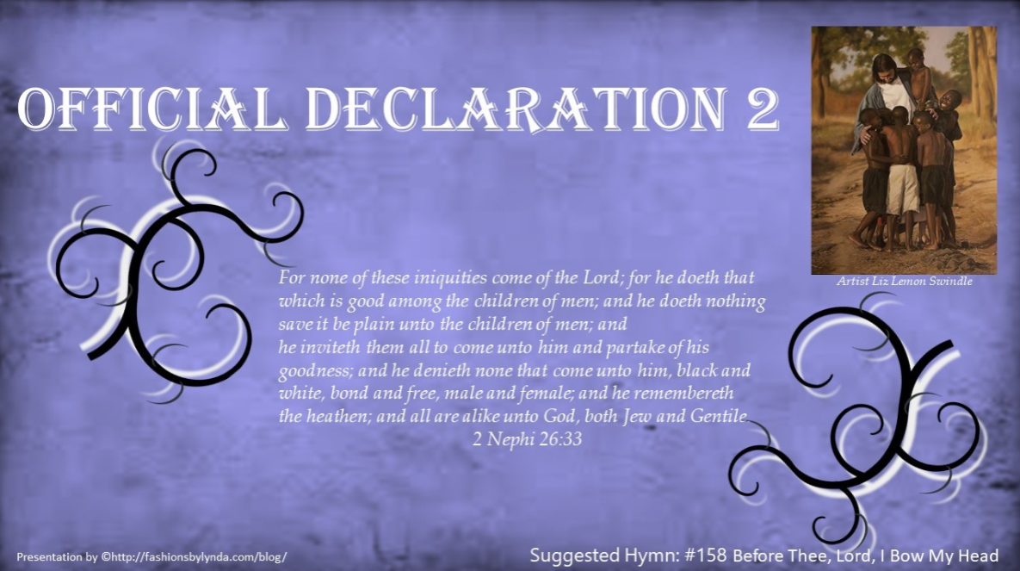

Slide 2

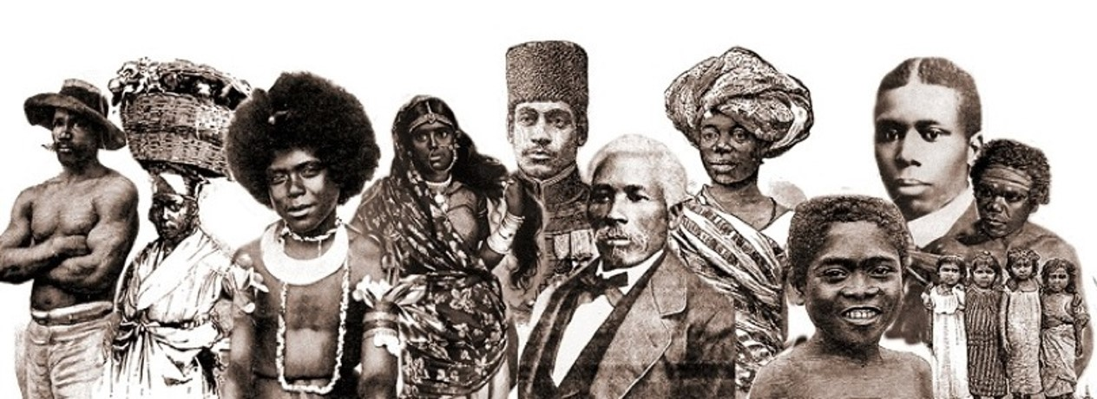
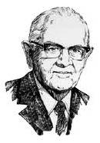
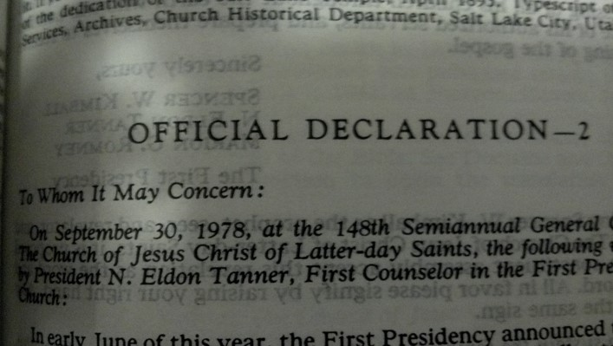
Introductory
During the 20th century, missionary work spread throughout the earth. Church leaders prayed for guidance concerning restrictions on priesthood ordination and temple ordinances for Church members of African descent.
A definitive revelation came to Church President Spencer W. Kimball and was affirmed to his counselors in the First Presidency and the members of the Quorum of the Twelve Apostles in the Salt Lake Temple on June 1, 1978.
In a letter dated June 8, 1978, they announced the revelation.

Slide 3
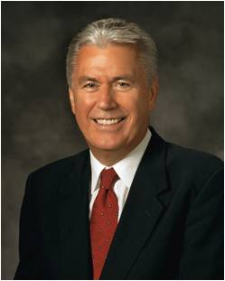
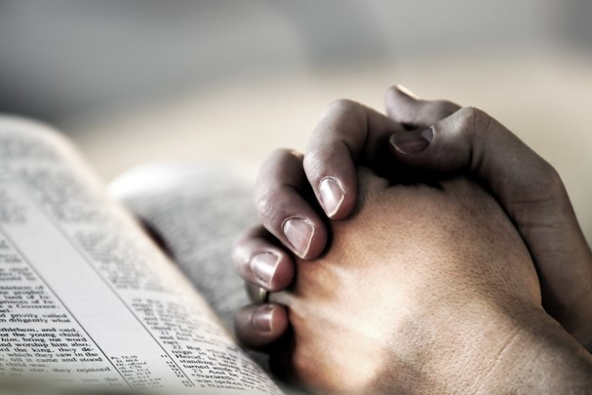

Asking is Good
If any of you lack wisdom, let him ask of God, that giveth to all men liberally, and upbraideth not; and it shall be given him.
But let him ask in faith, nothing wavering. For he that wavereth is like a wave of the sea driven with the wind and tossed.
James 1:5-6
“My dear young friends, we are a question-asking people because we know that inquiry leads to truth. …
“… Inquiry is the birthplace of testimony. Some might feel embarrassed or unworthy because they have searching questions regarding the gospel, but they needn’t feel that way. Asking questions isn’t a sign of weakness; it’s a precursor of growth.”
President Dieter F. Uchtdorf

Slide 4

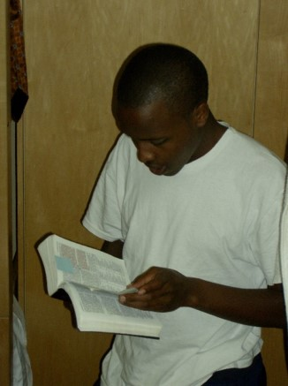
Ask God
And when ye shall receive these things, I would exhort you that ye would ask God, the Eternal Father, in the name of Christ, if these things are not true; and if ye shall ask with a sincere heart, with real intent, having faith in Christ, he will manifest the truth of it unto you, by the power of the Holy Ghost.
Moroni 10:4
“God commands us to seek answers to our questions and asks only that we seek ‘with a sincere heart, with real intent, having faith in Christ.’
When we do so, the truth of all things can be manifested to us ‘by the power of the Holy Ghost.’
“Fear not; ask questions. Be curious, but doubt not! Always hold fast to faith and to the light you have already received.”
President Dieter F. Uchtdorf

Slide 5
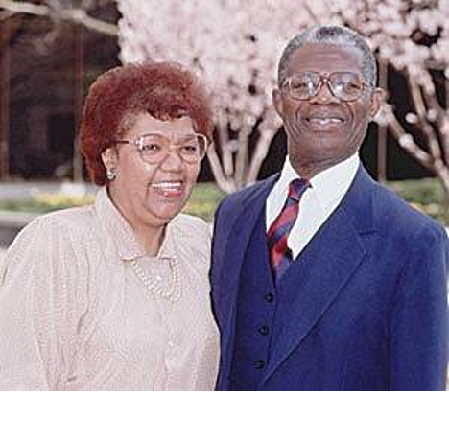
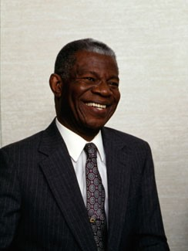
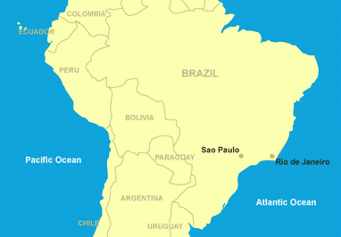
Elder Helvécio Martins
On a clear April night in 1972 … Helvécio Martins contemplated his family’s search for truth. He and his wife, Rudá, had investigated many religions, but none seemed to fill their spiritual void. ‘I conversed with God that night, asking for help,’
A few days later missionaries came to their home in Rio de Janeiro, Brazil. Elder Martins recalled, “The moment those two young men stepped into our apartment, all of my gloom and spiritual discomfort immediately disappeared and was replaced by a calm and serenity which I now know came from the influence of the Holy Spirit.”
Elder Helvécio Martins

Slide 6
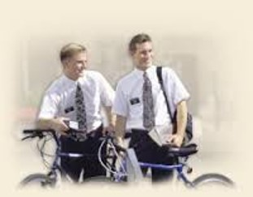
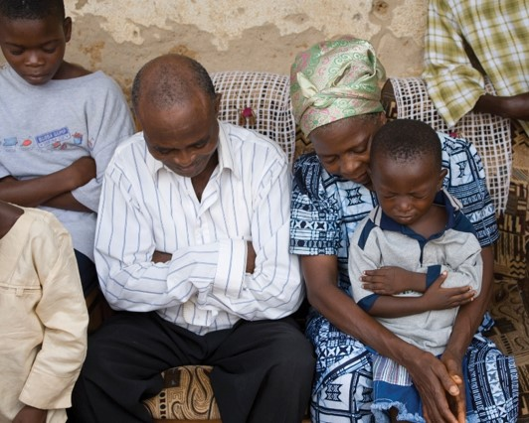
Asking Questions
As Helvécio and Rudá, who are of African descent, conversed with the missionaries, Helvécio asked about the role of black people in the Church.
The Martins learned that at that time, Church policy restricted black males of African descent from being ordained to the priesthood. This led them to ask the missionaries further questions.
Elder Helvécio Martins

Slide 7
The Book of Mormon teaches that “all are alike unto God,” including “black and white, bond and free, male and female” (2 Nephi 26:33).
Throughout the history of the Church, people of every race and ethnicity in many countries have been baptized and have lived as faithful members of the Church.
During Joseph Smith’s lifetime, a few black male members of the Church were ordained to the priesthood. Early in its history, Church leaders stopped conferring the priesthood on black males of African descent.
Church records offer no clear insights into the origins of this practice. Church leaders believed that a revelation from God was needed to alter this practice and prayerfully sought guidance. The revelation came to Church President Spencer W. Kimball and was affirmed to other Church leaders in the Salt Lake Temple on June 1, 1978. The revelation removed all restrictions with regard to race that once applied to the priesthood.
Official Declaration 2 Introductory

Slide 8

Official Position of the Church
“Church records offer no clear insights into the origins of this practice.”
While some people may suggest reasons why males of African descent were not ordained to the priesthood for a time, those reasons may not be accurate.

Slide 9

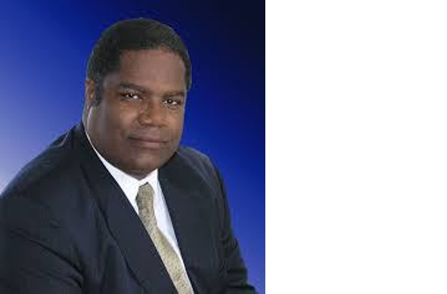
The Martins Family
The Martins family was baptized on July 2, 1972, and served faithfully in the Church.
When their oldest son, Marcus, received his patriarchal blessing, it promised that he would preach the gospel.
Although the priesthood restriction at that time prevented Marcus from serving a full-time mission, his parents opened a missionary savings account.
Elder Helvécio Martins

Slide 10
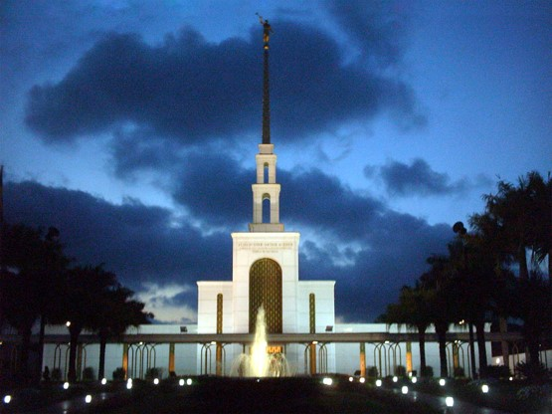
Temple to Be Built
In 1975 the Church announced that a temple would be built in São Paulo, Brazil.
To help with the fundraising, Sister Martins sold her jewelry.
Brother Martins faithfully served as a member of the publicity committee for the temple.
The Martins family made these sacrifices even though they believed they would not have the opportunity to receive priesthood ordinances in the temple.
Elder Helvécio Martins

Slide 11
Finding An Answer
Why do you think the Martins family was willing to be baptized and serve faithfully in the Church, even though they were affected by the priesthood restriction at that time?
“‘We had found the truth, and nothing would stop us from living it.’ … ‘When the Spirit tells you the gospel is true, how can you deny it?’”
Elder Helvécio Martins

Slide 12
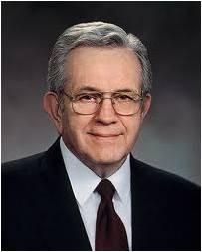
We Simply Do Not Know
“A teacher (leader and or missionary) must expect to be confronted frequently with difficult questions. Often these are questions to which there is no satisfying or comforting answer. A teacher cannot know everything. The Lord has not yet revealed everything. And yet, to a teacher the questions will come, asking about everything. [A teacher] should have the humility to say, ‘I don’t know.’ Often that will be the only true answer.”
I Don’t Know
It is appropriate to explain to others that we do not know why the priesthood restriction began. In addition, we can share and testify of the truths we do know.
President Boyd K. Packer

Slide 13
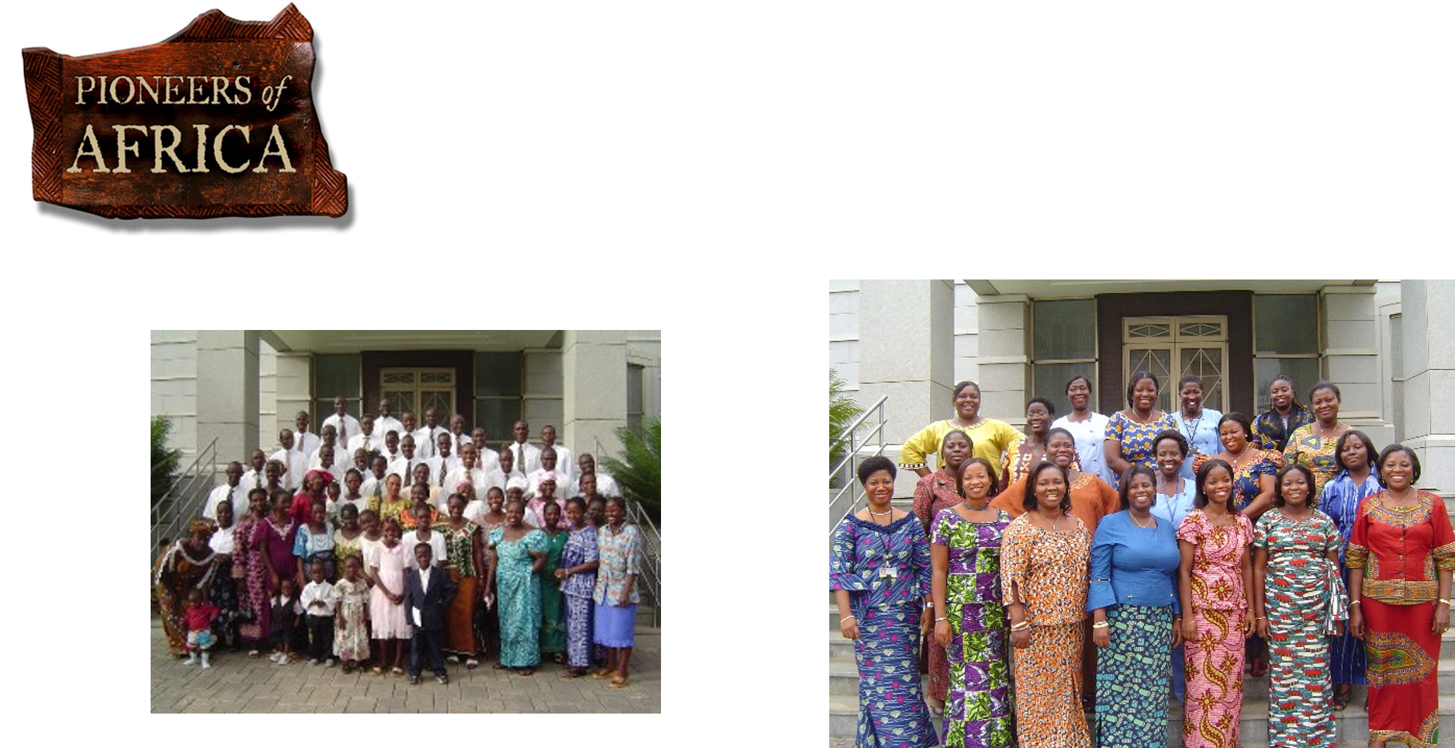
Coming to know of the truthfulness
Thousands of people of African descent in various nations had come to know of the truthfulness of the restored gospel in the decades preceding the 1978 revelation.

Slide 14
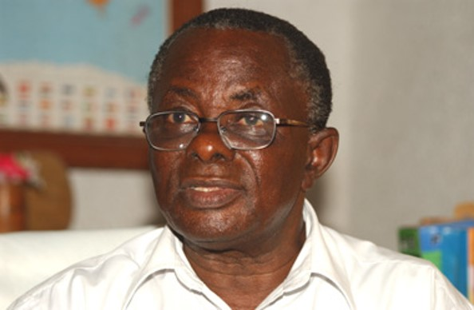
Preparing the Way
The LORD was preparing the way in black Africa many years before the 1978 Revelation!
Joseph W. B. Johnson received a “vision of Jesus and many angels in 1964, telling him to teach The Book of Mormon and the Joseph Smith Story to his countrymen.
He was one of the first black Africans who received the Priesthood after the 1978 Revelation.
Brother Joseph W. B. Johnson prepared several hundred people for baptism years before missionaries arrived.
By 1978, after much trial, tribulation, and persecution, Joseph W. B. Johnson had converted over 14,000 people to The Book of Mormon.
The great majority of these people were eventually baptized into the Church after 1978.
Lds.org

Slide 15


Letters from Africa
Church leaders in Salt Lake City received a flood of letters from unbaptized converts in Nigeria and Ghana requesting that missionaries be sent to Africa.
For years, Church leaders prayerfully considered the matter but felt the time had not yet come to send missionaries to Africa, where local members would not be able to preside or perform ordinances.

Slide 16


Official Declaration 2
Dear Brethren:
As we have witnessed the expansion of the work of the Lord over the earth, we have been grateful that people of many nations have responded to the message of the restored gospel, and have joined the Church in ever-increasing numbers. This, in turn, has inspired us with a desire to extend to every worthy member of the Church all of the privileges and blessings which the gospel affords.
Aware of the promises made by the prophets and presidents of the Church who have preceded us that at some time, in God’s eternal plan, all of our brethren who are worthy may receive the priesthood, and witnessing the faithfulness of those from whom the priesthood has been withheld, we have pleaded long and earnestly in behalf of these, our faithful brethren, spending many hours in the Upper Room of the Temple supplicating the Lord for divine guidance.

Slide 17
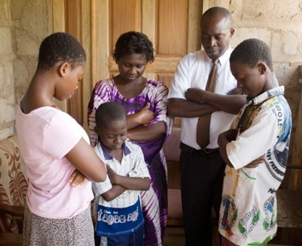
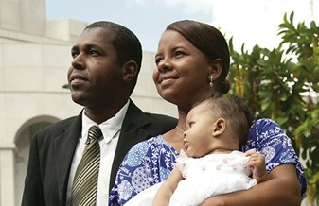
He Has Heard Our Prayers
The Lord directs His Church through revelation to His prophets.
He has heard our prayers, and by revelation has confirmed that the long-promised day has come when every faithful, worthy man in the Church may receive the holy priesthood, with power to exercise its divine authority, and enjoy with his loved ones every blessing that flows therefrom, including the blessings of the temple.
Accordingly, all worthy male members of the Church may be ordained to the priesthood without regard for race or color. Priesthood leaders are instructed to follow the policy of carefully interviewing all candidates for ordination to either the Aaronic or the Melchizedek Priesthood to insure that they meet the established standards for worthiness.

Slide 18

The Martins continued
“I could not contain my emotions. Rudá and I went into our bedroom, knelt down, and prayed. We wept as we thanked our Father in Heaven for an event we had only dreamed about. The day had actually arrived, and in our mortal lives.”
The Martins family was sealed in the temple. Their son Marcus was the first Church member of African descent to serve a mission after the revelation to end the priesthood restriction.
Helvécio Martins became a local priesthood leader and eventually was called to serve as a member of the Second Quorum of the Seventy.

Slide 19
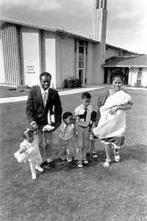
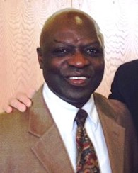
Joseph Freeman
Joseph Freeman, Jr. (born July 24, 1952) was the first man of black African descent to receive the Melchizedek priesthood and be ordained an Elder in The Church of Jesus Christ of Latter-day Saints (LDS Church) after the announcement of the 1978 Revelation on Priesthood, which allowed "all worthy male members of the Church" to "be ordained to the priesthood without regard for race or color."
Wikipedia

Slide 20
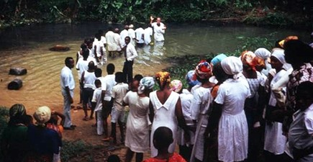
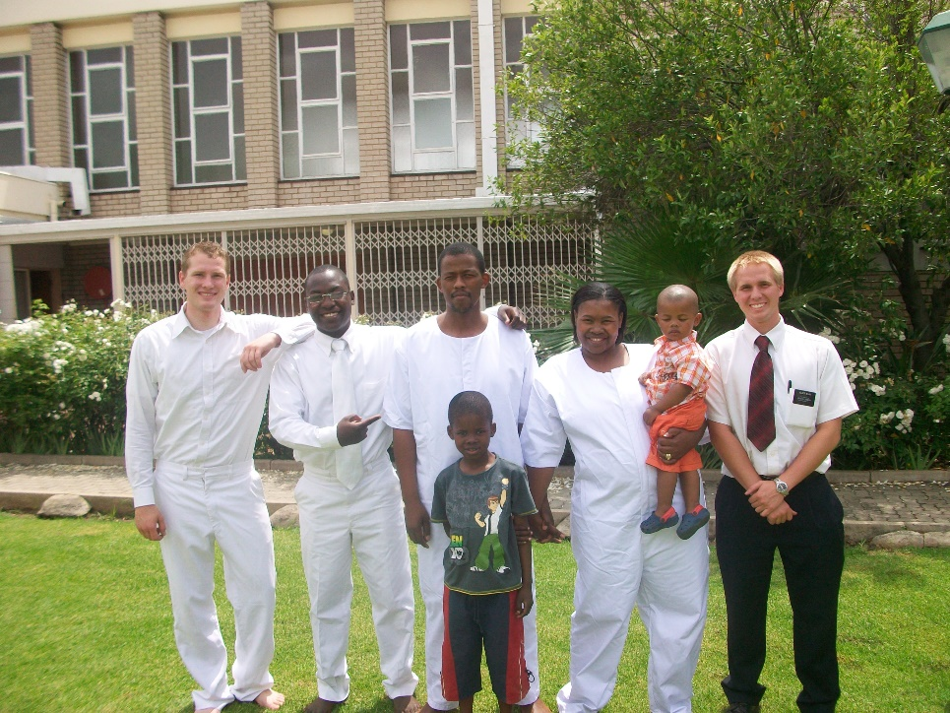
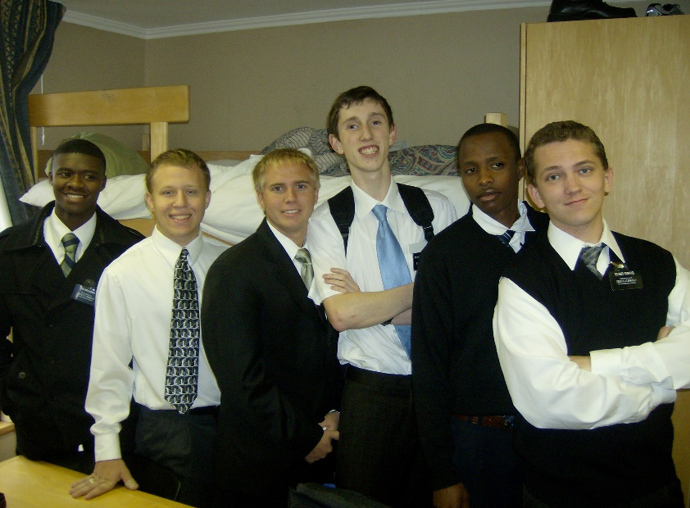
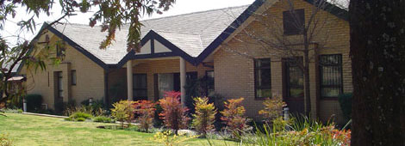
Missionaries to Africa
Soon after the revelation ending the priesthood restriction was received, missionaries were sent to Africa.
2008
Johannesburg Mission Training Center

Slide 21
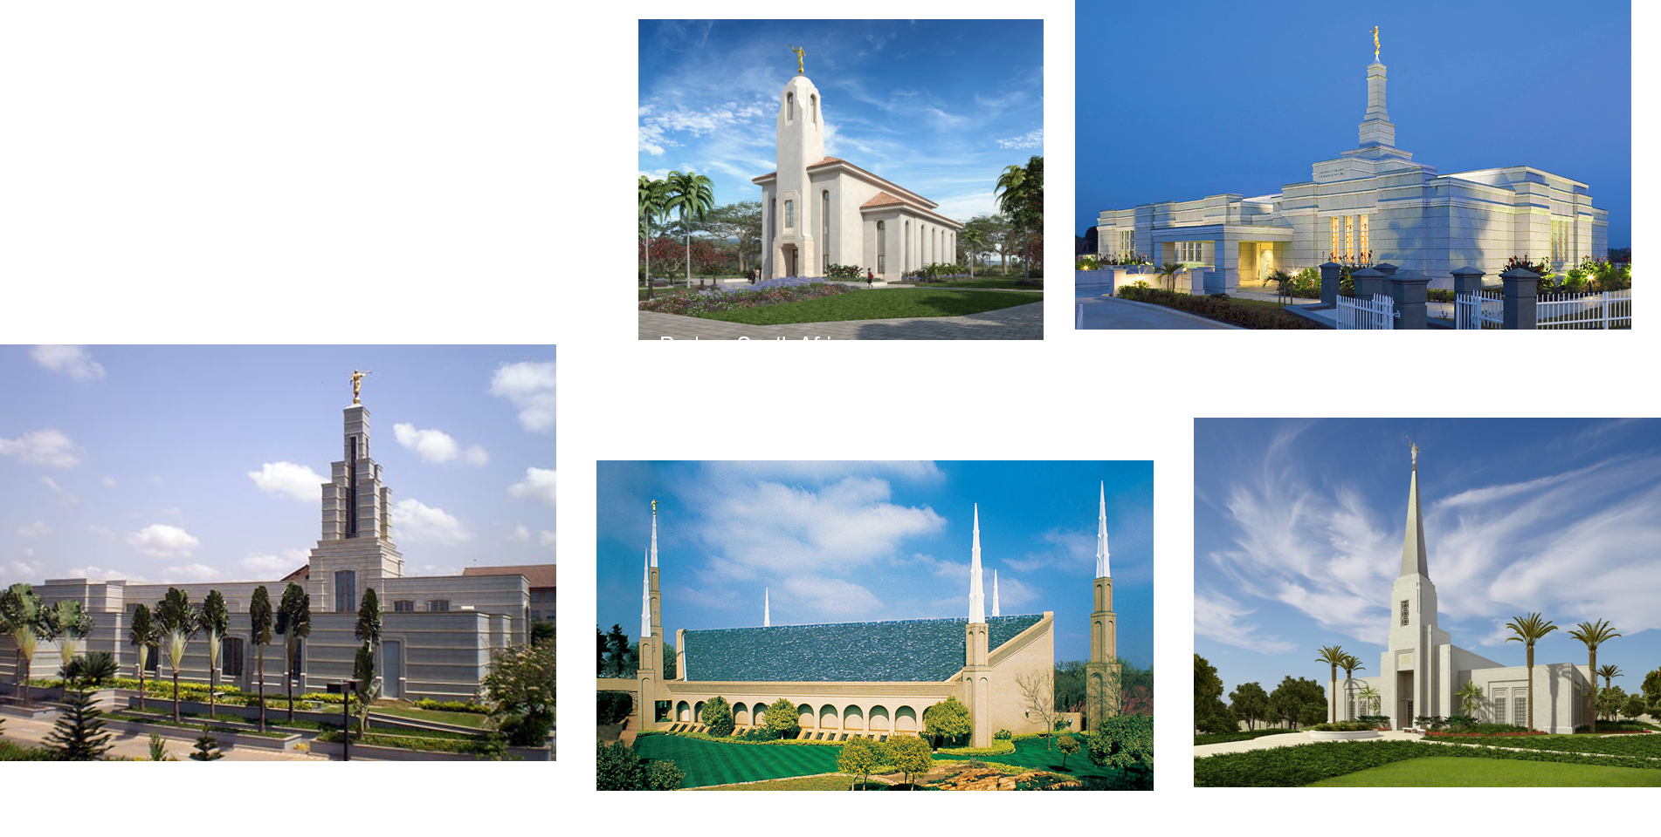
Temples in Africa
Temples have since been built on that continent, and hundreds of thousands of people there have received the ordinances of the gospel for themselves and for their deceased ancestors.

Slide 22
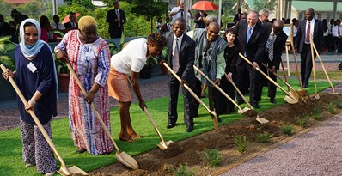
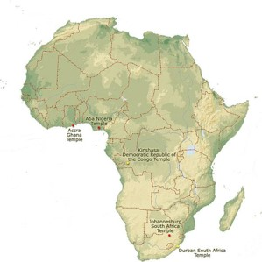
Oct. 02, 2018
The First Presidency of The Church of Jesus Christ of Latter-day Saints has announced open house and dedication dates for the Kinshasa Democratic Republic of the Congo Temple in Africa.
This will be the fourth operating temple in Africa. The three other temples currently operating are in Johannesburg, South Africa; Accra, Ghana; and Aba, Nigeria. The Durban South Africa Temple is under construction. Plans have been announced to build temples in Harare, Zimbabwe; Nairobi, Kenya; and the Abidjan Ivory Coast (Côte d’Ivoire).

Slide 23
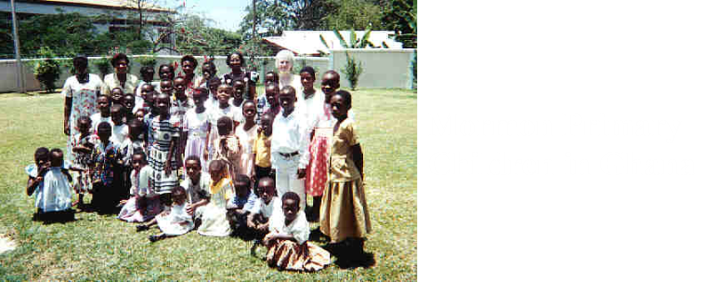
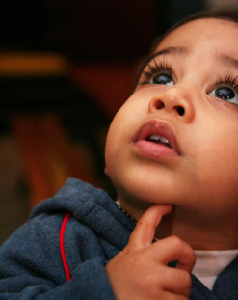
Sources:
He Denieth None That Come unto Him (2:22)
Long-Promised Day (8:41)
President Dieter F. Uchtdorf (“The Reflection in the Water”) [Church Educational System devotional, Nov. 1, 2009]
(“Elder Helvécio Martins of the Seventy,” Ensign, May 1990, 106).
(with Mark Grover, The Autobiography of Elder Helvécio Martins [1994], 43).
(in “Elder Helvécio Martins of the Seventy,” 106).
(Autobiography, 69–70)
Presentation by ©http://fashionsbylynda.com/blog/
President Boyd K. Packer(Teach Ye Diligently [1975], 65).
Joseph W. B. Johnson A Faithful, Visionary People Africa Southwest lds.org
https://www.lds.org/church/news/lessons-of-faith-from-church-history-in-africa?lang=eng
Presentation by ©http://fashionsbylynda.com/blog/

Slide 24
Official Declaration 2: Introductory
The Book of Mormon teaches that “all are alike unto God,” including “black and white, bond and free, male and female” (2 Nephi 26:33). Throughout the history of the Church, people of every race and ethnicity in many countries have been baptized and have lived as faithful members of the Church. During Joseph Smith’s lifetime, a few black male members of the Church were ordained to the priesthood. Early in its history, Church leaders stopped conferring the priesthood on black males of African descent. Church records offer no clear insights into the origins of this practice. Church leaders believed that a revelation from God was needed to alter this practice and prayerfully sought guidance. The revelation came to Church President Spencer W. Kimball and was affirmed to other Church leaders in the Salt Lake Temple on June 1, 1978. The revelation removed all restrictions with regard to race that once applied to the priesthood.
Official Declaration 2: Introductory
The Book of Mormon teaches that “all are alike unto God,” including “black and white, bond and free, male and female” (2 Nephi 26:33). Throughout the history of the Church, people of every race and ethnicity in many countries have been baptized and have lived as faithful members of the Church. During Joseph Smith’s lifetime, a few black male members of the Church were ordained to the priesthood. Early in its history, Church leaders stopped conferring the priesthood on black males of African descent. Church records offer no clear insights into the origins of this practice. Church leaders believed that a revelation from God was needed to alter this practice and prayerfully sought guidance. The revelation came to Church President Spencer W. Kimball and was affirmed to other Church leaders in the Salt Lake Temple on June 1, 1978. The revelation removed all restrictions with regard to race that once applied to the priesthood.
Official Declaration 2: Introductory
The Book of Mormon teaches that “all are alike unto God,” including “black and white, bond and free, male and female” (2 Nephi 26:33). Throughout the history of the Church, people of every race and ethnicity in many countries have been baptized and have lived as faithful members of the Church. During Joseph Smith’s lifetime, a few black male members of the Church were ordained to the priesthood. Early in its history, Church leaders stopped conferring the priesthood on black males of African descent. Church records offer no clear insights into the origins of this practice. Church leaders believed that a revelation from God was needed to alter this practice and prayerfully sought guidance. The revelation came to Church President Spencer W. Kimball and was affirmed to other Church leaders in the Salt Lake Temple on June 1, 1978. The revelation removed all restrictions with regard to race that once applied to the priesthood.
Official Declaration 2: Introductory
The Book of Mormon teaches that “all are alike unto God,” including “black and white, bond and free, male and female” (2 Nephi 26:33). Throughout the history of the Church, people of every race and ethnicity in many countries have been baptized and have lived as faithful members of the Church. During Joseph Smith’s lifetime, a few black male members of the Church were ordained to the priesthood. Early in its history, Church leaders stopped conferring the priesthood on black males of African descent. Church records offer no clear insights into the origins of this practice. Church leaders believed that a revelation from God was needed to alter this practice and prayerfully sought guidance. The revelation came to Church President Spencer W. Kimball and was affirmed to other Church leaders in the Salt Lake Temple on June 1, 1978. The revelation removed all restrictions with regard to race that once applied to the priesthood.

Slide 25
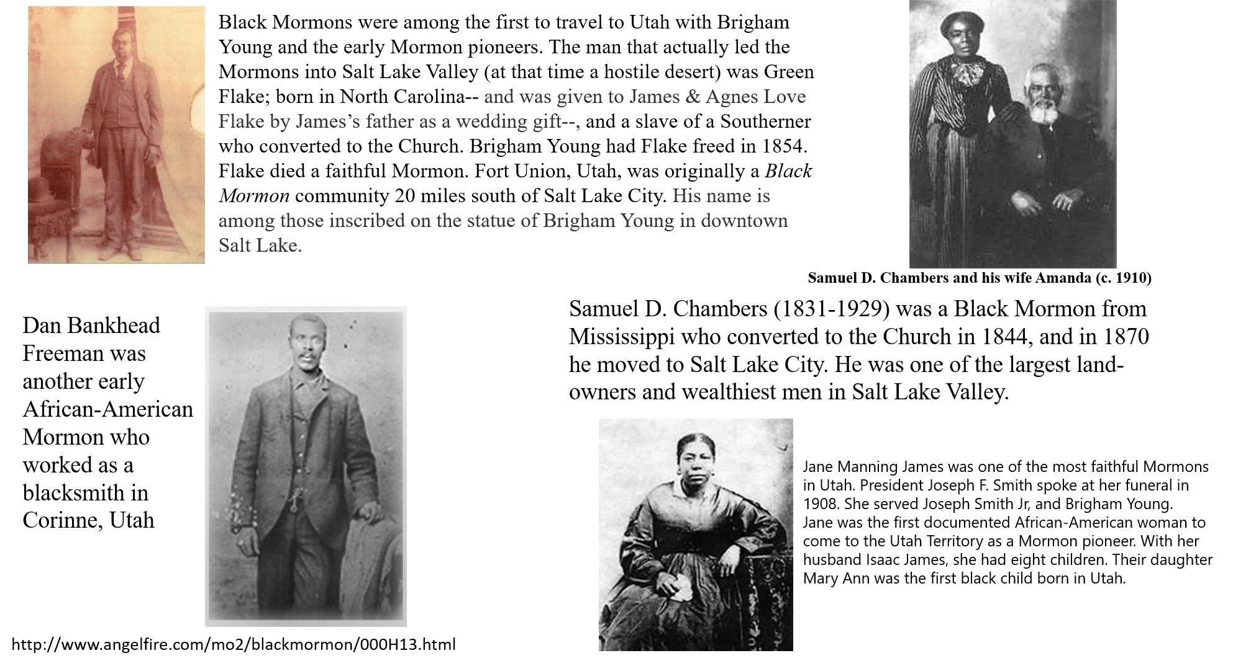

Slide 26
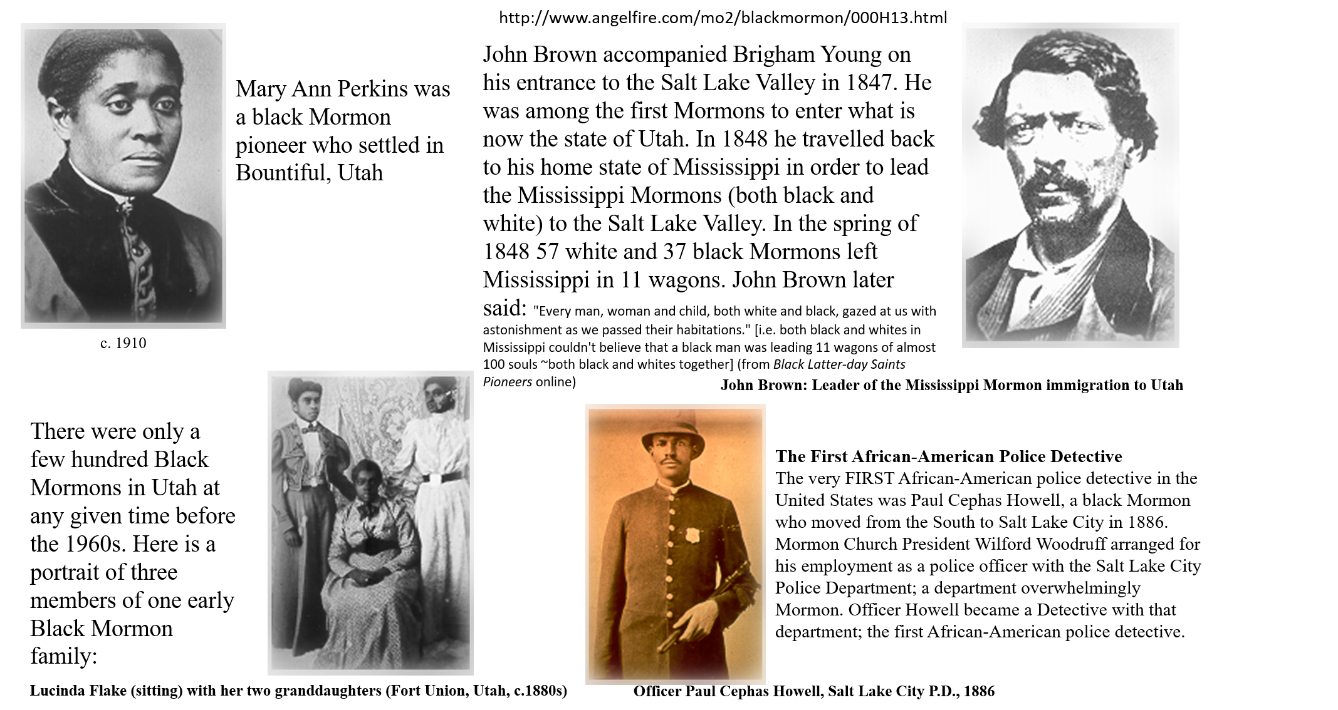

Slide 27
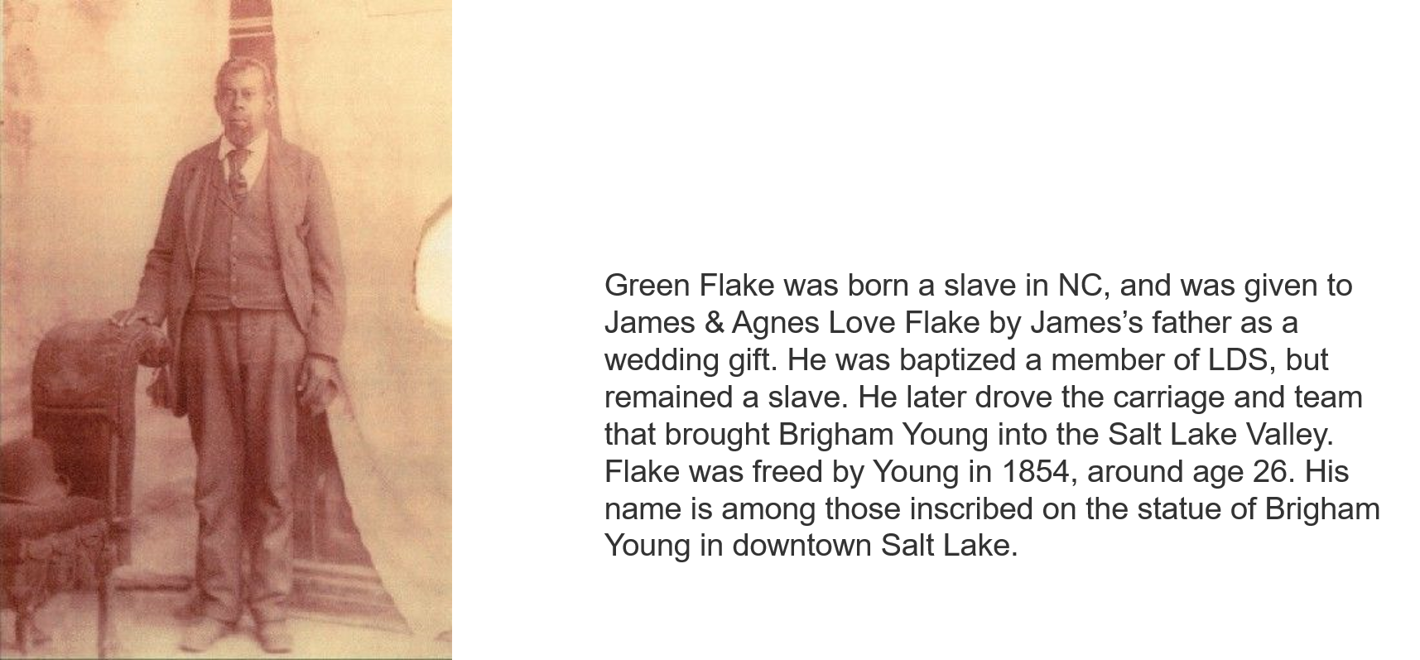

Slide 28
Helvécio Martins was born on 27 July 1930 to Honório and Benedicta Martins in Rio de Janeiro. He left school at age twelve to help support his seven brothers and sisters. “I have no regrets about the difficulties of my youth,” he said. “Learning to work hard has been a great asset in my life.”
After he married Rudá Tourinho de Assis on 7 December 1956, Rudá encouraged him to finish his high school equivalency, obtain a bachelor’s degree in accounting, and take graduate classes. Helvécio later became the financial management controller for the largest corporation in Brazil and later was the financial director for a subsidiary company. He also became an assistant professor at Rio de Janeiro State University.
The Martinses have four children: Marcus Helvécio, thirty-one; Marisa Helena, twenty-four; Raphael, fifteen; and Aline, thirteen; and three grandchildren: Flavio, Natalia, and Felipe. “We’re a family that loves to talk and tell stories—especially Helvécio,” says Rudá. “Often we’ll sit for hours talking, with the kids saying, ‘Dad, tell this story, tell that story.’ ”
Elder Martins has served as a counselor to two stake presidents, as a bishop, and, until June 1990, as president of the Brazil Forteleza Mission. Of his being the first black General Authority, he says, “Rudá and I are somewhat embarrassed [by all the publicity]. But if my calling encourages others and furthers the work, then the publicity is okay. It’s an enormous responsibility, but God is the same yesterday, today, and tomorrow, and I confide in him.”
Elder Martins served in the Second Quorum of the Seventy with distinction, and having fulfilled his five-year call, was honorably released on September 30, 1995.
Elder Helvecio Martins, 75, died May 14 in Sao Paulo, Brazil, of heart problems. Elder Neil L. Andersen of the Seventy, president of the Brazil South Area, said: "Elder Helvecio Martins was a living example of Alma 13:3: 'called and prepared from the foundation of the world according to the foreknowledge of God.' Within five days of meeting the missionaries in 1972, Brother Martins was at the Church, helping and cleaning, serving in whatever way he could. Once he believed something was right, he had a steel determination to hold firm and never let go. "Elder Martins' courage and determination continued to the end of his life. Just this past January, he graduated from law school at age 74. Asked to give a commencement address at graduation, Elder Martins stirred the faculty and students with a passionate plea of how the law must protect the interests of the traditional family. His talk ended with him receiving an extended standing ovation from those in attendance. His powerful witness of the Savior and of the Restoration was heard to the very end of his life. Each week as the gospel doctrine teacher in Sunday School, he raised his voice in testimony of those things he knew to be true.“
http://www.gapages.com/martih1.htm
Marcus Martins was born in Rio de Janeiro, Brazil, and became an American citizen in 2010. The Martins family joined the LDS Church in 1972. In February 1978, Marcus Martins became engaged to Mirian Abelin Barbosa, who had just returned from serving in the church's Brazil São Paulo South Mission. Initially they planned on getting married in May 1978, but then planned to postpone the marriage until after the dedication of the São Paulo Brazil Temple so Mirian could be sealed to her parents at the same time. However, she then decided to not follow that plan and they set a new marriage date of August 5. On June 8, 1978, Official Declaration—2 was announced. After much contemplation and prayer, Martins decided to serve a mission rather than get married. He served in the Brazil São Paulo North Mission from 1978 to 1980.^{[3]}
After returning from his mission, Martins married Mirian. He worked as a construction inspector and later as a systems analyst. During this time he also served as a bishop in the church (a position he would again occupy years later in Hawaii). In the early 1980s Martins was involved in making a new translation of the Book of Mormon into Portuguese.
Martins then went to Provo, Utah, where he studied for six years at Brigham Young University (BYU), earning degrees in business management, organizational behavior, and a Ph. D in Sociology. During his doctoral work he was a part-time Religion and Sociology instructor at BYU, and later worked as a religion professor at Ricks College, before taking a position at BYU-Hawaii in the Summer of 2000. As department chair at BYUH he put forth initiatives to enhance religious education through the use of educationa technology and public relations. He also served as chair of the Faculty Advisory Council (akin to a faculty senate), and member of the strategic planning and academic planning committees. He was the first BYU-Hawaii professor to work closely with BYU Television in taking academic lectures to an international audience.
He has spoken to LDS and professional audiences throughout the United States, Brazil, and Japan, and participated in professional conferences in China, Hong Kong, Malaysia, Singapore, and Qatar.
From 2011 to 2014, Martins served as president of the Brazil São Paulo North Mission
Wikipedia

Slide 29
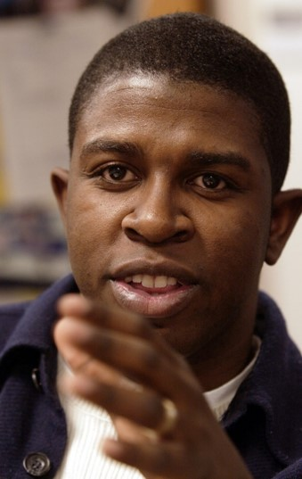
Rob Foster:
In February 2002 BYU's student body elected its first ever African American BYUSA president, Robert J. Foster, '03. The election's significance was heralded by students and journalists, but the occasion marked more than progress in race relations. It represented personal triumph.
Because his parents were struggling with drug addictions, Foster's extended family raised him. When he was 14 years old his father died of an overdose, and his mother moved from New Jersey to North Carolina to be with her children and conquer her own drug dependence. She returned to the Church of Jesus Christ, and Foster was soon baptized.
In addition to his parents' absence, Foster's youth was marked by a strong stutter that made him self-conscious and hesitant to participate in school. But on the high school basketball court, this hesitance disappeared. He earned an athletic scholarship to Ricks College, where after a mission to Arcadia, Calif., and two seasons on the team, he shifted his focus to leadership. "I thought clubs would be a great place to touch individual lives," he explains. His contributions earned him the Ricks College 2000 Man of the Year Award.
After graduating from Ricks, BYU was the natural next step. Foster became involved in BYUSA, and was soon appointed to the university student council. In January 2002 he decided to run for BYUSA president. He won the three-candidate election, securing 43 percent of the votes.
Foster—the first African American student body president of a largely white school—faced the bright media spotlight cast on Utah by the 2002 Olympic Winter Games. He suddenly had two or three interviews a week and seemingly endless speaking engagements—a significant challenge for someone who hated even speaking in class. "I'm not one that likes to draw attention to myself," he says. "However, if I feel the cause is necessary and that someone needs to speak, I'm not afraid to."
The attention is something Foster did not anticipate and feels he does not deserve. "Being the first African American president here is an honor, but where much is given much is required," he says. "I feel that I have a lot of work to accomplish here."
A current emphasis is solidifying the gospel choir he started during his first year at BYU as vice president of the Black Student Union.
"It's a passion of mine, something I love being a part of," he says. "I'm not the greatest singer, but I've learned how to lead people."
Foster, who will graduate in April and plans to attend optometry school, thinks his experience with BYUSA will help him be a stronger leader;
but the best thing it has taught him is the meaning of service. "People ask if this was a resume filler. Absolutely not. In reality it would be so
much easier to not do BYUSA, but I feel that I'm able to give so much to the student body and to individuals that might need it.“
LEARNING TO LEAD By Charity Brunson, '04 BYU Magazine
After graduation he received additional training in Specialty Contact Lenses and Corneal Disease training at the Contact Lens Institute in Raleigh, NC
Dr. Foster started Legacy Eye Care to offer patients outstanding eye care at an affordable price. Giving patients the best technology available along with
great patient care. He specializes in Specialty Contact Lenses fits, Vision Therapy, the Dynamic Reader program for children reading below grade level and
improved Geriatric care.—Legacy Eye Care, Dr. Rob Foster

Slide 30
Joseph W.B. Johnson of Ghana.
He later recounted this vision:
"One early morning about 5:30 am, while about to prepare for my daily work, I saw the heavens open and angels with trumpets singing songs of praise unto God...In the course of this I heard my name mentioned thrice, 'Johnson, Johnson, Johnson. If you will take up my work as I command you, I will bless you and your land.' Trembling and in tears, I replied, 'Lord, with Thy help I will do whatever you will command me.' From that day onward, I was constrained by that Spirit to go from street to street...to deliver the message which we read from The Book of Mormon...I did exactly as the Lord commanded me...and immediately our persecution started." (Mormon Identities in Transition, p.84)
Avoid attaching man-made reasons to God’s revelations
“In a 1988 interview on the tenth anniversary of the revelation on the priesthood, [Elder Dallin H. Oaks of the Quorum of the Twelve Apostles] explained [his] attitude toward attempts to supply mortal reasons for divine revelation:
“‘If you read the scriptures with this question in mind, “Why did the Lord command this or why did he command that,” you find that in less than one in a hundred commands was any reason given.
It’s not the pattern of the Lord to give reasons. We [mortals] can put reasons to revelation. We can put reasons to commandments. When we do, we’re on our own.
Some people put reasons to the one we’re talking about here, and they turned out to be spectacularly wrong.
There is a lesson in that. … I decided a long time ago that I had faith in the command and I had no faith in the reasons that had been suggested for it.’
“When asked if [he] was even referring to reasons given by General Authorities, [he] replied:
“‘I’m referring to reasons given by general authorities and reasons elaborated upon … by others. The whole set of reasons seemed to me to be unnecessary risk taking.
… Let’s don’t make the mistake that’s been made in the past, here and in other areas, trying to put reasons to revelation.
The reasons turn out to be man-made to a great extent. The revelations are what we sustain as the will of the Lord and that’s where safety lies’
[“Apostles Talk about Reasons for Lifting Ban,” Daily Herald, Provo, Utah, June 5, 1988, 21 (AP)]” (Dallin H. Oaks, Life’s Lessons Learned [2011], 68–69).
Elder M. Russell Ballard
“In our Heavenly Father’s great priesthood-endowed plan, men have the unique responsibility to administer the priesthood, but they are not the priesthood. Men and women have different but equally valued roles. Just as a woman cannot conceive a child without a man, so a man cannot fully exercise the power of the priesthood to establish an eternal family without a woman. In other words, in the eternal perspective, both the procreative power and the priesthood power are shared by husband and wife. And as husband and wife, a man and a woman should strive to follow our Heavenly Father. The Christian virtues of love, humility, and patience should be their focus as they seek the blessings of the priesthood in their lives and for their family.
“It is crucial for us to understand that Heavenly Father has provided a way for all of His sons and His daughters to have access to the blessings of and be strengthened by the power of the priesthood” (“This Is My Work and Glory,” Ensign or Liahona,May 2013, 19).
People of African descent can be found in large numbers all over the world. There are over 100,000,000 Black people in southern India, mostly of the Dalit group. More Black people live in Brazil than in the United States of America. The majority of people in the Caribbean are also of African descent. If one travels to the Pacific Islands, to Borneo, Fiji, Vanuatu, or the Solomon Islands, it becomes obvious that the original inhabitants of those lands came from Africa. Even the so-called Aborigines of Australia and New Zealand have African roots.
Africans dispersed from the Motherland in many periods of history, not just during the Slave Trade.
http://www.afro-vision.com/The_African_Diaspora_.html

Slide 31
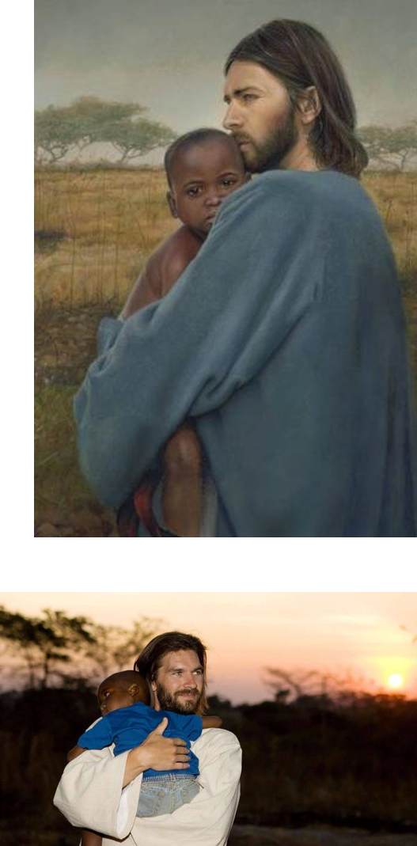
AMERICAN FORK — One day in June 2007, Phillip Miner woke up in a backpacker’s hostel near Lusaka, Zambia, and couldn’t get out of bed. He was dizzy and felt that he might vomit.
For the past few days Miner, with trimmed beard and chocolate-brown, shoulder-length hair, had dressed as Jesus and interacted with African orphans as part of a photo and video shoot. Despite being "a shy people-avoider," he was suddenly the center of attention, and the experience had left him emotionally drained.
“I was overcome, stretched beyond my ability to cope,” Miner said as he sat comfortably on a sofa in an art studio. “But it was fairly clear to me at the time that it was not just physical symptoms; it was much more.”
Those were the circumstances right before Miner had the spiritual awakening of his life.
Acting as the Savior brought Miner closer to the Savior. Two months after modeling as the Savior in Africa, Miner had a new faith, wife and family.
“The truth is the Spirit touched my heart and gave me a wake-up call,” Miner said. “He knows me and loves me.”
The shoot took place at a Zambian orphanage for children whose parents had died of AIDS. Some of the children also had AIDS. Zambia is a Christian nation, so the children were all familiar with the figure of Christ.
Miner worried how the children would react if they learned he wasn’t the real Jesus. He hoped they wouldn’t be as annoyed as he was when he learned the truth about Santa Claus. But even when he said his name was Phillip, the children gushed with tears of happiness and came forward to hug him. They also sang songs about Heavenly Father in broken English.
Meanwhile, [artist Liz Lemon] Swindle said she was walking on eggshells. As Miner played with the children in front of the cameras for a few days, Swindle struggled to find inspiration and battled the desire to go home. Yet the artist was also concerned about Miner, who was starting to feel ill with flu-like symptoms. During one difficult moment, she offered a prayer. When she looked up, she saw Miner holding a 3-year-old boy named Kennedy. At that moment, he kissed the back of the orphan’s head.
“That was so darling to me,” Swindle said. “He (Kennedy) looked right at me with no life in his eyes. An epiphany just washed right over me. Here is what you should paint. This is Africa. This little Kennedy represents the hopelessness, the sadness, the death and the poverty that no amount of dollars can fix. The only one who can fix this problem is the Savior. The symbolism of the Savior kissing this little African boy was so profound and so simple. I had the shot and the whole thing shifted for me.”
Swindle eventually painted “The Worth of a Soul” for Mothers Without Borders. The artist later wrote: "For the first time in my life I felt what Isaiah meant when he said, 'He will swallow up death in victory, and the Lord God will wipe away tears from off all faces.' To Kennedy and all who struggle to understand why, I promise that God has not forgotten you.“
In an effort to spread hope, Swindle is working with churches and other groups to give away free pictures of Jesus Christ. She believes it will inspire people.
Excerpts from: Modeling as Savior helps man find his faith By Trent Toone, Deseret News Dec. 7 2011

Slide 32
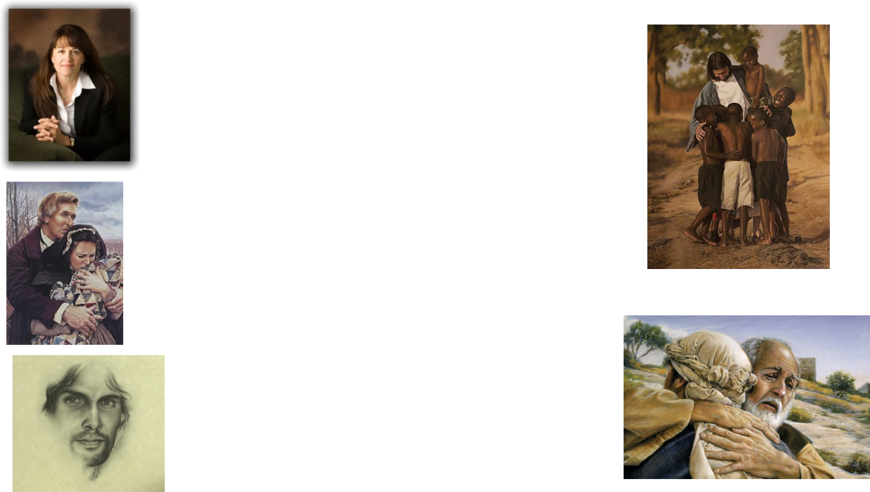
Liz Lemon Swindle began her painting career in first grade. Her first exhibitions were on the refrigerator, encouraged by her father. In the early 1980s she tutored under renowned wildlife artist, Nancy Glazier. In 1992, Liz began painting a subject matter she had long desired to approach: her faith. Her paintings are now held in corporate and private collections around the world and have been published in countless magazines and books. Liz and her husband Jon have five children and thirteen grandchildren (FoundationArts.com).
Swindle is a member of The Church of Jesus Christ of Latter-day Saints and her devout belief inspires the themes of most of her work. She is extremely prolific, and has created numerous paintings around a central theme, one group being of the life and experiences of Mormon prophet Joseph Smith, and another group centered on the life of Christ.
The following is her bio as reported by The Greenwich Workshop:
  Liz Lemon Swindle has a deep, abiding faith that she feels blessed to share through her art. A lifelong Utah resident, she studied fine arts at Utah State University. She worked for several years as a set designer and painter for the Osmond Studios television production company. As her family grew (she and her husband Jon Swindle today have five children), she saw the need for a more flexible career and decided to focus on oil painting. In the early 1980s she tutored under renowned wildlife artist Nancy Glazier and soon after established her own impressive reputation as a wildlife painter, participating in shows at major galleries in the central and western United States. However, Lemon Swindle became increasingly discontent, feeling artistically and spiritually unfulfilled. In October 1988 she reached a turning point when she submitted a portrait of children to the National Arts for the Parks competition and received the coveted Founders' Favorite award. She realized then that there was an audience for her portrait painting and by the early 1990s she had devoted herself to the topic closest to her heart: her faith. A one-woman show of her Christian art traveled to cities nationwide in the summer of 1997 and a book of her paintings, "She Shall Bring Forth a Son" was published in 1998.
"If we can get a picture of Christ in every home, that would be the coolest thing in the whole world," she said. "I don't want people to think I would profit by it ... but you live differently when you know Christ.“ Liz Lemon Swindle--Deseret News

