Slide 1
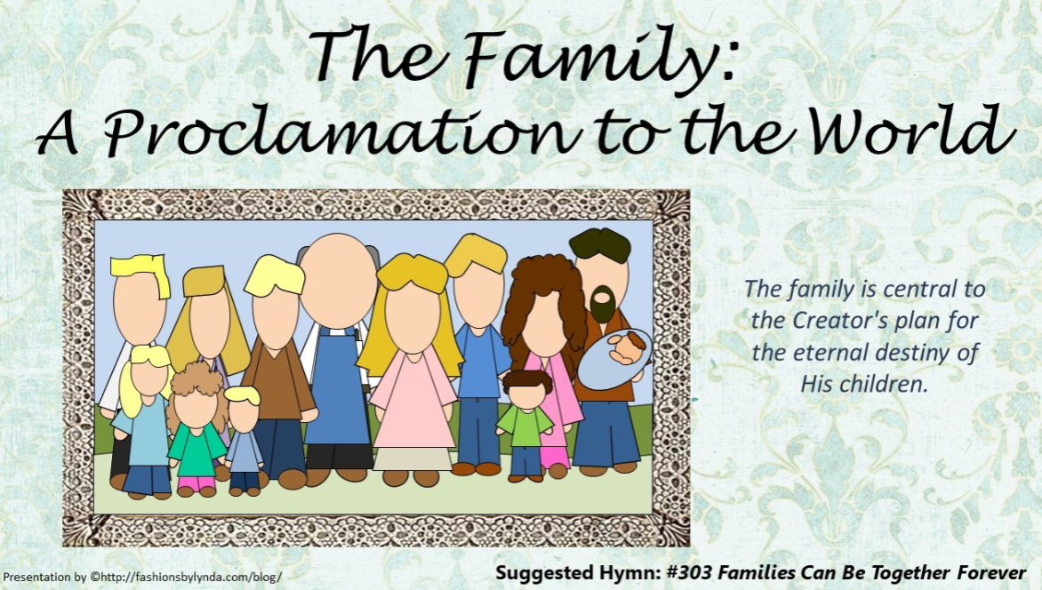

Slide 2
The importance of marriage and family
Roles
of fathers
Gender
Sexual relations outside of marriage
Abortion
Divorce
Abuse
Having Children
Happiness in
families
Same-sex marriage
Roles of mothers
Where do you think people often go to find answers about these issues?

Slide 3


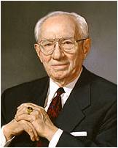
September 23, 1995
“With so much of sophistry that is passed off as truth, with so much of deception concerning standards and values, with so much of allurement and enticement to take on the slow stain of the world, we have felt to warn and forewarn.
In furtherance of this we of the First Presidency and the Council of the Twelve Apostles now issue a proclamation to the Church and to the world as a declaration and reaffirmation of standards, doctrines, and practices relative to the family which the prophets, seers, and revelators of this church have repeatedly stated throughout its history”
--President Gordon B. Hinckley

Slide 4

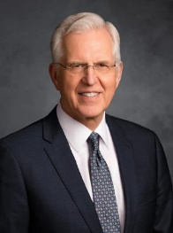

Family is central to Heavenly Father’s plan for His children.
Knowing why we left the presence of our Heavenly Father and what it takes to return and be exalted with Him, it becomes very clear that nothing relative to our time on earth can be more important than physical birth and spiritual rebirth, the two prerequisites of eternal life. …
A family built on the marriage of a man and woman supplies the best setting for God’s plan to thrive—the setting for the birth of children, who come in purity and innocence from God, and the environment for the learning and preparation they will need for a successful mortal life and eternal life in the world to come.
D. Todd Christofferson

Slide 5

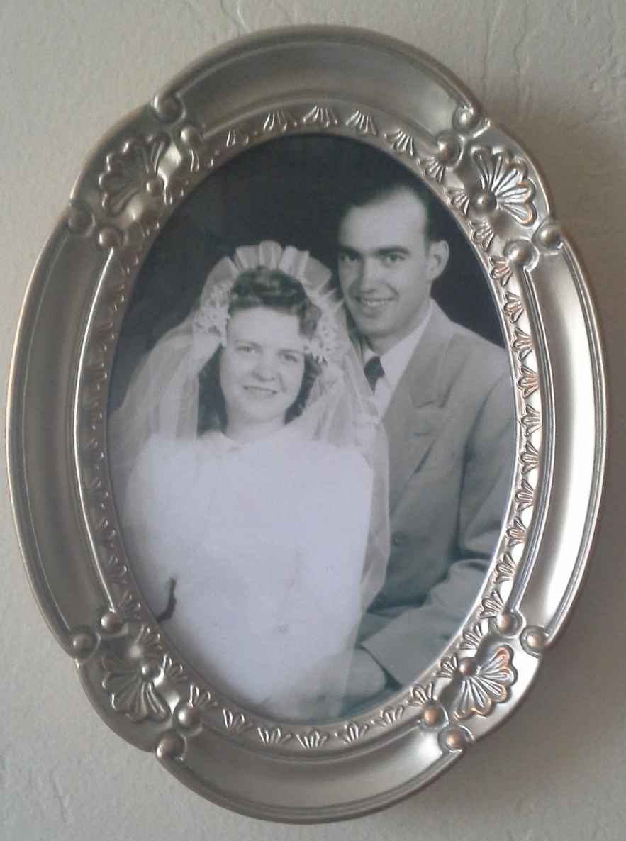

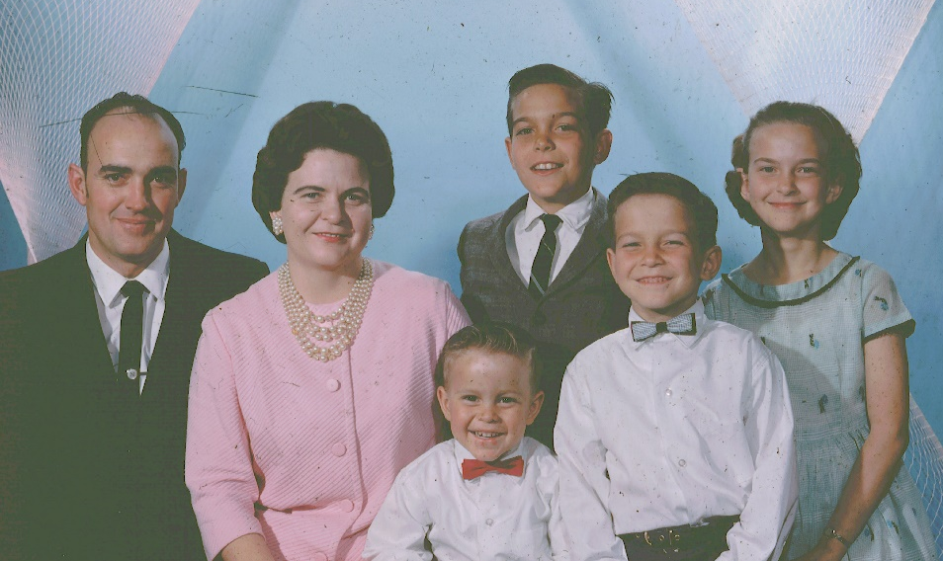
Marriage
The First Presidency and Council of the Twelve Apostles of The Church of Jesus Christ of Latter-day Saints
We, the First Presidency and the Council of the Twelve Apostles of The Church of Jesus Christ of Latter-day Saints, solemnly proclaim that marriage between a man and a woman is ordained of God and that the family is central to the Creator’s plan for the eternal destiny of His children.
The Blau Family
Nibley,, Utah
Marriage between a man and a woman is ordained of God
The family is central to Heavenly Father’s plan
Paragraph 1

Slide 6

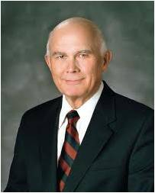
What if people feel the teachings of the family proclamation exclude them?
Some who are listening to this message are probably saying, “But what about me?”
We know that many worthy and wonderful Latter-day Saints currently lack the ideal opportunities and essential requirements for their progress.
Singleness, childlessness, death, and divorce frustrate ideals and postpone the fulfillment of promised blessings. …
But these frustrations are only temporary.
The Lord has promised that in the eternities no blessing will be denied his sons and daughters who keep the commandments, are true to their covenants, and desire what is right.
Dallin H. Oaks

Slide 7



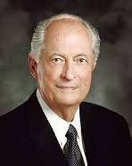
Satan’s most strenuous opposition is directed at whatever is most important to [God’s] plan.
Consequently, he seeks to oppose progress toward exaltation by distorting marriage, discouraging childbearing, or confusing gender.
However, we know that in the long run, the divine purpose and plan of our loving Heavenly Father will not be changed.
Personal circumstances may change, and God’s plan assures that in the long run, the faithful who keep their covenants will have the opportunity to qualify for every promised blessing.
Marriage and family are under attack because Satan knows that they are essential to obtaining eternal life—as essential as the Creation, the Fall, and the Atonement and Resurrection of Jesus Christ.
Having failed to destroy any of those pillars of the plan, Satan seeks to destroy our understanding and practice of marriage and family.
Dallin H. Oaks
Robert D. Hales

Slide 8


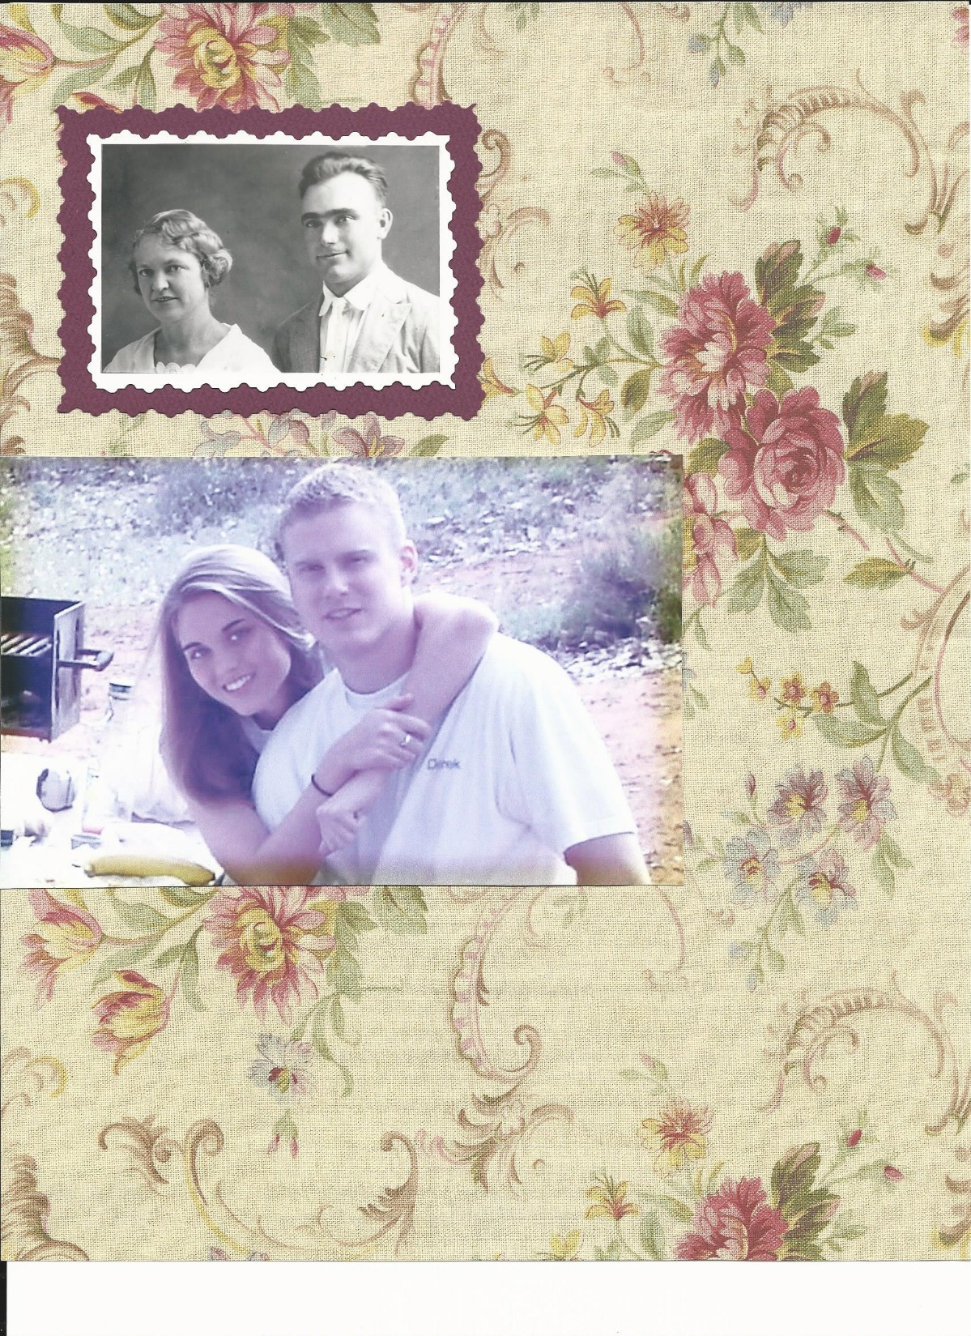
Gender
All human beings—male and female—are created in the image of God.
Each is a beloved spirit son or daughter of heavenly parents, and, as such, each has a divine nature and destiny.
Gender is an essential characteristic of individual premortal, mortal, and eternal identity and purpose.
Leeta Richardson Blau
Paragraph 2
George Blau

Slide 9

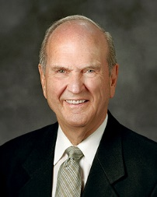


First and foremost, you are a child of God.
Second, as a member of the Church, you are a child of the covenant.
And third, you are a disciple of Jesus Christ.
Tonight, I plead with you not to replace these three paramount and unchanging identifiers with any others, because doing so could stymie your progress or pigeonhole you in a stereotype that could potentially thwart your eternal progression. …
There are various labels that may be very important to you, of course.
Please do not misunderstand me. I am not saying that other designations and identifiers are not significant. I am simply saying that no identifier should displace, replace, or take priority over these three enduring designations: “child of God,” “child of the covenant,” and “disciple of Jesus Christ.”
Russell M. Nelson

Slide 10


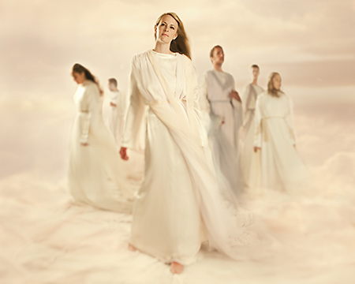
Premortal Realm
For as in Adam all die, even so in Christ shall all be made alive.
1 Corinthians 15:22
In the premortal realm, spirit sons and daughters knew and worshipped God as their Eternal Father and accepted His plan by which His children could obtain a physical body and gain earthly experience to progress toward perfection and ultimately realize their divine destiny as heirs of eternal life.

Slide 11

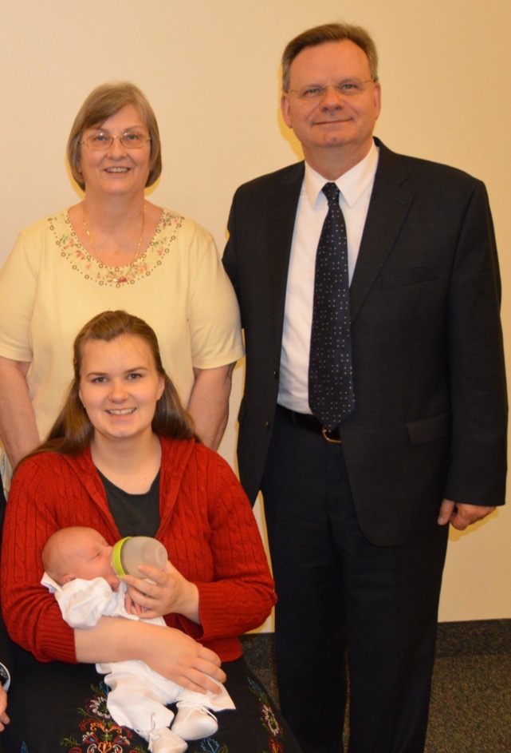

Divine Plan of Happiness
The divine plan of happiness enables family relationships to be perpetuated beyond the grave.
Sacred ordinances and covenants available in holy temples make it possible for individuals to return to the presence of God and for families to be united eternally.
The Miller Family
Caserta, Italy
Paragraph 3

Slide 12


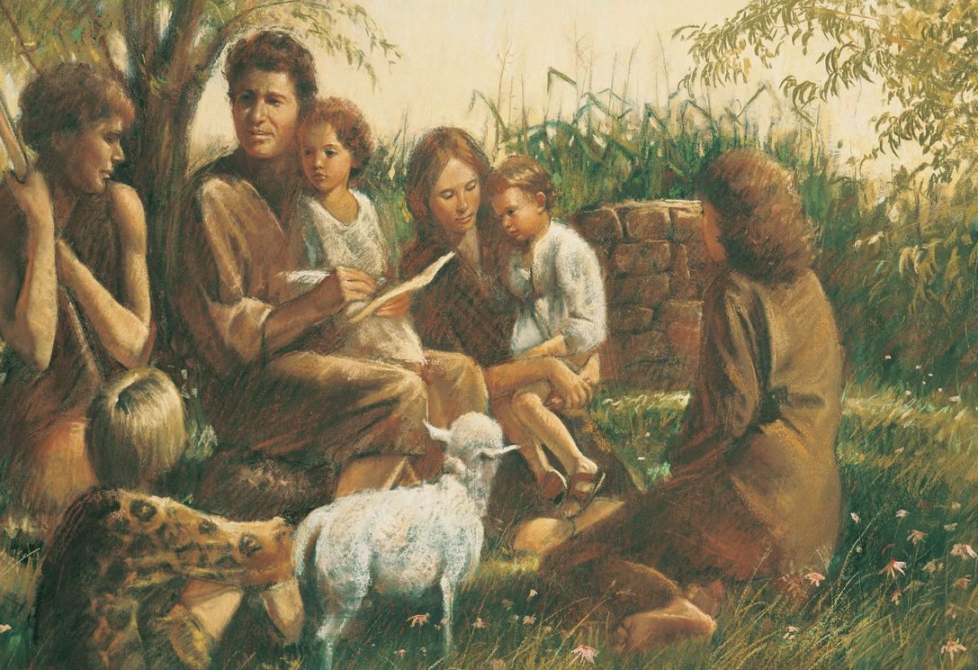
To Have Children
The first commandment that God gave to Adam and Eve pertained to their potential for parenthood as husband and wife.
God’s commandment for husbands and wives to have children remains in force today
Paragraph 4

Slide 13


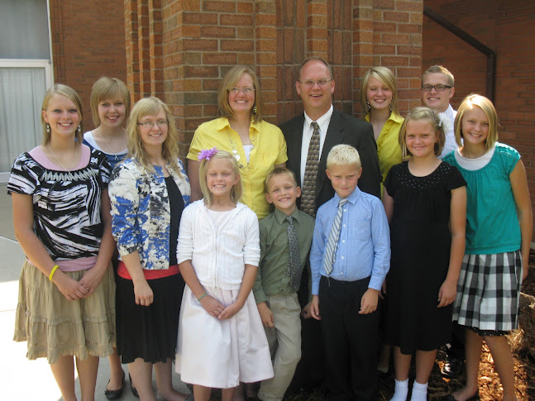
Lawfully Wedded
We further declare that God has commanded that the sacred powers of procreation are to be employed only between man and woman, lawfully wedded as husband and wife.
Paragraph 4
The Rhiner Family

Slide 14


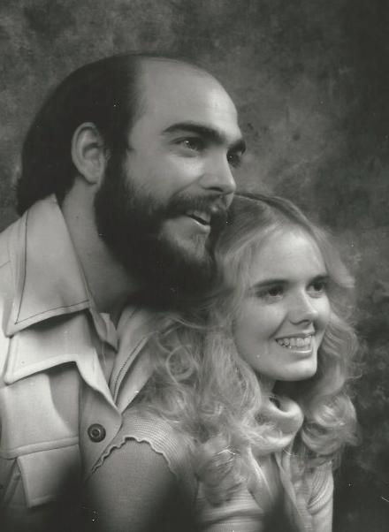
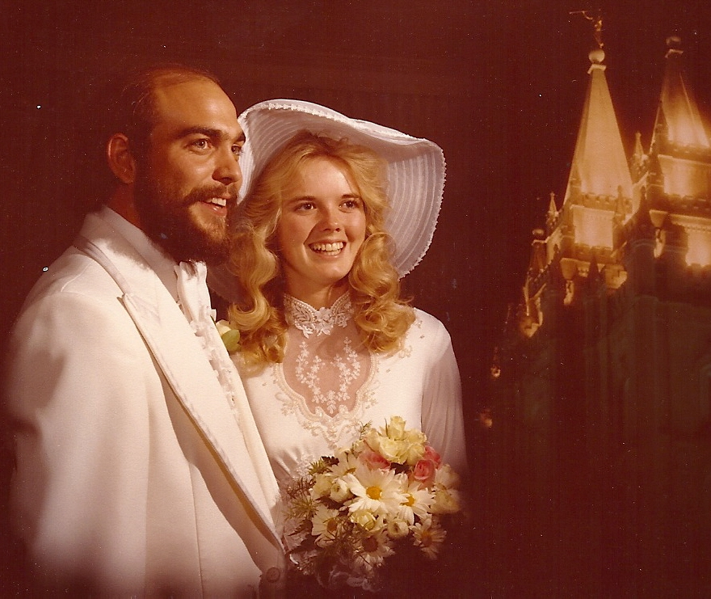
“I also assert the virtue of a temple marriage. It is the highest and most enduring type of marriage that our Creator can offer to His children.”
“While salvation is an individual matter, exaltation is a family matter.”
That proclamation on the family helps us realize that celestial marriage brings greater possibilities for happiness than does any other relationship.”
Elder Russell M. Nelson

Slide 15

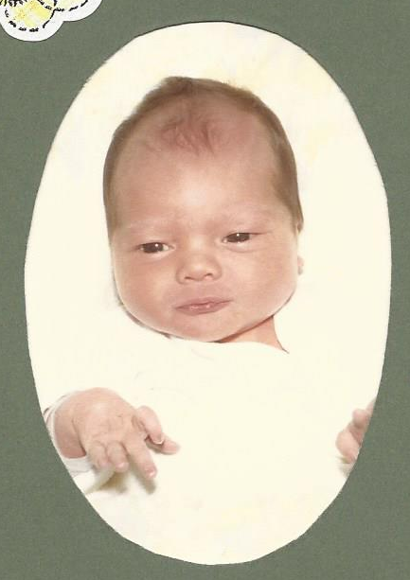

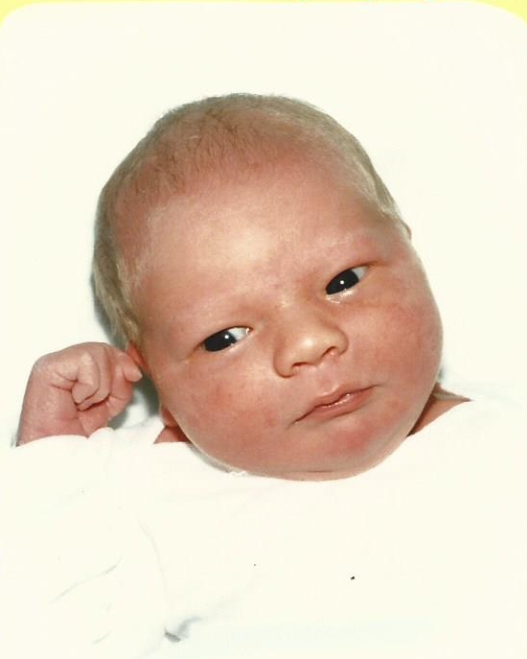
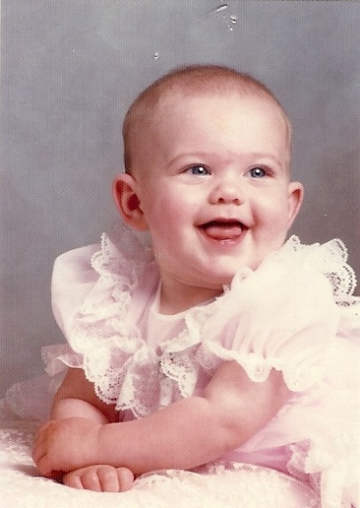
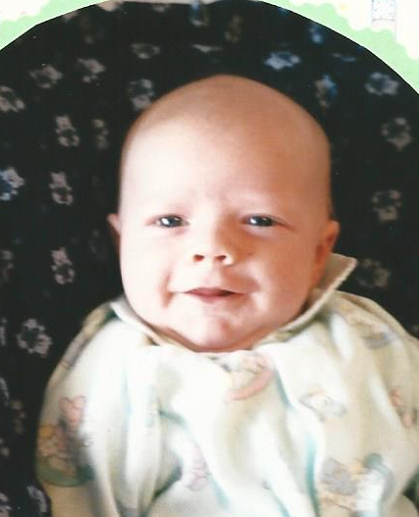
Divinely Appointed
We declare the means by which mortal life is created to be divinely appointed. We affirm the sanctity of life and of its importance in God’s eternal plan.
Paragraph 3 and 5

Slide 16


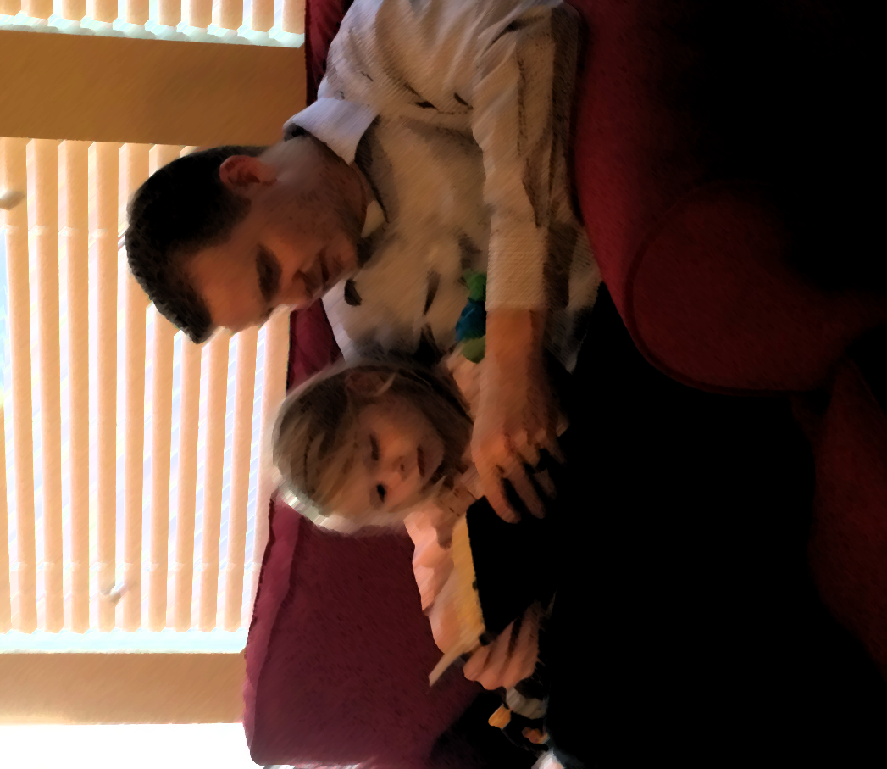
Sacred Duty
Husband and wife have a solemn responsibility to love and care for each other and for their children. “Children are an heritage of the Lord”
Lo, children are an heritage of the Lord: and the fruit of the womb is his reward. Psalm 127:3

Slide 17



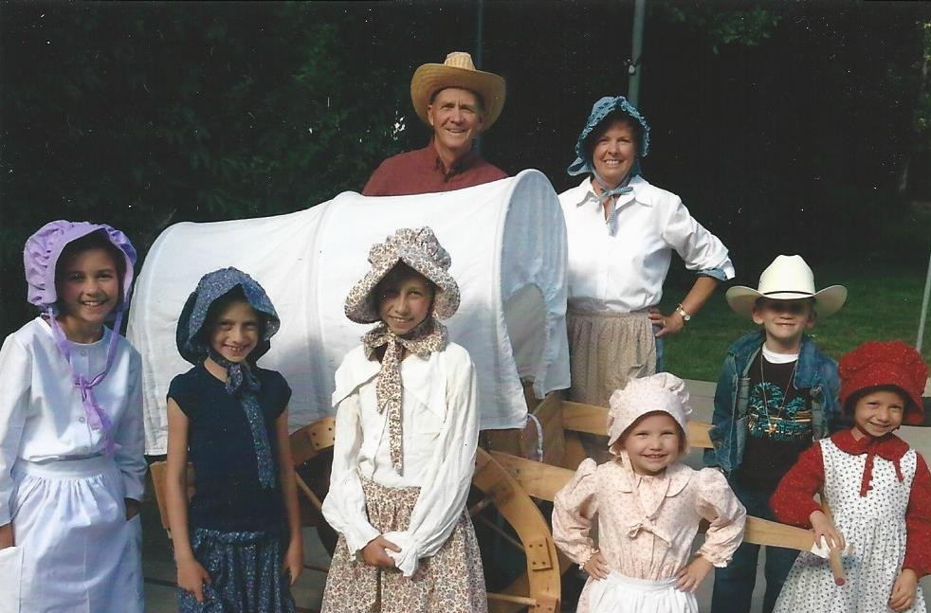
Blau and Frandsen
The Jenson’s and the Dudley’s
Parents have a sacred duty to rear their children in love and righteousness, to provide for their physical and spiritual needs, and to teach them to love and serve one another, observe the commandments of God, and be law-abiding citizens wherever they live.

Slide 18


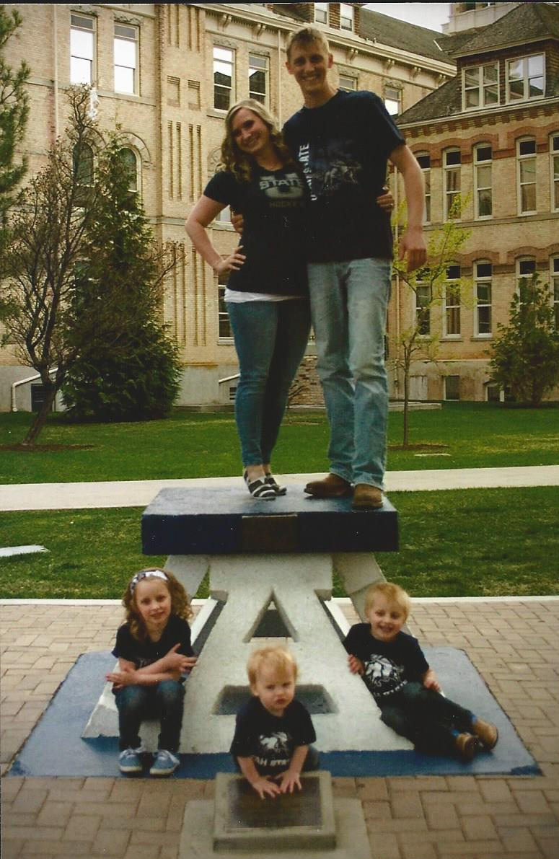
Husbands and wives—mothers and fathers—will be held accountable before God for the discharge of these obligations.
The Sovine Family
Logan, Utah

Slide 19

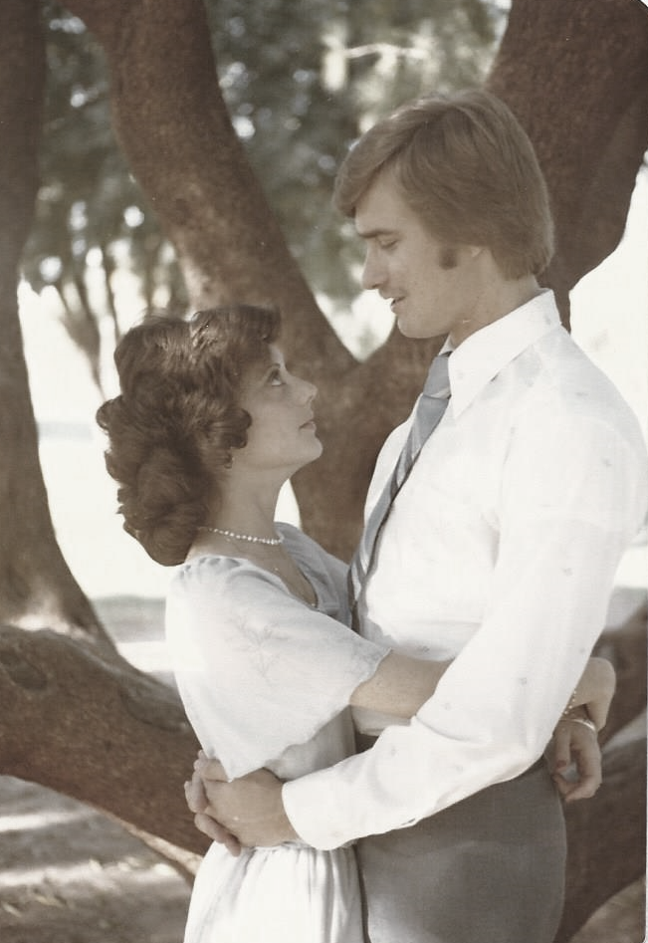

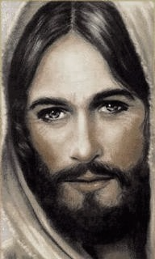
The family is ordained of God. Marriage between man and woman is essential to His eternal plan. Children are entitled to birth within the bonds of matrimony, and to be reared by a father and a mother who honor marital vows with complete fidelity.
Happiness in family life is most likely to be achieved when founded upon the teachings of the Lord Jesus Christ.
Gary and Pat Blau
Mesa, Arizona

Slide 20


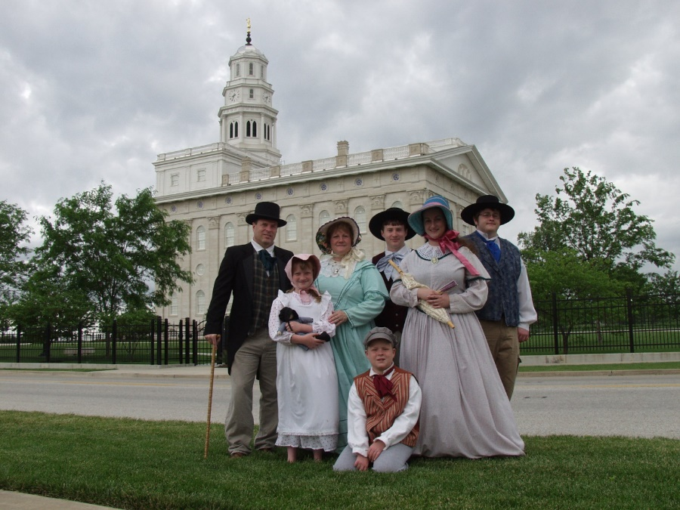
Successful marriages and families are established and maintained on principles of faith, prayer, repentance, forgiveness, respect, love, compassion, work, and wholesome recreational activities.
The Campbell Family
Mt. Pleasant, Utah
Paragraph 7

Slide 21


Fathers
By divine design, fathers are to preside over their families in love and righteousness and are responsible to provide the necessities of life and protection for their families.
partners
Joseph Moroni Green Family

Slide 22


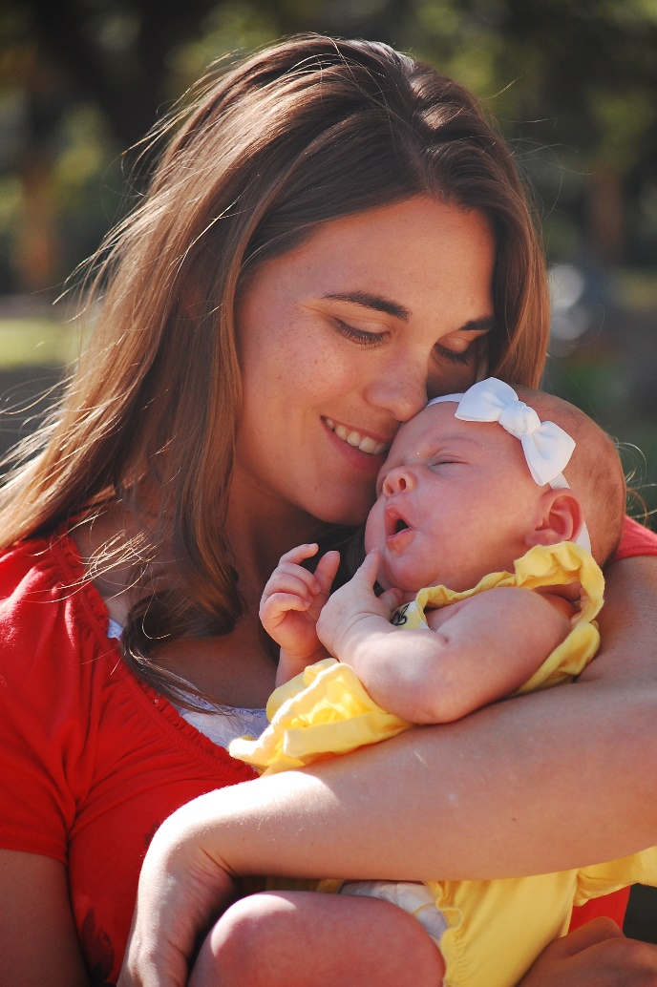
Mothers
Mothers are primarily responsible for the nurture of their children. In these sacred responsibilities, fathers and mothers are obligated to help one another as equal partners.
Disability, death, or other circumstances may necessitate individual adaptation.
Extended families should lend support when needed.

Slide 23

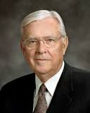
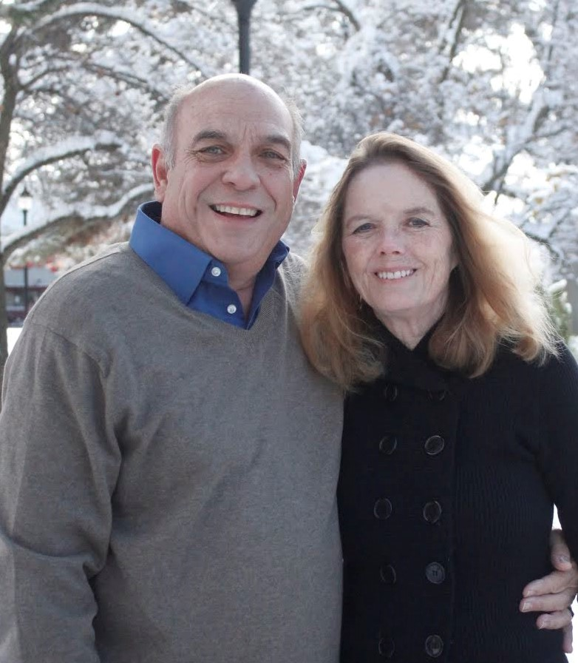
Equal Partners
Our Father in Heaven loves all of His children equally, perfectly, and infinitely. His love is no different for His daughters than for His sons.
Our Savior, the Lord Jesus Christ, also loves men and women equally. His atonement and His gospel are for all of God’s children. …
The gospel of Jesus Christ can sanctify both men and women in the same way and by identical principles.
For example, faith repentance, baptism, and the gift of the Holy Ghost are requirements for all of God’s children, regardless of gender. … [Heavenly Father] loves us all equally, and His greatest gift, the gift of eternal life, is available to all.
M. Russell Ballard

Slide 24

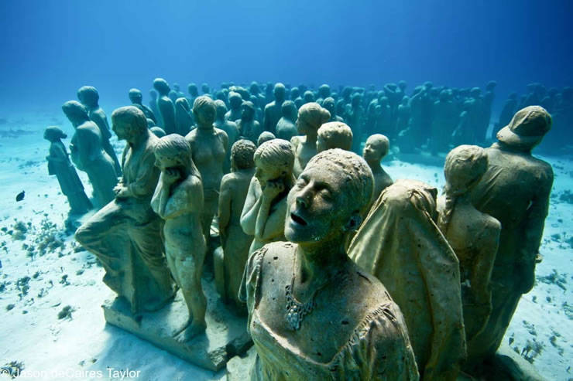
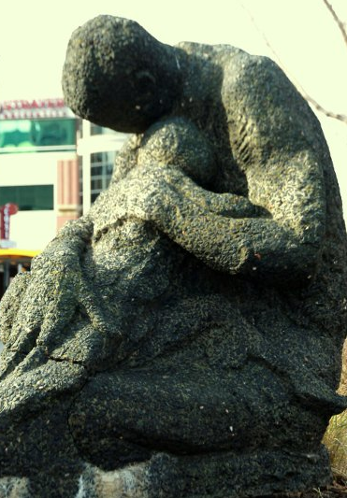
We warn that individuals who violate covenants of chastity, who abuse spouse or offspring, or who fail to fulfill family responsibilities will one day stand accountable before God.
Jason deCaires Taylor—underwater statues
Further, we warn that the disintegration of the family will bring upon individuals, communities, and nations the calamities foretold by ancient and modern prophets.
Mother and Child—
Arlington

Slide 25

Life in Relation to Abortion
The only possible exceptions are when:
Pregnancy resulted from forcible rape or incest.
A competent physician determines that the life or health of the mother is in serious jeopardy.
A competent physician determines that the fetus has severe defects that will not allow the baby to survive beyond birth.
The Lord commanded, “Thou shalt not … kill, nor do anything like unto it”.
The Church opposes elective abortion for personal or social convenience. Members must not submit to, perform, arrange for, pay for, consent to, or encourage an abortion
Even these exceptions do not automatically justify abortion. Abortion is a most serious matter. It should be considered only after the persons responsible have received confirmation through prayer. Members may counsel with their bishops as part of this process.
Doctrine and Covenants 59:6; General Handbook

Slide 26


We call upon responsible citizens and officers of government everywhere to promote those measures designed to maintain and strengthen the family as the fundamental unit of society.

Slide 27

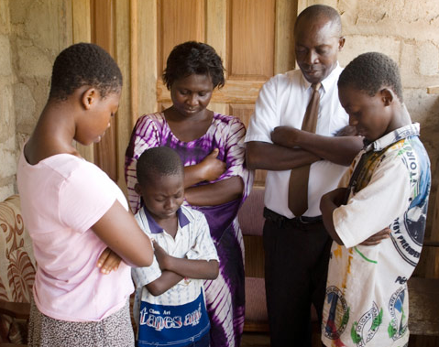

Happiness in Family Life
Happiness in family life is most likely to be achieved when founded upon the teachings of the Lord Jesus Christ.
Pray in your families unto the Father, always in my name, that your wives and your children may be blessed.
3 Nephi 18:21
Wherefore, I say unto you, that ye ought to forgive one another;
D&C 64:9
Paragraph 7

Slide 28

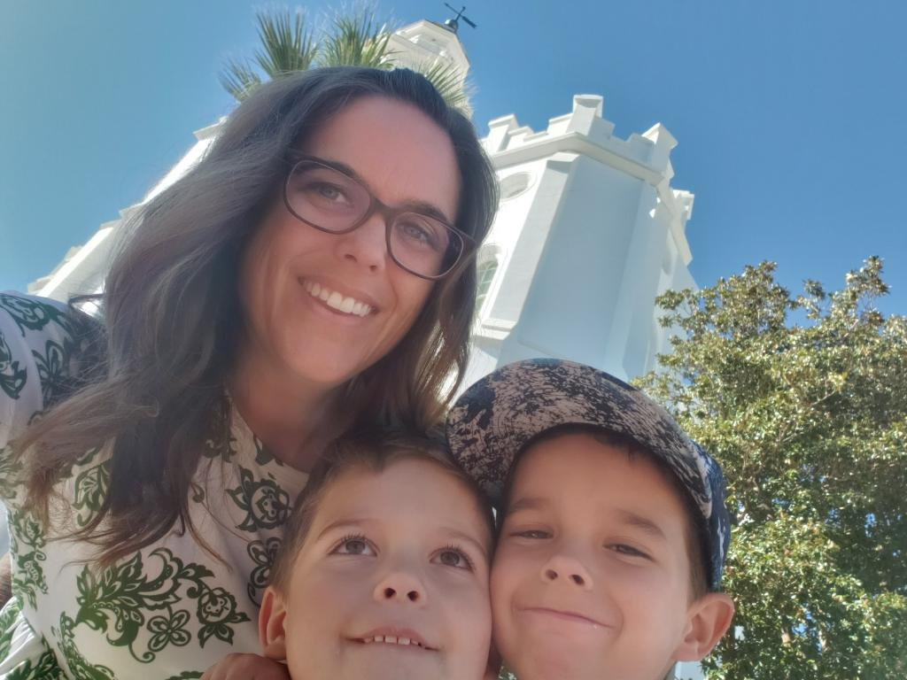
Various Family Situations
Entire family active in the Church.
Part-member family.
Divorced parents.
Single-parent family.
Families are part of Heavenly Father’s plan.
Like people, they come in different shapes and sizes.
Sometimes it may seem like there are “perfect families” all around us, but in reality, this world is made up of imperfect people in family units just trying to figure things out.
That’s right, no family is perfect!
Friends magazine

Slide 29


Whatever bad things may have occurred in your family, I testify and promise that the Lord Jesus Christ is the source of the healing, renewing, and restoring that you need. …
With the help of the Lord, you can create an eternal family, even if you did not come from the kind of Latter-day Saint home that sometimes is featured on the covers of the Liahona or Ensign magazines.
Please always remember:
it begins with you!
David A. Bednar

Slide 30

Sources:
Videos:
Defenders of the Proclamation(1:05)
Proclamation (2:12)
Gender is an Essential Characteristic (1:51)
“Plan of Salvation—We’re Still a Family” (4:47)
D. Todd Christofferson, “Why Marriage, Why Family,” Ensign or Liahona, May 2015, 51–52
President Gordon B. Hinckley (“Stand Strong against the Wiles of the World,” Ensign, Nov. 1995, 100).
(Dallin H. Oaks, “The Great Plan of Happiness,” Ensign, Nov. 1993, 75); Divine Love in the Father’s Plan,” Liahona, May 2022, 103)
Russell M. Nelson, “Choices for Eternity” [worldwide devotional for young adults, May 15, 2022], broadcasts.ChurchofJesusChrist.org
Robert D. Hales, “The Plan of Salvation: A Sacred Treasure of Knowledge to Guide Us,” Ensign, Oct. 2015, 29
http://twistedsifter.com/2011/01/astonishing-underwater-sculptures-by-jason-decaires-taylor-30-pics/
Defenders of the Proclamation(1:05)
Proclamation (2:12)
Presentation by http://fashionsbylynda.com/blog/
“Gender Is an Essential Characteristic.”
Elder Russell M. Nelson Celestial Marriage
October 2008 General Conference
General Handbook: Serving in the Church of Jesus Christ of Latter-day Saints, 38.6.1, ChurchofJesusChrist.org)
David A. Bednar, “A Welding Link” [worldwide devotional for young adults, Sept. 10, 2017], broadcasts.ChurchofJesusChrist.org
Different Kinds of Family Friends Magazine July 2018
M. Russell Ballard, “Equality through Diversity,” Ensign, Nov. 1993, 89
Presentation by http://fashionsbylynda.com/blog/

Slide 31
The Father’s plan provides us the way to inherit eternal life, the life our heavenly parents lead. In the plan, “neither is the man without the woman, [nor] the woman without the man, in the Lord” [1 Corinthians 11:11]. The very essence of eternal life includes the eternal marriage of man and woman, which is an essential part of becoming like our heavenly parents. (Robert D. Hales, “The Plan of Salvation: A Sacred Treasure of Knowledge to Guide Us,” Ensign, Oct. 2015, 29)
The purpose of mortality is to become more like God by gaining physical bodies, exercising agency, and assuming roles that previously belonged only to heavenly parents—roles of husband, wife, and parent. …
Heavenly Father wants us to … obey His first commandment to “multiply and replenish”—not only to fulfill His plan but also to find the joy that His plan was designed to give His sons and daughters. …
… One essential purpose of mortal life is that we can replicate that family experience ourselves, only this time as parents rather than just as the children. (M. Russell Ballard, “The Opportunities and Responsibilities of CES Teachers in the 21st Century” [evening with a General Authority, Feb. 26, 2016], broadcasts.ChurchofJesusChrist.org)
The Spirit will confirm to each of us individually our divine worth. Truly knowing that you are a [child] of God will affect every aspect of your life and guide you in the service you render each day. President Spencer W. Kimball (1895–1985) explained in these glorious words:
“God is your Father. He loves you. He and your mother in heaven value you beyond any measure. … You are unique. One of a kind, made of the eternal intelligence which gives you claim upon eternal life.
“Let there be no question in your mind about your value as an individual. The whole intent of the gospel plan is to provide an opportunity for each of you to reach your fullest potential, which is eternal progression and the possibility of godhood” [“Privileges and Responsibilities of Sisters,” Ensign, Nov. 1978, 105]. …
… As the Savior lifts us to higher ground, we can see more clearly not only who we are but also that we are closer to Him than we ever imagined. (Joy D. Jones, “Value beyond Measure,” Ensign or Liahona, Nov. 2017, 14, 15)
Heavenly Father intends that sexual relations in marriage be used to create children and to express love and strengthen the emotional, spiritual, and physical connections between husband and wife. In marriage, sexual intimacy should unite wife and husband together in trust, devotion, and consideration for each other. …
The doctrine of eternal families in The Church of Jesus Christ of Latter-day Saints is unique among Christian traditions. We were not created solely to praise, adore, and serve some incomprehensible God. We were created by loving heavenly parents to grow up to become like them. Male and female spirits were created to complement each other. That is why gender is not fluid in the eternities—because it provides the basis for the ultimate gift Heavenly Father can give, His kind of life.
For us to realize this blessing, Heavenly Father commanded that sexual intimacy is to be reserved for marriage between a man and a woman. … We cannot achieve the kind of life our Heavenly Father enjoys by ourselves or without a complete commitment to fidelity within a marriage to our husband or wife according to God’s plan. …
… Sexual relations are “one of the ultimate expressions of our divine nature” [David A. Bednar, “We Believe in Being Chaste,” Ensign, May 2013, 42]. Our proper expression of sexuality makes it possible for God’s plan to unfold on earth and in the eternities, qualifying us to become like our Heavenly Father. God promises eternal life for the faithful that includes eternal marriage, children, and all other blessings of an eternal family. (Dale G. Renlund and Ruth Lybbert Renlund, “The Divine Purposes of Sexual Intimacy,” Ensign, Aug. 2020, 15–17)
Divine Love:
Eternal doctrine … provides a distinctive perspective on children. Through this perspective we see the bearing and nurturing of children as part of the divine plan. It is a joyful and sacred duty of those given the power to participate in it. Therefore, we are commanded to teach and contend for principles and practices that provide the best conditions for the development and happiness of children under God’s plan. (Dallin H. Oaks, “Divine Love in the Father’s Plan,” Liahona, May 2022, 102)
Men and Women are equal: Even though men and women are equal before God in their eternal opportunities, they have different, but equally significant, duties in His eternal plan. … [God] can acknowledge and even encourage our differences while providing equal opportunity for growth and development. …
… Many of the requirements [for an exalted family life] are exactly the same for men and women. For example, obedience to the laws of God should be the same for men and women. Men and women should pray in the same way. They both have the same privilege of receiving answers to their prayers and thereby obtaining personal revelation for their own spiritual development. (M. Russell Ballard, “Equality through Diversity,” Ensign, Nov. 1993, 89–90)

Slide 32
“A Righteous marriage is a commandment and an essential step in the process of creating a loving family relationship that can be perpetuated beyond the grave.
“Two compelling doctrinal reasons help us to understand why eternal marriage is essential to the Father’s plan.
Elder David A. Bednar
(“Marriage Is Essential to His Eternal Plan,” Elder David A. Bednar Ensign, June 2006, 82–84).
“Reason 1: The natures of male and female spirits complete and perfect each other, and therefore men and women are intended to progress together toward exaltation.
“The eternal nature and importance of marriage can be fully understood only within the overarching context of the Father’s plan for His children. …
“‘Gender is an essential characteristic of individual premortal, mortal, and eternal identity and purpose’ and in large measure defines who we are, why we are here upon the earth, and what we are to do and become. For divine purposes, male and female spirits are different, distinctive, and complementary.
“After the earth was created, Adam was placed in the Garden of Eden. Importantly, however, God said it was ‘not good that the man should be alone’ (Genesis 2:18; Moses 3:18), and Eve became Adam’s companion and helpmeet. The unique combination of spiritual, physical, mental, and emotional capacities of both males and females were needed to implement the plan of happiness. Alone, neither the man nor the woman could fulfill the purposes of his or her creation.
“By divine design, men and women are intended to progress together toward perfection and a fulness of glory. Because of their distinctive temperaments and capacities, males and females each bring to a marriage relationship unique perspectives and experiences. The man and the woman contribute differently but equally to a oneness and a unity that can be achieved in no other way. The man completes and perfects the woman and the woman completes and perfects the man as they learn from and mutually strengthen and bless each other. ‘Neither is the man without the woman, neither the woman without the man, in the Lord’ (1 Corinthians 11:11; italics added).
“Reason 2: By divine design, both a man and a woman are needed to bring children into mortality and to provide the best setting for the rearing and nurturing of children.
“The commandment given anciently to Adam and Eve to multiply and replenish the earth remains in force today. ‘God has commanded that the sacred powers of procreation are to be employed only between man and woman, lawfully wedded as husband and wife. … The means by which mortal life is created [are] divinely appointed.’ Thus, marriage between a man and a woman is the authorized channel through which premortal spirits enter mortality. Complete sexual abstinence before marriage and total fidelity within marriage protect the sanctity of this sacred channel.
“A home with a loving and loyal husband and wife is the supreme setting in which children can be reared in love and righteousness and in which the spiritual and physical needs of children can be met. Just as the unique characteristics of both males and females contribute to the completeness of a marriage relationship, so those same characteristics are vital to the rearing, nurturing, and teaching of children” (“Marriage Is Essential to His Eternal Plan,” Elder David A. Bednar Ensign, June 2006, 82–84).

Slide 33
The Church’s position on same-sex marriage
“The Church distinguishes between same-sex attraction and behavior. While maintaining that feelings and inclinations toward the same sex are not inherently sinful, engaging in homosexual behavior is in conflict with the ‘doctrinal principle, based on sacred scripture … that marriage between a man and a woman is essential to the Creator’s plan for the eternal destiny of His children’ [“First Presidency Statement on Same-Gender Marriage”].
“Because the Church believes that the sacred powers of procreation are ‘to be exercised only between a man and a woman lawfully wedded as husband and wife … any other sexual relations, including those between persons of the same gender, undermine the divinely created institution of the family.’ Accordingly, the Church favors measures that define marriage as the union of a man and a woman. However, ‘protecting marriage between a man and a woman does not remove Church members’ Christian obligations of love, kindness and humanity toward all people’
[“The Divine Institution of Marriage,” Aug. 13, 2008, mormonnewsroom.org]” (“Same-Sex Attraction,” LDS.org).
“The Eternal Nature and Purpose of Gender” (The Eternal Family Class Preparation Material [2022], 29–33) (Note the three sections of this resource that begin with questions.)
“Transgender: Understanding Yourself” in the “Life Help section” of Gospel Library
“Transgender: Supporting Others” in the “Life Help” section of Gospel Library

Slide 34
The Family: A Proclamation to the World
The First Presidency and Council of the Twelve Apostles of The Church of Jesus Christ of Latter-day Saints
We, the First Presidency and the Council of the Twelve Apostles of The Church of Jesus Christ of Latter-day Saints, solemnly proclaim that marriage between a man and a woman is ordained of God and that the family is central to the Creator’s plan for the eternal destiny of His children.
All human beings—male and female—are created in the image of God. Each is a beloved spirit son or daughter of heavenly parents, and, as such, each has a divine nature and destiny. Gender is an essential characteristic of individual premortal, mortal, and eternal identity and purpose.
In the premortal realm, spirit sons and daughters knew and worshipped God as their Eternal Father and accepted His plan by which His children could obtain a physical body and gain earthly experience to progress toward perfection and ultimately realize their divine destiny as heirs of eternal life. The divine plan of happiness enables family relationships to be perpetuated beyond the grave. Sacred ordinances and covenants available in holy temples make it possible for individuals to return to the presence of God and for families to be united eternally.
The first commandment that God gave to Adam and Eve pertained to their potential for parenthood as husband and wife. We declare that God’s commandment for His children to multiply and replenish the earth remains in force. We further declare that God has commanded that the sacred powers of procreation are to be employed only between man and woman, lawfully wedded as husband and wife.
We declare the means by which mortal life is created to be divinely appointed. We affirm the sanctity of life and of its importance in God’s eternal plan.
Husband and wife have a solemn responsibility to love and care for each other and for their children. “Children are an heritage of the Lord” (Psalm 127:3). Parents have a sacred duty to rear their children in love and righteousness, to provide for their physical and spiritual needs, and to teach them to love and serve one another, observe the commandments of God, and be law-abiding citizens wherever they live. Husbands and wives—mothers and fathers—will be held accountable before God for the discharge of these obligations.
The family is ordained of God. Marriage between man and woman is essential to His eternal plan. Children are entitled to birth within the bonds of matrimony, and to be reared by a father and a mother who honor marital vows with complete fidelity. Happiness in family life is most likely to be achieved when founded upon the teachings of the Lord Jesus Christ. Successful marriages and families are established and maintained on principles of faith, prayer, repentance, forgiveness, respect, love, compassion, work, and wholesome recreational activities. By divine design, fathers are to preside over their families in love and righteousness and are responsible to provide the necessities of life and protection for their families. Mothers are primarily responsible for the nurture of their children. In these sacred responsibilities, fathers and mothers are obligated to help one another as equal partners. Disability, death, or other circumstances may necessitate individual adaptation. Extended families should lend support when needed.
We warn that individuals who violate covenants of chastity, who abuse spouse or offspring, or who fail to fulfill family responsibilities will one day stand accountable before God. Further, we warn that the disintegration of the family will bring upon individuals, communities, and nations the calamities foretold by ancient and modern prophets.
We call upon responsible citizens and officers of government everywhere to promote those measures designed to maintain and strengthen the family as the fundamental unit of society.
This proclamation was read by President Gordon B. Hinckley as part of his message at the General Relief Society Meeting held September 23, 1995, in Salt Lake City, Utah.

