Slide 1

The Living Christ
Part 1and 2
Presentation by http://fashionsbylynda.com/blog/

Slide 2
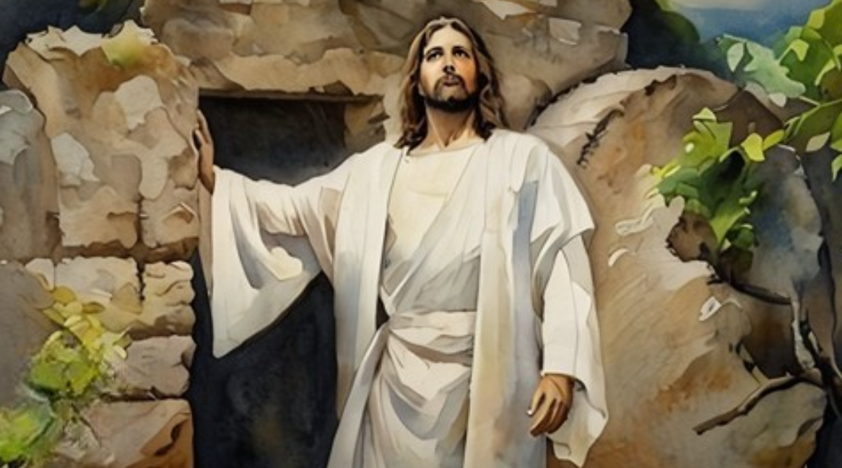
Declaration
On January 1, 2000, the First Presidency and the Quorum of the Twelve Apostles issued a declaration known as “The Living Christ: The Testimony of the Apostles.”
Their testimony commemorated the 2,000th anniversary of the Savior’s birth.

Slide 3
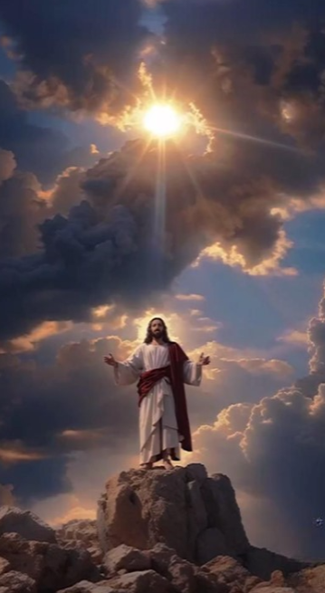
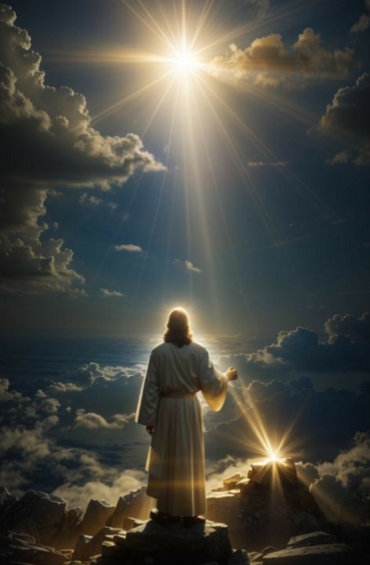
Closer or Further
Why does it matter if the world is getting closer to or farther away from the Lord?
Why does it matter to you if you are moving closer to or farther away from the Lord?

Slide 4
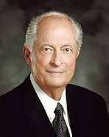
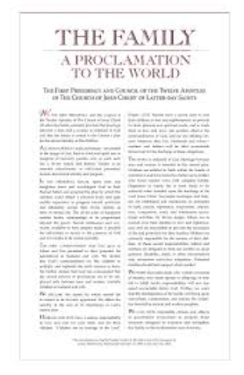
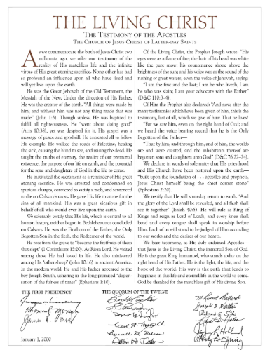
The World
The world is moving away from the Lord faster and farther than ever before.
The adversary has been loosed upon the earth. We watch, hear, read, study, and share the words of prophets to be forewarned and protected.
For example, “The Family: A Proclamation to the World” was given long before we experienced the challenges now facing the family.
“The Living Christ: The Testimony of the Apostles” was prepared in advance of when we will need it most.
Robert D. Hales, “General Conference: Strengthening Faith and Testimony,” Ensign or Liahona, Nov. 2013, 7

Slide 5


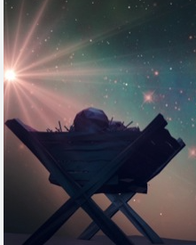


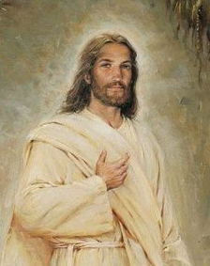
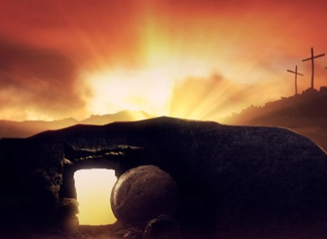
Names of Jesus Christ
Great Jehovah
Redeemer
Firstborn
Creator
All things were made by him; and without him was not any thing made that was made.
John 1:3
Only Begotten
The Risen Lord
Messiah

Slide 6
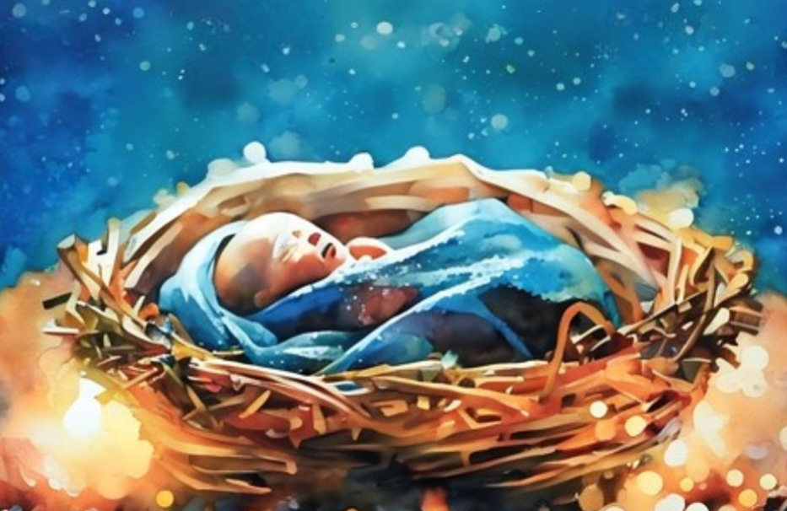
King Immanuel
Hebrew Name “God with us.”
Name-title given as a sign of God’s deliverance
Specific to the prophecy in Matthew 1:23
Therefore the Lord himself shall give you a sign; Behold, a virgin shall conceive, and bear a son, and shall call his name Immanuel.
Isaiah 7:14
Behold, a virgin shall be with child, and shall bring forth a son, and they shall call his name Emmanuel, which being interpreted is, God with us.
Let the earth break forth into singing. Let the dead speak forth anthems of eternal praise to the King Immanuel, who hath ordained, before the world was, that which would enable us to redeem them out of their prison; for the prisoners shall go free.
D&C 128:22
Therefore, the Lord himself shall give you a sign—Behold, a virgin shall conceive, and shall bear a son, and shall call his name Immanuel.
2 Nephi 17:14
Latter-day scripture

Slide 7
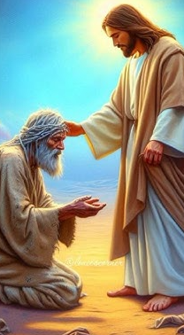
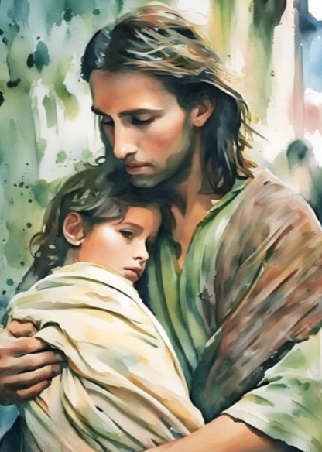
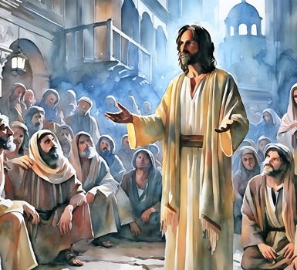
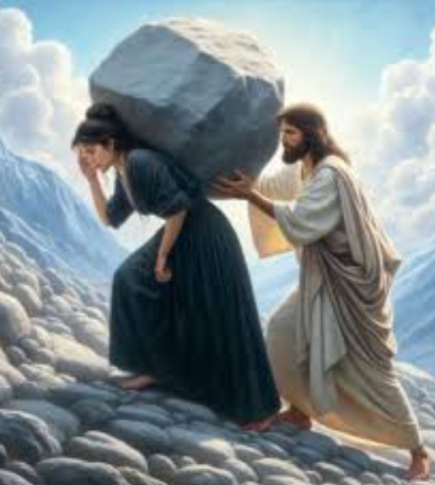
What Has Jesus Done For You?
Healer for you
Matchless Love for you
Peace Giver unto you
Sacrifice and Atonement for you
He is the light, life, and hope of the world

Slide 8
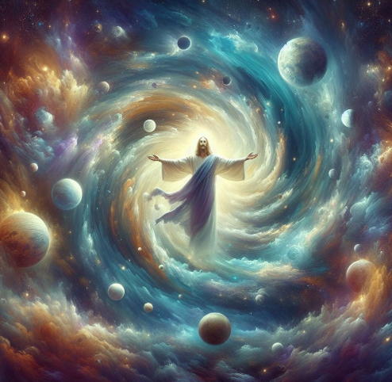
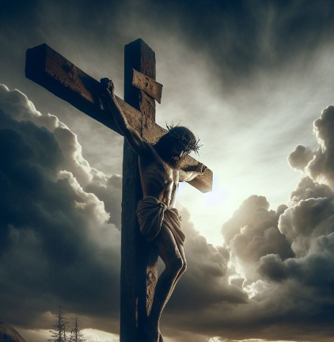
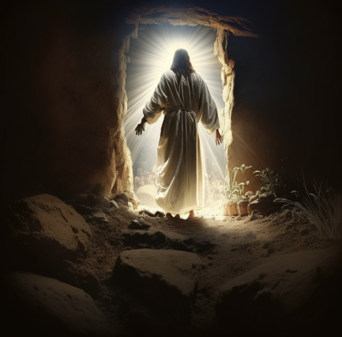
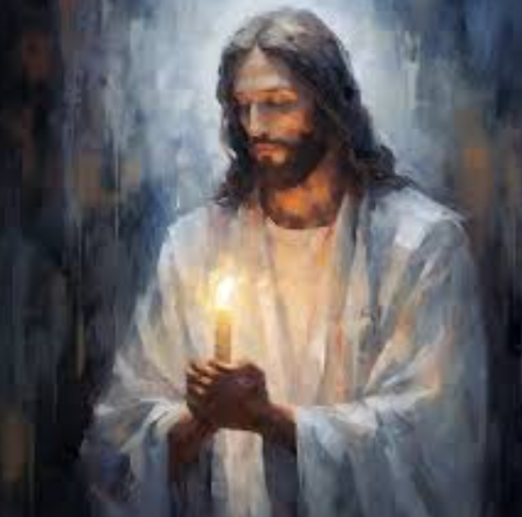
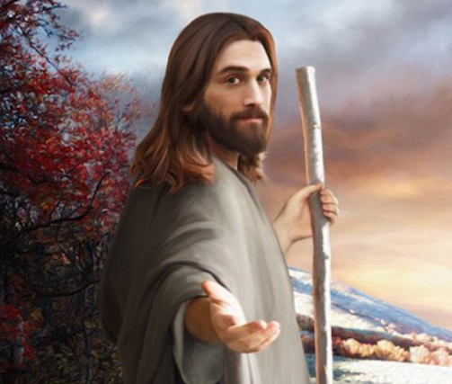
Truths About Jesus Christ
Under the direction of the Father, Jesus Christ created the earth.
Jesus Christ gave His life to atone for the sins of all mankind.
Jesus Christ was resurrected and lives today.
Jesus Christ is the light, the life, and the hope of the world.
Jesus Christ’s way is the path that leads to happiness in this life and eternal life in the world to come.

Slide 9

Expand Your Understanding
Search the hymnbook by topic, looking for what the hymns teach about Jesus Christ and His various roles.
Look for statements by Church leaders.
DICTIONARY
HYMNS
Use a dictionary to define difficult words.

Slide 10
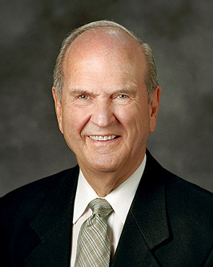
As you seek to learn more about Jesus Christ, I urge you to study “The Living Christ.”
As we invest time in learning about the Savior and His atoning sacrifice, we are drawn to participate in another key element to accessing His power:
we choose to have faith in Him and follow Him.
Russell M. Nelson, “Drawing the Power of Jesus Christ into Our Lives,” Ensign or Liahona, May 2017, 40)

Slide 11
Sharing
Holy Bible
The
Book
of
Mormon
Doctrine
And
Covenants
Knowledge
Jesus Christ
ANOTHER TESTAMENT
OF JESUS CHRIST
Scriptures
What Do You Want to Share With Others?
Time
Testimony
Talents

Slide 12
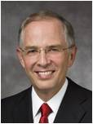
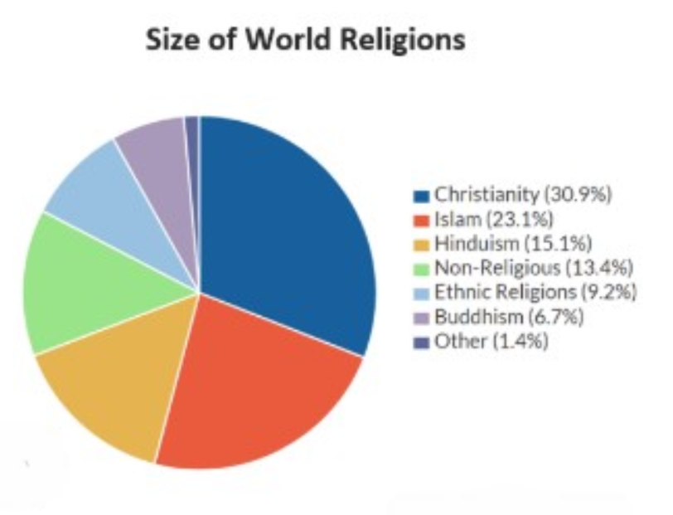
There are many on the earth who know very little of Jesus Christ, and in some parts of the world where His name has been proclaimed for centuries, faith in Jesus Christ is diminishing. …
[A] worldwide … study predicts that in the decades ahead, more than twice as many will leave Christianity as will embrace it. …
… If the world is going to speak less of Him, who is going to speak more of Him? We are!
Neil L. Andersen, “We Talk of Christ,” Ensign or Liahona, Nov. 2020, 88–89

Slide 13
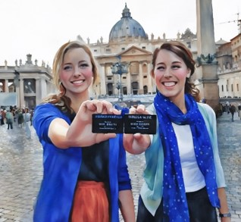
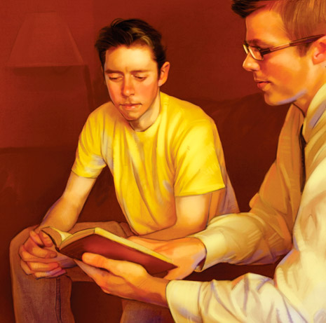
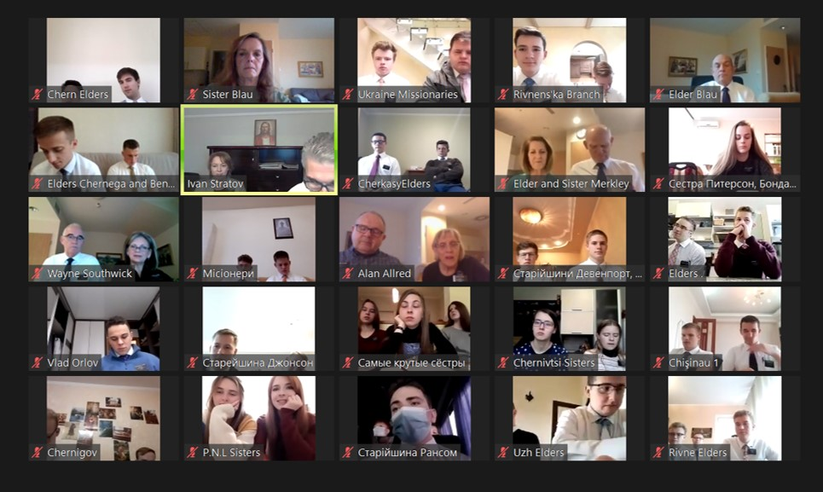
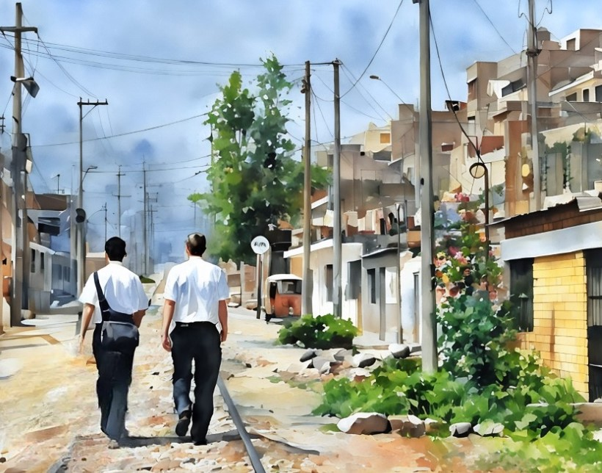
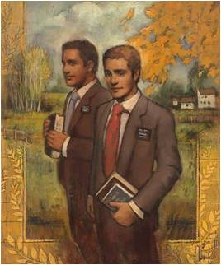
Testimonies
And we talk of Christ, we rejoice in Christ, we preach of Christ, we prophesy of Christ, and we write according to our prophecies, that our children may know to what source they may look for a remission of their sins.
2 Nephi 25:26
As we talk and rejoice about Jesus Christ, others can know that He can save them from their sins.

Slide 14
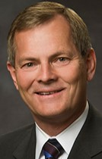
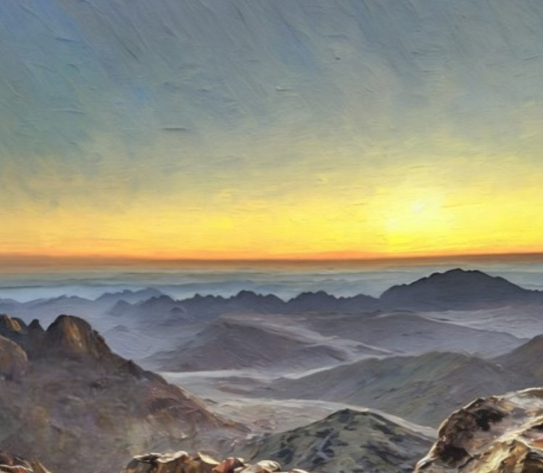
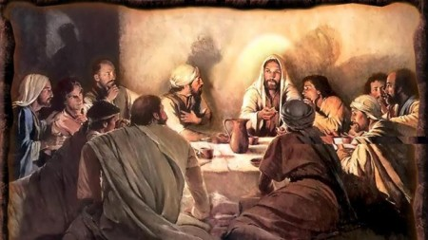
Imagine with me, for a moment, standing on a mountain in Galilee, witnessing the wonder and glory of the resurrected Savior visiting His disciples. How awe-inspiring to consider personally hearing these words, which He shared with them, His solemn charge to “go ye therefore, and teach all nations, baptizing them in the name of the Father, and of the Son, and of the Holy Ghost” [Matthew 28:19]. Surely these words would empower, inspire, and move each of us, as they did His Apostles. Indeed, they devoted the rest of their lives to doing just that.
Interestingly, it wasn’t only the Apostles who took Jesus’s words to heart. Members of the early Church, from the newest to the most seasoned, took part in the Savior’s great commission, sharing the good news of the gospel with those they met and knew. The determination to share their testimony of Jesus Christ helped His newly established Church grow expansively.
We too, as Christ’s disciples, are invited to heed His commission today, as if we were there on that mountain in Galilee when He first proclaimed it.
Gary E. Stevenson, “Love, Share, Invite,” Liahona, May 2022, 84–85

Slide 15

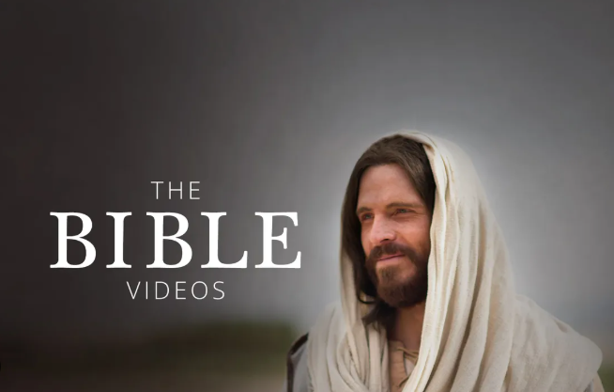
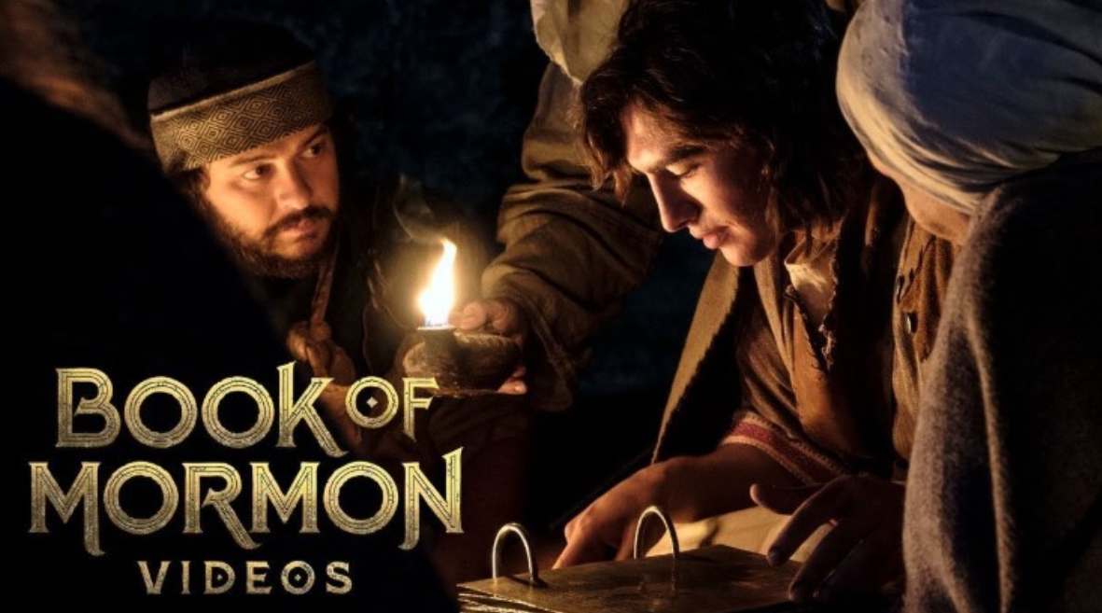
Other Ways to Share the Gospel
Children’s Bible Videos
Bible Videos
Book of Mormon Videos

Slide 16

My Testimony
During this year I have gain a tremendous yearning for learning, and deep new respect for the Latter-day Saints who began building their testimonies on a newly found Book of Mormon.
I can’t even imagine the great strength it took to believe in something so new, yet so old, and I can’t imagine suffering the great persecution the early Saints did along with the Prophet Joseph Smith.
Through all the reading and scripture studying I questioned the exactness of the Doctrine and Covenants…and I can tell you without a doubt that the things I learned and pondered are true.
I believe Joseph Smith did receive the priesthood, which was taken from the
earth…and restored it to its fullest by revelation from Heavenly Father.
I believe in a Heavenly Father, and in His Son, Jesus, and in the power and
companionship of the Holy Ghost. Many mornings that companionship has
brought more comfort than I could possibly dream of.
Thank you for being with me this Seminary year and sharing the most
important principles of the gospel.
A special thank you my husband who totally supports me.---Sister Blau

Slide 17
Videos:
“Excerpts from ‘The Living Christ: The Testimony of the Apostles’”(2:45)
“Living Apostles Testify of Jesus Christ” (2:16)
“A Living Witness of the Living Christ” from time code 0:00 to 0:50.
“Memorize the Living Christ: Goal Setting Ideas” (2:05).
Presentation by http://fashionsbylynda.com/blog/

Slide 18
Drawing the Power of Jesus Christ into Our Lives:
The importance of the Savior’s mission was emphasized by the Prophet Joseph Smith, who declared emphatically that “the fundamental principles of our religion are the testimony of the Apostles and Prophets, concerning Jesus Christ, that He died, was buried, and rose again the third day, and ascended into heaven; and all other things which pertain to our religion are only appendages to it” [Teachings of Presidents of the Church: Joseph Smith (2007), 49].
It was this very statement of the Prophet that provided the incentive for 15 prophets, seers, and revelators to issue and sign their testimony to commemorate the 2,000th anniversary of the Lord’s birth. That historic testimony is titled “The Living Christ.” (Russell M. Nelson, “Drawing the Power of Jesus Christ into Our Lives,” Ensign or Liahona, May 2017, 40)
That Your Joy Might Be Full:
As I have studied the life and teachings of Jesus Christ with more focus and committed “The Living Christ” to memory, my gratitude and love for our Savior have increased. Each sentence of that inspired document contains a sermon and has enhanced my understanding of His divine roles and earthly mission. What I have learned and felt through this period of study and reflection confirms that Jesus truly “is the light, the life, and the hope of the world.” (Jean B. Bingham, “That Your Joy Might Be Full,” Ensign or Liahona, Nov. 2017, 85)

