Slide 1

Doctrine and Covenants 93:1-22
Knowledge of Jesus Christ
O righteous Father, the world hath not known thee: but I have known thee, and these have known that thou hast sent me.
John 17:25
Presentation by http://fashionsbylynda.com/blog/

Slide 2
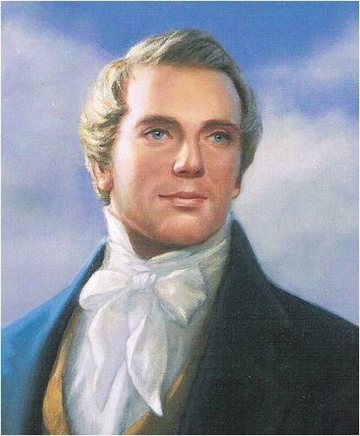
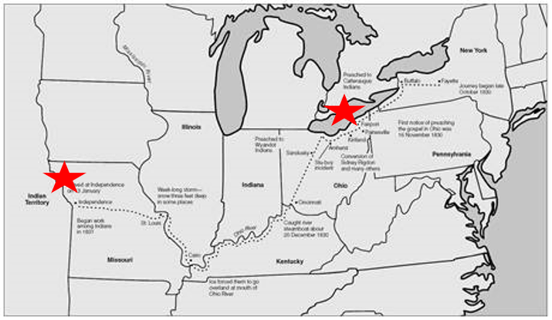
Background
May 6, 1833
In Zion, in Jackson County, Missouri, a special conference was held on 6 April to commemorate the organization of the Church.
Prophet Joseph Smith received the revelation recorded in Doctrine and Covenants 93. In it, the Savior revealed important truths about Himself to help us better understand who He is.
In April 1833 mobs gathered to persecute the Saints in Missouri.
In both Kirtland and Independence members of the Church apostatized and turned against their former brethren, and Joseph was faced with the possibility of a schism between the Church in Missouri and in Ohio.
Schism--a split or division between strongly opposed sections or parties, caused by differences in opinion or belief.

Slide 3
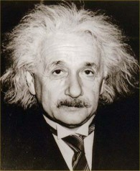
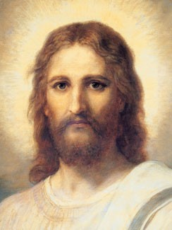
Do You Know Who I Am?
Why do you think so many people know who this person is?
Why do you think so many people know who this person is?
Is it important to know who this person is?
Is it important to know who this person is?
We are not able to achieve our full potential as children of God unless we know about Jesus Christ

Slide 4
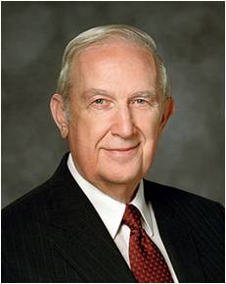
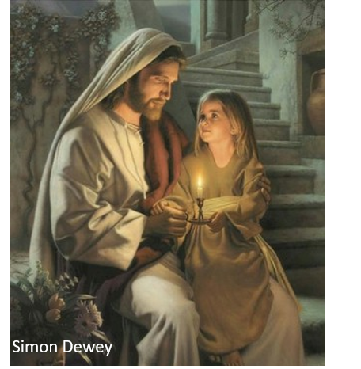
How Can You Know?
What must we do to gain a testimony of Jesus Christ?
“A testimony is not emotion.
It is the very essence of …making countless correct decisions.
These choices are made with trusting faith in things that are believed and, at least initially, are not seen.
A strong testimony gives peace, comfort, and assurance.
A testimony grows from understanding truth distilled from prayer and the pondering of scriptural doctrine.”
Elder Richard G. Scott
And when ye shall receive these things, I would exhort you that ye would ask God, the Eternal Father, in the name of Christ, if these things are not true; and if ye shall ask with a sincere heart, with real intent, having faith in Christ, he will manifest the truth of it unto you, by the power of the Holy Ghost.
Moroni 10:4
What can we know about Him if we do these things?

Slide 5
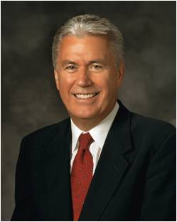
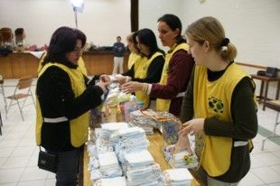

Go and Do Something
“Often, the answer to our prayer does not come while we’re on our knees but while we’re on our feet serving the Lord and serving those around us.
Selfless acts of service and consecration refine our spirits, remove the scales from our spiritual eyes, and open the windows of heaven. By becoming the answer to someone’s prayer, we often find the answer to our own”
President Dieter F. Uchtdorf
Service not only includes physical labor but also charity of the heart

Slide 6




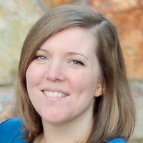
A Large Fire comes From Small Kindling
You may have heard a testimony compared to a burning fire before, but think about how a fire is built.
If you try to light a big log, it probably won’t catch fire. You have to have some sort of kindling, like smaller sticks or leaves, to get the fire going. Likewise, small experiences can kindle the fire of your testimony.
Sometimes people may put lighter fluid on a log, which makes the flames become bright, but once the lighter fluid is burned, the fire dies back down because it was the lighter fluid and not the log burning. Your testimony may sometimes be flamed by a strong spiritual experience, but that may not be enough to maintain a constantly burning testimony.
Even if you have a nice fire burning, it will eventually die if you don’t continue to put wood on it. In like manner, you must continue to feed the fire of your testimony so that it doesn’t smolder out.
Mindy Raye Friedman

Slide 7
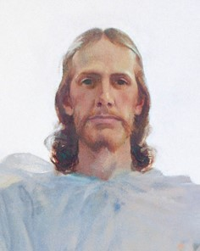
Shall See His Face
The reward will come for those who are faithful
Beloved, now are we the sons of God, and it doth not yet appear what we shall be: but we know that, when he shall appear, we shall be like him; for we shall see him as he is.
1 John 3:2
If we forsake our sins, come unto Christ, call on His name, obey His voice, and keep His commandments, then we shall see His face and know that He is
D&C 93:1

Slide 8

The True Light
All are born with the ability to know right from wrong
For behold, the Spirit of Christ is given to every man, that he may know good from evil; wherefore, I show unto you the way to judge; for every thing which inviteth to do good, and to persuade to believe in Christ, is sent forth by the power and gift of Christ; wherefore ye may know with a perfect knowledge it is of God.
Moroni 7:16
D&C 93:2

Slide 9
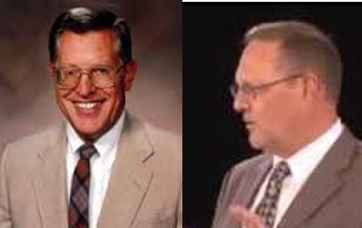
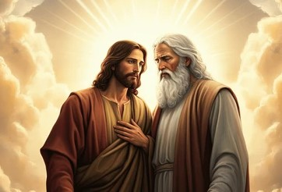
The Father And I Are One
“To know Jesus Christ is to know the father. The Father is manifested through the Son by means of his attributes and perfection…”
If ye had known me, ye should have known my Father also: and from henceforth ye know him, and have seen him.
John 14:7
“They are one in that they have the same purpose in all things.”
The Father has a body of flesh and bones as tangible as man’s; the Son also; but the Holy Ghost has not a body of flesh and bones, but is a personage of Spirit. Were it not so, the Holy Ghost could not dwell in us.
D&C 130:22
D&C 93:3 McConkie and Ostler

Slide 10
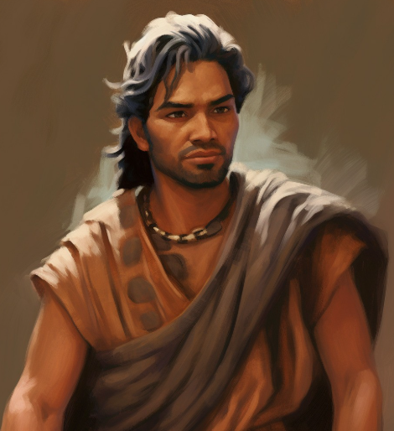
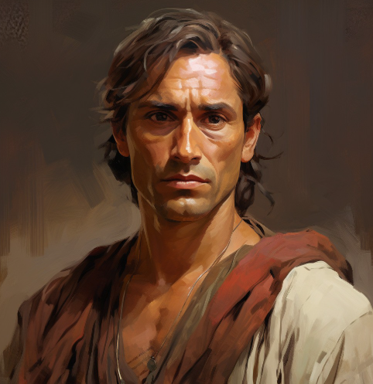
Flesh of My Tabernacle
He was not spoken of as our Father in heaven, but, rather, the Father of heaven
…saith Jesus Christ, the Son of God, the Father of the heavens and of the earth, and all things that in them are.
Ether 4:7
“He did not cease to be the Father, but because he came into mortality, he became the Only begotten Son of God in the flesh..”
…that I know that Jesus Christ shall come, yea, the Son, the Only Begotten of the Father, full of grace, and mercy, and truth. And behold, it is he that cometh to take away the sins of the world, yea, the sins of every man who steadfastly believeth on his name.”
Alma 5:48
D&C 93:4 McConkie and Ostler

Slide 11
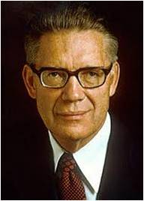
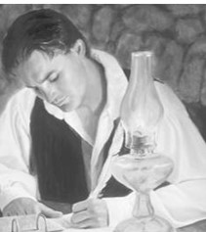
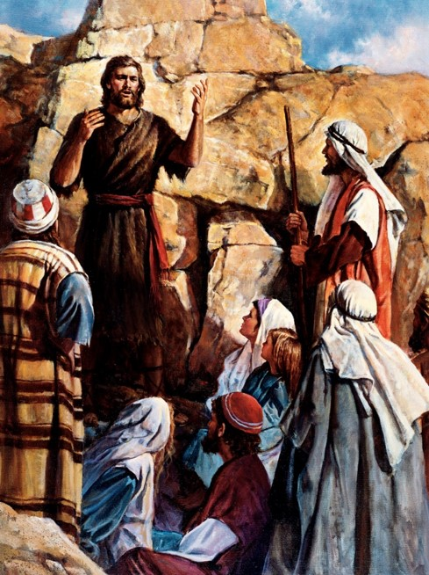
John’s Account
“John the Baptist [was] destined to write of the gospel of that Lord whose witness he is, but his account, perhaps because it contains truths and concepts that the saints and the world are not yet prepared to receive, has so far not been given to men.”
Reveled to Joseph Smith – 11 verses of John the Baptist’s writings and the promise of the fullness of the record of John
“From what has been revealed of the writings of the Baptist, and from what John the Apostle has written in his Gospel, it is clear that John the Apostle had before him the writings of John the Baptist when he wrote his Gospel. John 1:1–38 and John 3:23–36 are quoted or paraphrased from that which was first written by the Baptist”
D&C 93:6-18 Elder Bruce R. McConkie

Slide 12
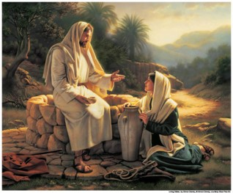
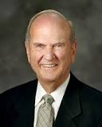
The Word—The Messenger of Salvation
Greek---Logos, or ‘expression.’
Jesus Christ is referred to as “the Word”
“We use words to convey our expression to others. So Jesus was the Word, or expression, of His Father to the world”
Jesus Christ is called the messenger of salvation because He declares the Father’s words to us, and those who hear and obey His message will receive salvation.
D&C 93:8 Elder Russell M. Nelson

Slide 13
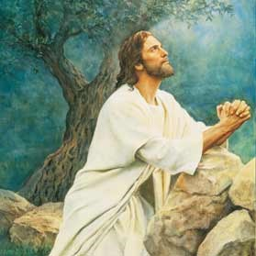
The Light and the Redeemer of the World
Through the Light of Christ, Jesus Christ gives life and light to all things.
He is also called the Light of the World because He provides the perfect example of how all people should live.
Jesus Christ is the Redeemer of the world because through His Atonement He paid the price for the sins of all mankind and made possible the resurrection of all people.
As long as I am in the world, I am the light of the world.
John 9:5
D&C 93:9

Slide 14
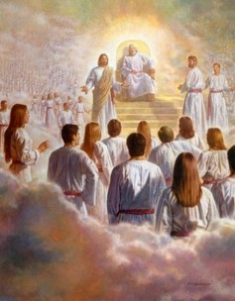
The Spirit of Truth
Jesus Christ does not lie and He possesses a fulness of truth
A title given to Jesus in the Premortal life.
He is the receiver and the dispenser of all the truths of salvation
This title is also used to refer to the Holy Ghost, who testifies of Jesus Christ
But when the Comforter is come, whom I will send unto you from the Father, even the Spirit of truth, which proceedeth from the Father, he shall testify of me:
John 15:26
D&C 93:9 McConkie and Ostler

Slide 15
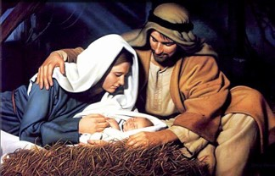
The Only Begotten of the Father
Jesus Christ is the greatest being to be born on this earth. God is the Father of the spirits of all mankind, but Jesus Christ is the only person who was born into the world as the literal Son of God in the flesh.
Because Jesus Christ was born of an immortal father, He had power over death.
This power allowed Him to accomplish the Atonement and Resurrection for all mankind.
For as the Father hath life in himself; so hath he given to the Son to have life in himself;
John 5:26
D&C 93:11

Slide 16
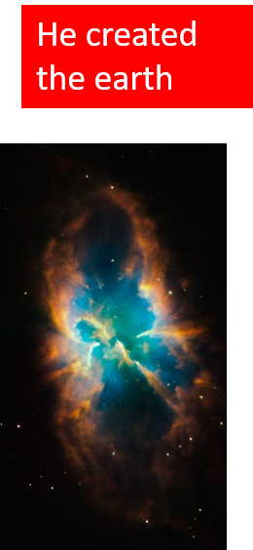
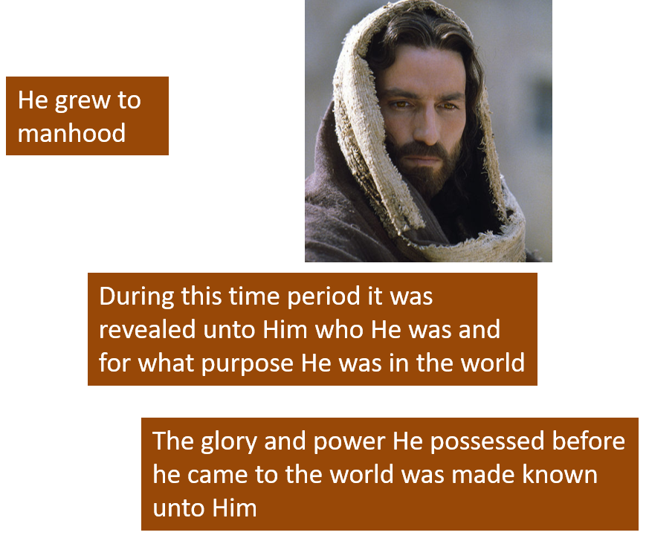
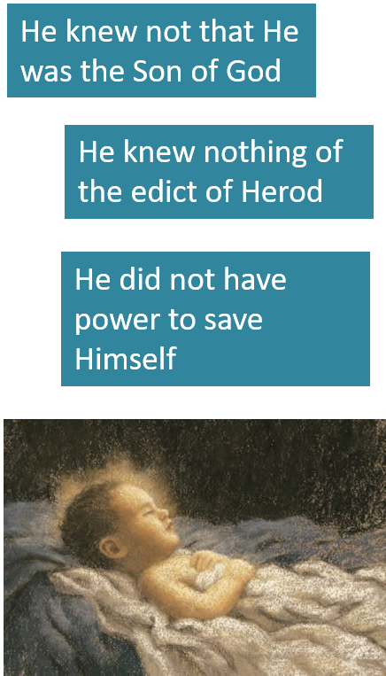
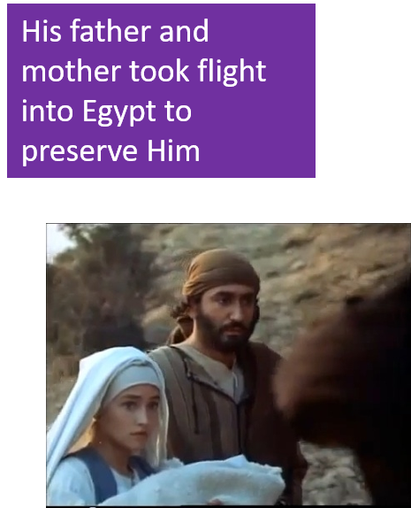
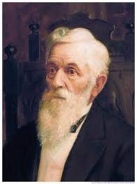
From Grace to Grace
Jesus grew until He had a fulness of grace, truth, glory, and power. John saw that Jesus “received a fulness of the glory of the Father
He received all power both in heaven and on earth, and the glory of the Father was with him, for he dwelt in him.”
D&C 93:12-17 President Lorenzo Snow

Slide 17

One Step at a Time
“It is not wisdom that we should have all knowledge at once presented before us; but that we should have a little at a time; then we can comprehend it.”
“When you climb up a ladder, you must begin at the bottom, and ascend step by step, until you arrive at the top; and so it is with the principles of the gospel—you must begin with the first, and go on until you learn all the principles of exaltation.
But it will be a great while after you have passed through the veil before you will have learned them. It is not all to be comprehended in this world; it will be a great work to learn our salvation and exaltation even beyond the grave.”
D&C 93:12, 19-20 Joseph Smith

Slide 18
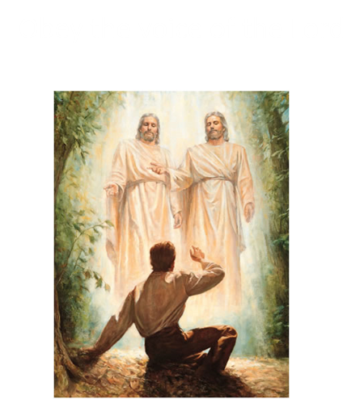
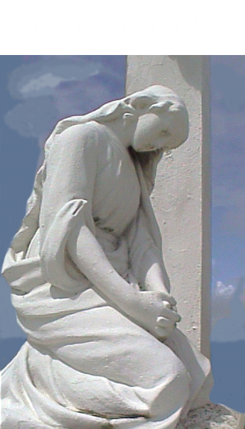
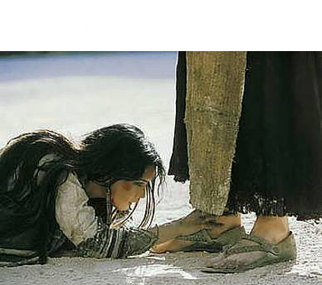
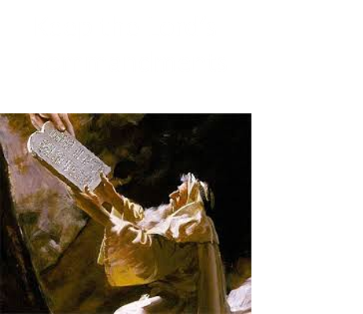
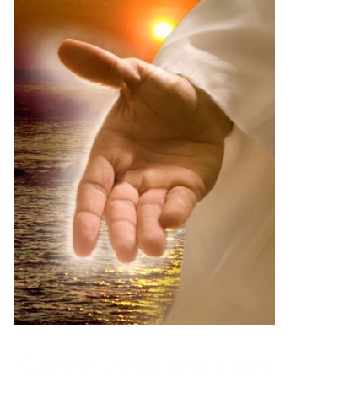

How to Worship
In order to attain the level of worship we must properly prepare ourselves
D&C 93:19-20 Otten and Caldwell

Slide 19
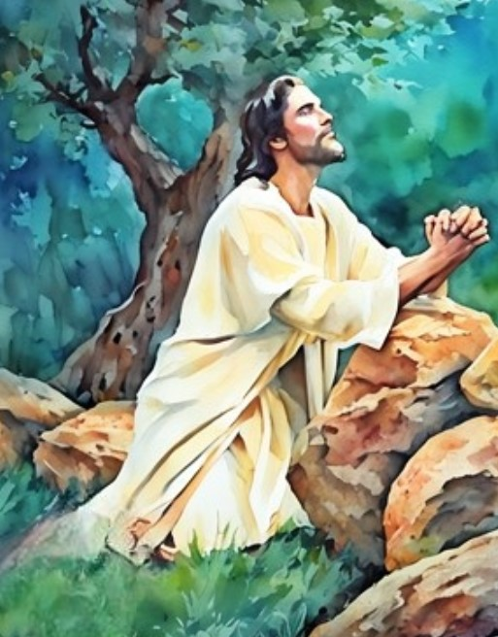
What to Worship
We worship God our Father and His son Jesus Christ
“Jesus Christ was able to perform both portions of the atonement for mankind:
From His Father, the Savior inherited power over physical death and was able to provide the resurrection for all
Because Jesus was totally obedient to the commandments of His Father, He conquered all sin and opened the doors of salvation to the penitent as He redeemed them from their sins.”
D&C 93:19-20 Otten and Caldwell

Slide 20
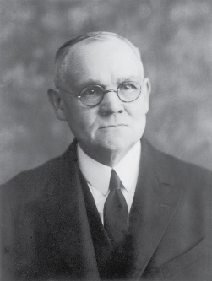

The Purpose of Worship
A day to day keeping of the Lord’s commandments
“To worship the Lord is to put first in our lives the things of his kingdom, to live by every word that proceedeth forth from the mouth of God, to center our whole hearts upon Christ and that salvation which comes because of him.”
James E. Talmage
Once we understand the purpose of what we are to do as individuals, we are then better prepared and responsible to share that experience with our families.
And now behold, I say unto you that the right way is to believe in Christ, and deny him not; and Christ is the Holy One of Israel; wherefore ye must bow down before him, and worship him with all your might, mind, and strength, and your whole soul; and if ye do this ye shall in nowise be cast out.
2 Nephi 25:29
D&C 93:19-20 Otten and Caldwell

Slide 21
Receiving the Fullness
“Do not expect to become perfect at once. If you do, you will be disappointed.
Be better today than you were yesterday, and be better tomorrow than you are today.
The temptations that perhaps partially overcome us today, let them not overcome us so far tomorrow.
Thus continue to be a little better day by day; and do not let your life wear away without accomplishing good to others as well as to ourselves.”
President Lorenzo Snow

Slide 22

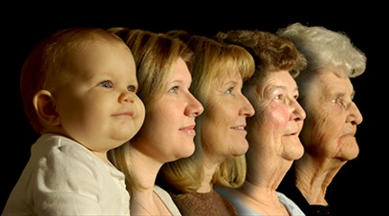
First Born
1901—Church Presidency
“Jesus…is the firstborn among all the sons of god—the first begotten in the spirit, and the only begotten in the flesh. He is our elder brother, and we, like him are in the image of God.”
Jesus Christ is the firstborn of all the spirit children of Heavenly Father
Responsibilities of the First Born
Hath in these last days spoken unto us by his Son, whom he hath appointed heir of all things, by whom also he made the worlds; Hebrews 1:2
He is the “appointed heir” of all the Father has
We have the opportunity to be “joint-heirs with Christ” and be numbered among “the church of the Firstborn”
And if children, then heirs; heirs of God, and joint-heirs with Christ; if so be that we suffer with him, that we may be also glorified together. Romans 8:17
D&C 93:21 Smith and Sjodahl

Slide 23

Begotten Through Jesus
To be spiritually reborn and cleansed from all sin through the power of the Atonement
D&C 93:22

Slide 24
Sources:
Christlike Attributes (2:53)
Elder Richard G. Scott (“The Transforming Power of Faith and Character,” Ensign or Liahona, Nov. 2010, 45–46).
President Dieter F. Uchtdorf Waiting on the Road to Damascus Ensign or Liahona, May 2011, 76).
Mindy Raye Friedman Youth Article Gaining and Keeping a Testimony
Presentation by ©http://fashionsbylynda.com/blog/
Joseph Fielding McConkie and Craig J. Ostler Revelations of the Restoration p. 668
Teachings of Presidents of the Church: Joseph Smith[2007], 268).
L.G. Otten and C.M. Caldwell Sacred Truths of the Doctrine and Covenants pg. 142
Bruce R. McConkie (Mortal Messiah, 1:426–27).
Elder Russell M. Nelson (“Jesus the Christ: Our Master and More,” Ensign, Apr. 2000, 4).
President Lorenzo Snow (In Conference Report, Apr. 1901, p. 3.)
Teachings of Presidents of the Church: Lorenzo Snow [2012], 103).
Presentation by ©http://fashionsbylynda.com/blog/

Slide 25
D&C 93:9“A light turned on in a dark room is like receiving a message from God quickly, completely, and all at once. Many of us have experienced this pattern of revelation as we have been given answers to sincere prayers or been provided with needed direction or protection, according to God’s will and timing. … However, this pattern of revelation tends to be more rare than common.
“The gradual increase of light radiating from the rising sun is like receiving a message from God ‘line upon line, precept upon precept’ (2 Nephi 28:30). Most frequently, revelation comes in small increments over time and is granted according to our desire, worthiness, and preparation. … This pattern of revelation tends to be more common than rare” (“The Spirit of Revelation,” David A. Bednar Ensign or Liahona, May 2011, 88).
Witness and Testimony:
Elder Francis M. Lyman taught: “Every Latter-day Saint is entitled to this witness and testimony. If we have not received [it] … the fault is ours, and not the Lord’s; for every one is entitled to that witness through faith and repentance, forsaking all sin, baptism by immersion for the remission of sins, and the reception of the Holy Ghost through the laying on of hands. Now, if any of our brethren and sisters have lived for years without really knowing, being thoroughly satisfied and thoroughly convinced, just as positive as of anything in life, that this work is of God, if they have lacked that witness and testimony it is their fault, for it is not possible for a man to do the will of the Father and not know the doctrine.” (In Conference Report, Apr. 1910, pp. 29–30.)
D&C 93:5 The Important Mission of Jesus Christ Mortal Ministry:
“In all that Jesus came to say and do, including and especially in His atoning suffering and sacrifice, He was showing us who and what God our Eternal Father is like, how completely devoted He is to His children in every age and nation. In word and in deed Jesus was trying to reveal and make personal to us the true nature of His Father, our Father in Heaven.
“He did this at least in part because then and now all of us need to know God more fully in order to love Him more deeply and obey Him more completely. …
“So feeding the hungry, healing the sick, rebuking hypocrisy, pleading for faith—this was Christ showing us the way of the Father, He who is ‘merciful and gracious, slow to anger, long-suffering and full of goodness’ Elder Jeffrey R. Holland [Lectures on Faith (1985), 42.]” (“The Grandeur of God,” Ensign, Nov. 2003, 70, 72).
D&C 93:12-16 Becoming what our Heavenly Father wants us to be:
“The gospel of Jesus Christ is a plan that shows us how to become what our Heavenly Father desires us to become.
“A parable illustrates this understanding. A wealthy father knew that if he were to bestow his wealth upon a child who had not yet developed the needed wisdom and stature, the inheritance would probably be wasted. The father said to his child:
“‘All that I have I desire to give you—not only my wealth, but also my position and standing among men. That which I have I can easily give you, but that which I am you must obtain for yourself. You will qualify for your inheritance by learning what I have learned and by living as I have lived. I will give you the laws and principles by which I have acquired my wisdom and stature. Follow my example, mastering as I have mastered, and you will become as I am, and all that I have will be yours.’
“This parable parallels the pattern of heaven. The gospel of Jesus Christ promises the incomparable inheritance of eternal life, the fulness of the Father, and reveals the laws and principles by which it can be obtained” Elder Dallin H. Oaks (“The Challenge to Become,” Ensign, Nov. 2000, 32).

Slide 26
Worship: James E. Talmage
The word worship comes from two Anglo-Saxon words: weorth, worthy, and scipe, state or condition. The Lord deserves to be worshiped because His condition is a worthy one. Elder James E. Talmage said: “The worship of which one is capable depends upon his comprehension of the worthiness characterizing the object of his reverence. Man’s capacity for worship is a measure of his comprehension of God.” (Articles of Faith,pp. 395–96.)
We worship to express our feelings about divine things. If we have reverence for God’s truth and grace and desire to be like Him, we can worship Him by keeping His commandments. Elder Bruce R. McConkie explained:
“To worship the Lord is to follow after him, to seek his face, to believe his doctrine, and to think his thoughts.
“It is to walk in his paths, to be baptized as Christ was, to preach that gospel of the kingdom which fell from his lips, and to heal the sick and raise the dead as he did.
“To worship the Lord is to put first in our lives the things of his kingdom, to live by every word that proceedeth forth from the mouth of God, to center our whole hearts upon Christ and that salvation which comes because of him.
“It is to walk in the light as he is in the light, to do the things that he wants done, to do what he would do under similar circumstances, to be as he is.
“To worship the Lord is to walk in the Spirit, to rise above carnal things, to bridle our passions, and to overcome the world.
“It is to pay our tithes and offerings, to act as wise stewards in caring for those things which have been entrusted to our care, and to use our talents and means for the spreading of truth and the building up of his kingdom.
“To worship the Lord is to be married in the temple, to have children, to teach them the gospel, and to bring them up in light and truth.
“It is to perfect the family unit, to honor our father and our mother; it is for a man to love his wife with all his heart and to cleave unto her and none else.
“To worship the Lord is to visit the fatherless and the widows in their affliction and to keep ourselves unspotted from the world.
“It is to work on a welfare project, to administer to the sick, to go on a mission, to go home teaching, and to hold family home evening.
“To worship the Lord is to study the gospel, to treasure up light and truth, to ponder in our hearts the things of his kingdom, and to make them part of our lives.
“It is to pray with all the energy of our souls, to preach by the power of the Spirit, to sing songs of praise and thanksgiving.
“To worship is to work, to be actively engaged in a good cause, to be about our Father’s business, to love and serve our fellowmen.
“It is to feed the hungry, to clothe the naked, to comfort those that mourn, and to hold up the hands that hang down and to strengthen the feeble knees.
“To worship the Lord is to stand valiantly in the cause of truth and righteousness, to let our influence for good be felt in civic, cultural, educational, and governmental fields, and to support those laws and principles which further the Lord’s interests on earth.
“To worship the Lord is to be of good cheer, to be courageous, to be valiant, to have the courage of our God-given convictions, and to keep the faith.
“It is ten thousand times ten thousand things. It is keeping the commandments of God. It is living the whole law of the whole gospel.” (In Conference Report, Oct. 1971, pp. 168–69; or Ensign, Dec. 1971, p. 130.)

