Slide 1
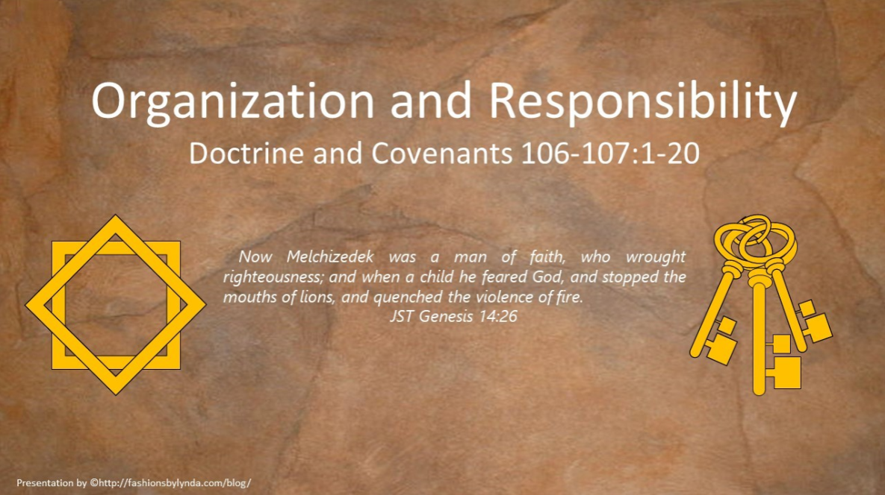

Slide 2


Background
November 25, 1834
On his journey among the churches in early 1834, the Prophet Joseph Smith stopped in the village of Freedom, New York.
Here he was entertained by Warren A. Cowdery, a brother of Oliver. (There were eight children in the Cowdery family, of which Warren was the oldest and Oliver the youngest.)
Joseph Smith received the Revelation in Section 106

Slide 3
Warren A. Cowdery
He was born in October 1788 at Poultney, Vermont
He was the older brother to Oliver Cowdery
He became a successful farmer and medical practitioner in Freedom, New York
On September 22, 1814, he married Patience Simonds and in 1816 the couple moved to Freedom, New York—they had 11 children
Oliver Cowdery introduced him to the Book of Mormon, and he joined the Church in 1831
On November 25, 1834, he was called as a “presiding high priest” in his community
He accused one of the Twelve Apostles of misusing funds for missions, but repented, then moved to Kirtland in 1836 and apologized in a news article printed in the Messenger and Advocate
He served in various capacities as a scribe, recorder, editor, and agent for the Church and also a member of the Kirtland High Council
He left the Church after 1838 and never returned. He died in Kirtland on February 23, 1851
Who’s Who and Wikipedia

Slide 4
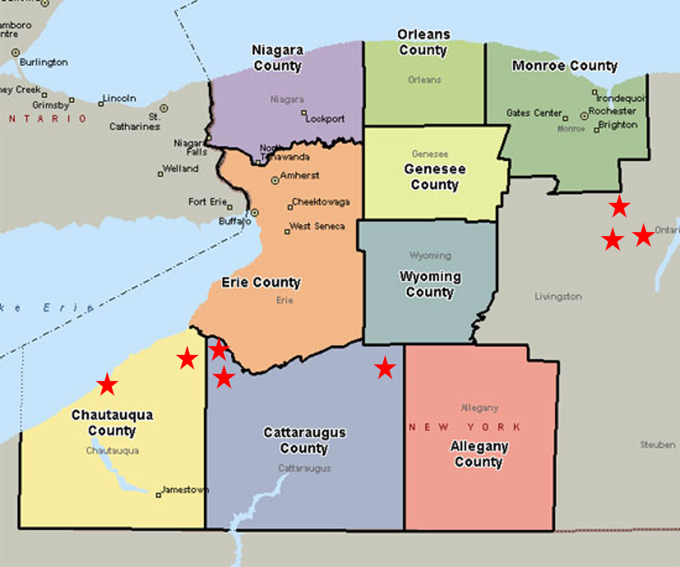
Western New York
Freedom was in Cattaraugus County, New York, and there were Saints in Perrysburg and Palmersville, also in the same county.
In Chautauqua County, immediately west, there were Saints in Westfield and Villanova.
In Livingston County, which was located northeast of Freedom, there were Saints in Genoese, Avon, and Livonia.
Livonia is about fifteen miles from Manchester, New York, where the latter-day work began, and so there were probably Saints living in small towns all over the western part of New York.
Manchester, New York
D&C 106:1-8

Slide 5
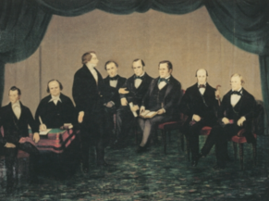
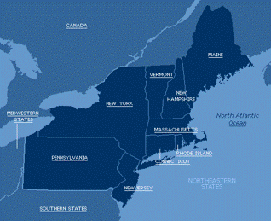
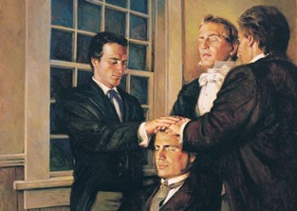
Background
On 14 February 1835, the Three Witnesses to the Book of Mormon, under the direction of Joseph Smith, chose the first Quorum of the Twelve Apostles in this dispensation.
On 12 March 1835, during a meeting of the Twelve, Elders Orson Hyde and William E. McLellin, acting as clerks, recorded the following:
“This evening the Twelve assembled, and the Council was opened by President Joseph Smith, Jun., and he proposed we take our first mission through the Eastern States, to the Atlantic Ocean, and hold conferences in the vicinity of the several branches of the Church for the purpose of regulating all things necessary for their welfare.
“It was proposed that the Twelve leave Kirtland on the 4th day of May, which was unanimously agreed to.”
Joseph Smith

Slide 6
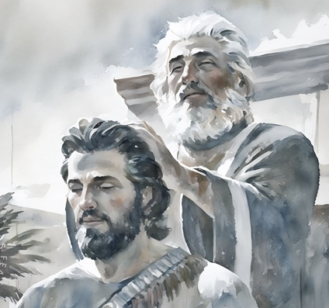
The Prince of Peace
The Melchizedek Priesthood is after the order of the Son of God.
Now Melchizedek was a man of faith, who wrought righteousness; and when a child he feared God, and stopped the mouths of lions, and quenched the violence of fire.
JST, Genesis 14:26
But Melchizedek having exercised mighty faith, and received the office of the high priesthood according to the holy order of God, did preach repentance unto his people. And behold, they did repent; and Melchizedek did establish peace in the land in his days; therefore he was called the prince of peace, for he was the king of Salem; and he did reign under his father.
Alma 13:18
The Melchizedek Priesthood is after the order of the Son of God
As king of Salem, he “did establish peace in the land in his days; therefore he was called the prince of peace
D&C 107:1-4

Slide 7
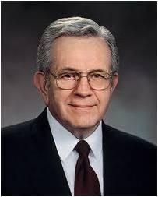
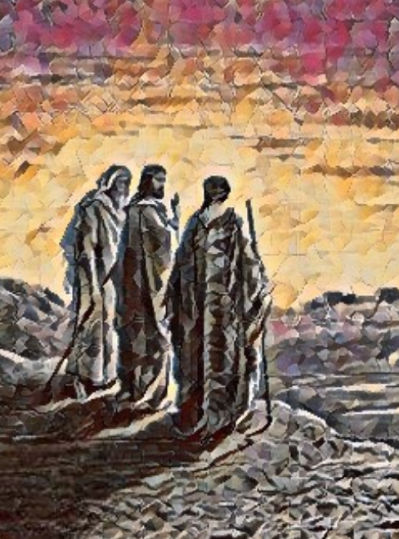
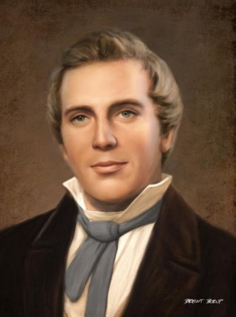
Priesthood
“When priesthood authority is exercised properly, priesthood bearers do what He [Jesus Christ] would do if He were present” Elder Boyd K. Packer
“Although there are two Priesthoods, yet the Melchizedek Priesthood comprehends the Aaronic or Levitical Priesthood, and is the grand head, and holds the highest authority which pertains to the Priesthood, and the keys of the Kingdom of God in all ages of the world to the latest posterity on the earth, and is the channel through which all knowledge, doctrine, the plan of salvation, and every important matter is revealed from heaven.”
Joseph Smith
D&C 107:1-4

Slide 8
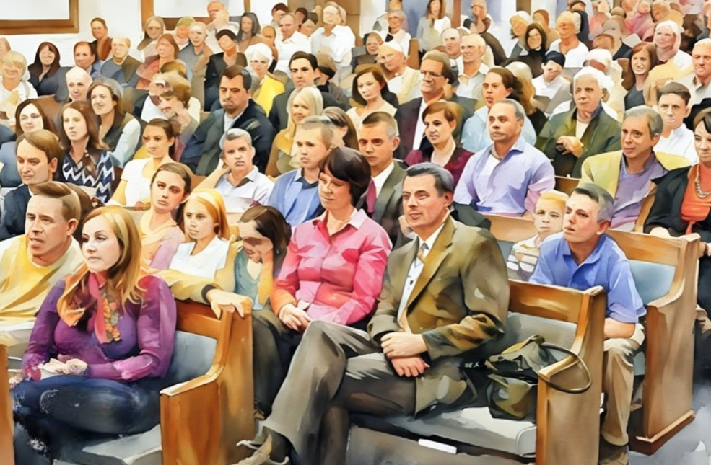
Appendages of the Priesthood
A part of
I am the vine, ye are the branches: He that abideth in me, and I in him, the same bringeth forth much fruit: for without me ye can do nothing.
John 15:5
FIRST PRESIDENCY
1ST Counselor President 2nd Counselor
Council of the Twelve
Presiding Bishopric
Priesthood
Executive
Committee
Leadership Training Executive Committee
Missionary Executive Committee
Temple and Genealogy Executive Committee
Welfare Services
Financial
Translation Distribution
Management Data
Physical Faculties
Purchasing
Membership and statistical Reports
Youth
Adult
Curriculum Resources
Primary
Sunday School
Aaronic Priesthood
Young Men
Young Women
Melchizedek Priesthood
Relief Society
Single Adults
Instructional Development
Magazines
Graphics, Editing and Text Processing
Music
All authorities and offices in the Savior’s Church are appendages to the Melchizedek Priesthood.
D&C 107:1-4

Slide 9
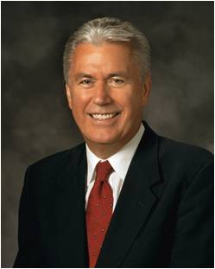
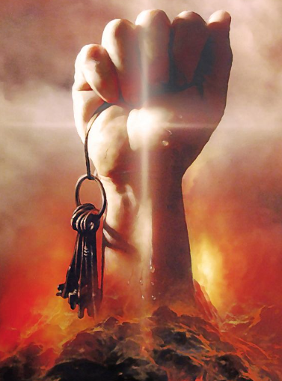
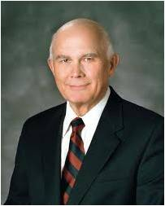
Keys to the Priesthood
Ultimately, all keys of the priesthood are held by the Lord Jesus Christ, whose priesthood it is. He is the one who determines what keys are delegated to mortals and how those keys will be used. …
… Since the scriptures state that “all other authorities [and] offices in the church are appendages to this [Melchizedek] priesthood”, all that is done under the direction of those priesthood keys is done with priesthood authority.
Dallin H. Oaks
Christ is the source of all true priesthood authority and power on earth. It is His work, in which we are privileged to assist.
Dieter F. Uchtdorf
D&C 107:5

Slide 10
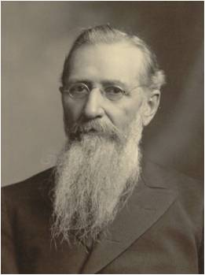
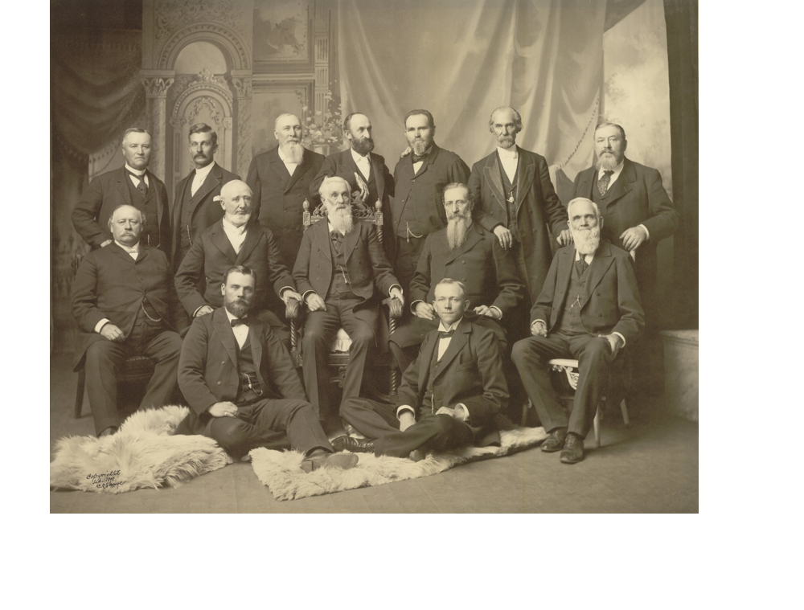
Government of the Church
“There is no government in the Church of Jesus Christ separate and apart, above, or outside of the holy Priesthood or its authority. … [Auxiliary organizations] are not outside of, nor above it, nor beyond its reach.
They acknowledge the principle of the Priesthood.
Wherever they are they always exist with the view of accomplishing some good; some soul’s salvation, temporal or spiritual”
Joseph F. Smith
D&C 107:8-12

Slide 11
Doctrinal Mastery
The Melchizedek Priesthood holds the right of presidency, and has power and authority over all the offices in the church in all ages of the world, to administer in spiritual things.
D&C 107:8

Slide 12

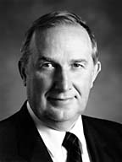
Spiritual Things VS Outward Ordinances
Spiritual Things=Knowledge
Outward Ordinances
Sacrament
Baptism
Gift of Holy Ghost
Temple Endowment
Marriage Sealing
Priesthood Blessings
In humility, seek divine light
Exercise faith in Jesus Christ
Hearken to His counsel
Keep His commandments
As spiritual knowledge unfolds, it must be understood, valued, obeyed, remembered, and expanded.
Elder Richard G. Scott
Of the Quorum of the Twelve Apostles
In Conference Report, Oct. 1993, 117–20; or Ensign, Nov. 1993, 86–88

Slide 13
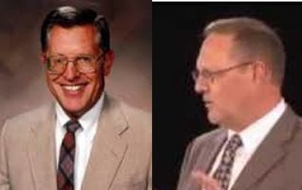
The Right of Presidency
Commonly referred to as holding keys—the right to preside
All keys conferred upon them
Presides at meetings
Quorum of Twelve
In a sense, the Twelve hold every office in the Church and preside over all offices and auxiliaries
Can confer priesthood upon others—only by direction of those holding keys of the priesthood
High Priesthood Presidency—First Presidency of the Church
Presides over all other offices and officers in the Church
Hold all keys of the kingdom
(D&C 90:2)
“Revelations of the mind and will of God to the church, are to come through the Presidency” Joseph Smith
D&C 107:8-9 McConkie and Ostler

Slide 14
The Melchizedek Priesthood holds the right of presidency, power, and authority over all the offices in the Church, and the authority to administer in spiritual things

Slide 15
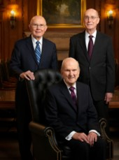
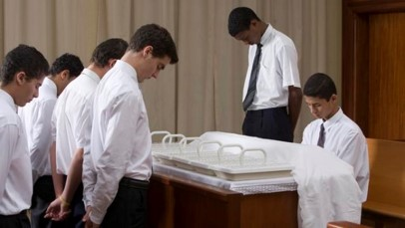
Administering of Spiritual Matters
Melchizedek Priesthood
Aaronic Priesthood
High Priest
Apostle
Seventy
Patriarch
Elder
Bishop
Priest
Teacher
Deacon
Bishop
In the absence of those called to preside, high priest can act in their stead. In the absence of high priest, the responsibility falls to the elders
Bishop must also be a High Priest (D&C 68:19)
D&C 107:10-11 McConkie and Ostler

Slide 16
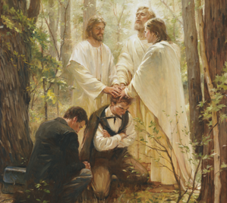
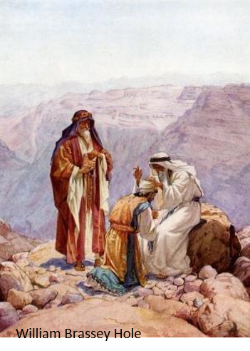
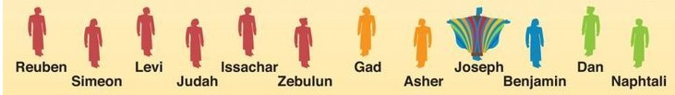
Priesthood of Aaron
The Aaronic Priesthood holds the keys of the ministering of angels and administering in outward ordinances
“From the days of Aaron to the time of Christ, the only priesthood known generally among the house of Israel in the Old World was the Aaronic, or Levitical, priesthood.
The right to hold this priesthood was limited to those who were of the tribe of Levi.”
“With the coming of the gospel in the meridian day came the restoration of the Melchizedek Priesthood. The Aaronic Priesthood was retained, with the right to hold it again extended to all the tribes of Israel.
Following the same pattern, both priesthoods have been restored in our day.”
“Both priesthoods can be held by all worthy males, regardless of the tribe of Israel from which they descend, the promise given to those of the tribe of Levi are still remembered and will be honored as part of the restoration of all things.”
D&C 107:13 McConkie and Ostler

Slide 17
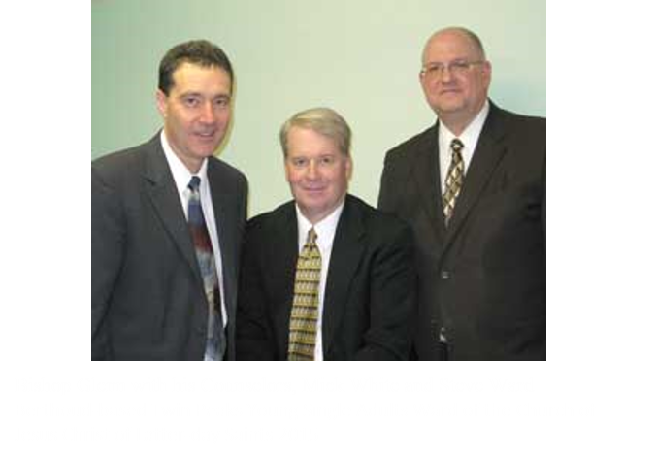
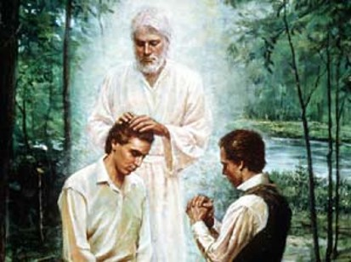
Bishopric—an office or calling
The word is used in the latter days
“Ward bishoprics did not function as we now know them until after the Saints had moved west.”
“According to this revelation, the presiding bishop and his counselors hold the keys restored by John the Baptist to Joseph Smith and Oliver Cowdery, and thus give direction and leadership to all who hold the Aaronic Priesthood.”
D&C 107:15 McConkie and Ostler

Slide 18
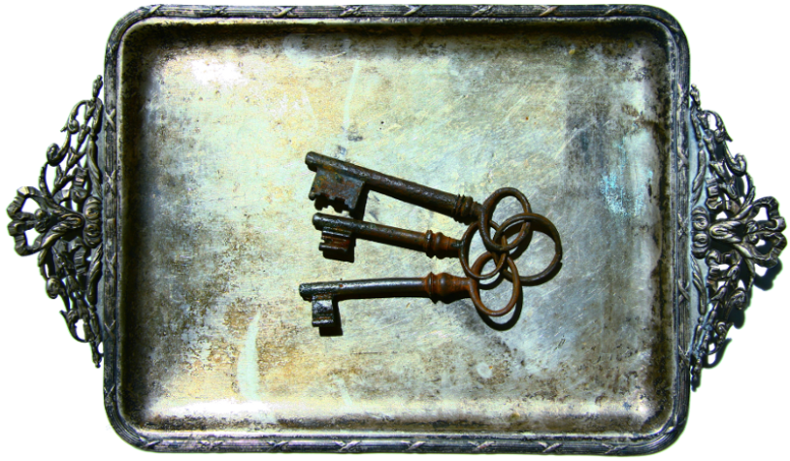
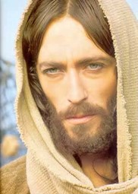
Keys of All Spiritual Blessings
“Priesthood keys are the authority God has given to priesthood leaders to direct, control, and govern the use of His priesthood on earth. The exercise of priesthood authority is governed by those who hold its keys. Those who hold priesthood keys have the right to preside over and direct the Church within a jurisdiction.
“Jesus Christ holds all the keys of the priesthood pertaining to His Church. He has conferred upon each of His Apostles all the keys that pertain to the kingdom of God on earth. The senior living Apostle, the President of the Church, is the only person on earth authorized to exercise all priesthood keys.”
D&C 107:15 McConkie and Ostler

Slide 19
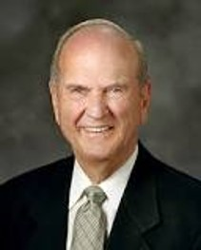
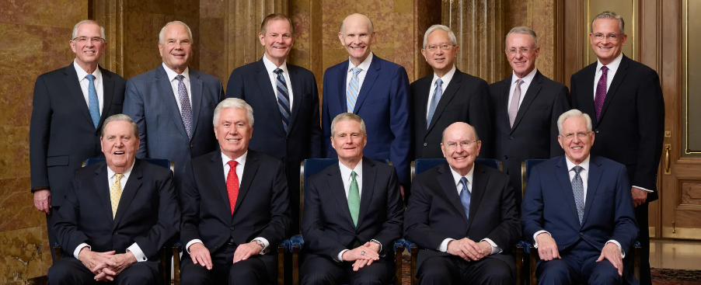
Keys of All Spiritual Blessings
“Seventies act by assignment and by the delegation of authority from the First Presidency and Quorum of the Twelve Apostles. Area Presidents are assigned to administer areas under the authorization of the First Presidency and the Twelve. The Presidency of the Seventy are set apart and are given the keys to preside over the Quorums of Seventy.
“The President of the Church delegates priesthood keys to other priesthood leaders so they can preside in their areas of responsibility. Priesthood keys are bestowed on presidents of temples, missions, stakes, and districts; bishops; branch presidents; and quorum presidents.
This presiding authority is valid only for the designated responsibilities and within the geographic jurisdiction of each leader’s calling. When priesthood leaders are released from their callings, they no longer hold the associated keys.
2024- Quorum of the Twelve Apostles
D&C 107:15 McConkie and Ostler

Slide 20
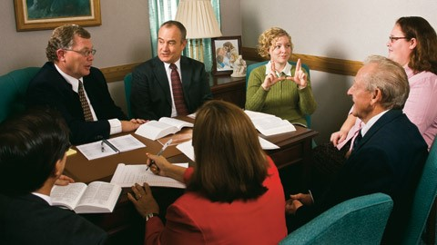
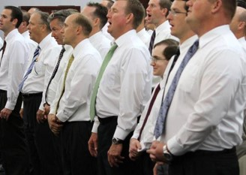
Keys of All Spiritual Blessings
“Counselors to priesthood leaders do not receive keys. They are set apart and function in their callings by assignment and delegated authority.
“All ward and stake auxiliary organizations operate under the direction of the bishop or stake president, who holds the keys to preside. Auxiliary presidents and their counselors do not receive keys. They receive delegated authority to function in their callings.”
D&C 107:15 Handbook 2: Administering the Church [1010], 2.1.1

Slide 21
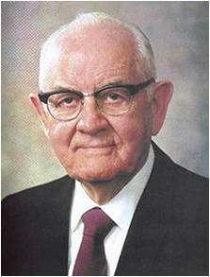
“[The Melchizedek Priesthood] is the means whereby the Lord acts through men to save souls. Without this priesthood power, men are lost.
Only through this power does man ‘hold the keys of all the spiritual blessings of the church,’ enabling him to receive ‘the mysteries of the kingdom of heaven, to have the heavens opened’ unto him enabling him to enter the new and everlasting covenant of marriage and to have his wife and children bound to him in an everlasting tie, enabling him to become a patriarch to his posterity forever, and enabling him to receive a fullness of the blessings of the Lord.”
President Spencer W. Kimball
The Melchizedek Priesthood holds the keys of all the spiritual blessings of the Church
D&C 107:18-19

Slide 22


Brent Borup
“[The Melchizedek Priesthood] is the channel through which all knowledge, doctrine, the plan of salvation, and every important matter is revealed from heaven.”
Joseph Smith
D&C 107:18-19 HC

Slide 23
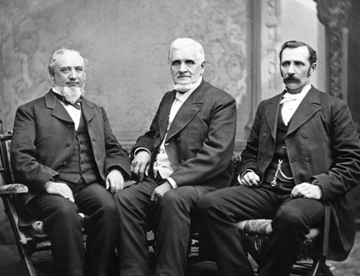
Sources:
Video:
The Magnificent Priesthood, Part 1 (2:34)
Doctrine and Covenants Who’s Who by Ed J. Pinegar and Richard J. Allen pg. 20-21
Joseph Smith (History of the Church, 2:209.)
(History of the Church, 4:207; see also D&C 107:14.
2:477—revelation
Joseph Smith, in History, 1838–1856 [Manuscript History of the Church], volume C-1, 1104, josephsmithpapers.org; spelling, punctuation, and capitalization modernized
Elder Boyd K. Packer (“The Power of the Priesthood,” Ensign, May 2010, 7)
Presentation by http://fashionsbylynda.com/blog/
Joseph F. Smith (Teachings of Presidents of the Church: Joseph F. Smith [1998],341–42)
Joseph Fielding McConkie and Craig J. Ostler Revelations of the Restoration pg. 787-789
President Spencer W. Kimball (“The Example of Abraham,” Ensign, June 1975, 3; see also Doctrine and Covenants Institute Student Manual, 2nd ed. [Church Educational System manual, 2001], 263).
Dieter F. Uchtdorf, “The Joy of the Priesthood,” Ensign or Liahona, Nov. 2012, 59
Dallin H. Oaks, “The Keys and Authority of the Priesthood,” Ensign or Liahona, May 2014, 50)
The First Presidency of the Church from 1880 to 1887: President John Taylor (center)and his counselors, George Q. Cannon (left) and Joseph F. Smith (right).
Presentation by http://fashionsbylynda.com/blog/

Slide 24
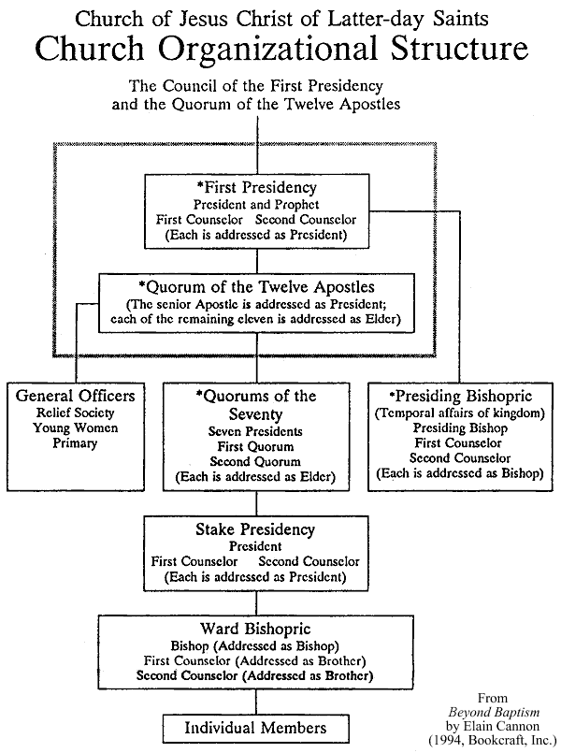
On 28 March 1835 Elders Hyde and McLellin wrote:
“This afternoon the Twelve met in council, and had a time of general confession. On reviewing our past course we are satisfied, and feel to confess also, that we have not realized the importance of our calling to that degree that we ought; we have been light-minded and vain, and in many things have done wrong. For all these things we have asked the forgiveness of our heavenly Father; and wherein we have grieved or wounded the feelings of the Presidency, we ask their forgiveness. The time when we are about to separate is near; and when we shall meet again, God only knows; we therefore feel to ask of him whom we have acknowledged to be our Prophet and Seer, that he inquire of God for us, and obtain a revelation, (if consistent) that we may look upon it when we are separated, that our hearts may be comforted. Our worthiness has not inspired us to make this request, but our unworthiness. We have unitedly asked God our heavenly Father to grant unto us through His Seer, a revelation of His mind and will concerning our duty [during] the coming season, even a great revelation, that will enlarge our hearts, comfort us in adversity, and brighten our hopes amidst the powers of darkness.” (History of the Church, 2:209–10.)
The Prophet Joseph did inquire of the Lord and on 28 March 1835 received verses 1–52, 56–58 of this section. The other verses were revealed at different times. (See History of the Church, 2:210; Smith, Teachings, pp. 38–39.)
Elder Bruce R. McConkie wrote:
“The priesthood is greater than any of its offices. No office adds any power, dignity, or authority to the priesthood. All offices derive their rights, prerogatives, graces, and powers from the priesthood. This principle may be diagramed by dividing a circle into segments. The priesthood is the circle; the segments of the circle are the callings or offices in the priesthood. Anyone who serves in a segment of the circle must possess the power of the whole circle. No one can hold an office in the priesthood without first holding the priesthood.
“Thus it is that priesthood is conferred upon worthy individuals, and they are then ordained to offices in the priesthood; and thus it is that all offices in the priesthood and in the Church are specifically designated as appendages to the priesthood; that is, they grow out of the priesthood, they are supplemental to it, they are less than the priesthood in importance. (D. & C. 84:29–30; 107:5.) It follows that it is greater and more important to hold the Melchizedek Priesthood, for instance, than it is to hold any office in that priesthood. …
“Further, there is no advancement from one office to another within the Melchizedek Priesthood. Every elder holds as much priesthood as an apostle or as the President of the Church, though these latter officers hold greater administrative assignments in the kingdom. It follows, also, that any holder of the Melchizedek Priesthood could perform any priestly function he was appointed to do by the one holding the keys of the kingdom.” (Mormon Doctrine, pp. 595–96.)

