Slide 1

Doctrine and Covenants 109:1-46
The Kirtland Temple: House of Glory
And it shall come to pass in the last days, saith God, I will pour out of my spirit upon all flesh: and your sons and your daughters shall prophesy, and your young men shall see visions, and your old men shall dream dreams:
Acts 2:7
Presentation by ©http://fashionsbylynda.com/blog/

Slide 2
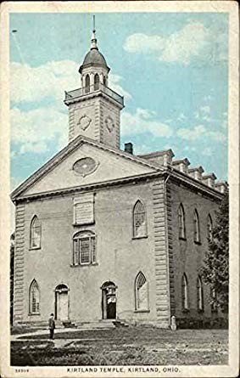
Background—3 Years Labor
July 23, 1833- March 27, 1836
‘While the brethren labored in their departments,’ ‘the sisters were actively engaged in boarding and clothing workmen not otherwise provided
for—all living as
abstemiously as possible,
so that every cent might
be appropriated to the
grand object.’ And thus
they toiled on from the
23rd of July 1833, when
the corner stones were
laid, until it was
completed for dedication.
Tullidge—Smith and Sjodahl
“In the Revelation given on the 1st of June 1833, the Lord indicated the special object for which this house was to be built:
‘I gave unto you a commandment, that you should build an house, in the which house I design to endow those whom I have chosen, with power from on high’ (Sec. 95:8).
It was to be a place in which the Church would receive a Pentecostal baptism in the fire of the Holy Spirit [see Acts 2].
A special house, consecrated and dedicated, was needed for that purpose, hence the commandment of God to the Saints concerning this house.”
HC

Slide 3
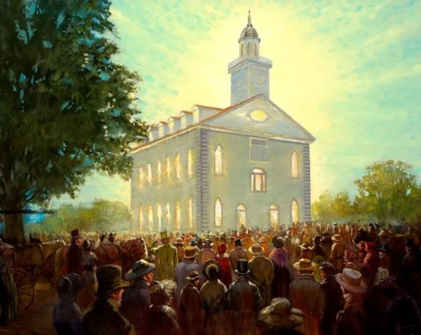
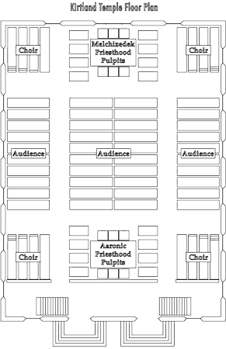
Day of Dedicatory Service
The Kirtland Temple was dedicated on March 27, 1836. Many Latter-day Saints who attended the ceremonies and events associated with the dedication experienced great spiritual manifestations.
These included hearing the sound of a rushing mighty wind, speaking in tongues, seeing visions, and witnessing the visitation of angels.
Almost 1,000 Latter-day Saints attended the dedicatory service for the Kirtland Temple. Many more wanted to attend but could not fit in the building.
The Prophet Joseph Smith arranged for them to participate in a meeting in another building, and the dedicatory service was repeated for them a few days later.

Slide 4
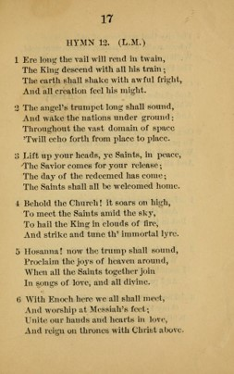
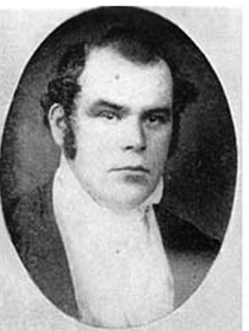
First Hymn Sung
Author: Parley P. Pratt
The last verse
Our hearts and tongue shall join in one,
To praise the Father and the Son,
While all the heavens shall shout again,
And all creatures say, Amen.
Directed by:
M.G. Davis
HC

Slide 5
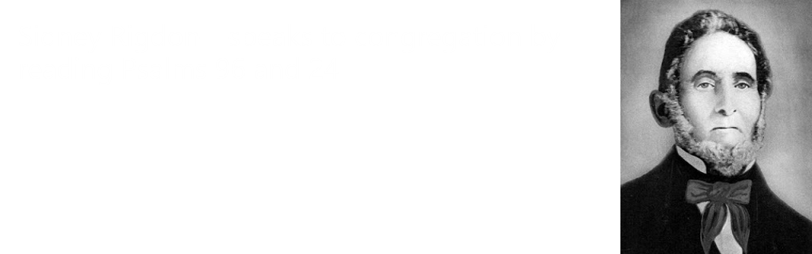
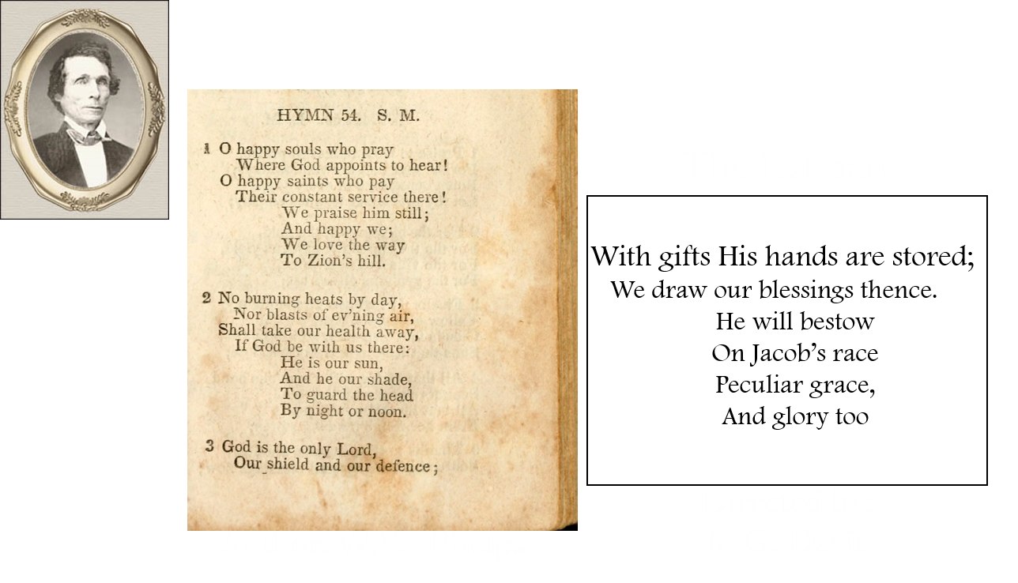
Sermon and Rest Hymn
Sidney Rigdon then reads from Matthew chapters 18-20 with emphasis on chapter 20—
He spoke 2 ½ hours
“At one point, he drew tears from many eyes.”
“He admitted there are many houses…built for the worship of God, but not one except this, on the face of the whole earth, that was built by divine revelation…”
Joseph Smith
HC

Slide 6
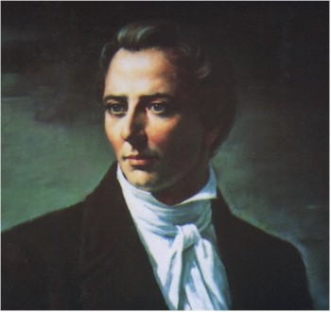

The Raising of Their Hands
The Prophet Joseph Smith was sustained by the Quorum as Prophet and Seer
The services of the day were resume by singing Adam-ondi-Ahman.
“He then called upon all the congregation of Saints, also, to give their assent by rising on their feet, which they did unanimously.”
The Prophet Joseph Smith then made a short address and sustained the Presidency as prophets and Seers
HYMNS
The Prophet Joseph Smith then had the Quorum of the Twelve sustained as Prophets, Seers, Revelators, and special witnesses to all the nations of the earth.
The Hymn Now Let Us Rejoice was sung then there was a twenty-minute intermission during which the congregation kept their seats.
HC

Slide 7
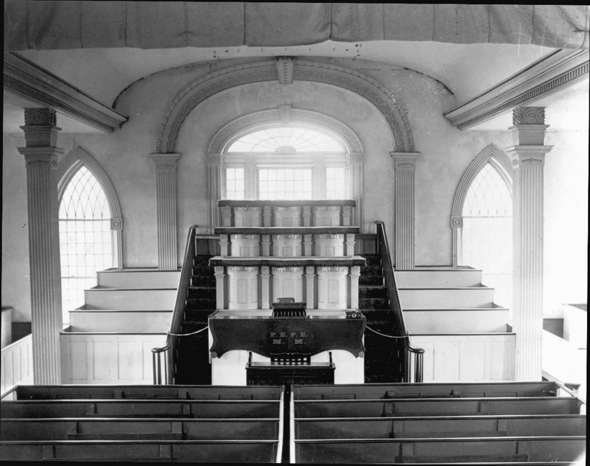
Dedicatory Prayer
“This pattern was set by the Prophet Joseph Smith in the dedication of the Kirtland Temple.
The prayer given on that occasion was revealed to him (Joseph Smith) by the Lord; all prayers used since then have been written by the spirit of inspiration and have been read by such of the Brethren as have been appointed to do so.”
“When we dedicate a house to the Lord, what we really do is dedicate ourselves to the lord’s service, with a covenant that we shall use the house in the way He intends that it shall be used.”
D&C 109 Church News

Slide 8
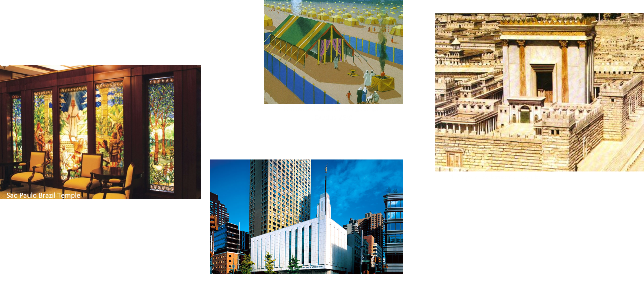
Why Temples?
“Whenever the Lord has given His people access to the fullness of the gospel, He has also commanded His people to build a house unto Him.”
The Lord commands us to build temples
D&C 109:1-4 Otten and Caldwell

Slide 9
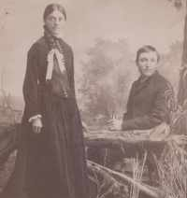
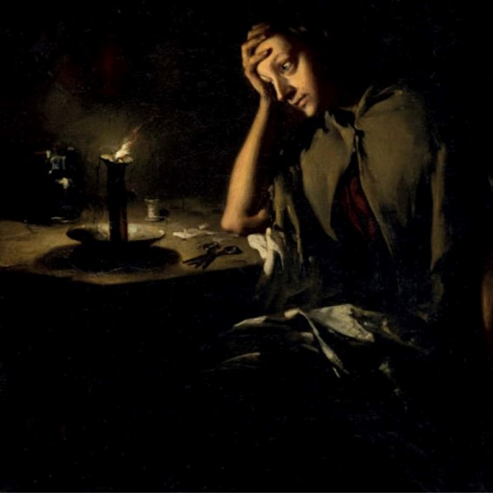
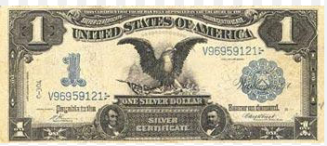
Other Sacrifices for the Temple
‘Between June 1833 and March 1836, Church members sacrificed time, money, and possessions to help build the first temple in this dispensation. Men provided skilled labor for the building’s construction, and women made clothing and provided lodging for the workers. Some Latter-day Saints donated much of their wealth to the building of the temple.
When many of the men were away with Zion’s Camp, some women continued the work on the temple.
Some Latter-day Saints, like John Tanner and Vienna Jacques, gave much of their wealth for the building of the temple.
George and Emelia Funk
The temple cost approximately 60,000 United States dollars—an incredible sum for that time, especially considering the poverty of the Saints.
By comparison, that amount would be worth well over 1,000,000 United States dollars today.
D&C 109:5

Slide 10
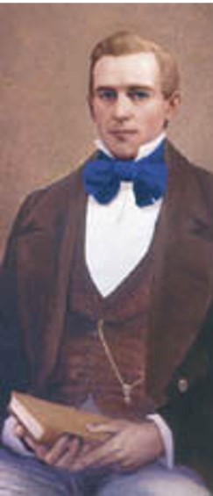
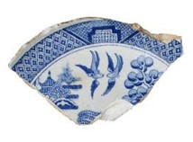
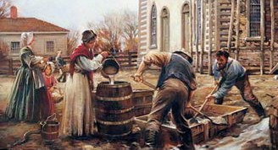
Artemus Millet From Canada
Millet sold the family farm, took his family to Kirtland, and labored on the temple from the laying of the cornerstone to the project's completion, having full charge of the work.
Brother Millet gave up his job as a stone mason for the Canadian government so he and his family could move to Kirtland, where he served as the superintendent of the construction of the temple.
He served so well, inventing an extraordinarily hard exterior plaster that shone with the china dishes broken up in it, and feeding many of the workers on the temple from his own resources that he was later called by Joseph Smith to do the masonry for the Nauvoo Temple, where that same marvelous exterior plaster was used.
Artemus Millet's greatest legacies of faith are his conversion and his lifelong commitment to establishing Zion.
D&C 109:5 BYU Studies and Eugene England

Slide 11
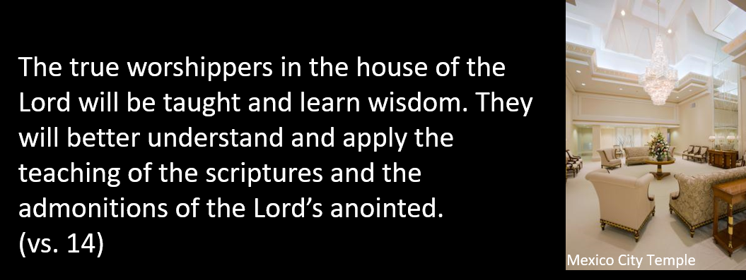
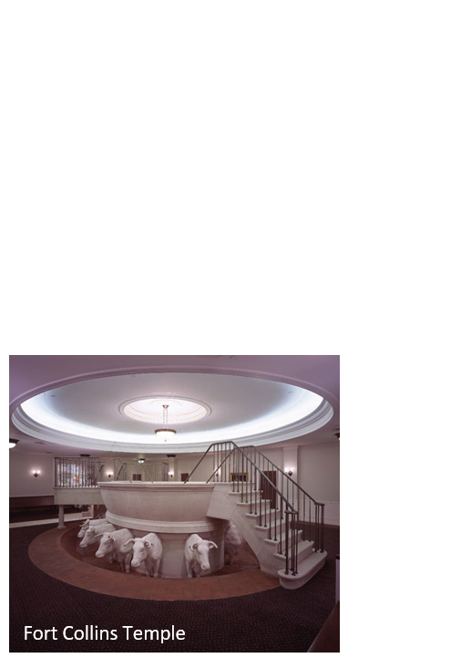
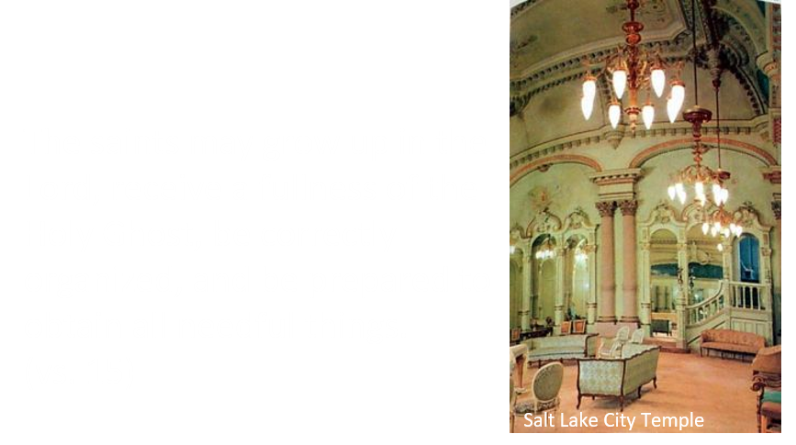
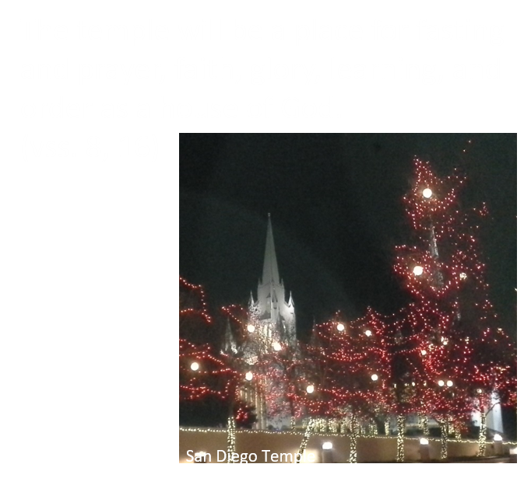
Blessings Promised In The House of the Lord
In the temple, the Lord can manifest Himself to us.
D&C 109:12-15

Slide 12
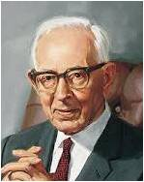
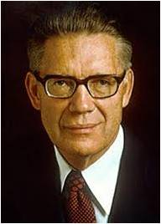
Reverence In The Lord’s House
“The most decorous conduct—unmarred by loud laughter, unnecessary conversation, untoward actions of any sort, or even by evil thoughts—is essential to reverencing the Lord’s sanctuary. And what is said of his temples is also true of his meetinghouses.”
Elder Bruce R. McConkie
“Self-respect requires, among other things, that one shall behave like a true gentleman, in a house of worship.
No self-respecting person will go to a house devoted to the service of God to whisper, gossip and visit; rather, it is one’s duty to put on self-restraint, to give one’s undivided attention to the speaker, and concentrate the mind upon his words that his thoughts may be grasped to one’s benefit and profit.”
President Joseph F. Smith
D&C 109:21

Slide 13
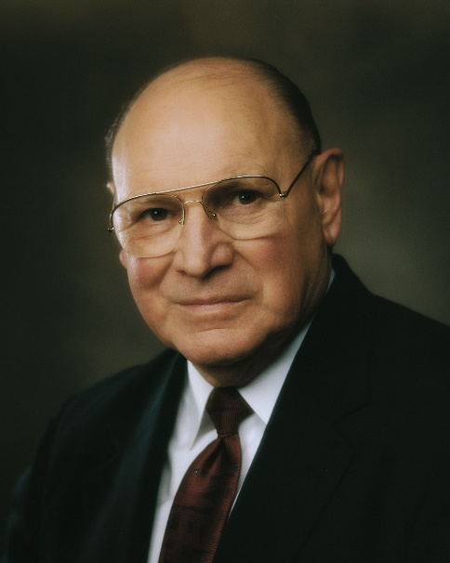
A Power For Righteousness
“They can better withstand evil and can better propagate truth as an influence for good to all of Father's children.”
“Those who receive the ordinances and blessings of the temple have a power for righteousness that comes from the Lord.”
“In the house of the Lord, faithful Church members can be endowed ‘with power from on high’, power that will enable us to resist temptation, honor covenants, obey the Lord’s commandments, and bear fervent, fearless testimony of the gospel to family, friends, and neighbors.”
Elder Joseph B. Wirthlin
Receiving temple blessings arms us with power and with the Lord’s help as we serve Him
D&C 109:22-49 Otten and Caldwell

Slide 14
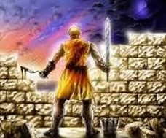
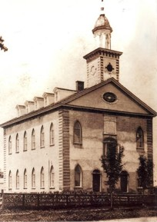
Protection
During the construction of the Kirtland Temple, mobs threatened to destroy the temple.
President Brigham Young told of “laborers on the walls, holding the sword in one hand to protect themselves from the mob, while they placed the stone and moved the trowel with the other”
(Discourses of Brigham Young, sel. John A. Widtsoe [1954], 415).
And it came to pass from that time forth, that the half of my servants wrought in the work, and the other half of them held both the spears, the shields, and the bows, and the habergeons; and the rulers were behind all the house of Judah.
Nehemiah 4:16
At times, the men who worked on the temple during the day had to guard it at night.
If the Lord’s people are worthy and worship Him in the temple, then wickedness will not prevail over them.
D&C 109:24-46

Slide 15
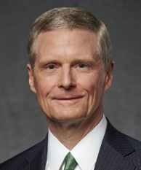
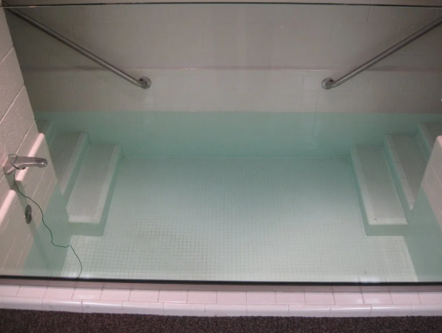
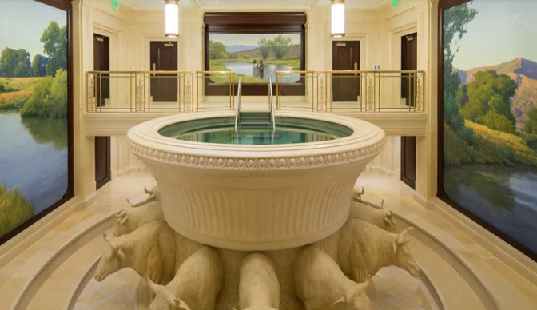
Hold a Name and Standing
The process of taking upon ourselves the name of Jesus Christ that is commenced in the waters of baptism is continued and enlarged in the house of the Lord.
As we stand in the waters of baptism, we look to the temple.
As we partake of the sacrament, we look to the temple.
We pledge to always remember the Savior and to keep His commandments as preparation to participate in the sacred ordinances of the temple and receive the highest blessings available through the name and by the authority of the Lord Jesus Christ.
Thus, in the ordinances of the holy temple we more completely and fully take upon us the name of Jesus Christ.
David A. Bednar
D&C 109:24

Slide 16
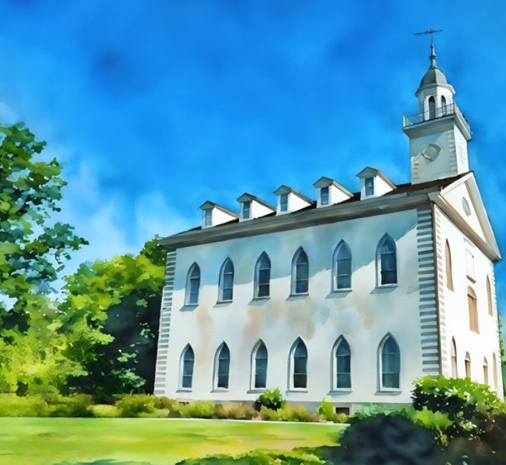
We do not come to the temple to hide from or escape the evils of the world. Rather, we come to the temple to conquer the world of evil.
As we invite into our lives the “power of godliness” by receiving priesthood ordinances and making and keeping sacred covenants, we are blessed with strength beyond our own to overcome the temptations and challenges of mortality and to do and become good.
David A. Bednar
Kirtland Temple Today
Doctrine and Covenants 84:20–21

Slide 17
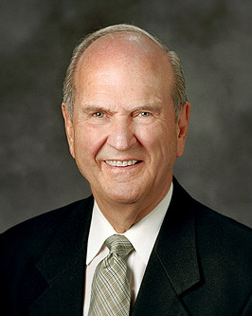
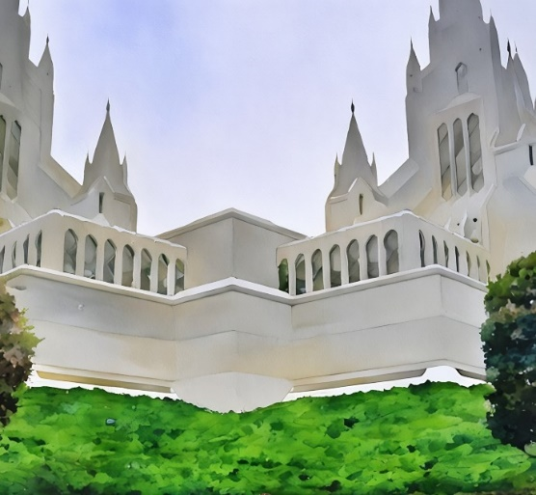
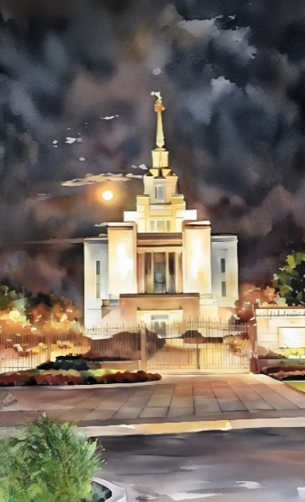
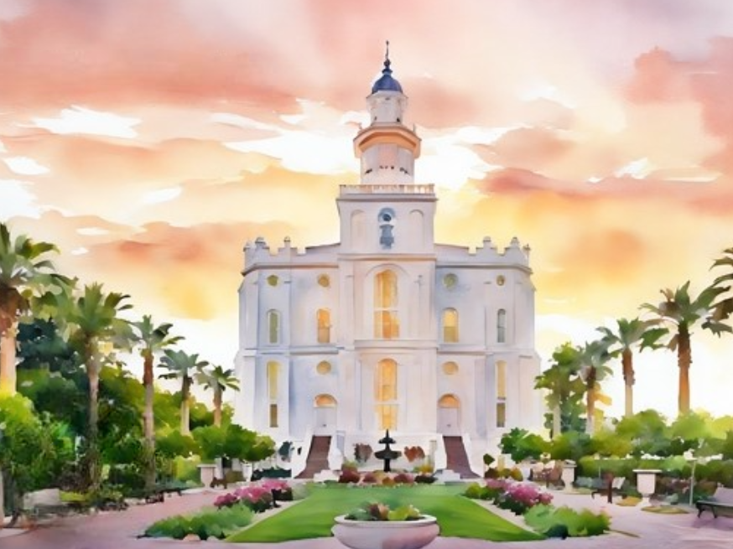
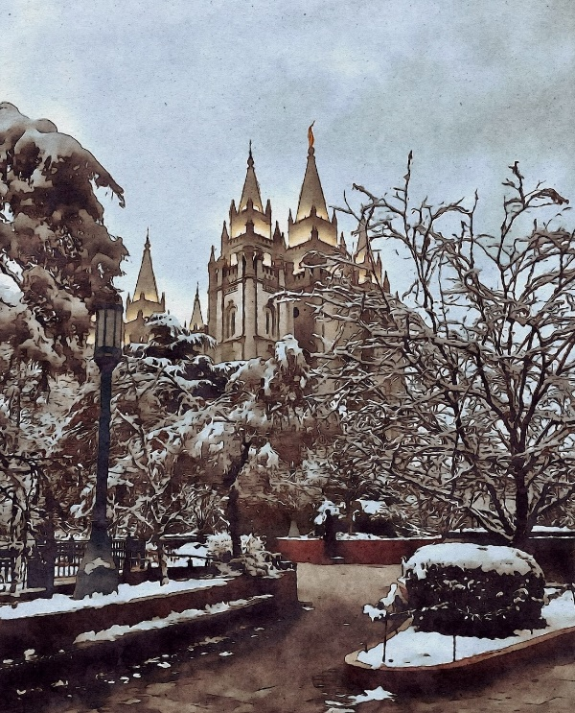
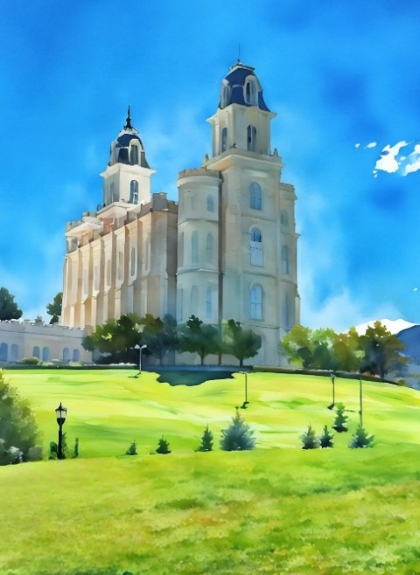
[The temple] is His house. It is filled with His power. Let us never lose sight of what the Lord is doing for us now. …
I promise that increased time in the temple will bless your life in ways nothing else can.
Russell M. Nelson

Slide 18
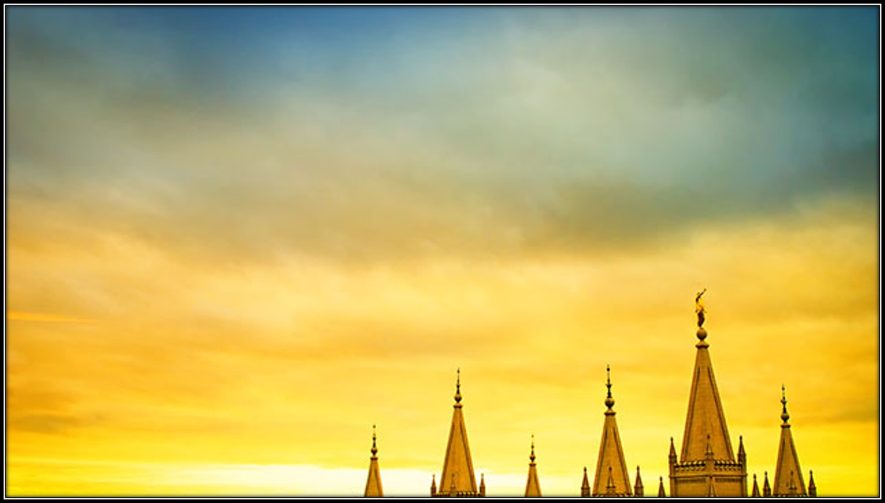
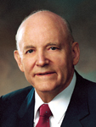
“Truly, the Lord desires that His people be a temple-motivated people. It would be the deepest desire of my heart to have every member of the Church be temple worthy. …
Let us be a temple-attending and a temple-loving people. Let us hasten to the temple as frequently as time and means and personal circumstances allow.”
President Howard W. Hunter

Slide 19
Sources:
Videos:
“The Blessings of the Temple” (3:37)
“Strength beyond My Own” (3:47).
Treasure in Heaven: The John Tanner Story (20:31)
Why Mormons Build Temples(3:14)
Tullidge--Hyrum M. Smith and Janne M. Sjodahl Doctrine and Covenants Commentary pg. 720-721
History of the Church, Vol. II., p. 412-18, 428
Church News, Feb. 12, 1972
Presentation by ©http://fashionsbylynda.com/blog/
L.G. Otten and C.M. Caldwell Sacred Truths of the Doctrine and Covenants Vol. 2 pg. 241-244
BYU Studies: The Conversation with Artemus Millet and His Call to Kirtland Author: Keith A. Erekson, Lloyd D. Newell
Categories: Kirtland Period Journal: 41:2
Eugene England Without Purse or Scrip: A 19-Year-Old Missionary in 1853 July 1975 Ensign
Elder Joseph B. Wirthlin (“Cultivating Divine Attributes,” Ensign, Nov. 1998, 27).
Elder Bruce R. McConkie (Mormon Doctrine, p. 652.)
President Joseph F. Smith (Gospel Doctrine, p. 334.)
David A. Bednar, “Honorably Hold a Name and Standing,” Ensign or Liahona, May 2009, 98); “Let This House Be Built unto My Name,” Ensign or Liahona, May 2020, 86)
Russell M. Nelson, “Focus on the Temple,” Liahona, Nov. 2022, 121
President Howard W. Hunter (“The Great Symbol of Our Membership,” Ensign, Oct. 1994, 5).
Presentation by ©http://fashionsbylynda.com/blog/

Slide 20
Day of Dedication:
“Now the day of dedication had come. The people assembled early, full of joy and gratitude, and they were not disappointed in their expectations. The manifestations of the divine presence were such as to leave no room in the minds of the true Saints for doubt concerning the nature of the work in which they were engaged. Heber C. Kimball relates that during the ceremonies of the dedication, an angel appeared and sat near Joseph Smith, Sr., and Frederick G. Williams, so that they had a fair view of his person. He was tall, and had black eyes and white hair; wore a garment extending to near his ankles, and had sandals on his feet. ‘He was sent,’ President Kimball says, ‘as a messenger to accept of the dedication.’ (Whitney’s Life of Heber C. Kimball, p. 103). A few days afterwards, a solemn assembly was held … and blessings were given. ‘While these things were being attended to,’ Heber C. Kimball says, ‘the beloved disciple John was seen in our midst by the Prophet Joseph, Oliver Cowdery, and others’ (Ibid., p. 104). On the 6th of April, a meeting was held which was prolonged into the night. On this occasion the spirit of prophecy was poured out upon the Saints, and many in the congregation saw tongues of fire upon some of those present, while to others angels appeared. ‘This,’ President Kimball says, ‘continued several days and was attended by a marvelous spirit of prophecy. Every man’s mouth was full of prophesying, and for a number of days and weeks our time was spent in visiting from house to house, administering bread and wine, and pronouncing blessings upon each other to that degree, that from the external appearances one would have supposed that the last days had truly come, in which the Spirit of the Lord was poured out upon all flesh’ (Ibid., p. 105; see also Hist. of the Church, Vol. II., p. 427). Nor were the Saints the only ones who were aware of supernatural manifestations at this time. Elder George A. Smith rose to prophesy, when a noise was heard like the sound of a rushing wind. All the congregation arose, and many began to speak in tongues and prophesy. And then people of the neighborhood came running together (hearing an unusual sound within and seeing a bright light like a pillar of fire resting upon the Temple), and were astonished at what was taking place. This continued until the meeting closed, at 11 p.m. (History of the Church, Vol. II., p. 428).” (Commentary, pp. 720–21.)

Slide 21
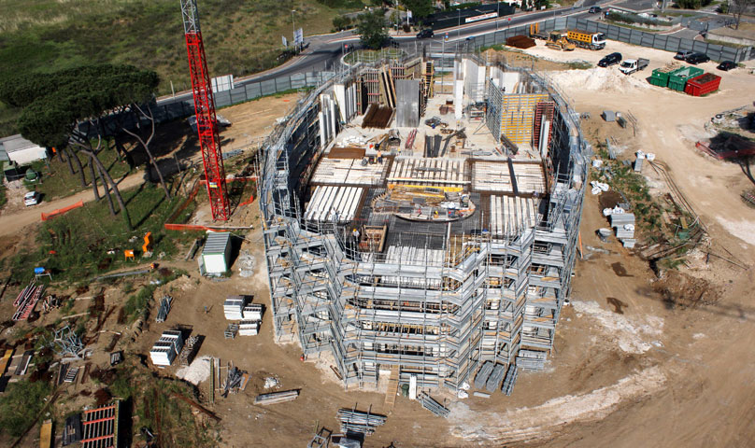
Transcript of Vienna Jaques: Consecrated Faith
Her Sacrifice
Vienna Jacques, a single woman in her 40's converted to the restored Gospel, left her home, and upon request of the prophet, consecrated her entire life savings of $1,400 (about $20,000 in today’s standards) to the Church. While this may sound like a repetition of other familiar stories (like that of John Tanner), her situation was unique and shows her incredible love for the Lord.
Why was her sacrifice so unique?
In this time period, most women were denied access to higher education and well-paying jobs.
Vienna Jacques’ small economic success as a single woman was rare and very fortunate.
Even though she had done relatively well to this point, she had absolutely no guarantee that she could get another job.
But, she trusted the prophet and the Lord and donated her life savings.
A commandment from the Lord
28 And again, verily I say unto you, it is my will that my handmaid Vienna Jaques should receive money to bear her expenses, and go up unto the land of Zion;
29 And the residue of the money may be consecrated unto me, and she be rewarded in mine own due time.
30 Verily I say unto you, that it is meet in mine eyes that she should go up unto the land of Zion, and receive an inheritance from the hand of the bishop;
31 That she may settle down in peace inasmuch as she is faithful, and not be idle in her days from thenceforth.
And the Lord DID take care of her
-Married Daniel Shearer who passed away before too long from unknown reasons.
-Migrated with the Saints to Salt Lake when she was 60 years old and arrived on October 2, 1847.
-She was given some property and lived in Salt Lake City until she died at 96.
Obituary read: “She was true to her covenants and esteemed the Gospel as a priceless treasure.”(Woman’s Exponent)
by Larissa Kranewitte
Rome Temple
Armed With Power:
“The Lord is here with us,” said President Brigham Young, “not in person, but his angels are round us, and he takes cognizance of every act of the children of men, as individuals and as nations. He is here ready by his agents, the angels, and by the power of his Holy Spirit and Priesthood, which he has restored in these last days, to bring most perfect and absolute deliverance unto all who put their trust in Him, when they are ready to receive it; and, until they are ready, the work of preparation must be vigorously progressed in, while at the same time we in patience must possess our souls.” (In Journal of Discourses, 11:14.)

Slide 22
More on Vienna Jaques
The Saints Kirtland Sept 4th 1833——
Dear Siste[r]
—Having a few Leisur moments I sit down to communicate to you a few wordes which I know I am under obligation to improve for to your Satisfaction if it should be a satisfaction for you to receive a few words from your unworthy brother in Christ, I received your Letter some time since containing a history of your Journey and your safe arival for which I bless the Lord I have often felt a whispering since I received your letter like this Joseph thou art indebted to thy God for the offering of thy Sister Viana [Vienna Jaques] which proved a Savior of life as pertaining to thy pecunary concern therefor she should not be forgotten of thee for the Lord hath done this and thou shouldst remember her in all thy prayers and also by letter for she oftentimes calleth on the Lord saying O Lord inspire thy Servant Joseph to communicate by letter some word to thine unworthy handmaid canst thou not speak peaciably unto thine handmaid and say all my sins are forgiven and art thou not content with the chastisement wherewith thou hast chastised thy handmaid yea siste[r] this seams to be the whisperings of a spirit and Judge ye what spirit it is I was sensable, when you left Kirtland that the Lord would chasten you but I pray<ed> fervantly in the name of Jesus that you might live to receive your inheritance agreeable to the commandm[e]nt which was given concerning you I am not at all astonished at what has happened to you neithe[r] to what has happened to Zion and I could tell all the why’s & wherefores of all there calamities but alas it is in vain to warn and give precepts for all men are naturally disposed to walk in their own paths as they are pointed out by their own fingers and are not willing to considder and walk in the path which is pointed out by another saying this is the way walk ye in it altho he should be an uner[r]ing director and the Lord his God sent him neverthe less I do not feel disposed to cast any reflections but I feel to cry mightily unto the Lord that all things might work together for good which has happened yea I feel to say O Lord let Zion be comforted let her waste places be built up and established an hundred fold [p. [1]]
let thy saints come unto Zion out of every nation let her be exalted to the third heavens and let thy Judgments be sent forth unto victory and after this great tribulation let thy blessings fall upon thy people and let thy handmaid live till her soul shall be sat isfied in beholding the glory of Zion notwithstanding her present affliction she shall yet arise and put on her beautiful garments and be the Joy and praise <glory> of the whole earth therefore let your heart be comferted live in strict obedience to the commandments of God and walk humble before him and he will exalt thee in his own due time the brethren in this place are gaining ground in spiritual things and are trying to overcome all things that is not well pleasing to their heavenly father we have common there has many brethren mooved to this place from different parts of the country so much so that one house is not sufficient to contain them for public worship and we have divided and hold meetings in two sepperete places namely at the school house on the flats and Uncle John Smiths who lives on brother [Joseph Coes] place we have commenced building the house of the Lord in this place and are making great progress in it so much so that I feel great hopes that by spring it will be finished so that we can have a place to worship where we shall not be molested a few days since Brothe[r] Ball and Siste[r] Elizabeth Chase arived here <from> boston broth[er] ball has gone about three miles from this place to work at his trade and Siste[r] Elizab eth lives with me at present Agnes [Coolbrith] & Mary [Bailey] Lives with father Smith——
I will assure you that the Lord has respect unto the offering you made he is a God that changes not and and his word cannot fail remember what he has said in the book of mormon respecting those who should assist in bringing this work forth we frequently have inteligenc from our elder abroad that are proclaming the word that God is working with them for they have attained to great faith insomuch that signs do follow them that believe [p. [2]]
Brothe[r] David Pettin [David W. Patten] has Just returned from his tour from <to> the east and gives us great satisfaction as to his ministry he has raised up a church of about Eighty <three> members in that part of the country where his friends live in the state of New York many were healed by through his instrumantality several criples were restored as many as twelve that were afflicted came at at a time from a distanc[e] to be healed he <and others> administered in the name of Jesus and they were made whole thus you see that the Laborers in the Lords vineyard are Labouring with their mights while the day lasts knowing the night soon cometh wherein no man can work I wish you to say to brothe[r] [Edward] Partridge that we received his lette[r] of the 13 August directed to Bro Frederick [G. Williams] requesting an explination on the Plan of the house which is to be built in Zion and also of the City Platt that <the> brothern whom we have recently sent to Zion will give them all the information they need about it I have but little time to write at present for I am Labouring on the house of the Lord with my own hands therefor I must bid you farewell and subscribe myself your unworthy brother in christ amen
[Joseph Smith Jr.]
Joseph Smith Papers

Slide 23
The Church of Jesus Christ of Latter-day Saint Temples
As of October 2018
Temples of the Restoration | Dedication Date | Dedicated By
Kirtland Temple* | 27 March 1836 | Joseph Smith
Nauvoo Temple** | 1 May 1846 | Orson Hyde
* No longer owned by the Church
** Destroyed by fire; rebuilt in 2002, see No. 113

Slide 24
 | Temple | Dedication Date | Dedicated By
1 | St. George Utah Temple | 6 April 1877 | Daniel H. Wells
2 | Logan Utah Temple | 17 May 1884 | John Taylor
3 | Manti Utah Temple | 21 May 1888 | Lorenzo Snow
4 | Salt Lake Temple | 6 April 1893 | Wilford Woodruff
5 | Laie Hawaii Temple | 27 November 1919 | Heber J. Grant
6 | Cardston Alberta Temple | 26 August 1923 | Heber J. Grant
7 | Mesa Arizona Temple | 23 October 1927 | Heber J. Grant
8 | Idaho Falls Idaho Temple | 23 September 1945 | George Albert Smith
9 | Bern Switzerland Temple | 11 September 1955 | David O. McKay
10 | Los Angeles California Temple | 11 March 1956 | David O. McKay
11 | Hamilton New Zealand Temple | 20 April 1958 | David O. McKay
12 | London England Temple | 7 September 1958 | David O. McKay
13 | Oakland California Temple | 17 November 1964 | David O. McKay
14 | Ogden Utah Temple | 18 January 1972 | Joseph Fielding Smith
15 | Provo Utah Temple | 9 February 1972 | Harold B. Lee (reader)

Slide 25
 | Temple | Dedication Date | Dedicated By
16 | Washington D.C. Temple | 19 November 1974 | Spencer W. Kimball
17 | São Paulo Brazil Temple | 30 October 1978 | Spencer W. Kimball
18 | Tokyo Japan Temple | 27 October 1980 | Spencer W. Kimball
19 | Seattle Washington Temple | 17 November 1980 | Spencer W. Kimball
20 | Jordan River Utah Temple | 16 November 1981 | Marion G. Romney
21 | Atlanta Georgia Temple | 1 June 1983 | Gordon B. Hinckley
22 | Apia Samoa Temple | 5 August 1983 | Gordon B. Hinckley
23 | Nuku'alofa Tonga Temple | 9 August 1983 | Gordon B. Hinckley
24 | Santiago Chile Temple | 15 September 1983 | Gordon B. Hinckley
25 | Papeete Tahiti Temple | 27 October 1983 | Gordon B. Hinckley
26 | México City México Temple | 2 December 1983 | Gordon B. Hinckley
27 | Boise Idaho Temple | 25 May 1984 | Gordon B. Hinckley
28 | Sydney Australia Temple | 20 September 1984 | Gordon B. Hinckley
29 | Manila Philippines Temple | 25 September 1984 | Gordon B. Hinckley
30 | Dallas Texas Temple | 19 October 1984 | Gordon B. Hinckley
31 | Taipei Taiwan Temple | 17 November 1984 | Gordon B. Hinckley

Slide 26
 | Temple | Dedication Date | Dedicated By
32 | Guatemala City Guatemala Temple | 14 December 1984 | Gordon B. Hinckley
33 | Freiberg Germany Temple | 29 June 1985 | Gordon B. Hinckley
34 | Stockholm Sweden Temple | 2 July 1985 | Gordon B. Hinckley
35 | Chicago Illinois Temple | 9 August 1985 | Gordon B. Hinckley
36 | Johannesburg South Africa Temple | 24 August 1985 | Gordon B. Hinckley
37 | Seoul Korea Temple | 14 December 1985 | Gordon B. Hinckley
38 | Lima Perú Temple | 10 January 1986 | Gordon B. Hinckley
39 | Buenos Aires Argentina Temple | 17 January 1986 | Thomas S. Monson
40 | Denver Colorado Temple | 24 October 1986 | Ezra Taft Benson
41 | Frankfurt Germany Temple | 28 August 1987 | Ezra Taft Benson
42 | Portland Oregon Temple | 19 August 1989 | Gordon B. Hinckley
43 | Las Vegas Nevada Temple | 16 December 1989 | Gordon B. Hinckley
44 | Toronto Ontario Temple | 25 August 1990 | Gordon B. Hinckley
45 | San Diego California Temple | 25 April 1993 | Gordon B. Hinckley
46 | Orlando Florida Temple | 9 October 1994 | Howard W. Hunter
47 | Bountiful Utah Temple | 8 January 1995 | Howard W. Hunter

Slide 27
 | Temple | Dedication Date | Dedicated By
48 | Hong Kong China Temple | 26 May 1996 | Gordon B. Hinckley
49 | Mount Timpanogos Utah Temple | 13 October 1996 | Gordon B. Hinckley
50 | St. Louis Missouri Temple | 1 June 1997 | Gordon B. Hinckley
51 | Vernal Utah Temple | 2 November 1997 | Gordon B. Hinckley
52 | Preston England Temple | 7 June 1998 | Gordon B. Hinckley
53 | Monticello Utah Temple | 26 July 1998 | Gordon B. Hinckley
54 | Anchorage Alaska Temple | 9 January 1999 | Gordon B. Hinckley
55 | Colonia Juárez Chihuahua México Temple | 6 March 1999 | Gordon B. Hinckley
56 | Madrid Spain Temple | 19 March 1999 | Gordon B. Hinckley
57 | Bogotá Colombia Temple | 24 April 1999 | Gordon B. Hinckley
58 | Guayaquil Ecuador Temple | 1 August 1999 | Gordon B. Hinckley
59 | Spokane Washington Temple | 21 August 1999 | Gordon B. Hinckley
60 | Columbus Ohio Temple | 4 September 1999 | Gordon B. Hinckley
61 | Bismarck North Dakota Temple | 19 September 1999 | Gordon B. Hinckley
62 | Columbia South Carolina Temple | 16 October 1999 | Gordon B. Hinckley
63 | Detroit Michigan Temple | 23 October 1999 | Gordon B. Hinckley

Slide 28
 | Temple | Dedication Date | Dedicated By
64 | Halifax Nova Scotia Temple | 14 November 1999 | Gordon B. Hinckley
65 | Regina Saskatchewan Temple | 14 November 1999 | Boyd K. Packer
66 | Billings Montana Temple | 20 November 1999 | Gordon B. Hinckley
67 | Edmonton Alberta Temple | 11 December 1999 | Gordon B. Hinckley
68 | Raleigh North Carolina Temple | 18 December 1999 | Gordon B. Hinckley
69 | St. Paul Minnesota Temple | 9 January 2000 | Gordon B. Hinckley
70 | Kona Hawaii Temple | 23 January 2000 | Gordon B. Hinckley
71 | Ciudad Juárez México Temple | 26 February 2000 | Gordon B. Hinckley
72 | Hermosillo Sonora México Temple | 27 February 2000 | Gordon B. Hinckley
73 | Albuquerque New Mexico Temple | 5 March 2000 | Gordon B. Hinckley
74 | Oaxaca México Temple | 11 March 2000 | James E. Faust
75 | Tuxtla Gutiérrez México Temple | 12 March 2000 | James E. Faust
76 | Louisville Kentucky Temple | 19 March 2000 | Thomas S. Monson
77 | Palmyra New York Temple | 6 April 2000 | Gordon B. Hinckley
78 | Fresno California Temple | 9 April 2000 | Gordon B. Hinckley
79 | Medford Oregon Temple | 16 April 2000 | James E. Faust

Slide 29
 | Temple | Dedication Date | Dedicated By
80 | Memphis Tennessee Temple | 23 April 2000 | James E. Faust
81 | Reno Nevada Temple | 23 April 2000 | Thomas S. Monson
82 | Cochabamba Bolivia Temple | 30 April 2000 | Gordon B. Hinckley
83 | Tampico México Temple | 20 May 2000 | Thomas S. Monson
84 | Nashville Tennessee Temple | 21 May 2000 | James E. Faust
85 | Villahermosa México Temple | 21 May 2000 | Thomas S. Monson
86 | Montréal Québec Temple | 4 June 2000 | Gordon B. Hinckley
87 | San José Costa Rica Temple | 4 June 2000 | James E. Faust
88 | Fukuoka Japan Temple | 11 June 2000 | Gordon B. Hinckley
89 | Adelaide Australia Temple | 15 June 2000 | Gordon B. Hinckley
90 | Melbourne Australia Temple | 16 June 2000 | Gordon B. Hinckley
91 | Suva Fiji Temple | 18 June 2000 | Gordon B. Hinckley
92 | Mérida México Temple | 8 July 2000 | Thomas S. Monson
93 | Veracruz México Temple | 9 July 2000 | Thomas S. Monson
94 | Baton Rouge Louisiana Temple | 16 July 2000 | Gordon B. Hinckley
95 | Oklahoma City Oklahoma Temple | 30 July 2000 | James E. Faust

Slide 30
 | Temple | Dedication Date | Dedicated By
96 | Caracas Venezuela Temple | 20 August 2000 | Gordon B. Hinckley
97 | Houston Texas Temple | 26 August 2000 | Gordon B. Hinckley
98 | Birmingham Alabama Temple | 3 September 2000 | Gordon B. Hinckley
99 | Santo Domingo Dominican Republic Temple | 17 September 2000 | Gordon B. Hinckley
100 | Boston Massachusetts Temple | 1 October 2000 | Gordon B. Hinckley
101 | Recife Brazil Temple | 15 December 2000 | Gordon B. Hinckley
102 | Porto Alegre Brazil Temple | 17 December 2000 | Gordon B. Hinckley
103 | Montevideo Uruguay Temple | 18 March 2001 | Gordon B. Hinckley
104 | Winter Quarters Nebraska Temple | 22 April 2001 | Gordon B. Hinckley
105 | Guadalajara México Temple | 29 April 2001 | Gordon B. Hinckley
106 | Perth Australia Temple | 20 May 2001 | Gordon B. Hinckley
107 | Columbia River Washington Temple | 18 November 2001 | Gordon B. Hinckley
108 | Snowflake Arizona Temple | 3 March 2002 | Gordon B. Hinckley
109 | Lubbock Texas Temple | 21 April 2002 | Gordon B. Hinckley
110 | Monterrey México Temple | 28 April 2002 | Gordon B. Hinckley
111 | Campinas Brazil Temple | 17 May 2002 | Gordon B. Hinckley

Slide 31
 | Temple | Dedication Date | Dedicated By
112 | Asunción Paraguay Temple | 19 May 2002 | Gordon B. Hinckley
113 | Nauvoo Illinois Temple | 27 June 2002 | Gordon B. Hinckley
114 | The Hague Netherlands Temple | 8 September 2002 | Gordon B. Hinckley
115 | Brisbane Australia Temple | 15 June 2003 | Gordon B. Hinckley
116 | Redlands California Temple | 14 September 2003 | Gordon B. Hinckley
117 | Accra Ghana Temple | 11 January 2004 | Gordon B. Hinckley
118 | Copenhagen Denmark Temple | 23 May 2004 | Gordon B. Hinckley
119 | Manhattan New York Temple | 13 June 2004 | Gordon B. Hinckley
120 | San Antonio Texas Temple | 22 May 2005 | Gordon B. Hinckley
121 | Aba Nigeria Temple | 7 August 2005 | Gordon B. Hinckley
122 | Newport Beach California Temple | 28 August 2005 | Gordon B. Hinckley
123 | Sacramento California Temple | 3 September 2006 | Gordon B. Hinckley
124 | Helsinki Finland Temple | 22 October 2006 | Gordon B. Hinckley
125 | Rexburg Idaho Temple | 10 February 2008 | Thomas S. Monson
126 | Curitiba Brazil Temple | 1 June 2008 | Thomas S. Monson
127 | Panamá City Panamá Temple | 10 August 2008 | Thomas S. Monson

Slide 32
 | Temple | Dedication Date | Dedicated By
128 | Twin Falls Idaho Temple | 24 August 2008 | Thomas S. Monson
129 | Draper Utah Temple | 20 March 2009 | Thomas S. Monson
130 | Oquirrh Mountain Utah Temple | 21–23 August 2009 | Thomas S. Monson
131 | Vancouver British Columbia Temple | 2 May 2010 | Thomas S. Monson
132 | Gila Valley Arizona Temple | 23 May 2010 | Thomas S. Monson
133 | Cebu Philippines Temple | 13 June 2010 | Thomas S. Monson
134 | Kiev Ukraine Temple | 29 August 2010 | Thomas S. Monson
135 | San Salvador El Salvador Temple | 21 August 2011 | Henry B. Eyring
136 | Quetzaltenango Guatemala Temple | 11 December 2011 | Dieter F. Uchtdorf
137 | Kansas City Missouri Temple | 6 May 2012 | Thomas S. Monson
138 | Manaus Brazil Temple | 10 June 2012 | Dieter F. Uchtdorf
139 | Brigham City Utah Temple | 23 September 2012 | Boyd K. Packer
140 | Calgary Alberta Temple | 28 October 2012 | Thomas S. Monson
141 | Tegucigalpa Honduras Temple | 17 March 2013 | Dieter F. Uchtdorf
142 | Gilbert Arizona Temple | 2 March 2014 | Thomas S. Monson
143 | Ft. Lauderdale Florida Temple | 4 May 2014 | Dieter F. Uchtdorf

Slide 33
 | Temple | Dedication Date | Dedicated By
144 | Phoenix Arizona Temple | 16 November 2014 | Thomas S. Monson
145 | Cordoba Argentina Temple | 17 May 2015 | Dieter F. Uchtdorf
146 | Payson Utah Temple | 7 June 2015 | Henry B. Eyring
147 | Trujillo Peru Mormon Temple | 21 June 2015 | Dieter F. Uchtdorf
148 | Indianapolis Indiana Temple | 23 August 2015 | Henry B. Eyring
149 | Tijuana Mexico Temple | 13 December 2015 | Dieter F. Uchtdorf
150 | Provo City Center Temple | 20 March 2016 | Dallin H. Oaks
151 | Sapporo Japan Temple | 21 August 2016 | Russell M. Nelson
152 | Philadelphia Pennsylvania Temple | 18 September 2016 | Henry B. Eyring
153 | Fort Collins Colorado Temple | 16 October 2016 | Dieter F. Uchtdorf
154 | Star Valley Wyoming Temple | 30 October 2016 | David A. Bednar
155 | Hartford Connecticut Temple | 20 November 2016 | Henry B. Eyring
156 | Paris France Temple | 21 May 2017 | Henry B. Eyring
157 | Tucson Arizona Temple | 13 August 2017 | Dieter F. Uchtdorf
158 | Meridian Idaho Temple | 19 November 2017 | Dieter F. Uchtdorf
159 | Cedar City Utah Temple | 10 December 2017 | Henry B. Eyring
160 | Concepción Chile Temple | 28 October 2018 | Russell M. Nelson

Slide 34
 | Temples Under Construction | Groundbreaking Date | Presiding
161 | Rome Italy Mormon Temple | 23 October 2010 | Thomas S. Monson
162 | Fortaleza Brazil Temple | 15 November 2011 | David A. Bednar
163 | Lisbon Portugal Temple | 5 December 2015 | Patrick Kearon
164 | Kinshasa Democratic Republic of the Congo Temple | 12 February 2016 | Neil L. Andersen
165 | Barranquilla Colombia Temple | 20 February 2016 | Juan A. Uceda
166 | Durban South Africa Temple | 9 April 2016 | Carl B. Cook
167 | Winnipeg Manitoba Temple | 3 December 2016 | Larry Y. Wilson
168 | Rio de Janeiro Brazil Temple | 4 March 2017 | Claudio R. M. Costa
169 | Arequipa Peru Temple | 4 March 2017 | Carlos A. Godoy
170 | Port-au-Prince Haiti Temple | 28 October 2017 | Walter F. Gonzále

Slide 35
 | Temples Announced | Announcement Date | Presiding
171 | Urdaneta Philippines Temple | 2 October 2010 | First Presidency
172 | Abidjan Cote d’Ivoire Temple | 5 April 2015 | First Presidency
173 | Bangkok Thailand Temple | 5 April 2015 | First Presidency
174 | Quito Ecuador Temple | 3 April 2016 | First Presidency
175 | Harare Zimbabwe Temple | 3 April 2016 | First Presidency
176 | Belém Brazil Temple | 3 April 2016 | First Presidency
177 | Lima Peru Los Olivos Temple | 3 April 2016 | First Presidency
178 | Brasília Brazil Temple | 2 April 2017 | First Presidency
179 | The Greater Manila Philippines AreaTemple | 2 April 2017 | First Presidency
180 | Nairobi Kenya Temple | 2 April 2017 | First Presidency
181 | Pocatello Idaho Temple | 2 April 2017 | First Presidency
182 | Saratoga Springs Utah Temple | 2 April 2017 | First Presidency
183 | Bengaluru India Temple | 1 April 2018 | First Presidency
184 | Cagayan de Oro Philippines Temple | 1 April 2018 | First Presidency
185 | Layton Utah Temple | 1 April 2018 | First Presidency
186 | Managua Nicaragua Temple | 1 April 2018 | First Presidency

Slide 36
 | Temples Announced | Announcement Date | Presiding
187 | Richmond Virginia Temple | 1 April 2018 | First Presidency
188 | Salta Argentina Temple | 1 April 2018 | First Presidency
189 | (A major city in Russia to be announced) Temple | 1 April 2018 | First Presidency
190 | Mendoza Argentina Temple | 7 October 2018 | First Presidency
191 | Yuba City California Temple | 7 October 2018 | First Presidency
192 | Phnom Penh Cambodia Temple | 7 October 2018 | First Presidency
193 | Praia Cape Verde Temple | 7 October 2018 | First Presidency
194 | Yigo Guam Temple | 7 October 2018 | First Presidency
195 | Puebla México Temple | 7 October 2018 | First Presidency
196 | Auckland New Zealand Temple | 7 October 2018 | First Presidency
197 | Lagos Nigeria Temple | 7 October 2018 | First Presidency
198 | Davao Philippines Temple | 7 October 2018 | First Presidency
199 | San Juan Puerto Rico Temple | 7 October 2018 | First Presidency
200 | Washington County Utah Temple | 7 October 2018 | First Presidency

