Slide 1

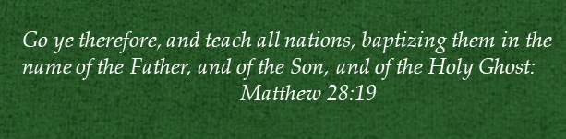
Doctrine and Covenants 112
The Lord God Shall Lead
Thee By The Hand

Slide 2




Have You Ever Experienced…

Slide 3
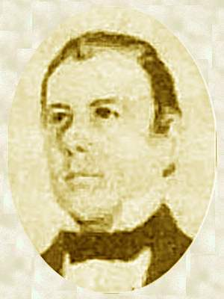
Background
1835
Nov. 1836
Jan. 1837
Spring
1837
June 1837
July 24, 1837
Thomas B. Marsh
Called an Apostle and appointed President of the Quorum of the Twelve Apostles
Kirtland Safety Society created
Contentions among the Saints
Church Leaders organize bank called Kirtland Safety Society (Bank Failed)
President Marsh learned that one of the Twelve Apostles, Elder Parley P. Pratt, was planning a mission to England without President Marsh’s direction
Elders Heber C. Kimball and Orson Hyde, departed for England after receiving mission calls from the Prophet Joseph Smith.
President Marsh, who was in Missouri, wrote to Elder Pratt and the other members of the Twelve and invited them to meet him in Kirtland, Ohio, on July 24, 1837, so they could be unified in their plans for missions
President Marsh was apparently upset that members of the Twelve were proceeding to preach the gospel in England without his involvement.
On July 23, 1837, the Prophet Joseph Smith received a revelation for Thomas B. Marsh recorded in D&C 112, the only revelation given in 1837

Slide 4
Thomas B. Marsh
RECAP
He was born November 1, 1800, in Acton, Massachusetts to James Marsh and Mary Law
He became acquainted with Martin Harris, while on a visit to Palmyra, who gave him a sheet containing the first 16 pages of the Book of Mormon
He and his wife gained a testimony and was baptized by David Whitmer on September 3, 1830, and later ordained an elder
He was called to the Quorum of the Twelve and served as president in 1835
He was called on a mission to Canada with Joseph Smith and Sidney Rigdon
In 1838 his wife, Elizabeth Godkin, and the wife of George W. Harris, Lucinda, had a dispute and there became a rift between Thomas and the priesthood
He was excommunicated in 1839
He made his way to Salt Lake City in 1857, confessed his sins, and received full fellowship as a member of the Church
He wrote an autobiography in 1864, recounting his Church service and rebellion. It was published in the Millennial Star and he died in January of 1866 and buried in Ogden City Cemetery
Sections 31 and 112 are dedicated to him

Slide 5
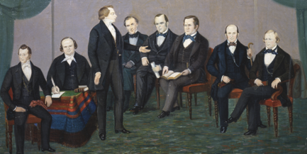
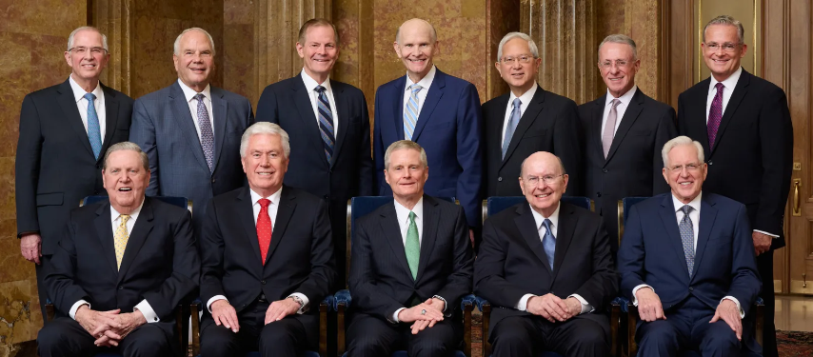
Quorum of the Twelve
On 14 February 1835, the first Quorum of the Twelve in this dispensation was organized, its members chosen to be special witnesses of the Savior throughout the world.
The Twelve were arranged in seniority according to age. Elder Thomas B. Marsh, being the oldest, became President of the Quorum and thus responsible for the other eleven.
Since that time, seniority in the Quorum has been determined by date of ordination.
D&C 112:1

Slide 6
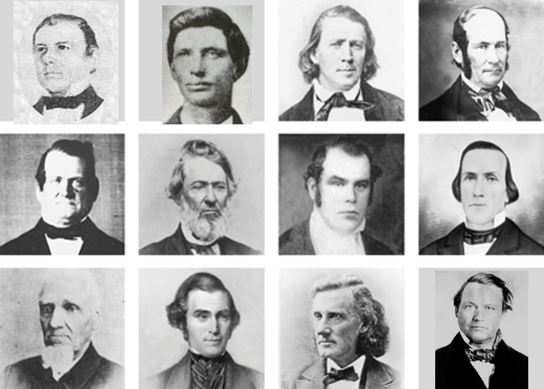
1836
Members of the original Quorum of the Twelve Apostles.
Top row, left to right: Thomas B. Marsh, David W. Patten, Brigham Young, Heber C. Kimball.
Middle row: Orson Hyde, William E. M’Lellin, Parley P. Pratt, Luke S. Johnson.
Bottom row: William B. Smith, Orson Pratt, John F. Boynton, Lyman E. Johnson.
D&C 112:10

Slide 7
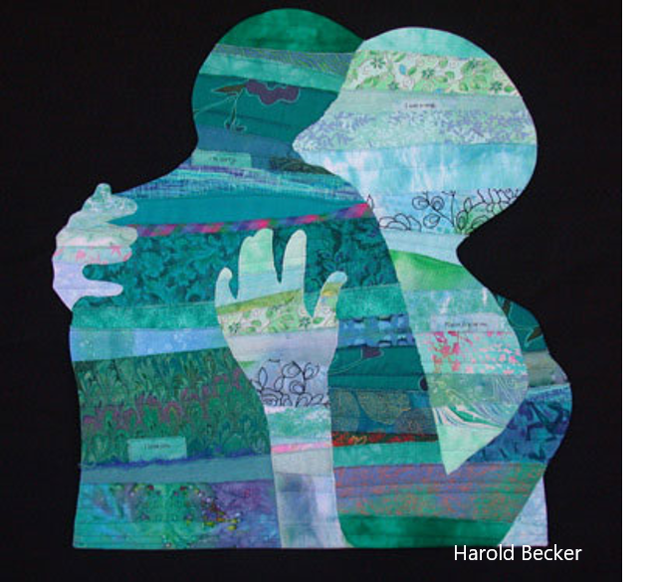
Abased
Thomas B. Marsh, at this time, was sincere in his prayers and sacrifices, which is proved by the fact that the Lord had accepted them. As the President of the council of Twelve Apostles, he had their welfare at heart.
Cause to be humbled
“Forgiveness comes only to those who are humble and truly repentant.”
D&C 112:1-3 Smith and Sjodahl

Slide 8
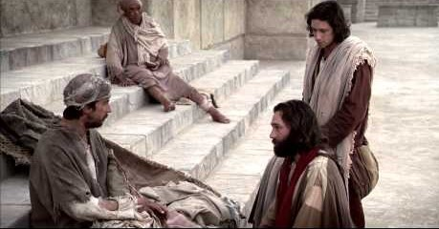
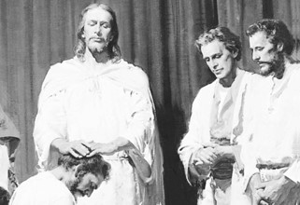
Bear Record—Sent Forth
The office and calling
As an Apostle, it is the office and calling to preach the gospel, administer the ordinances of the church, heal the sick, and perform mighty works, plant and set churches in order, and ordain to the Priesthood and offices in the Church.
And when he had called unto him his twelve disciples, he gave them power against unclean spirits, to cast them out, and to heal all manner of sickness and all manner of disease.
Matthew 10:1
And when they had ordained them elders in every church, and had prayed with fasting, they commended them to the Lord, on whom they believed. Acts 14:23
D&C 112:4 Smith and Sjodahl

Slide 9
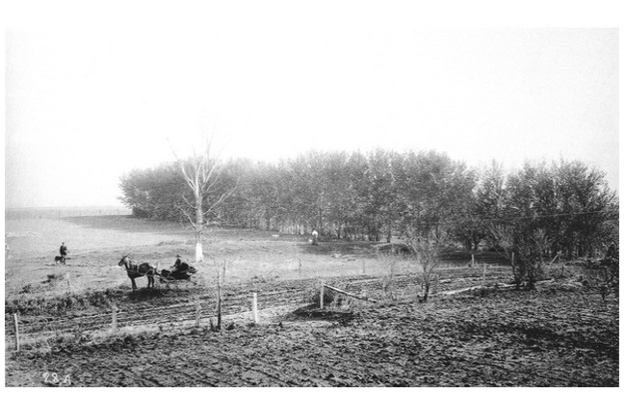
Council to Thomas B. Marsh
Testify of Christ
“In 1832, Thomas B. Marsh received an inheritance—about thirty acres—on the Big Blue river, Missouri, and there he built a comfortable log house. When the Saints were driven from Jackson County, he went to Lafayette County, while most of the exiles sought refuge in Clay County. In 1834, he, too, went to Clay County. After an extended visit to Kirtland, he returned to his home on Fishing River, Clay County. In 1836, he built a house in Far West.
In June 1837, he again visited Kirtland. It was necessary, for the success of his mission, that his residence in Zion should be known, and that his house should not be moved.”
Smith and Sjodahl
Contend thou—Early 19th century—”use earnest effort to obtain, or to defend and preserve.”
Webster Dictionary 1828
Remove not thy house
Publish Thy Name—make gospel known among all men
D&C 112:4-6

Slide 10
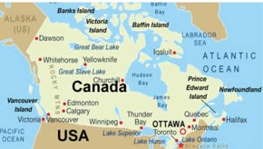

Thomas B. Marsh’s Mission
Four days after this revelation was given, the Prophet Joseph Smith, along with Sidney Rigdon and Thomas B. Marsh, started for Canada to visit the members of the Church
History of the Church, 2:502
The Savior had other opportunities for Thomas B. Marsh to bear witness to the nations is apparent from this verse.
They were not realized, however, since Thomas B. Marsh later apostatized and left the Church.
D&C 112:7

Slide 11
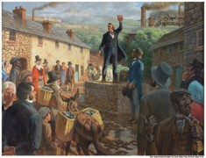
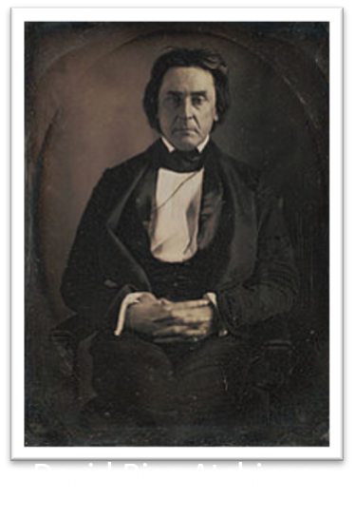
The Speaker
Thomas B. Marsh was a power speaker.
In 1836, he was a member of a committee selected to pass resolutions on behalf of the exiled Saints, at a meeting at the City of Liberty.
On that occasion, he spoke of the persecution the Saints had suffered, so eloquently that General Atchinson and others wept.
D&C 112:9

Slide 12
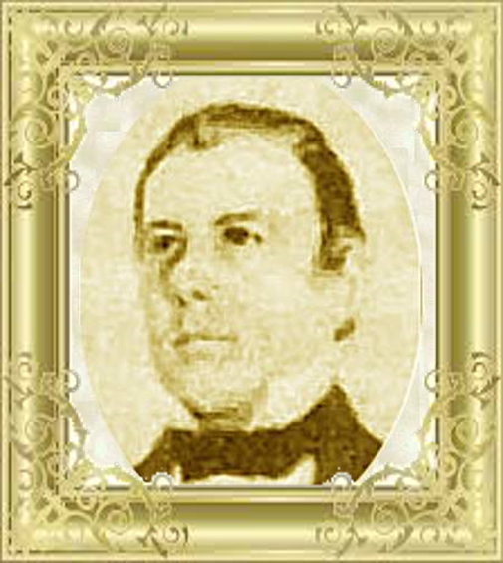
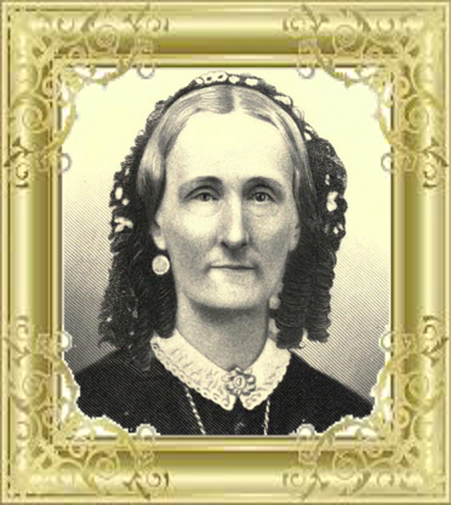
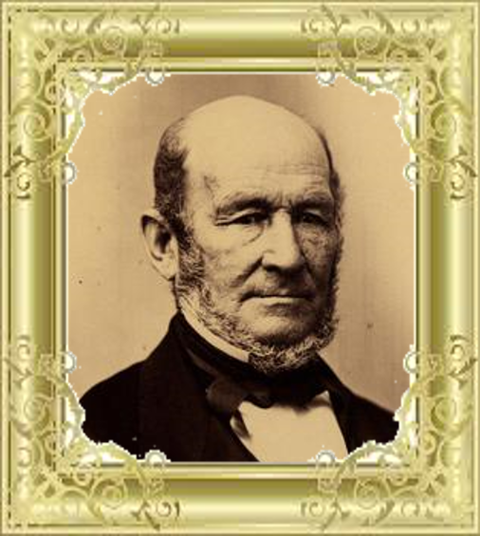
Pride
Thomas B. Marsh told Vilate Kimball that her husband, Elder Heber C. Kimball, would not be effective on his mission in England. President Marsh apparently felt that because proclaiming the gospel abroad was his responsibility, the door to missionary work in England could not be opened until he either sent someone or went himself.

Slide 13
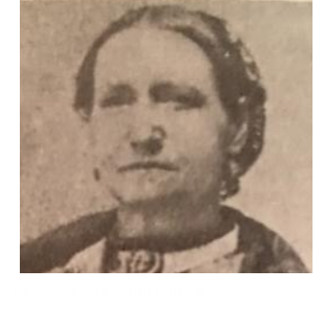
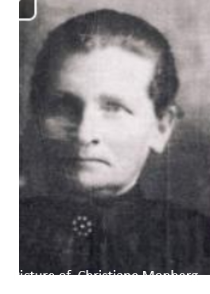
A Matter of Milk
In September 1838, while Thomas was beset by this spirit of apostasy, his wife, Elizabeth, became involved in a dispute.
She and another woman, Mrs. Harris, both members of the Church, had agreed to regularly exchange milk to have enough to make cheese, but Sister Marsh was accused of violating her agreement by keeping the part of the milk that was richest in cream.
The matter was brought before Church leaders more than once. It was even brought before the First Presidency. Each time, it was decided that Sister Marsh was at fault. President Marsh was angry and unsatisfied with these decisions.
While this situation did not lead him to leave the Church, it compounded with his other frustrations.

Slide 14
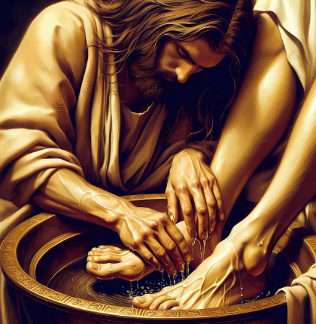
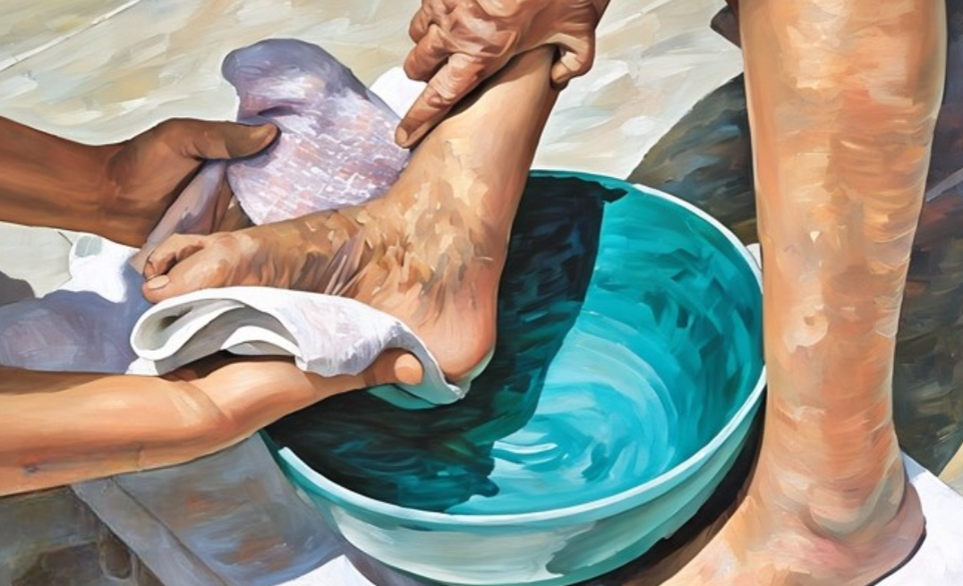
Humility
To be humble is to recognize gratefully our dependence on the Lord—to understand that we have constant need for His support.
Humility is an acknowledgment that our talents and abilities are gifts from God.
It is not a sign of weakness, timidity, or fear; it is an indication that we know where our true strength lies.
Topics and Questions
D&C 112:10

Slide 15
Be Thou Humble
President Thomas B. Marsh’s pride led to his eventual apostasy. His excommunication is a poignant reminder that the Lord has counseled his Saints to be humble.
“Pride was the weakness of Thomas B. Marsh. If he had been humble, he would not have fallen.
He began by defying the righteous decisions of the High Council and the First Presidency, in a trivial case in which his wife was interested, and he ended by [opposing] the Church.”
Thomas B. Marsh eventually repented and was rebaptized.
If we are humble, the Lord will lead us and give us answers to our prayers
D&C 112:10 Smith and Sjodahl

Slide 16
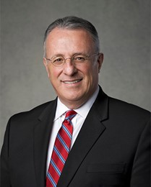
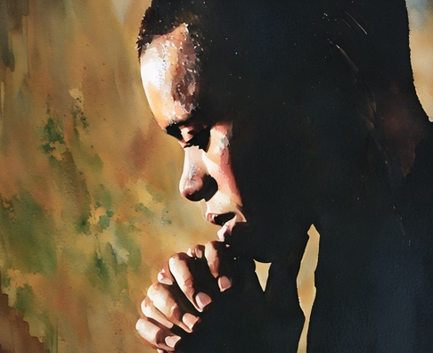


The Humble
I believe, brothers and sisters, that only those who are humble are able to acknowledge and understand the Lord’s answers to their prayers.
The humble are teachable, recognizing how dependent they are on God and desiring to be subject to His will.
The humble are meek and have the ability to influence others to be the same.
God’s promise to the humble is that He will lead them by the hand.
I truly believe that we will avoid detours and sadness in our lives as long as we walk hand in hand with the Lord.
Ulisses Soares
D&C 112:10

Slide 17
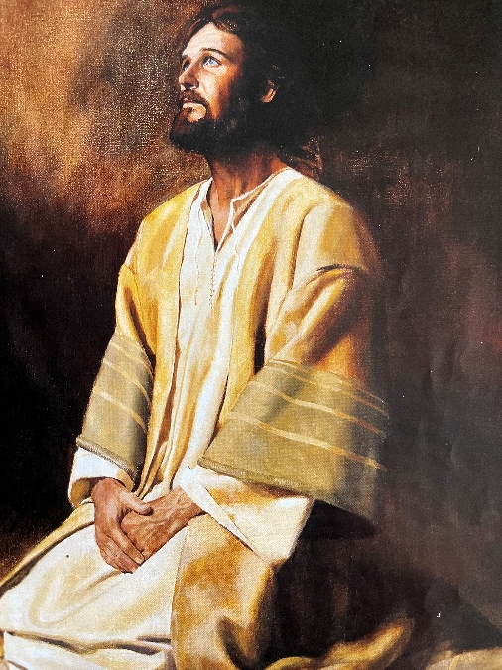
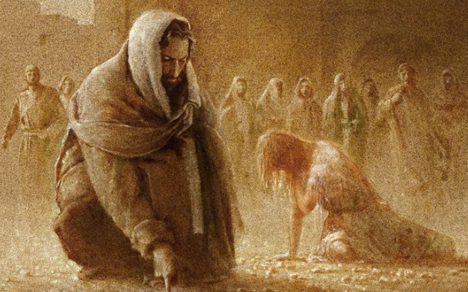
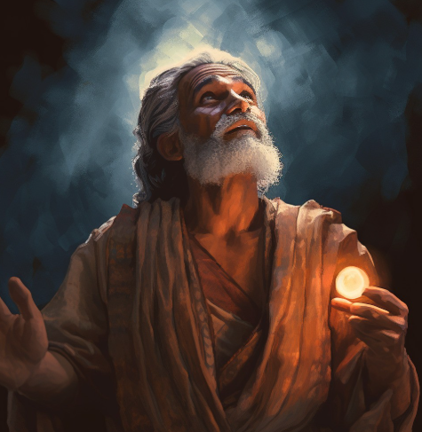
Humble in Prayer
3 Nephi 19:19-20, 27-28
Ether 3:1-6
Hebrews 12:5-9
O Lord, and do not be angry with thy servant because of his weakness before thee; for we know that thou art holy and dwellest in the heavens, and that we are unworthy before thee;
Michael Jarvis Nelson
Furthermore we have had fathers of our flesh which corrected us, and we gave them reverence: shall we not much rather be in subjection unto the Father of spirits, and live?
And he turned from them again, and went a little way off and bowed himself to the earth; and he prayed again unto the Father, saying:

Slide 18
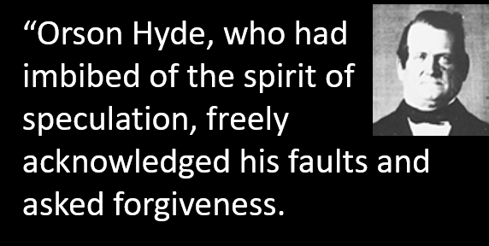
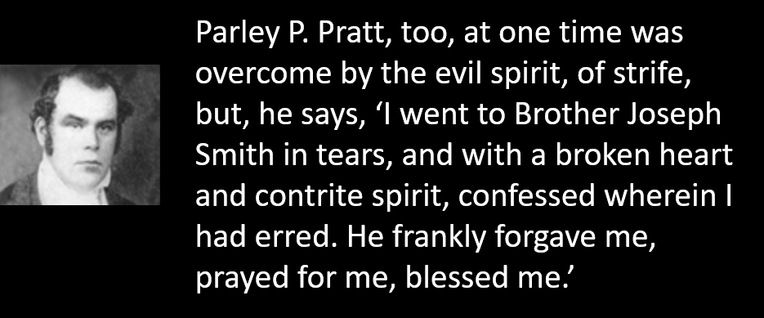
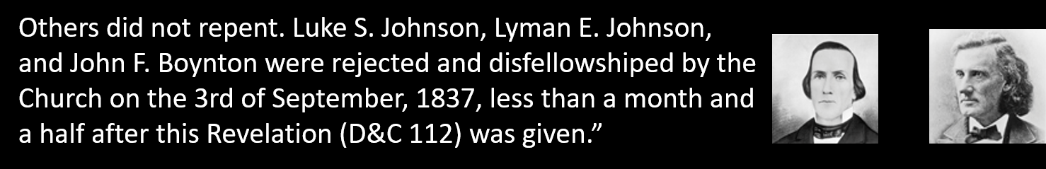
Humility of Those in Church Positions
D&C 112:10 Smith and Sjodahl

Slide 19
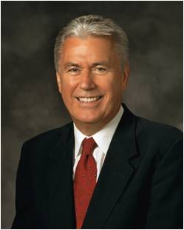
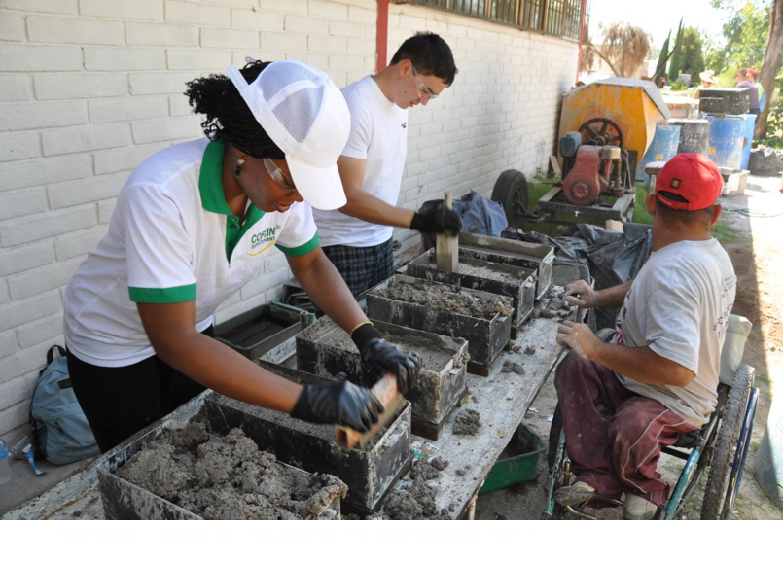
Humility in Serving God
“We don’t discover humility by thinking less of ourselves; we discover humility by thinking less about ourselves. It comes as we go about our work with an attitude of serving God and our fellowman.
“… The moment we stop obsessing with ourselves and lose ourselves in service, our pride diminishes and begins to die.”
President Dieter F. Uchtdorf
D&C 112:22

Slide 20
Make our prayers meaningful.
When making a request through prayer, we must do all we can to to assist in its being granted.
Use language that shows love, respect, reverence, and closeness.
Praying With Greater Humility
Seek the guidance of the Holy Ghost.
Always give thanks to Heavenly Father
Remember the needs of others as we pray.
Seek Heavenly Father's guidance and strength in all we do.
Topics and Questions

Slide 21
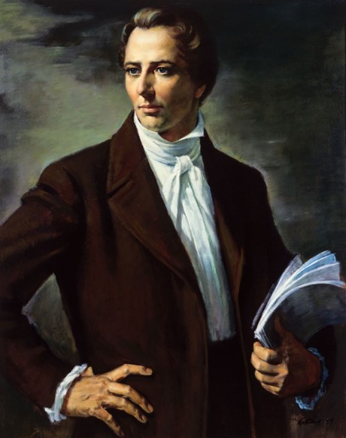
Joseph Smith’s Position as President and Prophet
Several passages in the Doctrine and Covenants show that when the Lord spoke of Joseph Smith, his statements pertained also to Joseph’s position as President and prophet of the Church.
“Joseph Smith was called to stand at the head of the Dispensation of the Fulness of Times, preparatory to the second advent of the Son of God”
So, in addition to holding the keys of the kingdom, the Prophet Joseph Smith also held the keys of this dispensation, and these keys will never be taken from him.”
“The keys of the Priesthood were committed to Joseph, to build up the Kingdom of God on the earth, and were not to be taken from him in time or in eternity”
President Brigham Young
D&C 112:15 Smith and Sjodahl

Slide 22
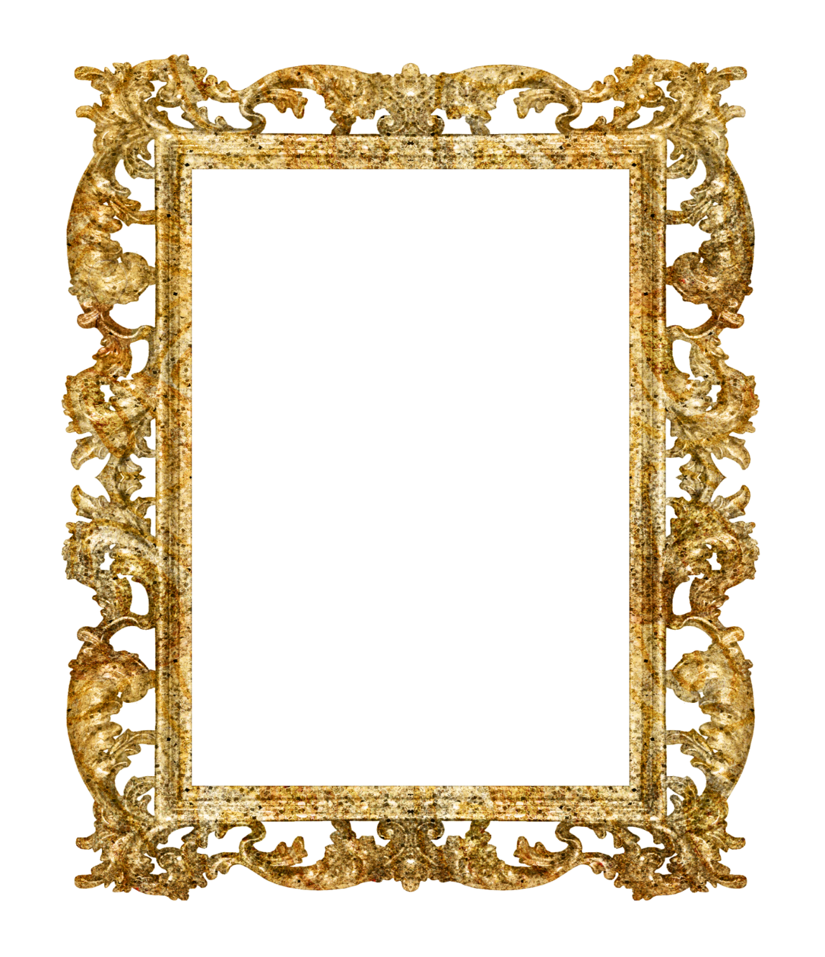
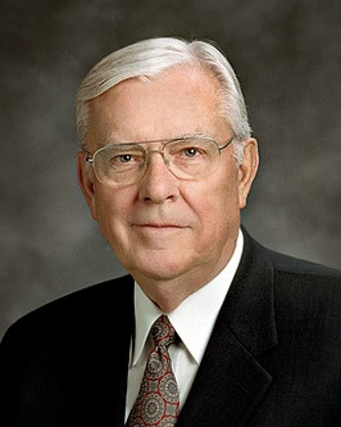
President M. Russell Ballard has served as a member of the Quorum of the Twelve Apostles of The Church of Jesus Christ of Latter–day Saints since October 6, 1985. He was set apart as Acting President of the Quorum of the Twelve Apostles by President Russell M. Nelson on January 14, 2018.
General Authorities and General Officers lds.org

Slide 23
The President of the Quorum of the Twelve Apostles holds the keys to direct the work of the Twelve in proclaiming the gospel in all nations
D&C 112:16-17

Slide 24
Counselors to the Twelve
The First Presidency, the Lord said, were to be counselors to the Twelve. By this is meant that the twelve should not go forth without the counsel and direction of the First Presidency.”
President Joseph Fielding Smith
Counselors to the Twelve
D&C 112:20

Slide 25
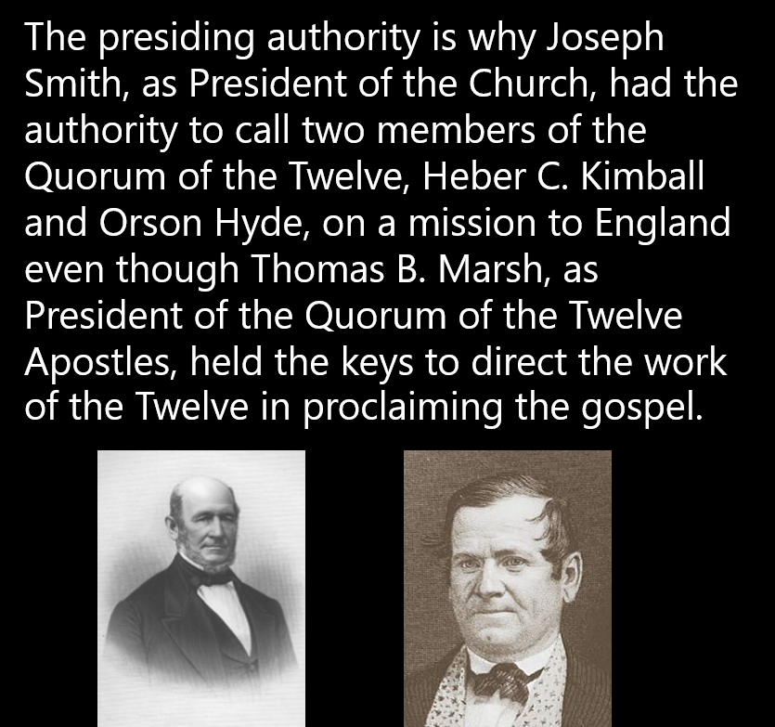
Authority of The President
The keys of the priesthood have been restored for the last time in the dispensation of the fulness of times
D&C 112:30

Slide 26
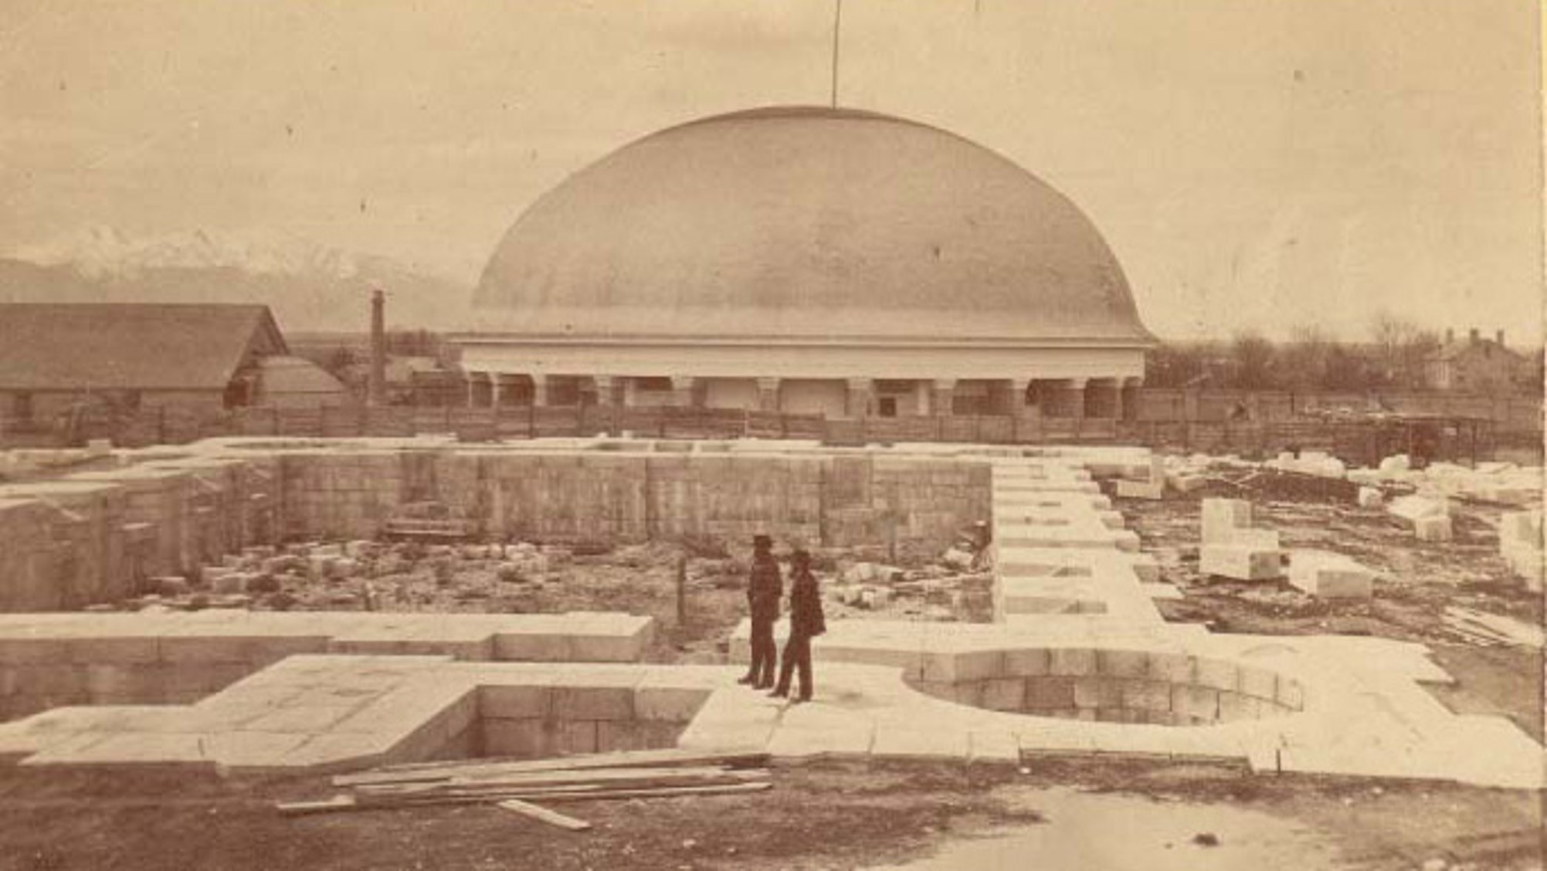
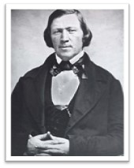
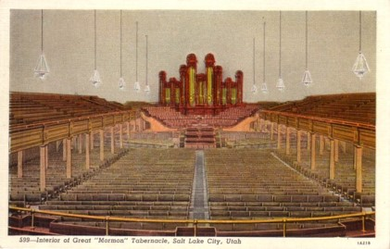
The Return of Thomas B. Marsh
“Brother Thomas B. Marsh, formerly the President of the Quorum of the Twelve Apostles, has now come to us, after an absence of nearly nineteen years. He is on the stand today, and wishes to make a few remarks to the congregation.”
…He came into my office and wished to know whether I could be reconciled to him, and whether there could be a reconciliation between himself and the Church of the living God. He reflected for a moment and said, I am reconciled to the Church, but I want to know whether the Church can be reconciled to me.”
He is here, and I want him to say what he may wish to. [Brother Marsh then arose, and the President continued.] Brethren and sisters, I now introduce to you brother Thomas B. Marsh. When the Quorum of the Twelve was first organized, he was appointed to be their President.”
President Brigham Young

Slide 27

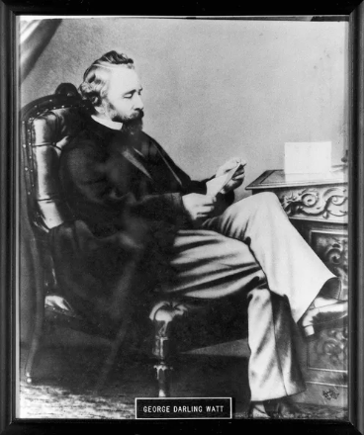
First Mission To England
A week after the missionaries began preaching, the first converts were baptized in the River Ribble. Two of these converts were so excited to become baptized, they raced each other to the river. George D. Watt won the race and became the first baptized convert in England.
Saints

Slide 28
Sources:
Video: “If They Harden Not Their Hearts” (11:21)
“How I #HearHim: Elder Neil L. Andersen” [2:51]
Timeline: Doctrine and Covenants Student Manual Religion 324-325 Section 112
Hyrum M. Smith and Janne M. Sjodahl Doctrine and Covenants Commentary pg. 732-35
President Dieter F. Uchtdorf (“Pride and the Priesthood,” Ensign or Liahona, Nov. 2010, 58)
President Brigham Young (Discourses of Brigham Young, p. 138, 206).
President Joseph Fielding Smith (Church History and Modern Revelation,2:73.)
Presentation by ©http://fashionsbylynda.com/blog/
Topics and Questions, “Humility,” topics.ChurchofJesusChrist.org; “Prayer”
Photo of Tabernacle…Where the Prophet Brigham Young Spoke
Ulisses Soares, “Be Meek and Lowly of Heart,” Ensign or Liahona, Nov. 2013, 10
Saints, 1:281–82; Global Histories, England, “George D. Watt and the Journal of Discourses,” history.ChurchofJesusChrist.org.)
Presentation by ©http://fashionsbylynda.com/blog/

Slide 29
Be Thou Humble:
Elder Harold B. Lee related: “I remember at a stake conference some years ago a young man was called to a high position. When we had asked him to express himself, expecting a humble testimony in his acceptance, he stood up and in a rather flamboyant, boastful way gave a dramatic performance. At the close of the service as we walked home, one of the high council whispered to me and said, calling him by name: ‘When he stood up there in the pulpit this morning, he was all alone.’” (In Conference Report, Oct. 1960, p. 17.)
David Rice Atchison (General)
Atchison was born to William Atchison in Frogtown (later Kirklevington), which is now part of Lexington, Kentucky. He was educated at Transylvania University in Lexington, where his classmates included five future Democratic senators (Solomon Downs of Louisiana, Jesse Bright of Indiana, George W. Jones of Iowa, Edward Hannegan of Indiana, and Jefferson Davis of Mississippi). Atchison was admitted to the Kentucky bar in 1829.
Missouri lawyer and politician
In 1830 he moved to Liberty in Clay County in western Missouri, and set up practice there, where he also farmed. Atchison's law practice flourished, and his best-known client was Latter Day Saint Movement founder Joseph Smith.
Atchison represented Smith in land disputes with non-Mormon settlers in Caldwell County and Daviess County
Alexander William Doniphan joined Atchison's law practice in Liberty in May, 1833.
The two became fast friends and spent many leisure time hours playing cards, going the horse races, hunting, fishing, attending social functions and political events. Atchison, already a member of the Liberty Blues, a volunteer militia in Missouri, got Doniphan to join.
Atchison was elected to the Missouri House of Representatives in 1834.
He worked hard for the Platte Purchase, which extended the northwestern boundary of Missouri to the Missouri River in 1837.
When the earlier disputes broke out into the so-called Mormon War of 1838, Atchison was appointed a major general in the state militia and took part in suppression of the violence by both sides.
In 1838 he was re-elected to the Missouri State House of Representatives. Three years later, he appointed a circuit court judge for the six-county area of the Platte Purchase. In 1843 he was named a county commissioner in Platte County, where he then lived.
Atchison himself never claimed that he was technically President of the United States for one day — Sunday, March 4, 1849. Outgoing President James Polk’s term ended at noon on March 4, which was a Sunday. His successor, Zachary Taylor, refused to be sworn into office on Sunday. As President pro tempore, and therefore Acting Vice President, under the presidential succession law in place at the time, Atchison was believed by some to be Acting President.
Wikipedia
Open rebellion:
President Joseph Fielding Smith explained: “At the time this revelation was given some of the members of the council of the apostles were in open rebellion and had displayed a very bitter spirit towards the Prophet. The Lord endeavored to impress upon them the fact that the Prophet was the one who held the keys of this dispensation and that he would hold them constantly until the Lord should come. In a former revelation (Sec. 43:4–7.) the Lord had said that the keys were in the hands of Joseph Smith and that if he should transgress and lose them they would be given to another. At that day the Prophet had not been tested and proved by tribulation and suffering, but now in July 1837, the Prophet having shown his integrity in all kinds of difficulties and tribulation the Lord declared that the keys shall never be taken from him. The Lord wished to impress upon the apostles and others in the councils of the Church that he had not forsaken his prophet and would be with him to the end.” (Church History and Modern Revelation, 2:72–73.)

Slide 30
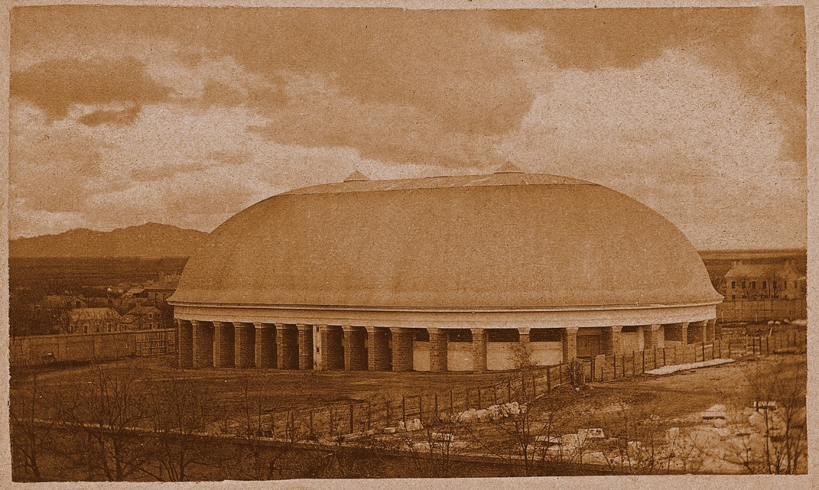
REMARKS BY THOMAS B. MARSH. I do not know that I can make all this vast congregation hear and understand me. My voice never was very strong, but it has been very much weakened of late years by the afflicting rod of Jehovah. He loved me too much to let me go without whipping. I have seen the hand of the Lord in the chastisement which I have received. I have seen and known that it has proved he loved me; for if he had not cared anything about me, he would not have taken me by the arm and given me such a shaking.
If there are any among this people who should ever apostatize and do as I have done, prepare your backs for a good whipping, if you are such as the Lord loves. But if you will take my advice, you will stand by the authorities; but if you go away and the Lord loves you as much as he did me, he will whip you back again.
Many have said to me, “How is it that a man like you, who understood so much of the revelations of God as recorded in the Book of Doctrine and Covenants, should fall away?” I told them not to feel too secure, but to take heed lest they also should fall; for I had no scruples in my mind as to the possibility of men falling away.
I can say, in reference to the Quorum of the Twelve, to which I belonged, that I did not consider myself a whit behind any of them, and I suppose that others had the same opinion; but, let no one feel too secure: for, before you think of it, your steps will slide. You will not then think nor feel for a moment as you did before you lost the Spirit of Christ; for when men apostatize, they are left to grovel in the dark.
I have sought diligently to know the Spirit of Christ since I turned my face Zion ward, and I believe I have obtained it. I have frequently wanted to know how my apostasy began, and I have come to the conclusion that I must have lost the Spirit of the Lord out of my heart….
I derive strength from a superior source. I have been drinking from that source for many years; and, as I told you last Sabbath, I have been trying to be a disciple of Jesus Christ. And, if we are faithful, we will all be counted worthy to be his disciples. God bless you! Amen.
Thomas B. Marsh…Brigham Young Journal of Discourse 206-207
Salt Lake City Tabernacle

