Slide 1


Slide 2

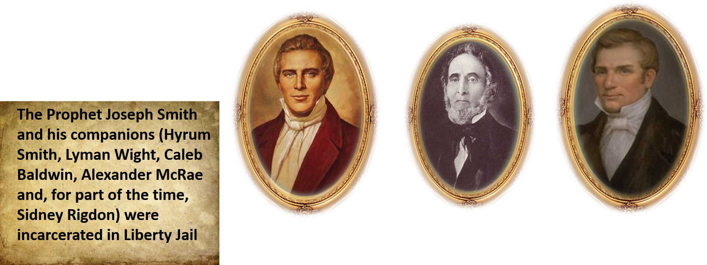

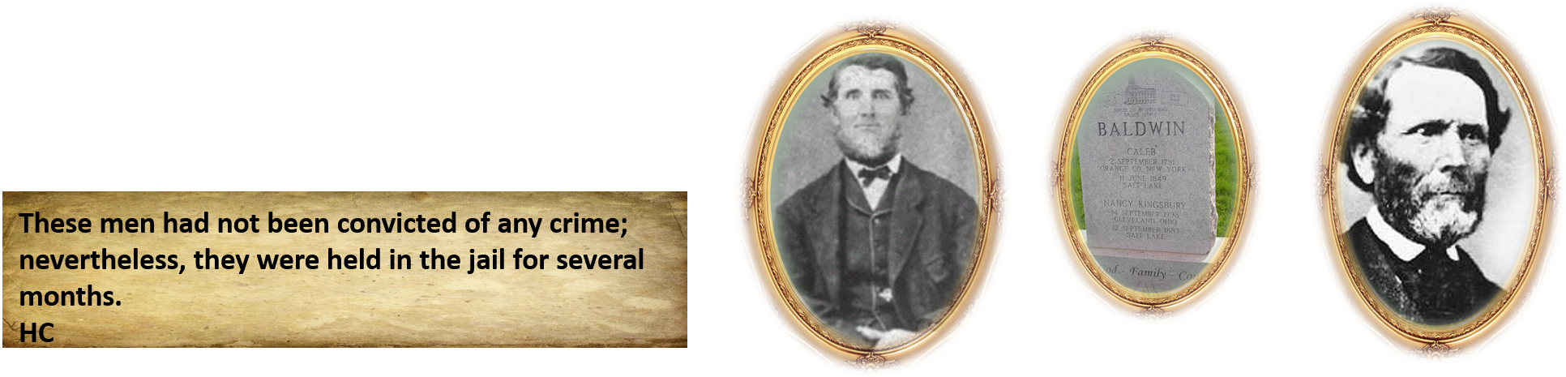
Liberty Jail
November 30, 1838

Slide 3
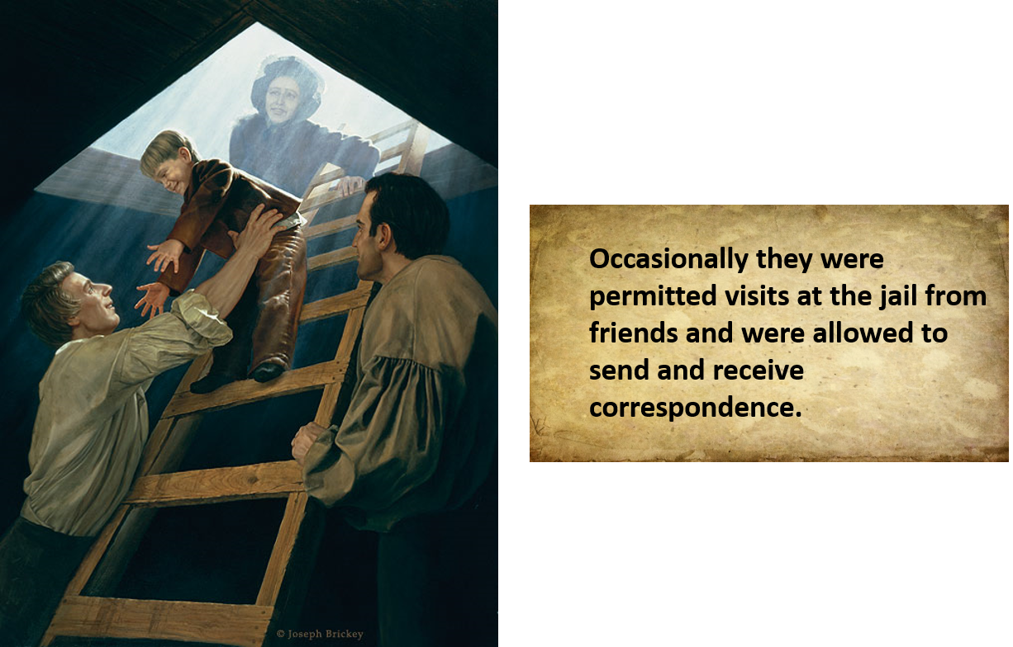
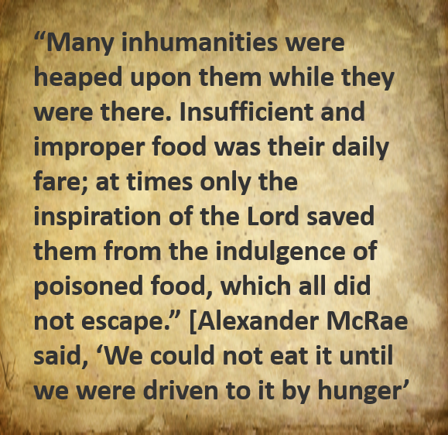
Inside Liberty Jail
Student Manual

Slide 4

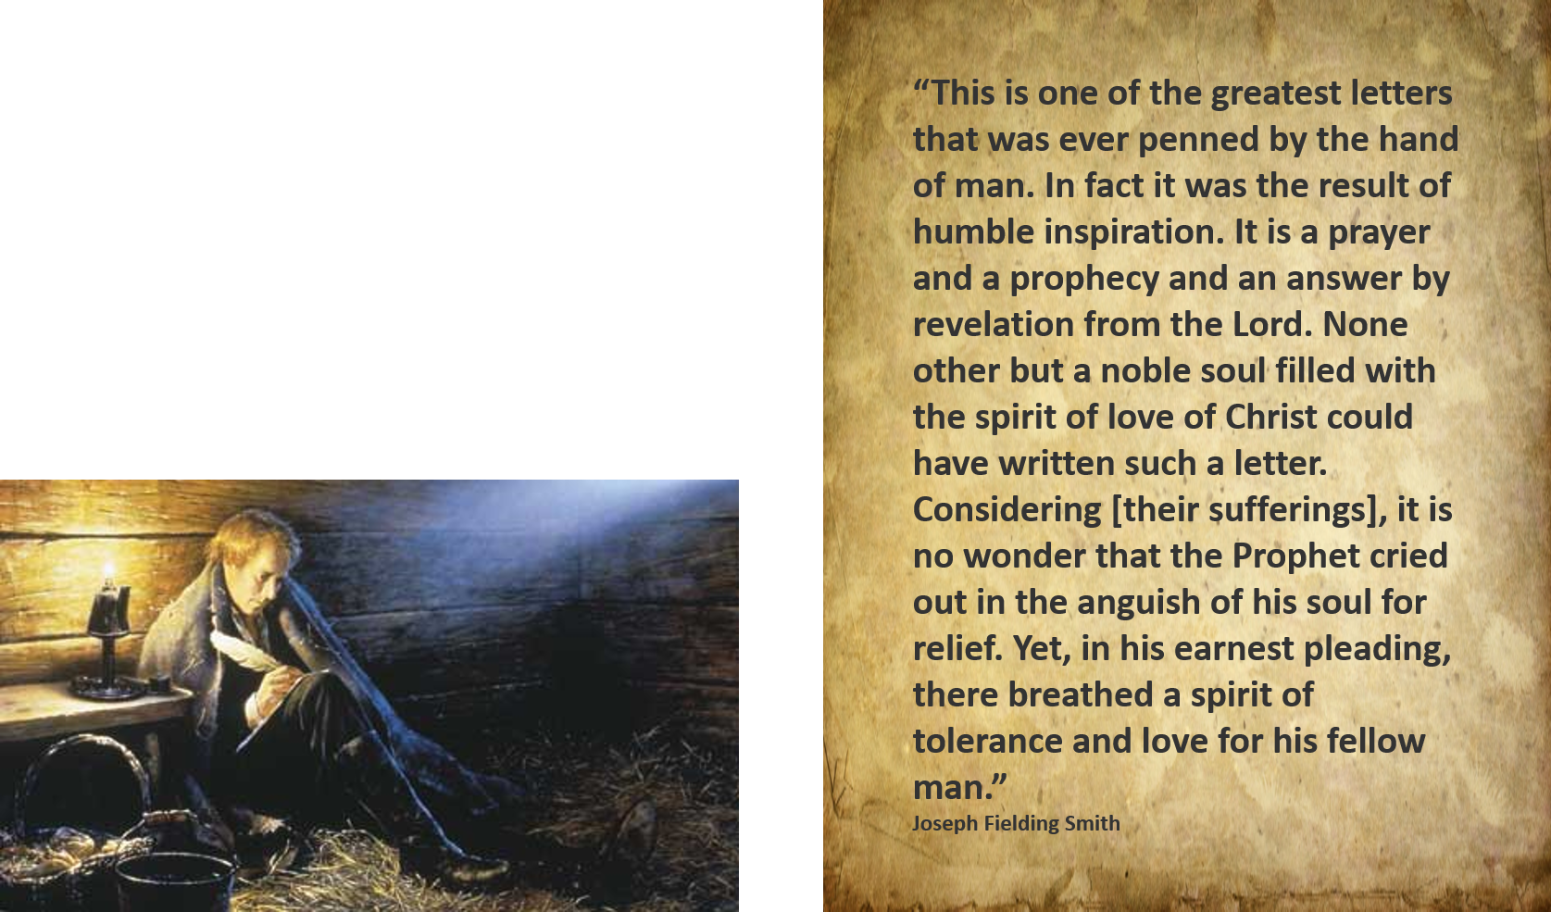
Between 20 March and 25 March 1839, the Prophet Joseph dictated a lengthy communication that was signed by all the prisoners (actually there were two letters, although the Prophet identified the second as a continuation of the first). ’

Slide 5
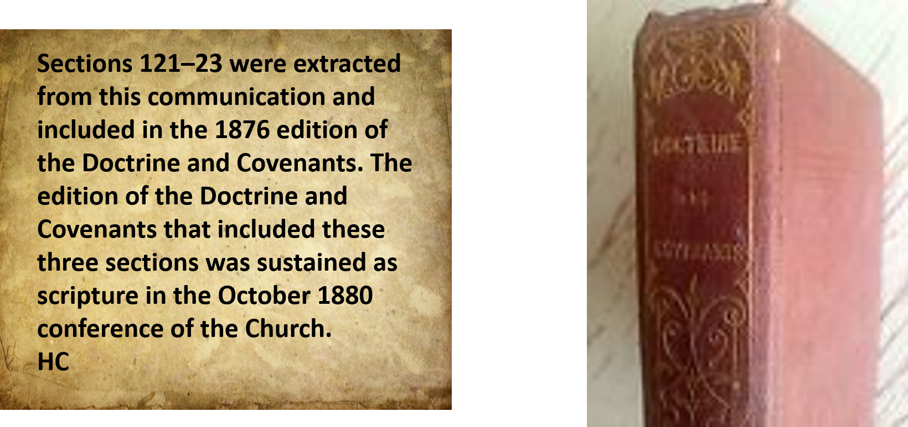
Sustained as Scripture
Student Manual

Slide 6

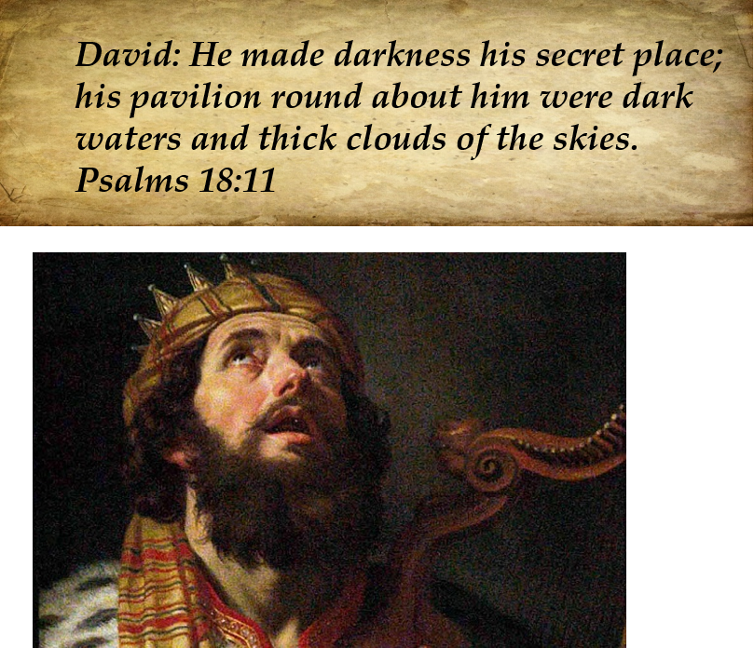
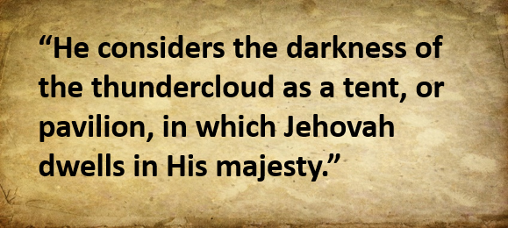
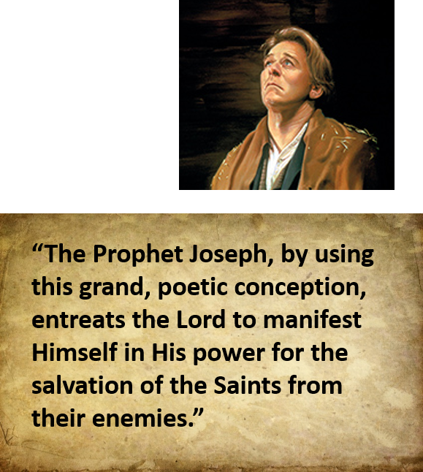
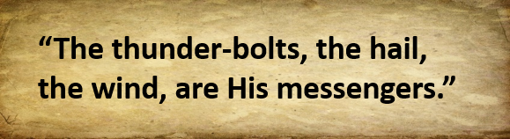
Pavilion and Hiding Place
D&C 121: 1 Smith and Sjodahl

Slide 7
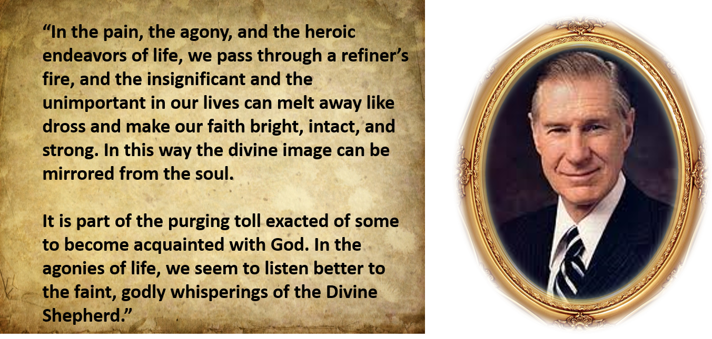
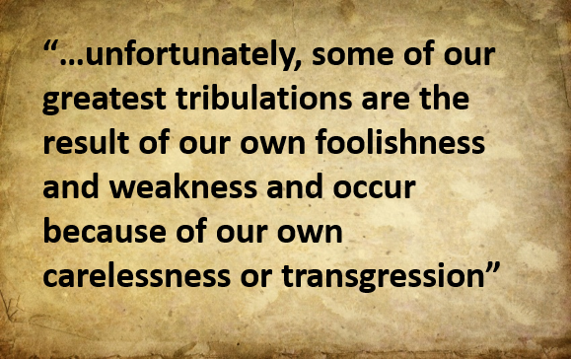
D&C 121:7 James E. Faust

Slide 8
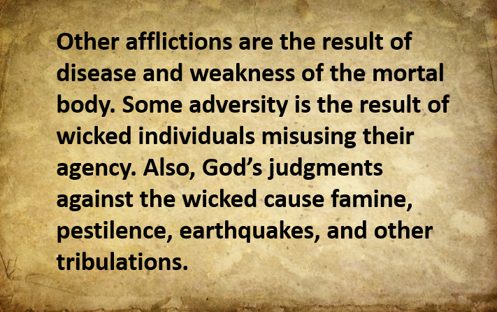
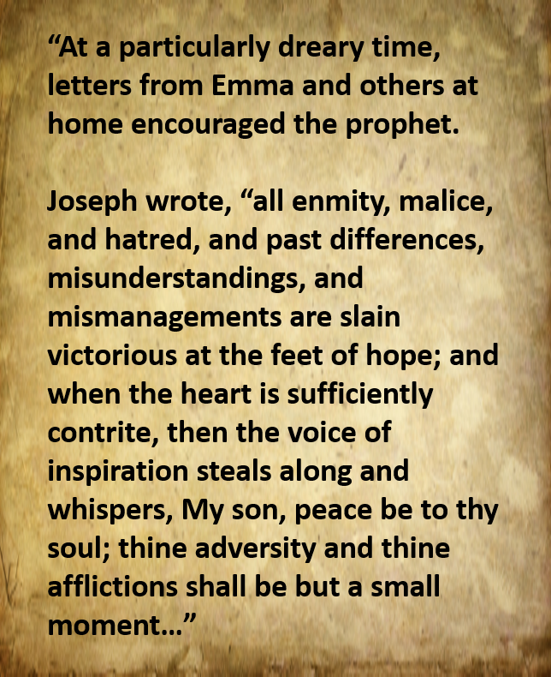
Adversity
When we call upon the Lord during times of adversity and affliction, we can receive His peace.
D&C 121:7-10 McConkie and Ostler HC

Slide 9
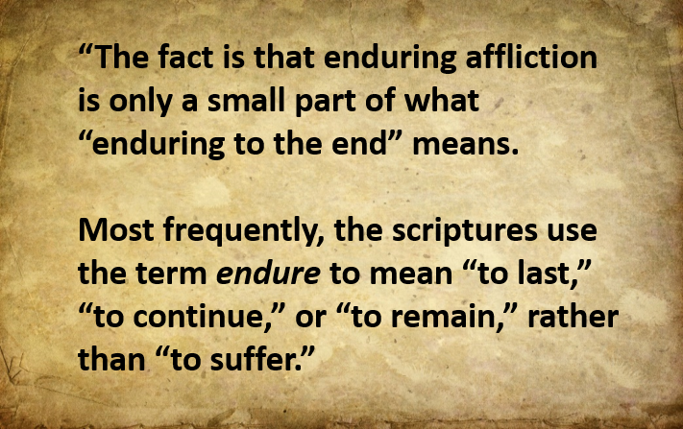
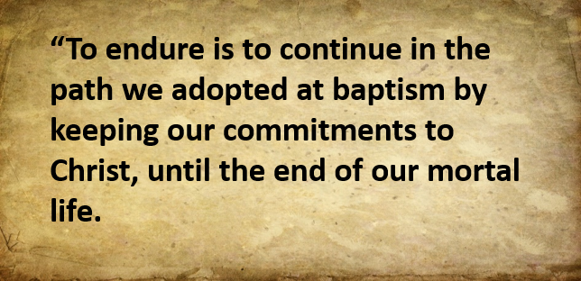
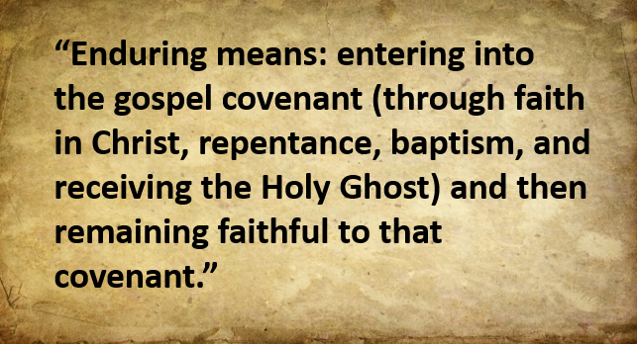
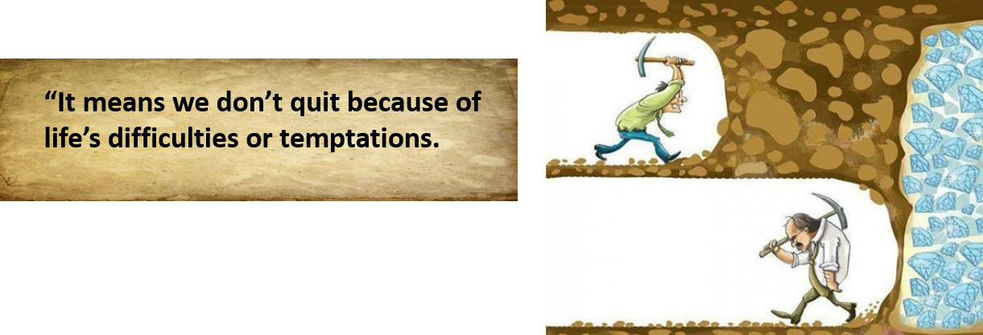
Endure It Well
If we endure trials well in mortality, God will bless us now and in the eternities.
D&C 121:7-10 Stephen E. Robinson

Slide 10
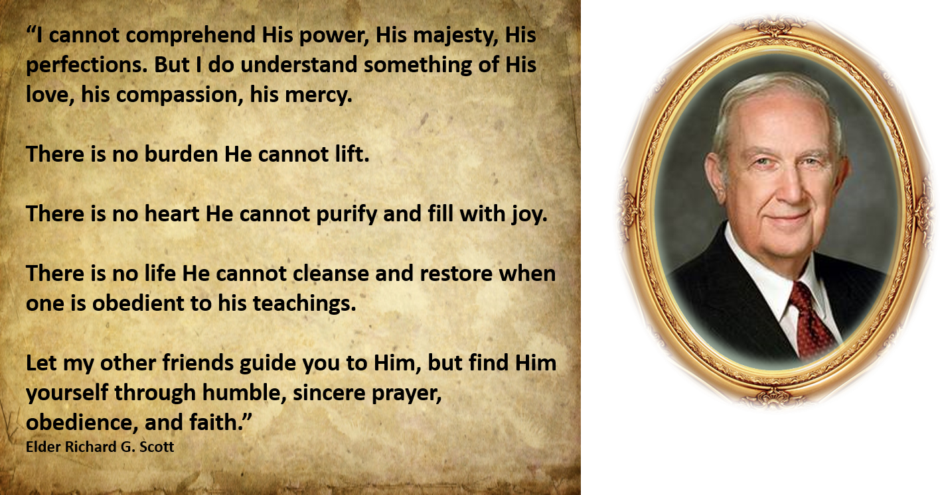
Trials
In times of trial, we can find comfort in the support of true friends.
D&C 121:7-10

Slide 11
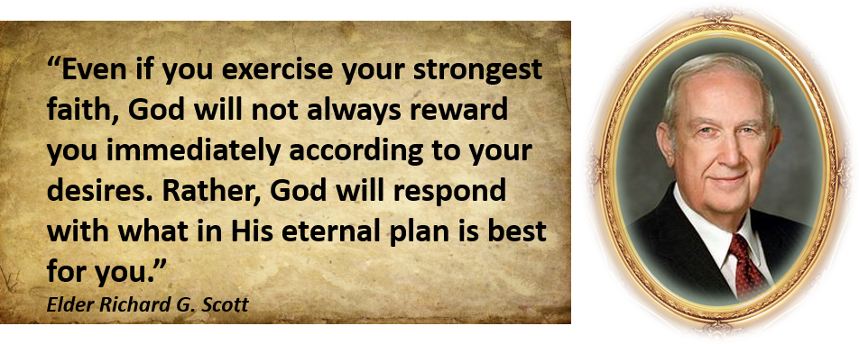
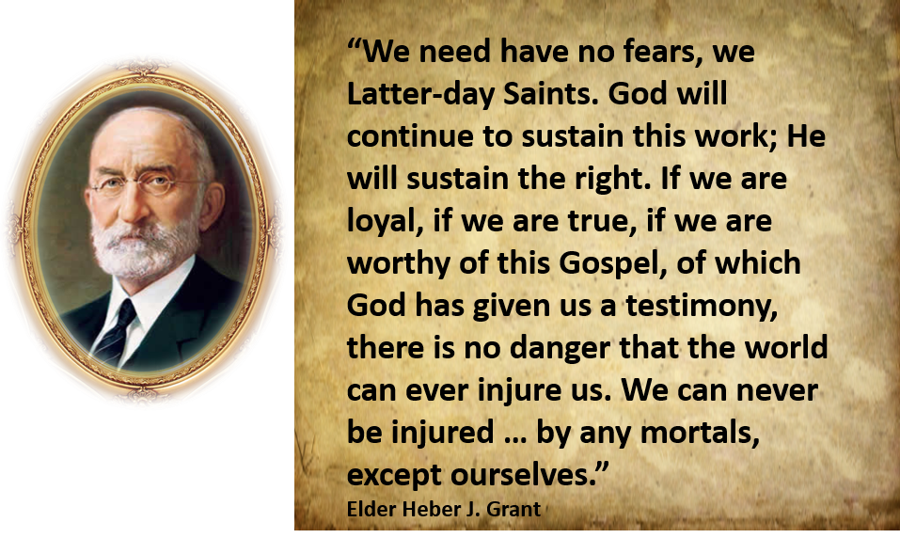
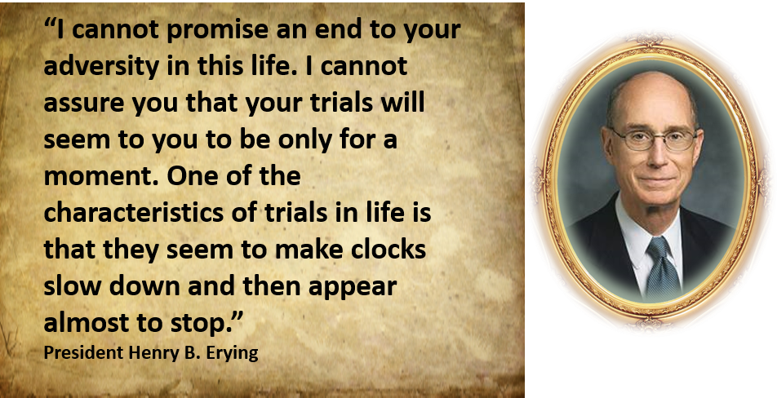

Slide 12
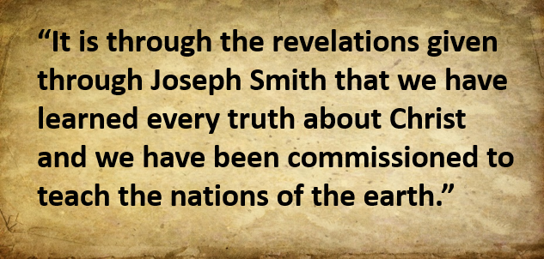
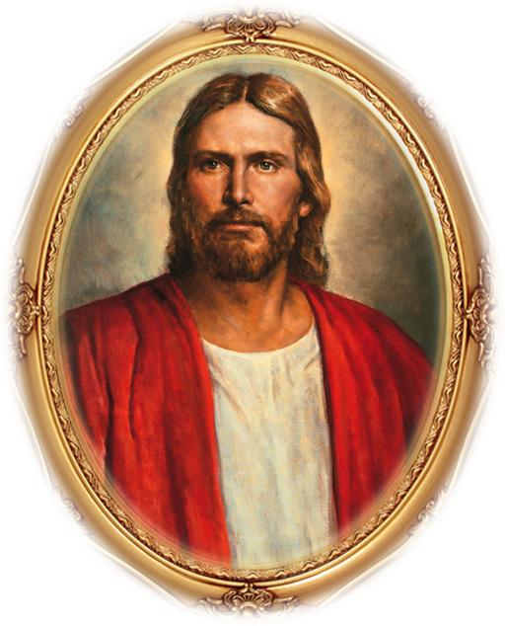
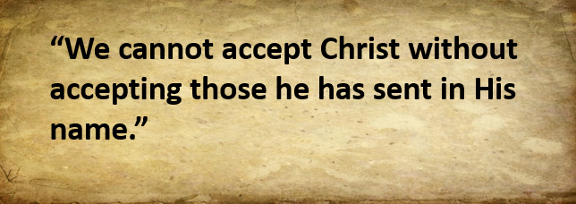
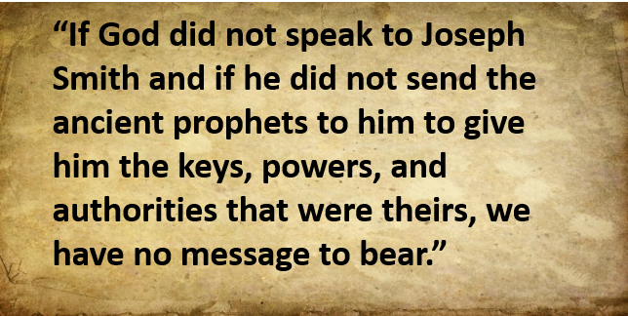
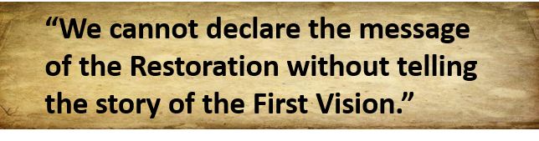
Because of Him
D&C 122:1-2 McConkie and Ostler

Slide 13


Polished Through Affliction
I am like a huge rough stone rolling down from a high mountain, and the only polishing I get, is when some corner gets rubbed off by coming in contact with something else striking with accelerated force … ; … knocking off a corner here and a corner there; thus, I will become a smooth and polished shaft in the quiver of the Almighty. Joseph Smith
D&C 122

Slide 14
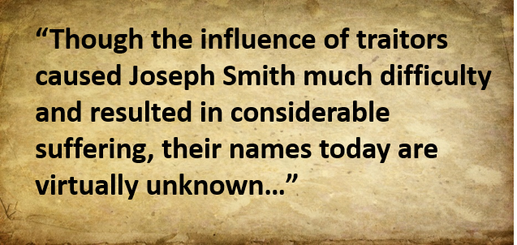
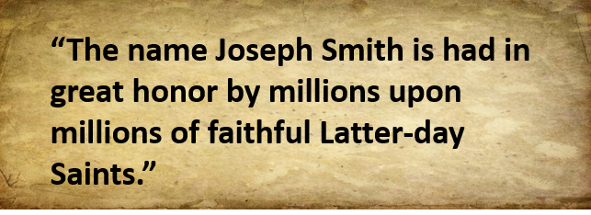
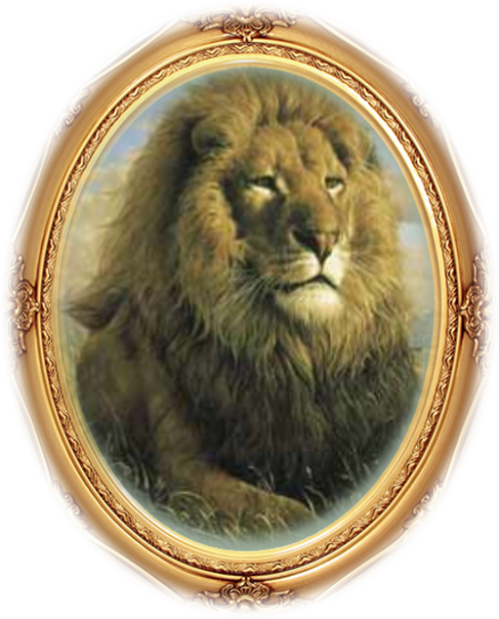
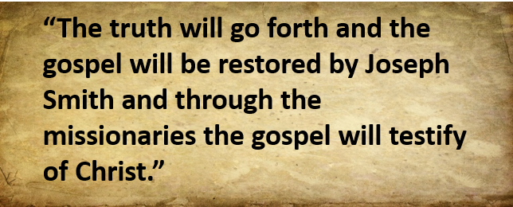
In the Midst of His Enemies
God allows us to go through afflictions because He knows they can give us experience and be for our good.
D&C 122:4 McConkie and Ostler

Slide 15
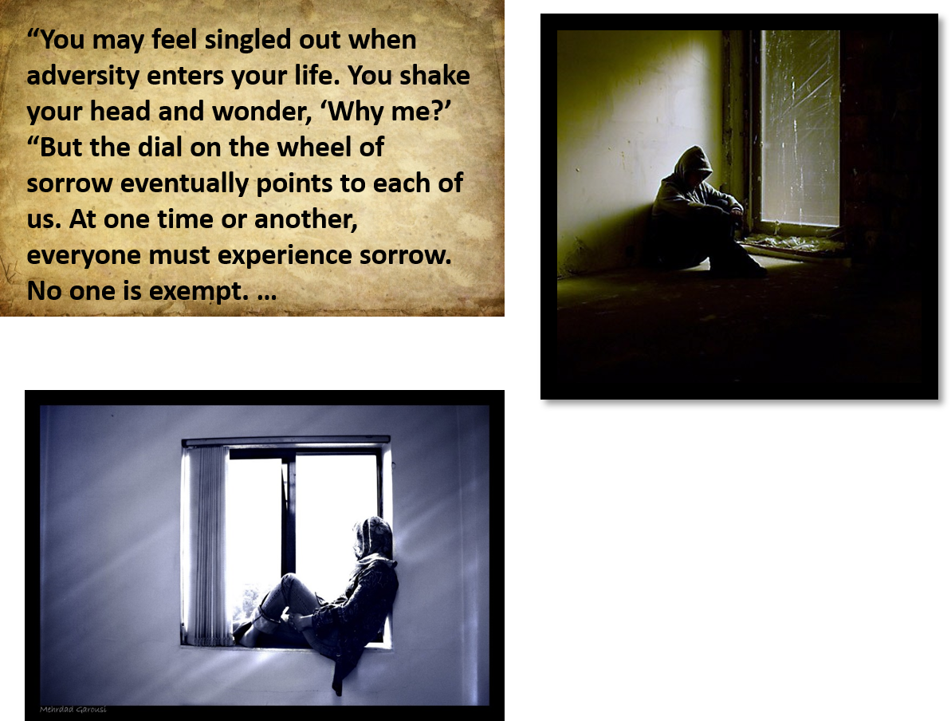
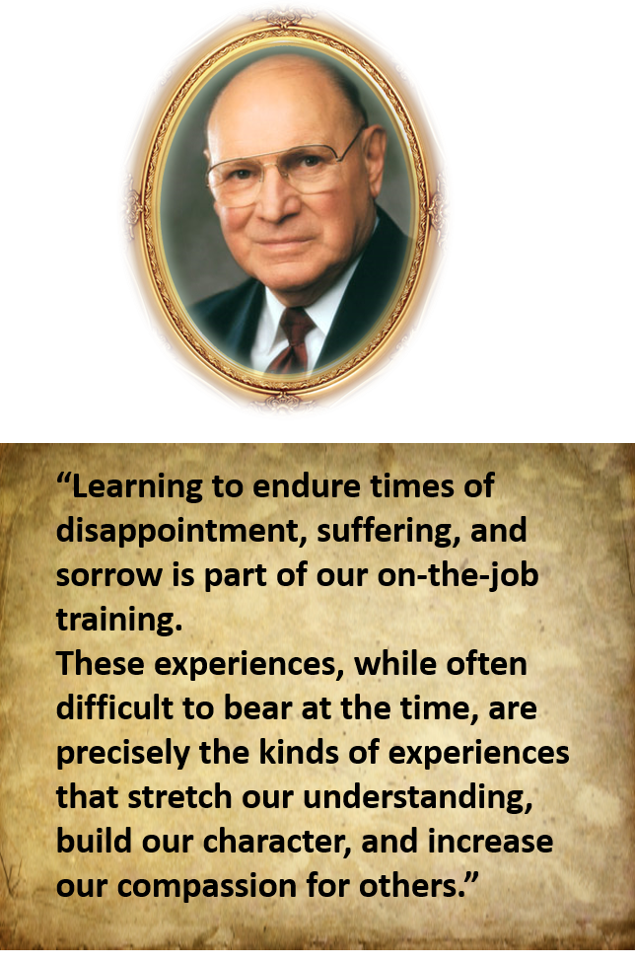
D&C 122:5-7 Elder Joseph B. Wirthlin

Slide 16
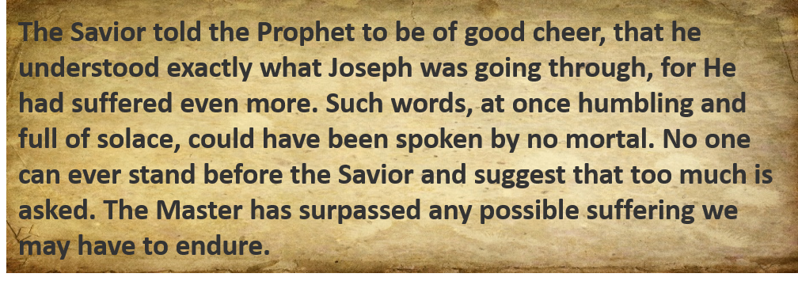

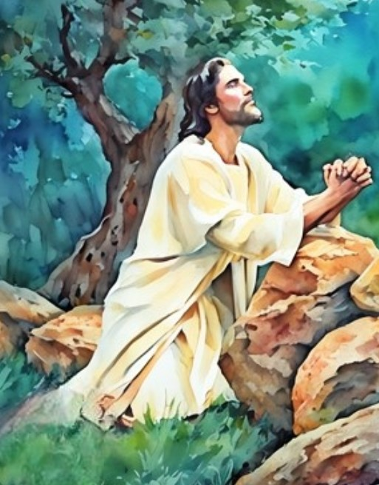
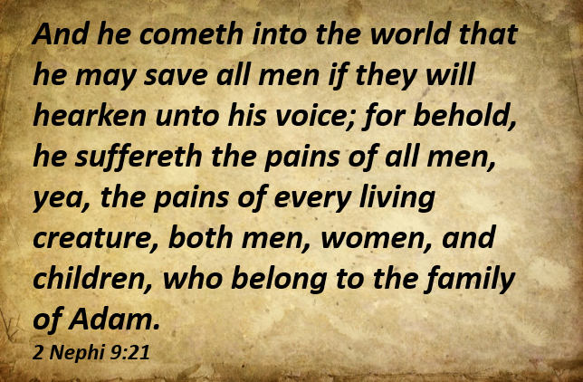
The Savior Descended Below All
D&C 122:8

Slide 17
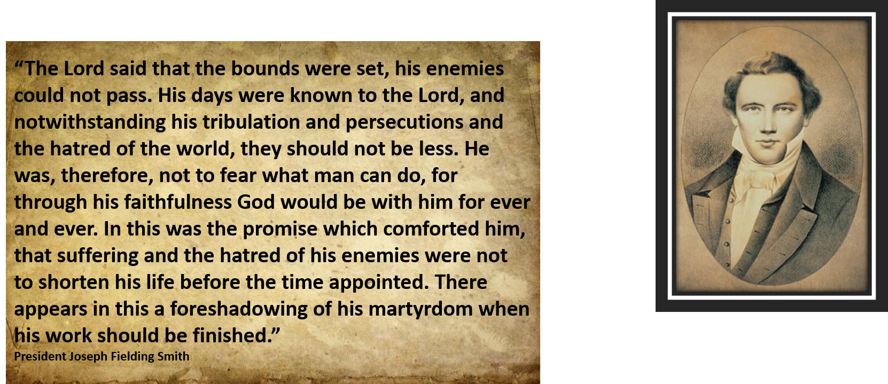
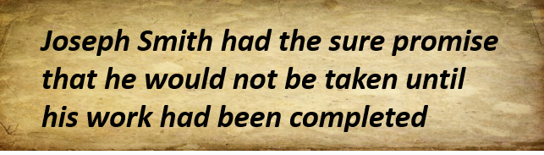
A Promise to The Prophet
D&C 122:9 McConkie and Ostler

Slide 18

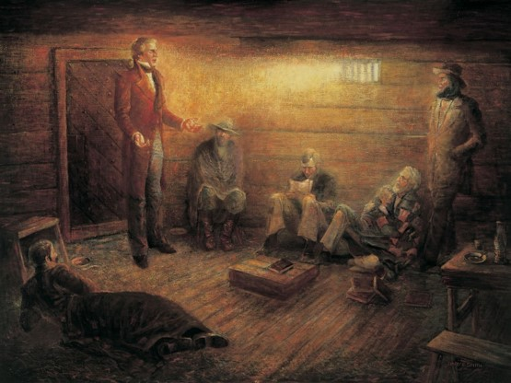
Sources:
Videos:
Haun's Mill (1:37)
“If Thou Endure It Well” (2:12)
Trial of Adversity (2:40)
Come What May, and Love It(3:31)
History of the Church, 3:188–89, 215; 3: 293; full text of document 3:289–305.)’
Art—Joseph F. Brickley
Alexander McRae (Roberts, Comprehensive History of the Church, 1:521).
Doctrine and Covenants Student Manual Religion 324-325 Section
Joseph Fielding Smith (Church History and Modern Revelation, 2:176.)
Presentation by ©http://fashionsbylynda.com/blog/
Hyrum M. Smith and Janne M. Sjodahl Doctrine and Covenants Commentary pg. 753
James E. Faust, in Conference Report, Apr. 1979, pp. 77–78; or Ensign, May 1979, pp. 53–54
Joseph Fielding McConkie and Craig J. Ostler Revelations of the Restoration pg. 945, 959-960
Stephen E. Robinson Enduring to the End October 1993 Ensign
President Henry B. Eyring Mountains to Climb April 2012 Gen. Conf.
Elder Richard G. Scott The Sustaining Power of Faith in Times of Uncertainty and Testing April 2003 Gen. Conf.
True Friends That Lift October 1988 Gen. Conf.
Elder Heber J. Grant (In Conference Report, Apr. 1909, p. 110
Elder Joseph B. Wirthlin “Come What May, and Love It,” Ensign or Liahona, Nov. 2008, 27).
President Joseph Fielding Smith (Church History and Modern Revelation,2:182.)
Joseph Smith, in History, 1838–1856 [Manuscript History of the Church], volume D-1, 1556, josephsmithpapers.org
Presentation by ©http://fashionsbylynda.com/blog/

Slide 19
While in Liberty Jail:
“The jail had no sleeping quarters, and thus they were forced to seek rest and recuperation on beds of straw placed on hardened plank and stone floors. They were suffered very little contact with the outside world, especially during the first month or so of their confinement. And this, at a crucial time when the Latter-day Saints were at the peak of persecution in Missouri, and were desperately in need of their prophet-leader.” (Dyer, Refiner’s Fire, pp. 275–76.)
"During the time I was in the hands of my enemies I must say that although I felt great anxiety respecting my family and friends, who were so inhumanly treated and abused, and who had to mourn the loss of their husbands and children who had been slain, and, after having been robbed of nearly all that they possessed, be driven from their homes, and forced to wander as strangers in a strange country, in order that they might save themselves and their little ones from the destruction they were threatened with in Missouri,-yet as far as I was concerned I felt perfectly calm and resigned to the will of my heavenly Father. I knew my innocency, as well as that of the saints, and that we had done nothing to deserve such treatment from the hands of our oppressors. Consequently I could look to that God who has the hearts of all men in his hands, and who had saved me frequently from the gates of death, for deliverance; and notwithstanding that every avenue of escape seemed to be entirely closed, and death stared me in the face, and that my destruction was determined upon, as far as man was concerned; yet from my first entrance into the camp I felt an assurance that I with my brethren and our families should be delivered. Yes, that still small voice which has so often whispered consolation to my soul in the depth of sorrow and distress, bade me be of good cheer, and promised deliverance, which gave me great comfort. And although the heathen raged and the people imagined vain things, yet the Lord of Hosts, the God of Jacob was my refuge; and when I cried unto him in the day of trouble he delivered me; for which I call upon my soul and all that is within me to bless and praise his holy name. For although I was 'troubled on every side, yet not distressed; perplexed, but not in despair; persecuted, but not forsaken; cast down, but not destroyed.‘ Joseph Smith
The following is from the pen of Lucy Smith, the mother of the prophet, concerning her banishment from Missouri:-
"Just as we got our goods into the wagon a man came to us and said that Sidney Rigdon's family were ready to start and must have the wagon immediately. Accordingly our goods were taken out, and we were compelled to wait until the team could come after us again. We put our goods into the wagon a second time, but the wagon was wanted for Emma and her family, so our goods were again taken out. However, we succeeded after a long time, in getting one single wagon to convey beds, clothing, and provisions for our family, Salisbury's family, and Mr. M'Cleary's family, besides considerable luggage for Don Carlos, who, with his family and the remainder of his baggage, was crowded into a buggy, ¹ and went in the same company with us.
"For the want of teams we were compelled to leave most of our provisions and furniture. Another inconvenience which we suffered was, the horses were windbroken, consequently we were obliged to walk much of the way, especially up all the hills, which was very tiresome work.”
Lucy Mack Smith
Adversity:
Elder Marion G. Romney said: “All … who are being tried in the crucible of adversity and affliction: Take courage; revive your spirits and strengthen your faith. In these lessons so impressively taught in precept and example by our great exemplar, Jesus Christ, and his Prophet of the restoration, Joseph Smith, we have ample inspiration for comfort and for hope.
“If we can bear our afflictions with the understanding, faith, and courage, and in the spirit in which they bore theirs, we shall be strengthened and comforted in many ways. We shall be spared the torment which accompanies the mistaken idea that all suffering comes as chastisement for transgression. …
“We can draw assurance from the Lord’s promise that ‘he that is faithful in tribulation, the reward of the same is greater in the kingdom of heaven.
“‘Ye cannot behold with your natural eyes, for the present time, [he said,] the design of your God concerning those things which shall come hereafter, and the glory which shall follow much tribulation.
“‘For after much tribulation come the blessings. …’ (D&C 58:2–4.)” (In Conference Report, Oct. 1969, p. 59.)

Slide 20
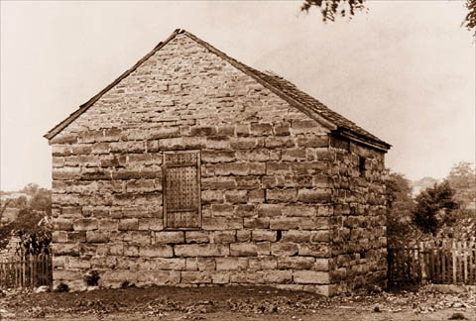
Elder Orson F. Whitney said:
“The Prophet was lying in a dungeon [Liberty, Missouri] for the gospel’s sake. He called upon God, ‘who controlleth and subjecteth the devil,’ and God answered telling him that his sufferings should be but ‘a small moment.’ ‘Thou art not yet as Job,’ said the Lord, ‘thy friends do not contend against thee.’ Job’s friends, it will be remembered, tried to convince him that he must have done something wrong or those trials would not have come upon him. But Job had done no wrong; it was ‘without cause’ that Satan had sought to destroy him. God said to Joseph: ‘If thou art called to pass through tribulation; if thou art in perils among false brethren; perils among robbers; perils by land and sea; if fierce winds become thine enemy; if the billowing surge conspire against thee, if the very jaws of hell shall gape open the mouth wide after thee, know thou, my son, that all these things shall give thee experience and shall be for thy good.’
“There is the reason. It is for our development, our purification, our growth, our education and advancement, that we buffet the fierce waves of sorrow and misfortune; and we shall be all the stronger and better when we have swum the flood and stand upon the farther shore.” (Improvement Era, Nov. 1918, pp. 5–6.)
Before Joseph Smith was imprisoned in Liberty Jail, he and several other Church leaders, including Parley P. Pratt, were unjustly imprisoned in Richmond, Missouri. While in the jail at Richmond, they heard the prison guards describe, in filthy language, horrid deeds of robbery, rape, and murder that had been committed against Latter-day Saints. Parley P. Pratt recounted that after listening to this for some time, Joseph responded:
“On a sudden [Joseph] arose to his feet, and spoke in a voice of thunder, or as the roaring lion, uttering, as near as I can recollect, the following words:
“‘SILENCE, ye fiends of the infernal pit. In the name of Jesus Christ I rebuke you, and command you to be still; I will not live another minute and bear such language. Cease such talk, or you or I die THIS INSTANT!’”
The guards “begged his pardon, and remained quiet till a change of guards.” Parley later recalled of this experience: “I have seen the ministers of justice … in the Courts of England; I have witnessed a Congress in solemn session to give laws to nations; … but dignity and majesty have I seen but once, as it stood in chains, at midnight, in a dungeon in an obscure village of Missouri” (Autobiography of Parley P. Pratt, ed. Parley P. Pratt Jr. [1938], 211; see also page 210).

