Slide 1
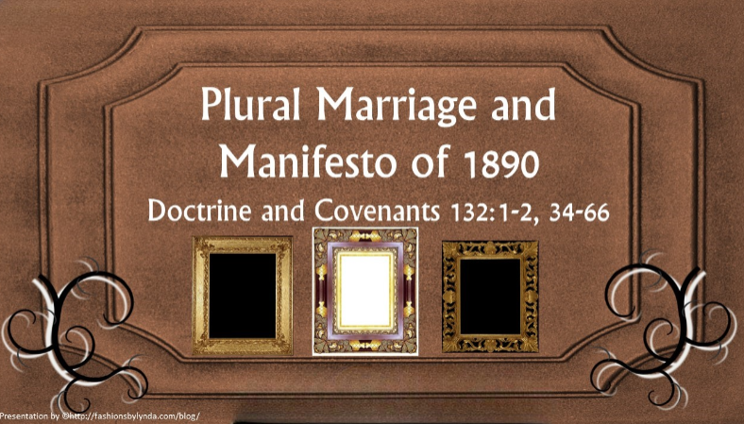

Slide 2

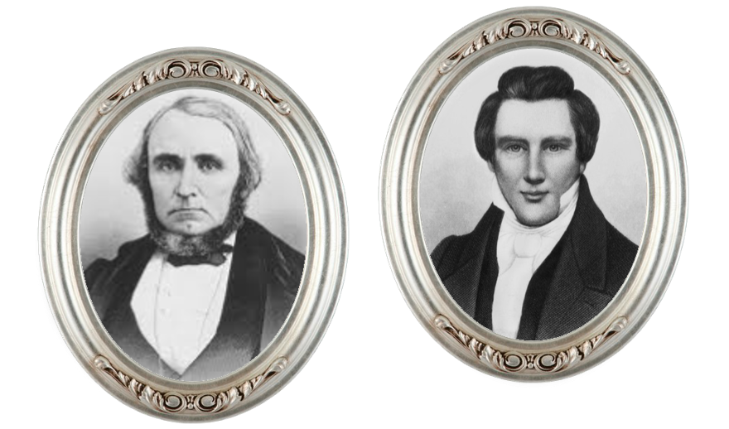
Background
Although this revelation was recorded on July 12, 1843, some of the truths in the revelation were known and taught by the Prophet Joseph Smith as early as 1831.
The Prophet knew the Lord’s will on plural marriage within the new and everlasting covenant probably as early as 1831 History of the Church 5:39
In March 1843 he spoke to William Clayton of eternal marriage.
In July of that year, he was discussing the doctrine with his brother Hyrum in William Clayton’s presence when Hyrum said, “If you will write the revelation on celestial marriage, I will take it and read it to Emma, and I believe I can convince her of its truth, and you will hereafter have peace” History of the Church, 5:32

Slide 3
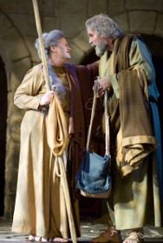
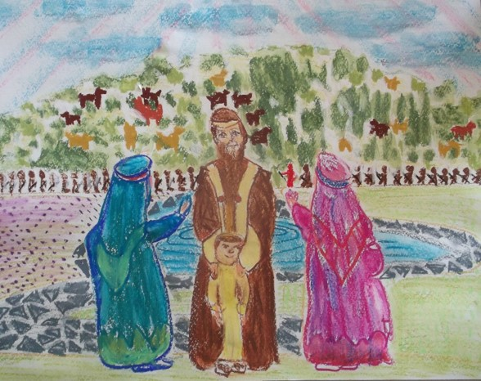
Bible Question
While Joseph Smith was working on the inspired translation of the Old Testament in 1831, he read about some of the ancient prophets practicing plural marriage (also called polygamy).
Under this practice, one man is married to more than one living wife. The Prophet studied the scriptures, pondered what he learned, and eventually took his questions about plural marriage to Heavenly Father in prayer.
Read Genesis 16:1-3

Slide 4
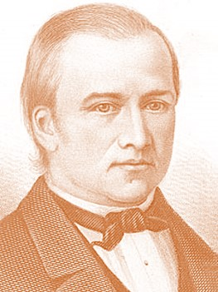
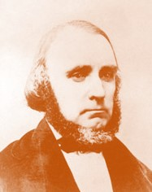
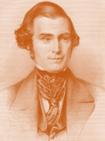
The Revelation
The Prophet consented and told William Clayton to get some paper to write; but to his brother’s “urgent request” that the Prophet use the Urim and Thummim to recall the exact revelation, Joseph replied that he did not need it, “for he knew the revelation from beginning to end.”
History of the Church 5:32
When he had finished dictating, William Clayton read it back slowly, and Joseph said that it was exact..
Bishop Newel K. Whitney heard the revelation read and asked permission of the Prophet Joseph Smith to have it copied. With the Prophet’s approval, Bishop Whitney sent Joseph C. Kingsbury the next day to copy it. Brothers Kingsbury and Clayton compared the copy line by line to the original and found it correct.
The revelation was not made public until Elder Orson Pratt, under the direction of President Brigham Young, announced it at a Church conference on 29 August 1852.
The revelation was placed in the Doctrine and Covenants in 1876.

Slide 5

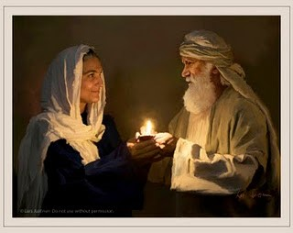
Today’s Question
Plural marriage is approved of the Lord only when He commands it.
Why did Sarah give Abraham another wife?
Why would the Lord command righteous men and women to obey the principle of plural marriage at certain times?
The Lord’s promises to Abraham, including the promise that Abraham would have posterity as numerous as the stars
What did Sarah and Abraham’s obedience help to fulfill?
D&C 132:34
Genesis 15:5

Slide 6
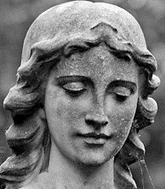
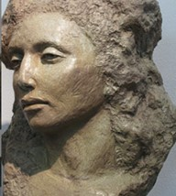
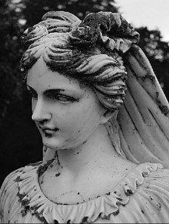
Receiving Concubines
Concubine is a term used to describe women in the Old Testament who, in the time and culture in which they lived, were legally married to a man but had a lower social status than a wife.
For Abraham—Genesis 16:2 the revelation from the Lord makes it clear, however, that God commanded Abraham to accept Sarah’s recommendation that he take Hagar to wife.
Concubines were not part of the practice of plural marriage in our dispensation
D&C 132:37-38

Slide 7
According to His Commandment
The Lord affirmed that when people practice the principle of plural marriage according to His commandment, they are not guilty of the sin of adultery.
However, if anyone practices plural marriage under any circumstances that the Lord does not command, they are guilty of adultery.
Destroy—
those who violate their sacred covenants will be separated from God and from His covenant people
And it shall come to pass that all those who will not hear that prophet shall be cut off from among the people.
1 Nephi 22:20
D&C 132:39, 41-43

Slide 8
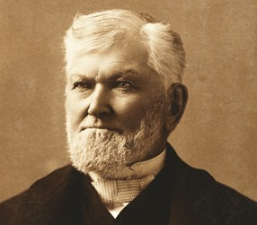
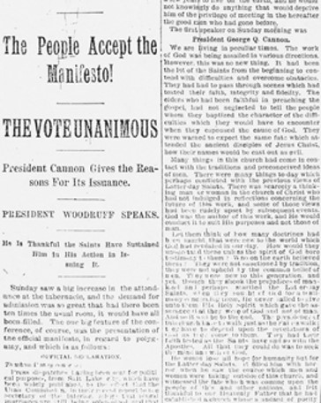
Part of the Restoration
The commandment to live the law of plural marriage in the latter days was part of the restoration of all things
Plural marriage can be authorized only through the priesthood keys given to the President of the Church
In 1890, the Lord inspired Church President Wilford Woodruff to issue a statement that led to the end of the practice of plural marriage in the Church.
President Woodruff declared his intention to abide by U.S. law forbidding plural marriage and to use his influence to convince members of the Church to do likewise
D&C 132:40, 45-48

Slide 9
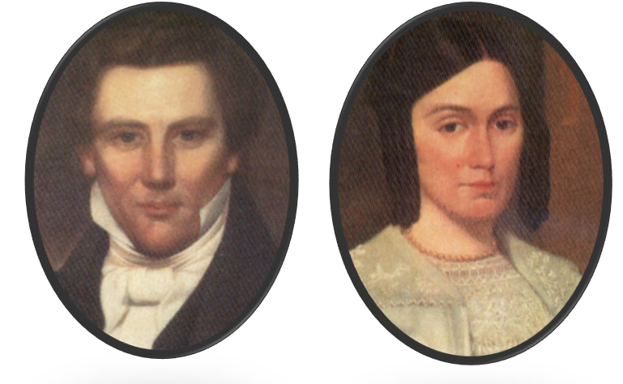
The Practice of Plural Marriage
The Prophet Joseph Smith was reluctant to begin the practice of plural marriage. He stated that he did not begin the practice until he was warned that he would be destroyed if he did not obey
Historical Record
Because of a lack of historical documentation, we do not know about Joseph Smith’s early attempts to comply with the commandment.
However, by 1841 the Prophet had begun to obey the commandment and to teach it to some members of the Church, and over the next three years he married additional wives in accordance with the Lord’s commands.
The Prophet Joseph Smith’s obedience to the Lord’s commandment to practice plural marriage was a trial of faith for him and his wife Emma, whom he loved dearly.
Seminary Manual
D&C 132:49-66

Slide 10
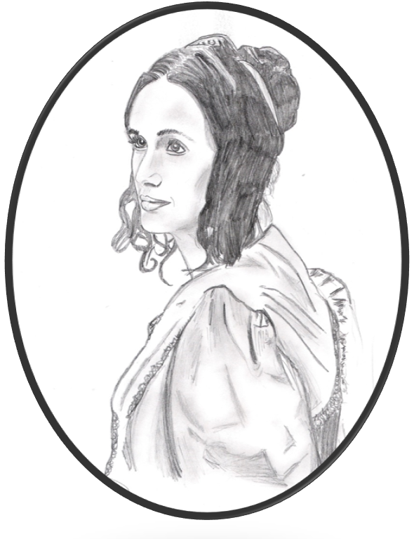
To Emma Smith
The Lord commanded Emma to receive those who had been sealed to her husband, the Lord commanded her to abide in His law and forgive Joseph of his trespasses.
“All those that have been given unto my servant Joseph” refers to those who had been sealed to Joseph Smith.
And again, verily I say, let mine handmaid forgive my servant Joseph his trespasses; and then shall she be forgiven her trespasses, wherein she has trespassed against me; and I, the Lord thy God, will bless her, and multiply her, and make her heart to rejoice.
D&C 132:52-56

Slide 11
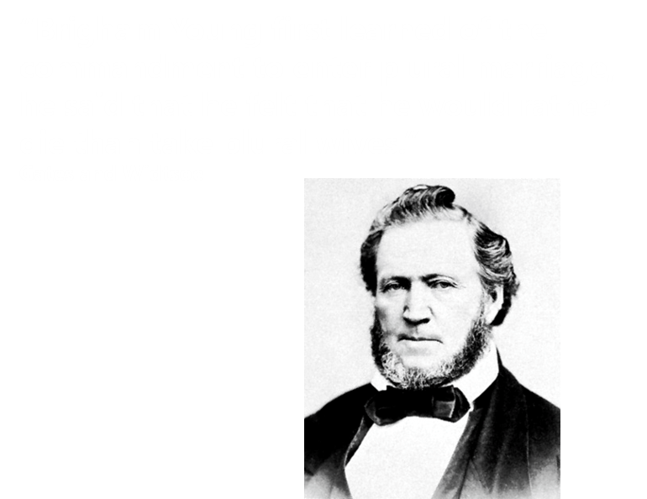
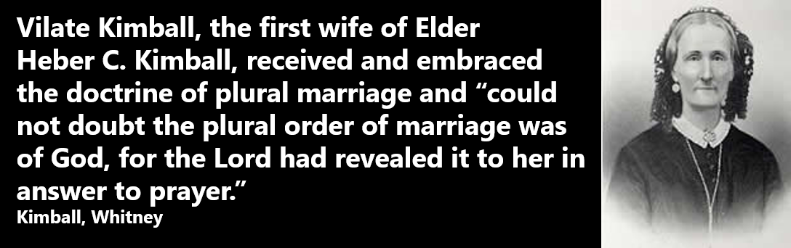
Others To Practice Plural Marriage
In 1841, Joseph Smith began to teach other faithful men and women the principle of plural marriage. They also struggled initially to understand and accept this principle.
Although these faithful Church members were hesitant and frustrated about the command at first, they received individual confirmations through the Holy Ghost and accepted the principle of plural marriage.
Practicing plural marriage brought additional challenges. Because the practice was initially kept very quiet, rumors began to spread about Church leaders marrying additional wives. These rumors greatly distorted the truth, slandered the names of the Prophet and other Church leaders, and contributed to increased persecution against the Saints.
D&C 132:52-56

Slide 12


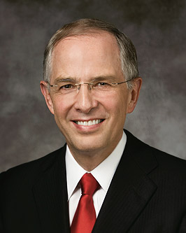

Useless Speculation
Much unreliable information pertaining to plural marriage exists on the Internet and in many print sources. Be cautious and wise with such information. Some authors who write about the Church and its history present information out of context or include partial truths that can be misleading. The intent of some of these writings is to destroy faith.
“There have always been a few who want to discredit the Church and to destroy faith. Today they use the Internet.
“Some of the information about the Church, no matter how convincing, is just not true.”
Elder Neil L. Andersen

Slide 13

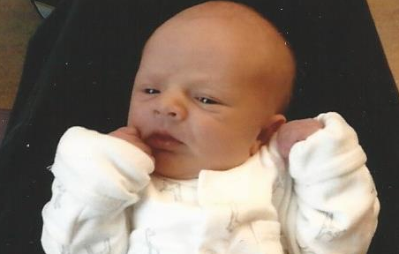
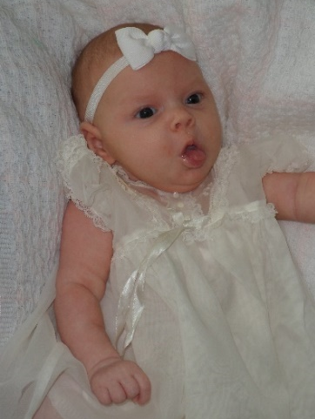
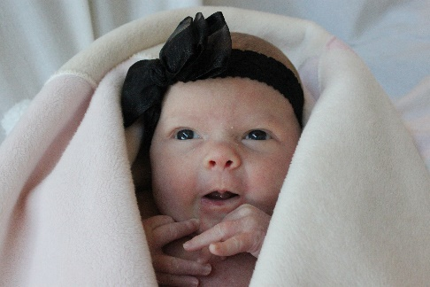
Multiply and Replenish the Earth
“When a child is born to a husband and wife, they are fulfilling part of our Heavenly Father’s plan to bring children to earth.
The Lord said, ‘This is my work and my glory—to bring to pass the immortality and eternal life of man’ [Moses 1:39]. Before immortality, there must be mortality”
Elder Neil L. Andersen
The Lord has at times instituted plural marriage to provide further opportunities for His people to raise up righteous children unto Him.
D&C 132:63

Slide 14



Jacob 2:27, 30
Why would the Lord command righteous men and women to obey the principle of plural marriage at certain times?
Wherefore, my brethren, hear me, and hearken to the word of the Lord: For there shall not any man among you have save it be one wife; and concubines he shall have none;
For if I will, saith the Lord of Hosts, raise up seed unto me, I will command my people; otherwise they shall hearken unto these things.

Slide 15
Sources:
Videos: Do Not Practice Polygamy (1:10)
“Is It Hard to Be the Prophet?” (1:54)
HR-- “Plural Marriage,” Historical Record, May 1887, 222)
Susa Young Gates and Leah D. Widtsoe, The Life Story of Brigham Young[1930], 321
Helen Mar Kimball, in Orson F. Whitney, Life of Heber C. Kimball [1967], 325; see also pages 326–28
Elder Neil L. Andersen(“Children,” Ensign or Liahona, Nov. 2011, 28).
(“Trial of Your Faith,” Ensign or Liahona, Nov. 2012, 41).
Presentation by ©http://fashionsbylynda.com/blog/
Doctrine and Covenants Student Manual, 2nd ed. [Church Educational System manual, 2001], 334).
Presentation by ©http://fashionsbylynda.com/blog/

Slide 16
Concubine, a word commonly used in the Old Testament, was defined by Elder Bruce R. McConkie as follows: “Anciently they were considered to be secondary wives, that is, wives who did not have the same standing in the caste system then prevailing as did those wives who were not called concubines. There were no concubines connected with the practice of plural marriage in this dispensation, because the caste system which caused some wives to be so designated did not exist.” (Mormon Doctrine, pp. 154–55.)
Official Declaration 1
To Whom It May Concern:
Press dispatches having been sent for political purposes, from Salt Lake City, which have been widely published, to the effect that the Utah Commission, in their recent report to the Secretary of the Interior, allege that plural marriages are still being solemnized and that forty or more such marriages have been contracted in Utah since last June or during the past year, also that in public discourses the leaders of the Church have taught, encouraged and urged the continuance of the practice of polygamy—
I, therefore, as President of The Church of Jesus Christ of Latter-day Saints, do hereby, in the most solemn manner, declare that these charges are false. We are not teaching polygamy or plural marriage, nor permitting any person to enter into its practice, and I deny that either forty or any other number of plural marriages have during that period been solemnized in our Temples or in any other place in the Territory.
One case has been reported, in which the parties allege that the marriage was performed in the Endowment House, in Salt Lake City, in the Spring of 1889, but I have not been able to learn who performed the ceremony; whatever was done in this matter was without my knowledge. In consequence of this alleged occurrence the Endowment House was, by my instructions, taken down without delay.
Inasmuch as laws have been enacted by Congress forbidding plural marriages, which laws have been pronounced constitutional by the court of last resort, I hereby declare my intention to submit to those laws, and to use my influence with the members of the Church over which I preside to have them do likewise.
There is nothing in my teachings to the Church or in those of my associates, during the time specified, which can be reasonably construed to inculcate or encourage polygamy; and when any Elder of the Church has used language which appeared to convey any such teaching, he has been promptly reproved. And I now publicly declare that my advice to the Latter-day Saints is to refrain from contracting any marriage forbidden by the law of the land.
Wilford Woodruff
President of The Church of Jesus Christ of Latter-day Saints.
President Lorenzo Snow offered the following:
“I move that, recognizing Wilford Woodruff as the President of The Church of Jesus Christ of Latter-day Saints, and the only man on the earth at the present time who holds the keys of the sealing ordinances, we consider him fully authorized by virtue of his position to issue the Manifesto which has been read in our hearing, and which is dated September 24th, 1890, and that as a Church in General Conference assembled, we accept his declaration concerning plural marriages as authoritative and binding.”
Salt Lake City, Utah, October 6, 1890.
See more Official Declaration 1 (Doctrine and Covenants)
https://www.lds.org/scriptures/dc-testament/od/1?lang=eng
The Bible Concubines:
Among the Israelites, men commonly acknowledged their concubines, and such women enjoyed the same rights in the house as legitimate wives.
The concubine may not have commanded the same respect and inviolability as the wife. In the Levitical rules on sexual relations, the Hebrew word that is commonly translated as "wife" is distinct from the Hebrew word that means "concubine". However, on at least one other occasion the term is used to refer to a woman who is not a wife - specifically, the handmaiden of Jacob's wife. In the Levitical code, sexual intercourse between a man and a wife of a different man was forbidden and punishable by death for both persons involved. Since it was regarded as the highest blessing to have many children, wives often gave their maids to their husbands if they were barren, as in the cases of Sarah and Hagar, and Rachel and Bilhah. The children of the concubine often had equal rights with those of the wife; for example, King Abimelech was the son of Gideon and his concubine. Later biblical figures such as Gideon, and Solomon had concubines in addition to many childbearing wives. For example, the Books of Kings say that Solomon had 700 wives and 300 concubines.
There are no concubines in the New Testament. Paul, the apostle, emphasizes that church leaders should be in monogamous marriages, that believers should not have sexual relationships outside marriage. and that unmarried believers should be celibate. Marriage is to reflect the exclusive relationship between the husband (Christ) and wife (his church), described as a "mystery".

Slide 17
Eliza R. Snow, who was sealed to the Prophet Joseph Smith, recorded the details of the Prophet Joseph teaching the principle of plural marriage to her brother Lorenzo Snow. She noted the anguish and pain that the principle caused Joseph Smith and that he only moved forward in establishing the principle because of divine revelation:
“The Prophet Joseph unbosomed his heart [to Lorenzo Snow], and described the trying mental ordeal he experienced in overcoming the repugnance of his feelings, the natural result of the force of education and social custom, relative to the introduction of plural marriage. He knew the voice of God—he knew the commandment of the Almighty to him was to go forward—to set the example, and establish Celestial plural marriage. He knew that he had not only his own prejudices and prepossessions to combat and to overcome, but those of the whole Christian world stared him in the face; but God, who is above all, had given the commandment, and He must be obeyed. Yet the Prophet hesitated and deferred from time to time, until an angel of God stood by him with a drawn sword, and told him that, unless he moved forward and established plural marriage, his Priesthood would be taken from him and he should be destroyed! This testimony he not only bore to my brother, but also to others—a testimony that cannot be gainsayed [contradicted]” (Biography and Family Record of Lorenzo Snow [1884], 69–70).
President Brigham Young explained:
“If any man had asked me what was my choice when Joseph revealed that doctrine, provided that it would not diminish my glory, I would have said, ‘let me have but one wife.’ …
“… I was not desirous of shrinking from any duty nor of failing in the least to do as I was commanded, but it was the first time in my life that I had desired the grave, and I could hardly get over it for a long time. And when I saw a funeral I felt to envy the corpse its situation, and to regret that I was not in the coffin. …
“… But the saints who live their religion will be exalted, for they never will deny any revelation which the Lord has given or may give, though, when there is a doctrine coming to them which they cannot comprehend fully, they may be found saying, ‘the Lord sendeth this unto me, and I pray that he will save and preserve me from denying anything which proceedeth from him, and give me patience to wait until I can understand it for myself’” (in “Provo Conference,” Deseret News, Nov. 14, 1855, 282).
Vilate Kimball, President Heber C. Kimball’s first wife, received a testimony of plural marriage. Her daughter Helen recounted:
“‘My mother often told me that she could not doubt the plural order of marriage was of God, for the Lord had revealed it to her in answer to prayer.
“‘In Nauvoo, shortly after his return from England, my father, among others of his brethren, was taught the plural wife doctrine. …
“‘My father realized the situation fully, and the love and reverence he bore for the Prophet were so great that he would sooner have laid down his life than have betrayed him. This was one of the greatest tests of his faith he had ever experienced. …
“‘My mother [Vilate Kimball] had noticed a change in his manner and appearance, and when she inquired the cause, he tried to evade her questions. At last he promised he would tell her after a while, if she would only wait. This trouble so worked upon his mind that his anxious and haggard looks betrayed him daily and hourly, and finally his misery became so unbearable that it was impossible to control his feelings. He became sick in body, but his mental wretchedness was too great to allow of his retiring, and he would walk the floor till nearly morning, and sometimes the agony of his mind was so terrible that he would wring his hands and weep like a child, and beseech the Lord to be merciful and reveal to her this principle. …
“‘The anguish of their hearts was indescribable, and when she found it was useless to beseech him longer, she retired to her room and bowed before the Lord and poured out her soul in prayer to Him who hath said: “If any lack wisdom let him ask of God, who giveth to all men liberally and upbraideth not.” …
“‘Before her was illustrated the order of celestial marriage, in all its beauty and glory, together with the great exaltation and honor it would confer upon her in that immortal and celestial sphere, if she would accept it and stand in her place by her husband’s side. She also saw the woman he had taken to wife, and contemplated with joy the vast and boundless love and union which this order would bring about, as well as the increase of her husband’s kingdoms, and the power and glory extending throughout the eternities, worlds without end.
“‘With a countenance beaming with joy, for she was filled with the Spirit of God, she returned to my father, saying: “Heber, what you kept from me the Lord has shown me.” She told me she never saw so happy a man as father was when she described the vision and told him she was satisfied and knew it was from God.
“‘She covenanted to stand by him and honor the principle, which covenant she faithfully kept, and though her trials were often heavy and grevious to bear, she knew that father was also being tried, and her integrity was unflinching to the end. She gave my father many wives, and they always found in my mother a faithful friend’” (in Orson F. Whitney, Life of Heber C. Kimball[1967], 325–28).

Slide 18
President John Taylor said of the time when the principle of plural marriage was introduced:
“I had always entertained strict ideas of virtue, and I felt as a married man that this was to me, outside of this principle, an appalling thing to do. … It was a thing calculated to stir up feelings from the innermost depths of the human soul. I had always entertained the strictest regard of chastity. … Hence, with the feelings I had entertained, nothing but a knowledge of God, and the revelations of God, and the truth of them, could have induced me to embrace such a principle as this” (in B. H. Roberts, The Life of John Taylor, Third President of the Church of Jesus Christ of Latter-day Saints [1963], 100).
David:
The Lord declared that David sinned in taking Bathsheba, the wife of Uriah. David later orchestrated the death of Uriah to hide his sin. As a result, David fell from his exaltation. The inclusion of David’s example in Doctrine and Covenants 132:38–39 underscores the strict laws governing the practice of plural marriage. Even in times when the Lord instituted this practice and commanded His people to live it, they were required to do so according to His commandments and the direction He gave to His servants who held the necessary priesthood keys
Elder Dallin H. Oaks of the Quorum of the Twelve Apostles, who remarried after his first wife died, explained in an interview that on the subject of the eternal nature of marriage, we know some things and do not know other things:
“There are a lot of people that live on this earth that have been married to more than one person. Sometimes those marriages have ended with death; sometimes they’ve ended with divorce. What does the next life mean to them in relation to a covenant they once made and so on? I don’t think those people have much of an answer for that question. It might not bother them because they don’t believe that people will live as married couples in the next life. And if they don’t make and live for the covenants to do that, [as for themselves] they’re right! But for people who live in the belief, as I do, that marriage relations can be for eternity, then you must say, ‘What will life be in the next life, when you’re married to more than one wife for eternity?’ I have to say I don’t know. But I know that I’ve made those covenants, and I believe if I am true to the covenants that the blessing that’s anticipated here will be realized in the next life” (in “Elder Oaks Interview Transcript from PBS Documentary,” July 20, 2007, mormonnewsroom.org).

