Slide 1
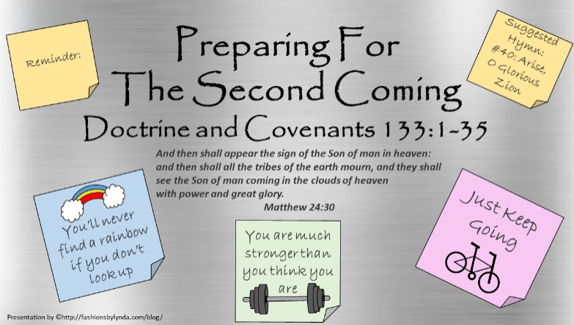

Slide 2

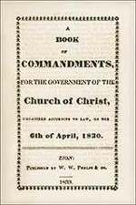
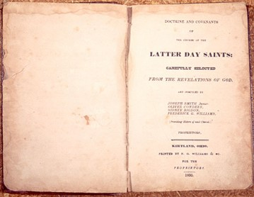
Background
On November 3, 1831, two days after the Lord directed Joseph Smith to publish the Book of Commandments, the Prophet received the revelation recorded in Doctrine and Covenants 133.
This revelation was included in the 1835 edition of the Doctrine and Covenants as section 100 and was designated as the book’s appendix
Those who were working with the manuscript originally intended the revelation to be a bookend with section 1 to the revelations included in the 1835 edition.

Slide 3


TEST
TODAY
Study for test
Have you ever been at school and realized that you have forgotten to prepare for a test?
How do you feel when you know you have prepared well for a test?

Slide 4

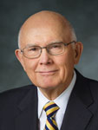
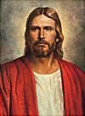
“Today I have felt prompted to speak of the importance of preparation for a future
event of supreme importance to each of us— _________________________”
The Second Coming of the Lord
Jesus Christ invites us to prepare for His Second Coming.
Elder Dallin H. Oaks“ Preparation for the Second Coming,” Ensign or Liahona, May 2004, 7.)

Slide 5
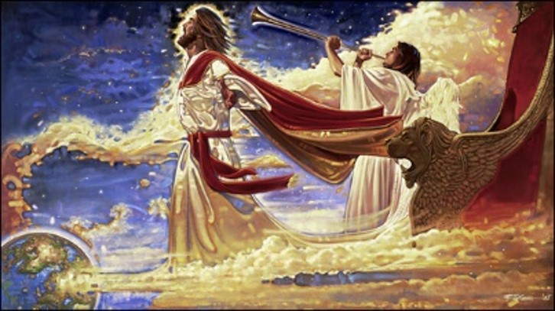
Expression of recognition of the Lord for those who have made a covenant with Him
Hearken, O ye people of my church
Suddenly come
He shall appear to take vengeance on the wicked
“make bare his holy arm”
The Lord revealing His strength and power to the world
At His Second Coming, Jesus Christ will come in judgment against the ungodly
D&C 133:1-3

Slide 6
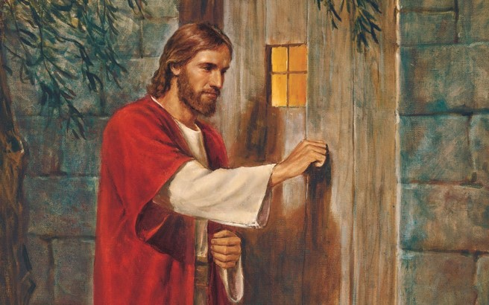
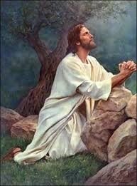
Preparation For The Second Coming
“This preparation demands first that a people, to receive the coming of the Lord, must be taught the personality and the nature of God and his Son, Jesus Christ.
“… How can one meet a person whose identity is unknown? How can one be prepared to meet a person about whom he has no knowledge? How can one be prepared to meet a being whose personality he cannot comprehend? …
“To my thinking, another requisite of that preparation to receive the Lord at the beginning of his millennial reign demands that the people be taught to accept the divinity of the mission of Jesus as the Savior of the world [see Alma 11:37, 40]. …
“… We must accept the divine mission of the Prophet Joseph Smith as the instrumentality through which the restoration of the gospel and the organization of the Church of Jesus Christ was accomplished. Each member of the Church, to be prepared for the millennial reign, must receive a testimony, each for himself, of the divinity of the work established by Joseph Smith.”
D&C 133:4 President Harold B. Lee

Slide 7
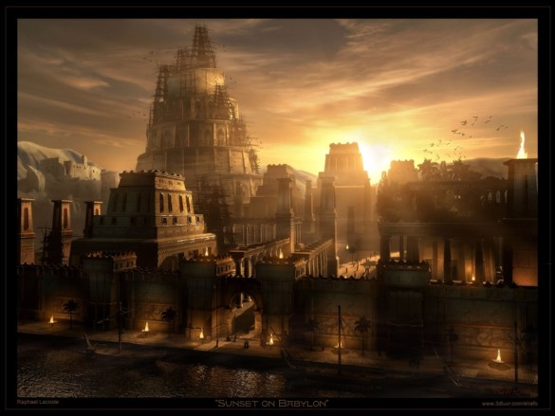
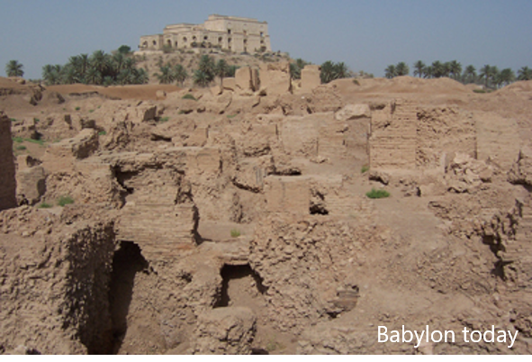
Babylon—Get Thee Out
"Lech lecha" is variously translated as "Get thee out,"
Used as a symbol of worldliness
The ancient city had the reputation of being the first where men combined against God with the deliberate goal of frustration and wresting control from him.
The city of Babylon was originally Babel, of Tower of Babel fame, and later became the capital of the Babylonian empire.
Zion is both a place and a people.
Babylon is both a place and a people
The antithesis and antagonist of Zion is Babylon
How do we get ourselves out of Babylon?
D&C 133:5 Elder D. Todd Christofferson

Slide 8
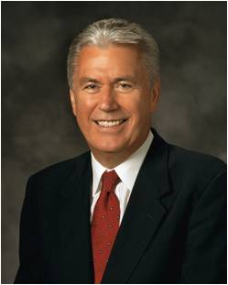
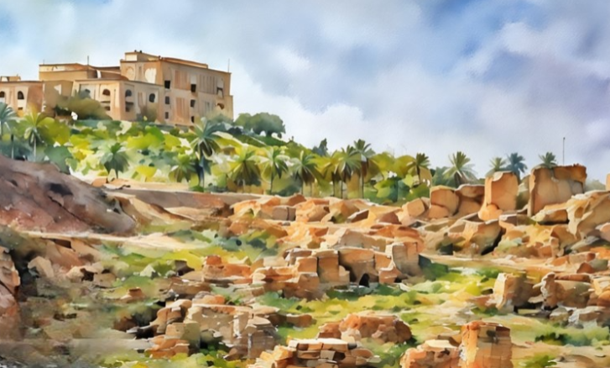
The ancient city of Babylon is in ruins. Its splendor is long gone.
But Babylon’s worldliness and wickedness live on. Now it falls to us to live as believers in a world of disbelief.
… We will have to stay calm under peer pressure, not be impressed by popular trends or false prophets, disregard the ridicule of the ungodly, resist the temptations of the evil one, and overcome our own laziness.
Dieter F. Uchtdorf

Slide 9
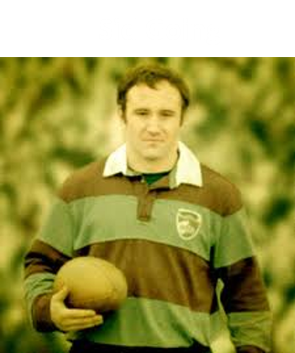
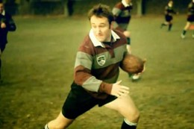
Send Forth Elders
A Sacrifice of Service
In 1961, at age 18 and holding the Aaronic Priesthood, Sidney Going was becoming a star in New Zealand rugby.
Because of his remarkable abilities, many thought he would be chosen the very next year for the national All Blacks rugby team.
For Sid it was not what he was leaving behind—it was the opportunity and responsibility ahead. He had a priesthood duty to offer two years of his life to declare the reality of the Lord Jesus Christ and His restored gospel.
Nothing—not even a chance to play on the national team, with all the acclaim it would bring—would deter him from that duty.
He was called by a prophet of God to serve in the Western Canadian Mission. Forty-eight years ago this month, 19-year-old Elder Sidney Going left New Zealand to serve as a missionary for The Church of Jesus Christ of Latter-day Saints.
D&C 133:8

Slide 10
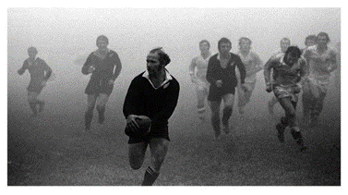
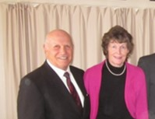
The Blessings
“The blessing of [bringing others] into the gospel far outweighs anything [you] will ever sacrifice.”
You’re probably wondering what happened to Sid Going following his mission.
Most important: an eternal marriage to his sweetheart, Colleen; five noble children; and a generation of grandchildren.
He has lived his life trusting in his Father in Heaven, keeping the commandments, and serving others.
And rugby? After his mission Sid Going became one of the greatest halfbacks in All Blacks history, playing for 11 seasons and serving for many years as captain of the team.
In 2013, Going was appointed the president of the LDS Church's Hamilton New Zealand Temple. He had previously also been a bishop in the church.
D&C 133:8

Slide 11
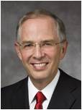
Prepared Through Missionaries
One of your important responsibilities is to help prepare the world for the Second Coming of the Savior. …
“Your mission will be a sacred opportunity to bring others to Christ and help prepare for the Second Coming of the Savior.
“… The world is being prepared for the Second Coming of the Savior in large measure because of the Lord’s work through His missionaries”
Elder Neil L. Andersen
Why do you think it is not enough to prepare only ourselves for the Second Coming?

Slide 12
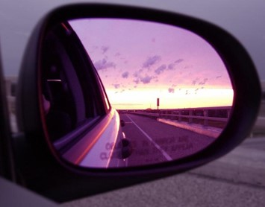
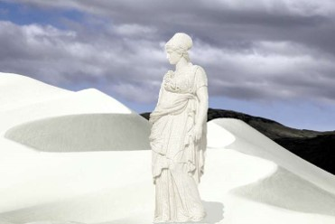
The Lord’s Warning
What do you think it means to “not look back” after we have removed ourselves from worldly influences?
Do Not Look Back
We “look back” when we attempt to forsake the world but then return to our former ways. Rather than allowing our hearts to change, we long for and then return to our previous lifestyle
Looking back keeps us faced toward Babylon…
“Never forget which way you face!”
Boyd K. Packer
If we return to wickedness and former sins, then we will not be prepared for the Second Coming of Jesus Christ.
D&C 133:15

Slide 13
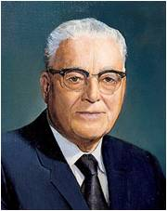
Mountain of the Lord
But in the last days it shall come to pass, that the mountain of the house of the Lord shall be established in the top of the mountains, and it shall be exalted above the hills; and people shall flow unto it.
Micah 4:1
“The expression ‘the mountain of the Lord’s house,’ as here indicated, was undoubtedly to be referred to as a place as well as a definition of a righteous people”
And it shall come to pass in the last days, that the mountain of the Lord’s house shall be established in the top of the mountains, and shall be exalted above the hills; and all nations shall flow unto it.
Isaiah 2:2
D&C 133:13

Slide 14
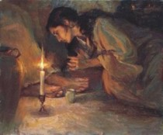
Repent
As we repent, we prepare to meet the Lord
Repentance is one of the first principles of the gospel and is essential to our temporal and eternal happiness. It is much more than just acknowledging wrongdoings.
It is a change of mind and heart that gives us a fresh view about God, about ourselves, and about the world. It includes turning away from sin and turning to God for forgiveness.
It is motivated by love for God and the sincere desire to obey His commandments.
Repentance requires both turning away from evil and turning to God
When thou art in tribulation, and all these things are come upon thee, even in the latter days, if thou turn to the Lord thy God, and shalt be obedient unto his voice;
Deuteronomy 1:4
D&C 133:16 Gospel Topics and Elder Neal A. Maxwell

Slide 15
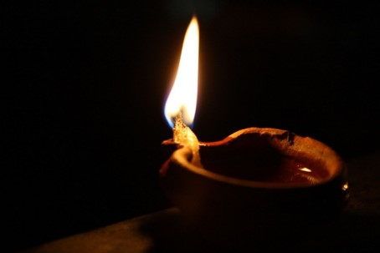
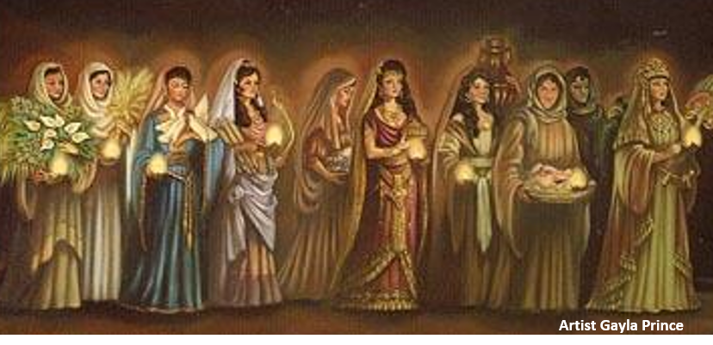
The Coming of the Bridegroom
Matthew 25:12-13
Go ye out to meet him
All ten were invited to the wedding feast, but only half of them were prepared with oil in their lamps when the bridegroom came.
The five who were prepared went into the marriage feast, and the door was shut. The five who had delayed their preparations came late.
The door had been closed, and the Lord denied them entrance, saying, “I know you not”
“Watch therefore,” the Savior concluded, “for ye know neither the day nor the hour wherein the Son of man cometh”
D&C 133:19 Elder Dallin H. Oaks

Slide 16
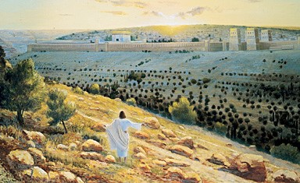
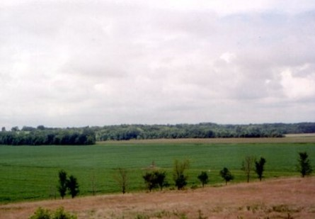
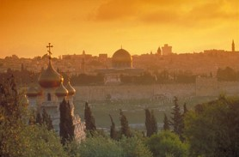
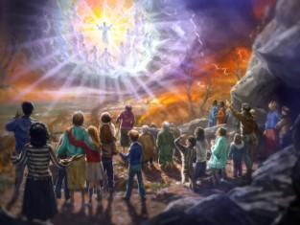
Appearances of the Lord
1. The appearance at the temple in the city of New Jerusalem (D&C 84:1–5; 97:10, 15–16; 133:2)
2. The appearance at Adam-ondi-Ahman
(Daniel 7:9–14; D&C 107:53–57; 116:1).
3. The appearance at the Mount of Olives.
(Zechariah 14:1–9; D&C 45:48–53; 133:20).
4. The appearance to the whole world.
( D&C 88:95; 101:23–25; 133:40–42, 48–51).
D&C 133:20-22

Slide 17
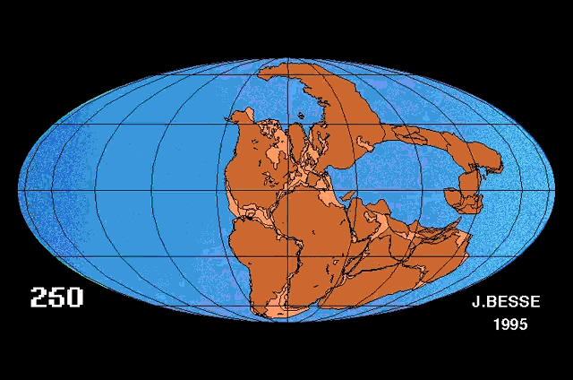
Genesis indicates that in the early history of the world the land masses were united. Moses recorded that one of the great-great-grandsons of Shem was named Peleg (a Hebrew word meaning division) because “in his days was the earth divided” (Genesis 10:25).
An article published early in the history of the Church under the direction of the Prophet Joseph Smith stated:
“The Eternal God hath declared that the great deep shall roll back into the north countries and that the land of Zion and the land of Jerusalem shall be joined together, as they were before they were divided in the days of Peleg.
Many scholars have passed this reference off as meaning some sort of cultural or political division, but modern prophets have taught that this statement should be taken literally.
No wonder the mind starts at the sound of the last days!”
(“The Last Days,” Evening and Morning Star, Feb. 1833, p. 1.)
D&C 133:23-24 Student Manual

Slide 18
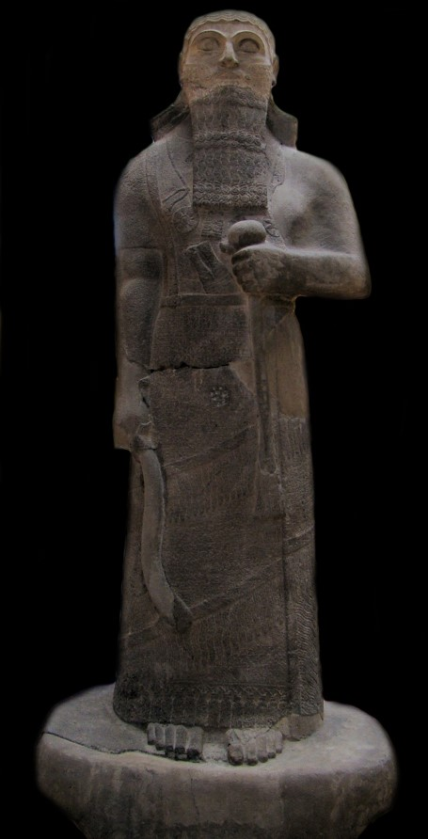
The Tribe of Judah
“When Shalmanezer overran the Kingdom of Israel(about 721 B.C.), he carried the Ten Tribes comprising that kingdom captive into Assyria.
From thence they were led into the lands of the north and have been called the Lost Tribes because they are lost to the knowledge of other people. (1 Ne. 22:4.)
‘We have no knowledge of the location or condition of that part of the Ten Tribes who went into the north country.”
D&C 133:26-34 Bruce R. McConkie

Slide 19
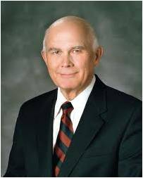
Tomorrow?
What confessions would we make?
What practices would we discontinue?
What accounts would we settle?
What forgivenesses would we extend?
What testimonies would we bear?
If we would do those things then, why not now?
Why not seek peace while peace can be obtained?
Dallin H. Oaks
What if the day of His coming were tomorrow?
If we knew that we would meet the Lord tomorrow—through our premature death or through His unexpected coming—what would we do today?

Slide 20
Sources:
Videos:
“Go Ye Out of Babylon” (2:27)
“Your Day For A Mission” (3:31)
Help Prepare for the Second Coming (0:32)
Prepare Today for the Second Coming (1:07)
“Men’s Hearts Shall Fail Them” from time code 0:00 to 0:54.
Elder D. Todd Christofferson Come to Zion October 2008 Gen. Conf.
President Harold B. Lee (In Conference Report, Oct. 1956, pp. 61–62.)
Pres. Boyd K. Packer quoted in Elder Lynn G. Robbins Which Way Do You Face? October 2014 Gen. Conf
President Harold B. Lee (“The Way to Eternal Life,” Ensign, Nov. 1971, p. 15).
Elder Neal A. Maxwell Repentance October 1991 Gen. Conf. and (“Preparing the World for the Second Coming,” Ensign or Liahona, May 2011, 49, 50, 51).
Presentation by ©http://fashionsbylynda.com/blog/
Dallin H. Oaks Preparation for the Second Coming April 2004
Doctrine and Covenants Student Manual Religion 324-325 Section 133
Bruce R. McConkie (Compendium. p. 88.)
Dieter F. Uchtdorf, “Be Not Afraid, Only Believe,” Ensign or Liahona, Nov. 2015, 77–78)
Dallin H. Oaks, “Preparation for the Second Coming,” Ensign or Liahona, May 2004, 9)
Presentation by ©http://fashionsbylynda.com/blog/

Slide 21
D&C 133:2 Elder Orson Pratt said: “We read in the scriptures of divine truth that the Lord our God is to come to his temple in the last days. … It is recorded in the 3rd chapter of Malachi that ‘the Lord whom ye seek shall suddenly come to his temple.’ This had no reference to the first coming of the Messiah, to the day when he appeared in the flesh; but it has reference to that glorious period termed the last days, when the Lord will again have a house, or a temple reared up on the earth to his holy name.” (In Journal of Discourses, 14:274.)
Several Appearances of the Lord:
Elder Charles W. Penrose explained that Christ will make several appearances, namely, to the Saints gathered to Zion, to the Jews gathered back to their homeland, and to the rest of the world:
“Among the first-mentioned of these three classes of men [that is, among the Saints in Zion] the Lord will make his appearance first; and that appearance will be unknown to the rest of mankind. He will come to the Temple prepared for him, and his faithful people will behold his face, hear his voice, and gaze upon his glory. From his own lips they will receive further instructions for the development and beautifying of Zion and for the extension and sure stability of his kingdom.
“His next appearance will be among the distressed and nearly vanquished sons of Judah. At the crisis of their fate, when the hostile troops of several nations are ravaging the city and all the horrors of war are overwhelming the people of Jerusalem, he will set his feet upon the Mount of Olives, which will cleave and part asunder at his touch. Attended by a host from heaven, he will overthrow and destroy the combined armies of the Gentiles, and appear to the worshipping Jews as the mighty Deliverer and Conqueror so long expected by their race; and while love, gratitude, awe, and admiration swell their bosoms, the Deliverer will show them the tokens of his crucifixion and disclose himself as Jesus of Nazareth, whom they had reviled and whom their fathers put to death. Then will unbelief part from their souls, and ‘the blindness in part which has happened unto Israel’ be removed. ‘A fountain for sin and uncleanness shall be opened to the house of David and the inhabitants of Jerusalem,’ and ‘a nation will be born’ unto God ‘in a day.’ They will be baptized for the remission of their sins, and will receive the gift of the Holy Ghost, and the government of God as established in Zion will be set up among them, no more to be thrown down for ever.
“The great and crowning advent of the Lord will be subsequent to these two appearances; but who can describe it in the language of mortals? The tongue of man falters, and the pen drops from the hand of the writer, as the mind is rapt in contemplation of the sublime and awful majesty of his coming to take vengeance on the ungodly and to reign as King of the whole earth.” (“The Second Advent,” Millennial Star,10 Sept. 1859, pp. 582–83.)
The Mountain of the Lord’s house:
Elder Erastus Snow said: “‘The mountain of the Lord’s house’—this is a peculiar phrase, and was probably used by the Prophet because it was a common mode of expression in Israel in the days of David and many of the Prophets several hundred years after him, for, in speaking of Mount Moriah, on which the Temple of Solomon was built, they spoke of it as the mountain of the Lord’s house. Moriah is a hill in the city of Jerusalem, on which David located the site of the Temple, and on which his son Solomon built it, and it was called the mountain of the house of the Lord.” (In Journal of Discourses, 16:202.)
Continents Rejoined:
President Joseph Fielding Smith wrote: “If … the earth is to be restored as it was in the beginning, then all the land surface will again be in one place as it was before the days of Peleg, when this great division was accomplished. Europe, Africa, and the islands of the sea including Australia, New Zealand, and other places in the Pacific must be brought back and joined together as they were in the beginning.” (Answers to Gospel Questions, 5:74.)
“The Lost Tribes are not lost unto the Lord. In their northward journeyings they were led by prophets and inspired leaders. They had their Moses and their Lehi, were guided by the spirit of revelation, kept the law of Moses, and carried with them the statutes and judgments which the Lord had given them in ages past. They were still a distinct people many hundreds of years later, for the resurrected Lord visited and ministered among them following his ministry on this continent among the Nephites. (3 Ne. 16:1–4; 17:4.) Obviously he taught them in the same way and gave them the same truths which he gave his followers in Jerusalem and on the American continent; and obviously they recorded his teachings, thus creating volumes of scripture comparable to the Bible and Book of Mormon. (2 Ne. 29:12–14.) “In due course the Lost Tribes of Israel will return and come to the children of Ephraim to receive their blessings. This great gathering will take place under the direction of the President of The Church of Jesus Christ of Latter-day Saints, for he holds the keys. … Keys are the right of presidency, the power to direct; and by this power the Lost Tribes will return, with ‘their prophets’ and their scriptures to ‘be crowned with glory, even in Zion, by the hands of the servants of the Lord, even the children of Ephraim.’ (D. & C. 133:26–35.)” (Mormon Doctrine, 2nd ed. [1966], 457–58; see also Doctrine and Covenants Student Manual, 2nd ed. [Church Educational System manual, 2001], 340–41). Bruce R. McConkie

Slide 22
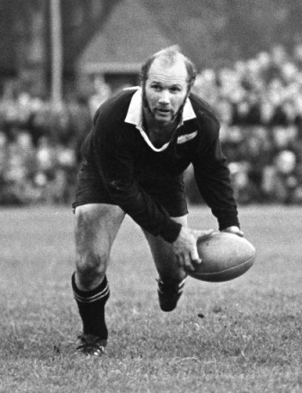
Sid Going:
Missionary service requires sacrifice. There will always be something you leave behind when you respond to the prophet’s call to serve.
Those who follow the game of rugby know that the New Zealand All Blacks, a name given because of the color of their uniform, is the most celebrated rugby team ever. To be selected for the All Blacks in New Zealand would be comparable to playing for a football Super Bowl team or a World Cup soccer team.
In 1961, at age 18 and holding the Aaronic Priesthood, Sidney Going was becoming a star in New Zealand rugby. Because of his remarkable abilities, many thought he would be chosen the very next year for the national All Blacks rugby team.
At age 19, in this critical moment of his ascending rugby career, Sid declared that he would forgo rugby to serve a mission. Some called him crazy. Others called him foolish. They protested that his opportunity in rugby might never come again.
For Sid it was not what he was leaving behind—it was the opportunity and responsibility ahead. He had a priesthood duty to offer two years of his life to declare the reality of the Lord Jesus Christ and His restored gospel. Nothing—not even a chance to play on the national team, with all the acclaim it would bring—would deter him from that duty.
He was called by a prophet of God to serve in the Western Canadian Mission. Forty-eight years ago this month, 19-year-old Elder Sidney Going left New Zealand to serve as a missionary for The Church of Jesus Christ of Latter-day Saints.
Sid told me of an experience he had on his mission. It was evening, and he and his companion were just about to return to their apartment. They decided to visit one more family. The father let them in. Elder Going and his companion testified of the Savior. The family accepted a Book of Mormon. The father read all night. In the next week and a half he read the entire Book of Mormon, the Doctrine and Covenants, and the Pearl of Great Price. A few weeks later the family was baptized.
A mission instead of a place on the New Zealand All Blacks team? Sid responded, “The blessing of [bringing others] into the gospel far outweighs anything [you] will ever sacrifice.”
You’re probably wondering what happened to Sid Going following his mission. Most important: an eternal marriage to his sweetheart, Colleen; five noble children; and a generation of grandchildren. He has lived his life trusting in his Father in Heaven, keeping the commandments, and serving others.
And rugby? After his mission Sid Going became one of the greatest halfbacks in All Blacks history, playing for 11 seasons and serving for many years as captain of the team.
Preparing the World for the Second Coming
Neil L. Andersen April 2011
https://www.lds.org/pages/mormon-messages?lang=eng#your-day-for-a-mission
"The greatest match winner Rugby has known, Sid Going, M.B.E. halfback extraordinary. Fellow All Black Grant Batty said of him in 1977. He was and still is the greatest Rugby player in the world. " Super Sid, " The Story Of A Great All Black, was written by Bob Howitt Sid Going, the great All Black half back was born on August 19 1943 in Kawakawa New Zealand. He was a Maori rugby player, who his fans called Super Sid, and one of three brothers, all of whom were All Blacks.
Sid served a mission in Canada. Going was honored with an MBE (Member of the Order of the British Empire) in 1978 for his contributions to Rugby, and continued to be involved with the game after retiring that same year. He coached Northland secondary school teams from 1988 to 1992, and was selector-coach of the provincial side from 1993 to 1996.

