Slide 1
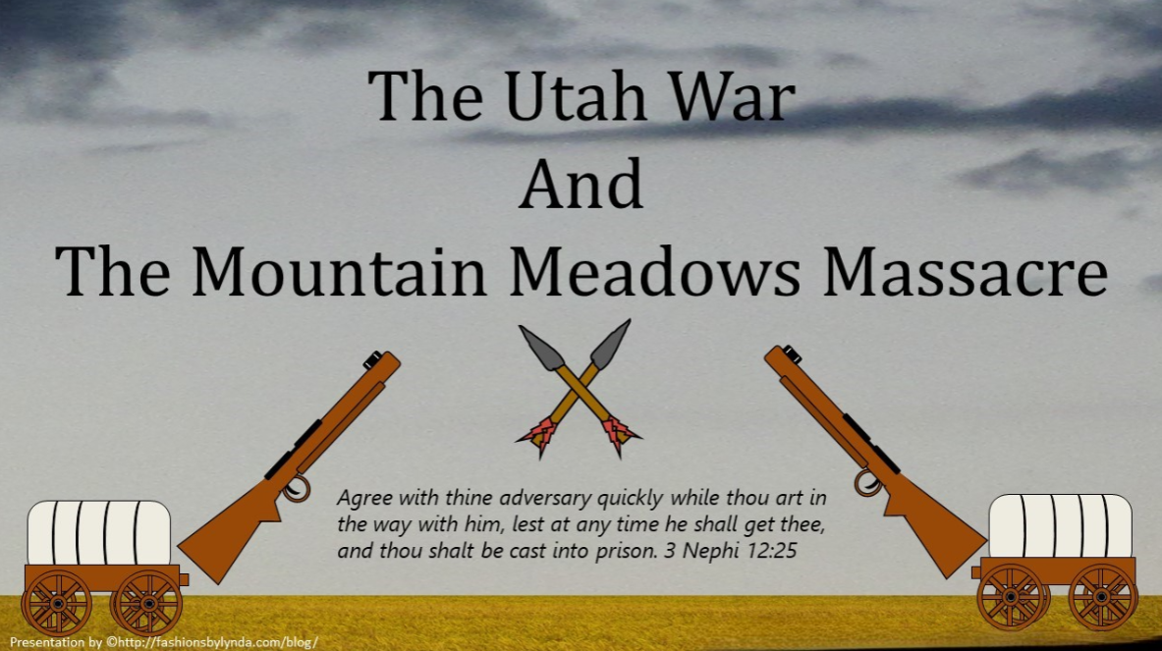

Slide 2
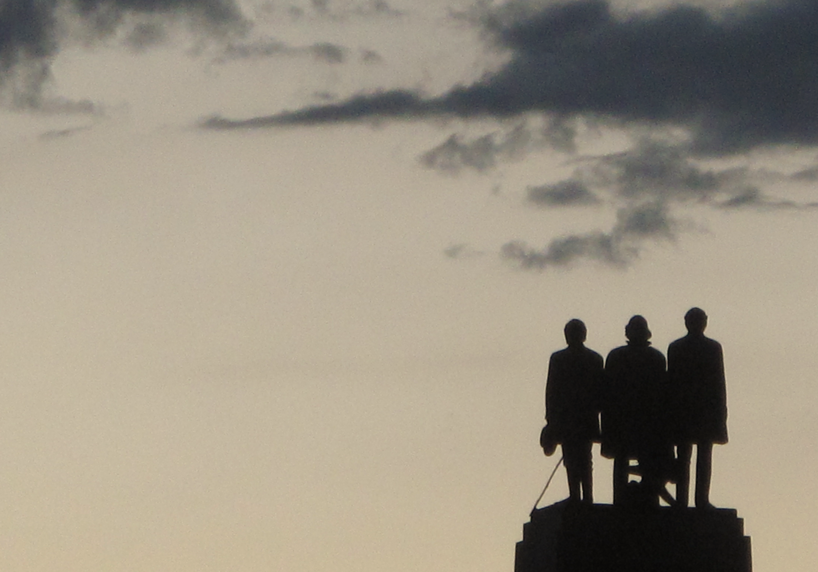
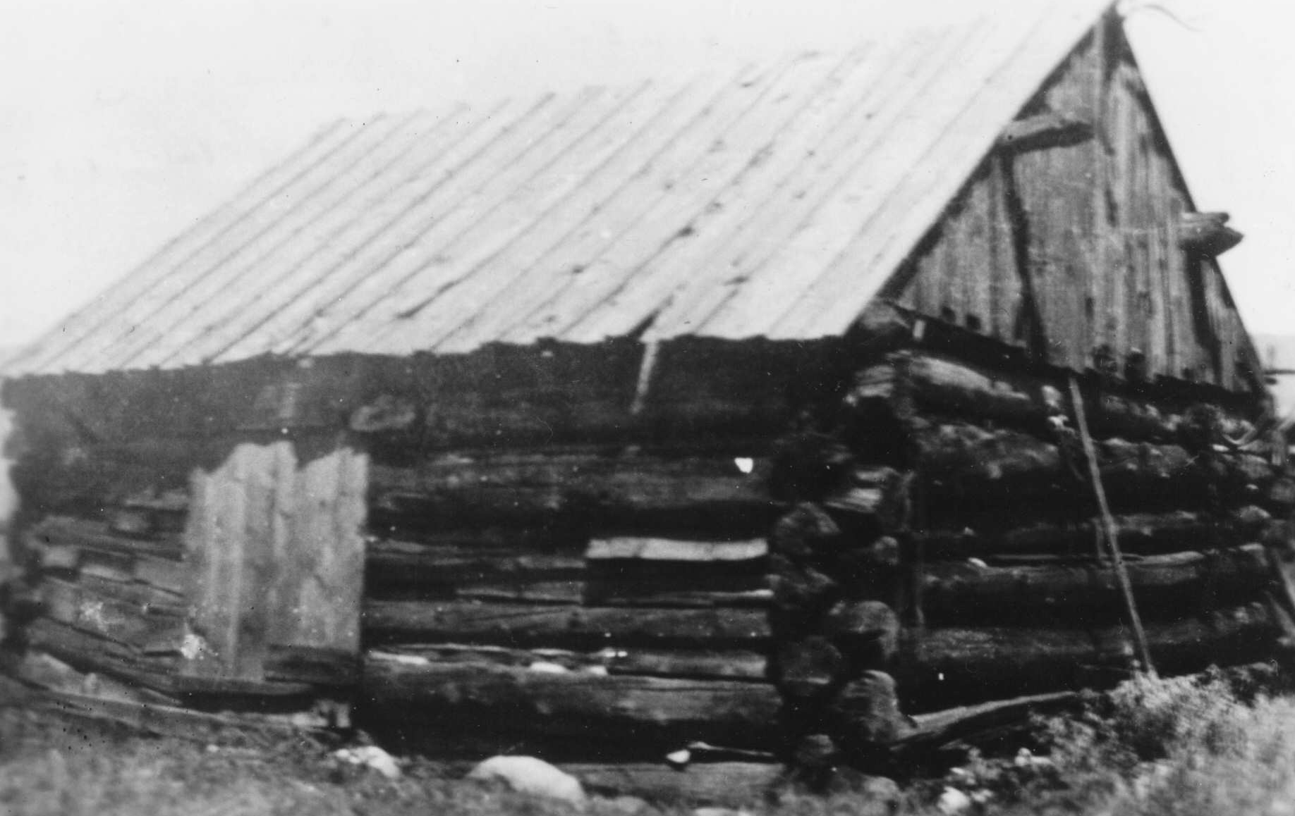
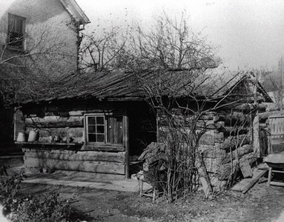
Lesson 151
Establishing Zion
When the Saints first arrived in the Salt Lake Valley, they were satisfied that they were isolated from their enemies and could build the kingdom of God in peace and safety.
“If the people of the United States will let us alone for ten years, we will ask no odds of them.” July 24, 1847—Brigham Young
First home built in Utah by John and Harriet Ellis at Woods Cross, Utah
With the sustaining help of the Lord and by their own industry, the Saints established a strong refuge within the ten years
First Home in Salt Lake
Student Manual

Slide 3
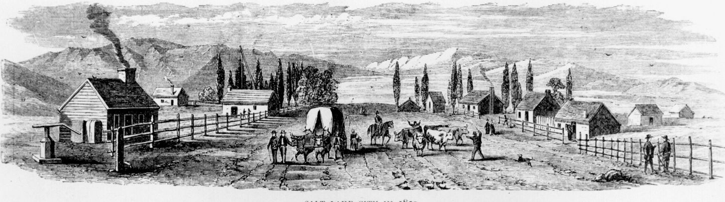
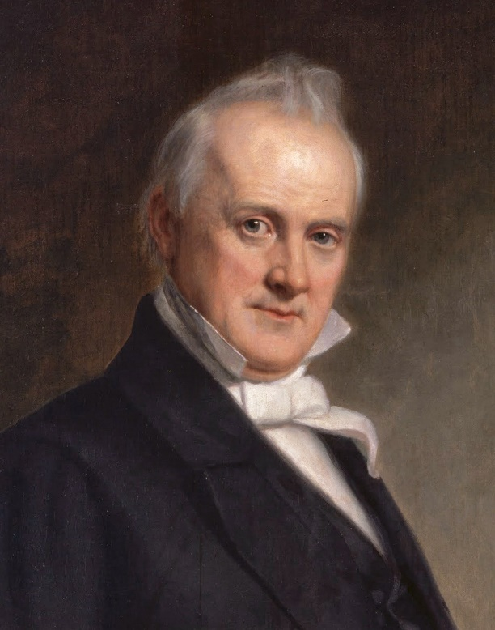
Saints Want Own Government
The Saints wanted to be governed by leaders of their own choosing and had rejected federal appointees who did not share their values.
That led some federal officials to consider them in rebellion against the United States government.
Without approval from Congress, United States President James Buchanan sent approximately 1,500 troops to Salt Lake City to force Utahn’s to accept new officials.
On July 24, 1857, President Brigham Young was with a group of Saints celebrating the 10th anniversary of their arrival in the Salt Lake Valley when he received confirmation of earlier news that an army was coming to Salt Lake City.
In previous years, disagreements and miscommunication had resulted in growing tension between the Latter-day Saints and officials of the United States government.

Slide 4
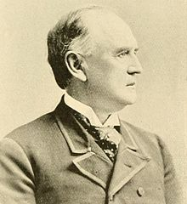
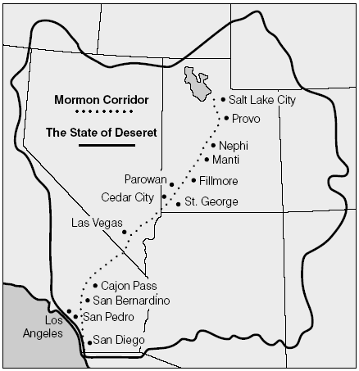
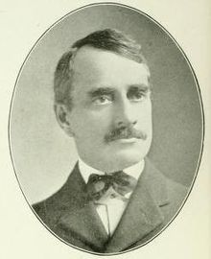
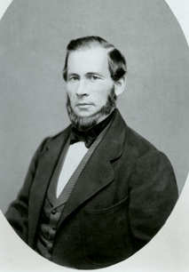
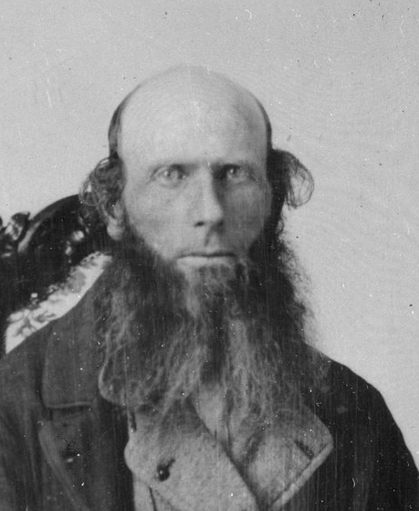
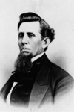
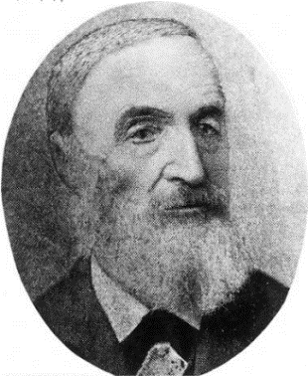
Lesson 151
Settlements Throughout Utah
Including Nevada and California
The appointees for the new territory of Utah were Brigham Young, governor and superintendent of Indian affairs; Broughton D. Harris of Vermont, secretary; Joseph Buffington of Pennsylvania, chief justice; Zerubbabel Snow of Ohio and Perry E. Brocchus of Alabama, associate justices; Seth M. Blair of Utah, U.S. attorney; Joseph L. Heywood of Utah, U.S. marshal; and Henry R. Day, Indian agent.
Broughton D. Harris
Joseph Buffington
Seth M. Blair
Perry E. Brocchus
Joseph L. Heywood
—founder of Nephi, Utah
Zerubbabel Snow
Student Manual

Slide 5
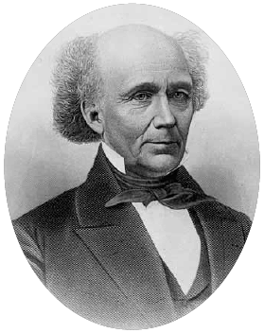
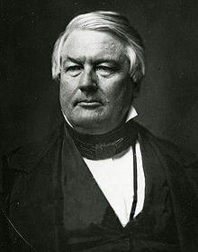
Lesson 151
Representatives
John M. Bernhisel (1799–1881) was born and raised in Pennsylvania. He studied medicine at the University of Pennsylvania. After joining the Church he was called to serve as a bishop in New York in 1841.
After the Saints had established a home in the Rocky Mountains, Bernhisel was chosen to represent them as a delegate to Congress. He served in this office for four consecutive terms (1851–59). He was reelected in 1861 and served until 1863, when he retired from public office.
Millard Fillmore
13th President of the US
Bernhisel’s skill as a lobbyist became particularly important as President Fillmore considered appointment of officers for the new territory. Meeting with the president, Bernhisel stated:
“The people of Utah cannot but consider it their right, as American citizens to be governed by men of their own choice, entitled to their confidence, and united with them in opinion and feeling.”
Student Manual

Slide 6
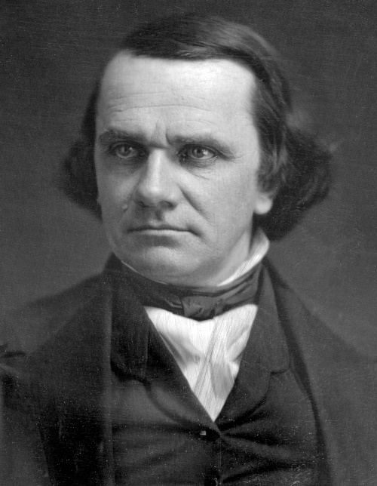
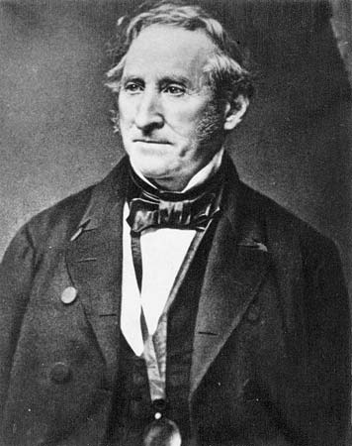
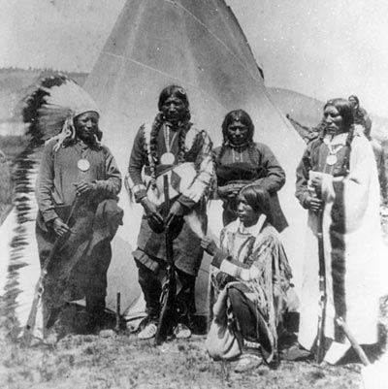
Lesson 151
Name Change
On 9 September 1850 President Millard Fillmore signed the bill creating the Utah Territory.
Senator Douglas decided to call for territorial status instead, to appease the South, which could not accept more senators from “free” states.
He also changed Deseret’s name to Utah (after the Ute Indians) to avoid offending his colleagues, particularly Senator Thomas Benton of Missouri, who thought Deseret sounded too much like desert.
Stephen Arnold Douglas
Friend of Joseph Smith and the Mormons
Senator Thomas Benton
Student Manual and Journal History of the Church

Slide 7
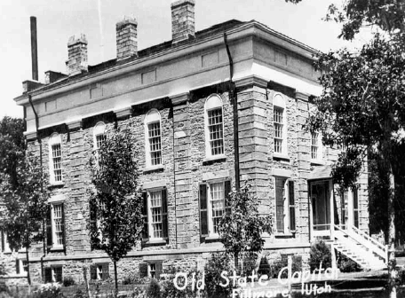
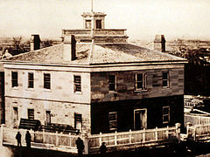
Lesson 151
Fillmore Chosen Capital of Utah
Named after Millard Fillmore
Initially the leaders of the Church preferred a geographically centralized location for the territorial capital. Thus, Fillmore was chosen in October 1851. The capitol building, designed by Truman O. Angell, was started in December 1851 with only the south wing being completed by March 1857.
The territorial legislature first met here in December 1855. Only the one session was held in Fillmore. It was decided to hold the legislative sessions in Salt Lake City until the federal government provided enough funds to complete the building.
In 1856, the legislature decided to move the Territorial Capital to the larger community of Salt Lake City.
Student Manual and Andrew Jenson
Council House where they held meetings in Salt Lake

Slide 8
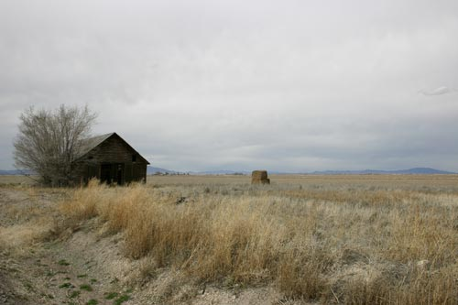
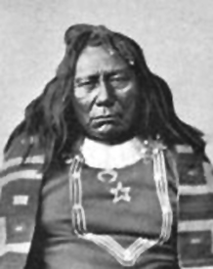
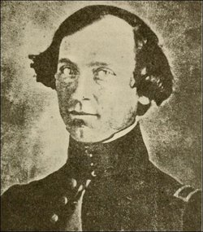
Gunnison Massacre
On May 3, 1853, Joe Williams Gunnison received orders to take charge of an expedition to survey a route for a Pacific railroad between the 38th and 39th parallels. The surveying party left St. Louis, Missouri in June 1853 and arrived by mid-October in Manti, Utah Territory. In Utah Territory, with Lieutenant E. G. Beckwith as assistant commander, Gunnison began the survey of a possible route, surveying areas across the Rocky Mountains.
The weather was beginning to turn "cold and raw" with snow flurries and Captain Gunnison sought to speed up mapping before returning to winter quarters.
At Lake Sevier, the team was divided into two detachments. On the morning of October 26, 1853, Gunnison and the eleven men in his party were attacked by a band of Pahvants (Ute.)
In the resulting massacre, Gunnison and seven of his men were killed. Several survivors of the attack alerted the other detachment of the survey team who rode to aid Gunnison and his party.
It seems that Gunnison had entered Utah in the midst of the Walker War, a sometimes bloody conflict between the Mormons and the Ute Chief Walkara.
Student Manual and Wikipedia

Slide 9
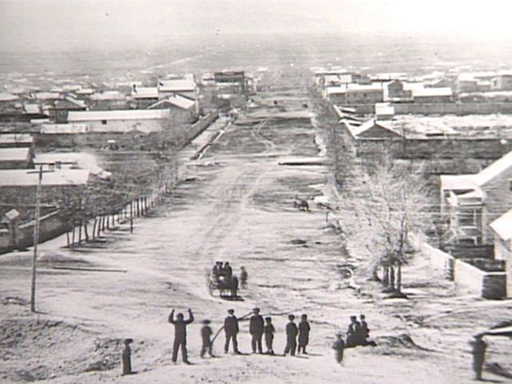
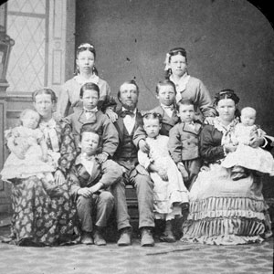
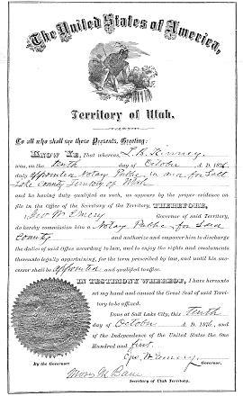
Army Coming
The Latter-day Saints considered themselves loyal American citizens and were indignant when they heard a large army was on its way west to put down a “Mormon rebellion.”
For the next few months the Saints prepared to defend themselves. Church leaders and members alike were unwilling to suffer oppression again.
Two issues were at the center of the Church’s conflict with the federal government: the Saints’ practice of plural marriage and the Church’s control of the Utah territorial government.
When Utah reapplied for statehood in 1856 and ran into stiff opposition, the “Mormon question” entered national politics.
Throughout the summer of 1857 many politicians of both major parties spoke out against the Latter-day Saints and their alleged wrongdoing.
Student Manual

Slide 10
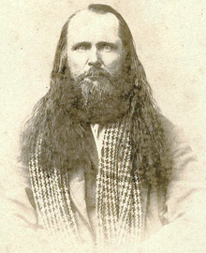
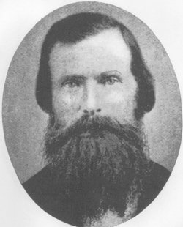
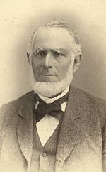
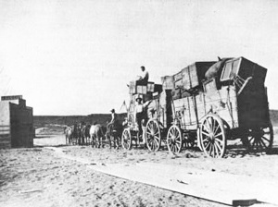
Supply Trains For the Army
On 1 July 1857, officials of Brigham Young’s mail delivery and express company, the Y. X. Company, stopped at the federal post office in Independence, Missouri, to pick up the mail.
En route they had become curious when they saw several supply trains heading west on the overland route
Abraham O. Smoot
Judson Lyman Stoddard
Porter Rockwell
Abraham O. Smoot, mayor of Salt Lake City and leader of this group of trusted Latter-day Saints, and his companions Porter Rockwell and Judson Stoddard, sped as quickly as possible to Salt Lake City with the news, arriving on 23 July and found Brigham Young celebrating the 24th in Big Cottonwood Canyon.
Student Manual

Slide 11
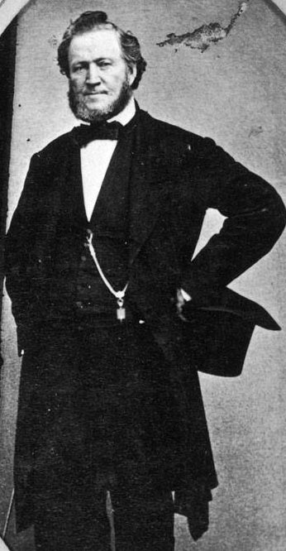
Response
“We are invaded by a hostile force, who are evidently assailing us to accomplish our overthrow and destruction. …
“… The government has not condescended to cause an investigating committee, or other persons to be sent, to inquire into and ascertain the truth, as is customary in such cases. …
“The issue which has thus been forced upon us, compels us to resort to the great first law of self-preservation, and stand in our own defense and right, guarantied unto us by the genius of the institutions of our country, and on which the government is based.
Our duties to ourselves and families requires us not to tamely submit to be driven and slain, without an attempt to preserve ourselves. Our duty to our country, our holy religion, our God, to freedom and liberty, requires that we shall not quietly stand still.”
Student Manual and “Citizens in Utah”

Slide 12
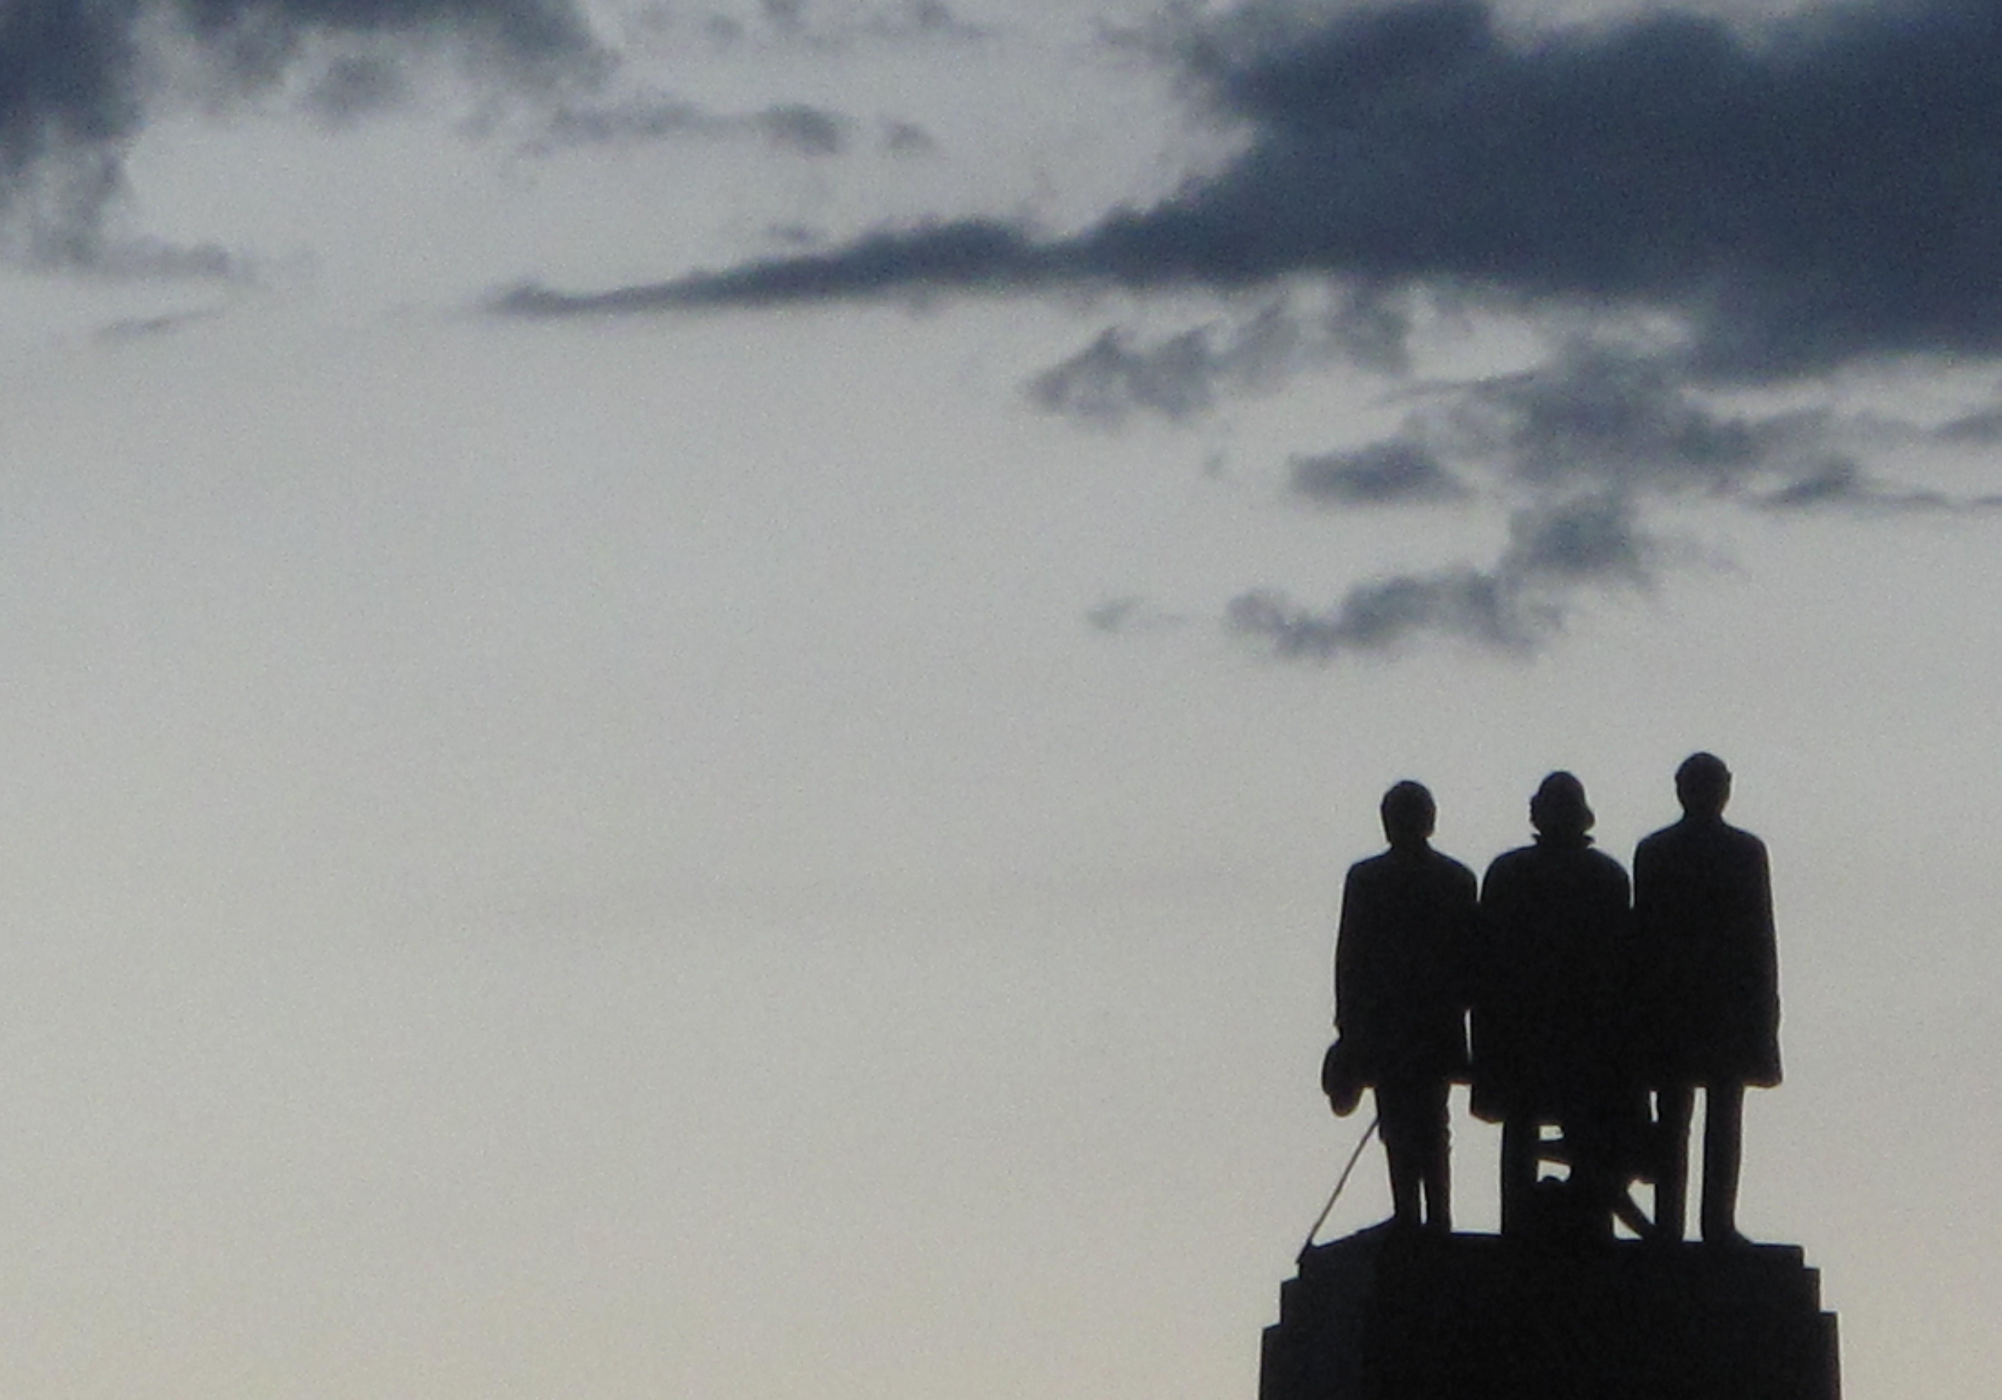
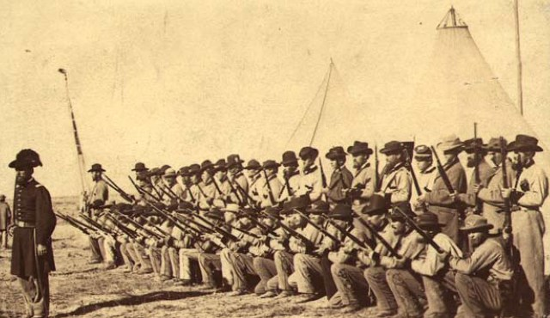
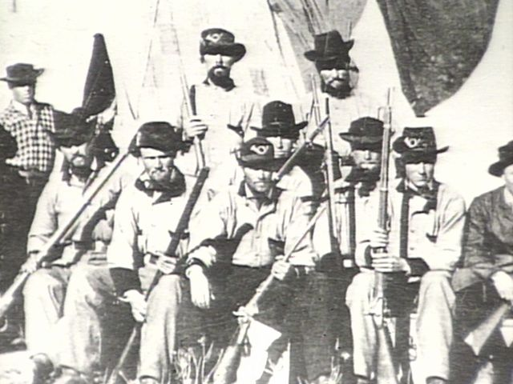
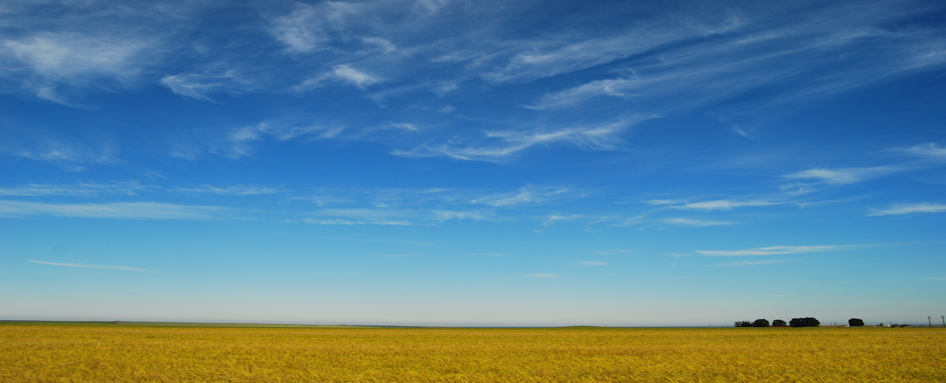
Lesson 151
Militia of Utah
Utah (Nauvoo) Legion
President Young, who for years had asked the Saints to save grain, renewed his instructions so they would have food to eat if they needed to flee from the troops.
Utah Territorial Militia
As governor of the Utah Territory, he also directed the territory’s militia to prepare to defend the territory.

Slide 13
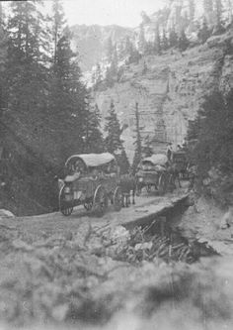
Lesson 151
Meanwhile
The tension and miscommunication between Latter-day Saints and officials of the United States government led to the Utah War of 1857–58.
Motivated by anger and fear, some Latter-day Saints in southern Utah planned and carried out the massacre of about 120 emigrants traveling to California. This atrocity is now known as the Mountain Meadows Massacre.
In September 1857, conflict also arose between some Latter-day Saints and members of an emigrant wagon train passing through Utah.
.

Slide 14
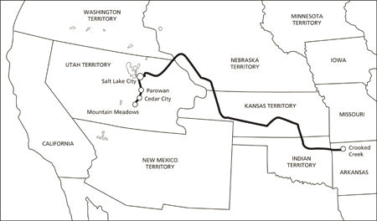
Lesson 151
Emigrant Wagon Train
Baker-Fancher Party
An emigrant wagon train traveling west from Arkansas to California entered Utah just as Latter-day Saints were preparing to defend the territory against the coming United States troops.
Some members of the wagon train became frustrated because they had a difficult time purchasing much-needed grain from the Saints, who had been instructed to save their grain.
The emigrants also came into conflict with Saints who did not want the wagon train’s horses and cattle to consume food and water resources the Saints needed for their own animals.

Slide 15
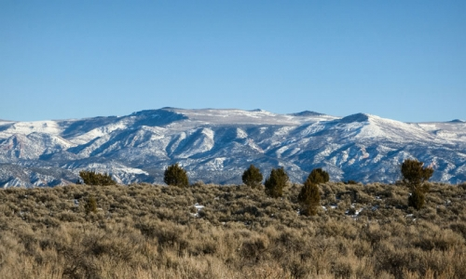
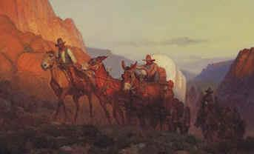
Lesson 151
Cedar City
Tensions erupted in Cedar City, the last settlement in Utah on the route to California.
Confrontations occurred between some members of the wagon train and some of the Latter-day Saints.
Some members of the wagon train threatened to join the incoming government troops against the Saints.
Even though the captain of the wagon train rebuked his companions for making these threats, some Cedar City leaders and settlers viewed the emigrants as enemies.
The wagon company left town only about an hour after arriving, but some of the settlers and leaders in Cedar City wanted to pursue and punish the men who had offended them.

Slide 16

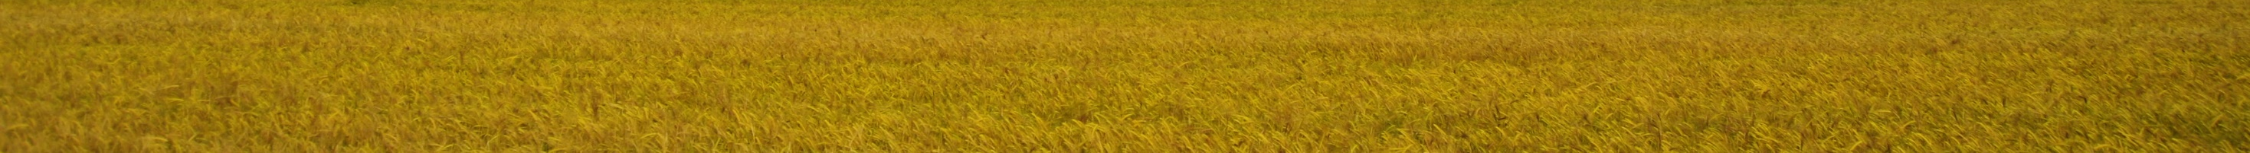
Lesson 151
Agree With Thine Adversary
“Resolve our differences early on, lest the passions of the moment escalate into physical or emotional cruelty, and we fall captive to our anger.”
Elder David E. Sorensen
If we resolve conflict with others in the Lord’s way, then we can avoid the harmful effects of contention

Slide 17
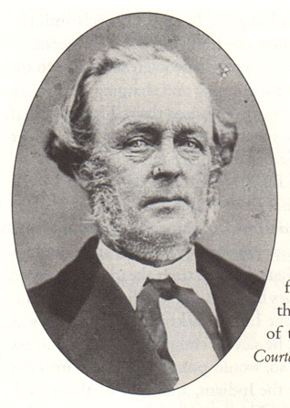
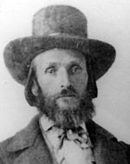
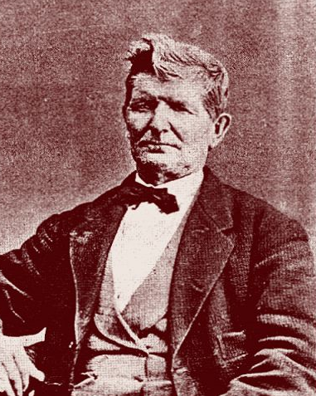
Lesson 151
The Conflict
Because these Saints did not resolve their conflict with the emigrants in the Lord’s way, the situation became much more serious. Isaac Haight, the Cedar City mayor, militia major, and stake president, requested permission from the militia commander, who lived in the nearby settlement of Parowan, to call out the militia to confront the offenders from the wagon train.
The militia commander, William Dame, counseled Isaac Haight to ignore the emigrants’ threats. Instead of yielding to this counsel, Isaac Haight and other Cedar City leaders decided to persuade some local Indians to attack the wagon train and steal their cattle as a way of punishing the emigrants. Isaac Haight asked John D. Lee, a local Church member and militia major, to lead this attack, and the two planned to blame Indians for the deed.
Haight was also lieutenant colonel in the Iron county militia
William H. Dame was a colonel and regimental commander of the Tenth Regiment and bishop of the Parowan Ward
John D. Lee
Local church member and Militia major

Slide 18
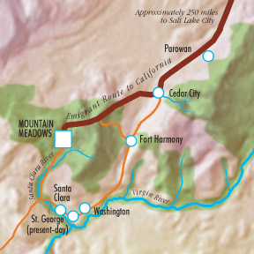
Lesson 151
Ignoring Council
That the rights of the priesthood are inseparably connected with the powers of heaven, and that the powers of heaven cannot be controlled nor handled only upon the principles of righteousness.
D&C 121:36
These men acted contrary to their priesthood responsibilities
That they may be conferred upon us, it is true; but when we undertake to cover our sins, or to gratify our pride, our vain ambition, or to exercise control or dominion or compulsion upon the souls of the children of men, in any degree of unrighteousness, behold, the heavens withdraw themselves; the Spirit of the Lord is grieved; and when it is withdrawn, Amen to the priesthood or the authority of that man.
D&C 121:37
If we ignore counsel to do what is right, then we become more susceptible to making poor choices

Slide 19
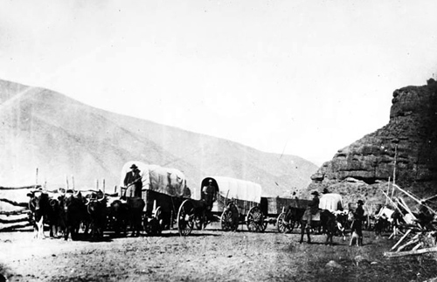
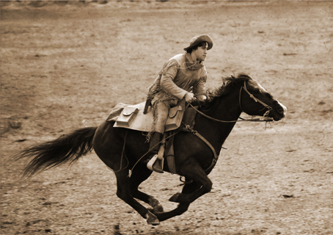
Lesson 151
Planning an Attack
Isaac Haight presented the plan to attack the wagon train to a council of local leaders in the Church, community, and militia.
Some council members strongly disagreed with the plan and asked Haight if he had consulted with President Brigham Young about the matter.
Saying he had not, Haight agreed to send a messenger, James Haslam, to Salt Lake City with a letter explaining the situation and asking what should be done.
However, because Salt Lake City is approximately 250 miles from Cedar City, it would require about a week of hard riding on horseback for the messenger to reach Salt Lake City and return to Cedar City with President Young’s instructions.

Slide 20
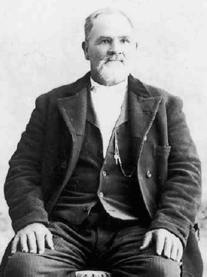
Lesson 151
“Too late, too late!”
Brigham's verbal answer: “go with all speed, spare no horse flesh. The emigrants must not be meddled with, if it takes all Iron county to prevent it. They must go free and unmolested.”
Excerpts from Brigham Young’s letter:
“In regard to emigration trains passing through our settlements we must not interfere with them until they are first notified to keep away. You must not meddle with them. The Indians we expect will do as they please, but you should try and preserve good feelings with them.”
Haslem returned by relay of horses, arriving at Cedar on Sunday the 13th of September and delivered his message from Governor Young to Isaac C. Haight, who as he read it, burst into tears and said: “Too late, too late!”
B.H. Roberts
James Holt Haslem
Isaac C. Haight

Slide 21
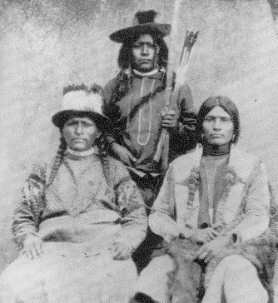
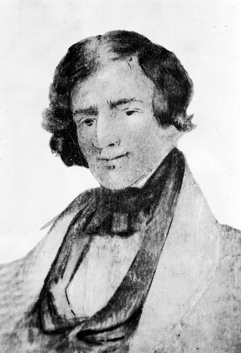
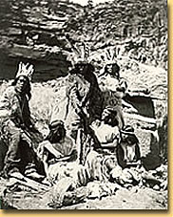
Lesson 151
Paiutes
The Southern Paiutes of Utah live in the southwestern corner of the state where the Great Basin and the Colorado Plateau meet.
Most scholars agree that the Paiutes entered Utah about A.D. 1100-1200.
Historically, the largest population concentrations of Paiutes were along the Virgin and Muddy rivers; other Paiutes adapted to a more arid desert environment that centered on water sources such as springs.
The first recorded contact between Utah Paiutes and Europeans occurred in 1776 when the Escalante-Dominguez party encountered Paiute women gathering seeds. In 1826-27 Jedediah Smith passed through Paiute country and established an overland route to California. Trappers, traders, and emigrants on their way to California soon followed. The increased presence of Europeans and their animals had serious effects on the Paiutes.
The animals of the emigrants
ate the grasses and often the
corn that served as food for
the Paiute. The Paiutes,
especially young women
and children, became
commodities as mounted
Utes and Navajos raided for
slaves to trade to the Europeans.
Although the Euro-American travelers posed a threat to the Paiutes, it was the arrival of the Mormons in the 1850s that destroyed their sovereignty and traditional lifestyle. The Mormons came to stay, and they settled in places that had traditionally served the Paiutes as foraging and camping areas. As a result, starvation and disease drastically reduced the Paiute population. Between 1854 and 1858 the Mormons conducted a fairly intensive missionary effort among the Paiutes.
Ronald L. Holt Utah History Encyclopedia

Slide 22

Lesson 151
Concealing The Truth
Shortly before Isaac Haight sent his letter with the messenger, John D. Lee and a group of Indians attacked the emigrant camp at a place called the Mountain Meadows.
Lee led the attack but concealed his identity so that it would appear that only the Indians were involved.
Some of the emigrants were killed or wounded, and the remainder fought off their attackers, forcing Lee and the Indians to retreat. The emigrants quickly pulled their wagons into a tight circle, or corral, for protection. Two additional attacks followed during a five-day siege on the wagon train.

Slide 23


Lesson 151
The Baker-Fancher Party
Fifty-two years old at the time, Jack Baker decided to travel with the Fancher Party, as did his son Abel Baker.
1 April 1857, Jack Baker departed from Carroll County, Arkansas.
According to Mountain Meadows Massacre survivor Nancy Sophronia Huff, Captain John Twitty Baker "had me in his arms when he was shot down, and fell dead" on 11 September 1857.
He was 52 years old when he died. Jack Baker's son Abel Baker, son George Washington Baker, daughter-in-law, Minerva Ann (Beller) Baker, granddaughter Mary Lovina Baker, daughter Sarah C. (Baker) Mitchell, son-in-law, Charles Roark Mitchell, and infant grandson John Mitchell, all died in the Mountain Meadows Massacre.
Three of his grandchildren, Martha Elizabeth Baker, Sarah Frances Baker, and William Twitty Baker, survived the Massacre and were returned to Jack Baker's widow, Mary A. (Ashby) Baker, in Carroll County, Arkansas in 1859.
Christopher Kit Fancher (survivor of the Mountain Meadows massacre)
Martha Elizabeth Baker Terry

Slide 24

Lesson 151
He Held Me In His Arms
"I am the daughter of Peter Huff; my mother’s maiden name was Salidia Brown, daughter of Alexander Brown of Tennessee. I was born in Benton County, Arkansas, in 1853. My father started to move from that county in the spring of 1857, with the ill fated train bound for California. I was then a little past four years old. I can recollect my father and mother very well, as well as many little incidents that occurred about that time -- our travels on the road, etc. I recollect passing through Salt Lake City, and passing through other places, and I recollect we were in a small prairie. One morning before day I was woke up by the firing of guns, and learned that our camp had been attacked, we suppose, by Indians. Some of the men folk were wounded. The men dug a ditch around our camp, and fortified the best they could. The women and children got in the ditches, and were comparatively out of danger.
“Captain Baker had me in his arms when he was shot down, and fell dead.”
Nancy Sophrona Huff Cate—she was 4 years old at the time

Slide 25



Lesson 151
Fate of the Children
“Too young to tell tales”
“The children that were saved were distributed among the settlers, but two years later they were gathered up by M. Jacob Forney, who was the Indian agent for the territory of Utah in 1857, and were sent east where congress having in the meantime appropriated the sum of $10,000 for their recovery and restoration:”
B.H. Roberts
Seventeen of the children under the age of 6 were later reclaimed by the U.S. Army and returned to relatives in Arkansas.
^{Wikipedia}
Jacob Forney

Slide 26

Lesson 151
Trial of John D. Lee
The 1st trial of John D. Lee opened on July 23, 1875 before U. S. District Judge Jacob Boreman in Beaver, Utah.
U. S. attorneys William C. Carey and Robert Baskin managed the prosecution.
It was a hung jury and Lee was acquitted.
The second trial began on September 14, 1876, soon after the prosecution dropped all charges against William Dame.
Sumner Howard replaced William Carey as the U. S. Attorney for Utah.
September 20, 1876, at 3:30 in the afternoon in Beaver.
John Lee was guilty of murder in the first degree.
John D. Lee
Ronald L. Holt Utah History Encyclopedia

Slide 27

Lesson 151
The Fate of John D. Lee
When asked by Judge Boreman if he wished to say anything prior to sentencing, Lee remained silent. Boreman sentenced Lee to be executed in three weeks. Lee told the judge, "I prefer to be shot."
Five months after Lee’s death, President Brigham Young Passed away on August 29, 1877
Appeals delayed Lee's scheduled execution over five months. Lee used much of the time to write his autobiography.
On a March afternoon in 1877 in Beaver, Utah, U. S. Marshal William Nelson led John Lee to a closed carriage that would take him south over the emigrant trail to Mountain Meadows.
On March 23, 1877 Lee, dressed in a red flannel shirt, sat down on the coffin while the Marshal read his death warrant. When the reading ended, he rose to address the federal officers, firing squad, and seventy or so spectators.
"Center my heart, boys! Don't mangle my body!"
When the shots came, he fell back without a cry.
Ronald L. Holt Utah History Encyclopedia

Slide 28


Lesson 151
The Choices We Make
The choices of some Latter-day Saint leaders and settlers in southern Utah Territory led to the tragic Mountain Meadows Massacre.
In contrast, Church and territory leaders in Salt Lake City resolved the conflict with the United States government through peace talks and negotiation in 1858.
During this conflict—later called the Utah War—the United States troops and Utah militiamen engaged in acts of aggression but never in battle.
The Mountain Meadows Massacre not only resulted in the deaths of about 120 victims, but it also caused great suffering to the surviving children and other relatives of the victims.
Paiute Indians also suffered from being unjustly blamed for the crime. In addition, those “who carried out the massacre labored the rest of their lives under a horrible sense of guilt and recurring nightmares of what they had done and seen” Richard E. Turley Jr.
Choosing to hide our sins can lead us to commit further sins.
Choosing to hide our sins can bring regret and suffering

Slide 29



Lesson 151
The Reputation of the Mormons
Because a number of local Latter-day Saints were responsible for planning and carrying out the Mountain Meadows Massacre, some people have allowed this event to negatively affect their view of the entire Church.
“The gospel of Jesus Christ that we espouse, abhors the cold-blooded killing of men, women, and children. Indeed, it advocates peace and forgiveness. What was done [at the Mountain Meadows] long ago by members of our Church represents a terrible and inexcusable departure from Christian teaching and conduct.”
President Henry B. Eyring

Slide 30


Lesson 151
Survivors of the Tragedy
James Sanders is a great-grandson of Nancy Saphrona Huff, one of the children who survived the massacre. “I still feel pain; I still feel anger and sadness that the massacre happened,”
“But I know that the people who did this will be accountable before the Lord, and that brings me peace.”
Brother Sanders, who serves as a family history consultant in his Arizona ward, said that learning his ancestor had been killed in the massacre
“didn’t affect my faith because it’s based on Jesus Christ, not on any person in the Church.”
Sharon Chambers of Salt Lake City is a great-granddaughter of child survivor Rebecca Dunlap.
“The people who did this had lost their way. I don’t know what was in their minds or in their hearts,” she said. “I feel sorrow that this happened to my ancestors. I also feel sorrow that people have blamed the acts of some on an entire group, or on an entire religion.”

Slide 31
Martial Law
In mid-September 1857 he proclaimed martial law in the territory and forbade the entry of armed forces.
He ordered the Nauvoo Legion to prepare for the invasion. And that no grain or other staple be sold to passing immigrants or speculators.
In nearly every Utah community, preparations for defense were accelerated. And instructed bishops in the villages to prepare to burn everything should hostilities actually break out.
He also selected raiding parties to harass the army and supply trains.
He sent a group known as the White Mountain Expedition to find another suitable location for the settlement, should the Saints have to abandon their homes.
Missionaries and settlers in distant colonies were called home to aid the defense.
All emigration plans for the next season were cancelled.
They covered up the foundation of the building of the temple.
Student Manual

Slide 32


Acting as “Snipers”
General Daniel H. Wells of the Nauvoo Legion sent about eleven hundred men east to Echo Canyon, which lay on the route through the mountains to Salt Lake City.
These soldiers built walls and dug trenches from which they could act as snipers.
They also loosened huge boulders that could easily be sent crashing down on the moving columns, and they constructed ditches and dams that could be opened to flood the enemy’s path.
General Daniel H. Wells
Philo Dibble, a hard-headed Mormon raider who survived a gunshot to the head, wrote his name on this rock along the Mormon Trail in Wyoming. He took part in many raids against Johnston's Army.
Student Manual

Slide 33


The Raid
Forty-four “Mormon raiders,” a unit of the Nauvoo Legion under the direction of Major Lot Smith, were sent to eastern Utah (now western Wyoming) to harass the oncoming troops.
They were instructed, among other things, “on ascertaining the locality or route of the troops, proceed at once to annoy them in every possible way.
Use every exertion to stampede their animals, and set fire to their trains.
Burn the whole country before them and on their flanks. Keep them from sleeping by night surprises. … Take no life, but destroy their trains, and stampede or drive away their animals, at every opportunity.”
Arlington
Major Lot Smith
--also served in the Mormon Battalion at age 16
James Parshall Terry
“I never saw a scareder lot in my life until they found that they was not going to be hurt. They laughed and said they was glad the wagons was going to be burnt as they would not have to bull whack any more, as they called it. The teamsters were permitted to take their private clothing and guns out of the wagons and then they were burnt.”
James Terry
Student Manual

Slide 34



The Delay Tactics
Major Smith’s raider succeeded in torching a total of seventy-four wagons, containing enough supplies to outfit the large army for three months.
They also captured fourteen hundred of the two thousand head of cattle accompanying the expedition.
Major Smith’s militia assisted in burning the two key Mormon outposts, Fort Bridger and Fort Supply, which government forces had expected to occupy.
Student Manual

Slide 35



The Stay in Camp Scott
These tactics succeeded so well in delaying the army that when its commanding officer, Colonel (soon to become General) Albert Sidney Johnston, finally joined his troops in early November, it was clearly too late in the season to reach Salt Lake City.
It took the army fifteen days to push thirty-five miles through storms and sub-zero weather to burned-out Fort Bridger.
Approximately twenty-five hundred American soldiers and several hundred civilian officials (including Governor Cumming and his wife), freighters, and camp followers spent a miserable winter in western Wyoming in a city of tents and improvised shelters called Camp Scott and in a newly created community named “‘Eckelsville,’ after the new chief justice of the territory.”
Governor Alfred Cumming
Replaces Brigham Young on April 12, 1858
Colonel Albert Sidney Johnston
Student Manual

Slide 36


The Stay in Camp Scott
After a long process of negotiations with the government, and the aid of Colonel Thomas Leiper Kane, Brigham Young allowed Alfred Cumming, who was appointed to be the new governor to enter into the city, however without the troops.
Governor Alfred Cumming
Replaces Brigham Young on April 12, 1858
In April Brigham Young delivered the territorial records and seal to the new governor, and after several meetings, good feelings were engendered.
He had the Saints move from the city
Thomas Leiper Kane
Student Manual

Slide 37

The Army Enters The City
On 26 June 1858 the army entered the quiet and mostly deserted capital city. As they marched they sang, “One Eyed Riley,” a coarse, yet long treasured, barracks ditty reported to have had a thousand verses, most of which are unprintable.
The band had to be commanded to stop and serenade Governor Cumming at his new home. Because they believed him to be sympathetic to the Latter-day Saints, they were less than enthusiastic in their performance.
Only a few Latter-day Saints had been left behind to set the torch to the city if the army did not respect its pledge to leave the property alone.
Philip St. George Cooke
Those Saints who were left behind saw Lieutenant Colonel Philip St. George Cooke take off his hat and place it over his heart as a gesture of respect for the soldiers he had led in the long march of the Mormon Battalion.
In the next few days General Johnston led his troops to Cedar Valley, west of Utah Lake, and established Camp Floyd, named after the Secretary of War.
On 1 July, Brigham Young authorized the return of the bedraggled Saints to their homes.
Student Manual

Slide 38




Utah Becomes a state
January 4, 1896
Utahns tried and tried—for almost 50 years—to win statehood
The choir sings in the tabernacle to celebration Utah’s statehood
The pen Grover Cleveland used to sign the Enabling Act, permitting Utahns to "form a Constitution and be admitted into the Union on an equal footing with the other States."
http://ilovehistory.utah.gov/topics/government/statehood.html

Slide 39
Sources:
Videos:
Forgiveness: My Burden Was Made Light (8:24)
The Mountain of the Lord (30:04–34:02)
Brigham Young Journal Discourses pg. 5:226
Student Manual The Fulness of Times Church History Chapter 28
Elder David E. Sorensen (“Forgiveness Will Change Bitterness to Love,” Ensign or Liahona, May 2003, 11).
Name change: Journal History of The Church of Jesus Christ of Latter-day Saints, 5, 21, 27 Mar. 1850, Historical Department, Salt Lake City.
Jenson, Andew. Encyclopedic History of the Church of Jesus Christ of Latter-day Saints. (Salt Lake City, Utah: Deseret News Press, 1941) p. 250
“Citizens of Utah,” Pioneer and Democrat, 1 Jan. 1858, p. 2.
In Arrington, Brigham Young: American Moses,p. 255.
James Parshall Terry, “Utah War Incidents,” inVoices from the Past: Diaries, Journals, and Autobiographies, Campus Education Week Program(Provo: Brigham Young University Press, 1980), p. 66.
Presentation by ©http://fashionsbylynda.com/blog/
Mountain Meadow Massacre: Statement of one of the Few Survivors, Daily Arkansas Gazette, September 1, 1875, Nancy Sophrona Huff Cate http://www.legendsofamerica.com/ut-mountainmeadowshistoricaccounts10.html
Jack Baker http://www.mtn-meadows-assoc.com/johntwittybaker.htm
B.H. Roberts History of the Church Vol. 4 pg. 151, 158
Richard E. Turley Jr., “The Mountain Meadows Massacre,” 20
President Henry B. Erying (“150th Anniversary of Mountain Meadows Massacre,”)
Sept. 11, 2007,mormonnewsroom.org/article/150th-anniversary-of-mountain-meadows-massacre).
http://mountainmeadowsmassacre.com/294/mountain-meadows-massacre-peace-and-violence-collide
Presentation by ©http://fashionsbylynda.com/blog/

Slide 40
The Council House, often called the State House, was the first public building in Utah; being constructed in 1849–50. The building stood in Salt Lake City, Utah Territory, on the corner of Main Street and South Temple Street. On June 21, 1883 the building was destroyed when a neighboring wagon depot caught fire and several barrels of gunpowder exploded, spreading the fire to the Council House. Wikipedia
Colonel Thomas Leiper Kane:
In March 1850, in the midst of debate over establishing Utah territory, Kane delivered an important lecture before the Philadelphia Historical Society. He described the religion of the Latter-day Saints, their conflicts with other settlers, and the desolation he witnessed during a visit to the recently abandoned Nauvoo, Illinois. He also described the Saint's westward trek. One thousand copies of the lecture, with associated notes and materials, were printed and distributed, primarily to members of the U.S. Congress and influential men in the Executive Branch. The lecture was reprinted in several Mormon publications: the Frontier Guardian (August 7, 1850), and in the Millennial Star (April 15 to July 15, 1851) where it reached an even larger audience. Six months later, he defended Brigham Young in the eastern newspapers. Kane was asked to provide recommendations and information about the Mormons to President Millard Fillmore. When Utah was granted a territorial government by Congress on September 9, 1850, Fillmore asked Kane to be the first governor. He declined and recommended Young. Throughout the 1850s, he promoted Utah statehood and defended the Church's interests at every opportunity.
Runaway Officials:
Brocchus, Harris, Brandebury, and Day left Utah on 28 September 1851. These “runaway officials” as the Saints called them, went to Washington, D.C., with highly colored stories about the Mormons, including the practice of plural marriage.
They claimed they had been compelled to leave Utah because of the lawless acts and seditious tendencies of Brigham Young and the majority of the residents.
Gunnison Attack: October
An additional survivor of the attack and the bodies of the victims were retrieved later that day. The remains of the eight dead were found in a mutilated state. Killed with Gunnison were Richard H. Kern (topographer and artist), F. Creuzfeldt (botanist), Wiliam Potter (a Mormon guide), Private Caulfield, Private Liptoote, Private Mehreens, and John Bellows (camp roustabout.). The site of the massacre was added to the National Register of Historic Places in 1976.
In Preparation for the Army to enter Salt Lake and Government Issues: Early 1858
Church records and assets were removed or buried by the public works department. One group hid all the stone that had been cut for the Salt Lake Temple, and leveled and covered over its foundation so that the plot would resemble a plowed field and remain unmolested. Another group boxed all of the tithing grain in bins and transported twenty thousand bushels to specially erected granaries in Provo. Additional wagon trains carried machinery and equipment to be housed in hastily constructed warehouses and sheds.
The move south occupied almost two months. It was completed by mid-May. A daily average of six hundred wagons passed through Salt Lake City during the first two weeks of the month. An estimated thirty thousand Saints left their homes in Salt Lake and the northern settlements. Governor Cumming and his wife pleaded with Church members not to leave their homes, but the Saints chose to heed their prophet. The exodus of such a large body of people drew national and international attention to the Church.
Some time early in 1858, President Buchanan decided to send a peace commission to Utah; in early June two commissioners, Ben McCulloch and Lazarus W. Powell, arrived in Salt Lake City, carrying an offer of pardon for the Saints if they would reaffirm their loyalty to the government. Church leaders were indignant at the idea of a pardon, for they had never been disloyal.
Temple Foundation Buried:
Church leaders halted construction and directed workers to bury the entire foundation in order to hide the temple site from a U.S. Army contingent sent to occupy the territory. Mistrustful of a government that had failed to protect them in Illinois, Missouri, Ohio and New York, work on the temple proceeded slowly as Church leaders and appointed federal governors learned to trust each other and work together in moving Utah toward statehood. Newsroom Granite and Faith LDS

Slide 41
CITIZENS OF UTAH:
We are invaded by hostile forces, who are evidently assailing us to accomplish our overthrow and destruction.
For the last twenty-five years we have trusted officials of the govern­ment, from Constables and Justices to Judges, Governors and Presidents, only to be scorned, held in derision, insulted and betrayed. Our houses have been plundered and then burned; our fields laid waste, our principal men butchered while under the pledged faith of the Government for their safety, and our families driven from their homes to find that shelter in the barren wilderness, and that protection among hostile savages, which were denied them in the boasted abodes of Christianity and civilization.
The constitution of our common country guarantees unto us all that we do now or ever claimed.
If the constitutional rights, which pertain unto us as American citi­zens, were extended to Utah, according to the spirit and meaning there­of, and fairly and impartially administered, it is all that we could ask.
Our opponents have availed themselves of prejudices existing against us, because of our religious faith, to send out a formidable host to accomplish our destruction. We have had no privilege, no opportunity of defending ourselves from the false, foul and unjust aspersions against us before the Nation. The Government has not condescended to cause an investigating committee or other person to be sent to inquire into and ascertain the truth, as is customary in such cases. We know those asper­sions to be false, but that avails us nothing. We are condemned unheard, and forced to an issue with an armed mercenary mob, which has been sent against us at the instigation of anonymous letter writers, ashamed to father the base, slanderous falsehoods which they have given to the public; of corrupt officials who have brought false accusations against us, to screen themselves in their own infamy; and of hireling priests and howling editors, who prostitute the truth for filthy lucre's sake.
The issue which has been thus forced upon us compels us to resort to the great first law of self preservation, and stand in our own defense, a right guaranteed unto us by the genius of the institutions of our country, and upon which the Government is based.
Our duty to our families requires us not to tamely submit to be driven and slain without an attempt to preserve ourselves. Our duty to our country, our holy religion, our God, to freedom and liberty, requires that we should not quietly stand still and see those fetters forging around, which are calculated to enslave and bring us into subjection to an unlawful military despotism, such as can only emanate (in a country of constitutional law) from usurpation, tyranny and oppression.
Therefore, I, Brigham Young, Governor and Superintendent of Indian Affairs for the Territory of Utah, in the name of the people or the United States in the Territory of Utah,
First - Forbid all armed forces of every description from coming into this Territory, under any pretense whatever.
Second - That all the forces in said Territory hold themselves in readi­ness to march at a moment's notice, to repel any and all such invasion
Third - Martial law is hereby declared to exist in this Territory, from and after the publication of this Proclamation; and no person shall be allowed to pass or repass, into or through, or from this Territory without a permit from the proper officer.
Given under my hand and seal at Great Salt Like City, Territory of Utah, this fifteenth day of September, A.D. eighteen hundred and fifty seven, and of the Independence of the United States of America, the eighty -second.
(Signed) BRIGHAM YOUNG
PROCLAMATION BY THE GOVERNOR September 15, 1857

Slide 42
Continued account of Mountain Meadows Massacre: Statement of one of the Few Survivors, Daily Arkansas Gazette, September 1, 1875, Nancy Sophrona Huff Cate
The fighting went on at intervals for six days, when failing to drive our men from their fortifications, the attacking party went off. Soon afterward a party that we thought to be friends came up with a white flag, and said that they could protect us. They said they were our friends, and if we would come out and leave what we had they would take us to Cedar City, where we would be safe, and that they would protect us, and see that none of us were hurt. Our people agreed to this, and all started out, men, women and children, and left everything we had behind. When we had got out a short distance from the wagons, where we had been fortified, we came to a place where tall sage brush was growing on both sides of the road, and as we were passing through this place we found we were trapped, as men had hid in it, and began to shoot among us, and then rushed upon our people from both sides, killing everybody they came to. Captain Baker had me in his arms when he was shot down, and fell dead. I saw my mother shot in the forehead and fall dead. The women and children screamed and clung together. Some of the young women begged the assassins after they had run out on us not to kill them, but they had no mercy on them, clubbing them with their guns and beating out their brains.
Some of the murderers were white men and some I supposed were Indians from their dress. At the close of the massacre there was eighteen children still alive, one girl, some ten or twelve years old, they said was too big and could tell, so they killed her, leaving seventeen. A man, I afterwards learned to be named John Willis, took me in his charge (the children were divided) and carried me to his house the next day in a wagon; he lived at Cedar City and was a Mormon; he kept me there that winter. Next spring he moved to a place called Toquerville. I stayed there about a year, until Dr. Forney had us children gathered up and carried us to Santa Clara, from there we went to Salt Lake City and remained two months, from there we came back to the states. I know that most of the party that did the killing were white men. The Mormons got all the plunder. I saw many things afterward.
John Willis had, in his family, bed clothes, clothing, and many other things that I recognized as having belonged to my mother. When I claimed the things, they told me I was a liar, and tried to make me believe it was the Indians that killed and plundered our people, but I knew better, because I recollected seeing them kill our folks, and knew many things that they carried off that I saw in their possession afterward. I saw Willis during the massacre; he carried me off from the spot; I could not be mistaken. Living with him made me know him beyond a doubt. I saw them shoot the girl after we were gathered up. I had a sister that was nearly grown, and four brothers that they killed. I was the youngest child of our family -- the only one that was spared. They kept the children all separated whilst we remained with them. The scenes and incidents of the massacre were so terrible that they were indelibly stamped on my mind, notwithstanding I was so young at the time."
The remains of about forty people were later found and buried, and Union Army officer James Henry Carleton had a large cross made from local trees, the transverse beam bearing the engraving, "Vengeance Is Mine, Saith The Lord: I Will Repay" and erected a cairn of rocks at the site. A large slab of granite was put up on which he had the following words engraved: "Here 120 men, women and children were massacred in cold blood early in September, 1857. They were from Arkansas."
For two years the monument stood as a warning to those travelling the Spanish Trail through Mountain Meadow. Some claim that, in 1861, Young brought an entourage to Mountain Meadows and had the cairn and cross destroyed, while exclaiming, "Vengeance is mine and I have taken a little". Wikipedia
In 1859-MAY, the U.S. Army buried the remains of 34 bodies in a rifle pit, and erected a cairn on the location.
In 1998, Mormon president Hinckley decided to build a new monument at the location of the original cairn. The Dan Sill Hill monument has the names of the people who are known to have been killed there. One year later, a second monument was built at the bottom of a draw at the meadows.
Ronald L. Holt
Brigham Young’s Death:
Before his death in Salt Lake City on August 29, 1877, Young was suffering from cholera morbus and inflammation of the bowels.
It is believed that he died of peritonitis from a ruptured appendix.His last words were "Joseph! Joseph! Joseph!", invoking the name of the late Joseph Smith, founder of the Mormon faith.
On September 2, 1877, Young's funeral was held in the Tabernacle with an estimated 12,000 to 15,000 people in attendance.
He is buried on the grounds of the Mormon Pioneer Memorial Monument in the heart of Salt Lake City.
A bronze marker was placed at the grave site June 10, 1938, by members of the Young Men and Young Women organizations, which he founded

Slide 43

Two Latter-day Saints were eventually excommunicated from the Church for their participation, and a grand jury that included Latter-day Saints indicted nine men. Only one participant, John D. Lee, was convicted and executed for the crime, which fueled false allegations that the massacre had been ordered by Brigham Young.
In the resulting book, published by Oxford University Press in 2008, authors Ronald W. Walker, Richard E. Turley Jr., and Glen M. Leonard concluded that while intemperate preaching about outsiders by Brigham Young, George A. Smith, and other leaders contributed to a climate of hostility, President Young did not order the massacre. Rather, verbal confrontations between individuals in the wagon train and southern Utah settlers created great alarm, particularly within the context of the Utah War and other adversarial events. A series of tragic decisions by local Church leaders—who also held key civic and militia leadership roles in southern Utah—led to the massacre—Church essay-- http://mountainmeadowsmassacre.com/294/mountain-meadows-massacre-peace-and-violence-collide

Slide 44



"Although only three years old at the time, Sara Baker later said, "Its funny how you will recall unimportant details, after so many years." She remembered the black borders on the bright red blankets in the wagon. "[The] wounded and the young children, including me, my two sisters and my baby brother were put in another wagon. My mother and father had been wounded during the fighting, so they were in the wagon with us children." Sarah's older sister , Martha Elizabeth, told a reporter in 1938 that "she heard her father tell her mother to get up and put the children in the wagon. That was the last time she saw her mother."
Survivors
Long after I had grown up and married and settled down, Cap­tain Lynch, the man who res­cued us, came to see me one day. He was in mighty high spirits and I could see right away he had something up his sleeve. He asked me if I remembered little Sarah Dunlap, one of the children he had rescued, and a sister of the two Dunlap girls who were killed. I said I sure did. Sarah was blind and had been educated at the school for the blind in Little Rock . I don't recall whether any injury she might have gotten in the massacre was what made her blind, but I do remember she grew up to be a really beautiful girl. Well, Cap­tain Lynch said: “Guess what? I'm on my way to see Sarah.”
When he mentioned her name it looked like he was going to blow up with happiness. Then he told me why. He was on his way right then to marry Sarah, and he did. I guess he must have been forty years older than she was, but he sure was a spry man just the same. I never saw anybody could beat him when it came to dancing and singing.
Christopher Carson “Kit” Fancher
Kit Fancher was one of the 17 surviving children of the Mountain Meadows Massacre. He and his younger sister, Tryphenia, were the children of Captain Alexander Fancher and his wife, Eliza Ingram Fancher.
Tryphenia

Slide 45


Slide 46

Camp Floyed--On 9 November 1858, amid gun fire and patriotic music, the soldiers of Camp Floyd, Utah Territory, raised the United States flag above their newly completed garrison. Named for Secretary of War, John B. Floyd, the post housed the largest concentration of U.S. troops to that time, in what immediately became the third largest city in Utah.
Camp Floyd was a product of the so-called "Utah War." Influenced by rumors of rebellion in Utah, President James Buchanan ordered 2,500 soldiers led by General William S. Harney to the territory in May 1857. Colonel Albert Sidney Johnston took over the command of the Utah Expedition as Harney was retained in Kansas to direct troops in the escalating troubles there.
Extreme cold and harassment by Mormon guerrillas forced Johnston's Army into a winter encampment called Camp Scott near Fort Bridger. Successful peace negotiations resulted in orders in the spring of 1858 for the army to march through Salt Lake City and on to a garrison site in Cedar Valley, forty miles south of the Mormon center. After a short stay at the north end of the valley, Johnston moved his men across a creek from present-day Fairfield where soldiers, aided by Mormon laborers and artisans, built Camp Floyd.
Though originally intended to be an occupying force, the army found itself virtually isolated from most of Utah's citizens. Nevertheless, it organized its own theatrical productions, a circus, a temperance society, and a Masonic lodge (the first in Utah). During the three-year tenure of the post, the men engineered a unique watering system, planted gardens, and regularly honed their military skills through drills and instruction. Some served in brief forays against Indians in western Utah and present-day eastern Nevada. A detachment escorted the seventeen surviving children of the Mountain Meadows Massacre to Fort Leavenworth. Others guarded army paymasters and immigrant trains between Utah and California.
The most significant contribution of the army came in its assistance in improving western immigrant roads. Under the direction of Captain James H. Simpson of the Army Corps of Engineers, new routes were mapped which shortened travel time between the states and California; already existing trails were also improved. Scientists and artists accompanying the troops studied the scenery, flora and fauna, collecting specimens and sketching their findings to add to the knowledge of this newly opening area.
In 1860, after Floyd's Southern sympathies caused his dismissal from cabinet, the post was renamed Fort Crittenden. Then, when fighting in the South escalated into the Civil War, the frontier troops were called back east to that conflict. By midsummer of 1861 Camp Floyd/Fort Crittenden was abandoned.
The government sold at auction supplies not deemed transportable, and destroyed munitions and armaments. Many local citizens
benefited from the sale as provisions and other items sold at rock-bottom prices. After the army left, scavengers hauled away stones,
lumber, and other abandoned items to construct needed farm buildings.
Little remains today to remind the visitor of the huge military reservation which covered nearly 100 acres, or the satellite community
of camp followers known as Frogtown. Only one storehouse and the army cemetery still exist at the site of the encampment. However,
many Utah families trace their roots to soldiers who chose to remain in Utah after leaving the army.
Audrey M. Godfrey
http://www.uen.org/utah_history_encyclopedia/c/CAMP_FLOYD.html

Slide 47
Thursday, September 3, 1857: A wagon train of approximately 140 people, mostly from Arkansas, passes through Cedar City, Utah. Some members of the wagon train become embroiled in conflict with some of the local Latter-day Saints. After some members of the wagon train refuse arrest, local Church and civic leaders in Cedar City seek permission from William Dame, the military district commander in nearby Parowan, to call out the militia to confront the emigrants.
Friday, September 4, 1857: William Dame sends a message of reply instructing the leaders in Cedar City not to take action against the emigrants. Isaac C. Haight and other leaders in Cedar City formulate a plan to persuade local Indians to attack the emigrant wagon train. Haight recruits John D. Lee from nearby Fort Harmony to lead the attack.
Sunday, September 6, 1857: Isaac C. Haight presides over a council meeting in Cedar City and informs additional local leaders of the plan to attack the emigrants. Some leaders object to this plan and persuade Haight to send a messenger, James Haslam, to seek President Brigham Young’s counsel on the matter.
Monday, September 7, 1857: John D. Lee and Indians attack the emigrant wagon train at the Mountain Meadows. James Haslam, carrying a letter requesting guidance from President Brigham Young, leaves Cedar City for Salt Lake City. Two Cedar City militiamen attack two emigrants who are outside the wagon corral. One emigrant survives and returns to the corral, bringing news that local settlers are attacking the emigrants.
Tuesday, September 8, 1857: Some Latter-day Saints and Indians participate in two more attacks against the wagon train. The emigrants successfully defend their position, but Cedar City men kill two more men who try to escape and seek help.
Wednesday, September 9, 1857: Isaac C. Haight travels from Cedar City to Parowan to meet with William Dame. The Parowan council decides that the emigrant company should be allowed to go on their way in peace, but Haight privately lobbies for and receives Dame’s permission to call out the militia to attack the besieged emigrants.
Thursday, September 10, 1857: Isaac C. Haight returns to Cedar City and confers with local leaders. They send orders to kill all of the emigrants except for the young children. James Haslam reaches Salt Lake City, delivers Haight’s message, and begins the return journey to Cedar City with President Young’s response.
Timeline of Mountain Meadows Massacre
Friday, September 11, 1857: Local militiamen lure the remaining emigrants out of their camp. The militia and Indians attack and kill the emigrants, except for 17 small children.
Sunday, September 13, 1857: James Haslam returns from Salt Lake City with Brigham Young’s written instruction to let the emigrants go in peace.
1859: Federal officials retrieve the surviving children and return them to Arkansas to live with relatives.
1870: President Brigham Young learns additional details about the massacre and excommunicates Isaac C. Haight and John D. Lee.
1874: Nine men are indicted by a territorial grand jury for their roles in the massacre.
1875: John D. Lee is the only perpetrator tried, but the case results in a hung jury.
1876: John D. Lee is retried and convicted of murder for his role in the massacre.
Friday, March 23, 1877: John D. Lee is executed by firing squad at the Mountain Meadows.

Slide 48
Becoming a State:
1847
In July 1847 the Mormon pioneers began entering the Salt Lake Valley. At that time, Mexico owned this land.
1848
The United States won the Mexican War. In the Treaty of Guadalupe Hidalgo, Mexico had to give what is now the American West (including Utah) to the United States. The leaders of the Mormon settlers began to plan a strategy to gain statehood.
1849
The Mormon leaders hosted a constitutional convention to write a constitution for the new state they wanted. They wanted to name the state Deseret, and it would have been huge. It would have included Utah, most of Nevada and Arizona, and parts of southern California, Wyoming, Colorado, New Mexico, Oregon, and Idaho.
The Mormons also elected all-Mormon leaders for this “state,” with Brigham Young as governor. They sent Almon Babbitt to Washington D.C. as their state representative. But the U.S. House of Representatives would not give him a seat.
1850
Congress didn’t want to create such a huge state. Besides, southern states and northern states had been fighting about whether slavery would be allowed in new states. Under the Compromise of 1850, Congress formed the Utah Territory and New Mexico Territory. Each could vote for themselves whether to allow slavery.
Utah Territory was smaller than the state of Deseret the Mormons wanted, but it was much larger than today’s state of Utah.
President Millard Fillmore appointed Brigham Young as territorial governor. He also appointed other Mormon and non-Mormon officials.
Mormons didn’t like some of these appointed officials. They wanted to be able to elect their own government. To do this, Utah would have to be a state, not a territory.
1852
LDS church authorities announced in public that some Mormons were practicing plural marriage. The rest of the country was SHOCKED. During the next 38 years, polygamy pretty much kept Utah from gaining statehood.
1856
Mormons wrote another “state” constitution. But by then, people in the East were very upset about polygamy. The Republicans said it was barbaric, and a “twin” of slavery. Utah’s representatives decided not to ask for statehood right then.
1857-58
President Buchanan removed Brigham Young as governor of Utah Territory. He sent a 2,500-man army and the new governor, Alfred Cumming, to Utah.
1862
Another constitutional convention met. They formed a constitution for a state to be named Deseret. Congress rejected the petition for statehood. And then it passed the Morrill Anti-bigamy Act. This Act prohibited polygamy in the territories and disincorporated the LDS church.
1867
In January 1867 the Utah legislature petitioned Congress to repeal the Morrill Act and asked again to be let into the Union as a state. Congress did neither.
1869
The completion of the transcontinental railroad ended Utah’s isolation and brought in many people who weren’t Mormons. Tensions between Mormons and non-Mormons (“Gentiles”) grew.
1870
Gentiles and dissident Mormons organized the Liberal political party. This party opposed the Mormon People’s party, and people usually voted along religious lines.
1872
The legislature called for yet another constitutional convention and again asked Congress for statehood for “Deseret.” They asked in vain.
1874
Congress passed the Poland Act, which gave authorities more power to successfully prosecute polygamists.
1879
The U.S. Supreme Court upheld the constitutionality of federal laws against polygamy. So the law making plural marriage a crime was found to be valid 1885
Federal officials chased and arrested lots of polygamists—while others went into hiding. The Mormons presented President Cleveland with a formal protest—to no avail.
1887
Congress passed the Edmunds-Tucker bill. This would confiscate LDS church property and take away the right of Utah women to vote.
Utahn’s came up with another constitution. This one made polygamy a misdemeanor (a minor offense). People around the country didn’t believe the Mormons really meant to abandon polygamy. Congress did not grant Utah statehood.
1890
LDS President Wilford Woodruff made an announcement that he advised against illegal marriages. This announcement has been called the “Manifesto.” It signaled a beginning of major shift of direction by the LDS church and cleared the path toward statehood.
1891
Utahn’s established national political parties (Democratic and Republican) in Utah. Mormons disbanded the People’s party and leaders advised the members to join one of the two national parties.
1894
Congress passed the Enabling Act, which set forth the steps Utah must take to achieve statehood. One of these requirements was to ban polygamy in the state constitution.
1895
Mormon and non-Mormon delegates met to frame Utah’s state constitution. On March 4, 1895, the delegates met in the new Salt Lake City and County Building and framed Utah's constitution. The people ratified the constitution and elected state leaders.
1896
On January 4, 1896, President Cleveland proclaimed Utah a state on an equal footing with the other states of the Union.
Finally! Utahn’s throughout the new 45th state celebrated.

