Slide 1
Doctrine and Covenants 64:1-17
Required to Forgive
Pater noster-Latin-our father
Presentation by ©http://fashionsbylynda.com/blog/

Slide 2
The Need to Forgive
On August 27 1831, after dedicating Zion in Missouri, Joseph Smith, Oliver Cowdery, Isaac Morley, Ezra Booth, and others were returning home to Ohio. Extreme heat, dangerous traveling conditions, and disagreements with leadership led the group to criticize and quarrel with one another. After they arrived home, tension still lingered between them.
Saints: The Story of the Church of Jesus Christ in the Latter Days, vol. 1, The Standard of Truth, 1815–1846 [2018], 133–34, 136–37

Slide 3
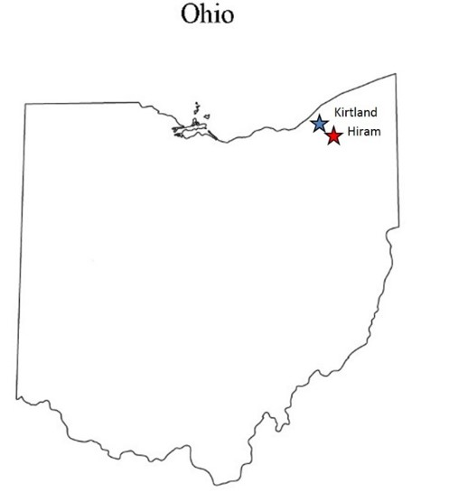
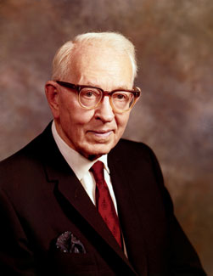
Background
“Because of interference and because he needed a quiet place in which to work, the Prophet, on September 12, 1831, moved to the home of John Johnson in the township of Hiram.
This was in Portage County, Ohio, about thirty miles southeast of Kirtland. From the time he moved until early in October, the Prophet spent most of his spare time preparing for the continuation of the translation of the Bible.
By translation is meant a revision of the Bible by inspiration or revelation as the Lord had commanded him, and which was commenced as early as June 1830.
(D.H.C. 1:215.)
Sidney Rigdon continued to write for the Prophet in the work of revision. The day before the Prophet moved from Kirtland he received an important revelation, Section 64, as it now appears in the Doctrine and Covenants.”
Joseph Fielding Smith

Slide 4
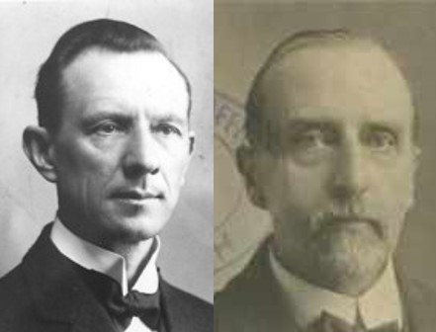
Overcometh The World
For whatsoever is born of God overcometh the world: and this is the victory that overcometh the world, even our faith.
1 John 5:4
“When we overcome that desire and do not conform to the spirit of the world, then His commandments are not difficult, and, if we really believe that Jesus is the Son of God, we shall not take any notice of the world, which is in rebellion against Him…
Elders of the Church should not conform to the world in their worship, in their life, in their amusements. Some had failed in this respect.”
Smith and Sjodahl
D&C 64:1-2

Slide 5
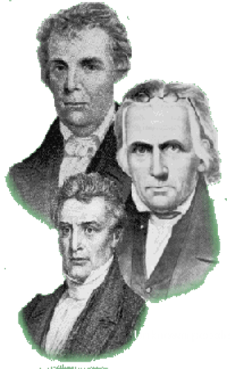
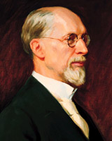
Apostasy of Some Members
Ezra Booth—He gathered a mob that tried to assassinate the Prophet Joseph Smith and Sidney Rigdon in Hiram
Jacob Scott—removed himself from the church and persecuted the Saints
Simons Rider—misspelled name cause discord with Church, and one of the leaders in the tar and feathering of Joseph Smith and Sidney Rigdon in Hiram, Ohio (Simons Ryder—Simonds Ryder)
Eli Johnson—also one of leaders in the tar and feathering Joseph Smith and Sidney Rigdon
And others
“The Spirit of Apostasy was little know, but when these men apostatized, they became more violent, more cruel. And manifested a greater spirit of persecution than any other of our enemies.”
George A. Smith (Journal of Discourse Vol. XI p. 4)
There will always be those members of the Church who will think they know more about how the Church should be run, and profess that the Prophets are wrong and misguided.

Slide 6
Ezra Booth
He was born in Connecticut on February 14, 1792
By 1831 he had become a Methodist minister in Ohio
He became convinced that the Book of Mormon was true and was baptized
He witnessed a miracle preformed by Joseph Smith to Mrs. Johnson who had a “lame” arm
He was called to travel to Missouri and preach along the way however, he went into apostasy and lost his fellowship in the church
He became the author of “anti-Mormon” literature by publishing nine letters
He participated in the tarring and feathering of Joseph in 1832
He created the “Church of Christ” in which the church claimed that Smith was a false prophet and the Book of Mormon was not true and the church disbanded after several meetings
He move to Cuyahoga Falls, Ohio, not far from Hiram and buried on January 12, 1873, but the precise date of his death is unknown.
Who’s Who and Wikipedia

Slide 7
Isaac Morley
He was born on March 11, 1786, in Massachusetts
He was a prosperous farmer in Kirtland, Ohio
He became infused with religious fervor through the preaching of Sidney Rigdon and organized a community group called “the family”
The Missionaries who were sent to preach to the Lamanites also converted him and his wife
Joseph Smith resided at his place for a time, and a conference was held at his home in 1831 (the 4th Conference)
He was ordained a high priest and counselor to Bishop Partridge
He was asked to sell his farm and consecrate the proceeds to the Church, which he did, though at first reluctantly
He and his family moved to Independence, Missouri and his family suffered through mob violence forcing them to leave Clay County, Missouri and then to Far West where he was ordained a patriarch
He moved close to Nauvoo at a place called Yelrome (Morley spelled backwards) until a mob destroyed his property and he was forced to move to Nauvoo after Joseph Smith’s martyrdom
He joined the pioneer exodus to the West and settled in Manti and died on June 24, 1865, staying strong in the Church
Who’s Who

Slide 8
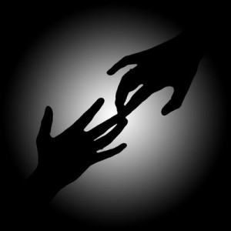
Merciful
Blessed are the merciful: for they shall obtain mercy.
“There were others, beside those whose sins have led them into apostasy, who had fallen into error, but the Lord had forgiven them, for His own glory and the salvation of souls”
Smith and Sjodahl
The Lord is compassionate, forgiving, and merciful.
D&C 64:1-4; Matthew 5:7

Slide 9
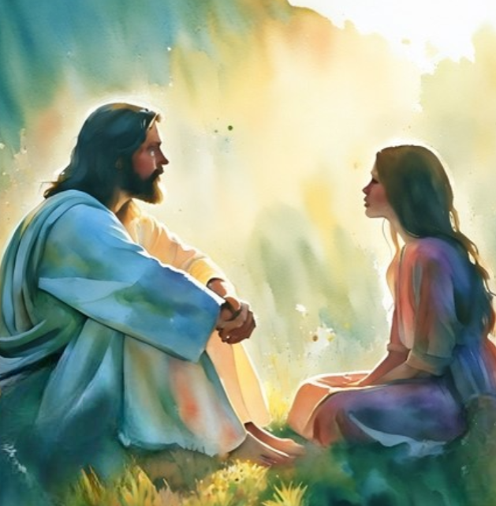
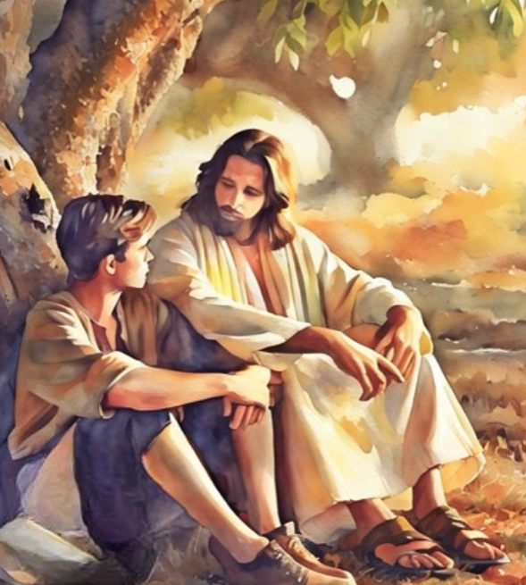
Willingness to Forgive
How do you feel when someone hurts your feelings?
For if ye forgive men their trespasses, your heavenly Father will also forgive you:
But if ye forgive not men their trespasses, neither will your Father forgive your trespasses.
Matthew 6:14-15
And ye shall also forgive one another your trespasses; for verily I say unto you, he that forgiveth not his neighbor’s trespasses when he says that he repents, the same hath brought himself under condemnation.
Mosiah 26:31
D&C 64:1-7

Slide 10
Can You Really Forgive?
1. A young woman is hurt and embarrassed after learning that some of her peers have been spreading gossip about her. Later, some of these peers apologize, but others do not. The young woman forgives those who have apologized but holds a grudge against the others.
2. A young man disobeys a commandment. He prays for forgiveness and discusses the problem with his bishop. However, even after the bishop has assured the young man that he has fully repented, the young man continues to feel unworthy because of his past sin.
3. A young woman is feeling sad and confused because of the actions of her father. He has abandoned his family. Before he left, he rarely showed love for the family and was often cruel. She does not understand why her father acted this way, and she carries feelings of anger toward him. She knows she should seek to forgive him but doesn’t think that she can.
D&C 64:8

Slide 11
Doctrinal Mastery
Wherefore, I say unto you, that ye ought to forgive one another; for he that forgiveth not his brother his trespasses standeth condemned before the Lord; for there remaineth in him the greater sin.
I, the Lord, will forgive whom I will forgive, but of you it is required to forgive all men.
And ye ought to say in your hearts—let God judge between me and thee, and reward thee according to thy deeds.
D&C 64:9-11

Slide 12
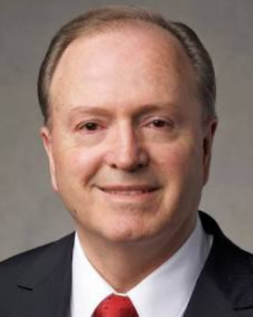
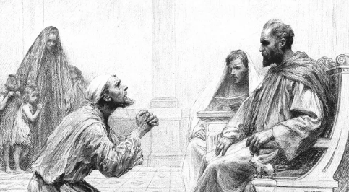
70 Times 7
70 X 7 = Putting no limit on how many times we need to forgive
The Savior essentially told Peter to not even count—to not establish limits on forgiveness. …
Obviously, the Savior was not establishing an upper limit of 490. That would be analogous to saying that partaking of the sacrament has a limit of 490, and then on the 491st time, a heavenly auditor intercedes and says, “I’m so sorry, but your repentance card just expired—from this point forward, you’re on your own.”
The Lord used the math of seventy times seven as a metaphor of His infinite Atonement, His boundless love, and His limitless grace. “Yea, and as often as my people repent will I forgive them their trespasses against me”
Lynn G. Robbins
Matthew 18:21-35

Slide 13
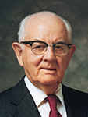
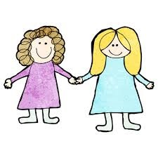
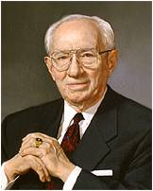
Sincere Forgiveness
“Many people who brought to a reconciliation with others, say that they forgive, but they continue to hold malice, continue to suspect the other party, continue to disbelieve the other’s sincerity .
This is sin, for when a reconciliation has been effected and when repentance is claimed, each should forgive and forget, build immediately the fences which have been breached, and restore the former compatibility.”
President Spencer W. Kimball
“I plead with you to ask the Lord for strength to forgive. … It may not be easy, and it may not come quickly. But if you will seek it with sincerity and cultivate it, it will come”
President Gordon B. Hinckley
When we refuse to forgive others, we bring affliction upon ourselves
D&C 64:8-10

Slide 14
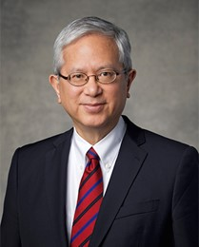
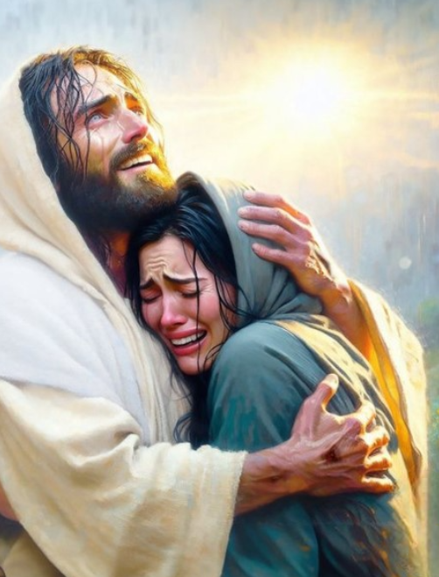
Sometimes our willingness to forgive someone else enables both them and us to believe we can repent and be forgiven.
Sometimes a willingness to repent and an ability to forgive come at different times.
Our Savior is our Mediator with God, but He also helps bring us to ourselves and each other as we come to Him.
Especially when hurt and pain are deep, repairing our relationships and healing our hearts is hard, perhaps impossible for us on our own.
But heaven can give us strength and wisdom beyond our own to know when to hold on and how to let go.
Gerrit W. Gong

Slide 15
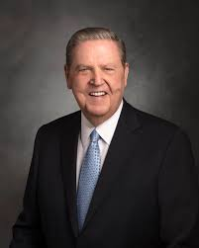
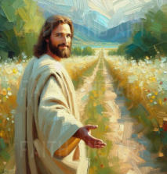
Forgive and Ye Shall Be Forgiven
...He did not say, “You are not allowed to feel true pain or real sorrow from the shattering experiences you have had at the hand of another.”
Nor did He say, “In order to forgive fully, you have to reenter a toxic relationship or return to an abusive, destructive circumstance.”
But notwithstanding even the most terrible offenses that might come to us, we can rise above our pain only when we put our feet onto the path of true healing.
That path is the forgiving one walked by Jesus of Nazareth, who calls out to each of us, “Come, follow me”
Jeffrey R. Holland
D&C 64:10; Luke 6:37; Luke 18:22

Slide 16
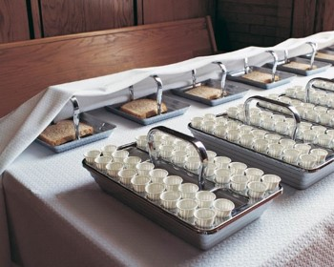
Forgiveness is Forgetfulness
A statement of greater sin
“I will forgive, but I will never forget”
“I can forgive, but I cannot forget is another way of saying I cannot forgive”
Henry Ward Beecher
“I may add that unless a person forgives his brother (or sister) his trespasses with all his heart he is unfit to partake of the sacrament.”
President Spencer W. Kimball
For he that eateth and drinketh unworthily, eateth and drinketh damnation to himself, not discerning the Lord’s body.
For this cause many are weak and sickly among you, and many sleep
1 Corinthians 11:29-30
D&C 64:8-10

Slide 17
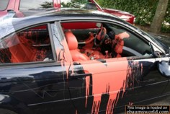
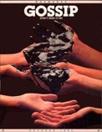
Be Aware of:
Hounding the Transgressor---by notes, criticizing on facebook, texting unkind words
Revenge--something done in vengeance or an opportunity to retaliate or gain satisfaction
Judgment—The Lord will do the judging in the final analysis
Bitterness—it poison’s mostly the one who harbors it in their hearts—it generates hate
Misinformation or Misunderstanding
Jesus Christ requires us to forgive all people.
D&C 64:8-10—President Spencer W. Kimball

Slide 18
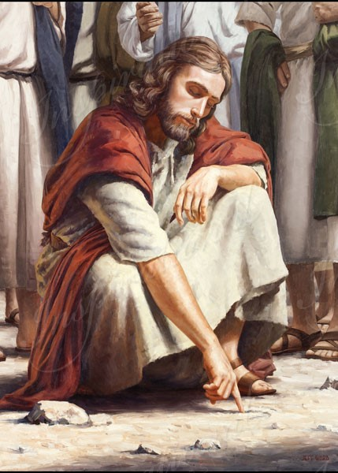
So when they continued asking him, he lifted up himself, and said unto them, He that is without sin among you, let him first cast a stone at her.
John 8:7
The Lord is compassionate, forgiving, and merciful
D&C 64:8-10

Slide 19
Why do you think Jesus Christ requires us to forgive everyone?
Why do you think we have “the greater sin” when we choose not to forgive others?
How do you think saying in our hearts “let God judge between me and thee” can help us forgive others?
What Christlike attributes will forgiving others help you develop?
D&C 64:9-11

Slide 20
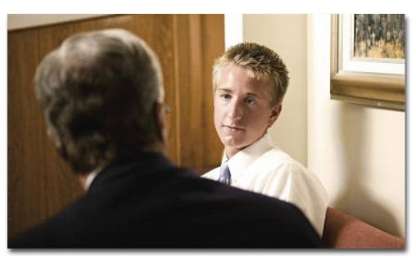
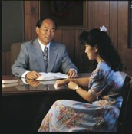
Transgressions Requiring Confession
Confession is a necessary requirement for complete forgiveness.
It is an indication of true “godly sorrow.”
It is part of the cleansing process—the starting anew requires a clean page in the diary of our conscience.
Confession should be made to the appropriate person who has been wronged by us and to the Lord also.
In addition, the nature of our transgression may be serious enough to require confession to a legal priesthood administrator.
Bishop J. Richard Clarke
D&C 64:12-13

Slide 21
The Lord’s Anger
Ezra Booth—Still the Lord’s servant—and lost the spirit--but he failed to keep the Law—persisted in evil doing
Isaac Morley—failed to keep the Law—and lost the spirit—but he repented and was forgiven
Edward Partridge—he too had sinned, perhaps by listening to the others—but he also repented and was forgiven
However: The Lord is not ‘angry’ long and will forgive if we submit ourselves to the Lord and not the world
The Lord is merciful and gracious, slow to anger, and plenteous in mercy.
Psalms 103:8
D&C 64:15-17

Slide 22
Sources:
Videos:
Required to Forgive 7:25
Forgiveness: My Burden Was Made Light 8:42
“We Must Forgive” (2:43) Story of Corre ten Boom (Holocaust survivor)
(Smith, Church History and Modern Revelation,1:234–35.)
Doctrine and Covenants Who’s Who by Ed J. Pinegar and Richard J. Allen pg. 9, 100-101
Booth Information: Wikipedia
Presentation by ©http://fashionsbylynda.com/blog/
Hyrum M. Smith and Janne M. Sjodahl Doctrine and Covenants Commentary pg. 389-390
President Gordon B. Hinckley (“Of You It Is Required to Forgive,” Ensign, June 1991
President Spencer W. Kimball Miracle of Forgiveness pgs. 262-275
Henry Ward Beecher statement found on pg. 263
Bishop J. Richard Clarke Confession 1980 Nov. Ensign
Lynn G. Robbins, “Until Seventy Times Seven,” Ensign or Liahona, May 2018, 23 President Spencer W. Kimball Chapter 9: Forgiving Others with All Our Hearts
Gerrit W. Gong, “Happy and Forever,” Liahona, Nov. 2022, 85
Jeffrey R. Holland, “The Ministry of Reconciliation,” Ensign or Liahona, Nov. 2018, 78–79)
Presentation by ©http://fashionsbylynda.com/blog/

Slide 23
Sin Unto Death:
Elder Bruce R. McConkie explained that “those who turn from the light and truth of the gospel; who give themselves up to Satan; who enlist in his cause, supporting and sustaining it; and who thereby become his children—by such a course sin unto death. For them there is neither repentance, forgiveness, nor any hope whatever of salvation of any kind. As children of Satan, they are sons of perdition.” (Mormon Doctrine, p. 737; see also Alma 5:41–42; Matthew 12:31–32; Hebrews 10:26–27;1 John 5:16–17.)
Seven Times Seven:
President Joseph Fielding Smith explained: “The Lord declared that when he was in his ministry his disciples sought occasion against one another and failed at times to forgive in their hearts. It was this condition which prompted Peter to ask the Lord how many times he should forgive his brother, ‘till seven times?’ The Lord answered him, ‘I say not unto thee, until seven times, but until seventy times seven.’ (Matt. 18:21–22.) As the disciples of old brought upon themselves affliction and chastening, so we, when we do not have in our hearts the spirit of forgiveness, bring upon ourselves affliction and chastening from the Lord.” (Church History and Modern Revelation, 1:235.)
Transgressions requiring confession to a bishop
Those transgressions requiring confession to a bishop are adultery, fornication, other sexual transgressions and deviancies, and sins of a comparable seriousness. President Kimball reminds us that “one must not compromise or equivocate—he must make a full confession.” (Miracle of Forgiveness, pp. 170, 189.) Remember, it is complete deliverance from the tortures of a guilt-ridden soul that we seek. The Prophet Alma says he wandered “through much tribulation, repenting nigh unto death,” feeling he was being consumed by an everlasting burning. Repentance is not easy. “Godly sorrow” brings one to the depth of humility. This is why the gift of forgiveness is so sweet and draws the transgressor so close to the Savior with a special bond of affection.
Elder Marion D. Hanks spoke about the importance of forgiving others:
“Someone has written: ‘… the withholding of love is the negation of the spirit of Christ, the proof that we never knew him, that for us he lived in vain. It means that he suggested nothing in all our thoughts, that we were not once near enough to him to be seized with the spell of his compassion for the world.’ …
“What is our response when we are offended, misunderstood, unfairly or unkindly treated, or sinned against, made an offender for a word, falsely accused, passed over, hurt by those we love, our offerings rejected? Do we resent, become bitter, hold a grudge? Or do we resolve the problem if we can, forgive, and rid ourselves of the burden?
“The nature of our response to such situations may well determine the nature and quality of our lives, here and eternally. …
“But not only our eternal salvation depends upon our willingness and capacity to forgive wrongs committed against us. Our joy and satisfaction in this life, and our true freedom, depend upon our doing so. When Christ bade us turn the other cheek, walk the second mile, give our cloak to him who takes our coat, was it to be chiefly out of consideration for the bully, the brute, the thief? Or was it to relieve the one aggrieved of the destructive burden that resentment and anger lay upon us?
“Paul wrote to the Romans that nothing ‘shall be able to separate us from the love of God, which is in Christ Jesus our Lord.’ (Rom. 8:39.)
“I am sure this is true. I bear testimony that this is true. But it is also true that we can separate ourselves from his spirit. …
“In every case of sin this is true. Envy, arrogance, unrighteous dominion—these canker the soul of one who is guilty of them. It is true also if we fail to forgive. Even if it appears that another may be deserving of our resentment or hatred, none of us can afford to pay the price of resenting or hating, because of what it does to us. If we have felt the gnawing, mordant inroads of these emotions, we know the harm we suffer. …
“It is reported that President Brigham Young once said that he who takes offense when no offense was intended is a fool, and he who takes offense when offense was intended is usually a fool. It was then explained that there are two courses of action to follow when one is bitten by a rattlesnake. One may, in anger, fear, or vengefulness, pursue the creature and kill it. Or he may make full haste to get the venom out of his system. If we pursue the latter course we will likely survive, but if we attempt to follow the former, we may not be around long enough to finish it.” (In Conference Report, Oct. 1973, pp. 15–16; Ensign, Jan. 1974, pp. 20–21.)
Who Do I Need To Forgive?
Our Savior has spoken so clearly on this subject that there is little room for private interpretation. “I, the Lord, will forgive whom I will forgive,” but then He said, “… of you it is required to forgive all men” [Doctrine and Covenants 64:10; emphasis added].
May I add a footnote here? When the Lord requires that we forgive all men, that includes forgiving ourselves. Sometimes, of all the people in the world, the one who is the hardest to forgive—as well as perhaps the one who is most in need of our forgiveness—is the person looking back at us in the mirror. (Dieter F. Uchtdorf, “The Merciful Obtain Mercy,” Ensign or Liahona, May 2012, 75)

