Slide 1
Doctrine and Covenants 65
Prepare for the Second Coming of Christ
And this gospel of the kingdom shall be preached in all the world for a witness unto all nations; and then shall the end come
Matthew 24:14
Presentation by ©http://fashionsbylynda.com/blog/

Slide 2
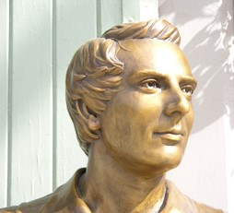
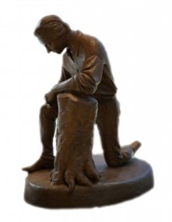
Background
October 1831 in Hiram, Ohio
13 Revelations were received by Joseph Smith at the home of the Johnson’s where he and his family resided
During this time Joseph Smith and Sidney Rigdon, as scribe, were in the process of translating the scriptures
The Prophet Joseph Smith indicated that this section is a prayer. He said, “In the fore part of October, I received the following prayer [D&C 65] through revelation” HC

Slide 3
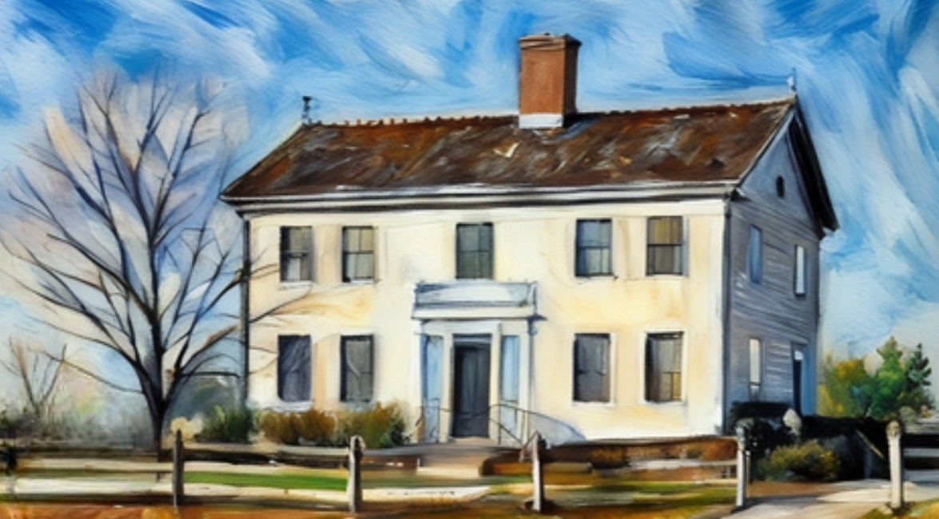
Prepare Ye the Way of the Lord
On September 12, 1831, Joseph Smith and his family moved 30 miles southeast of Kirtland, Ohio, to the John and Alice Johnson home in Hiram, Ohio. A Church service was held at the Johnson home on Sunday, October 30, 1831. On that same day, the Prophet received the revelation that is recorded in Doctrine and Covenants 65. Manual
The Prophet Joseph Smith indicated that this section is a prayer. He said, “In the fore part of October, I received the following prayer [D&C 65] through revelation” HC

Slide 4
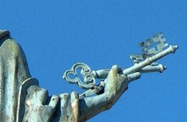
Setting Up the Kingdom of God
“Keys of the kingdom,” or “keys of the priesthood,” are “the rights of presidency, or the power given to man by God to direct, control, and govern God’s priesthood on earth”
Guide to the scriptures
“committed unto man” -- enables the gospel to fill the whole earth
“keys of the kingdom” --the priesthood authority to preside in the Church.
With these keys, the President of the Church leads our efforts to preach the gospel. He delegates some of the keys to general and local priesthood leaders.
D&C 65:1-2

Slide 5
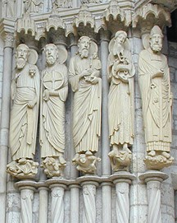
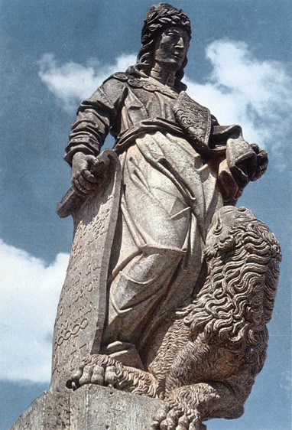
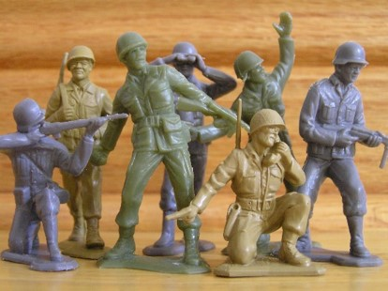
Our Role in the Kingdom
“The ancient prophets declared that in the last days the God of heaven should set up a kingdom which should never be destroyed, nor left to other people; and the very time that was calculated on, this people were struggling to bring it out. …
“I calculate to be one of the instruments of setting up the kingdom of Daniel by the word of the Lord, and I intend to lay a foundation that will revolutionize the whole world. …
It will not be by sword or gun that this kingdom will roll on: the power of truth is such that all nations will be under the necessity of obeying the Gospel.”
HC
D&C 65:1-6

Slide 6
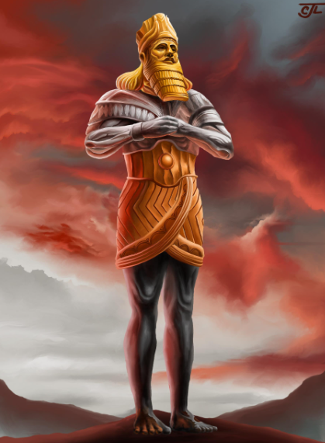
Stone Cut Out of the Mountain Without Hands
“The Lord’s Church [increasing] in magnitude until it fills the whole earth, ‘never [to] be destroyed … [but to] stand for ever’
The image represented different kingdoms of the earth. The head of gold represented Nebuchadnezzar’s kingdom, while the parts of the statue made of silver, brass, iron, and clay represented inferior kingdoms that were to follow.
As for the stone that destroyed the image, Daniel declared that in the days of the kingdoms of iron and clay “shall the God of heaven set up a kingdom, which shall never be destroyed: and the kingdom shall not be left to other people, but it shall break in pieces and consume all these kingdoms, and it shall stand forever”.
This stone is the restored gospel.
D&C 65:2; see Daniel 2:31-44
Casey Paul Griffiths

Slide 7
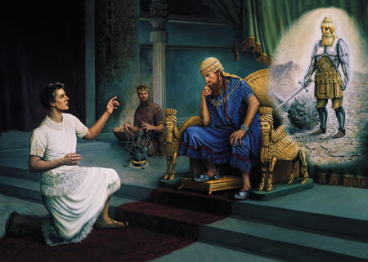
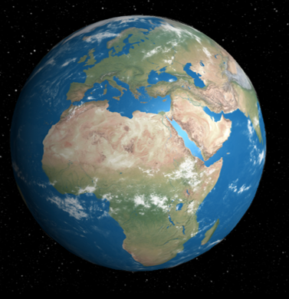
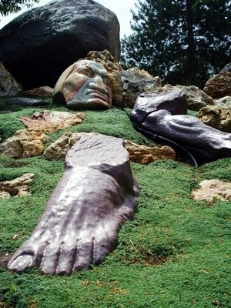
Nebuchadnezzar’s Dream
The Lord revealed the dream and its meaning to Daniel.
In the dream, a great statue, which represented various political kingdoms, was destroyed by a stone cut without hands from a mountain.
The stone started small but grew until it filled the whole earth.
Interpretation of the dream, which was to roll forth and smite the image and break it in pieces and to roll on until it should fill the whole earth.
Daniel 2:31-45

Slide 8
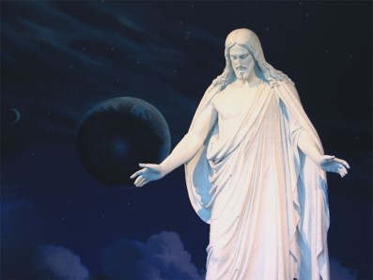
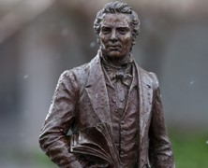
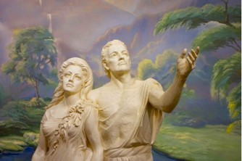
The Kingdom
Kingdom of God set up In the Days of Adam
Righteous men—God reveals His word and gives power and authority to administer in His name
Righteous Man
Priesthood of God
Kingdom of God
Priest
Righteous Man
Oracles of God
Kingdom of God
Prophet
Daniel 2:31-45 Prophet Joseph Smith

Slide 9
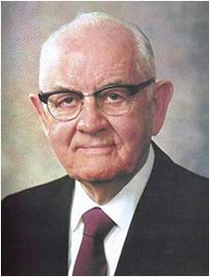
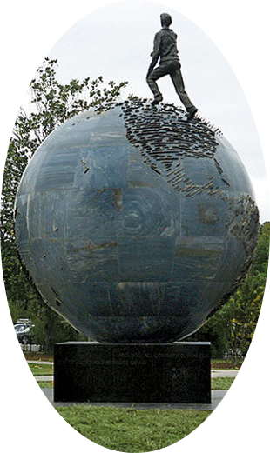
“We are citizens in the greatest kingdom on earth—a kingdom not directed by the wisdom of men but led by the Lord Jesus Christ.
Its presence is real. Its destiny is certain. This is the kingdom of which the prophet Daniel spoke—a stone, as it were, that should be cut out of the mountain without hands and roll forth and fill the earth
“No mortal man created this kingdom”
President Spencer W. Kimball
D&C 65:2

Slide 10
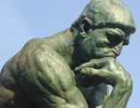
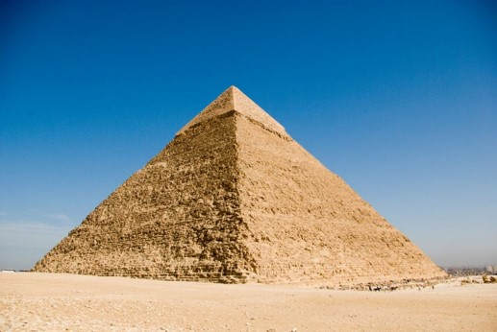
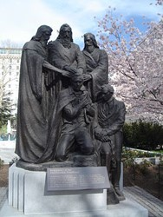
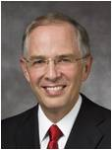
Why am I Here?
“Have you ever thought about why you were sent to earth at this specific time?
You were not born during the time of Adam and Eve or while pharaohs ruled Egypt or during the Ming dynasty.
You have come to earth at this time, 20 centuries after the first coming of Christ.
The priesthood of God has been restored to the earth, and the Lord has set His hand to prepare the world for His glorious return.
Elder Neil L. Andersen

Slide 11
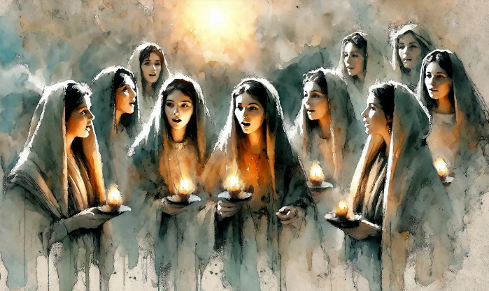
Make Ready the Bridegroom
The Church is His symbolic bride”
…the Savior invites us to be active participants in preparing the world for His coming.
The Saints are not to sit back and wait for a rapture to remove them from the ills of the world but to actively work to build the kingdom and end the ills of the world.
Casey Paul Griffiths
Matthew 25:1-13

Slide 12
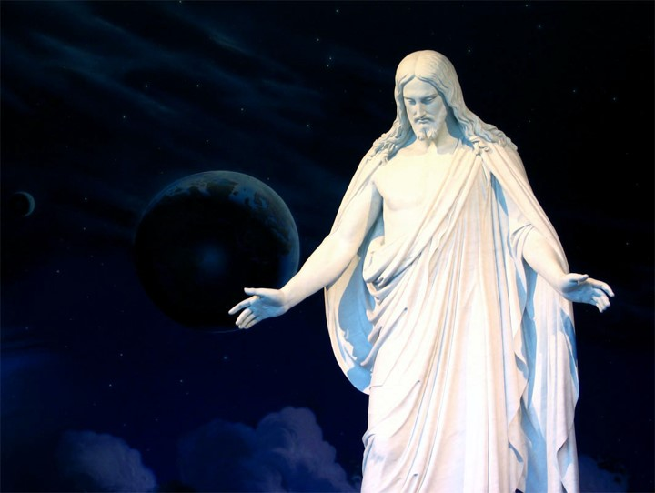
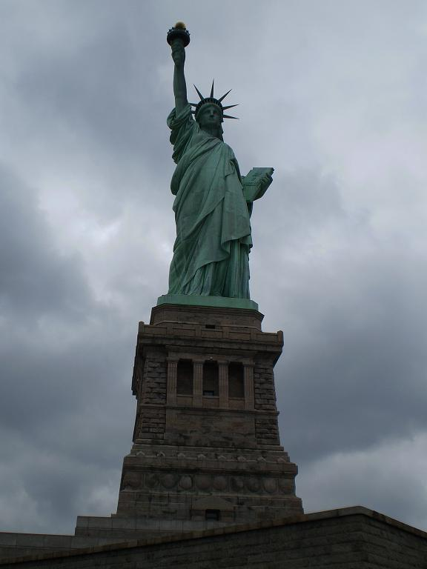
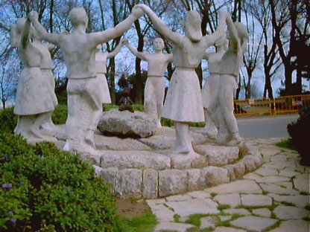
These are days of great opportunity and important responsibilities. These are your days. … One of your important responsibilities is to …”
…help prepare the world for the Second Coming of the Savior”
Elder Neil L. Andersen

Slide 13
Preparing Individually for the 2nd Coming
Living the gospel of Jesus Christ
Caring for those in need
Inviting all to receive the gospel
Uniting families for eternity
Making covenants to receive temple ordinance
Discover deceased ancestors and performing ordinances in the temple
Going to the temple regularly
Faith
Repentance
Covenants
Enduring to the End
Serving and ministering to individuals, families, and communities
Sharing resources for those in need
Helping others become self-reliant
Participating in Missionary work
Serving as missionaries
Helping new and returning Church member progress along the covenant path
Learning and teaching the gospel at home and at church
Becoming self-reliant in providing for ourselves and families temporally and spiritually
D&C 65:4-6; General Handbook

Slide 14
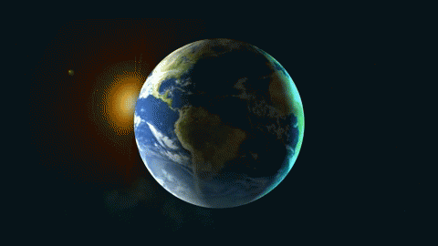
Kingdom of God VS Kingdom of Heaven
The Church of Jesus Christ of Latter-day Saints is the kingdom of God on the earth, but it is at present limited to an ecclesiastical kingdom.
During the Millennium, the kingdom of God will be both political and ecclesiastical.
The purpose of the Church is to prepare its members to live forever in the celestial kingdom or kingdom of heaven.
D&C 65:6; Guide to Scriptures

Slide 15
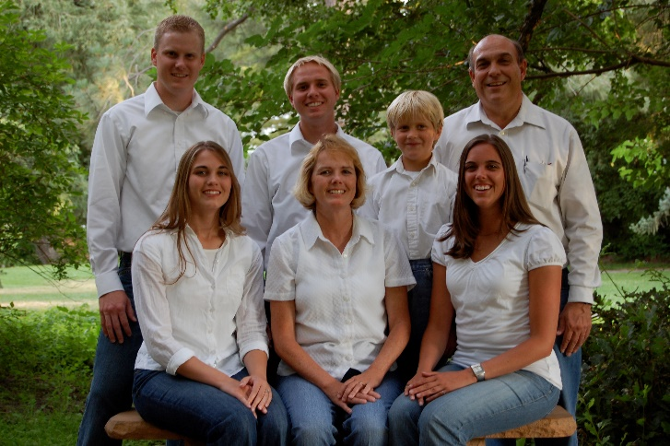
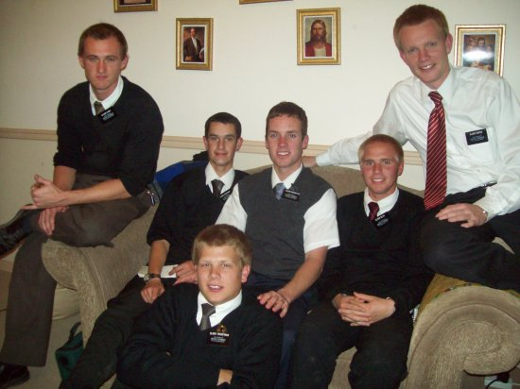
What Do We Pray For?
Food and Clothing
Family
Home
Missionary Effort
Health and Strength
Finding our ancestors

Slide 16
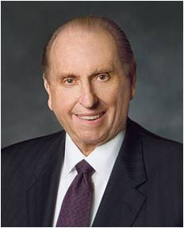
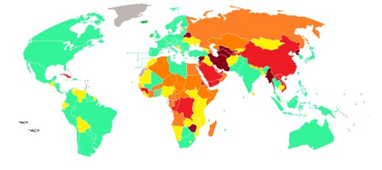
What Should We Pray For?
“I would ask that your faith and prayers continue to be offered in behalf of those areas where our influence is limited and where we are not allowed to share the gospel freely at this time. Miracles can occur as we do so.”
President Thomas S. Monson
There are many countries where missionaries are not allowed, including those where Christianity is illegal or suppressed, countries with restrictions on evangelism, and countries where foreign missionaries are limited:
Countries where Christianity is illegal or suppressed: Afghanistan, North Korea, Somalia, Libya, Yemen, Eritrea, Nigeria, and Pakistan
Countries with restrictions on evangelism: Most of the world's 49 majority-Muslim countries
Countries where foreign missionaries are limited: India, Bhutan, Laos, and Burma
Countries where online proselytizing is restricted: The People's Republic of China
Countries where Mormons are not allowed to missionize: Israel, Belarus
D&C 65:10

Slide 17
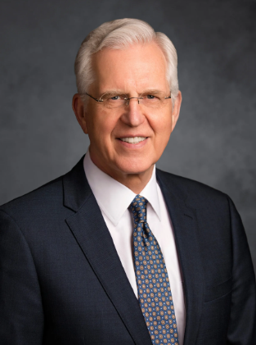
The Church of Jesus Christ of Latter-day Saints is uniquely empowered and commissioned to accomplish the necessary preparations for the Lord’s Second Coming; indeed, it was restored for that purpose. …
The Church of Jesus Christ is commissioned to prepare﻿—and is preparing﻿—the world for that day. D. Todd Christofferson

Slide 18
Sources:
The Church to Fill the Earth (1:36)
“The Gospel Shall Roll Forth” (2:47).
(History of the Church, 1:218)
(History of the Church,6:364–65.)
Prophet Joseph Smith (Teachings of the Prophet Joseph Smith, pp. 271–272).
Casey Paul Griffiths https://doctrineandcovenantscentral.org/sections/commentary-on-dc-65/?Verses-1-2
President Spencer W. Kimball (“Pillars of Truth,” Ensign, Jan. 1994, 4).
Elder Neil L. Andersen(“Preparing the World for the Second Coming,” Ensign or Liahona, May 2011, 49).
President Thomas S. Monson (“Welcome to Conference,”)
Ensign or Liahona, Nov. 2009, 6).
Presentation by ©http://fashionsbylynda.com/blog/
Countries where missionaries cannot preach: https://www.google.com/search?sca_esv=bbfe05642f884d57&sxsrf=ADLYWIJkc5ET6z4c7odSprRXNOJsztv_Lg:1731170250517&q=Countries+where+missionaries+are+not+allowed&sa=X&ved=2ahUKEwipqs_e18-JAxXrH0QIHSUOIpoQ1QJ6BAg9EAE&biw=1920&bih=919&dpr=1
D. Todd Christofferson, “Preparing for the Lord’s Return,” Ensign or Liahona, May 2019, 82, 84
Presentation by ©http://fashionsbylynda.com/blog/

Slide 19
Kingdom of God:
“‘Some say that the kingdom of God was not set up upon the earth until the day of Pentecost, and that John did not preach the baptism of repentance for the remission of sins, but I say to you in the name of the Lord that the kingdom of God was set up upon the earth in the days of Adam to the present time.
Whenever there has been a righteous man on the earth, unto whom God revealed His word and gave power and authority to administer in His name, and where there is a priest of God … to administer in the ordinances of the gospel, and officiate in the priesthood of God, there is the kingdom of God. … Where there is a prophet, a priest, or a righteous man unto whom God gives His oracles, there is the kingdom of God; and where the oracles of God are not, there the kingdom of God is not.’ Prophet Joseph Smith (Teachings of the Prophet Joseph Smith, pp. 271–272).
Where LDS Cannot Preach---just a blog answer
Saudi Arabia, Iran, Iraq, most Muslim theocratic countries, most communist countries(so North Korea, most of China, Cuba, etc) In Israel, we can't openly proselytize(so no missionaries), but we are allowed to worship and live there. And, of course, as long as someone is a closeted Mormon they can live in those Islamic Theocratic countries and the Communist countries, however they can't be open about it, and no worship is allowed, nor are missionaries allowed. Basically, as long as the country is at least semi-democratic(with the exception of Israel), Missionaries are allowed there. Undemocratic countries we are typically not allowed in. So, if you look at this map of the world, which shows the level of democracy each nation has, we are allowed in all Full and flawed democracies(again, Israel is the exception), and I'd say half of the Semi-dictatorships(We are allowed in Russia, for example). None of the Full dictatorships or oppressive regimes we are allowed in, except China allows us in a very few places, such as in Hong Kong. http://weblog.savetibet.org/wp-content/u...
Source:
I'm Mormon

