Slide 2
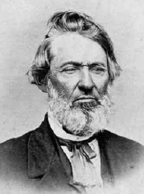
Background
William E. McLellin was baptized in the summer of 1831, he accepted a call to preach the gospel.
In October, he journeyed to Ohio to attend a Church conference.
There he met the Prophet Joseph Smith, and on October 29, 1831, he asked Joseph Smith to inquire of the Lord on his behalf.
In response to this request, the Lord gave Joseph Smith the revelation recorded in Doctrine and Covenants 66.
This revelation contains specific counsel regarding Brother McLellin’s spiritual standing, his calling to preach the gospel, and his potential to receive great blessings.
At this time William was in good standing with the Church and remained valiant for several years
D&C 66

Slide 3
William E. McLellin
He was born on January 18, 1806 in Tennessee
He learned of the restored Church in the summer of 1831 and was baptized in August 20, 1831 by Hyrum Smith
While staying with Joseph Smith in Ohio he received council from the Lord in Section 66
He preached in the surrounding areas and in the eastern states
He along with Orson Hyde, Lyman E. Johnson, and Luke S. Johnson was granted promises if he remained loyal and valiant (Section 68)
He became a member of the Quorum of the Twelve on February 15, 1835
The following year he apostatized, claiming he had lost confidence in the leadership of the Church and this action lead to excommunication in 1838
He joined the mobbers in persecuting the Saints and driving them from Missouri
After dabbling in various religious organizations he abandoned his religious interests
He passed away on April 24, 1883
Who’s Who

Slide 4
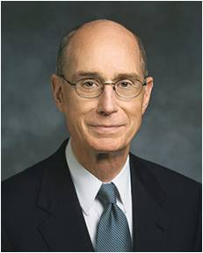
Which Direction
Far From God
Close to God
“If you want to stay close to someone who has been dear to you, but from whom you are separated, you know how to do it. You would find a way to speak to them, you would listen to them, and you would discover ways to do things for each other.
The more often that happened, the longer it went on, the deeper would be the bond of affection. If much time passed without the speaking, the listening, and the doing, the bond would weaken.
“God is perfect and omnipotent, and you and I are mortal. But he is our Father, he loves us, and he offers the same opportunity to draw closer to him as would a loving friend. And you will do it in much the same way: speaking, listening, and doing”
President Henry B. Erying
D&C 66

Slide 5
But Not All
Although Brother McLellin had made great progress and had been blessed for his efforts, he still needed to repent of some sins.
See notes on Journal of William E. McLellin
Honesty
Cheating
Chastity
Stealing
Jealousy
Why is it important to repent of all of our sins, and not just some of them?
We are commanded to repent of all our sins.
We are commanded to repent of all our sins
Lustful thoughts
D&C 66:3

Slide 6
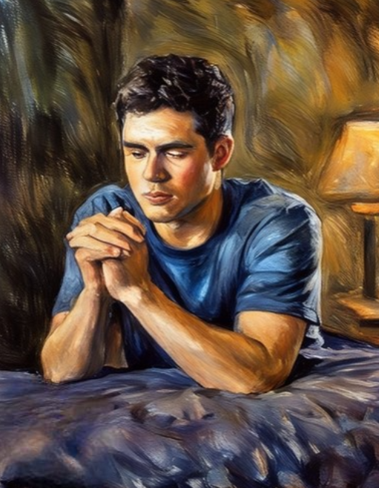
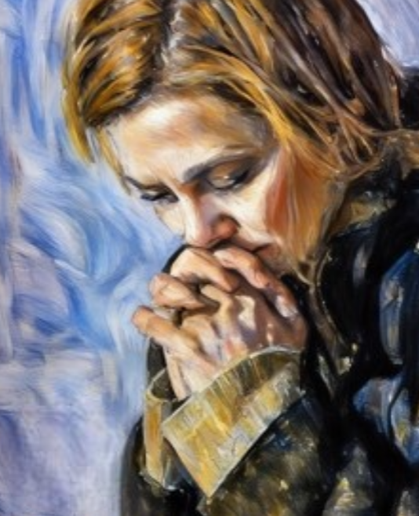
What Do I Need To Repent Of?
“One of the questions we must ask of our Heavenly Father in private prayer is this: ‘What have I done today, or not done, which displeases Thee?
If I can only know, I will repent with all my heart without delay.’ That humble prayer will be answered.”
President Henry B. Erying
What blessings have you received when you have repented and turned away from sin?
The Lord will show us the things we need to repent of
D&C 66:3

Slide 7
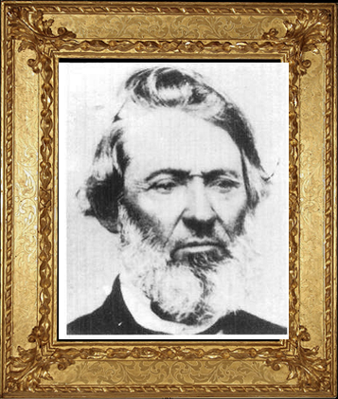
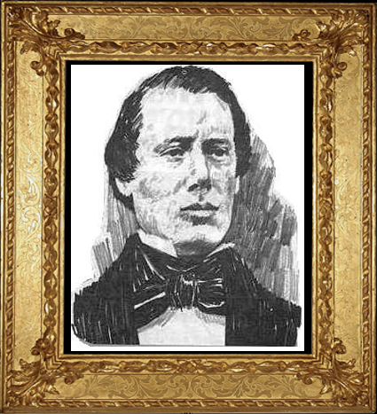
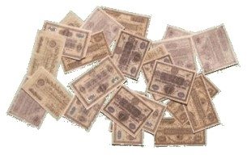
Where Shall I Go?
William E. McLellin wanted to know if he should preach the gospel, go to Zion, or remain in Kirtland.
The Lord wanted him to serve a mission in the East and to take Samuel Smith as his companion.
William E. McLellin was to send whatever money he could spare to the Saints in Zion.
D&C 66:4-8

Slide 8
Samuel H. Smith
He was born on March 13, 1808 at Tunbridge, Orange County, Vermont and one of the younger brothers of Joseph Smith, Jr. He was the 6th child of Joseph Smith Sr. and Lucy Mack Smith
He was baptized by Oliver Cowdery on May 25, 1829 and the 3rd person to be baptized in this dispensation
He was one of the Eight Witnesses to the Book of Mormon and one of the six original members of the Church upon its organization
He helped chop the wood, plow the land, and harvest the crops in 1829 so that Joseph was free to translate the gold plates
He was the first missionary in the result of converting Heber C. Kimball and Brigham Young at age 22
He married Mary Bailey on August 12, 1834. and had two daughters, Susannah and Mary, born in October 1835, and a son, Samuel Harrison Bailey Smith in August 1838
He was a member of the high council in Kirtland and later Presiding Bishop of the Church, then later serving as bishop in Nauvoo, and captain in the Nauvoo legion
He accompanied the bodies of Hyrum and Joseph back to Nauvoo from Carthage.
He died on July 30, 1844, 34 days after the death of his brothers
Who’s Who

Slide 9
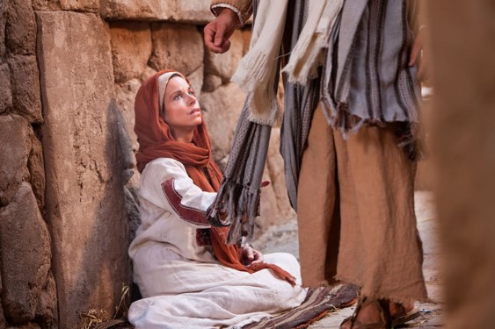
Healing of the Sick
“In the short time he had been a member of the Church, Elder McLellin had been raised from affliction in a healing blessing administered to him by Hyrum Smith.
He had assisted Hyrum in giving a blessing in which a sick child was instantly healed.
He also was healed by the Prophet of a sprained ankle.”
Journals of William E. McLellin 40, 43, 45
If we are faithful in doing the Lord's will, He will be with us and will bless us so we can accomplish what He requires of us
But Jesus turned him about, and when he saw her, he said, Daughter, be of good comfort; thy faith hath made thee whole. And the woman was made whole from that hour.
Matthew 9:22
D&C 66:9

Slide 10
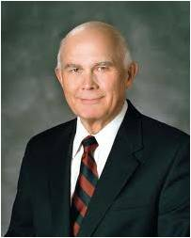
Miracles of Healing
Miracles happen when the authority of the priesthood is used to bless the sick.
There are five parts to the use of priesthood authority to bless the sick:
The anointing
The sealing of the anointing
The faith
The words of the blessing
The will of the Lord.
D&C 66:9 Elder Dallin H. Oaks

Slide 11
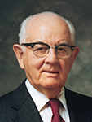
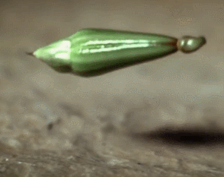
Cumber
“To want, to desire, to crave—that is to lust. So when the thought is born which starts a chain reaction, a sin has already been committed. If the thought is sown, then develops into lust, it is almost certain to bring eventually the full harvest of the act of the heinous sin, adultery. …
“… adultery is not the result of a single thought. There first is a deterioration of thinking. Many sinful chain-thoughts have been coursing through the offender’s mind before the physical sin is committed.
“Yes, as a man thinketh, so does he. If he thinks it long enough he is likely to do it, whether it be theft, moral sin, or suicide. Thus the time to protect against the calamity is when the thought begins to shape itself. Destroy the seed and the plant will never grow.
“Man alone, of all creatures of earth, can change his thought pattern and become the architect of his destiny.”
President Spencer W. Kimball
D&C 66:10

Slide 12
Forsake All Unrighteousness
The Lord wants us to forsake all things that cumber our spiritual progress
The Lord knows our specific challenges and temptations
D&C 66:10

Slide 13
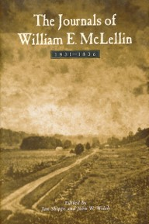
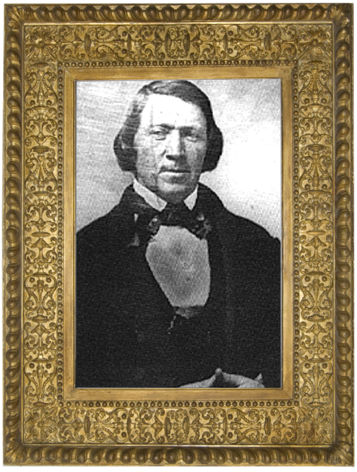
Receiving a Testimony
Brother McLellin served faithfully for several years and was called to serve as one of the first members of the Quorum of the Twelve Apostles in this dispensation.
However, he did not continue faithfully to the end. In fact, he turned against the Prophet Joseph Smith and he was excommunicated in 1838.
“Joseph Smith is a true Prophet … of the Lord and … has power and does receive revelations from God”
William E. McLellin
“While Joseph was in prison at Richmond, Mo., McLellin, who was a large and active man, went to the sheriff and asked for the privilege of flogging the Prophet. Permission was granted on condition that Joseph would fight. The sheriff made known … McLellin’s earnest request, to which Joseph consented, if his irons were taken off. McLellin then refused to fight unless he could have a club, to which Joseph was perfectly willing; but the sheriff would not allow them to fight on such unequal terms.”
History of Brigham Young
D&C 66:11

Slide 14
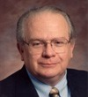
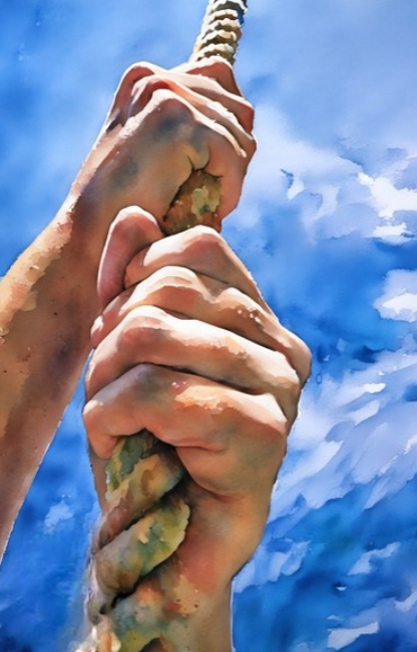
Continue in All Things
Behold, I am the law, and the light. Look unto me, and endure to the end, and ye shall live; for unto him that endureth to the end will I give eternal life.
3 Nephi 15:9
“To endure is to continue in the path we adopted at baptism by keeping our commitments to Christ, until the end of our mortal life.
“Usually the scriptures link “enduring to the end” with keeping one’s covenants with Christ.
If we continue faithfully to the end, we will receive eternal life
“So enduring to the end means, in general, entering into the gospel covenant (through faith in Christ, repentance, baptism, and receiving the Holy Ghost) and then remaining faithful to that covenant.”
D&C 66:12-13 Elder Stephen Robinson

Slide 15
Sources:
Videos:
What Lack I Yet? (10:26)
Whom the Lord Calls (0:29)
God Knows Who I Am (1:55)
Doctrine and Covenants Who’s Who by Ed J. Pinegar and Richard J. Allen pg. 96-98, 148
President Henry B. Erying (“To Draw Closer to God,” Ensign, May 1991, 66).
(“Do Not Delay,” Ensign, Nov. 1999, 34).
Presentation by ©http://fashionsbylynda.com/blog/
Elder Dallin H. Oaks Healing the Sick April 2010 Gen. Conf.
President Spencer W. Kimball (Miracle of Forgiveness, pp. 113–14.)
Letter from William E. McLellin to relatives, Aug. 4, 1832, RLDS Archives, 4; quoted in M. Russell Ballard, “What Came from Kirtland” [Church Educational System fireside for young adults, Nov. 6, 1994], 8,speeches.byu.edu).
(“History of Brigham Young,” Millennial Star, Dec. 17, 1864, 808).
Elder Stephen E. Robinson Enduring to the End October 1993 Gen. Conf.
Presentation by ©http://fashionsbylynda.com/blog/

Slide 16
Journal of William E. McLellin
“I received through him, and wrote from his mouth a revelation concerning myself . I had expected and believed that when I saw Bro. Joseph, I should receive (a revelation) and I went before the Lord in secret, and on my knees asked him to reveal the answer to five questions through his Prophet, and that too without his having any knowledge of my having made such request. I no testify in the fear of God, that every question which I had thus lodged in the ears of the Lord of Sabbaoth, were answered to my full and entire satisfaction. I desired it for a testimony of Joseph’s inspiration. And I to this day consider it to me an evidence which I cannot refute.” (Journals of William E. McLellin, 57; spelling and syntax standardized; (in Ensign of Liberty, of the Church of Christ, Jan. 1848, 61).
Although we have no record of the questions of which William E. McLellin speaks, they evidence themselves, at least in part, by a thoughtful reading of the revelation. Joseph Fielding McConkie and Craig J. Ostler Revelations of the Restoration pg. 478
There are five parts to the use of priesthood authority to bless the sick: (1) the anointing, (2) the sealing of the anointing, (3) faith, (4) the words of the blessing, and (5) the will of the Lord.
Anointing
The Old Testament frequently mentions anointing with oil as part of a blessing conferred by priesthood authority. Anointings were declared to be for sanctification ⁸ and perhaps can also be seen as symbolic of the blessings to be poured out from heaven as a result of this sacred act.
In the New Testament we read that Jesus’s Apostles “anointed with oil many that were sick, and healed them” (Mark 6:13). The book of James teaches the role of anointing in connection with the other elements in a healing blessing by priesthood authority:
“Is any sick among you? let him call for the elders of the church; and let them pray over him, anointing him with oil in the name of the Lord:
“And the prayer of faith shall save the sick, and the Lord shall raise him up” (James 5:14–15).
Sealing the Anointing
When someone has been anointed by the authority of the Melchizedek Priesthood, the anointing is sealed by that same authority. To seal something means to affirm it, to make it binding for its intended purpose. When elders anoint a sick person and seal the anointing, they open the windows of heaven for the Lord to pour forth the blessing He wills for the person afflicted.
President Brigham Young taught: “When I lay hands on the sick, I expect the healing power and influence of God to pass through me to the patient, and the disease to give way. … When we are prepared, when we are holy vessels before the Lord, a stream of power from the Almighty can pass through the tabernacle of the administrator to the system of the patient, and the sick are made whole.” ⁹
Although we know of many cases where persons blessed by priesthood authority have been healed, we rarely refer to these healings in public meetings because modern revelation cautions us not to “boast [ourselves] of these things, neither speak them before the world; for these things are given unto you for your profit and for salvation” (D&C 84:73).
Faith
Faith is essential for healing by the powers of heaven. The Book of Mormon even teaches that “if there be no faith among the children of men God can do no miracle among them” (Ether 12:12). In a notable talk on administering to the sick, President Spencer W. Kimball said: “The need of faith is often underestimated. The ill one and the family often seem to depend wholly on the power of the priesthood and the gift of healing that they hope the administering brethren may have, whereas the greater responsibility is with him who is blessed. … The major element is the faith of the individual when that person is conscious and accountable. ‘Thy faith hath made thee whole’ [Matthew 9:22] was repeated so often by the Master that it almost became a chorus.”

