Slide 1
Doctrine and Covenants 67
Testimony of Truth

Slide 2
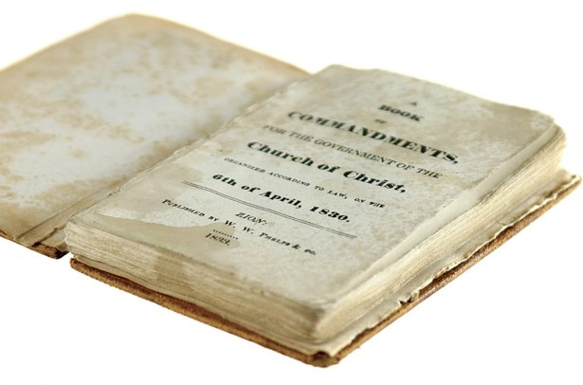
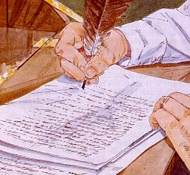
Background
November 1, 1831
Section 67 is in reference to Section 1 now being revealed as part of the Book of Commandments and waiting to be published
Many Church leaders supported publishing the revelations that the Prophet Joseph Smith had received and understood that they came from God.
Others focused on the imperfections they perceived in the revelations and, as a result, were unsure that they came from the Lord.
Joseph Smith had a collection of revelations from the Lord, but very few people had access to copies of them. The Lord revealed that they needed to publish them in a book. Like the Book of Mormon, the Book of Commandments (later published as the Doctrine and Covenants) was supposed to include testimonies from witnesses. However, some Church leaders were reluctant to testify; they had concerns with some of the language and wanted to improve it.
Section 66 and 67 were received at the same time

Slide 3
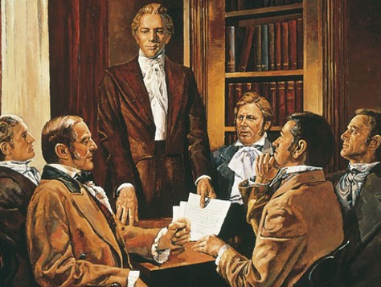
Ye Elders
Joseph Smith Jr.
Oliver Cowdery
Sidney Rigdon
William E. McLellin,
David Whitmer
John Whitmer
Peter Whitmer Jr.
Orson Hyde
Luke Johnson
Lyman Johnson
Only 10 were present
D&C 67:1

Slide 4
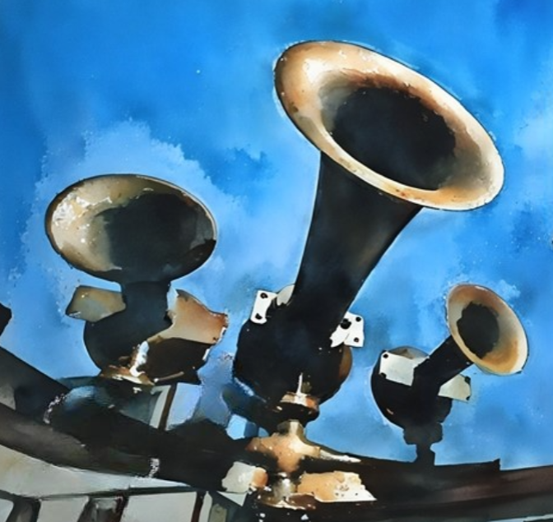
Behold and Harken
The Lord heard their prayers
The Lord knew what was in their hearts
The Lord was in their midst and His eyes were upon them
The Lord hears our prayers and knows our hearts, and can give us a testimony of the truth we seek.
Harken---The Lord requires their attention
D&C 67:1

Slide 5
Fear of making mistakes
What fears do people have that may stop them from obtaining blessings?
Fear of changing their lives
Fear of not fitting in
Fear of failure
Fear of repentance
Fear of rejection by loved ones
D&C 67:3

Slide 6
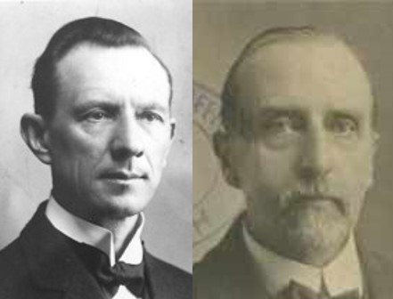
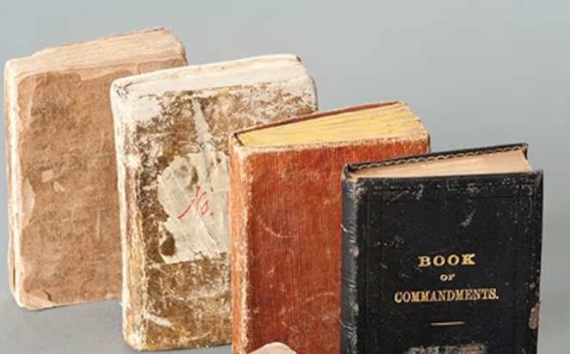
Lack of Faith
“The assembled Elders, or some of them, failed to receive a blessing which they had expected.
What that blessing was is not stated. It might have been a special manifestation concerning the Book of Commandments; or, some miraculous manifestation after the laying on of hands by the Prophet .
But whatever it was, some had failed to receive what they expected, and the reason is here stated: they lacked faith, and were consequently, dominated by fear.”
Smith and Sjodahl
The Book of Commandments was the original title for the collection of revelations that was to be published. When the press and most of the copies were destroyed by a mob in Jackson County, the Prophet decided to add additional revelations that had been received in the meantime. The expanded edition was called the Book of Doctrine and Covenants in 1835.
Student Manual
D&C 67:4, 14

Slide 7
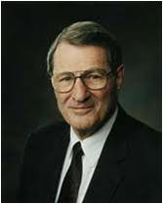
Imperfections
Why should we sustain our Church leaders even though we know they are imperfect?
“Imperfect people are, in fact, called by our perfect Lord to assist in His work. The Lord declared to certain associates of Joseph Smith that He knew that they had observed Joseph’s minor imperfections. Even so, the Lord then testified that the revelations given through the Prophet were true!
“Unsurprisingly, therefore, we do notice each other’s weaknesses. But we should not celebrate them. Let us be grateful for the small strides that we and others make, rather than rejoice in the shortfalls. And when mistakes occur, let them become instructive, not destructive.
D&C 67:5-8 Elder Neal A. Maxwell

Slide 8
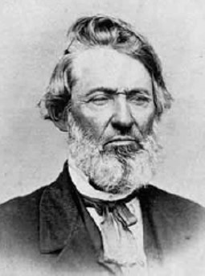
The Additional Test
A Challenge:
William E. McLellin decided to take the Lord’s challenge to write a revelation comparable to those that Joseph Smith had received.
“William E. M’Lellin, as the wisest man, in his own estimation, having more learning than sense, endeavored to write a commandment like unto one of the least of the Lord’s, but failed; it is an awful responsibility to write in the name of the Lord.
The Elders and all present that witnessed this vain attempt of a man to imitate the language of Jesus Christ, renewed their faith in the fulness of the Gospel, and in the truth of the commandments and revelations which the Lord had given to the Church through my instrumentality; and the Elders signified a willingness to bear testimony of their truth to all the world.” (History of the Church, 1:226).
D&C 67:9

Slide 9
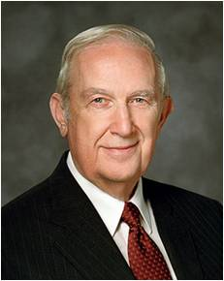
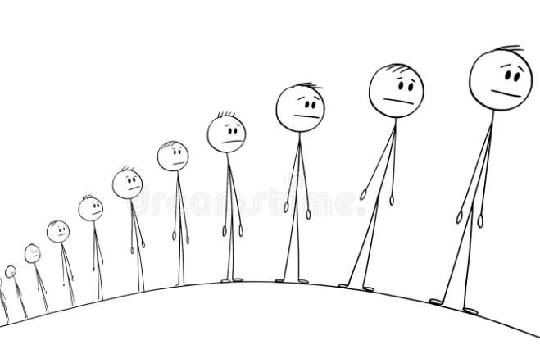
Righteousness With Faith
“None of the revelations contains anything that has a tendency to produce unrighteousness, or to condone it.”
Smith and Sjodahl
The Fruits of faith as you follow the principles God has established for its use.
• Trust in God and in His willingness to provide help when needed, no matter how challenging the circumstance.
• Obey His commandments and live to demonstrate that He can trust you.
• Be sensitive to the quiet prompting of the Spirit.
• Act courageously on that prompting.
• Be patient and understanding when God lets you struggle to grow and answers come a piece at a time over an extended period.
D&C 67:9-13 Elder Richard G. Scott

Slide 10
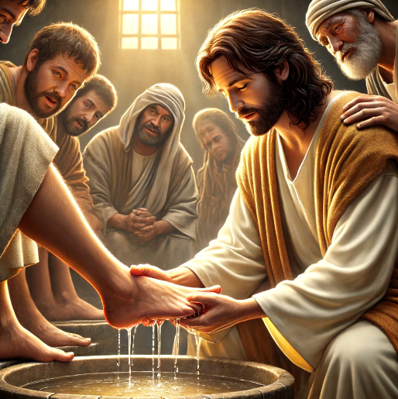
A Greater Spiritual Experience
…inasmuch as you strip yourselves from jealousies and fears, and humble yourselves before me,…
To be humble is to recognize gratefully our dependence on the Lord—to understand that we have constant need for His support. Humility is an acknowledgment that our talents and abilities are gifts from God.
It is not a sign of weakness, timidity, or fear; it is an indication that we know where our true strength lies.
We can be both humble and fearless. We can be both humble and courageous.
Topics and Questions
Humble yourselves in the sight of the Lord, and he shall lift you up.
James 4:10

Slide 11
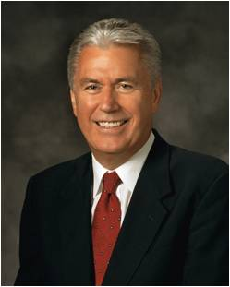
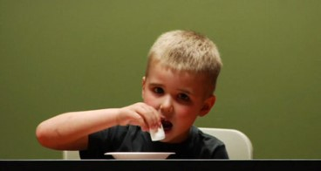
Continue in Patience
“In the 1960s, a professor at Stanford University began a modest experiment testing the willpower of four-year-old children. He placed before them a large marshmallow and then told them they could eat it right away or, if they waited for 15 minutes, they could have two marshmallows.
“He then left the children alone and watched what happened behind a two-way mirror. Some of the children ate the marshmallow immediately; some could wait only a few minutes before giving in to temptation. Only 30 percent were able to wait”
D&C 67:13 President Dieter F. Uchtdorf

Slide 12
Ability to Wait
“As time went on, [the professor] kept track of the children and began to notice an interesting correlation: the children who could not wait struggled later in life and had more behavioral problems, while those who waited tended to be more positive and better motivated, have higher grades and incomes, and have healthier relationships.
“… The ability to wait—to be patient—was a key character trait that might predict later success in life. …
“… Without patience, we cannot please God; we cannot become perfect. Indeed, patience is a purifying process that refines understanding, deepens happiness, focuses action, and offers hope for peace”
If we strip ourselves of jealousy and fear, humble ourselves, and continue in patience, we will be able to abide the presence of God.
D&C 67:10-14 President Dieter F. Uchtdorf

Slide 13
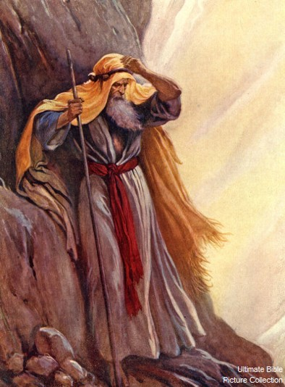
Natural Man Cannot See God
“The Natural man cannot see God, or abide in His presence, nor in the presence of angels, unless he be “quickened” by the Spirit of God”
Smith and Sjodahl
“…that sinful people can’t see God—only those who believe. And even then, a righteous person must be changed—transfigured—to see God (see D&C 67:11).
In the Pearl of Great Price account of Moses seeing God, Moses explains that it was his spiritual, not natural, eyes that saw God (see Moses 1:11).
Question and Answers
D&C 67:12

Slide 14
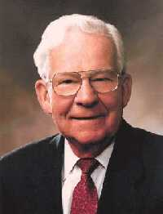
When Ye Are Worthy
Worthiness is a process, and perfection is an eternal trek. We can be worthy to enjoy certain privileges without being perfect.
Marvin J. Ashton
“I believe the Lord meant just what he said: that we should be perfect, as our Father in heaven is perfect. That will not come all at once, but line upon line, and precept upon precept, example upon example, and even then not as long as we live in this mortal life, for we will have to go even beyond the grave before we reach that perfection and shall be like God.”
Bruce R. McConkie

Slide 15
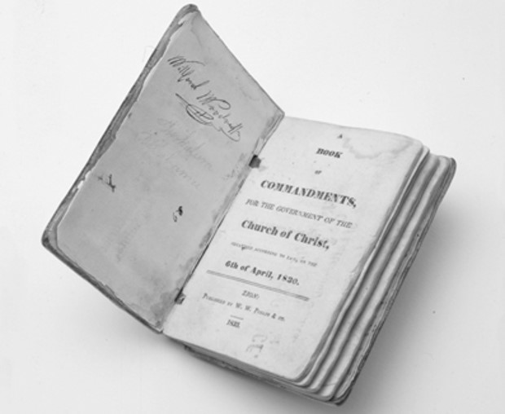
Sources:
Videos:
I’m a Mormon, Athlete, and Amputee Who Built a Leg (4:21
Continue in Patience---same as Marshmallow Experiment (2:41)
Hyrum M. Smith and Janne M. Sjodahl Doctrine and Covenants Commentary pg. 405, 407
Doctrine and Covenants Student Manual Religion 324-325 Section 67
Elder Richard G. Scott The Sustaining Power of Faith in Times of Uncertainty and Testing April 2003 Gen. Conf.
President Dieter F. Uchtdorf (“Continue in Patience,” Ensign or Liahona, May 2010, 56).
Presentation by ©http://fashionsbylynda.com/blog/
Questions and Answers How can I respond when my friends say that no man can see God? August 2011 Ensign
Doctrines of Salvation, comp. Bruce R. McConkie, 3 vols., Salt Lake City: Bookcraft, 1954–56, 2:18–19.
Marvin J. Ashton “On Being Worthy”
Presentation by ©http://fashionsbylynda.com/blog/

Slide 16
The conference:
“When Oliver Cowdery and John Whitmer were ready to start for Jackson County, Missouri, the Prophet decided that a conference of elders should convene at the Johnson home in Hiram to consider matters of importance pertaining to the duties assigned them. Foremost on his agenda was the publication of the revelations he had been preparing and arranging for publication for over a year.
“On the first day of the conference, November 1, 1831, the Lord approved the publication of the revelations by giving what is commonly referred to as the Lord’s own preface to the Book of Commandments. (D&C 1.) Its purpose was to serve as an introduction to the contents of the entire book. In this revelation the Lord proclaimed to the whole world his message of repentance and the fact that through his servant Joseph Smith, Jr., the gospel for the salvation of mankind was restored. ‘Wherefore the voice of the Lord is unto the ends of the earth, that all that will hear may hear: Search these commandments, for they are true and faithful, and the prophecies and promises which are in them shall all be fulfilled.’ (D&C 1:11, 37.)
“At the conference the elders decided that ten thousand copies of the sixty-five revelations should be printed under the title, ‘Book of Commandments.’ Oliver Cowdery read the Lord’s preface, and several brethren arose and bore witness to its truth and the truth of all the revelations received by the Prophet. The Prophet expressed his deep gratitude for the Lord’s commandments. He entertained no doubts concerning the divine inspiration of the revelation he received for the guidance of the Church. …
“Not all those present at the conference fully approved the revelations. One at least, questioned the language of them: William E. McLellin. The challenge was answered in a revelation: [D&C 67:5–8].
“McLellin, who, in the words of the Prophet, had ‘more learning than sense, endeavored to write a commandment like unto one of the least of the Lord’s.’ [History of the Church, 1:226.] McLellin had taught school rather successfully in five states of the Union and had acquired considerable learning. His attempt to write a revelation was a miserable failure. Joseph Smith said: ‘… It was an awful responsibility to write in the name of the Lord. The Elders and all present that witnessed this vain attempt of a man to imitate the language of Jesus Christ, renewed their faith in the fulness of the Gospel, and in the truth of the commandments and revelations which the Lord had given to the Church through my instrumentality. …’ [History of the Church, 1:226]
“After the conference adjourned, Joseph arranged the revelations, and Oliver Cowdery and John Whitmer carried them to Independence for William W. Phelps to print.” (Barrett, Joseph Smith, pp. 200–202.)
Challenging the language of the revelation:
Some of the elders at this time questioned the language of the revelations. They were looking at misspellings, errors in grammar, and other peculiarities. They reasoned that if these revelations were from the Lord, no such mistakes or peculiarities would be found. Thus came the challenge to them from the Lord to write a revelation. Elder Orson F. Whitney stated:
“Well, one of them, who thought himself the wisest, and who possessed some learning, took up the challenge and actually attempted to frame a revelation; but it was a flat failure. He could utter, of course, certain words, and roll out a mass of rhetoric; but the divine spirit was lacking, and he had to acknowledge himself beaten.
“It is not so easy to put the spirit of life into things. Man can make the body, but God alone can create the spirit.” (In Conference Report, Apr. 1917, p. 42.)
Seeing God:
One remarkable truth of the restored gospel is that the heavens are not sealed, that God still speaks to His children and reveals His will to them. And one amazing aspect of that knowledge is that God will reveal Himself to individuals who meet certain prerequisites. The scriptures record that many ancient prophets saw God, and the present dispensation was opened by a vision in which God and Christ appeared to Joseph Smith in the Sacred Grove. But several places in the Doctrine and Covenants, including section 67, teach that this privilege is not reserved for prophets alone but for anyone willing to pay the price required in personal righteousness. The Prophet Joseph Smith taught that “after a person has faith in Christ, repents of his sins, and is baptized for the remission of his sins and receives the Holy Ghost, (by the laying on of hands), which is the first Comforter, then let him continue to humble himself before God, hungering and thirsting after righteousness, and living by every word of God, and the Lord will soon say unto him, Son, thou shalt be exalted. When the Lord has thoroughly proved him, and finds that the man is determined to serve Him at all hazards, then the man will find his calling and his election made sure, then it will be his privilege to receive the other Comforter, which the Lord hath promised the Saints, as is recorded in the testimony of St. John, in the 14th chapter, from the 12th to the 27th verses. …
“Now what is this other Comforter? It is no more nor less than the Lord Jesus Christ Himself; and this is the sum and substance of the whole matter; that when any man obtains this last Comforter, he will have the personage of Jesus Christ to attend him, or appear unto him from time to time, and even He will manifest the Father unto him, and they will take up their abode with him, and the visions of the heavens will be opened unto him, and the Lord will teach him face to face, and he may have a perfect knowledge of the mysteries of the Kingdom of God; and this is the state and place the ancient Saints arrived at when they had such glorious visions—Isaiah, Ezekiel, John upon the Isle of Patmos, St. Paul in the three heavens, and all the Saints who held communion with the general assembly and Church of the Firstborn.” (Teachings, pp. 150–51.)

