Slide 1

Doctrine and Covenants 68
Preaching by the Holy Spirit
For the prophecy came not in old time by the will of man: but holy men of God spake as they were moved by the Holy Ghost.
2 Peter 1:21
Presentation by ©http://fashionsbylynda.com/blog/

Slide 2
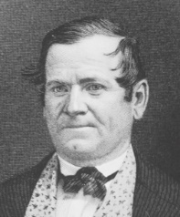
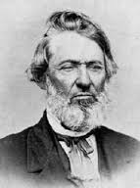
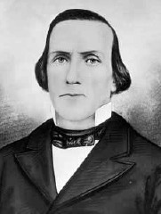
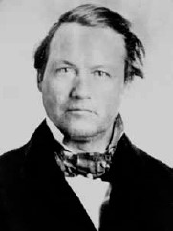
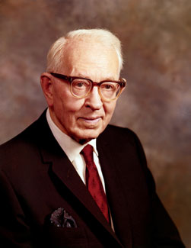
Background
“At the close of the conference of November 1–12, 1831, Elders Orson Hyde, Luke Johnson, Lyman E. Johnson and William E. M’Lellin, came to the Prophet and sought the will of the Lord concerning themselves, and their ministry. The Prophet made inquiry and received the revelation which appears as Section 68.
Surely the Lord in his wisdom poured out knowledge, line upon line, precept upon precept as the members of the Church were prepared to receive it.”
President Joseph Fielding Smith

Slide 3
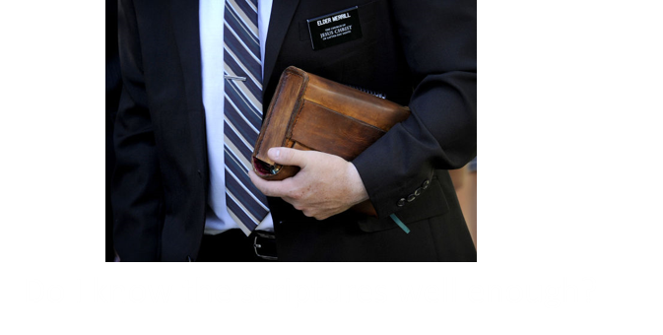
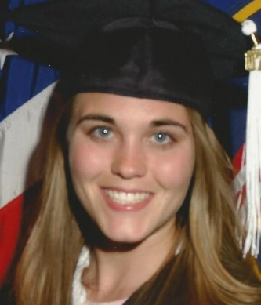


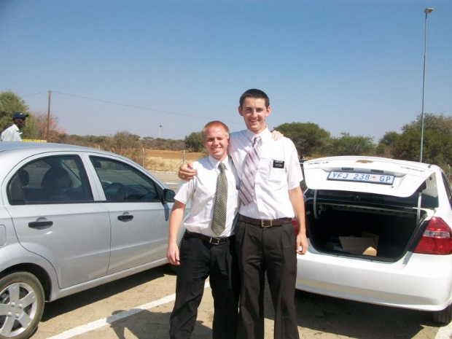

Preparing For A Mission
What worries or concerns might someone have about serving a full-time mission?
What about “My Girl”?
Can I leave my family and the comforts of home?
Will I get along with my companions?
Will I like the place where I will be going?

Slide 4





Uncertainty
What are some reasons people sometimes feel nervous about sharing the gospel with their family members and friends?

Slide 5
Orson Hyde
He was born on January 8, 1805, at Oxford, Connecticut and he was an orphan at youth
As a teenager he moved to Ohio and got a job at the Gilbert and Whitney Store in Kirtland
He was baptized by Sidney Rigdon on October 30, 1831
He was called to preach the gospel and went on a mission with Samuel Smith
He was part of the “School of Prophets” and very knowledgeable and knew the Bible in English, German, and Hebrew
He was a clerk for the First Presidency and recorded many of the early revelations.
After participating in Zion’s Camp, he returned to Kirtland and was called to the council of the Twelve Apostles in 1835
He served a mission in Great Britain with Heber C. Kimball
He lost his fellowship in the Church in 1838 and repented
He dedicated the Holy Land on October 24, 1841
He moved with the Saints to Salt Lake Valley in 1852 and was a member of the Quorum of Twelve and a distinguished public figure
He passed away on November 28, 1878
Who’s Who

Slide 6
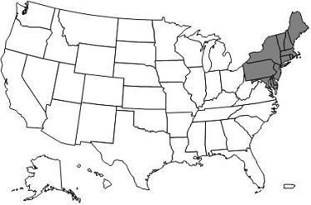

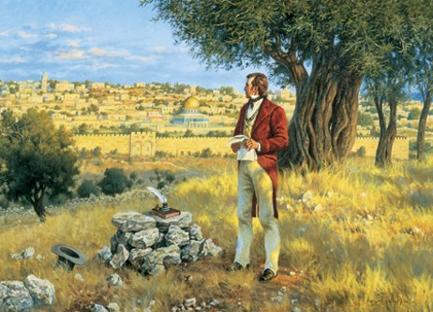
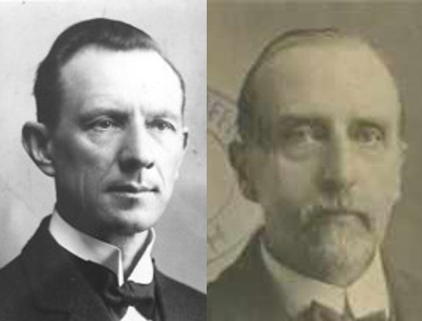
A Prophecy
From People to People, land to land
“The prophecy in this verse was literally fulfilled. Orson Hyde proclaimed the gospel ‘from people to people, from land to land.’ In 1832, he and Samuel H. Smith traveled in the States of New York, Massachusetts, Maine, and Rhode Island—two thousand miles—on foot.
In 1835 he was ordained an Apostle, and in 1837 he went on a mission to England.
In 1840 he was sent on a mission to Jerusalem. He crossed the Ocean, traveled through England and Germany, visited Constantinople, Cairo, and Alexandria, and, finally, reached the Holy City.
On October 24th, 1841, he went up on the Mount of Olives and offered a prayer, dedicating Palestine for the gathering of the Jews.”
Smith and Sjodahl
D&C 68:1

Slide 7
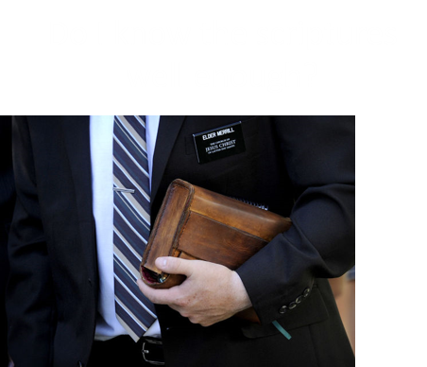
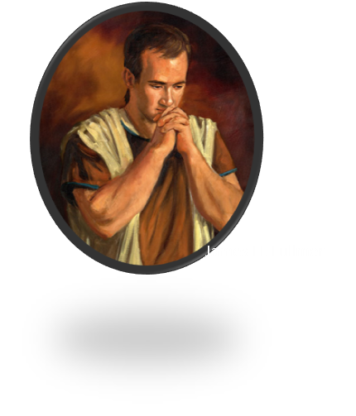
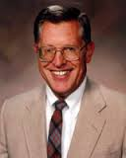
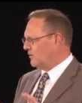
A Pattern For Preaching
Ensample: A model, or a pattern
…Behold, I have fasted and prayed many days that I might know these things of myself. And now I do know of myself that they are true; for the Lord God hath made them manifest unto me by his Holy Spirit; and this is the spirit of revelation which is in me.
Alma 5:46
“The things of the Spirit can be known only by the Spirit, it is the obligation of those who teach from the scriptures to know by revelation the verity of that which they teach.”
McConkie and Osteler
D&C 68:2-3; D&C 50:13-22

Slide 8
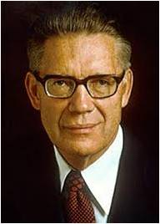


The Spirit Directs and Adds Personal Revelation
“Those who preach by the power of the Holy Ghost use the scriptures as their basic source of knowledge and doctrine.
They begin with what the Lord has before revealed to other inspired men.
But it is the practice of the Lord to give added knowledge to those upon who hearts the true meaning and intents of the scripture have been impressed.
…when they are in tune with the Infinite, the Lord lets them know, first the full and complete meaning of the scriptures…”
Elder Bruce R. McConkie
D&C 68:2-3

Slide 9
Scripture is the Mind and will of the Lord
None of the 4 men who were called to preach were over 27 years old, and all were only members for a few months
“By the world’s standards they were too young to be learned in theology, but their God loved young men who had faith.”
“Their success depended on their companionship with the Holy Spirit.”
When the Lord’s servants are moved upon by the Holy Ghost, their words will lead people to salvation
However:
Only the President of the Church has the right to receive and declare the will of the Lord for the entire Church. Under his direction, the other members of the First Presidency and the members of the Quorum of the Twelve Apostles also have the authority to declare God’s will for us.
D&C 68:4-5 excerpts from McConkie and Ostler

Slide 10
Luke S. Johnson
He was born on November 3, 1807, at Pomfret, Vermont and the son of John and Elsa Johnson
He was baptized after his parents on May 20, 1831, by Prophet Joseph Smith
He was called on a mission in November of 1831
He participated in Zion’s Camp as a scout and upon his return to Kirtland he was called to serve in the high council of the Church
In February 1835 he became a member of the Quorum of Twelve
His faith weakened and he was excommunicated in Far West in 1838
He remained strong to Joseph Smith and the Smith family and was rebaptized in March 1846
In 1847 he journeyed to the Salt Lake Valley along with the original company of pioneers
He served in various church leadership capacities and died on December 9, 1861
Who’s Who

Slide 11
Lyman E. Johnson
He was born on October 24, 1811, at Pomfret, Vermont, the son of John and Elsa Johnson, and younger brother to Luke Johnson
Following his baptism he was called to preach the gospel
He received a second mission call the next year as a companion with Orson Pratt
After serving in Zion’s Camp he was chosen as the first apostle to serve in the Quorum of the Twelve
He was disfellowshipped in 1837 over specious charges against the Prophet Joseph Smith, but later repented and was reinstated.
His return to the Church was short lived and was excommunicated on April 13, 1838 for apostate actions, but remained friendly toward the Saints and lamented over his downfall
He passed away in a sleighing accident in 1856
Who’s Who

Slide 12
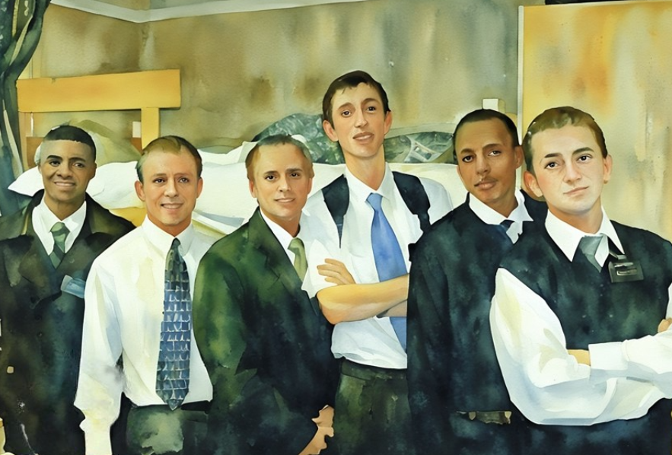
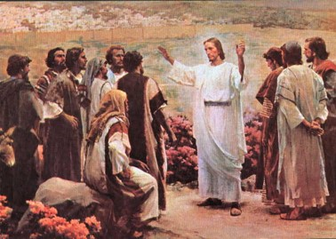
Calling Faithful Elders
And he said unto them, Go ye into all the world, and preach the gospel to every creature.
Mark 16:15
Go Ye into all the world---the same language that Christ commissioned the meridian Twelve to go into “all the world” to declare his gospel
This could also be our commission to preach the gospel whether it be among our friends and family or out into the world as full-time missionaries.
D&C 68:8

Slide 13
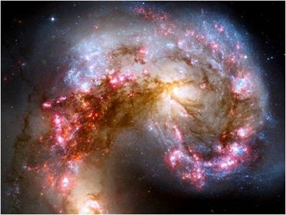


Faith Reveals Signs
People often desire to see a sign or hear a voice from the unseen world.
This desire may be manifest in some members of the Church at some stage of their spiritual development. A few honestly believe that such an experience would greatly strengthen their testimony or convince nonbelievers of the truth of the gospel of Jesus Christ.
People who possess such a notion should remember that signs are not usually given before faith is shown, for such desires and manifestations are a detriment to the development of true faith and are the symptoms of wickedness.
Signs are the offspring of faith and serve to confirm righteousness.
Signs follow faith, and without faith no miracle can occur. The outward manifestation of God’s power is an assurance that our faith and righteousness have received divine sanction.
Student Manual
D&C 68:10

Slide 14
Calling of Bishops
Bishop Partridge was the only bishop in the Church. Other bishops were called shortly after the Prophet received this revelation.
Applied only to the office of Presiding Bishop of the Church:
“It has no reference whatever to bishops of wards. Further, such a one must be designated by the First Presidency of the Church and receive his anointing and ordination under their hands.
The revelation comes from the Presidency, not from the patriarch, to establish a claim to the right to preside in this office. In the absence of knowledge concerning such a descendant, any high priest, chosen by the Presidency, may hold the office of Presiding Bishop and serve with counselors.”
President Joseph Fielding Smith
D&C 68:14-15

Slide 15
Descendent of Aaron
“The office of Presiding Bishop of the Church is the same as the office which was held by Aaron. …
It was this office which came to John the Baptist, and it was by virtue of the fact that he held the keys of this power and ministry that he was sent to Joseph Smith and Oliver Cowdery to restore that Priesthood, May 15, 1829.
The person who has the legal right to this presiding office has not been discovered; perhaps is not in the Church, but should it be shown by revelation that there is one who is the ‘firstborn among the sons of Aaron,’ and thus entitled by birthright to this presidency, he could ‘claim’ his ‘anointing’ and the right to that office in the Church.”
Joseph Fielding Smith
D&C 68:15-21

Slide 16
A Legal Right to the Bishopric
“As the descendants of Abraham have right by birth to the priesthood, assuming worthiness, so the first-born of son of Aaron and his posterity down through the generations have a right by birth to the office Aaron held.
The word bishopric, as used in scripture, simply means “office,” and in this case the office of bishop does not have reference to the presidency of three that presides over either the Aaronic Priesthood or wards.”
McConkie and Ostler
D&C 68:15-21

Slide 17

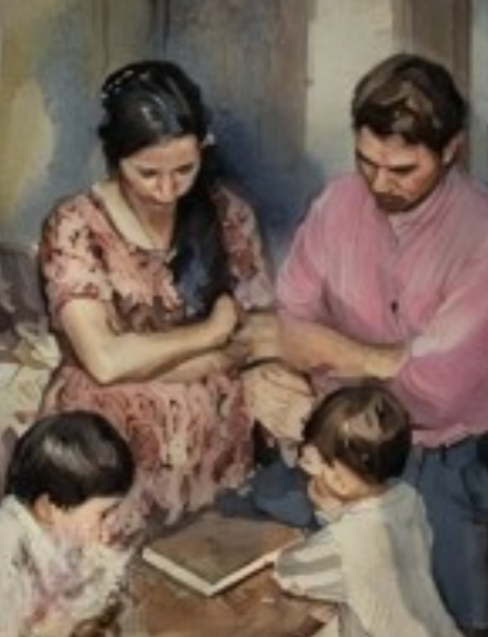
Parents Commanded to Teach Children
Why do you think it would be important for you to teach your children to pray?
How were you taught to pray?
How has prayer blessed you and your family?
What do you think it means to “walk uprightly before the Lord”?
The Lord has commanded parents to teach their children to understand the doctrine of repentance, faith in Christ, baptism, and the gift of the Holy Ghost
D&C 68:25-28

Slide 18

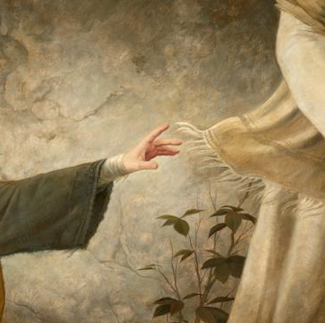

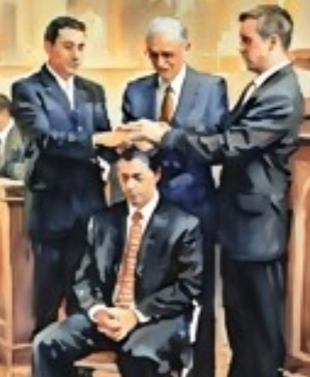
F
B
A
A
I
R
E
P
E
N
T
A
N
C
E
T
H
I
H
O
L
Y
G
H
O
S
T
M
D&C 68:25

Slide 19
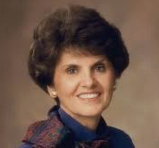
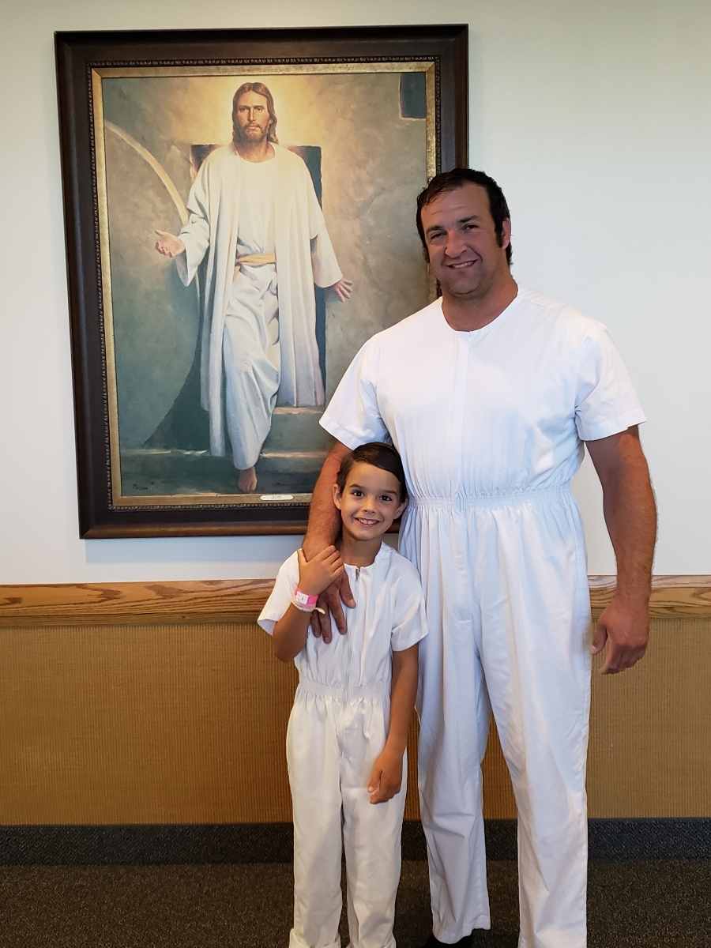
Age of Accountability=8
…little children are whole, for they are not capable of committing sin; Moroni 8:8
Accountability is the natural product of agency and is the basis of the plan of life.
We are responsible for our own actions and accountable to God for what we choose to do with our lives.
Spiritual maturity is understanding that we cannot blame anybody else for our actions.
Some factors may make it harder for us to perform according to God’s plan for us, but being accountable for how we use our agency means being answerable for our own behavior.
Elaine Cannon
D&C 68:27

Slide 20


Keeping the Sabbath Day Holy
“The Lord has commanded us not to be idle. Idleness can lead to inappropriate behavior, damaged relationships, and sin. One form of idleness is spending excessive amounts of time in activities that keep you from productive work, such as using the Internet, playing video games, and watching television”
For the Strength of Youth
How can idleness lead to wickedness?
What are some things that can help a person overcome a tendency to be lazy?
We are to eliminate idleness and greediness from our lives
D&C 68:29-30

Slide 21
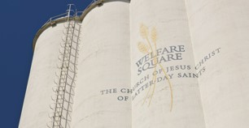

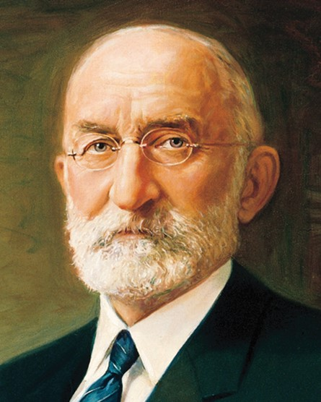
Eliminate Idleness and Greediness
“This principle involved living the law of consecration, and it was being practiced in Zion (or Missouri) when this revelation was given.” McConkie and Ostler
Today:
These same principles are done through our welfare system.
In 1936:
“Our primary purpose was to set up, in so far as it might be possible, a system under which the curse of idleness would be done away with, the evils of a dole abolished, and independence, industry, thrift and self-respect be once more established amongst our people. The aim of the church is to help the people to help themselves.”
President Heber J. Grant
D&C 68:31-32

Slide 22

Judge of My People
“The common judge in Israel is the ward bishop. It is his duty to watch over his flock.
To aid him he has the force of the Aaronic Priesthood and all of the brethren holding the Melchizedek Priesthood who are at liberty and who may be called to serve as acting teachers and priests in his ward.”
Joseph Fielding Smith
“We ought to be a praying people”
Joseph Fielding Smith
D&C 68:33

Slide 23
Sources:
Video:
Parents: The Prime Gospel Teachers of Their Children (0:55)
(Smith and Sjodahl, Commentary, p. 409.)
President Joseph Fielding Smith (Church History and Modern Revelation, 1:257–58.)
Elder Bruce R. McConkie Promised Messiah pgs. 515-516
Doctrine and Covenants Who’s Who by Ed J. Pinegar and Richard J. Allen pgs 54-55, 78-80
Revelations of the Restoration by Joseph Fielding McConkie and Craig J. Ostler pg. 487, 491, 493
Doctrine and Covenants Student Manual Religion 324-325 Section 68
President Joseph Fielding Smith (Doctrines of Salvation, 3:92.)
A praying people--Conference Report October 1918, 57
Presentation by ©http://fashionsbylynda.com/blog/
(Smith, Church History and Modern Revelation, 1:259.)
(For the Strength of Youth [booklet, 2011], 40).
President Heber J. Grant Conference Report October 1936,3
Joseph Fielding Smith, Church History and Modern Revelation, 1:261
Elaine Cannon “Agency and Accountability” October 1983 Gen. Conf.
Presentation by ©http://fashionsbylynda.com/blog/

Slide 24
What are scriptures:
Scripture is the mind and will of God revealed through His servants. Peter declared, “Prophecy came not in old time by the will of man: but holy men of God spake as they were moved by the Holy Ghost” (2 Peter 1:21). Such scripture has been written and preserved in the standard works as priceless gems of eternal truth. The standard works are not the only source of scripture, however. As President Joseph Fielding Smith taught: “When one of the brethren stands before a congregation of the people today, and the inspiration of the Lord is upon him, he speaks that which the Lord would have him speak. It is just as much scripture as anything you will find written in any of these records, and yet we call these the standard works of the Church. We depend, of course, upon the guidance of the brethren who are entitled to inspiration.
“There is only one man in the Church at a time who has the right to give revelation for the Church, and that is the President of the Church. But that does not bar any other member in this Church from speaking the word of the Lord, as indicated here in this revelation, section 68, but a revelation that is to be given as these revelations are given in this book, to the Church, will come through the presiding officer of the Church; yet, the word of the Lord, as spoken by other servants at the general conferences and stake conferences, or wherever they may be when they speak that which the Lord has put into their mouths, is just as much the word of the Lord as the writings and the words of other prophets in other dispensations.” (Doctrines of Salvation, 1:186.)
Elder Harold B. Lee further defined scripture when he said: “It is not to be thought that every word spoken by the General Authorities is inspired, or that they are moved upon by the Holy Ghost in everything they read and write. Now you keep that in mind. I don’t care what his position is, if he writes something or speaks something that goes beyond anything that you can find in the standard church works, unless that one be the prophet, seer, and revelator—please note that one exception—you may immediately say, ‘Well, that is his own idea.’ And if he says something that contradicts what is found in the standard church works (I think that is why we call them ‘standard’—it is the standard measure of all that men teach), you may know by that same token that it is false, regardless of the position of the man who says it.” (The Place of the Living Prophet, Seer, and Revelator [address delivered to seminary and institute of religion faculty, 8 July 1964], p. 14.)
President J. Reuben Clark Jr. said:
“How shall we know when the things they have spoken were said as they were ‘moved upon by the Holy Ghost?’
“I have given some thought to this question, and the answer thereto so far as I can determine, is: We can tell when the speakers are ‘moved upon by the Holy Ghost’ only when we, ourselves, are ‘moved upon by the Holy Ghost.’
“In a way, this completely shifts the responsibility from them to us to determine when they so speak.” (When Are the Writings or Sermons of Church Leaders Entitled to the Claim of Scripture? [address delivered to seminary and institute of religion personnel, 7 July 1954], p. 7.)
Transgression of Bishops
“In case of the transgression of the presiding bishop of the Church, he could not be tried by a high council in the stake in which he lives, but he would have to be tried by the First Presidency of the Church. The reason for this is that he … is not under the jurisdiction of any ward or stake in this capacity. This order given for the trial of the presiding bishop does not apply to a local bishop in a ward, who is under the jurisdiction of the presidency of the stake.” (Smith, Church History and Modern Revelation,1:259–60.)

Slide 25
Teaching Your Children:
Elder Harold B. Lee pointed out that the Lord “gave us what we might style as a five-point program by which parents could teach faith. First, he said, their children were to be baptized when they had reached the age of accountability at eight years; second, they were to be taught to pray; third, they were to be taught to walk uprightly before the Lord; fourth, they were to be taught to keep the Sabbath day holy; and fifth, they were to be schooled not to be idle, either in the Church, or in their private lives.
“All parents who have followed that formula and have so taught their children have reaped the reward of an increased faith in their family, which has stood and will yet stand the test of the difficulties into which their children would yet go.” (In Conference Report, Oct. 1952, p. 17.)
President N. Eldon Tanner noted: “Children who are taught obedience, to honor and obey the law, to have faith in God and to keep his commandments, will, as they grow up, honor their parents and be a credit to them; and they will be able to meet and solve their problems, find greater success and joy in life, and contribute greatly to the solution of the problems now causing the world such great concern. It is up to the parents to see to it that their children are prepared through obedience to law for the positions of leadership they will occupy in the future, where their responsibility will be to bring peace and righteousness to the world.” (In Conference Report, Apr. 1970, p. 65.)
Regarding rebellious children of righteous parents, President Spencer W. Kimball observed:
“I have sometimes seen children of good families rebel, resist, stray, sin, and even actually fight God. In this they bring sorrow to their parents, who have done their best to set in movement a current and to teach and live as examples. But I have repeatedly seen many of these same children, after years of wandering, mellow, realize what they have been missing, repent, and make great contribution to the spiritual life of their community. The reason I believe this can take place is that, despite all the adverse winds to which these people have been subjected, they have been influenced still more, and much more than they realized, by the current of life in the homes in which they were reared. When, in later years, they feel a longing to recreate in their own families the same atmosphere they enjoyed as children, they are likely to turn to the faith that gave meaning to their parents’ lives.
“There is no guarantee, of course, that righteous parents will succeed always in holding their children, and certainly they may lose them if they do not do all in their power. The children have their free agency.
“But if we as parents fail to influence our families and set them on the ‘strait and narrow way,’ then certainly the waves, the winds of temptation and evil will carry the posterity away from the path.
“‘Train up a child in the way he should go; and when he is old, he will not depart from it.’ (Prov. 22:6.) What we do know is that righteous parents who strive to develop wholesome influences for their children will be held blameless at the last day, and that they will succeed in saving most of their children, if not all.” (In Conference Report, Oct. 1974, p. 160; or Ensign, Nov. 1974, pp. 111–12.)

