Slide 1
Doctrine and Covenants 69-70
The Lord’s Steward
Presentation by ©http://fashionsbylynda.com/blog/

Slide 2
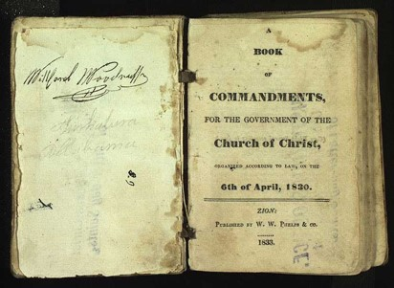
Background
November 1831
Each of the revelations selected for that volume was placed there because the Prophet considered it had some value to the Church in regard to its teachings.
There are some revelations still in possession of the Church which were not included. Some of these we can readily believe were not included because the inspiration of the Prophet was that it was not necessary, or because some of them had an application which was not intended for publication and to be sent to an unbelieving world.
HC
The Lord expects histories to be kept for the good of the Church and the rising generations
The Prophet Joseph Smith stated, “the Book of Commandments and Revelations was to be dedicated by prayer to the service of Almighty God by me; and after I had done this, I inquired of the Lord concerning these things, and received the following (Section 69):

Slide 3
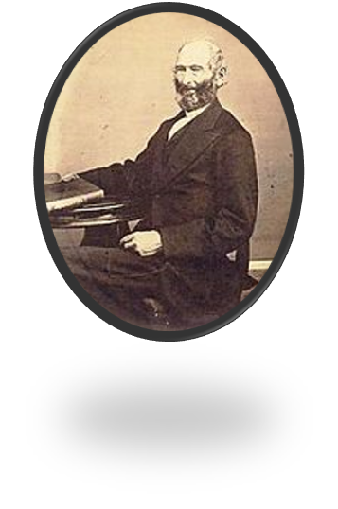
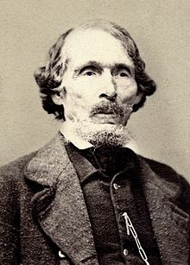
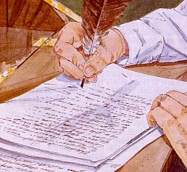
Something of Value
The Lord appoints John Whitmer to accompany Oliver Cowdery in delivering the manuscripts to Missouri where William W. Phelps would print them.
They left on 20 November, tarried a week in Winchester, Indiana, and arrived in Independence on 5 January 1832
John Whitmer was to continue as Church Historian
(D&C 47:2)
Manuscripts—
The Book of Commandments
A compilation of revelations received by the Prophet Joseph Smith
D&C 69:1-3

Slide 4
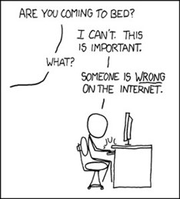
Historical Records
“The historical records of the church are exceeding valuable documents, and, as years go by, they increase in value to the entire world.
In the Records of the Church historians will always be found reliable sources of information concerning the Church.”
“Other historians either ignore the Church or write about it from a prejudiced, or even hostile, point of view.”
When reading on the internet or other sources of Church History your best bet whether it is true or false will come to you as a witness through the Holy Ghost.
Smith and Sjodahl

Slide 5
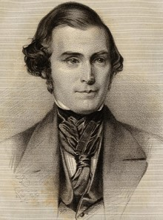
“If every elder had, during the last nineteen years kept a faithful record of all that he had seen, heard, and felt of the goodness, wisdom and power of God, the Church would now have been in possession of many thousand volumes, containing much important and useful information.
How many thousands have been miraculously healed in this Church, and yet no one has recorded the circumstances. Is this right?
Should these miraculous manifestations of the power of God be forgotten and pass into oblivion?
Should the knowledge of these things slumber in the hearts of those who witnessed them? …
We should keep a record because Jesus has commanded it. We should keep a record because the same will benefit us and the generations of our children after us. We should keep a record because it will furnish many important items for the general history of the Church which would otherwise be lost.”
Orson Pratt

Slide 6
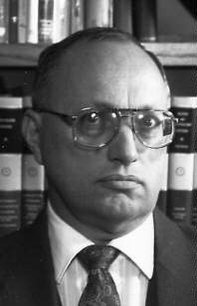
If Only:
If there had been a better record keeping system, there would be more information
If there had been more people on the earth who wrote about their experiences, there would be more information
If there had been a better way to preserve the records, there would be more information
But they taught them that they should keep their record, and that they might write one to another.
Mosiah 24:6
“The people of the northern kingdom that were taken away never returned to reclaim their land, and eventually they became the “lost tribes”—that is, lost to the record-keepers of Judah.”
John Tvedtnes
The only way we are going to know the truth is if we record it ourselves.
The more witnesses of the truthfulness of the Gospel, the more “convincing” the Gospel will be.

Slide 7
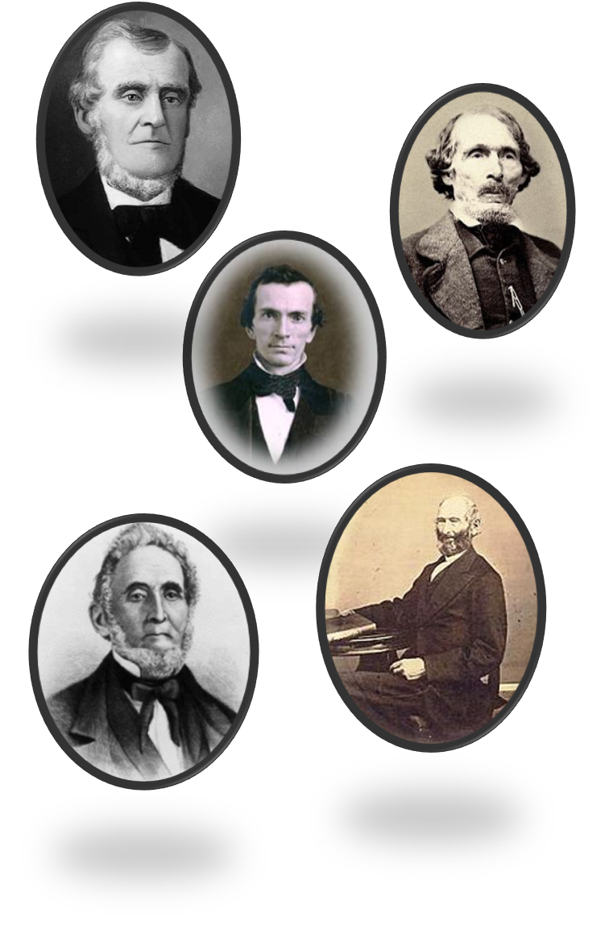
A Steward
Stewardship is not ownership.
Stewardship is management with a responsibility to account to the owner or master.
The basic principle was taught by the Lord when He said: “I, the Lord, stretched out the heavens, and built the earth, my very handiwork; and all things therein are mine.
… Behold, all these properties are mine, … and if the properties are mine, then ye are stewards; otherwise ye are no stewards.”
The Lord will hold us accountable for the duties He has entrusted to us
D&C 70:1-5 Student Manual

Slide 8
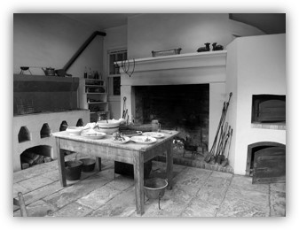
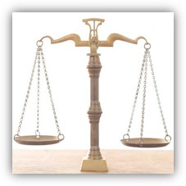
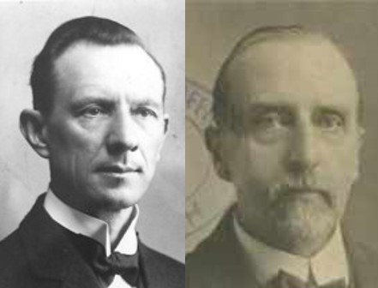
Temporal Needs
The brethren who were given the stewardship of the revelations to be published were to receive their livelihood from the proceeds.
The law of consecration included temporal needs as well as spiritual needs.
“According to the Law of God all share alike; one who administers in spiritual things is “worthy of his hire’ equal with one who manages some business, though the world generally rates business ability higher that spiritual excellence. “In your temporal things you shall be equal”
Smith and Sjodahl
D&C 70:6-14

Slide 9
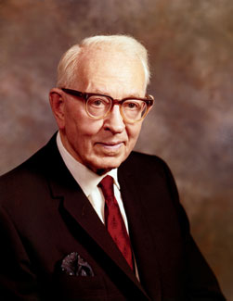
Equal
The dictionary defines equal as being of the same quantity, size, number, value, degree, or intensity. The Lord, however, does not endorse such a definition in His gospel.
“To be equal did not mean that all should have the same amount of food, but each should have according to his needs.
For instance, a man would receive in proportion to the number in his family, not according to the nature of his work.
He was to have, ‘for food and for raiment; for an inheritance; for houses and for lands, in whatsoever circumstances, I the Lord, shall place them, and whithersoever I, the Lord, shall send them.’”
President Joseph Fielding Smith
D&C 70:14

Slide 10
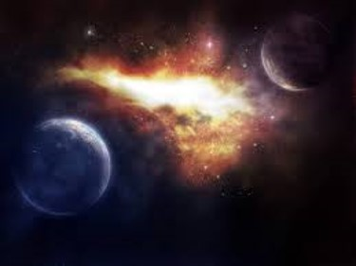
Reward For Diligence
God’s willingness to bless them wit temporal blessings, as well as spiritual
Those who can enjoy heaven can enjoy the earth, also.
D&C 70:15-17 Smith and Sjodahl

Slide 11
Sources:
HC (History of the Church,1:234).
Hyrum M. Smith and Janne M. Sjodahl Doctrine and Covenants Commentary pg. 418-421
Orson Pratt (Millennial Star, 15 May 1849, p. 152.)
Presentation by ©http://fashionsbylynda.com/blog/
John A. Tvedtnes The “Other Tribes”: Which Are They? January 1982 Ensign
Doctrine and Covenants Student Manual Religion 324-325 Section 70
President Joseph Fielding Smith (Church History and Modern Revelation, 1:268–69.)
Presentation by ©http://fashionsbylynda.com/blog/

