Slide 1
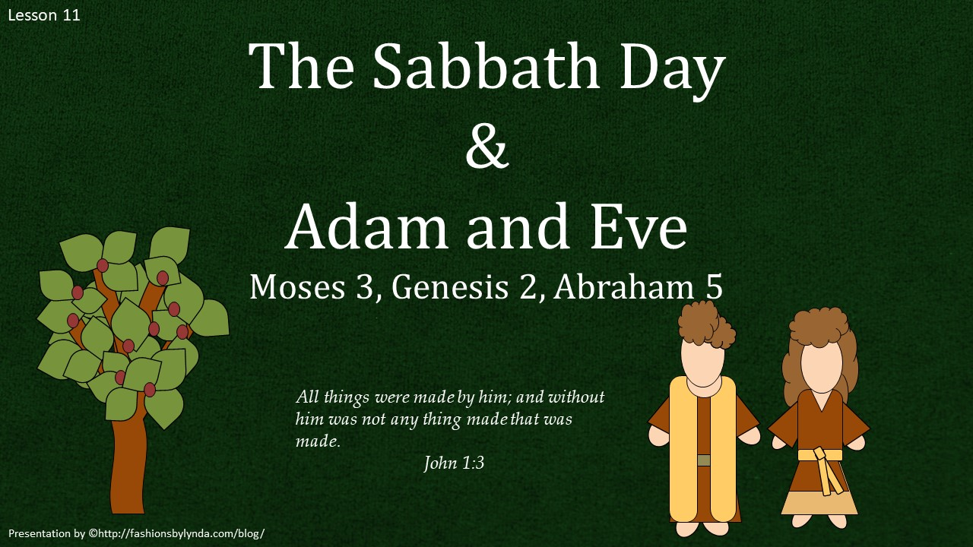

Slide 2

SABBATH
ABBA
Abba another name for Jesus
Moses 3:1-3

Slide 3
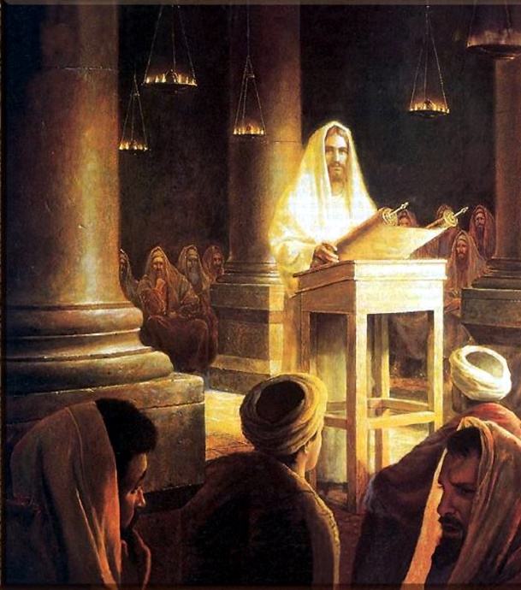
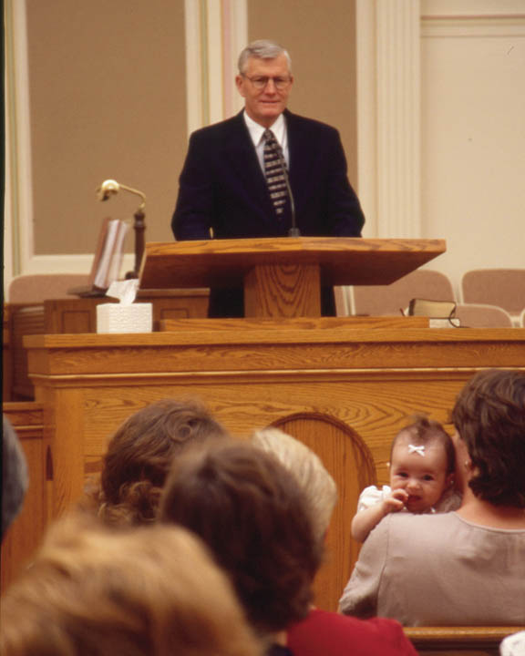
Sabbath Day
A day of religious observance and abstinence from work, kept by Jews from Friday evening to Saturday evening, and by most Christians on Sunday.
Speak thou also unto the children of Israel, saying, Verily my sabbaths ye shall keep: for it is a sign between me and you throughout your generations; that ye may know that I am the Lord that doth sanctify you.
Exodus 31:13
Six days shalt thou labour, and do all thy work:
But the seventh day is the sabbath of the Lord thy God: in it thou shalt not do any work, thou, nor thy son, nor thy daughter, thy manservant, nor thy maidservant, nor thy cattle, nor thy stranger that is within thy gates:
Exodus 20:9-10
Sanctify
To make something sacred or holy.
Moses 3:1-3

Slide 4
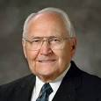
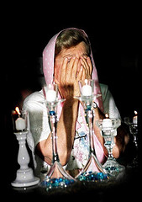
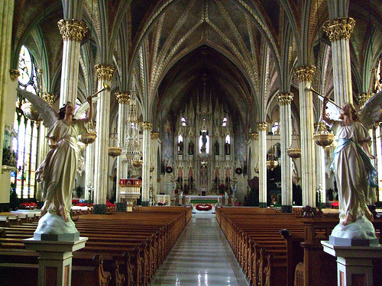
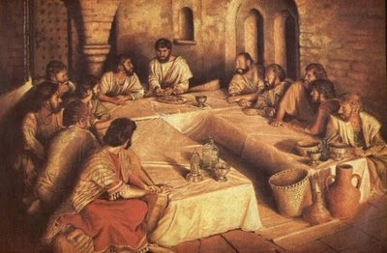
Worship
“The pattern of Sabbath day observance must always include worship”
“It is remarkable that even through the dark periods of apostasy, this pattern of Sabbath day worship and the sacrament continued to be practiced in many forms.”
“When the gospel was restored, Peter, James, and John, three of the Apostles who first received the sacrament from the Savior, appeared to Joseph Smith and Oliver Cowdery”.
We can keep the Sabbath day holy as we rest from our labors and focus on sacred things
Elder L. Tom Perry

Slide 5
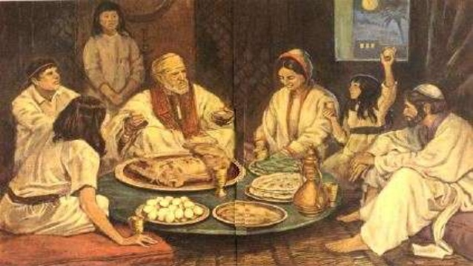
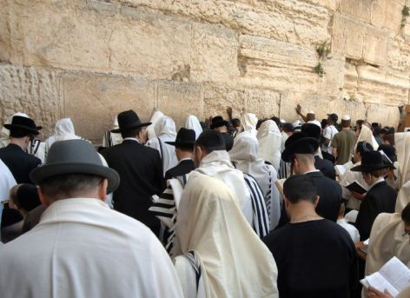
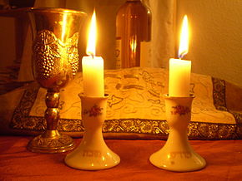
Shabbat--Rest
Shabbat observance entails refraining from work activities, often with great rigor, and engaging in restful activities to honor the day
Judaism's traditional position is that unbroken seventh-day Shabbat originated among the Jewish people, as their first and most sacred institution, though some suggest other origins. Variations upon Shabbat are widespread in Judaism
Shabbat is observed from a few minutes before sunset on Friday evening until the appearance of three stars in the sky on Saturday night.
Shabbat is ushered in by lighting candles and reciting a blessing.
Wikipedia

Slide 6
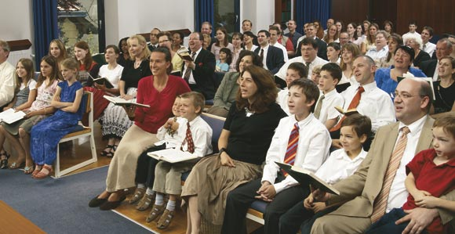
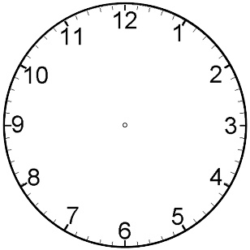
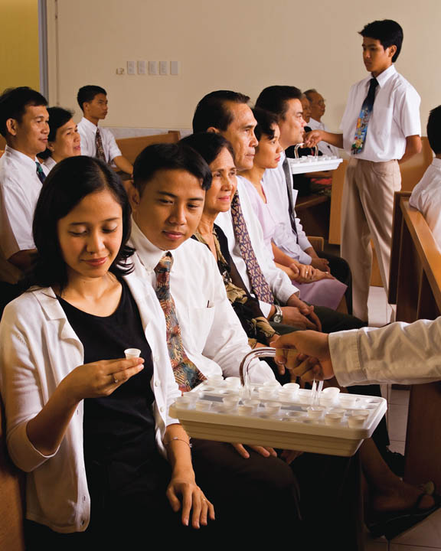
Honoring the Sabbath Day
Honoring the Sabbath day includes attending all your Church meetings. Go to sacrament meeting prepared to worship the Lord and partake worthily of the sacrament.
During sacrament meeting, be reverent and willing to learn. Refrain from activities that would distract you or others during this sacred meeting.
Be on time for your meetings.
As you do these things, you invite the Spirit of the Lord to be with you.
Youth
Moses 3:1-3

Slide 7

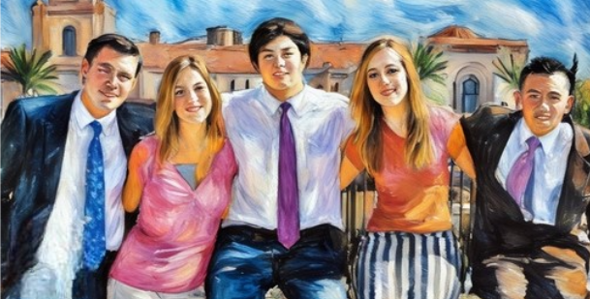

Prepare for The Sabbath Day
Prepare during the week so that you can reserve Sunday for the many uplifting activities that are appropriate for the Sabbath day.
Such activities include spending quiet time with your family, studying the gospel, fulfilling your Church callings and responsibilities, serving others, writing letters, writing in your journal, and doing family history work.
Your behavior and dress on the Sabbath should show respect for the Lord and His holy day.
Youth
Moses 3:1-3

Slide 8

True or False?
Some forms of life on the earth are not creations of God
We lived in heaven as spirit children of god before we were born on earth
Plants and animals were created spiritually in heaven before they were created physically on the earth
True
True
False
True
False
God created the spirits of all living things before they were created physically on the earth.
False
Moses 4-7

Slide 9
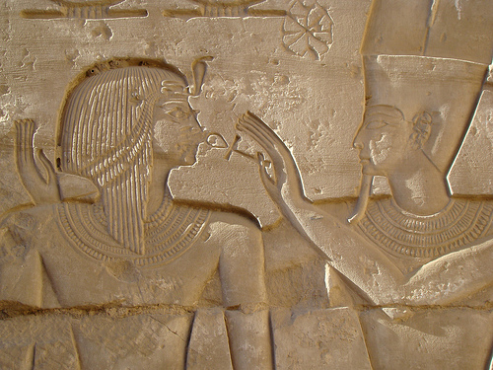
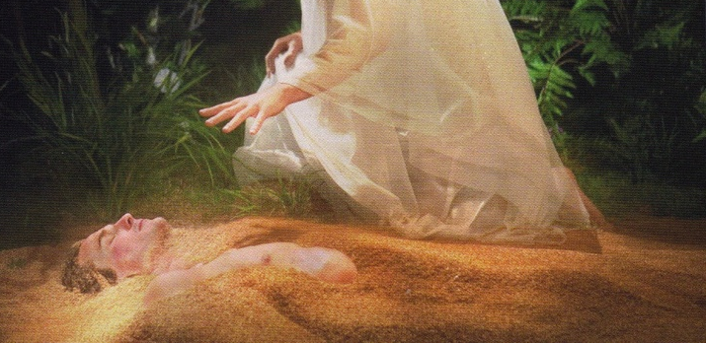
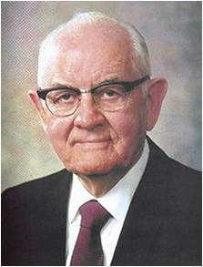
Dust—Living Soul
“Our father Adam—that is our earthly father—the progenitor of the human race of man, stands at the head being ‘Michael the Archangel, the Ancient of Days,’ and that he was not fashioned from earth life and adobe but begotten by his Father in Heaven.’”
First Presidency
And the Gods formed man from the dust of the ground, and took his spirit (that is, the man’s spirit), and put it into him; and breathed into his nostrils the breath of life, and man became a living soul.
“Man became a living soul—mankind, male and female. The Creators breathed into their nostrils the breath of life and man and woman became living souls.
We don’t know exactly how their coming into this world happened, and when we’re able to understand it the Lord will tell us.”
President Spencer W. Kimball
Moses 3:7; Abraham 5:7; Genesis 2:7

Slide 10
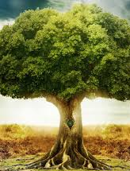
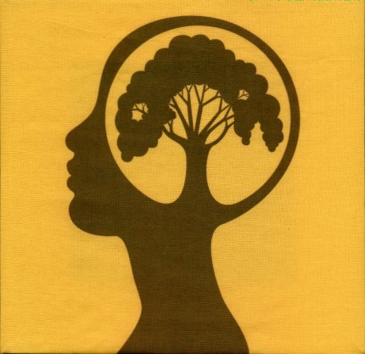
Eastward in Eden
Moses 3:8
Abraham 5:8
Genesis 2:8
And I, the Lord God, planted a garden eastward in Eden, and there I put the man whom I had formed.
And the Gods planted a garden, eastward in Eden, and there they put the man, whose spirit they had put into the body which they had formed.
And the Lord God planted a garden eastward in Eden; and there he put the man whom he had formed.
Tree of Knowledge of Good and Evil
Tree of Life

Slide 11
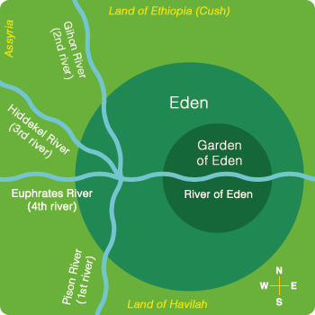
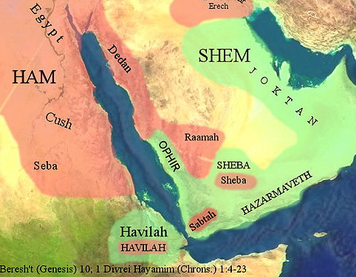
4 Rivers
Moses 3:10
Abraham 5:10
Genesis 2:10
And I, the Lord God, caused a river to go out of Eden to water the garden; and from thence it was parted, and became into four heads.
There was a river running out of Eden, to water the garden, and from thence it was parted and became into four heads.
And a river went out of Eden to water the garden; and from thence it was parted, and became into four heads.
The name of the first is Pison: that is it which compasseth the whole land of Havilah, …
Gen. 2:11
Havilah—both land and a people

Slide 12
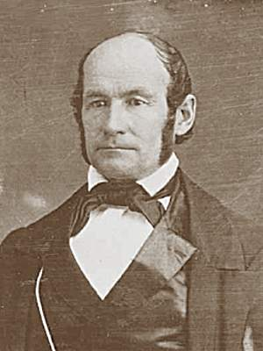
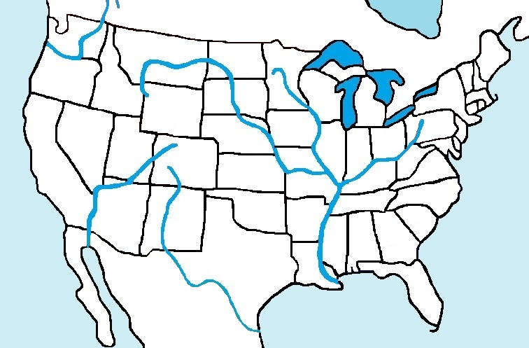
Eden
Independence, Missouri
Mississippi River
“The spot chosen for the garden of Eden was Jackson County, in the State of Missouri, where Independence now stands; it was occupied in the morn of creation by Adam.”
Heber C. Kimball
Missouri River
Illinois River
Ohio River
“Missouri has been and will be the site of many key events in Church history. It was the location of the Garden of Eden and Adam-ondi-Ahman, where Adam gathered his posterity for a final blessing.”
Shanna Butler
Read: D&C 107:53-57

Slide 13
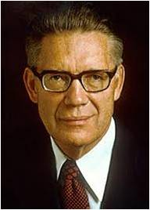
Dress This Garden
Moses 3:15
Abraham 5:8
Genesis 2:15
And I, the Lord God, took the man, and put him into the Garden of Eden, to dress it, and to keep it.
And the Gods took the man and put him in the Garden of Eden, to dress it and to keep it.
And the Lord God took the man, and put him into the garden of Eden to dress it and to keep it.
Eat Freely…except
Forbidden Fruit of Tree of Knowledge of good and Evil
“What is meant by partaking of the fruit of the tree of the knowledge of good and evil is that our first parents complied with whatever laws were involved so that their bodies would change from their state of paradisiacal immortality to a state of natural mortality.”
Elder Bruce R. McConkie

Slide 14
Help Meet—A Woman
Moses 3:18
Abraham 5:14
Genesis 2:18
And I, the Lord God, said unto mine Only Begotten, that it was not good that the man should be alone; wherefore, I will make an help meet for him.
And the Gods said: Let us make an help meet for the man, for it is not good that the man should be alone, therefore we will form an help meet for him.
And the Lord God said, It is not good that the man should be alone; I will make him an help meet for him.
The Rib--symbolizes the side-by-side partnership of equality of Adam and Eve and all married couples.
Marriage is honourable in all,
Hebrews 13:4
Marriage is ordained of God unto man.
D&C 49:15
Adam and Eve were married for eternity by the Lord. Such a marriage extends beyond the grave. All peoples should call for this kind of marriage.
President Spencer W. Kimball

Slide 15
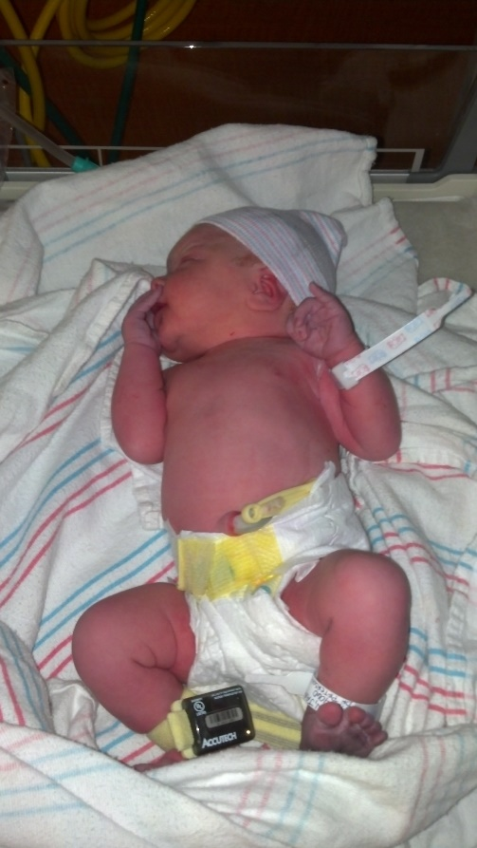
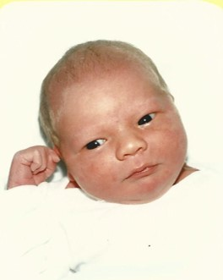
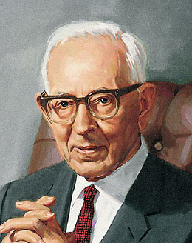
Food For Thought
“Just why the Lord would say to Adam that he forbade him to partake of the fruit of that tree is not made clear in the Bible account, but in the original as it comes to us in the Book of Moses it is made definitely clear. It is that the Lord said to Adam that if he wished to remain as he was in the garden, then he was not to eat the fruit, but if he desired to eat it and partake of death he was at liberty to do so. So really it was not in the true sense a transgression of a divine commandment. Adam made the wise decision, in fact the only decision he could make.”
Joseph Fielding Smith
If Adam and Eve chose to eat of the fruit…did we also choose to partake of mortal life?
Read 2 Nephi 2:22

Slide 16
Sources:
For the Strength of Youth Pamphlet
Elder L. Tom Perry The Sabbath and the Sacrament April 2011 Gen. Conf.
First Presidency: Joseph F. Smith, Anthon H. Lund, and Charles W. Penrose, as quoted in Melvin A. Cook and M. Garfield Cook, Science and Mormonism p. 156
President Spencer W. Kimball The Blessings and Responsibilities of Womanhood March 1976 Ensign
(Heber C. Kimball, in Journal of Discourses, 10:235)
Presentation by http://fashionsbylynda.com/blog/
Shanna Butler Independence: Living in Zion May 2005 Ensign
Elder Bruce R. McConkie Christ and the Creator June 1982 Ensign
Joseph Fielding Smith, Answers to Gospel Question p. 4:81

Slide 17
What does it mean to offer up our sacraments to the Lord? We acknowledge that all of us make mistakes. Each of us has a need to confess and forsake our sins and errors to our Heavenly Father and to others we may have offended. The Sabbath provides us with a precious opportunity to offer up these—our sacraments—to the Lord. He said, “Remember that on this, the Lord’s day, thou shalt offer thine oblations and thy sacraments unto the Most High, confessing thy sins unto thy brethren, and before the Lord.”
Elder Melvin J. Ballard has suggested, “We want every Latter-day Saint to come to the sacrament table because it is the place for self-investigation, for self-inspection, where we may learn to rectify our course and to make right our own lives, bringing ourselves into harmony with the teachings of the Church and with our brethren and sisters.”
As we worthily partake of the sacrament, we witness that we are willing to take the Savior’s name upon us and keep His commandments and do always remember Him, that we may have His Spirit to be with us. In this way the covenant of our baptism is renewed. The Lord assured His disciples, “As oft as ye do this ye will remember this hour that I was with you.”
Elder L. Tom Perry April 2011 Gen. Conf. The Sabbath and the Sacrament
Help Meet
The Hebrew word translated as help means succor or support, and the word translated as meet means suitable. Thus a husband and wife are to help, succor, and support one another as equal partners.
Cleave:
The word cleave means to cling or stick tightly to something and implies unity. Adam and Eve were commanded to be “one flesh,” meaning they were to be unified mentally, socially, sexually, and spiritually. This oneness was a command with which they could not fully comply until after the Fall.
Elder Jeffrey R. Holland of the Quorum of the Twelve Apostles explained:
“Human intimacy is reserved for a married couple because it is the ultimate symbol of total union, a totality and a union ordained and defined by God. From the Garden of Eden onward, marriage was intended to mean the complete merger of a man and a woman—their hearts, hopes, lives, love, family, future, everything. Adam said of Eve that she was bone of his bones and flesh of his flesh, and that they were to be ‘one flesh’ in their life together [see Genesis 2:23–24]. This is a union of such completeness that we use the word seal to convey its eternal promise. The Prophet Joseph Smith once said we perhaps could render such a sacred bond as being ‘welded’ [see D&C 128:18] one to another.
“But such a total union, such an unyielding commitment between a man and a woman, can only come with the proximity and permanence afforded in a marriage covenant, with solemn promises and the pledge of all they possess—their very hearts and minds, all their days and all their dreams” (“Personal Purity,” Ensign, Nov. 1998, 76).
All Things Created Spiritually
“This earth, all men [and women], animals, fish, fowls, plants, all things—all lived first as spirit entities. Their home was heaven, and the earth was created to be the place where they could take upon themselves mortality” (“Christ and the Creation,” Ensign, June 1982, 86). Elder Bruce R. McConkie
The Garden of Eden
“In the beginning, after this earth was prepared for man, the Lord commenced his work upon what is now called the American continent, where the Garden of Eden was made. In the days of Noah, in the days of the floating of the ark, he took the people to another part of the earth.” (Brigham Young, Discourses of Brigham Young, p. 157. and Joseph Fielding Smith, Discourses of Salvation, 2:139-40
The Origin of Man:
“It is held by some that Adam was not the first man upon this earth and that the original human being was a development from lower orders of the animal creation. These, however, are the theories of men. The word of the Lord declared that Adam was ‘the first man of all men’ (Moses 1:34), and we are therefore in duty bound to regard him as the primal parent of our race. It was shown to the brother of Jared that all men were created in the beginning after the image of God; whether we take this to mean the spirit or the body, or both, it commits us to the same conclusion: Man began life as a human being, in the likeness of our Heavenly Father.
“True it is that the body of man enters upon its career as a tiny germ embryo, which becomes an infant, quickened at a certain stage by the spirit whose tabernacle it is, and the child, after being born, develops into a man. There is nothing in this, however, to indicate that the original man, the first of our race, began life as anything less than a man, or less than the human germ or embryo that becomes a man” (“The Origin of Man,” Improvement Era, Nov. 1909, 80; “The Origin of Man,” Ensign, Feb. 2002, 30).
Rib
“The rib, coming as it does from the side, seems to denote partnership. The rib signifies … a lateral relationship as partners, to work and to live, side by side” Elder Russell M. Nelson (“Lessons from Eve,” Ensign, Nov. 1987, 87).

