Slide 1

The War of Words
Moses 4:1-4
Including Genesis 3
Presentation by http://fashionsbylynda.com/blog/

Slide 2

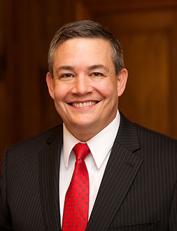

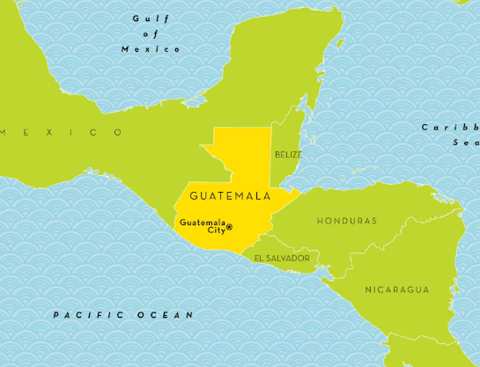
Doing Heavenly Father’s Will
In the premortal life, Heavenly Father chose Jesus Christ to be the Savior in His plan. Jesus Christ consistently obeys Heavenly Father’s will, even when it is hard.
Requiring to do hard things:
One 14-year-old young woman participated in competitive basketball. She dreamed of playing high school basketball like her older sister. She then learned that her parents had been called to preside over a mission in Guatemala.
Upon arrival, she discovered that a couple of her classes would be in Spanish, a language she did not yet speak. There was not a single girls’ sports team at her school. She lived on the 14th floor of a building with tight security. And to top it all off, she could not go outside alone for safety reasons.
Her parents listened to her cry herself to sleep every night for months.
Brother M. Joseph Brough

Slide 3

If you were in this young woman’s situation, what would have been most difficult for you?
What is a hard thing that God has required or may require of you?
How willing are you to do this hard thing? Why?

Slide 4
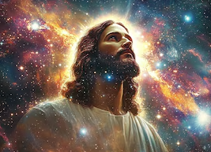
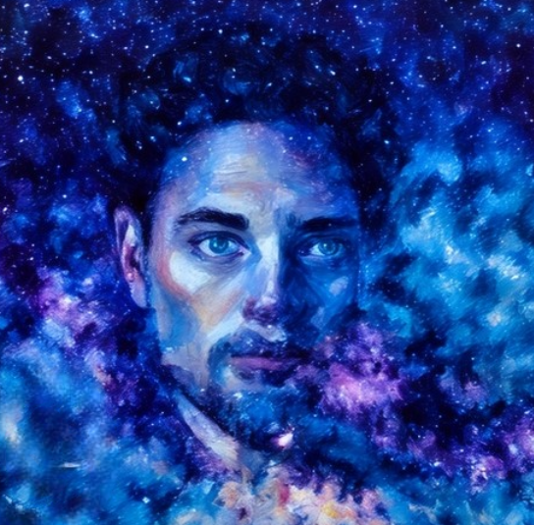
Character of
Jesus Christ VS Satan
Behold, here am I, send me, I will be thy son, and I will redeem all mankind, that one soul shall not be lost, and surely I will do it; wherefore give me thine honor.
Father, thy will be done, and the glory be thine forever.
Jesus accepted His Father’s plan and obeyed His will
Satan rebelled and sought to destroy the agency of man.
Moses 4:1-4

Slide 5

The Rest of the Story
They stayed on their mission for 3 years.
At the conclusion of our mission, I asked my daughter if she was going to serve a full-time mission. Her answer was “No, Dad, I have already served.”
I was just fine with that! But about six months later, the Spirit awoke me in the night with this thought: “I have called your daughter to serve a mission.”
My reaction was “Heavenly Father, she has given so much.” I was quickly corrected by the Spirit and came to understand that her missionary service was required of the Lord.
I soon took my daughter to lunch. From across the table, I said, “Ganzie, do you know why we are here?”
She said, “Yes, Dad. You know I have to serve a mission. I do not want to go, but I am going.”
Because she gave her will to Heavenly Father, she served Him with all of her heart, might, mind, and strength. She has taught her father how to do a hard thing.
Brother M. Joseph Brough

Slide 6

Advance Preparation
The Savior would be required to carry out Heavenly Father’s plan of happiness
Lucifer, one of Heavenly Father’s spirit children, rebelled against Heavenly Father’s plan. He is commonly known as Satan

Slide 7

Preparation
What are some other examples of solutions that can be prepared before a particular condition occurs?

Slide 8
Satan’s Demand
Redemption for all
Not One Soul Lost
Moses 4:1

Slide 9

One Plan
“Although we sometimes hear it said that there were two plans—Christ’s plan of freedom and agency, and Lucifer's of slavery and compulsion—such teaching does not conform to the revealed word.
Christ did not present a plan of redemption and salvation nor did Lucifer.
There were not two plans up for consideration; there was only one; and that was the plan of the Father: originated, developed, presented, and put in force by him. Christ, however, made the Father’s plan his own by his willing obedience to its terms and provisions.”
Elder Bruce R. McConkie
Plan 1
Heavenly Father’s Plan
Plan 2
Lucifer’s Plan

Slide 10
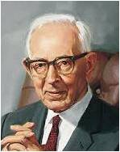
“Just what authority Lucifer held before his rebellion we do not know, but he was an angel of light, his name Lucifer, meaning torchbearer.
Agency was given unto the spirits of men, and they had their talents and individual traits of character there as they do here.
It was due to this fact that Lucifer, who was proud and ambitious, rebelled against the Father when his pan for salvation of fallen man was rejected.”
Joseph Fielding Smith
Moses 4:1

Slide 11
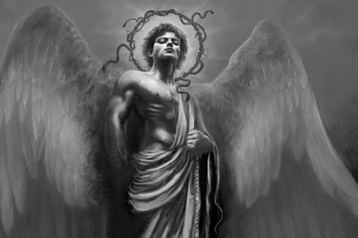
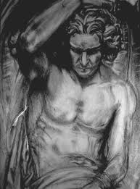
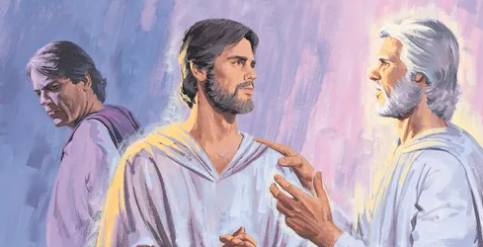
Lucifer’s Name
Appears only once in the Bible
How art thou fallen from heaven, O Lucifer, son of the morning! how art thou cut down to the ground, which didst weaken the nations!
For thou hast said in thine heart, I will ascend into heaven, I will exalt my throne above the stars of God: I will sit also upon the mount of the congregation, in the sides of the north:
I will ascend above the heights of the clouds; I will be like the most High.
Isaiah 14:12-14

Slide 12
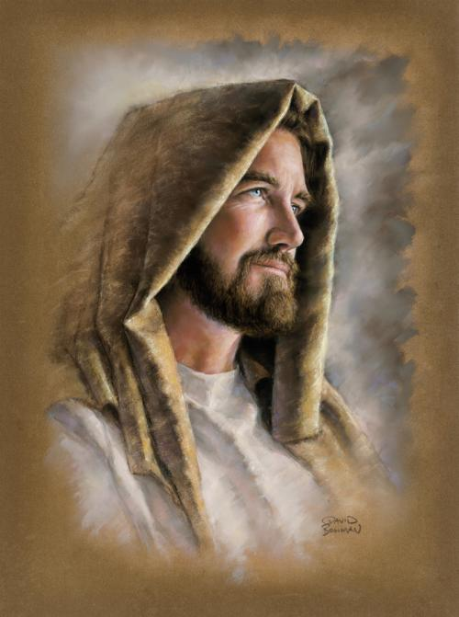
“My Beloved Son”
Who verily was foreordained before the foundation of the world, but was manifest in these last times for you.
1 Peter:1:20
Behold, I am he who was prepared from the foundation of the world to redeem my people. Behold, I am Jesus Christ.
Ether 3:14
And the Lord said: Whom shall I send? And one answered like unto the Son of Man: Here am I, send me. And another answered and said: Here am I, send me. And the Lord said: I will send the first.
Abraham 3:27
Jesus Christ was chosen in the premortal existence to be the Redeemer of mankind
Moses 4:2

Slide 13
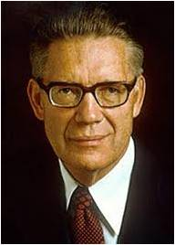
Rebellion and a War of Words
“There was war in Heaven. That war was a war of words; it was a conflict of ideologies; it was a rebellion against God and his laws.
Lucifer sought to dethrone God, to sit himself on the divine throne, and to save all men without reference to their works.
He sought to deny men their agency so they could not sin.
He offered a mortal life of…evil…
following which all men would be
saved.”
Elder Bruce R. McConkie
My Way or the Highway
Satan seeks to deceive and blind us so he can lead us captive at his will.
Moses 4:3-4

Slide 14
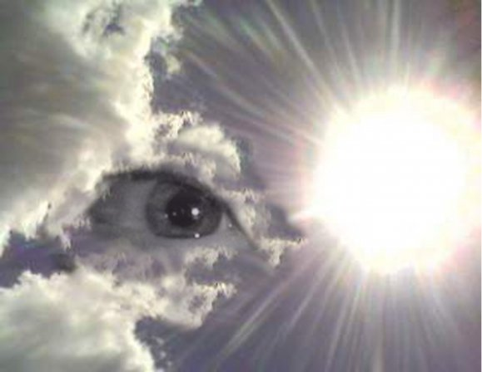
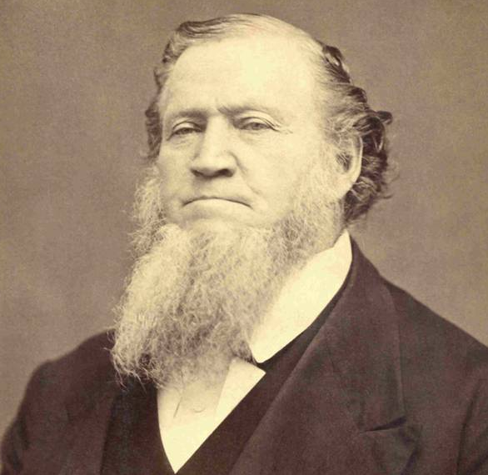
Fallen Spirits
“Every person who desires and strives to be a Saint is closely watched by fallen spirits that came here when Lucifer fell, and by the spirits of wicked persons who have been here in tabernacles and departed from them, but who are still under the control of the prince of the power of the air.
Those spirits are never idle: they are watching every person who wishes to do right and are continually prompting them to do wrong.”
Brigham Young
Those who followed Satan are called “Sons of Perdition”
Moses 4:3-4

Slide 15
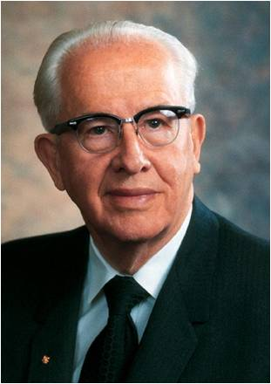
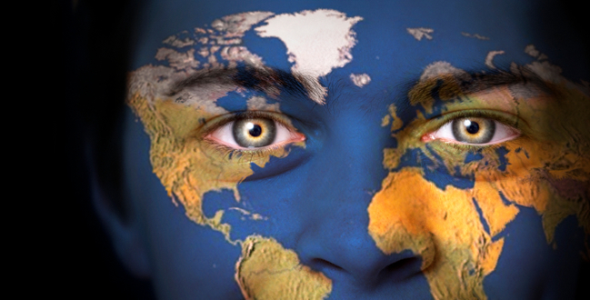
Satan’s Influence
“The war that began in heaven is not yet over. The conflict continues on the battlefield of mortality. And one of Lucifer’s primary strategies has been to restrict our agency through the power of earthly governments. Proof of this is found in the long history of humanity.”
Ezra Taft Benson
Moses 4:3-4

Slide 16

Isaiah 5:20 Review
Evil
Good
Darkness
Light
Bitter
How can knowing that many will try to get you to believe that evil is good and good is evil help you in your life?
Sweet

Slide 17
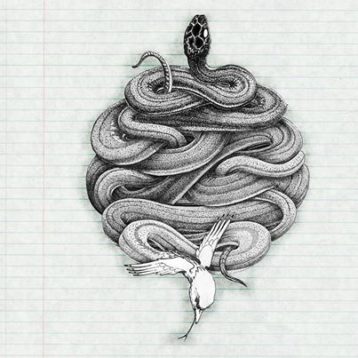
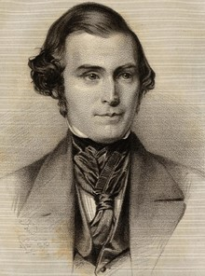

Through The Mouth of The Serpent
Satan is symbolic as a serpent and taught that Satan “sought to destroy the world” by tempting Adam and Eve in the Garden of Eden
Jeremiah Dirt
…even that old serpent that did beguile our first parents, which was the cause of their fall; Mosiah 16:3
“The devil can adapt himself to the belief of any person…If he could get you to swallow down one or two great lies that would effect your destruction, and which you would preach and destroy many others, he would not mind how many truths you might believe…he could only deceive you and lead you astray.” Orson Pratt
Chameleon’s have the ability to change skin color with their environment to deceive their predators—they have the ability to adapt themselves to their situations
Moses 4:5-6

Slide 18
Sources:
Brother M. Joseph Brough, (“Lift Up Your Head and Rejoice,” Ensign or Liahona, Nov. 2018, 14
Joseph Fielding Smith Church History and Modern Revelation 2:51-52
Improvement Era, April 1962 p. 230 (The Fall of Adam and Eve)
Elder Bruce R. McConkie Improvement Era May 1953 Millennial Messiah p. 666-67
Dallin H. Oaks “The Great Plan of Happiness,” Ensign, Nov. 1993, 72).
Brigham Young Journal of Discourses 7:239
Ezra Taft Benson The Constitution, a Heavenly Banner pp. 2-3
James E. Talmage Articles of Faith pp. 69-70
Orson Pratt Journal of Discourses 13:73
Presentation by http://fashionsbylynda.com/blog/
George Q. Cannon Gospel Truth 1:16
Who’s Who in the Old Testament by Ed J. Pinegar and Richard J. Allen pp. 8-10, 55-56
Elder Russel M. Nelson Lessons from Eve October 1987 Gen. Conf.
Tad R. Callister The Infinite Atonement pp. 31-39
Richard D. Draper, S. Kent Brown, Michael D. Rhodes The Pearl of Great Price Verse by Verse Commentary p. 50
Elder Earl C. Tingey (“The Great Plan of Happiness,” Ensign or Liahona, May 2006, 73).

Slide 19
Lucifer:
is the King James Version rendering of the Hebrew word הֵילֵל in Isaiah 14:12. This word, transliterated hêlêl or heylel, occurs only once in the Hebrew Bible and according to the KJV-influenced Strong's Concordance means "shining one, morning star". The word Lucifer is taken from the Latin Vulgate, which translates הֵילֵל as lucifer, meaning "the morning star, the planet Venus", or, as an adjective, "light-bringing". The Septuagint renders הֵילֵל in Greek as ἑωσφόρος (heōsphoros), a name, literally "bringer of dawn", for the morning star.
the Latin word lucifer meant "light-bringing" The Latin word lucifer is also used of Jesus in the Easter Proclamation prayer to God regarding the paschal candle:
("May this flame be found still burning by the Morning Star: the one Morning Star who never sets, Christ your Son, who, coming back from death's domain, has shed his peaceful light on humanity, and lives and reigns for ever and ever")
Wikipedia
Lucifer the name:
Treating "Lucifer" as a name for the devil or Satan, they may use that name when speaking of such accounts of the devil or Satan as the following: - Satan inciting David to number Israel (1 Chronicles 21:1) - Job tested by Satan (Book of Job) - Satan ready to accuse the high priest Joshua (Zechariah 3:1-2) - Sin brought into the world through the devil's envy (Wisdom 2:24) - "The prince of the power of the air, the spirit that is now at work in the sons of disobedience" (Ephesians 2:2) - "The god of this world" (2 Corinthians 4:4). - The devil disputing with Michael about the body of Moses (Jude 1:9) - The dragon of the Book of Revelation "who is called the devil and Satan" (Revelation 12:9;20:2)
In Islam the Devil is known as Iblīs
The name means the Shining One or Light bearer. He is also known as the Son of the Morning. Lucifer was a spirit son of Heavenly Father and led the rebellion in the premortal life. The name Lucifer appears only once in the Bible (Isa. 14:12). Latter-day revelation gives more detail on Lucifer’s fall (D&C 76:25–29). LDS Guide To the Scriptures
War In Heaven:
The Prophet Joseph Smith taught:
“The contention in heaven was—Jesus said there would be certain souls that would not be saved; and the devil said he would save them all, and laid his plans before the grand council, who gave their vote in favor of Jesus Christ. So the devil rose up in rebellion against God, and was cast down, with all who put up their heads for him” (Teachings of Presidents of the Church: Joseph Smith [2007], 209).
What happened to Lucifer?
The proposition of Lucifer was an act of rebellion against God.
God had already decreed that man should have his free agency.
Lucifer coveted and asked for a power which was the prerogative of the Almight and alone belonged to God
For the rebellion Lucifer was cast out and became Satan
The power by which he was cast out, was by a certain power or Priesthood which had been conferred by God on His Only Begotten.
Being cast down and becoming Satan,…the devil,…the father of lies…his office was to deceive and to blind men.
John Taylor Mediation and Atonement p. 98
Two truths concerning Satan: Elder Jeffrey R. Holland:
“Number one, Satan, or Lucifer, or the father of lies—call him what you will—is real, the very personification of evil. His motives are in every case malicious, and he convulses at the appearance of redeeming light, at the very thought of truth. Number two, he is eternally opposed to the love of God, the Atonement of Jesus Christ, and the work of peace and salvation. He will fight against these whenever and wherever he can. He knows he will be defeated and cast out in the end, but he is determined to take down with him as many others as he possibly can” (“We Are All Enlisted,” Ensign or Liahona, Nov. 2011, 44).
Cherubim
Figures representing heavenly creatures, the exact form being unknown. They are found in the Holy of Holies, on the Mercy Seat of the Ark (Ex. 25:18, 22; 1 Kgs. 6:23–28;Heb. 9:5), and in the visions of Ezekiel (Ezek. 10; 11:22). In the account of the Fall, cherubim are represented as keeping “the way of the tree of life” (Gen. 3:24). Bible Dictionary
Fire
Frequently the symbol of God’s presence, revealed either in mercy or in judgment. Bible Dictionary

Slide 20
If I Were The Devil By Paul Harvey
I would gain control of the most powerful nation in the world;
I would delude their minds into thinking that they had come from man's effort, instead of God's blessings;
I would promote an attitude of loving things and using people, instead of the other way around;
I would dupe entire states into relying on gambling for their state revenue;
I would convince people that character is not an issue when it comes to leadership;
I would make it legal to take the life of unborn babies;
I would make it socially acceptable to take one's own life, and invent machines to make it convenient;
I would cheapen human life as much as possible so that life of animals are valued more than human beings;
I would take God out of the schools, where even the mention of His name was grounds for a lawsuit;
I would come up with drugs that sedate the mind and target the young, and I would get sports heroes to advertise them;
I would get control of the media, so that every night I could pollute the minds of every family member for my agenda;
I would attack then family, the backbone of any nation. I would make divorce acceptable and easy, even fashionable. If the family crumbles, so does the nation;
I would compel people to express their most depraved fantasies on canvas and movies screens, and I would call it art;
I would convince the world that people are born homosexuals, and that their lifestyles should be accepted and marveled;
I would convince the people that right and wrong are determined by a few who call themselves authorities and refer to their agendas as politically correct;
I would persuade people that the church is irrelevant and out of date; the Bible is for the naive:
I would dull the minds of Christians, and make them believe that prayer is not important, and that faithfulness and obedience are optional;
I GUESS I WOULD LEAVE THINGS PRETTY MUCH THE WAY THEY ARE!

