Slide 1
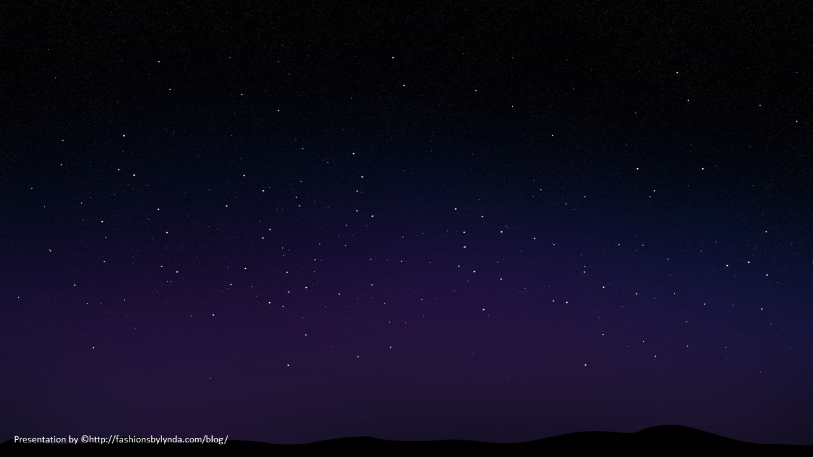
Order of the Stars
Abraham 3
The glory of God is intelligence, or, in other words, light and truth.
D&C 93:36

Slide 2
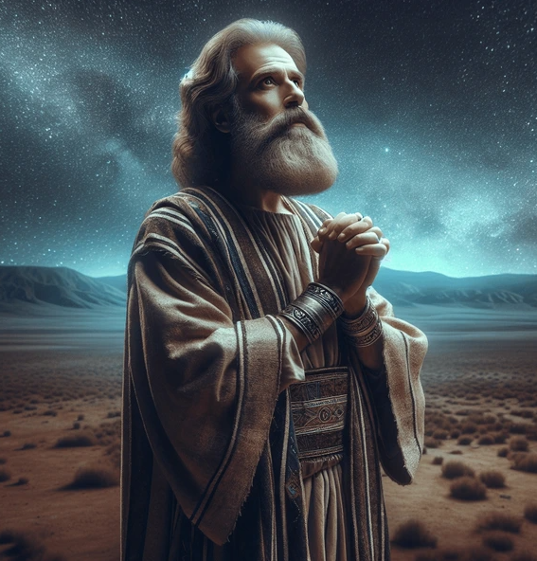
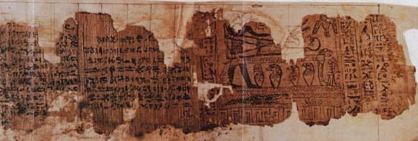
Abraham
Abraham recorded an experience that can help us understand more about the premortal life.
Abraham was born about 2,000 years before the birth of Jesus Christ.
He recorded a few details of his life along with visions he received from God that can be found in the book of Abraham.
This record originated from scrolls of papyrus discovered in Egypt and purchased by members of the Church.
This record was then revealed to the Prophet Joseph Smith by the gift and power of God.

Slide 3
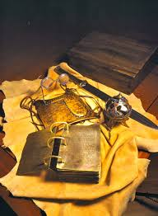
Urim and Thummin
Interpreters
¶And thou shalt put in the breastplate of judgment the Urim and the Thummim; and they shall be upon Aaron’s heart, when he goeth in before the Lord: and Aaron shall bear the judgment of the children of Israel upon his heart before the Lord continually.
Exodus 28:30
An ancient instrument or tool prepared by God and used by Joseph Smith to aid in the translation of the Book of Mormon.
God provided a Urim and Thummim to His prophets in ancient times.
“What became of these after his [Abraham’s] death we do not know.” (1)
“There were two stones in silver bows—and these stones, fastened to a breastplate, constituted what is called the Urim and Thummim.” (Joseph Smith—History 1:35)
Abraham 3:1

Slide 4
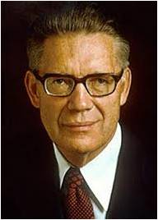
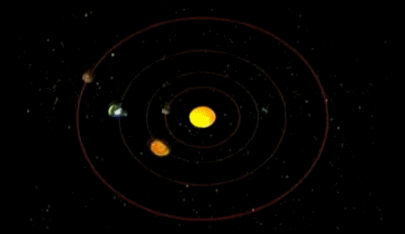
The Great Astronomer
He [Abraham] saw, recorded, and taught the truths relative to the creation of the earth;
Of the movements and relationships of the sun, moon, and stars;
And of the positions and revolutions of the various spheres in the sidereal heavens.
Abraham 3:2
(9)

Slide 5
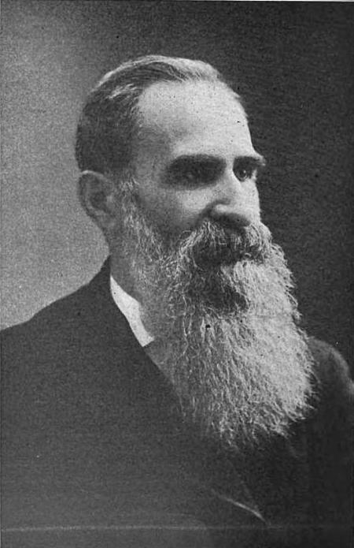
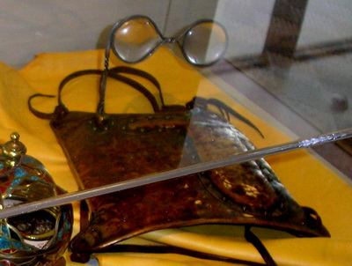
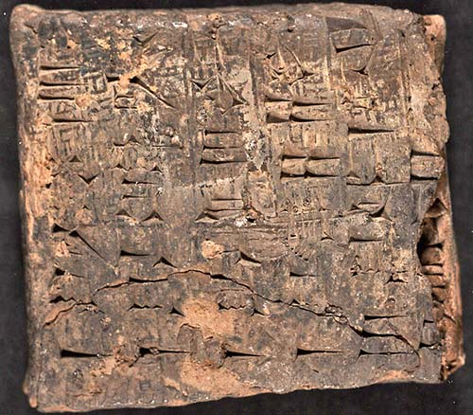
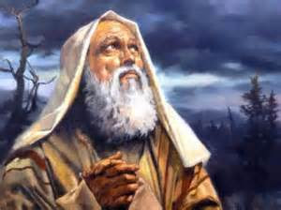
Abraham’s Knowledge
Through records handed down to him from the antediluvian patriarchs.
Antediluvian-of or belonging to the time before the biblical Flood.
“By direct communication with the Almighty, who, face to face, and with His own voice, explained to him the laws that govern His countless creations.”
By the use of the Urim and Thummim, which he received from the Lord in Ur of Chaldea
Abraham 3:2
(2)

Slide 6
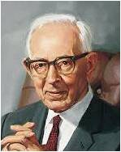
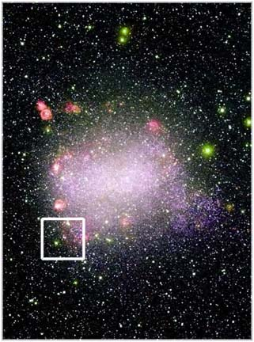
Kolob= The Great One
Which Star is nearest to the throne of God?
“…Kolob is the first creation, and is nearest to the celestial, or the residence of God. It is the first in government, the last pertaining to the measurement of time.”
The Lord’s teachings about stars and planets helped Abraham understand more about this earth and its relationship to Kolob. For example, he taught Abraham that one day on Kolob was equal to one thousand years of time on our earth.
“One day in Kolob is equal to a thousand years according to the measurement of this earth, which by the Egyptians was called Jah-oh-eh.
Oliblish, so called by the Egyptians, stands next to Kolob in the grand governing creation near the celestial, or place where God resides. .”
Abraham 3:3-4
(1a)

Slide 7
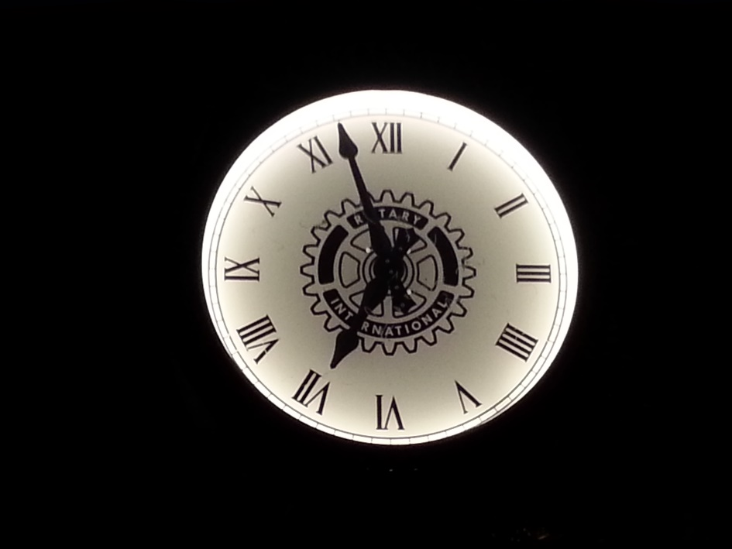
One Thousand Years
One day is with the Lord as a thousand years, and a thousand years as one day.
2 Peter 3:8
1000 years our time=1 day with the Lord
If you live 100 years on earth= 1/10 of one day with the Lord
Divide Lord’s day into 24 equal parts—as our day is= 2.4 hours.
100 years of life=2.4 hours in the Lord’s time calendar…
“Imagine yourself…in the spirit world before you came to earth…living in the presence of God…knowing firsthand of the fullness of the glory of God.
Wouldn’t you promise to endure almost anything for 2 hours to get the blessings that the Lord has promised of eternal life and to become as He is?”
Abraham 3:3-4
(5)

Slide 8
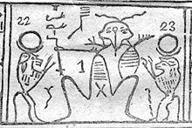
Kolob, A Symbol of the Savior
Kolob | The Savior
The great one (Abraham 3:3) | The Great I AM (D&C 29:1)
The first creation (Abraham 3:3) | The Firstborn (D&C 93:21)
Source of light for other stars and planets (Abraham 3:6) | Source of light for the immensity of space, including the sun, moon, stars, and earth (D&C 88:5-13)
(4)

Slide 9
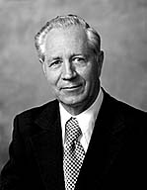
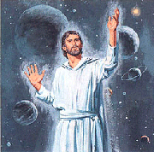
The Greatness of Jesus Christ
As fascinating as this knowledge of astronomy is, the far more important issue here may be why the information was given. The revelation helped teach Abraham (and thus all who would read his record) the greatness of Jesus Christ—
The awesome and premier position of the Only Begotten Son relative to all other beings and objects in the Father’s vast kingdom.
By explaining to Abraham the truly divine grandeur of something that might engage the mind of any mortal on a clear night—the stars of creation—God could go on to teach the even greater significance of something that one pondering the heavens might consider—the role of the Lord of creation.
Abraham 3:3-4
(4)

Slide 10
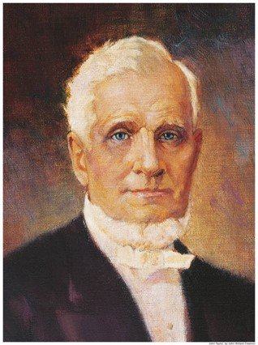
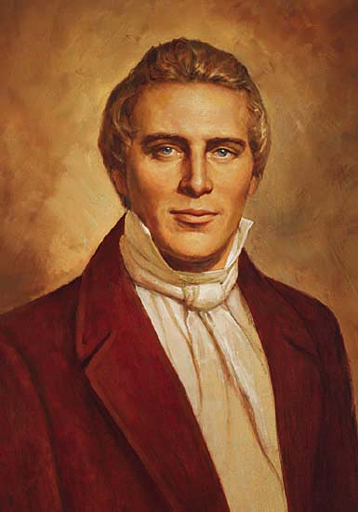
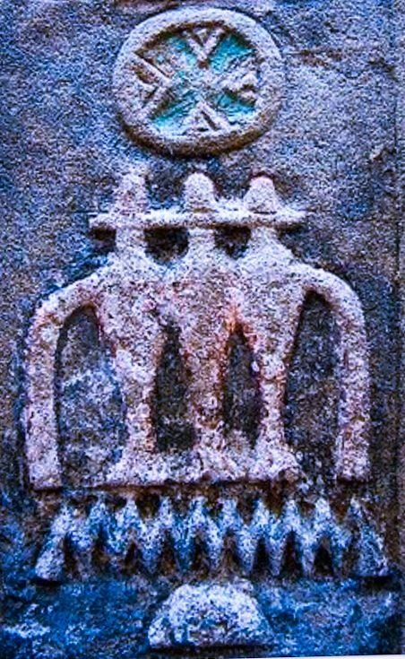
Who Taught the Egyptians?
“Who taught the Egyptians?
Abraham taught them the science of astronomy, so we are informed, by late Egyptologists, and revealed unto them the principle concerning the motions of the heavenly bodies.”
“The learning of the Egyptians, and their knowledge of astronomy was no doubt taught them by Abraham and Joseph, as their records testify, who received it from the Lord.”
Star Gates: Louvre, Paris, France from Egypt
Abraham 3:15
(6)

Slide 11
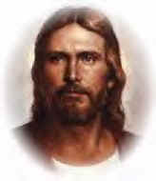
Intelligence
Jesus Christ is the greatest and most intelligent of all Heavenly Father’s children
Intelligence often refers to the degree of light and truth an individual has received.
We gain intelligence by obeying God’s commandments; thus, the more obedient we are, the greater our intelligence can be.
He that keepeth his commandments receiveth truth and light, until he is glorified in truth and knoweth all things.
D&C 93:28
Jesus Christ is nearest to and most like Heavenly Father because of the light and truth He has received through His perfect obedience.
Abraham 3:18-29

Slide 12
Doctrinal Mastery
Now the Lord had shown unto me, Abraham, the intelligences that were organized before the world was; and among all these there were many of the noble and great ones;
And God saw these souls that they were good, and he stood in the midst of them, and he said: These I will make my rulers; for he stood among those that were spirits, and he saw that they were good; and he said unto me: Abraham, thou art one of them; thou wast chosen before thou wast born.
Old Testament
Abraham 3:22-23

Slide 13
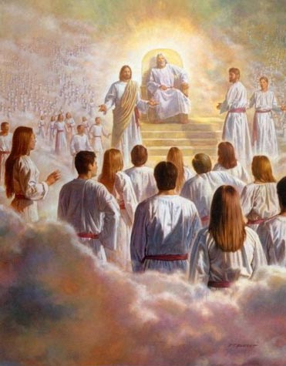
Noble and Great
“Every man who has a calling to minister to the inhabitants of the world was ordained to that very purpose in the Grand Council of heaven before this world was.”
God chose His noble and great spirit children to become rulers before they were born.
“In the premortal spirit world, God appointed certain spirits to fulfill specific missions during their mortal lives. This is called foreordination. …
“The doctrine of foreordination applies to all members of the Church, not just to the Savior and His prophets. Before the creation of the earth, faithful women were given certain responsibilities and faithful men were foreordained to certain priesthood duties. Although you do not remember that time, you surely agreed to fulfill significant tasks in the service of your Father.”
Abraham 3:22
(7)

Slide 14
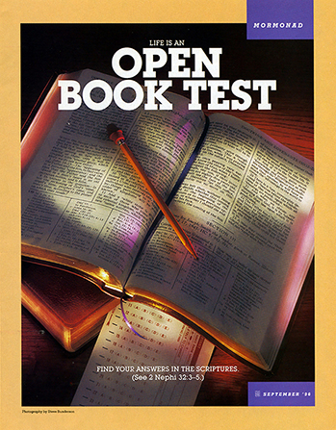
The Test of Life
“The great test of life is to see whether we will hearken to and obey God’s commands in the midst of the storms of life.”
Spiritual weaknesses through temptations of worldly desires
Physical weaknesses such as sicknesses, pain, and death
The test of life is to determine if we will do whatever God commands us.
Abraham 3:24-25
(8)

Slide 15
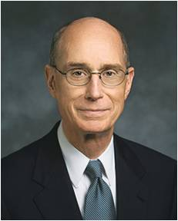

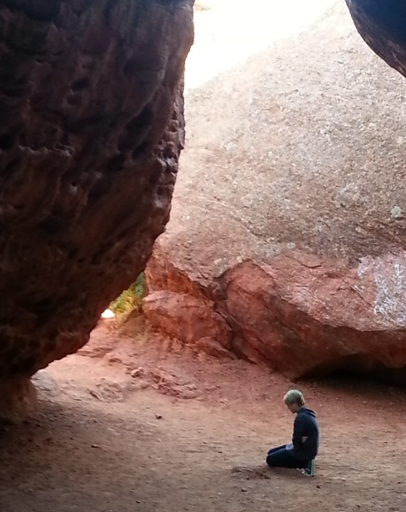
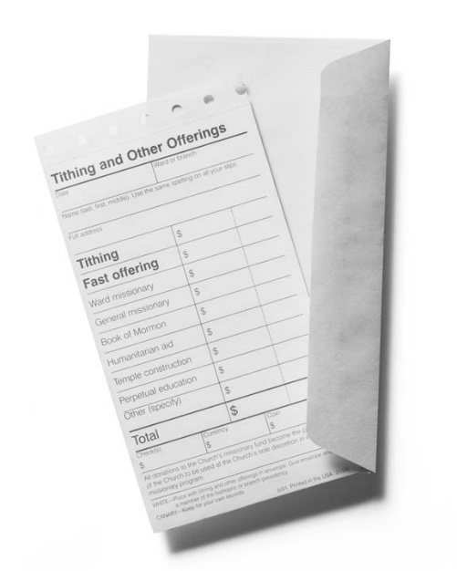
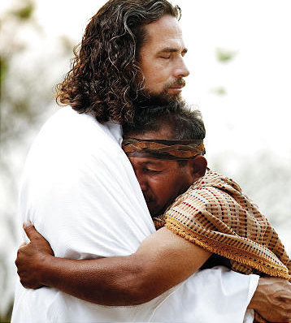
How to Prepare For Your Test
1. Feast Upon the Words of Christ and act quickly on what the Holy Ghost tells you
2. Pray always to accept Heavenly Father’s will and do it
4. Escape from sin and its effects. The best time to resist temptation is early. The best time to be forgiven is now.
3. Be a full tithe payer showing obedience to the Lord
Abraham 3:24-25
(8)

Slide 16
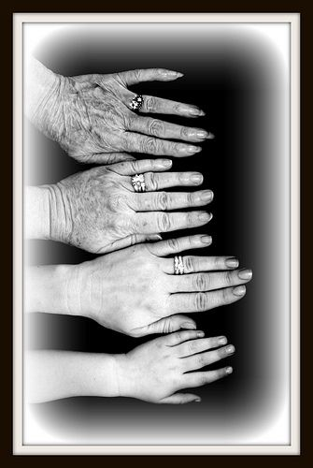
First Estate
Our Premortal State
“We lived in the presence of God in the spirit before we came here. We desired to be like him, we saw Him...
There is not a soul who has not seen both the Father and the Son…
but it became necessary for us to gain experiences which could not be obtained in that world of spirits, and so we were accorded the privilege of come down here upon the earth.”
Abraham 3:26
(1b)

Slide 17

First and Second Estate
What do you think it means to be “added upon”?
We were given the opportunity to progress to mortality and receive a physical body
What blessing did Heavenly Father plan to give to those who kept their first estate?
They would be “added upon.”
What were the consequences for spirits who chose not to keep their first estate?
They would neither receive a physical body nor have the opportunity to attain eternal glory
What do you think it means to keep our second estate?
The second estate refers to the time between our mortal birth and the Final Judgment. To keep our second estate, we must accept and live the gospel of Jesus Christ, including obeying all that Heavenly Father commands us to do
Abraham 3:26

Slide 18
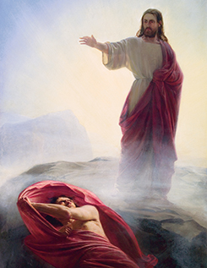
Whom Shall I Send?
And the Lord said: Whom shall I send? And one answered like unto the Son of Man: Here am I, send me. And another answered and said: Here am I, send me. And the Lord said: I will send the first.
And the second was angry, and kept not his first estate; and, at that day, many followed after him.
And they who keep not their first estate shall not have glory in the same kingdom with those who keep their first estate.
Abraham 3:26
Abraham 3:27-28

Slide 19
Sources:
Suggested Song: #284 If You Could Hie to Kolob
Joseph Fielding Smith Doctrines of Salvation, 3:222)
1a. Man: His Origin and Destiny, p. 461 1b. Doctrines of Salvation, 1:56
2. George Reynolds, Book of Abraham, p. 104
3. The Pearl of Great Price Student Manual The Book of Abraham
The Book of Abraham: A Most Remarkable Book by Andrew Skinner March 1997 Ensign
Eldred G. Smith Improvement Era, June 1966, p. 513
John Taylor Journal of Discourses, 25:215
Joseph Smith Teachings of the Prophet Joseph Smith, p. 251
Joseph Smith Teachings of the Prophet Joseph Smith, p. 365
(True to the Faith: A Gospel Reference [2004], 69, 70).
8. President Henry B. Eyring Spiritual Preparedness: Start Early and Be Steady Oct. 2005 Gen. Conf.
9. Elder Bruce R. McConkie Mormon Doctrine p. 57

Slide 20
Urim and Thummim:
Joseph Smith and his scribes wrote of two instruments used in translating the Book of Mormon. According to witnesses of the translation, when Joseph looked into the instruments, the words of scripture appeared in English. One instrument, called in the Book of Mormon the “interpreters,” is better known to Latter-day Saints today as the “Urim and Thummim.” Joseph found the interpreters buried in the hill with the plates. Those who saw the interpreters described them as a clear pair of stones bound together with a metal rim. The Book of Mormon referred to this instrument, together with its breastplate, as a device “kept and preserved by the hand of the Lord” and “handed down from generation to generation, for the purpose of interpreting languages.”
Topics—Book of Mormon Translators
Joseph Smith’s Poetic Explanation of the vision (D&C 76)
For thus saith the Lord, in the spirit of truth,
I am merciful, gracious and good unto those
That fear me, and live for the life that’s to come;
My delight is to honor the saints with repose;
That serve me in righteousness true to the end;
Eternal’s their glory, and great their reward;
I’ll surely reveal all my myst’ries to them, will,
The great hidden myst’ries in my kingdom stor’d—
From the council in Kolob, to time on the earth.
And for ages to come unto them I will show
My pleasure & will, what my kingdom will do.
Eternity’s wonders they truly shall know.
Times and Season 1 Feb. 1843
George Reynolds (January 1, 1842 – August 9, 1909) was a general authority of The Church of Jesus Christ of Latter-day Saints (LDS Church), a longtime secretary to the First Presidency of the LDS Church, and a party to the 1878 United States Supreme Court case Reynolds v. United States, the first freedom of religion case to issue from that court. Reynolds, George (1879). The Book of Abraham: Its Authenticity Established as a Divine and Ancient Record: With Copious References to Ancient and Modern Authorities. Salt Lake City, Utah: Deseret New Printing & Publishing.
Wikipedia
BYU Cosmology Study the picture on slide 5 is from
http://www.scari.org/Mormons.United.html
Abraham teaches the Egyptians:
“The book of Abraham states that God commanded the patriarch to show unto the Egyptians the things that He had revealed unto him. Josephus, in narrating this portion of Abraham's history—being only partially acquainted with the facts of the case from the authorities at his disposal—tells us that Abraham went down into Egypt to avoid the famine in Canaan, and to ‘become an auditor of their priests, and to know what they said concerning the gods; designing either to follow them it they had better notions than he, or to convert them into a better way if his own notions proved the truest.’ After his arrival in Egypt, …Joseph states that ‘Pharaoh gave Abraham leave to enter into conversation with the most learned among the Egyptians…” George Reynold, Book of Abraham, pp. 9-80. Josephus Book 1 Chapter 8 “Science came by the Chaldeans into Egypt, and from them to the Greeks also.”

Slide 21
Noble and Great:
“But now there is a warning. Despite that calling which is spoken of in the scriptures as ‘foreordination,’ we have another inspired declaration: ‘Behold, there are many called, but few are chosen…’ (D&C 121:34).
“This suggests that even though we have our free agency here, there are many who were foreordained before the world was, to a greater state than they have prepared themselves for here. Even though they might have been among the noble and great, from among whom the Father declared he would make his chosen leaders, they may fail of that calling here in mortality. Then the Lord poses this question: ‘…and why are they not chosen?’ (D&C 121:34)
“Two answers were given: First, “Because their hearts are set so much upon the things of this world…’ And second, they ‘…aspire in the honors of men.’ (D&C 121:35)
(Harold B. Lee, Stand Ye in Holy Places, p. 9) Also Bruce R. McConkie, Mortal Messiah, 1:26
A Good Read on Premortal Life and why we are here:
The Mystery of Life by Boyd K. Packer October 1983 Gen. Conf.
Greatness of the Savior in the premortal life:
Of [Jesus Christ] it was said that He is “more intelligent than they all.” (Abraham 3:19.) … Moreover, what the Lord knows is, fortunately, vastly more—not just barely more—than the combination of what all mortals know. (All These Things Shall Give Thee Experience [1979], 22)
Our Divine Redeemer … far surpasses the individual and [total combination of] … capacities and achievements of all who have lived, live now, and will yet live! (“O, Divine Redeemer,” Ensign, Nov. 1981, 8)

Slide 22
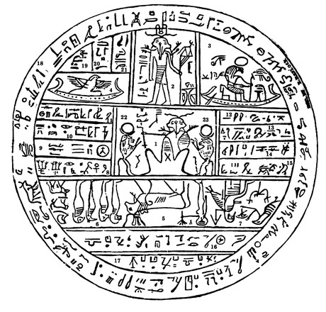
A Facsimile from the Book of Abraham No. 2
Fig. 5. Is called in Egyptian Enish-go-on-dosh; this is one of the governing planets also, and is said by the Egyptians to be the Sun, and to borrow its light from Kolob through the medium of Kae-e-vanrash, which is the grand Key, or, in other words, the governing power, which governs fifteen other fixed planets or stars, as also Floeese or the Moon, the Earth and the Sun in their annual revolutions. This planet receives its power through the medium of Kli-flos-is-es, or Hah-ko-kau-beam, the stars represented by numbers 22 and 23, receiving light from the revolutions of Kolob.
Fig. 1. Kolob, signifying the first creation, nearest to the celestial, or the residence of God. First in government, the last pertaining to the measurement of time. The measurement according to celestial time, which celestial time signifies one day to a cubit. One day in Kolob is equal to a thousand years according to the measurement of this earth, which is called by the Egyptians Jah-oh-eh.
Fig. 2. Stands next to Kolob, called by the Egyptians Oliblish, which is the next grand governing creation near to the celestial or the place where God resides; holding the key of power also, pertaining to other planets; as revealed from God to Abraham, as he offered sacrifice upon an altar, which he had built unto the Lord.
Fig. 6. Represents this earth in its four quarters.
Fig. 7. Represents God sitting upon his throne, revealing through the heavens the grand Key-words of the Priesthood; as, also, the sign of the Holy Ghost unto Abraham, in the form of a dove.
Fig. 8. Contains writings that cannot be revealed unto the world; but is to be had in the Holy Temple of God.
Fig. 9. Ought not to be revealed at the present time.
Fig. 10. Also.
Fig. 11. Also. If the world can find out these numbers, so let it be. Amen.
Fig. 3. Is made to represent God, sitting upon his throne, clothed with power and authority; with a crown of eternal light upon his head; representing also the grand Key-words of the Holy Priesthood, as revealed to Adam in the Garden of Eden, as also to Seth, Noah, Melchizedek, Abraham, and all to whom the Priesthood was revealed.
The above translation is given as far as we have any right to give at the present time.
Fig. 4. Answers to the Hebrew word Raukeeyang, signifying expanse, or the firmament of the heavens; also a numerical figure, in Egyptian signifying one thousand; answering to the measuring of the time of Oliblish, which is equal with Kolob in its revolution and in its measuring of time.
Figures 12, 13, 14, 15, 16, 17, 18, 19, 20, and 21 will be given in the own due time of the Lord.
https://www.lds.org/scriptures/pgp/abr/fac-2?lang=eng

