Slide 1
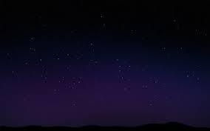
Moses Speaks With God
Introduction to the Book of Moses
Moses 1:1-26
For as the heavens are higher than the earth, so are my ways higher than your ways, and my thoughts than your thoughts.
Isaiah 55:9
Presentation by ©http://fashionsbylynda.com/blog/

Slide 2
Moses
He was born (c. 1370 B.C.) the son of Amram and Jochebed, who were Levites (Israelite—a covenant people).
He had a brother, Aaron (who was the spokesman for him), and a sister, Miriam
He was secretly hidden for 3 months because the Pharaoh ordered all newborn males to be slain
He was found on the Nile River and adopted into the royal Egyptian family by the Pharaoh's daughter, Princess Bithiah, and was raised in the courts by his Hebrew mother.
When he was about 40 year old, he rejected his place in Pharaoh's household and fled to Midian, near Mt. Sinai, and became a shepherd
He married Zipporah, daughter of Reuel (Jethro), and they had two son’s, Gershom and Eliezer. He was given the priesthood through his father-in-law
During his 40 years in Midian, the Lord told Moses to lead the captive Israelites away from Egypt to the promised land (the land of Canaan)
The journey from Egypt to Mt. Sinai took about 2 months as he prepared them to receive the full priesthood, ordinances, and blessings
At Mt Sinai the children of Israel were organized into 12 tribes, and the migration was organized into 4 companies and they lived as a desert people for 40 years.
He was translated and taken from the earth near Mt. Nebo at age 120 (Deuteronomy 31:2)
Who’s Who and Edward J. Brandt

Slide 3
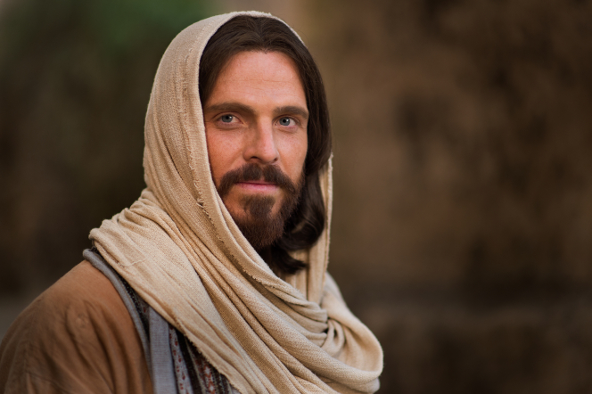

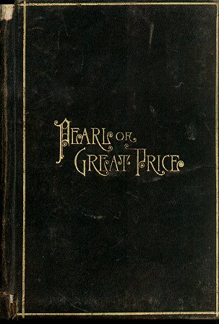
The Book of Moses
The book of Moses was received as part of the Joseph Smith Translation of the Old Testament.
The Joseph Smith Translation includes inspired revisions and restored truths of Genesis 1-6:13.
It contains the word of God as spoken to Moses and commanded him to keep a record
Jesus Christ speaks on behalf of Heavenly Father.
The authority to speak on behalf of Heavenly Father is referred to as divine investiture of authority.

Slide 4
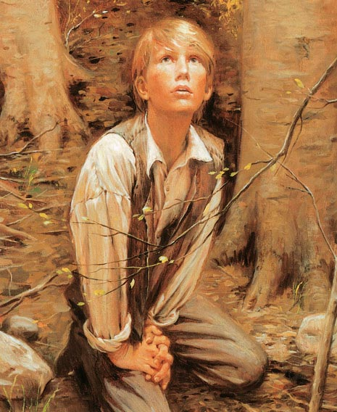
However…
And now of this thing Moses bore record; but because of wickedness it is not had among the children of men.
Moses 1:23
“because of wickedness”, many of the words and plain and precious truths he recorded were obscured or lost and are thus not preserved in the book of Genesis as it has come to us
The Lord promised to raise up another prophet in the latter days to restore Moses’s words so they would be “had again among the children of men.”
And in a day when the children of men shall esteem my words as naught and take many of them from the book which thou shalt write, behold, I will raise up another like unto thee; and they shall be had again among the children of men—among as many as shall believe.
Moses 1:41
In fulfillment of that promise, the Lord revealed the writings of Moses to the Prophet Joseph Smith.

Slide 5
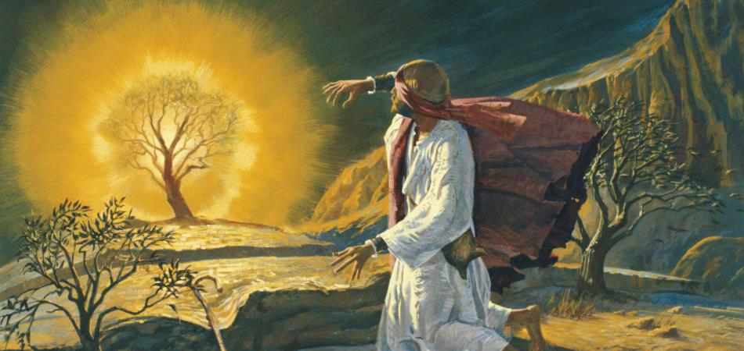
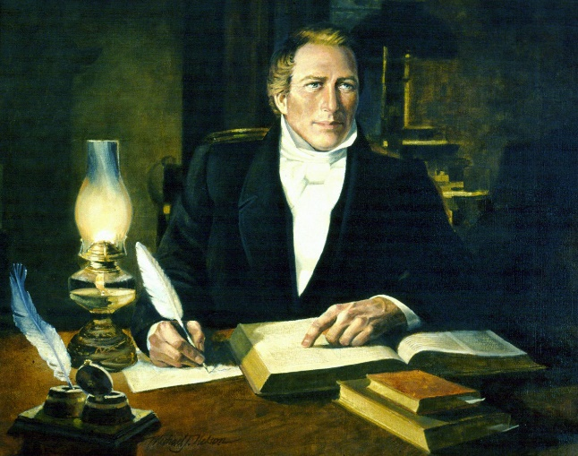
When Was Moses Recorded?
We do not know exactly when Moses received the revelations recorded in the book of Moses or where he was when he recorded them.
However, we know that the experiences recorded in Moses 1 occurred after Moses encountered the burning bush, but before he returned to Egypt to deliver the children of Israel from bondage.
It has been suggested that Moses recorded the material in Moses 2–8, which corresponds to his writings in Genesis 1:1–6:13, sometime in the 15th century B.C.
The writings contained in the book of Moses were revealed to the Prophet Joseph Smith as he was working on his inspired translation, or revision, of the King James Version of the Bible between June 1830 and February 1831.
Moses 1:17; Moses 1:25-26; Exodus 3:1–4:17

Slide 6
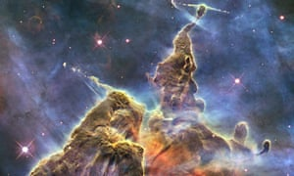
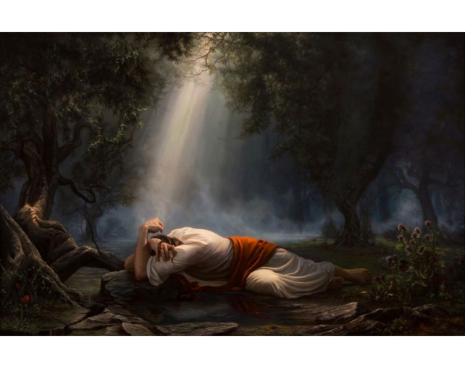
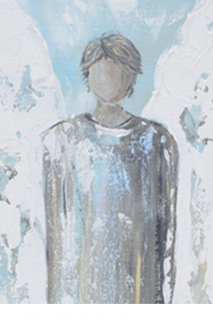
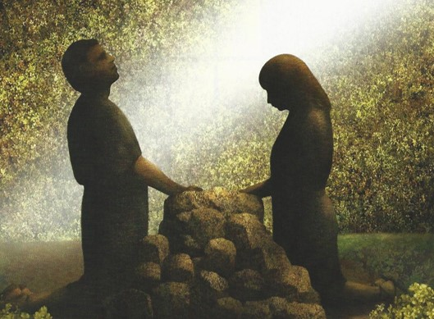
The Book of Moses Contains…
Moses 2
Moses 3-6
Moses 4:1-4
Moses 5-7
The spiritual creation of all things
The significance of the Fall of Adam and Eve and clear explanations of its effects on mankind
The actions of Lucifer before he was cast out of heaven
The importance of the Atonement of Jesus Christ
Adam Abram

Slide 7
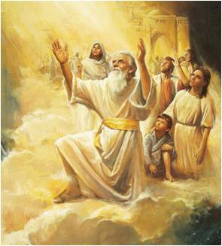
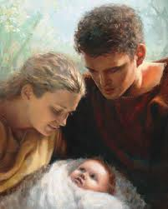

The Book of Moses Contains…
Moses 5-8
Moses 7
Moses 8
The establishment of Zion in Enoch’s day and his visions of the Lord
Details concerning the conditions on the earth before the Flood, as well as Noah’s efforts to teach the gospel of Jesus Christ and warn the people to repent
Evidence that Adam and Eve and their descendants enjoyed the blessings of the gospel of Jesus Christ

Slide 8

Who Are We?
We are children of our Heavenly Father
What does it mean to you to know that you are a child of Heavenly Father?
How can this knowledge affect the way you view yourself?
How can it affect the way you view others?
How might remembering that we are Heavenly Father’s children help us to make better choices each day?

Slide 9
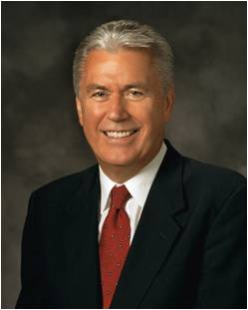


“You are something divine—more beautiful and glorious than you can possibly imagine. This knowledge changes everything. It changes your present. It can change your future. And it can change the world. …
“Because of the revealed word of a merciful God, … you have felt the eternal glory of that divine spirit within you. You are no ordinary beings, my beloved young friends all around the world. You are glorious and eternal. …
“It is my prayer and blessing that when you look at your reflection, you will be able to see beyond imperfections and self-doubts and recognize who you truly are: glorious sons and daughters of the Almighty God”
President Dieter F. Uchtdorf

Slide 10
Who Are You?
You are all the sons and daughters of God. Your spirits were created and lived as organized intelligences before the world was.
You have been blessed to have a physical body because of your obedience to certain commandments in that premortal state.
You are now born into a family to which you have come, into the nations through which you have come, as a reward for the kind of lives you lived before you came here and at a time in the world’s history.
President Harold B. Lee

Slide 11
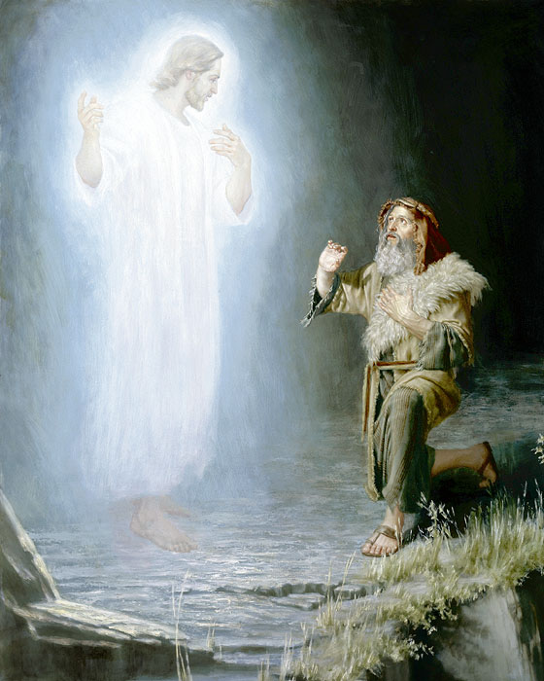
Seeing God Face to Face
“God showed Moses the workmanship of His hands, granting him a glimpse of His work and glory.”
President Dieter F. Uchtdorf
“It must be obvious then that to endure the glory of the Father or of the glorified Christ, a mortal being must be translated or other vise fortified. Moses, a prophet of God, held the protecting Holy Priesthood: ". . . and the glory of God was upon Moses; therefore Moses could endure his presence.”
Elder Spencer W. Kimball
Moses 1:2

Slide 12

Endless is My Name
“Endless , used as a noun and not as an adjective, is one of the names of God and signifies his unending, eternal continuance as the supreme, exalted ruler of the universe.”
Bruce R. McConkie
…For, behold, I am endless…
D&C 19:10
And thou art after the order of him who was without beginning of days or end of years, from all eternity to all eternity.
Moses 6:67
Moses 1:3

Slide 13
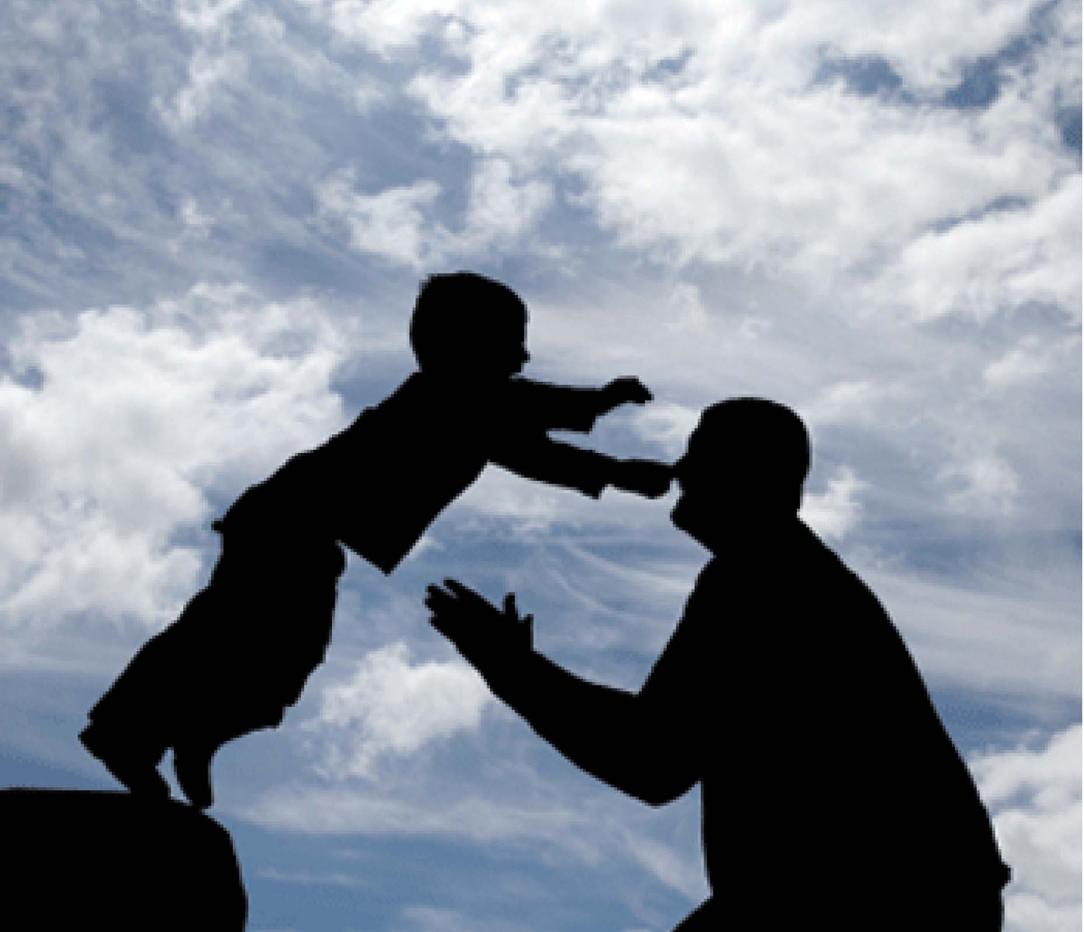
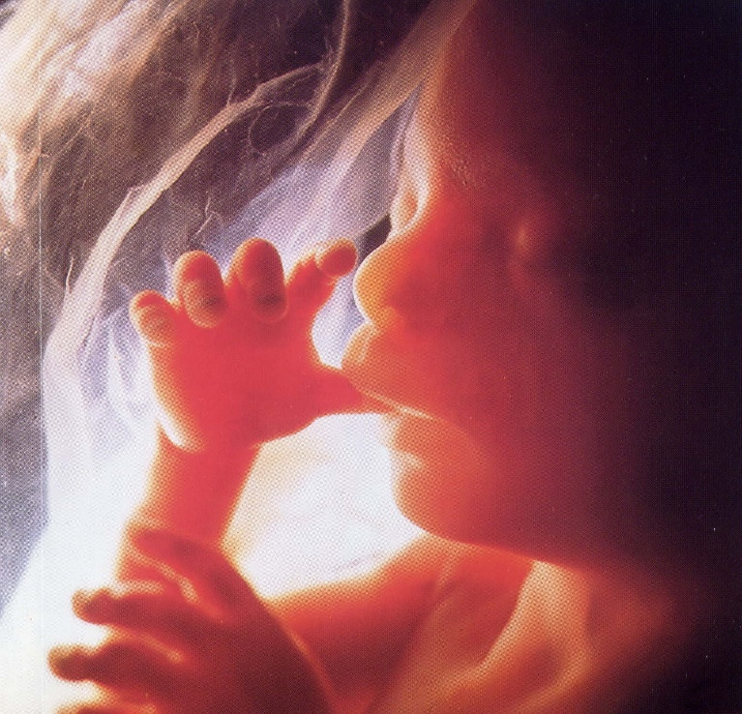
Thou Art My Son
The Lord Calls Moses “My Son” 4 times in Moses 1
“Man is the child of God, formed in the divine image and endowed with divine attributes, and even as the infant son of an earthly father and mother is capable in due time of becoming a man, so the undeveloped offspring of celestial parentage is capable, by experience through ages and aeons, of evolving into a God.”
The First Presidency
The Spirit shall return unto God who gave it
Ecclesiastes 12:7
God is the “Father of Spirits”
Hebrews 12:9
Moses 1:3

Slide 14
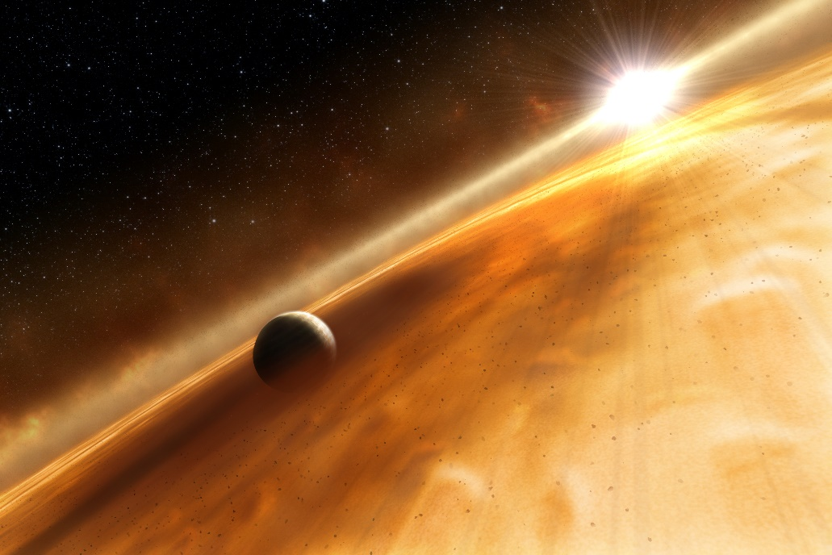
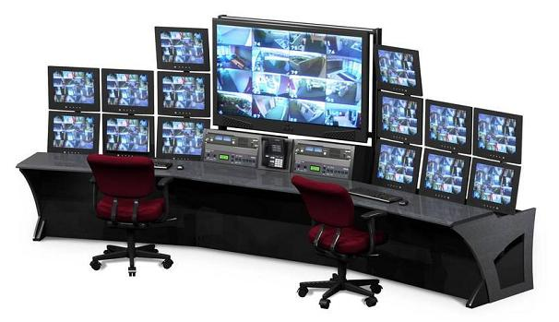
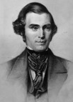
Should We Be Permitted to See All?
“Moses…at a certain time, was clothed upon with the glory of God; and while he was thus clothed upon, he was enabled to behold many things; and seeing some things that looked very glorious, he wanted to see more;…
“…the sight would be so overwhelming that the mortal tabernacle would melt away.
Should a mortal man be permitted to gaze upon all the works of God, which included all His glory?
Mortality could not endure it.”
Orson Pratt
Moses 1:4-5

Slide 15
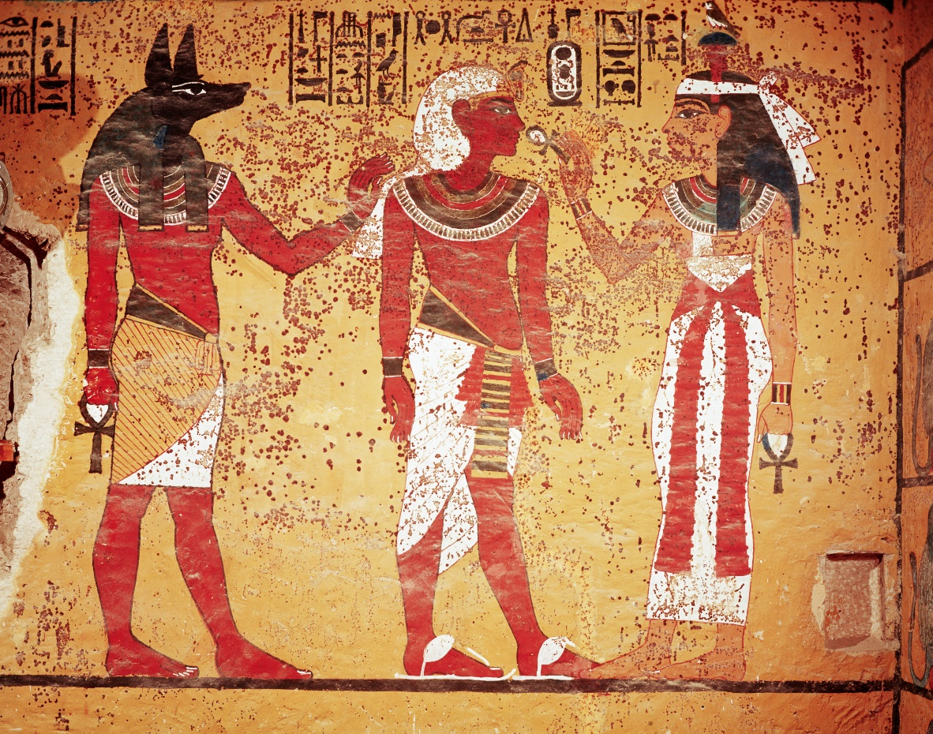
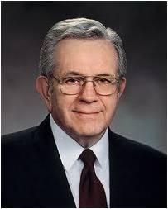
“No God Besides Me”
“Moses was reared in an atmosphere of idolatry.
There were numerous deities among the Egyptians.”
First Presidency Message
“The Father is the one true God. This thing is certain; no one will ever ascend above Him; no one will ever replace Him. Nor will anything ever change the relationship that we, His literal offspring, have with Him. He is Elohim, the Father. He is God. Of Him there is only one. We revere our Father and our God; we worship Him.”
Boyd K. Packer
Thou shalt have no other gods before me.
Exodus 20:2-5
Moses 1:6

Slide 16
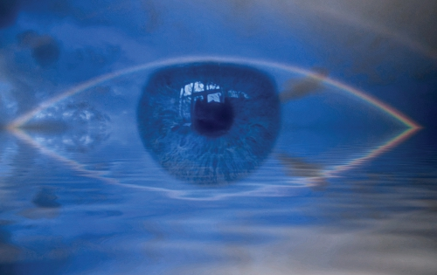
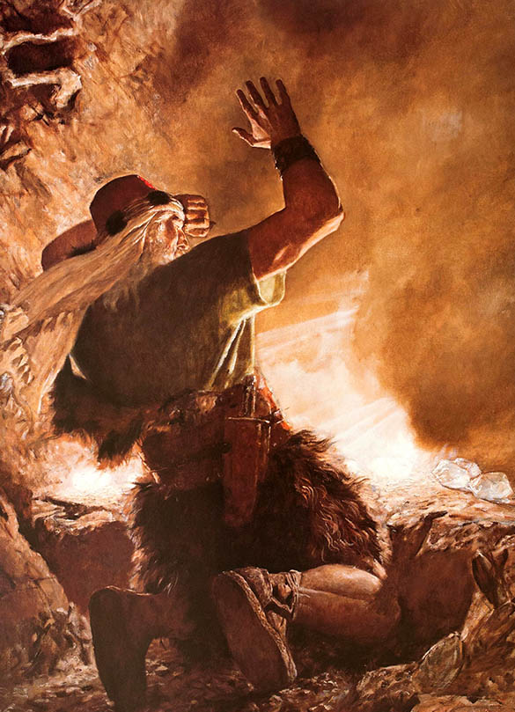
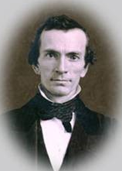
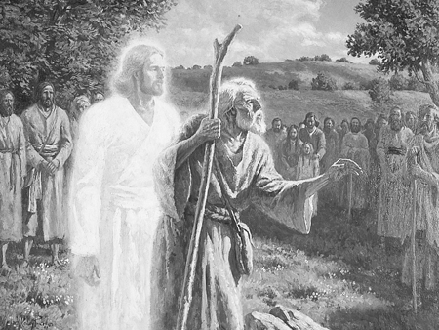
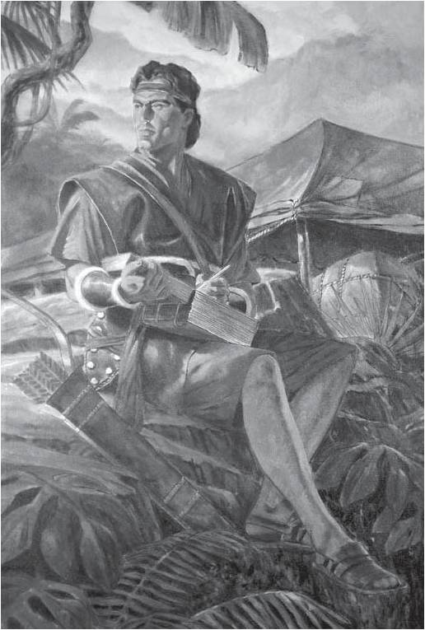
“Revealing the History of the World”
“When God manifests to his servants those things that are to come, or those which have been, he does it by unfolding them by the power of that Spirit which comprehends all things…”
“…the Lord showed the brother of Jared all things which were to transpire from that day to the end of the earth, as well as those which had taken place…”
Oliver Cowdery
Arnold Friberg
And also others who have been, to them hath he shown all things, and they have written them; and they are sealed up to come forth in their purity,
1 Nephi 14:26
And Adam stood up in the midst of the congregation; and, notwithstanding he was bowed down with age, being full of the Holy Ghost, predicted whatsoever should befall his posterity unto the latest generation.
D&C 107:56
Moses 1:7-8

Slide 17
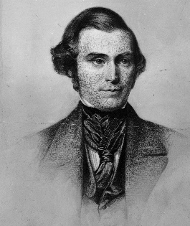
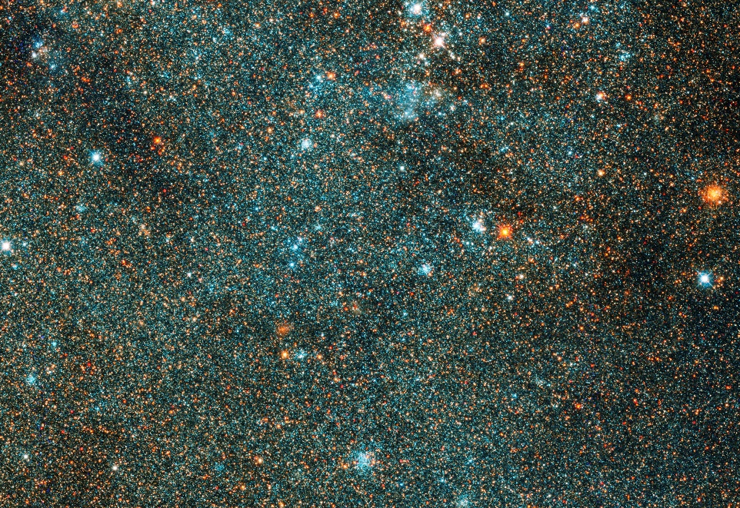
“Man is Nothing”
“There is but a small degree…of the purposes of god unfolded to the mind of man. The amount of knowledge, which we in our present state are in possession of, is extremely limited, so that when compared with that vast amount of knowledge that fills eternity, we might say that man, in his highest attainments here in this life, is, as it were, nothing.”
Orson Pratt
The Andromeda galaxy
For as the heavens are higher than the earth, so are my ways higher than your ways, and my thoughts than your thoughts.
Isaiah 55:9
Moses was granted the power to receive knowledge from God and greater information that the rest of the human family. But because of the vast knowledge and the eternal intelligence Moses found himself small compared to the vastness of the heavens.
Moses 1:9-10

Slide 18

“Spiritual Eyes”
Moses needed to be transfigured in order to stand as a mortal in the presence of God.
Transfiguration is a temporary change in appearance and nature that must take place so a mortal can endure the physical presence and glory of heavenly beings.
For no man has seen God at any time in the flesh, except quickened by the Spirit of God.
Neither can any natural man abide the presence of God, neither after the carnal mind.
D&C 67:11-12
Moses 1:11

Slide 19

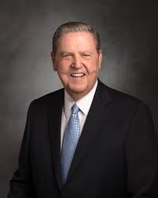
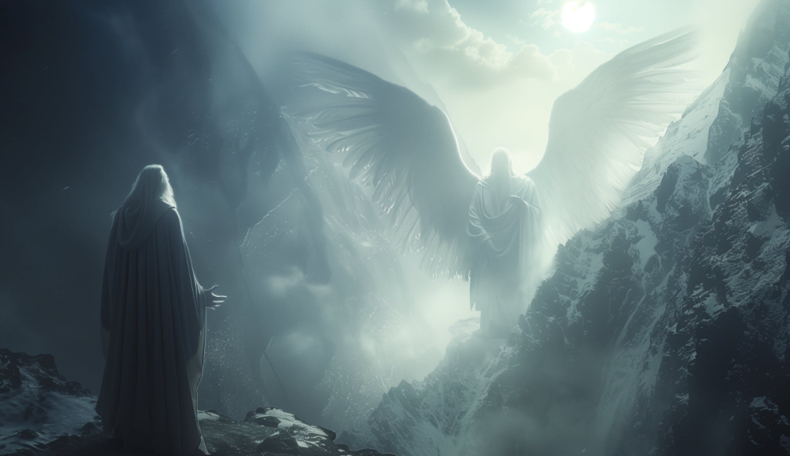
Satan
We speak boldly because Satan is a real being set on destroying you, and you face his influence at a younger and younger age.
Jeffrey R. Holland
Although Moses was a mighty prophet, he also faced great temptation.
Moses 1:12

Slide 20
Moses VS Satan
Satan came as an angel of light
How can you tell if it is Satan or God?
For behold, I could not look upon God, except his glory should come upon me, and I were transfigured before him.
But I can look upon thee in the natural man.
Is it not so, surely?
Moses 1:14
“Satan did not feel disposed to give up the attack, and he commanded him to worship him, and he exerted a great power and the earth shook and trembled, and Moses was filled with fear…”
Orson Pratt
Moses 1:12-23

Slide 21
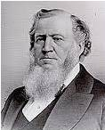
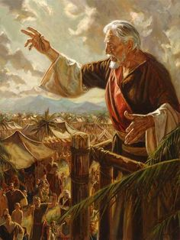
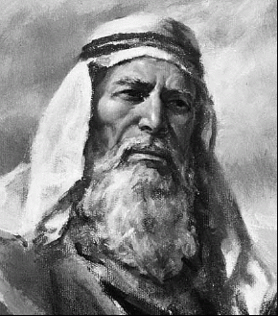
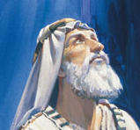
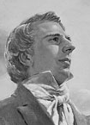
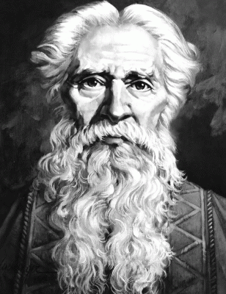
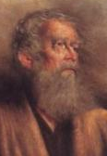
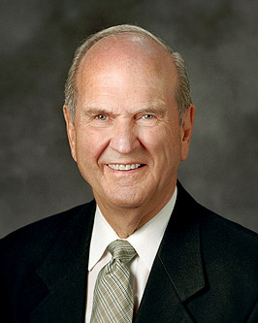
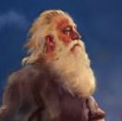
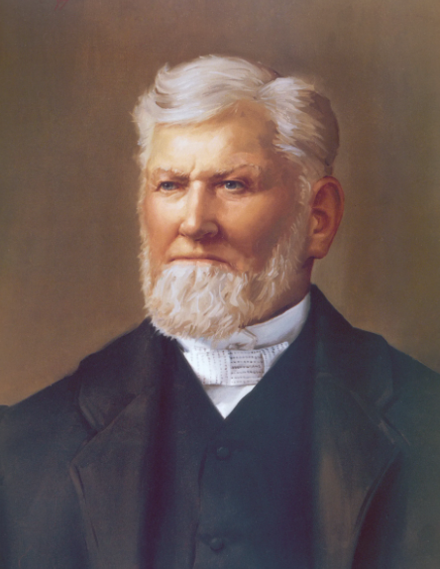
Led Astray
“People are liable in many ways to be led astray by the power of the adversary, for they do not fully understand that it is a hard matter for them to always distinguish the things of god from the things of the devil.”
“…who transformeth himself nigh unto an angel of light, and stirreth up the children of men…2 Nephi 9:9
“There is but one way by which they can know the difference, and that is by the light of the spirit of revelation, even the spirit of our Lord Jesus Christ.”
Brigham Young
“There never was a prophet in any age of the world but what the devil was continually at his elbow.”
Wilford Woodruff
Moses 1:12-23

Slide 22

Resisting Temptation
“If it be the devil as an angel of light, when you ask him to shake hands he will offer you his hand, and you will not feel anything; you may therefore detect him.”
D&C 129:8
We can resist Satan’s deceptions as we remember our previous spiritual experiences and have faith in them
“In moments of fear or doubt or troubling times, hold the ground you have already won, even if that ground is limited. … When those moments come and issues surface, the resolution of which is not immediately forthcoming, hold fast to what you already know and stand strong until additional knowledge comes. … The size of your faith or the degree of your knowledge is not the issue—it is the integrity you demonstrate toward the faith you do have and the truth you already know.”
Elder Jeffrey R. Holland
When we have the Spirit with us, we are better able to discern between good and evil
Moses 1:13-15

Slide 23

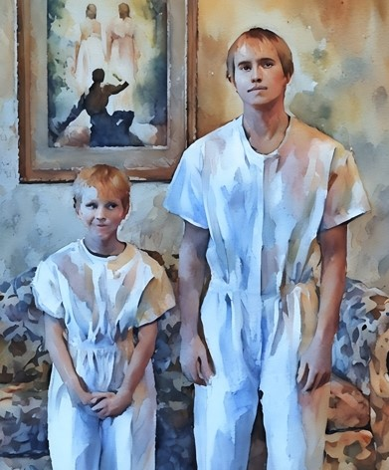
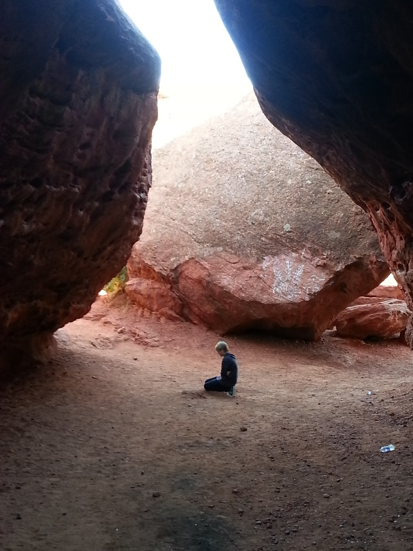
Overcoming Coming Temptations by…
… remembering that we are children of God
… recalling past spiritual experiences
… calling upon God for strength
Moses 1:13-15

Slide 24

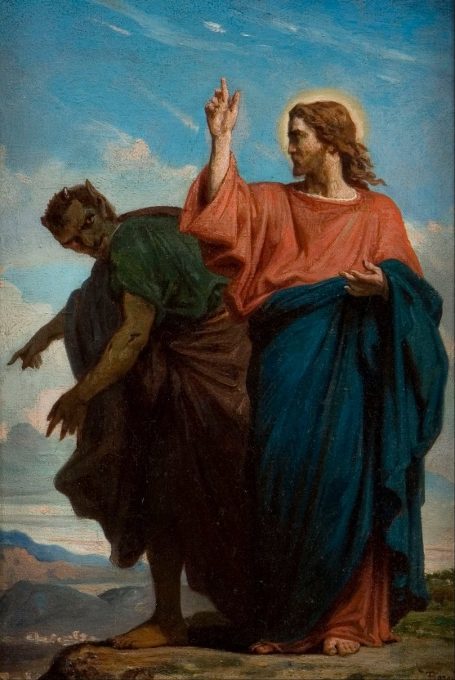
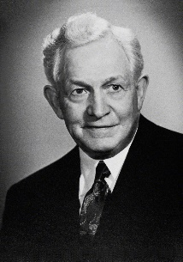
“Get Thee Hence”
“Your greatest weakness will be the point at which Satan will try to tempt you, will try to win you; and if you have made yourself weak, he will add to that weakness. Resist him, and you will gain in strength.
If he tempts you in another way, resist him again and he will become weaker. In turn, you become stronger, until you can say, no matter what your surroundings may be.”
David O. McKay
And Jesus answered and said unto him, Get thee behind me, Satan: for it is written, Thou shalt worship the Lord thy God, and him only shalt thou serve.
Luke 4:8
Moses 1:16
Félix Joseph Barrias (1822 - 1907

Slide 25
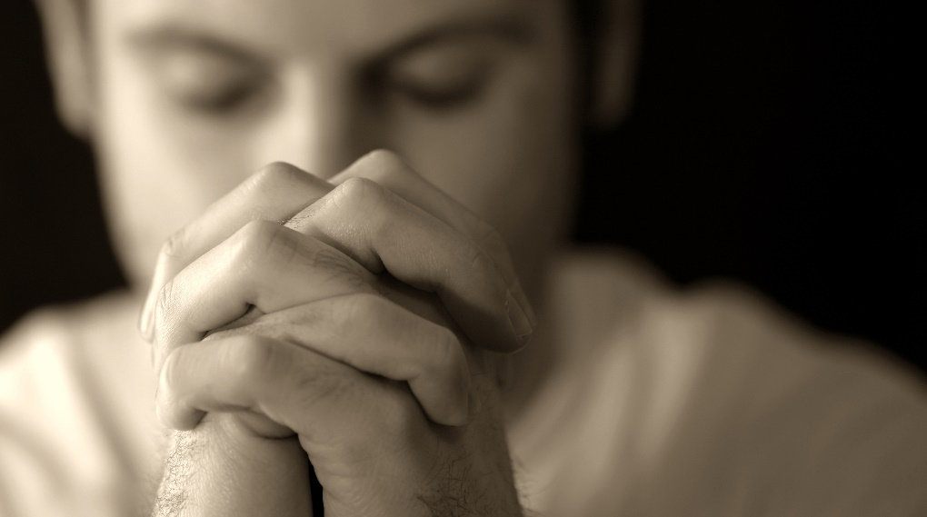
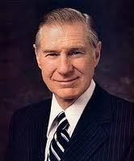
Calling on the Lord
When we are faithful and call upon God, we will receive strength to overcome Satan’s influence
“When God placed man on the earth, prayer became the lifeline between mankind and God. Thus, in Adam’s generation, men began “to call upon the name of the Lord.”
Through all generations since that time, prayer has filled a very important human need. Each of us has problems that we cannot solve and weaknesses that we cannot conquer without reaching out through prayer to a higher source of strength.”
President James E. Faust
Moses 1:19

Slide 26
Sources:
Suggested Song: I Am a Child of God
Videos:
“Our True Identity”
“I Am a Son of God” “
“Let God Guide You: From Weakness to Strength” (6:07),” from time code 2:50 to 6:30,
Old Testament Seminary Teacher Manual
Old Testament Who’s Who by Ed J. Pinegar and Richard J. Allen pp. 131-136
Edward J Brandt Journeys and Events in the Life of Moses October Ensign 1973
President Deiter F. Uchtdorf (“The Reflection in the Water”[Church Educational System fireside for young adults, Nov. 1, 2009]; LDS.org).
You Matter to Him October 2011 Gen. Conf.
President Harold B. Lee Understanding Who We Are Brings Self-Respect October 1973 Gen. Conf.
Presentation by ©http://fashionsbylynda.com/blog/
Elder Spencer W. Kimball For They Shall See God April 1964 Gen. Conf.
Bruce R. McConkie Mormon Doctrine p. 226
The First Presidency: Joseph F. Smith, John R. Winder, and Anthon H. Lund, in James R. Clark, comp., Messages of the First Presidency, 4:206
Orson Pratt Journal of Discourses, 2:245
Messages of the First Presidency, 4:270-71
Boyd K. Packer Conference Report Oct. 1984
Orson Pratt Journal of Discourses, 3:97; 15:235
Brigham Young Journal of Discourses 3:43
Wilford Woodruff Journal of Discourses 13:163
Elder Jeffrey R. Holland (“Lord, I Believe,” Ensign or Liahona, May 2013, 93–94); (“We are All Enlisted,” Ensign or Liahona, Nov. 2011, 45)
David O. McKay Improvement Era July 1968
President James E. Faust The Lifeline of Prayer April 2002 Gen. Conf.

Slide 27
The Nature of Satan
Why does Satan work so hard? He is out to win. Win what? Does he want to
replay the War in Heaven? No. God won that battle. Satan is not out to renegotiate the
War in Heaven. He knows he lost. Then why is he working so hard?
In the Book of Mormon, Lehi says to his children in 2 Nephi 2:17-18:
And I, Lehi, according to the things which I have read, must needs
suppose that an angel of God .... had fallen from heaven; wherefore he became
a devil, having sought that which was evil before God.
And because he had fallen from heaven and had become miserable
forever, he sought also the misery of all mankind.
Satan's objectives are not to win anything, save it be souls. What he really wants
is misery. It is not the desire to win that motivates him. It is something sinister, mean
and ugly. To understand it must be kept in mind - he is insane. When you work with the
insane they work differently. Everyone attributes great sanity to Satan, but in reality he is
the most insane creature this cosmos has ever developed. How did he go from being the
Son of the Morning to pathologically crazy?
Every sin anyone of us commits skews our thinking and makes us, to that degree,
insane, until we repent and come back into reality. Satan has committed the greatest of
all sins against God and so his thinking is completely skewed and he is completely
insane. He does not reason or think as we do. What drives him is the hunger for other
people's misery. Satan desires pain - he lusts for pain. He is sadistic through and
through. A long time ago he learned to stuff himself with other people's unhappiness.
He and his minions possessed the men with leather ribbon whips that sweated up the
pyramids, seasoning them with other people's tears and other people's broken hearts.
These lackeys of Hell coursed Europe on the black horses of the great plague and
rejoiced in the anguish if the people. He is a billion times hungrier for pain, sorrow and
sickness than even the meanest of mortal men. He gorges himself in the fear, the
depression and the tormented consciences of men.
The old saying really applies: You can't get something for nothing. The fact is,
from Satan you get Nothing for Something! In the end, the Devil will not support his
own. He will only laugh at their realization of their own fall and enjoy the anguish and
misery he has so carefully created for them over the years. (Richard Draper—Opening of the Seventh Seal)
The Andromeda galaxy, shown here, is the closest spiral galaxy to our own spiral, the Milky Way. Astronomers at the University of Utah and elsewhere have launched the Andromeda Project so thousands of volunteers can help them find star
When Feeling Tempted: Moses 1:13-15
Please remember that, first, your Heavenly Father loves you, and, second, your Savior, the Lord Jesus Christ, loves you. Get these truths right in your mind and then sink them deep into your heart. They will provide you a compass for how you should act and how you should treat others, and they will give you the strength to overcome temptation and stay on the Church covenant path. (“Children of Heavenly Father” [Brigham Young University devotional, Mar. 3, 2020])
In moments of fear or doubt or troubling times, hold the ground you have already won, even if that ground is limited. … When those moments come and issues surface, the resolution of which is not immediately forthcoming, hold fast to what you already know and stand strong until additional knowledge comes. … The size of your faith or the degree of your knowledge is not the issue—it is the integrity you demonstrate toward the faith you do have and the truth you already know. (“Lord, I Believe,” Ensign or Liahona, May 2013, 93–94)
The nearer a person approaches the Lord, a greater power will be manifested by the adversary to prevent the accomplishment of His purposes. (in Orson F. Whitney, Life of Heber C. Kimball [Salt Lake City: Bookcraft, 1967], 132)

Slide 28
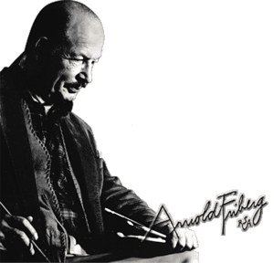
Artist Arnold Friberg, the son of Scandinavian immigrants, was born on December 21, 1913 in Winnetka Illinois, a suburb of Chicago. At the age of 3 Arnold moved to Arizona with his sister, Gertrude, and his parents. By age 7 young Friberg was already drawing original cartoons. Mr. Friberg remembers, "I never had to take an aptitude test, I always knew what I wanted to do, Art".The Fribergs were able to scrape together enough money to enroll Arnold in a correspondence course at the age of 10. While in Phoenix Arizona, young Friberg often shared his drawings with the newspaper staff of the Arizona Republican and he learned from them. During his high school years, Arnold earned money by making signs for local businesses. After graduating from high school, he began his studies at the Chicago Academy of Fine Arts.
While attending the Academy, Arnold worked part-time for printers. Arnold stayed in the Chicago area for several years and worked in the commercial art field. It was during this time that he became aquainted with the Northwest Paper Company and their ad campaign featuring the Canadian Mounties. Little did he know the importance this would play in his future. In 1940, Arnold moved to New York City into the publishing world of Manhattan. While there, he enrolled in night classes at the Grand Central School of Art, where he studied with Norman Rockwell under Harvey Dunn, one of the countries top illustrators.
In 1948 Arnold accepted a commission to do scenes of the American West for a calendar series by the Louis F. Dow Calendar Company. This would become the start of his serious interest in the West. By 1950 Arnold and his wife had moved to Utah, and Arnold started teaching commercial art at the University of Utah. During his teaching a great producer and director Cecil B. DeMille was planning his immense production of "The Ten Commandments". DeMille was in need of an artist with both "the rare talent and inner vision to set down in paint, all of the power, the color, the human drama." After a long search, which included Europe, a publisher friend in Sweden sent DeMille prints of Arnold's scriptural illustrations. Demille knew he had found his artist.
This led to the Fribergs move to Hollywood in 1953. There, Arnold worked with Cecil B. DeMille for over three years on the epic motion picture "The Ten Commandments" as his chief artist and designer. Arnold worked closely with DeMille to visualize, through hundreds of sketches and paintings, a variety of scenes and human characters for the motion picture. Arnold Friberg's 15 paintings for "The Ten Commandments" became the pictorial basis for the movie's scenes, characters and costumes, which earned him an Academy Award Nomination.
One of his largest and favorite pieces, painted in 1975, is of George Washington kneeling in prayer beside his horse at Valley Forge. Originally painted to honor our country's Bi-centennial year, "The Prayer at Valley Forge" in the past 20 years has become increasingly cherished and recognized as a supreme 20th century masterpiece of patriotic American art. In it we feel the cold, the suffering, and the weight of the burden falling on that tall and lonely man, driven to his knees there in the bitter snows of Valley Forge. This picture, marking a bold rejection of fleeting artistic and political 'fashions', now expresses a powerful affirmation of faith, patriotic duty, and the deep spiritual depths in the founding of our country.

