Slide 1

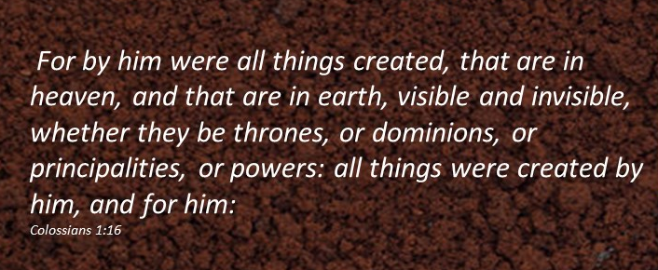
The Purpose of God’s Creations
Moses 1:24-42
Presentation by http://fashionsbylynda.com/blog/

Slide 2
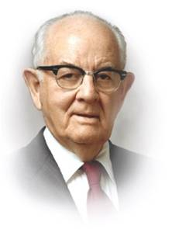
Is Satan Real?
“Satan is very much a personal, individual spirit being, but without a mortal body. His desires to seal each of us his are no less ardent in wickedness than our Father’s are in righteousness to attract us to his own eternal kingdom.”
President Spencer W. Kimball
Satan teaches that there is no hell and no devil
And behold, others he flattereth away, and telleth them there is no hell; and he saith unto them: I am no devil, for there is none—and thus he whispereth in their ears, until he grasps them with his awful chains, from whence there is no deliverance.
2 Nephi 28:22

Slide 3
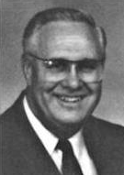
Is Satan Mentioned in the Bible?
The first time Satan is mentioned in the Bible.
1 Chronicles 21:1
His name appears only in 13 verses in the Old Testament, 10 of which are in the Book of Job.
The Devil/Devils are mentioned 4 times in the Old Testament. And numerous references in the New Testament
Leviticus 17:7
Deuteronomy 32:17
2 chronicles 11:15
Psalm 106:37
Serpents are identified as tempting Adam and Eve, but there is no reference that the serpent is Satan (Genesis 3:1-2)
The Book of Moses Satan appears 28 times and is also referred to as the devil.
H. Donl Peterson

Slide 4
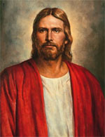
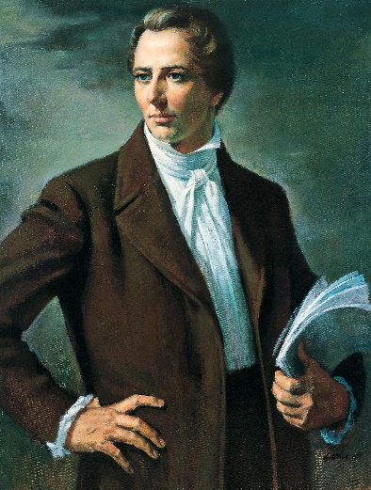
The Holy Ghost
“I have always declared God to be a distinct personage, Jesus Christ a separate and distinct personage from God the Father, and that the Holy Ghost was a distinct personage
and a Spirit; and
these three constitute
three distinct
personages and
three Gods.”
Joseph Smith
“The Holy Ghost ‘witnesses of the Father and the Son’
The Holy Ghost testifies of Jesus
But when the Comforter is come, whom I will send unto you from the Father, even the Spirit of truth, which proceedeth from the Father, he shall testify of me:
John 15:26
The Holy Ghost’s mission is to bear witness to the truth
Moses 1:24 excerpts from Bruce R. McConkie

Slide 5
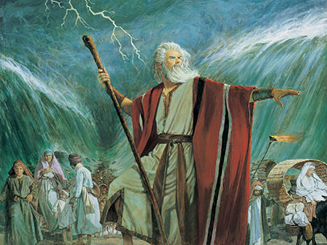
Many Waters
“Water is used for God’s own purposes—to give life to men; to cleanse them from their sins; to drown them in death when his judgments are poured out.”
“The miracle—Jehovah rules the waters, whether it be by His own voice or by the voice of his servants.”
Moses 1:25 Bruce R. McConkie

Slide 6
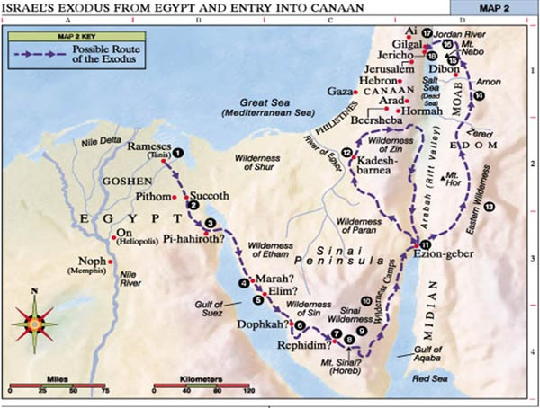
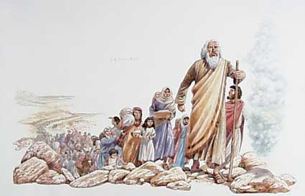
The Two Missions of Moses
To rescue Israel from Egyptian bondage, restoring the nation to the Land of Promise.
To convert the tribes to worship the true God.
“Moses was given a dispensation of gathering and leading Israel from Egypt to their promised land.”
Joseph Fielding Smith
A gospel dispensation is a period of time in which the Lord has at least one authorized servant on the earth who bears the keys of the holy priesthood.
Moses 1:26 Mark E. Peterson

Slide 7
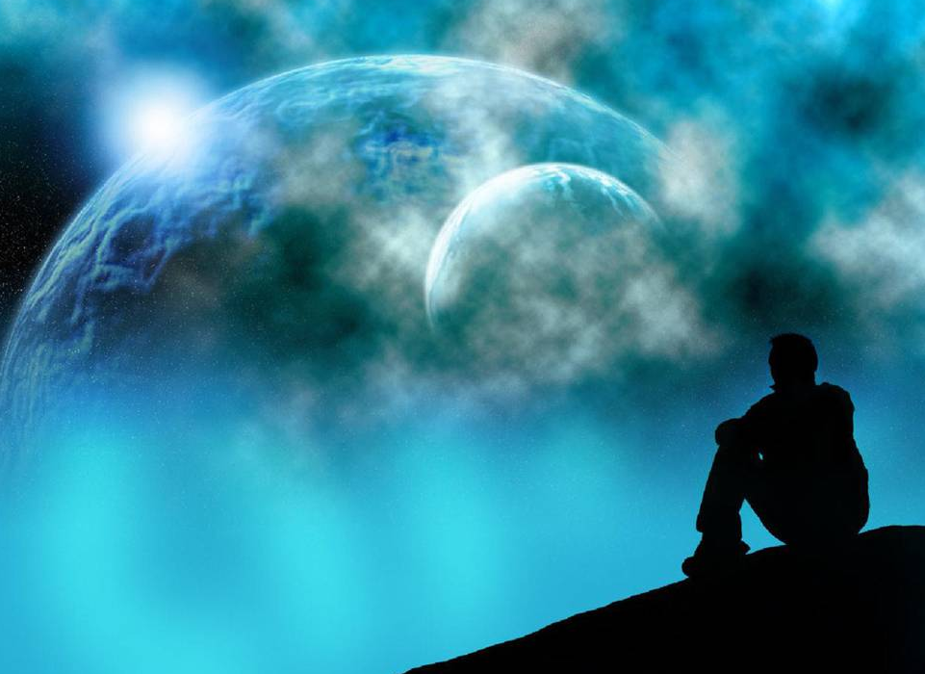
Why did God create the universe?
Why did God create us?
How do I feel about God and
what He does for me?

Slide 8


Every Particle
“Moses beheld every particle of the earth…discerning it by the Spirit of God.”
Orson Pratt
“Moses also beheld all the inhabitants of the earth…He was able to perceive as God does…comprehending their eternal souls.”
H. Donl Peterson
By the power of the Spirit our eyes were opened and our understandings were enlightened, so as to see and understand the things of God—
D&C 76:12
Moses 1:27-29

Slide 9

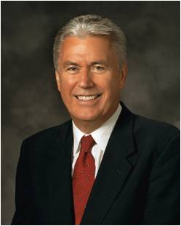
“Discovering who we really are is part of this great adventure called life. Mankind’s greatest minds have wrestled endlessly with these questions:
Where did we come from?
Why are we here?
What happens after we die?
And how does all this fit together—how does it make sense?
“Once we begin to understand the answers to these questions—not with the mind only, but with the heart and the soul—we will begin to understand
who we are, and we will feel like the
wanderer who is finally finding home. …
Everything finally makes sense”
President Dieter F. Uchtdorf
Moses 1:27-29

Slide 10
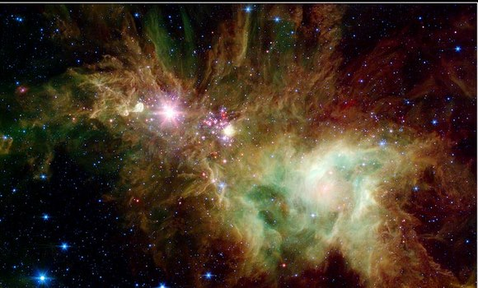
The Universe
“Moses was given a panoramic view of the universe. Not only did he see many worlds, but he also saw and recorded that they were inhabited.”
Behold, all these are kingdoms, and any man who hath seen any or the least of these hath seen God moving in his majesty and power.
D&C 88:47
Snowflake Cluster
Moses 1:29

Slide 11
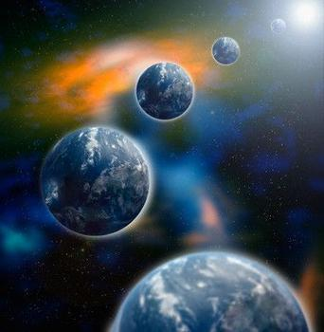
Worlds Without Numbers
Under the direction of Heavenly Father, Jesus Christ created worlds without number.
Hath in these last days spoken unto us by his Son, whom he hath appointed heir of all things, by whom also he made the worlds;
Hebrews 1:2
“His service and relationship to other worlds and their inhabitants are the same as his service and relationship to this earth and its inhabitants…”
H. Donl Peterson
Lift up your eyes on high, and behold who hath created these things, that bringeth out their host by number: he calleth them all by names by the greatness of his might, for that he is strong in power; not one faileth.
Isaiah 40:26
And he said: Yea, I believe that he created all things which are in the earth; but I do not know the heavens.
Alma 18:29
Moses 1:31-33

Slide 12
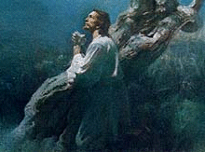
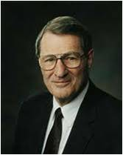
“For Mine Own Purpose”
“As the plan of salvation is executed and re-executed, again and again, in realms beyond our purview, His love is constant and personal.”
Because God’s “great and eternal plan”
does not vary, the same plan that will exalt the inhabitants of this earth is implemented for the same purpose in all the worlds God has created.
“We learn from Doctrine and Covenants 76:23–24 that the inhabitants of numerous worlds “are begotten sons and daughters unto God” through the Atonement of Jesus Christ.
This truth underscores the central role of Jesus Christ’s infinite Atonement in God’s plan for the salvation of our world as well as the many others created by His Only Begotten Son.”
Moses 1:31-33 Neal A. Maxwell

Slide 13
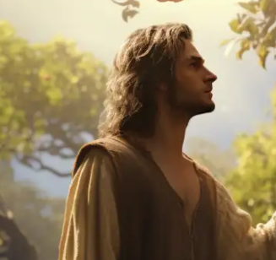
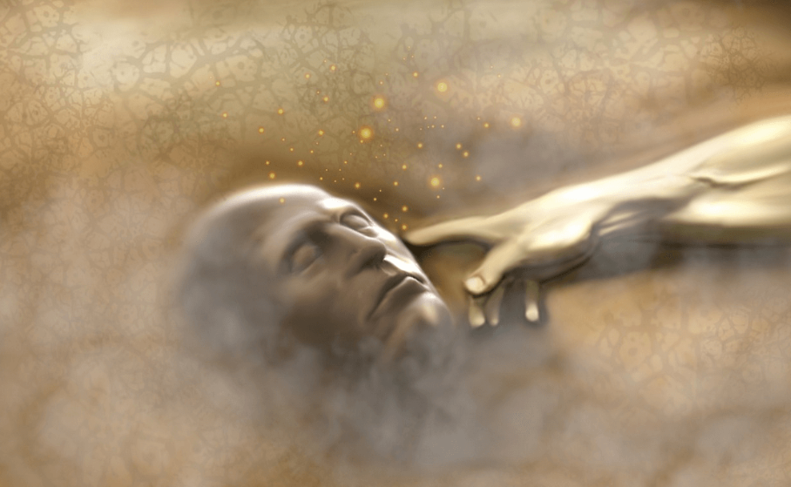
First Man—Called Adam
“Adam was placed on earth as the first of the human family and given a name which signifies many as pertaining to the greatness of the posterity which should flow from him.”
H. Donl Peterson
And he beheld that they did contain the five books of Moses, which gave an account of the creation of the world, and also of Adam and Eve, who were our first parents; 1 Nephi 5:12
And I, the Lord God, formed man from the dust of the ground, and breathed into his nostrils the breath of life; and man became a living soul, the first flesh upon the earth, the first man also; nevertheless, all things were before created; but spiritually
were they created and made
according to my word.
Moses 3:7
And from Enoch to Abel, who was slain by the conspiracy of his brother, who received the priesthood by the commandments of God, by the hand of his father Adam, who was the first man—
D&C 84:16
Moses 1:34

Slide 14
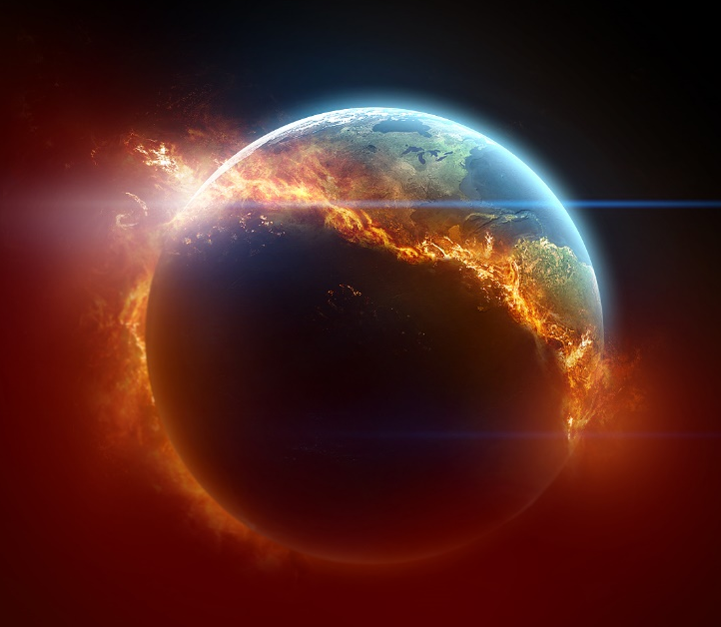

Many Worlds Have Passed Away
“Our heavens are filled with eternal worlds that have attained their exaltation. They are not dying. They have passed through the stage of death and have become eternal, glorious bodies, the habitations of sons and daughters of God who likewise have attained to glory.”
“The earth is a living body. It was created to become a celestial body and the abode for celestial beings.”
Moses 1:35-38 Joseph Fielding Smith

Slide 15
Doctrinal Mastery
Pearl of Great Price
Moses 1:39
For behold, this is my work and my glory—to bring to pass the immortality and eternal life of man.

Slide 16
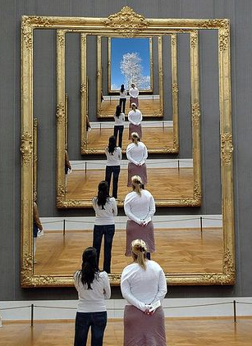
Immortality
To live forever as a resurrected being.
“Eternal life, or exaltation, is to become like God and live in His presence eternally as families”
(General Handbook: Serving in The Church of Jesus Christ of Latter-day Saints, 1.1, Gospel Library).

Slide 17
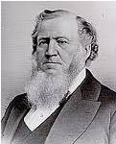
“My Work and My Glory”
Heavenly Father’s purpose is to bring about the immortality and eternal life of man
“The whole object of the creation of this world is to exalt the intelligences that are placed upon it, that they may live, endure, and increase for ever and ever. We are not here to quarrel and contend about the things of this world, but we are here to subdue and beautify it…”
Brigham Young
Immortality
Immortality made possible by…
Eternal Life
We receive eternal life by…
The condition of living forever in a resurrected state
The Atonement of Jesus Christ which includes His Resurrection…every person born with a physical body will be resurrected and will live forever
Becoming like God and live forever as families in His presence
Obedience to the laws and ordinances of the gospel…Jesus Christ made it possible for all to receive
Moses 1:39

Slide 18
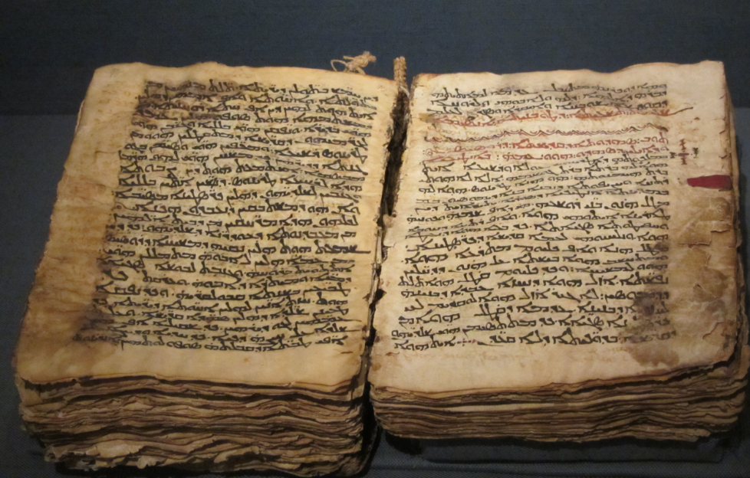
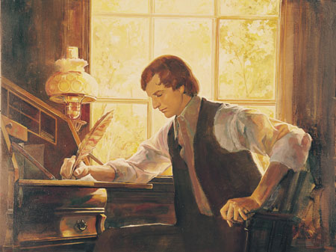
“Write the Words”
“These last records…shall establish the truth of the first (bible)…and shall make known the plain and precious things which have been taken away from the.” 1 Nephi 13:40
“Raise up the Man”
And in a day when the children of men shall esteem my words as naught and take many of them from the book which thou shalt write, behold, I will raise up another like unto thee; and they shall be had again among the children of men—among as many as shall believe.
Moses 1:40-42

Slide 19

…These last records, which thou hast seen among the Gentiles, shall establish the truth of the first, which are of the twelve apostles of the Lamb, and shall make known the plain and precious things which have been taken away from them;…
1 Nephi 13:40

Slide 20
Sources:
Suggested Hymn: # 86 How Great Thou Art
Video: Christ the Creator
President Spencer W. Kimball Teachings of Spencer W. Kimball p. 35
H. Donl Peterson The Pearl of Great Price, a History and Commentary p. 95. 101
Joseph Smith Teachings of the Prophet Joseph Smith 6:474
Bruce R. McConkie New Witness for the Articles of Faith p. 267
Mortal Messiah 2:354-56
Mark E. Peterson Moses, Man of Miracles p. 154
Presentation by http://fashionsbylynda.com/blog
Orson Pratt Journal of Discourses 16:337
President Dieter F. Uchtdorf (“The Reflection in the Water” [Church Educational System fireside for young adults, Nov. 1, 2009]; LDS.org).
Neal A. Maxwell (“Wisdom and Order,” Ensign, June 1994, 43).
Joseph Fielding Smith, Man: His Origin and Destiny, pp. 28-29
Doctrines of Salvation 1:72
Brigham Young Discourses of Brigham Young pp. 87-88
Presentation by ©http://fashionsbylynda.com/blog/

Slide 21
Satan:
Some critics of the bible have concluded from this and from the few references to Satan in the Old Testament that the Jewish people acquired the idea of Satan at a late date, probably during the Babylonian exile (609-539 B.C.). This view of the bible indicates a belief in the evolution of religious ideas rather than in direct revelation from God.”
H Donl Peterson p. 95
Dispensations:
Adam, Enoch, Noah, Abraham, Moses, Jesus Christ, Joseph Smith, and others have each started a new gospel dispensation. When the Lord organizes a dispensation, the gospel is revealed anew so that the people of that dispensation do not have to depend on past dispensations for knowledge of the plan of salvation. The dispensation begun by Joseph Smith is known as the “dispensation of the fulness of times.” Guide to the Scriptures “Dispensation”
Adam 4,000 B.C. | Enoch 3,000 B.C. | Noah 2,500 B.C. | Abraham 2,000 B.C. | Moses 1,500 B.C. | Jesus Christ | Joseph Smith 1,800 A.D.
Adam:
“The first man Adam was made a living soul.” (Corinthians 15:45.)
The brass plates of Laban contained an account of “Adam and Eve, who were our first parents.: (1 Nephi 5:11)
“Adam, who was the first man,” received the priesthood of god. (D&C 84:16)
“Abraham received the same priesthood held by the first man, who is Adam, or first father.” (Abraham 1:3)
Astronomers nicknamed this the “Snowflake Cluster,” the stars appear to have formed in regularly spaced intervals along linear structures in a configuration that resembles the pattern of a snowflake.
NASA’s Spitzer’s Infrared Array Camera (IRAC) and Multiband Imaging Photometer (MIPS) instruments.
Immortality and Eternal Life: Moses 1;39
[Heavenly Father] has given us the gospel and the Church of Jesus Christ. He has given us the plan of redemption, the plan of salvation, even the plan of happiness. …
He has given us the priceless gift of the Holy Ghost. …
He has given us 24/7 access to Him through prayers of faith and supplications of real intent.
He has given us modern-day apostles and prophets, who reveal the word of God in our day. …
He has restored His Church. …
He has given us the holy scriptures—His written word to us.
He has given myriad tools of modern technology to help us in our walk of discipleship. …
Why has our Heavenly Father given us so much help? Because He loves us. And because, as He said of Himself, “This is my work and my glory—to bring to pass the immortality and eternal life of man” (Moses 1:39). (“Our Father, Our Mentor,” Ensign, June 2016, 5)

