Slide 1

Introduction to the Book of Genesis
Presentation by ©http://fashionsbylynda.com/blog/

Slide 2

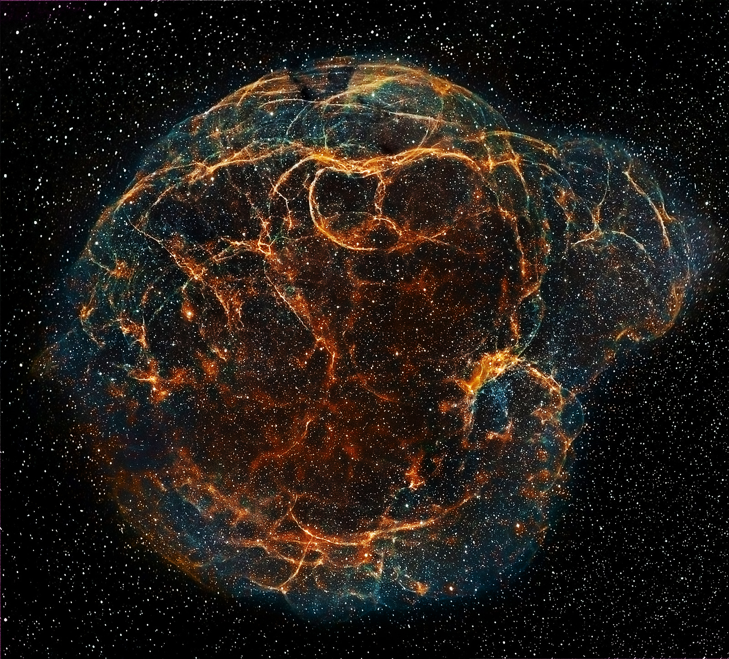
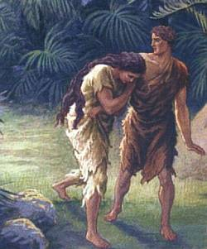
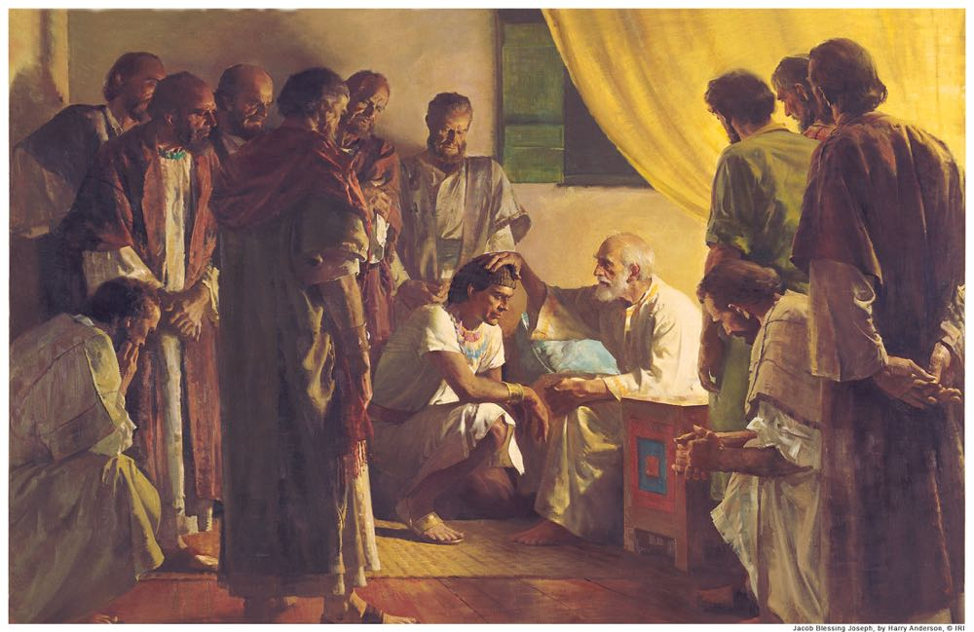
Genesis
The Creation of the earth and all life thereon
Book of beginnings
The establishment of covenants by a merciful Father in Heaven for the salvation of His children.
The origin of the house of Israel
The Fall of Adam and Eve and the introduction of sin into this world

Slide 3
Author of Genesis
Moses was a prophet who was called by God to lead the children of Israel out of bondage from Egypt, through the wilderness, to the promised land of Canaan.
Because the events in Genesis occurred before Moses’s time, he did not learn about them firsthand. They were made known to him through revelation...
and he may also have relied on historical sources available to him.
Moses 1:40; 2:1; Abraham 1:31

Slide 4
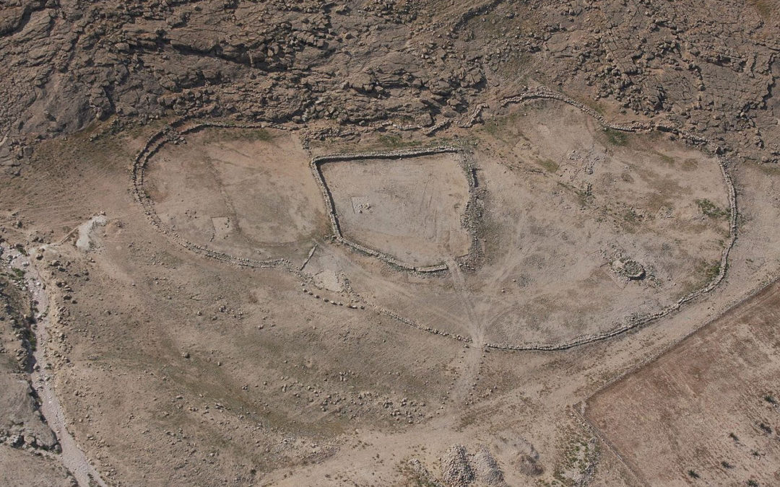
Where Was It Written?
Some scholars date the writing to sometime between the 15th and 13th centuries BC.
We do not know exactly where Moses was when he wrote this book.

Slide 5
An Introduction to the other books of Moses…
Genesis
Exodus
Leviticus
Deuteronomy
Numbers
as well as to the entire Old Testament

Slide 6



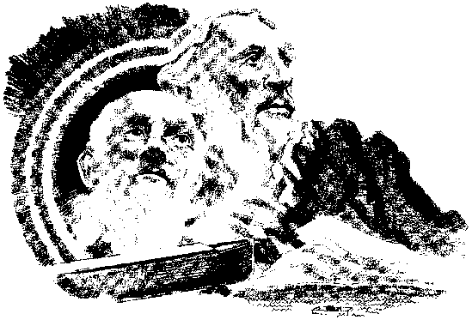
The Record
Genesis recounts events that occurred during the dispensations of Adam, Enoch, Noah, and Abraham.
Events in Genesis:
The Creation
The Fall of Adam and Eve
The Flood
The Abrahamic Covenant
39 chapters are dedicated to the lives of Abraham, Isaac, Jacob, and Jacob’s 12 sons.

