Slide 1

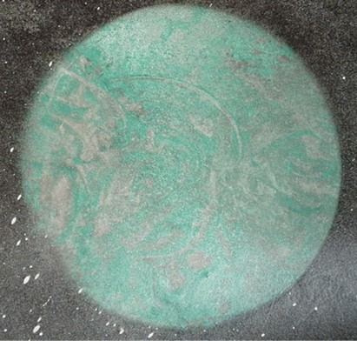
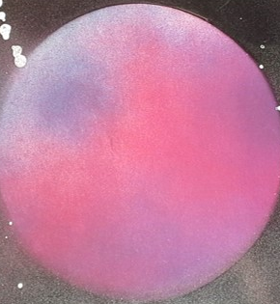
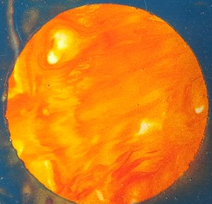
Creation of the Earth
Genesis 1:1-25
Includes Moses 2 and Abraham 4
Presentation by http://fashionsbylynda.com/blog/

Slide 2
The Gift
When has someone made something for you?
What feelings do you have for the person who made it?

Slide 3
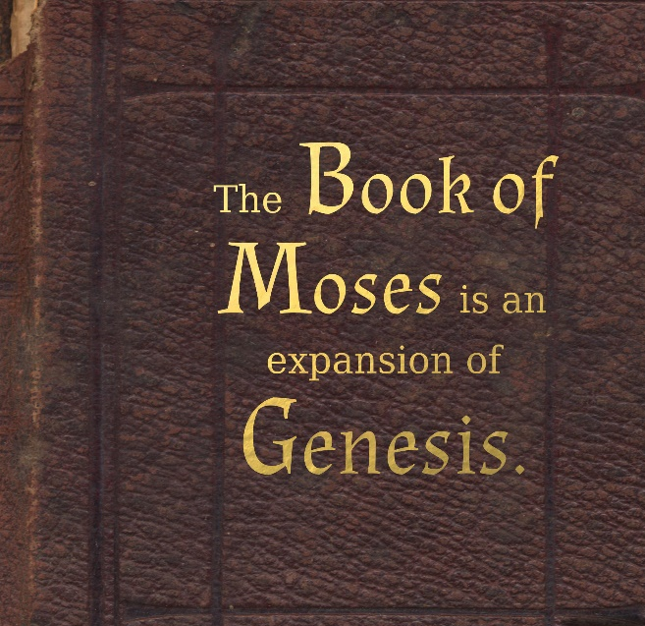
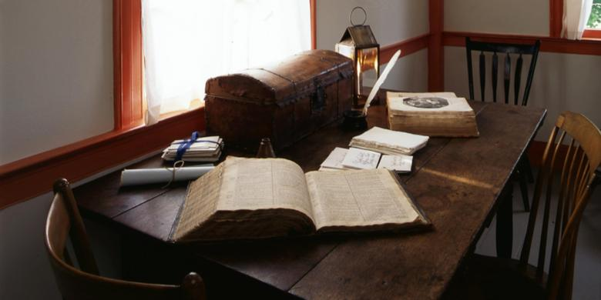
Moses 2
Moses 2 is the Joseph Smith translation of Genesis 1
“I believe the Bible as it read when it came from the pen of the original writers. Ignorant translators, careless transcribers, or designing and corrupt priests have committed many errors.”
Joseph Smith
In June 1830 the Prophet received by revelation the first part of the book of Moses. By February 1831 he had received the rest of the book. It appears in the JST manuscripts as chapters 1 through 6 of Genesis.
And, inasmuch as it is practicable, to preach in the regions round about until conference; and after that it is expedient to continue the work of translation until it be finished.
D&C 73:4
A Revelation given to Joseph Smith January 10, 1832

Slide 4
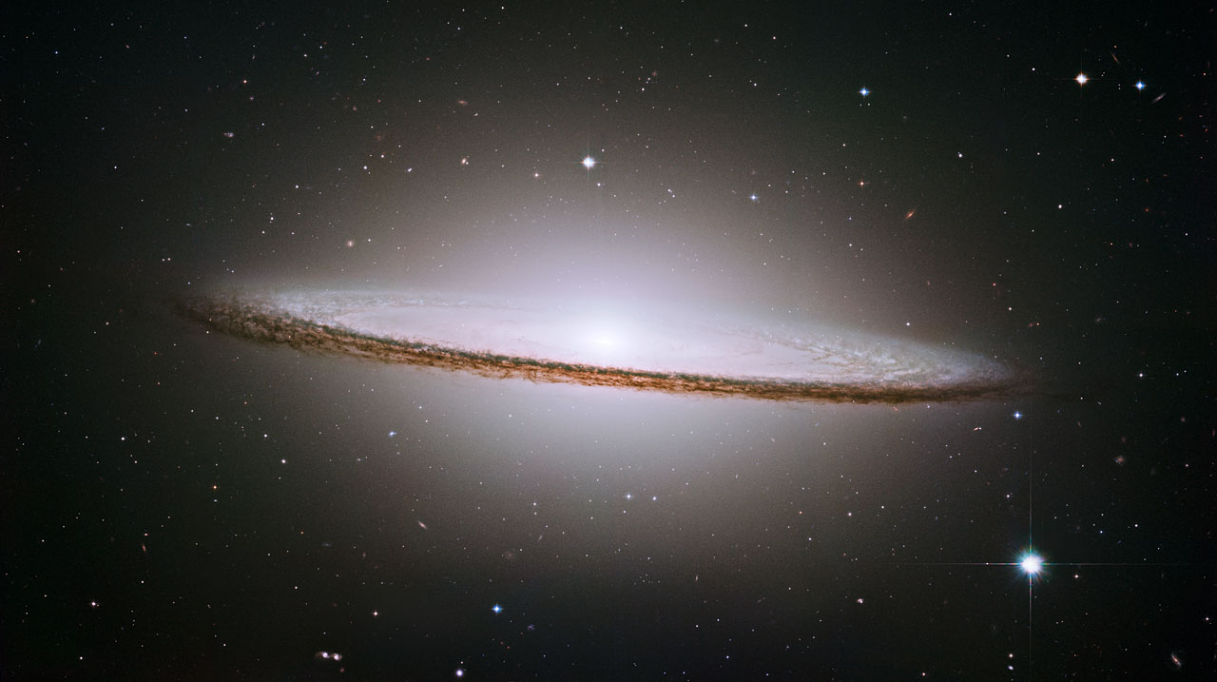
Jesus Christ Created the Earth
Under the direction of Heavenly Father
Under the direction of Heavenly Father, Jesus Christ created the heavens and the earth.
From scripture revealed through the Prophet Joseph Smith, we know that in the work of the Creation, the Lord organized elements that had already existed.
He did not create the world “out of nothing,” as some people believe.
Bible Dictionary
And he shall be called Jesus Christ, the Son of God, the Father of heaven and earth, the Creator of all things from the beginning; Mosiah 3:8
Sombrero equivalent to 800 billion suns Hubble
And there stood one among them that was like unto God, and he said unto those who were with him: We will go down, for there is space there, and we will take of these materials, and we will make an earth whereon these may dwell; Abraham 3:24
Moses 2:1

Slide 5
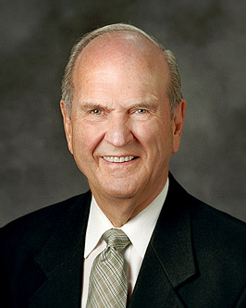
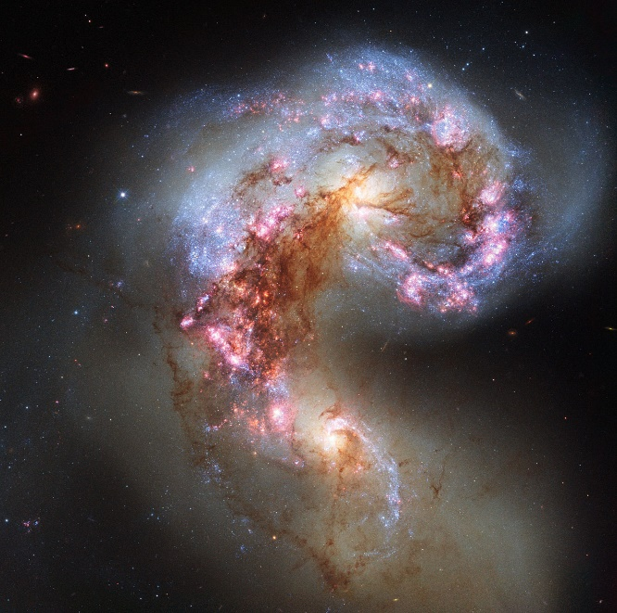
The Spiritual Creation
“the Lord God, created all things … spiritually, before they were naturally upon the face of the earth.”
…For I, the Lord God, created all things, of which I have spoken, spiritually, before they were naturally upon the face of the earth…
Moses 3:5
The NASA/ESA Hubble Space Telescope
Moses 2:1 Elder Russell M. Nelson

Slide 6
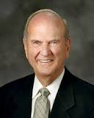
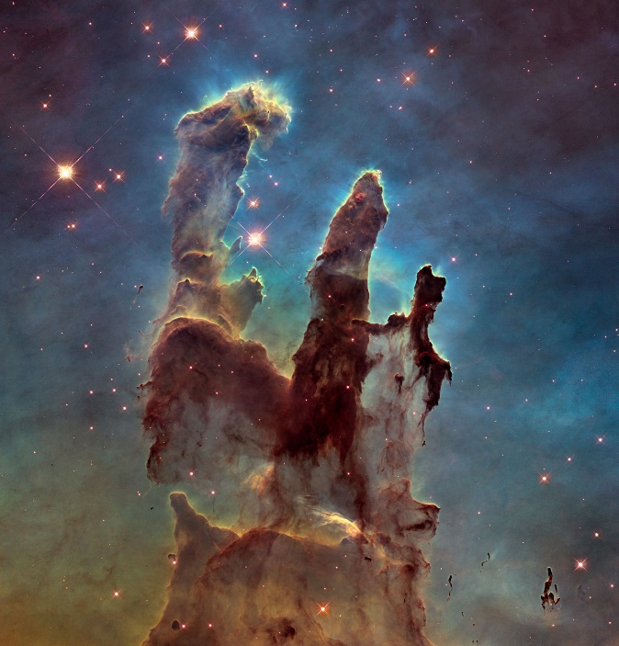
The Physical Creation
“Any manmade creation is possible only because of our divine Creator.”
“The physical Creation itself was staged through ordered periods of time.
In Genesis and Moses, those periods are called days. But in the book of Abraham, each period is referred to as a time.
Whether termed a day, a time, or an age, each phase was a period between two identifiable events—a division of eternity.”
The NASA/ESA Hubble Space Telescope
Moses 2:1 Elder Russell M. Nelson

Slide 7
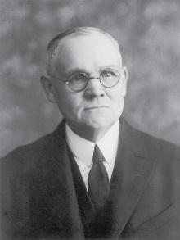
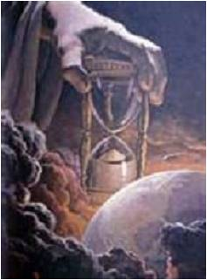
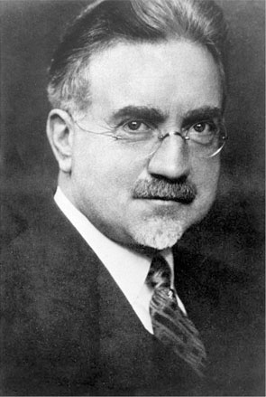
Periods of Time
“The physical Creation itself was staged through ordered periods of time.
In Genesis and Moses, those periods are called days.”
“…the book of Abraham, each period is referred to as a time. Whether termed a day, a time, or an age, each phase was a period between two identifiable events—a division of eternity.”
“We have no time unit by which to measure back through the ages to the time when at which, so far as the earth began, time began.”
James E. Talmage
“It seems reasonable to suppose that the great acts of creation could well have continued through eons of time.”
Dr. John A. Widtsoe
Moses 2:1 Elder Russell M. Nelson

Slide 8
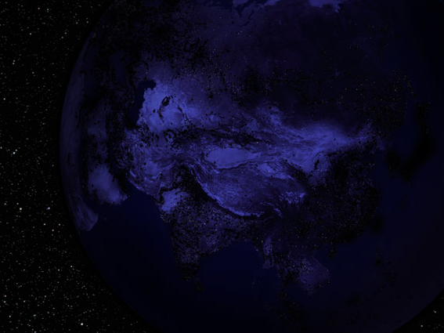
First Period
Earth is without form and void
“Where the light came from or how it was produced is not mentioned, but the Lord was obliged to create darkness in order to envelop the earth therein…
Period one included the creation of atmospheric heavens and physical earth, culminating in the emergence of light from darkness.”
Elder Russell M. Nelson
…The sun was not permitted to shine forth on the first, second, or third day of creation, but on the fourth day it was permitted to give its light to the earth.”
Orson Pratt
The earth that was left was empty and desolate
Genesis 2-5; Moses 2:2-5, Abraham 4:2-5

Slide 9
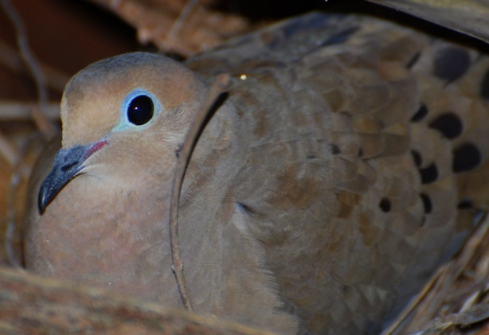

Second Period
Clouds, rain and storms give life to the earth
Brooding—to sit or incubate
A long quiet period of preparation in which seemingly nothing is happening.
In the creation, something was to come out of the water after a long time of incubating.
Relation of the Dove—a covering—the Atonement—a process of transformation
“The waters were divided between the surface of the earth and its atmospheric heavens. Provision was made for clouds and rain to give life to all that would later dwell upon the earth.”
Elder Russell M. Nelson
Firmament—
The atmosphere around the earth
The expanse of the heavens. It is the KJV English translation of a Hebrew word meaning expanse
Bible Dictionary
Genesis 1:6-8; Moses 2: 6-8; Abraham 4:11-12

Slide 10
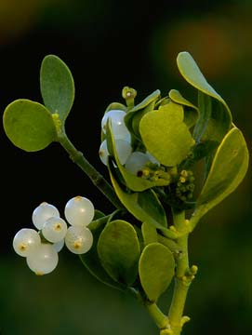
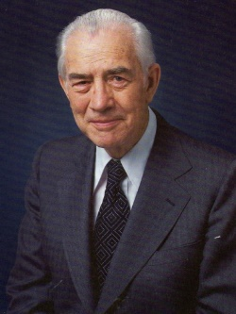
Third Period-Earth Organized
Dry land and vegetation comes forth from seeds
“In period three, plant life began. The earth was organized to bring forth grass, herbs, trees, and vegetation—each growing from its own seed.”
Elder Russell M. Nelson
“Each form of life was destined to bring forth after its own kind so that it would be perpetuated in the earth and avoid confusion.”
Mark E. Petersen
Genesis 1:11-12; Moses 2:11-12; Abraham 4:11-12

Slide 11
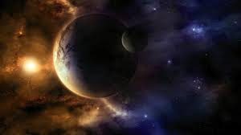
Fourth Period
The light is organized for seasons, days, and years. The sun, moon, and stars assume relationship to the earth
”Lights in the expanse of the heaven were organized so there could be seasons and other means of measuring time.
During this period, the sun, the moon, the stars, and the earth were placed in proper relationship to one another.
The sun, with its vast stores of hydrogen, was to serve as a giant furnace to provide light and heat for the earth and life upon it.”
Elder Russell M. Nelson
Genesis 1:14-19; Moses 2:14-19; Abraham 4:14–19.

Slide 12
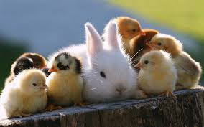
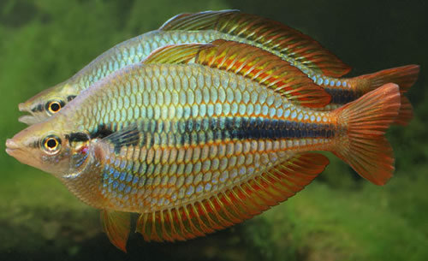

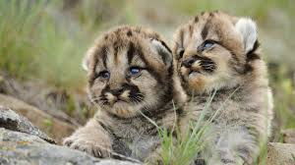
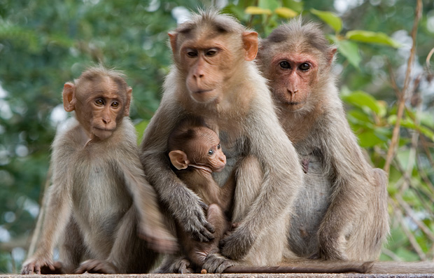
Fifth Period
“Every Living Creature—Be fruitful and multiply”
“Fish, fowl, and “every living creature” were added.
They were made fruitful and able to multiply—in the sea and on the earth—each after its own kind.”
Elder Russell M. Nelson
Its own kind
There was no provision for evolvement or change from one species to another.
Bruce R. McConkie
Genesis 1:20-23; Moses 2:20-23; Abraham 4:20-25.

Slide 13
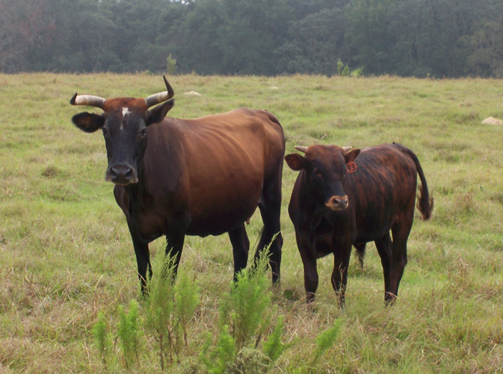
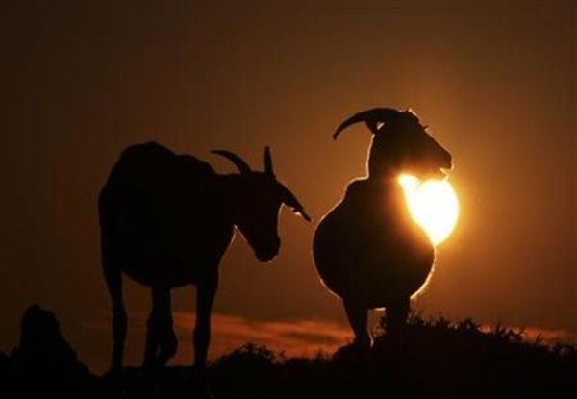
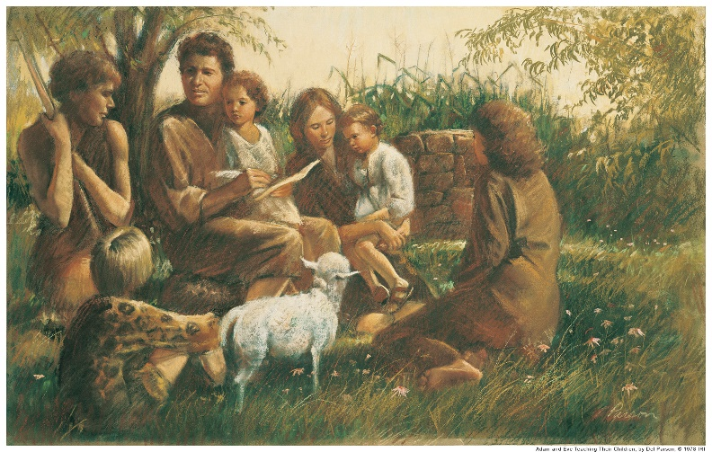
Sixth Period
“In the sixth period, creation of life continued. The beasts of the earth were made after their kind, cattle after their kind, and everything which “creepeth upon the earth”—again, after its own kind.
Then the Gods counseled together and said: “Let us go down and form man in our image, after our likeness.”
Elder Russell M. Nelson
Beasts of the Earth – Man is created
The Covenant Family
“So the Gods went down to organize man in their own image, in the image of the Gods to form they him, male and female to form they them.”
Thus, Adam and Eve were formed. And they were blessed to “be fruitful, and multiply, and replenish the earth, and subdue it: and have dominion over the fish of the sea, and over the fowl of the air, and over every living thing that moveth upon the earth.”
Elder Russell M. Nelson
Genesis 1:28, 5:2; Moses 2:28, 6:9; Abraham 4:28

Slide 14
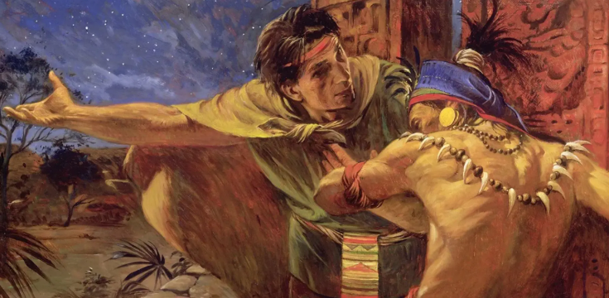
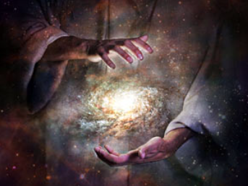
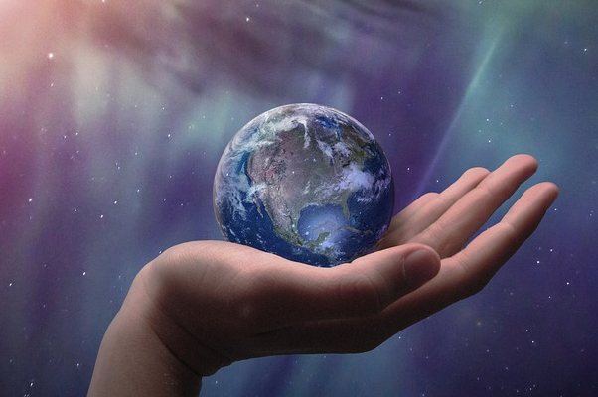
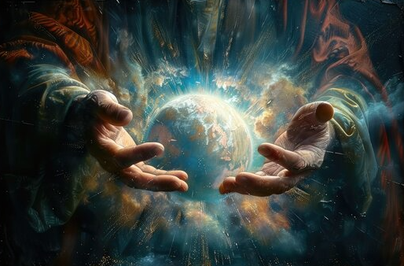
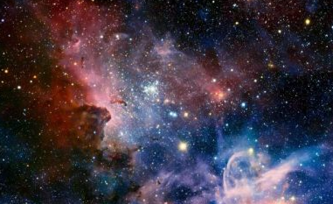
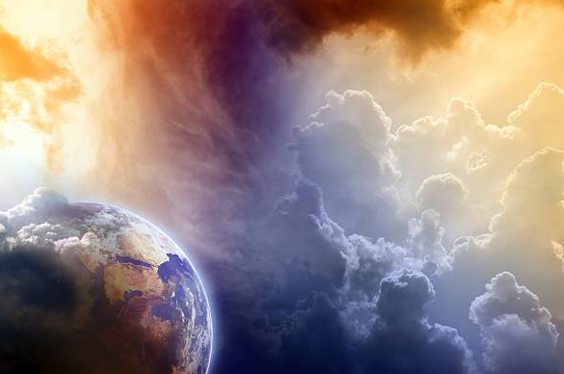
The Savior’s Role as Creator
Alma 30:43-44
D&C 38:1-3
D&C 59:18-20
…all things bear record of me.
D&C 76:22-24
Moses 1:33,39
Moses 6:63

Slide 15
Sources:
Suggested Hymn: #92 For the Beauty of the Earth
Video: God’s Greatest Creation (2:51)
Joseph Smith Teachings of the Prophet Joseph Smith, sel. Joseph Fielding Smith (1976), 327.
David Rolph Seely The Joseph Smith Translation: “Plain and Precious Things” Restored August 1997 Ensign
Elder Russell M. Nelson (“The Creation,” Ensign, May 2000, 85).
James E. Talmage Earth and Man p. 1
Dr. John A. Widtsoe in Hugh B. Brown’s What Is Man and What He May Become Brigham Young University Speeches of the Year (Provo, 25 March 1985 pp. 5-6)
Presentation by http://fashionsbylynda.com/blog/
Orson Pratt Journal of Discourses 16:314-15
Bruce R. McConkie Ensign June 1982

Slide 16
Day 1 | Moses 2:2–5 | Divided the light from the darkness
Day 2 | Moses 2:6–8
Day 3 | Moses 2:9–13
Day 4 | Moses 2:14–19
Day 5 | Moses 2:20–23
Day 6 | Moses 2:24–31
Day 1 | Moses 2:2–5 | Divided the light from the darkness
Day 2 | Moses 2:6–8
Day 3 | Moses 2:9–13
Day 4 | Moses 2:14–19
Day 5 | Moses 2:20–23
Day 6 | Moses 2:24–31
Day 1 | Moses 2:2–5 | Divided the light from the darkness
Day 2 | Moses 2:6–8
Day 3 | Moses 2:9–13
Day 4 | Moses 2:14–19
Day 5 | Moses 2:20–23
Day 6 | Moses 2:24–31
Day 1 | Moses 2:2–5 | Divided the light from the darkness
Day 2 | Moses 2:6–8
Day 3 | Moses 2:9–13
Day 4 | Moses 2:14–19
Day 5 | Moses 2:20–23
Day 6 | Moses 2:24–31
Set of 4

Slide 17
The Creation by By Elder Russell M. Nelson
Of the Quorum of the Twelve Apostles
Period one included the creation of atmospheric heavens and physical earth, culminating in the emergence of light from darkness.
In period two, the waters were divided between the surface of the earth and its atmospheric heavens. Provision was made for clouds and rain to give life to all that would later dwell upon the earth.
In period three, plant life began. The earth was organized to bring forth grass, herbs, trees, and vegetation—each growing from its own seed.
Period four was a time of further development. Lights in the expanse of the heaven were organized so there could be seasons and other means of measuring time. During this period, the sun, the moon, the stars, and the earth were placed in proper relationship to one another. The sun, with its vast stores of hydrogen, was to serve as a giant furnace to provide light and heat for the earth and life upon it.
In period five, fish, fowl, and “every living creature” were added. They were made fruitful and able to multiply—in the sea and on the earth—each after its own kind.
In the sixth period, creation of life continued. The beasts of the earth were made after their kind, cattle after their kind, and everything which “creepeth upon the earth”—again, after its own kind. Then the Gods counseled together and said: “Let us go down and form man in our image, after our likeness. …
“So the Gods went down to organize man in their own image, in the image of the Gods to form they him, male and female to form they them.” Thus, Adam and Eve were formed. And they were blessed to “be fruitful, and multiply, and replenish the earth, and subdue it: and have dominion over the fish of the sea, and over the fowl of the air, and over every living thing that moveth upon the earth.”
The seventh period was designated as a time of rest.
April 2000

Slide 18
Translation of the Bible:
The Prophet did not “translate” the Bible in the traditional sense of the word—that is, go back to the earliest Hebrew and Greek manuscripts to make a new rendering into English. Rather, he went through the biblical text of the King James Version and made inspired corrections, revisions, and additions to the biblical text. Both the Lord and Joseph Smith consistently refer to the process of these inspired revisions and additions as “translation” (D&C 76:15;D&C 124:89). The Prophet acknowledged the revelatory nature of this translation work. He introduced the first chapter of the book of Moses in his journal as an example of the Lord granting “‘line upon line of knowledge—here a little and there a little’ [see Isa. 28:13], of which the following was a precious morsel.”
But the Prophet never recorded exactly how he did this work called translation. One clue is the 1828 copy of the King James Bible that the Prophet and Oliver Cowdery purchased from E. B. Grandin in Palmyra on 8 October 1829. It was marked by Joseph Smith in ink and pencil; words were crossed out and verses marked with various symbols. In addition, there are five handwritten manuscripts containing long Joseph Smith Translation passages of the Bible. These are in the handwriting of various scribes, including Oliver Cowdery, John Whitmer, Sidney Rigdon, and others. Some of the manuscripts have entire biblical passages written out and others have only the specific verses or passages that were changed in some way by the Prophet.
From this evidence it appears “that the Prophet and a scribe would sit at a table, with the Prophet having the King James Version of the Bible open before him. Probably he would read from the King James Version and dictate the revisions, while the scribe recorded what he said.” Some of the corrections and revisions were small, including sometimes only vital punctuation changes. Other revisions were much more lengthy, restoring large passages of text.
The Joseph Smith Translation: “Plain and Precious Things” Restored
By David Rolph Seely August 1997 Ensign
The NASA/ESA Hubble Space Telescope has revisited one of its most iconic and popular images: the Eagle Nebula’s Pillars of Creation. This image shows the pillars as seen in visible light, capturing the multi-coloured glow of gas clouds, wispy tendrils of dark cosmic dust, and the rust-coloured elephants’ trunks of the nebula’s famous pillars.
The dust and gas in the pillars is seared by the intense radiation from young stars and eroded by strong winds from massive nearby stars. With these new images comes better contrast and a clearer view for astronomers to study how the structure of the pillars is changing over time.
Credit: NASA, ESA/Hubble and the Hubble Heritage Team
“Maleness and femaleness, marriage, and the bearing and nurturing of children are all essential to the great plan of happiness. …
“To the first man and woman on earth, the Lord said, ‘Be fruitful, and multiply’ (Moses 2:28; see also Gen. 1:28; Abr. 4:28). This commandment was first in sequence and first in importance. It was essential that God’s spirit children have mortal birth and an opportunity to progress toward eternal life” Dallin H. Oaks (“The Great Plan of Happiness,” Ensign, Nov. 1993, 72).

Slide 19
The World’s View---A Scientific Explanation
The core accretion mode
Approximately 4.6 billion years ago, the solar system was a cloud of dust and gas known as a solar nebula. Gravity collapsed the material in on itself as it began to spin, forming the sun in the center of the nebula.
With the rise of the sun, the remaining material began to clump up. Small particles drew together, bound by the force of gravity, into larger particles. The solar wind swept away lighter elements such as hydrogen and helium, from the closer regions, leaving only heavy, rocky materials to create smaller terrestrial worlds like Earth. But farther away, the solar winds had less impact on lighter elements, allowing them to coalesce into gas giants. In this way, asteroids, comets, planets, and moons were created.
Earth's rocky core formed first, with heavy elements colliding and binding together. Dense material sank to the center, while the lighter pieces created the crust. The planet's magnetic field probably formed around this time. Gravity captured some of the lighter elements that make up the planet's early atmosphere.
Early in its evolution, Earth suffered an impact by a large body that catapulted pieces of the young planet's mantle into space. Gravity caused many of these pieces to draw together and form the moon, which took up orbit around its creator.
The flow of the mantle beneath the crust causes plate tectonics, the movement of the large plates of rock on the surface of the Earth. collisions and friction gave rise to mountains and volcanoes, which began to spew gases into the atmosphere.
Although the population of comets and asteroids passing through the inner solar system is sparse today, they were more abundant when the planets and sun were young. Collisions from these icy bodies likely deposited much of the Earth's water on its surface. Because the planet is in the Goldilocks zone, the region where liquid water neither freezes nor evaporates but can remain as a liquid, the water remained at the surface, which many feel plays a key role in the development of life.
The disk instability model
Although the core accretion model works fine for terrestrial planets, gas giants would have needed to evolve rapidly to grab hold of the significant mass of lighter gases they contain. But simulations have not been able to account for this rapid formation. According to models, the process takes several million years, longer than the light gases were available in the early solar system. At the same time, the core accretion model faces a migration issue, as the baby planets are likely to spiral into the sun in a short amount of time.
According to a relatively new theory, disk instability, clumps of dust and gas are bound together early in the life of the solar system. Over time, these clumps slowly compact into a giant planet. These planets can form faster than their core accretion rivals, sometimes in as little as a thousand years, allowing them to trap the rapidly-vanishing lighter gases. They also quickly reach an orbit-stabilizing mass that keeps them from death-marching into the sun.
As scientists continue to study planets inside of the solar system, as well as around other stars, they will better understand how Earth and its siblings formed.
How Was Earth Formed?
by Nola Taylor Redd, SPACE.com
January 08, 2013

Slide 20
The First Day —Elohim, Jehovah, Michael, a host of noble and great ones—all these played their parts. “The Gods” created the atmospheric heavens and the temporal earth. It was “without form, and void”; as yet it could serve no useful purpose with respect to the salvation of man. It was “empty and desolate”; life could not yet exist on its surface; it was not yet a fit abiding place for those sons of God who shouted for joy at the prospect of a mortal probation. The “waters” of the great “deep” were present, and “darkness reigned” until the divine decree: “Let there be light.” The light and the darkness were then “divided,” the one being called “Day” and the other “Night.” Clearly our planet was thus formed as a revolving orb and placed in its relationship to our sun.
The Second Day —On this day “the waters” were “divided” between the surface of the earth and the atmospheric heavens that surround it. A “firmament” or an “expanse” called “Heaven” was created to divide “the waters which were under the expanse from the waters which were above the expanse.” Thus, as the creative events unfold, provision seems to be made for clouds and rain and storms to give life to that which will yet grow and dwell upon the earth.
The Third Day —This is the day when life began. In it “the waters under the heaven” were “gathered together unto one place,” and the “dry land” appeared. The dry land was called “Earth,” and the assembled waters became “the Sea.” This is the day in which “the Gods organized the earth to bring forth” grass and herbs and plants and trees; and it is the day in which vegetation in all its varied forms actually came forth from the seeds planted by the Creators. This is the day when the decree went forth that grass, herbs, and trees could each grow only from “its own seed,” and that each could in turn bring forth only after its own “kind.” And thus the bounds of the plant and vegetable kingdoms were set by the hands of those by whom each varied plant and tree was made.
The Sixth Day —The crowning day of creation is at hand. In its early hours, the great Creators “made the beasts of the earth after their kind, and cattle after their kind, and everything which creepeth upon the earth after his kind.” And the same procreative restrictions applied to them that apply to all forms of life; they too are to reproduce only after their kind.
All that we have recited is now accomplished, but what of man? Is man found upon the earth? He is not. And so “the Gods,” having so counseled among themselves, said: “Let us go down and form man in our image, after our likeness. … So the Gods went down to organize man in their own image, in the image of the Gods to form they him, male and female to form they them.” They then did as they had counseled, and the most glorious of all the creative acts was accomplished. Man is the crowning creature to step forth according to the divine will. He is in the image and likeness of the Eternal Elohim, and to him is given “dominion” over all things. And, then, finally, that his purposes shall roll everlastingly onward, God blesses the “male and female” whom he has created and commands them: “Be fruitful, and multiply, and replenish the earth, and subdue it, and have dominion over the fish of the sea, and over the fowl of the air, and over every living thing that moveth upon the earth.” As the “sixth day” closes, the Creators, viewing their creative labors with satisfaction, see that “all things” which they have “made “are “very good.”
The Fourth Day —After seeds in all their varieties had been planted on the earth; after these had sprouted and grown; after each variety was prepared to bring forth fruit and seed after its own kind—the Creators organized all things in such a way as to make their earthly garden a productive and beautiful place. They then “organized the lights in the expanse of the heaven” so there would be “seasons” and a way of measuring “days” and “years.” We have no way of knowing what changes then took place in either the atmospheric or the sidereal heavens, but during this period the sun, moon, and stars assumed the relationship to the earth that now is theirs. At least the light of each of them began to shine through the lifting hazes that enshrouded the newly created earth so they could play their parts with reference to life in all its forms as it soon would be upon the new orb.
The Fifth Day —Next came fish and fowl and “every living creature” whose abode is “the waters.” Their Creators placed them on the newly organized earth, and they were given the command: “Be fruitful, and multiply, and fill the waters in the sea; and let fowl multiply in the earth.” This command—as with a similar decree given to man and applicable to all animal life—they could not then keep, but they soon would be able to do so. Appended to this command to multiply was the heaven-sent restriction that the creatures in the waters could only bring forth “after their kind,” and that “every winged fowl” could only bring forth “after his kind.” There was no provision for evolvement or change from one species to another.
Bruce R. McConkie Christ and the Creation
June Ensign 1982

