Slide 1

God Created Man In His Own Image
Genesis 26-27
Includes: Moses 2:26-27 and Abraham 4:26-27
Every person on earth is a beloved son or daughter of heavenly parents and has a divine nature and destiny.
Presentation by http://fashionsbylynda.com/blog/

Slide 2
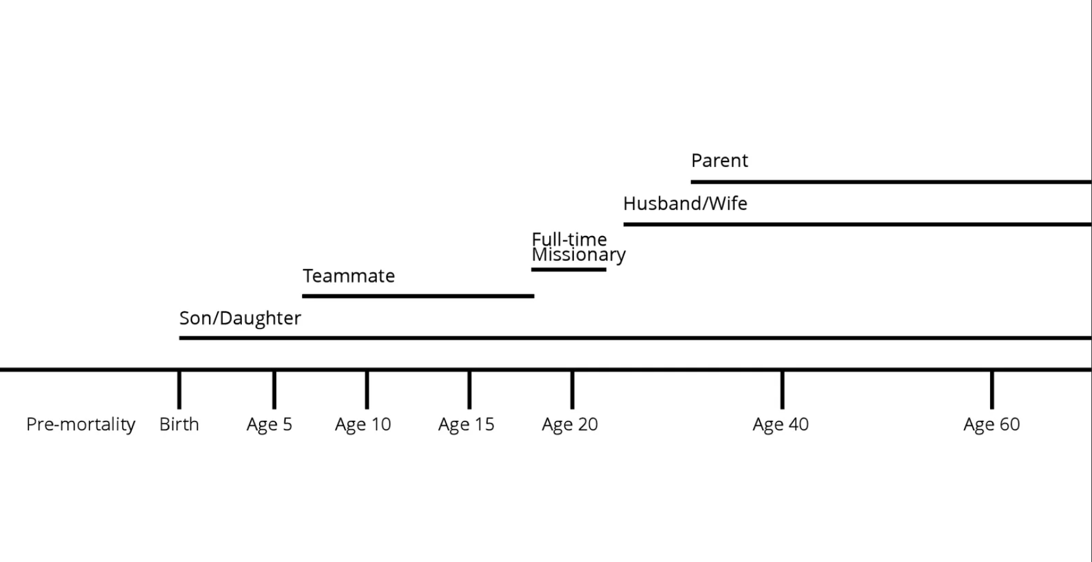

Labels on Which To Choose
What are some identities or titles you chose to put on your timeline?
Labels can be fun and indicate your support for any number of positive things. Many labels will change for you with the passage of time. And not all labels are of equal value. But if any label replaces your most important identifiers, the results can be spiritually suffocating.
President Russell M. Nelson
How will your labels influence your choices?

Slide 3
Doctrinal Mastery
And God said, Let us make man in our image, after our likeness: and let them have dominion over the fish of the sea, and over the fowl of the air, and over the cattle, and over all the earth, and over every creeping thing that creepeth upon the earth.
So God created man in his own image, in the image of God created he him; male and female created he them.
See: Moses 2:26-27
Genesis 1:26-27

Slide 4

Compare
Genesis 2:27
Moses 2:27
Abraham 4:27
And I, God, created man in mine own image, in the image of mine Only Begotten created I him; male and female created I them.
So the Gods went down to organize man in their own image, in the image of the Gods to form they him, male and female to form they them.
So God created man in his own image, in the image of God created he him; male and female created he them.

Slide 5
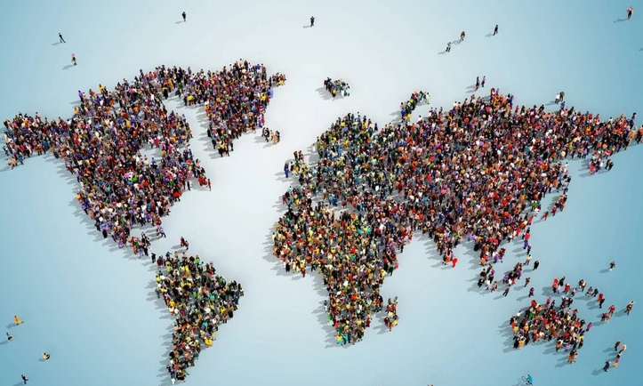
Created in the Image of God
All human beings—male and female—are created in the image of God.
Each is a beloved spirit son or daughter of heavenly parents, and, as such, each has a divine nature and destiny.
Gender is an essential characteristic of individual premortal, mortal, and eternal identity and purpose.
We are sons and daughters of heavenly parents, created in their image
“The Family: A Proclamation to the World,” ChurchofJesusChrist.org”

Slide 6
Scenarios
A young woman has been told that gender is a matter of chance. She has begun to question if gender matters and whether it should influence any of her choices in life
A young man does not like his body. He struggles with feelings of low self-worth because of his physical appearance.
A missionary is teaching a person who wants to know what God looks like.
Moses 2:26-27
Moses 2:27
Moses 2:26-27
created man in mine own image
male and female created I them.
We have been created in the Image of God

Slide 7
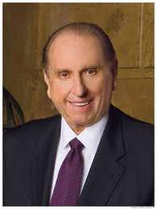
Scenario 1
“God our Father has ears with which to hear our prayers. He has eyes with which to see our actions. He has a mouth with which to speak to us. He has a heart with which to feel compassion and love. He is real. He is living. We are his children, made in his image. We look like him, and he looks like us.”
President Thomas S. Monson

Slide 8


Scenario 2
“All human beings—male and female—are created in the image of God. Each is a beloved spirit son or daughter of heavenly parents, and, as such, each has a divine nature and destiny. Gender is an essential characteristic of individual premortal, mortal, and eternal identity and purpose.”
Family Proclamation

Slide 9
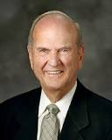
Scenario 3
“Think of [God’s] gift to you of your own physical body. The many amazing attributes of your body attest to your own ‘divine nature.’” Elder Russell M. Nelson
Whereby are given unto us exceeding great and precious promises: that by these ye might be partakers of the divine nature, having escaped the corruption that is in the world through lust.
2 Peter 1:4

Slide 10
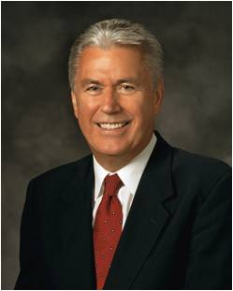
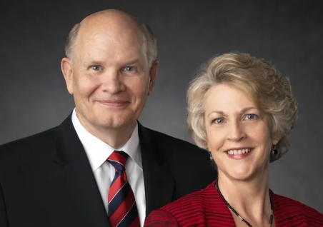
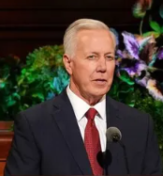
“I Am” a Child of God
When we sing the song “I Am a Child of God,” the lyrics penetrate our hearts. Pondering this truth—that we are children of heavenly parents—fills us with a sense of origin, purpose, and destiny.
It is good to remember that you are always a child of God. This knowledge will carry you through the most difficult times in your life and will inspire you to accomplish remarkable things. Elder Dieter F. Uchtdorf
Male and female spirits were created to complement each other. That is why gender is not fluid in the eternities—because it provides the basis for the ultimate gift Heavenly Father can give, His kind of life.
Elder Dale G. Renlund and sister Ruth L. Renlund
(The world teaches) that our circumstances define us. We should “embrace who we really are,” the world says, “and be authentic to our true selves.”
While it is indeed good to be authentic, we should be authentic to our real, true selves as sons and daughters of God with a divine nature and destiny to become like Him. If our goal is to be authentic to this divine nature and destiny, then we will all need to change. Elder Kevin S. Hamilton

Slide 11
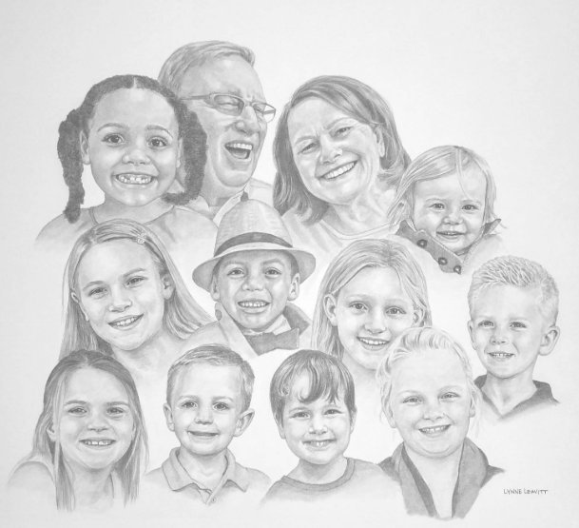
Divine Potential
Because we are the spirit children of God, we have inherited the potential to develop His divine qualities.
Through the Atonement of Jesus Christ, we can become like our Heavenly Father and receive a fulness of joy.
Topics and Questions

Slide 12
Sources:
Video:
“Running Toward the Light” (17:34)
President Russell M. Nelson (“Choices for Eternity” [worldwide devotional for young adults, May 15, 2022], broadcasts.ChurchofJesusChrist.org)
President Thomas S. Monson (“I Know That My Redeemer Lives,” Ensign, Apr. 1990, 6).
Family Proclamation (Ensign or Liahona, Nov. 2010)
Presentation by http://fashionsbylynda.com/blog/
Elder Russell M. Nelson (“Thanks Be to God,” Ensign or Liahona, May 2012, 78).
Elder Dieter F. Uchdorf “Living the Gospel Joyful” Ensign or Liahona Nov. 2014, 120-121
Elder Kevin S. Hamilton “Then Will I Make Weak Things Become Strong” Liahona May 2022, 50
Elder Dale G. Renlund and sister Ruth L. Renlund “The Divine Purposes of Sexual Intimacy” Ensign Aug. 2020, 16
Topics and Questions, “Spirit Children of Heavenly Parents,” topics.ChurchofJesusChrist.org

