Slide 1

Hope and Peace Through the Savior and His Atonement

Slide 2

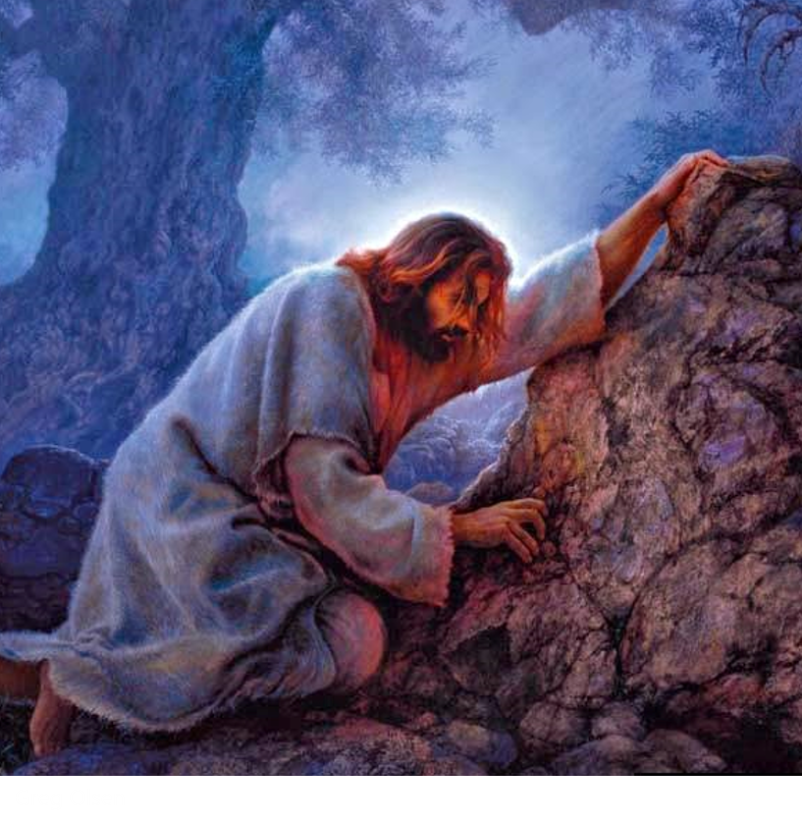
Jesus Christ Chosen to Be Our Savior
Jesus Christ was foreordained in the premortal council to be our Savior and Redeemer.
He came to earth and willingly suffered and died to redeem all mankind from the negative effects of the Fall and to pay the penalty for our sins.
Jesus Christ’s triumph over spiritual and physical death by His suffering, death, and Resurrection is called the Atonement.
His sacrifice benefits each of us and demonstrates the infinite worth of each and every one of Heavenly Father’s children.
D&C 18:10–11

Slide 3
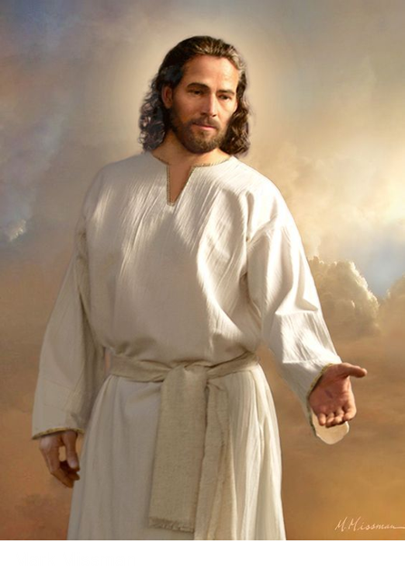
Jesus Christ – The Only One Capable
It is only through Jesus Christ that we can be saved because He was the only one capable of making an infinite and eternal Atonement for all mankind.
Only He had the power to overcome physical death. From His mortal mother, Mary, He inherited the ability to die.
From God, His immortal Father, He inherited the power to live forever or to lay down His life and to take it up again.
He alone could redeem us from our sins. Because He lived a perfect, sinless life, He was free from the demands of justice and could pay the debt for those who repent.
Alma 34:9-10
Old Testament Seminary Teachers Manual 2019

Slide 4
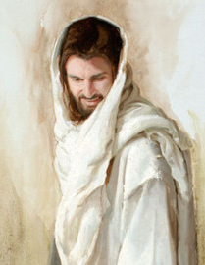
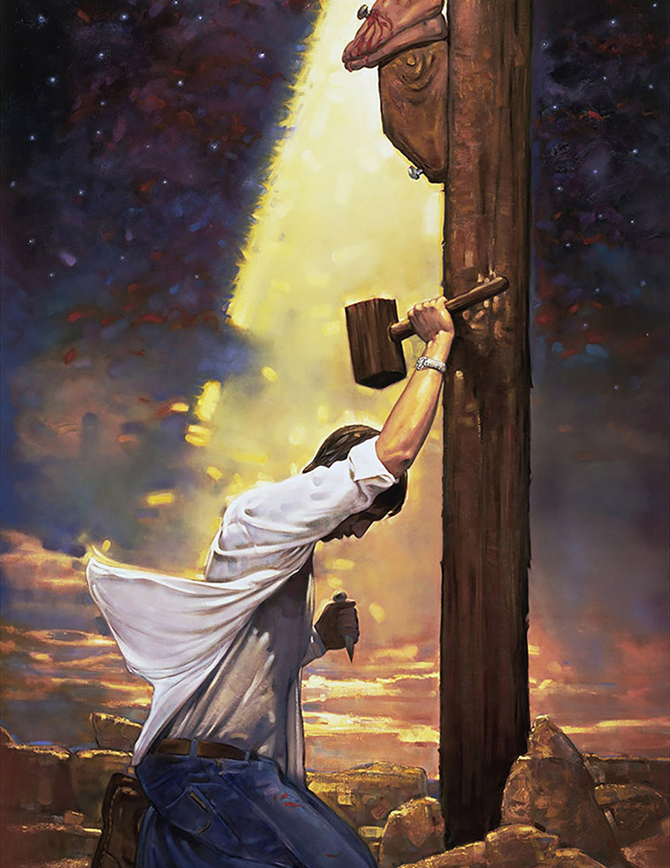
Possible For Us
The Atonement of Jesus Christ included His suffering for the sins of mankind in the Garden of Gethsemane, the shedding of His blood, His suffering and death on the cross, and His literal Resurrection.
He was the first to be resurrected. He rose from the tomb with a glorified, immortal body of flesh and bone.
Jared Barnes
Because of His Atonement all mankind will be resurrected with perfect, immortal bodies and be brought back into God’s presence to be judged.
Jesus Christ’s atoning sacrifice provided the only way for us to be cleansed and forgiven of our sins so that we can dwell in God’s presence eternally.
Ron DiCianni
Luke 24:36-39; Isaiah 1:18; D&C 19:16-19
Old Testament Seminary Teachers Manual 2019

Slide 5
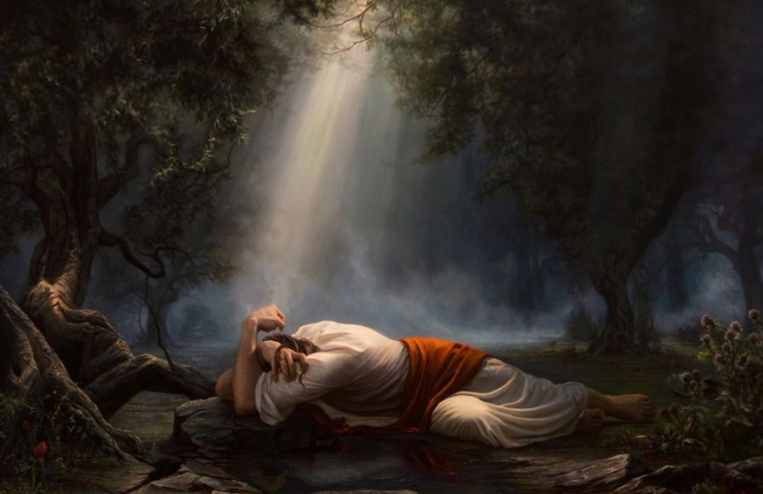

Taking On Himself
As part of His Atonement, Jesus Christ not only suffered for our sins, but He also took upon Himself the pains, temptations, sicknesses, and infirmities of all mankind.
Adam Abram
He understands our suffering because He has experienced it.
As we come to Him in faith, the Savior will strengthen us to bear our burdens and accomplish tasks that we could not do on our own.
Isaiah 53:3-5; Alma 7:11-13; Matthew 11:28-30; Ether 12:27
Old Testament Seminary Teachers Manual 2019

Slide 6


Effect
In paying the penalty for our sins, Jesus Christ did not eliminate our personal responsibility.
In order to accept His sacrifice, be cleansed from our sins, and inherit eternal life, we must exercise faith in Him, repent, be baptized, receive the Holy Ghost, and endure faithfully to the end of our lives.
Arti Chauhan
Sergey Selivanov
John 3:5; 1 Corinthians 15:20–22; Mosiah 3:19; 3 Nephi 11:10–11; 3 Nephi 27:20; D&C 76:22–24
Old Testament Seminary Teachers Manual 2019

Slide 7
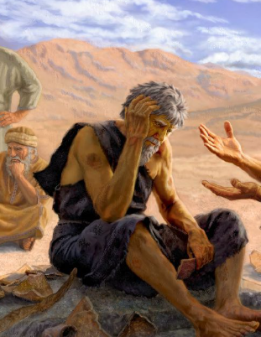
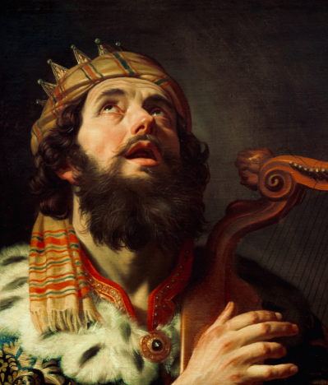
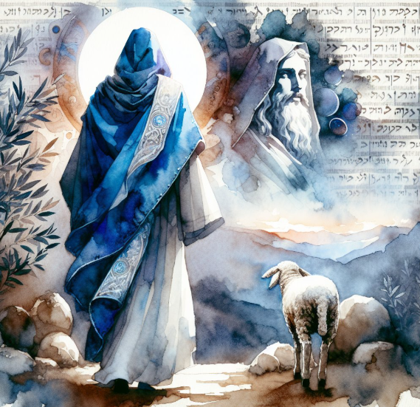
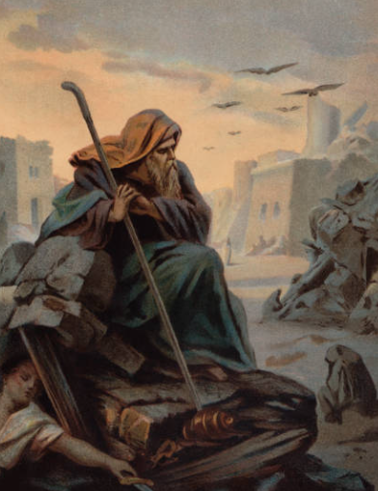
How Does the Savior Bring Hope Into Our Lives ?
Psalms 16:8–11
Job 19:25–26
Psalms 30:2–5
Psalms 33:18–22
Isaiah 1:18
Isaiah 12:2
Jeremiah 17:7–8
Isaiah 25:8–9
Isaiah 40:28–31

Slide 8

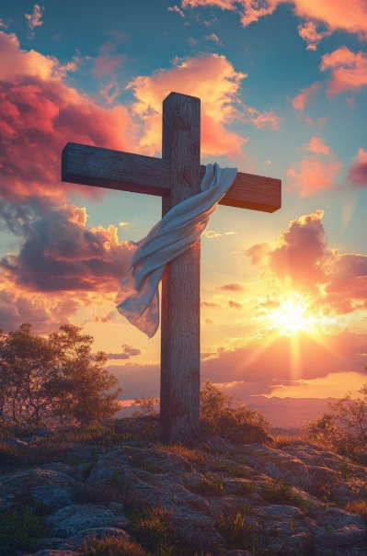
Because of Him
When He suffered for our sins and weaknesses, died on the cross, and rose again, the Savior rewrote humanity’s story.
Because of Him, we do not have to deal with our frailties, sins, and fears alone.
Because of Him, death is not the end. Resurrection will come to all who have ever lived. Because of Him, families can be together forever. Because of Jesus Christ, we celebrate Easter. And Easter is all about peace and hope. …
… At this Easter season, let us worship and praise Him for the peace, hope, light, and truth He brings to us.
President Russell M. Nelson

Slide 9
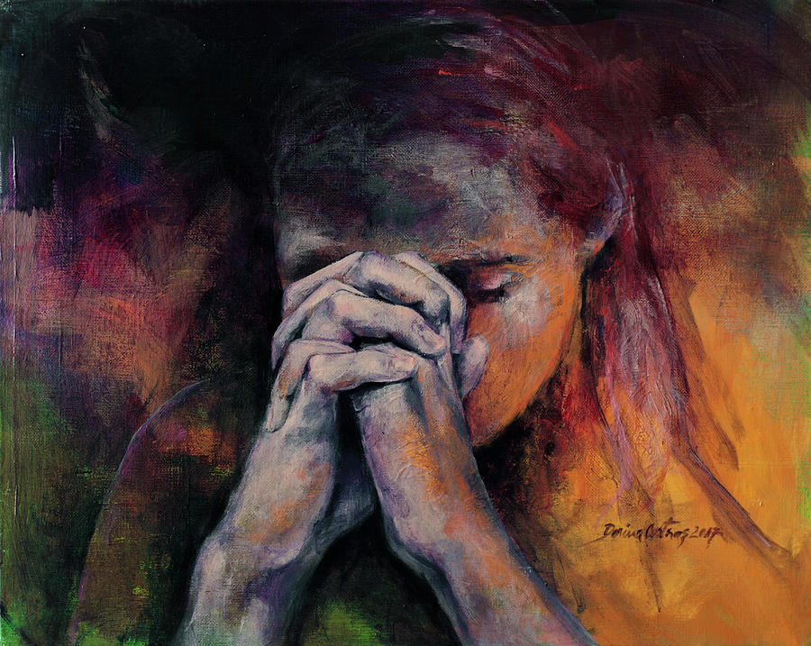
Expressing True Faith
The first principle of the gospel is faith in the Lord Jesus Christ. Our faith can lead to salvation only when it is centered in Jesus Christ.
Having faith in Jesus Christ includes having a firm belief that He is the Only Begotten Son of God and the Savior of the world.
We recognize that the only way we can return to live with our Heavenly Father is by relying on His Son’s infinite Atonement and by trusting Jesus Christ and following His teachings.
More than passive belief, true faith in Jesus Christ leads to action and is expressed by the way we live.
Our faith can increase as we pray, study the scriptures, and obey God’s commandments.
Dorina Costras
Helaman 5:12; James 2:17-18
Old Testament Seminary Teachers Manual 2019

Slide 10
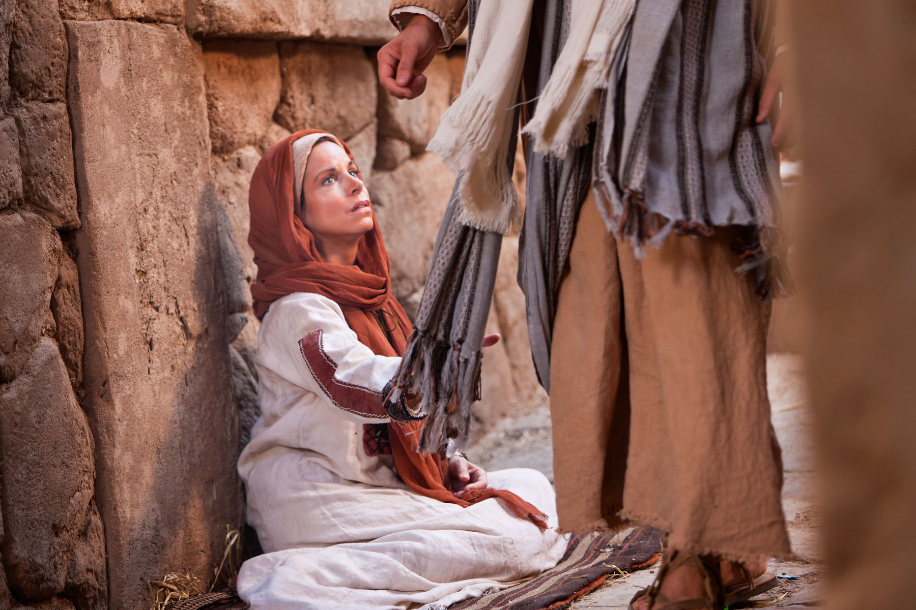
Faith and Repentance
Faith in Jesus Christ and our love for Him and Heavenly Father lead us to repent. Repentance is part of Heavenly Father’s plan for all of His children who are accountable for their choices.
This gift is made possible through the Atonement of Jesus Christ.
Repentance is a change of mind and heart. It includes turning away from sin and turning our thoughts, actions, and desires toward God and aligning our will with His.
Mosiah 3:19
Old Testament Seminary Teachers Manual 2019

Slide 11
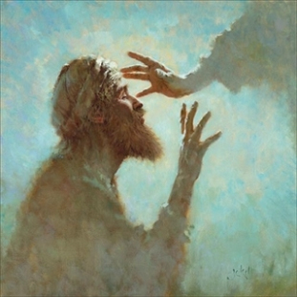
Repentance
Repentance includes recognizing our sins; feeling remorse, or godly sorrow, for committing sin; confessing our sins to Heavenly Father and, if necessary, to others; forsaking sin; seeking to restore, as far as possible, all that has been damaged as a result of our sins; and living a life of obedience to God’s commandments.
The Lord promises to forgive us of our sins at baptism, and we renew that covenant each time we sincerely partake of the sacrament with the intent of remembering the Savior and keeping His commandments.
D&C 58:42-43
Old Testament Seminary Teachers Manual 2019

Slide 12
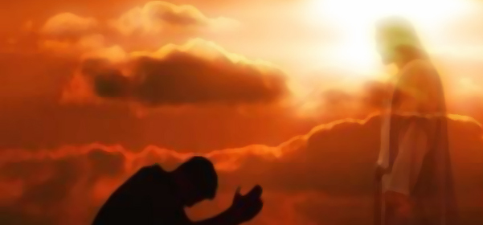
Sincere Repentance
Through sincere repentance and the grace offered through Jesus Christ’s Atonement, we can receive God’s forgiveness and feel peace.
We feel the influence of the Spirit in greater abundance, and we are more prepared to live eternally with our Heavenly Father and His Son.
Old Testament Seminary Teachers Manual 2019

Slide 13
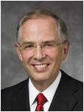

“Sometimes in our repentance, in our daily efforts to become more Christlike, we find ourselves repeatedly struggling with the same difficulties.
As if we were climbing a tree-covered mountain, at times we don’t see our progress until we get closer to the top and look back from the high ridges.
Don’t be discouraged. If you are striving and working to repent, you are in the process of repenting.”
Neil L. Andersen

Slide 14
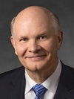
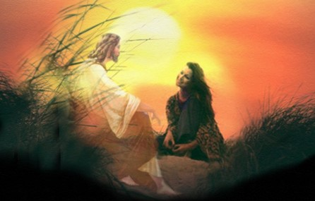
“God cares a lot more about who we are and who we are becoming than about who we once were.
He cares that we keep on trying.”
Dale G. Renlund

Slide 15
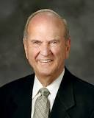
What is the purpose of an umbrella?
To provide protection or a covering from rain or sunlight
kaphar
“in Hebrew, the basic word for atonement is kaphar, a verb that means ‘to cover’ or ‘to forgive.’”
Russell M. Nelson
What can the Savior cover or shelter us from through His atoning sacrifice?
Why is Jesus Christ able to do this?

Slide 16
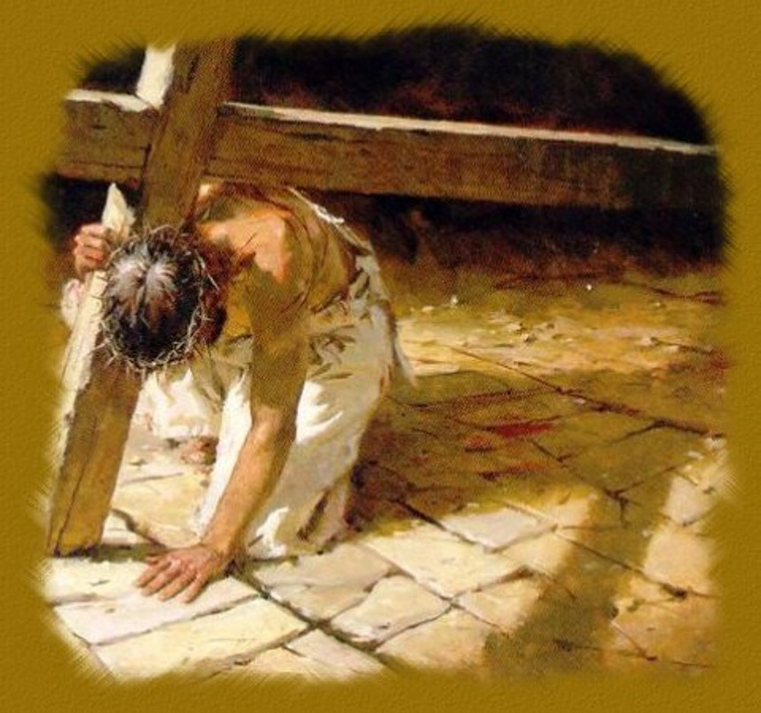
He is despised and rejected of men; a man of sorrows, and acquainted with grief: and we hid as it were our faces from him; he was despised, and we esteemed him not.
Surely he hath borne our griefs, and carried our sorrows: yet we did esteem him stricken, smitten of God, and afflicted.
But he was wounded for our transgressions, he was bruised for our iniquities: the chastisement of our peace was upon him; and with his stripes we are healed.
Isaiah 53:3-5

Slide 17
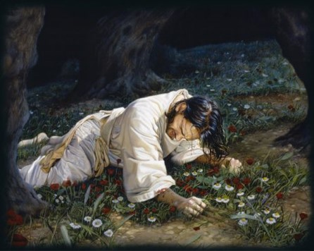
And he shall go forth, suffering pains and afflictions and temptations of every kind; and this that the word might be fulfilled which saith he will take upon him the pains and the sicknesses of his people.
And he will take upon him death, that he may loose the bands of death which bind his people; and he will take upon him their infirmities, that his bowels may be filled with mercy, according to the flesh, that he may know according to the flesh how to succor his people according to their infirmities.
Now the Spirit knoweth all things; nevertheless the Son of God suffereth according to the flesh that he might take upon him the sins of his people, that he might blot out their transgressions according to the power of his deliverance; and now behold, this is the testimony which is in me.
Alma 7:11-13
As part of His Atonement, Jesus Christ not only suffered for our sins, but He also took upon Himself the pains, temptations, sicknesses, and infirmities of all mankind.

Slide 18
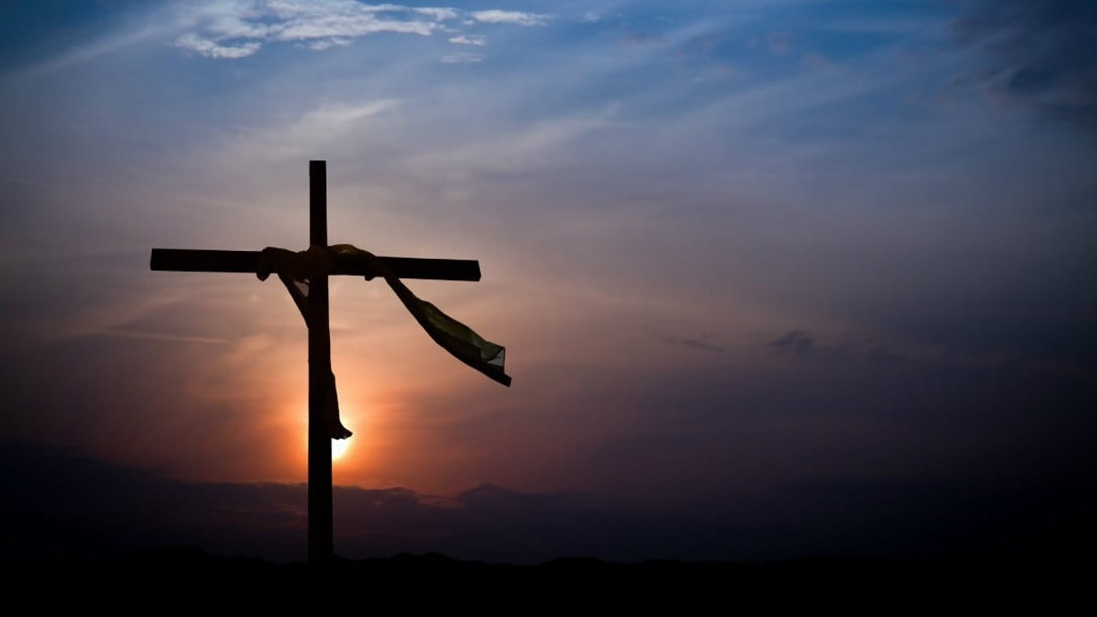
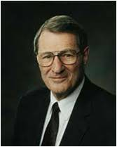
“Jesus’ perfect empathy was ensured when, along with His Atonement for our sins, He took upon Himself our sicknesses, sorrows, griefs, and infirmities and came to know these ‘according to the flesh’.
He did this in order that He might be filled with perfect, personal mercy and empathy and thereby know how to succor us in our infirmities.
He thus fully comprehends human suffering. Truly Christ ‘descended below all things, in that He comprehended all things’.”
Neal A. Maxwell
Alma 7:11–12; D&C 88:6

Slide 19
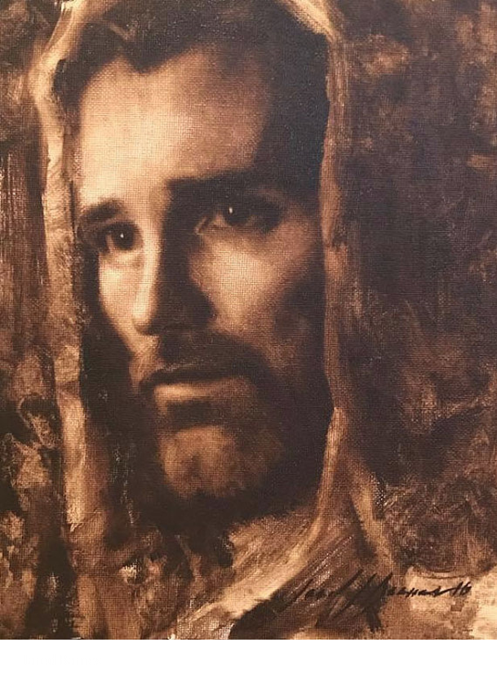
Because of the suffering He experienced through His atoning sacrifice, Jesus Christ has perfect empathy for us and can strengthen and comfort us through all of life’s difficulties.
Old Testament Seminary Teachers Manual 2019

Slide 20
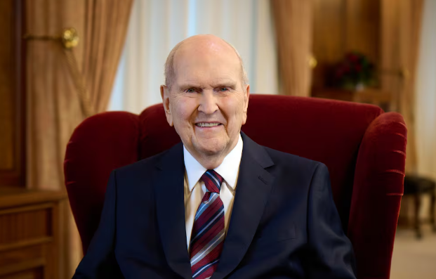
This Easter, I encourage you to focus on the Savior. If you are looking for a place to worship, please join with us. On [or near] Easter Sunday, the worldwide general conference of The Church of Jesus Christ of Latter-day Saints will be filled with Christ-centered messages and music.
We will gather [in person and] virtually to worship our Redeemer. Please join with us. Invite your friends!
Jesus Christ lives! As our resurrected and atoning Savior, He stands ready to help us grow from the dramatic, unexpected events in our lives. At this Easter season, let us worship and praise Him for the peace, hope, light, and truth He brings to us.
President Russell M. Nelson

Slide 21
Sources:
Video: “The Peace and Hope of Easter, President Russell M. Nelson Palm Sunday Invitation” from time code 3:50 to 5:11.
The Church of Jesus Christ of Latter-day Saints Seminary Manual (Old Testament) Seminary Teacher Manual…putting pictures with words
Presentation by ©http://fashionsbylynda.com/blog/
Neil L. Andersen, “Repent … That I May Heal You,” Ensign or Liahona, Nov. 2009, 41
Dale G. Renlund, “Latter-day Saints Keep on Trying,” Ensign or Liahona, May 2015, 56
Russell M. Nelson, “The Atonement,” Ensign, Nov. 1996, 34; (“The Peace and Hope of Easter, President Russell M. Nelson Palm Sunday Invitation,” video, ChurchofJesusChrist.org)
video, ChurchofJesusChrist.org)
Neal A. Maxwell, “Enduring Well,” Ensign, Apr. 1997, 7
ChurchofJesusChrist.org

