Slide 1

The Fall of Adam and Eve
Moses 4:5-32;
5:1-5
Presentation by http://fashionsbylynda.com/blog/

Slide 2
Adam
He helped in creating the earth
He was created in the image of God
His name means “man” or “many” (Moses 1:34)
He experienced ‘The Fall’ enabling his posterity to come to know the gospel of Jesus Christ
He was the first man on earth. The “first father” meaning the head of descending lineage of priesthood authority upon the earth (Abraham 1:3)
He held the keys of salvation under the counsel and direction of the Holy One (D&C 78:16)
He is also called “Michael—the father of all—in his premortal or post-mortal state and has the title of “Archangel” (D&C 107:54)
Michael in Hebrew means “one who is like God”
He will have his final defeat of Satan and his hosts at the end of the millennial period (D&C 88:112-115)
He rendered his final blessing to his posterity three years before his death at Adam-ondi-Ahman
He died at age 930
Who’s Who

Slide 3
Eve
Eve—meaning the mother of all living
She was the completion of the earth
She was the first woman of humankind and the divine “help meet” given to Adam (Genesis 2:18)
She was created in the image of God
She was joined together with Adam in marriage for time and for all eternity by the power of that everlasting priesthood (Genesis 2:24)
She used her God-given agency, in wisdom, in the best interests of her children for generations
She was partnered to Adam and taught their children to follow God
She and her partner worshipped the Lord in prayer
She and Adam heeded divine commandments of obedience and sacrifice
She is honored among the Latter-day Saints
Who’s Who and Elder Russell M. Nelson

Slide 4
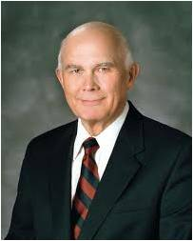
The First Commandment
“To the first man and woman on earth, the Lord said, ‘Be fruitful, and multiply’.
This commandment was first in sequence and first in importance.
It was essential that God’s spirit children have mortal birth and an opportunity to progress toward eternal life.”
Dallin H. Oaks
Moses 2:28; Gen. 1:28; Abr. 4:28

Slide 5
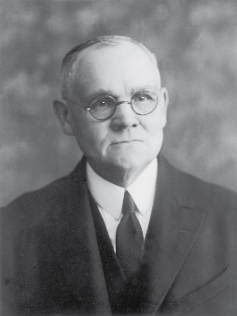
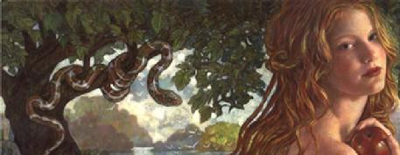
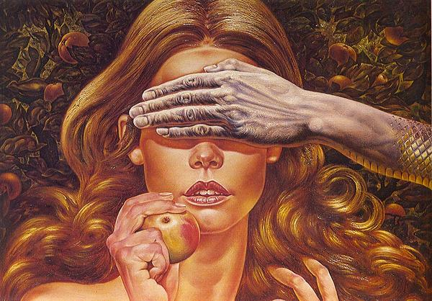
Beguiled
A deceptive way of charming or enchantment, winning over, seducing, spellbinding
“Eve was fulfilling the foreseen purposes of God by the part she took in the great drama of the fall…(Satan) knew not the mind of God…his effort contributed to the plan of man’s eternal progression.”
James E. Talmage
Rebecca Guay
But I fear, lest by any means, as the serpent beguiled Eve through his subtilty, so your minds should be corrupted from the simplicity that is in Christ.
2 Corinthians 11:3
Moses 4:6

Slide 6

The Fruit--Symbolically
The world has depicted the fruit eaten as an apple, however we do not know what kind of fruit it was.
The Lord has not revealed the nature of the fruit of the tree of knowledge of good and evil, nor has He elaborated on the specific processes that caused Adam and Eve to become mortal.
Blessed art thou among women, and blessed is the fruit of thy womb. Luke 1:24
Therefore shall they eat of the fruit of their own way, and be filled with their own devices.
Proverbs 1:31
And he that reapeth receiveth wages, and gathereth fruit unto life eternal: that both he that soweth and he that reapeth may rejoice together.
John 4:36
Moses 4:9; Genesis 3:3

Slide 7
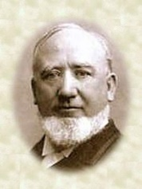
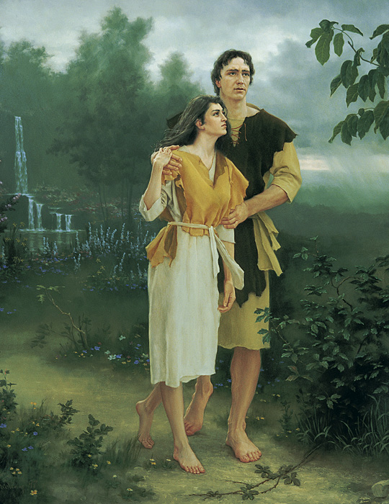

Truth Be Told
“The devil in tempting Eve told a truth when he said…that she should eat of the tree of knowledge of good and evil [that they] would become as Gods…
But it was accompanied with a lie.
He never tells the complete truth. The devil had to lie in order to accomplish his purposes.”
George Q. Cannon
“The Father had said that they should die (if they partook of the fruit.)”
George Q. Cannon
Because Adam and Eve transgressed this command and partook of the fruit of the tree of the knowledge of good and evil, they were cast out from the presence of the Lord.
lds topics—Fall of Adam
Moses 4:10

Slide 8
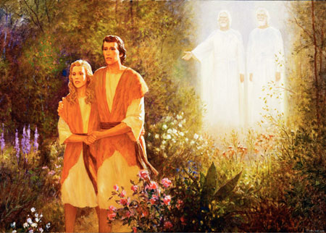
To Die
Spiritual Death—Away from the presence of Heavenly Father
They also became mortal—subject to physical death.
This spiritual and physical death is called the Fall.
The Lord stated, “Thou mayest choose for thyself”, indicating that the Fall had to occur as a result of human choice.
Moses 3:17, 4:12; Genesis 3:6

Slide 9

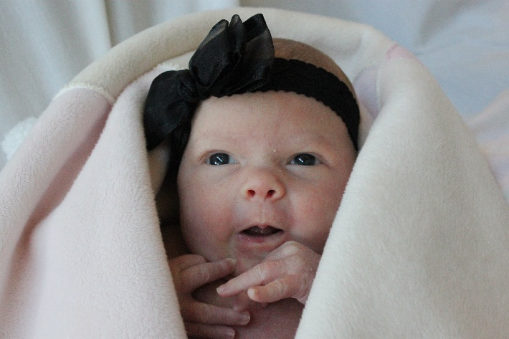
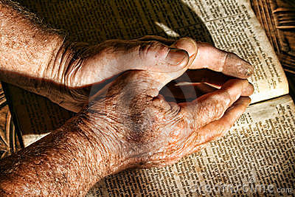
The Fall
“Adam had the privilege of making a choice, with the penalty of death awaiting him if he ate the fruit of the tree. We may assume that Adam would not have eaten if Eve had not partaken. When she did, Adam realized that he had to partake or he and Eve would have been separated forever.”
Joseph Fielding Smith
Because of the Fall, all mankind will experience physical death
If Adam and Eve had not partaken of the fruit, they would not have had the opportunity to have children in mortality. Therefore, we would not have been able to come to earth to receive physical bodies, be tested, and prepare for eternal life—frustrating the plan of salvation.
Adam Spizak
Because our bodies are mortal—or subject to physical death—we experience additional consequences of the Fall before we die, such as physical imperfections and pain.
Moses 4:29

Slide 10
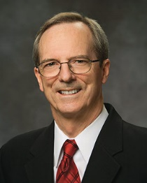

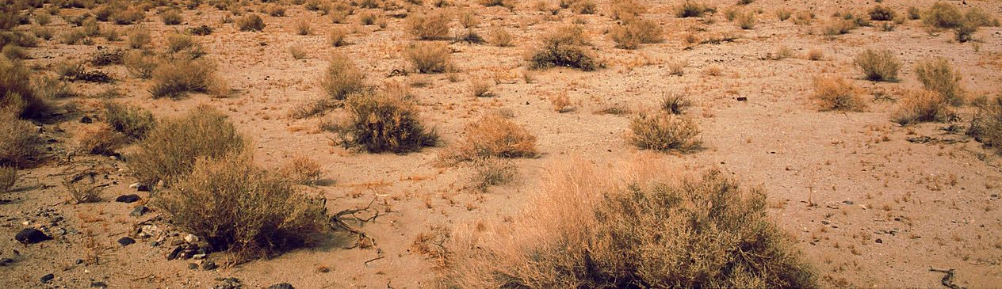
Before And After The Fall
Conditions before the Fall
Conditions after the Fall
Dwelt in the presence of Heavenly Father
Immortal
Not subject to pain, disease, or death
In a state of innocence—meaning they are to experience a fullness of joy--children
Cast out and removal from the presence of Heavenly Father, both temporality and spiritually
Mortality: Knowing good from evil and working hard for a living
Physical imperfections and pain
Injuries
Heartaches
Illness
Diseases
Able to bear children and take part in the plan of salvation
Sorrow
Pain
Difficulties
Death
Sorrow
Moses 4:13-25 excerpts from Tad R. Callister and Teacher Manual 2026

Slide 11
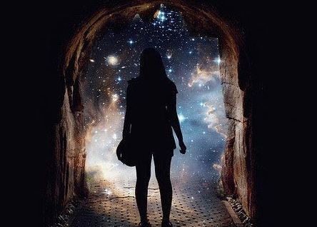
Progress
Toward immortality and eternal life
Immortality is to live forever as a resurrected being.
Because of the resurrection, our spirits and bodies will be reunited, never again to be separated.
Every person born on earth will be resurrected because Jesus Christ overcame death.
Eternal Life is also called exaltation.
God’s greatest gift to His children To live like God, in His presence as families
Like immortality in that it is possible through the Atonement of Jesus Christ.
Unlike immortality in that it is conditional and requires our “obedience to the laws and ordinances of the Gospel”
Moses 1:39; 1 Corinthians; Doctrine and Covenants 14:7; 131:1-4

Slide 12
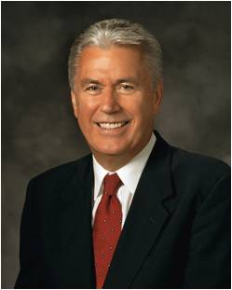

“If you truly believe the great mission of our Heavenly Father is to exalt and glorify His children and that He knows best how to do it—doesn’t it make sense to embrace and follow His commandments, even the ones that appear difficult?
… By choosing Heavenly Father’s path, you lay a divine foundation for your personal progress as a [child] of God.”
President Dieter F. Uchtdorf, then of the First Presidency
Moses 4:29-31

Slide 13
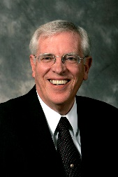
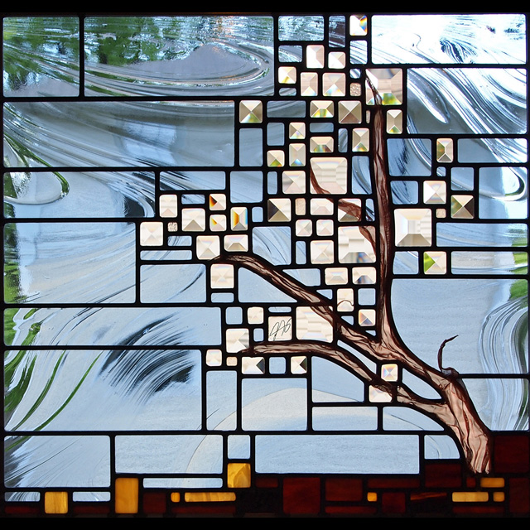
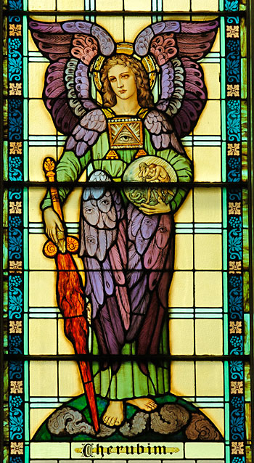
The Tree of Life
For behold, if Adam had put forth his hand immediately, and partaken of the tree of life, he would have lived forever, according to the word of God, having no space for repentance; yea, and also the word of God would have been void, and the great plan of salvation would have been frustrated.
Alma 42:5
if “[Adam and Eve] would have lived forever, … having no space for repentance; … the great plan of salvation would have been frustrated.
Cherubum—creatures of the heavenly world who are not a part of the earthly realm. Their holiness represents them in aspects of the sanctuary (Eden)
Flaming Sword—symbol of God’s justice, power, and punishment
Richard D. Draper
Moses 4:28

Slide 14
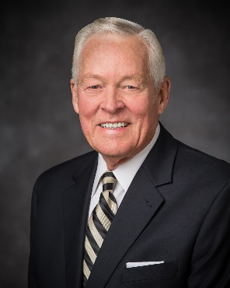

Spiritual Death
“Currently, we are all in the state of spiritual death. We are separated from God. He dwells in heaven; we live on earth. We would like to return to Him.”
Elder Earl C. Tingey
Because of the Fall, all mankind will experience spiritual death
What is the solution Heavenly Father prepared in advance to help us overcome physical and spiritual death?
Moses 4:29-31

Slide 15
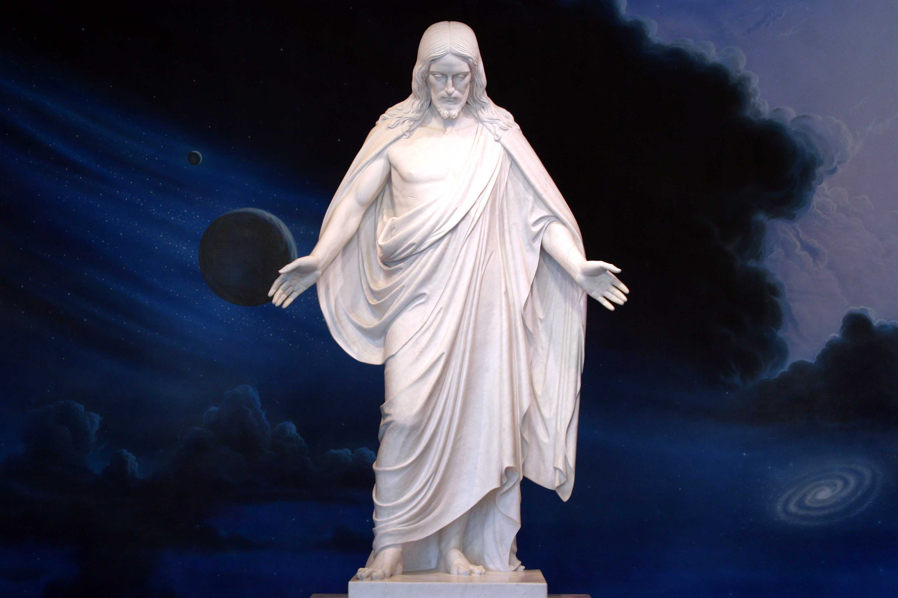
Part of the Plan
Jesus Christ was chosen in the premortal existence to be the Redeemer of mankind
Moses 4:29-31

Slide 16
Sources:
Video:
“Adam and Eve” (1:53)
President Dieter F. Uchtdorf, then of the First Presidency, “Living the Gospel Joyful,” Oct. 2014 general conference (Ensign or Liahona, Nov. 2014, 121).
Presentation by http://fashionsbylynda.com/blog/
George Q. Cannon Gospel Truth 1:16
Who’s Who in the Old Testament by Ed J. Pinegar and Richard J. Allen pp. 8-10, 55-56
Elder Russel M. Nelson Lessons from Eve October 1987 Gen. Conf.
Tad R. Callister The Infinite Atonement pp. 31-39
Richard D. Draper, S. Kent Brown, Michael D. Rhodes The Pearl of Great Price Verse by Verse Commentary p. 50
Elder Earl C. Tingey (“The Great Plan of Happiness,” Ensign or Liahona, May 2006, 73).

Slide 17
The Fall was an essential part of Heavenly Father’s divine plan. Without it no mortal children would have been born to Adam and Eve, and there would have been no human family to experience opposition and growth, moral agency, and the joy of resurrection, redemption, and eternal life. President Jeffrey R. Holland (Christ and the New Covenant: The Messianic Message of the Book of Mormon [1997], 207)
To Bare Children:
When Adam and Eve received the first commandment, they were in a transitional state, no longer in the spirit world but with physical bodies not yet subject to death and not yet capable of procreation. They could not fulfill the Father’s first commandment [to multiply and replenish the earth] without transgressing the barrier between the bliss of the Garden of Eden and the terrible trials and wonderful opportunities of mortal life. President Dallin H. Oaks(“The Great Plan of Happiness,” Ensign, Nov. 1993, 72–73)
Did Adam and Eve Sin when they ate of the fruit of the tree of knowledge of good and evil?
What did Adam do? The very thing the Lord wanted him to do. … Did Adam sin when he partook of the forbidden fruit? … No, he did not!
… Now this is the way I interpret [Moses 3:16–17]: The Lord said to Adam, here is the tree of the knowledge of good and evil. If you want to stay here, then you cannot eat of that fruit. If you want to stay here, then I forbid you to eat it. But you may act for yourself, and you may eat of it if you want to. And if you eat it, you will die.
I see a great difference between transgressing the law and committing a sin. President Joseph Fielding Smith(“Fall—Atonement—Resurrection—Sacrament,” in Charge to Religious Educators, 3rd ed. [1994], 124)
“To Rule Over” Moses 4:22
The concept of interdependent, equal partners is well-grounded in the doctrine of the restored gospel. …
Genesis 3:16 states that Adam is to “rule over” Eve, but this doesn’t make Adam a dictator. … Also, over in “rule over” uses the Hebrew bet, which means ruling with, not ruling over. If a man does exercise “dominion … in any degree of unrighteousness” (Doctrine and Covenants 121:37; emphasis added), God terminates that man’s authority.
Elder Bruce C. Hafen and Sister Marie K. Hafen
(“Crossing Thresholds and Becoming Equal Partners,” Ensign, Aug. 2007, 26, 27)
It was Eve who first transgressed the limits of Eden in order to initiate the conditions of mortality. Her act, whatever its nature, was formally a transgression but eternally a glorious necessity to open the doorway toward eternal life. Adam showed his wisdom by doing the same. And thus Eve and “Adam fell that men might be” (2 Nephi 2:25).
Some Christians condemn Eve for her act, concluding that she and her daughters are somehow flawed by it. Not the Latter-day Saints! Informed by revelation, we celebrate Eve’s act and honor her wisdom and courage in the great episode called the Fall. President Dallin H. Oaks(“The Great Plan of Happiness,” Ensign, Nov. 1993, 73)
[A righteous husband] will seek to minister; he will acknowledge error and seek forgiveness; he will be quick to offer praise; he will be considerate of family members’ preferences; he will feel the great weight of responsibility to provide “the necessities of life and protection” for his family; he will treat his wife with the utmost respect and deference. … He will bless his family. Elder Dale G. Renlund of the Quorum of the Twelve Apostles and Sister Ruth Lybbert Renlund (The Melchizedek Priesthood: Understanding the Doctrine, Living the Principles [2018], 23)

