Slide 1

Adam and Eve
Moses 4:5-32; 5:1-15 Part 2
Adam fell that men might be
2 Nephi 2:25

Slide 2

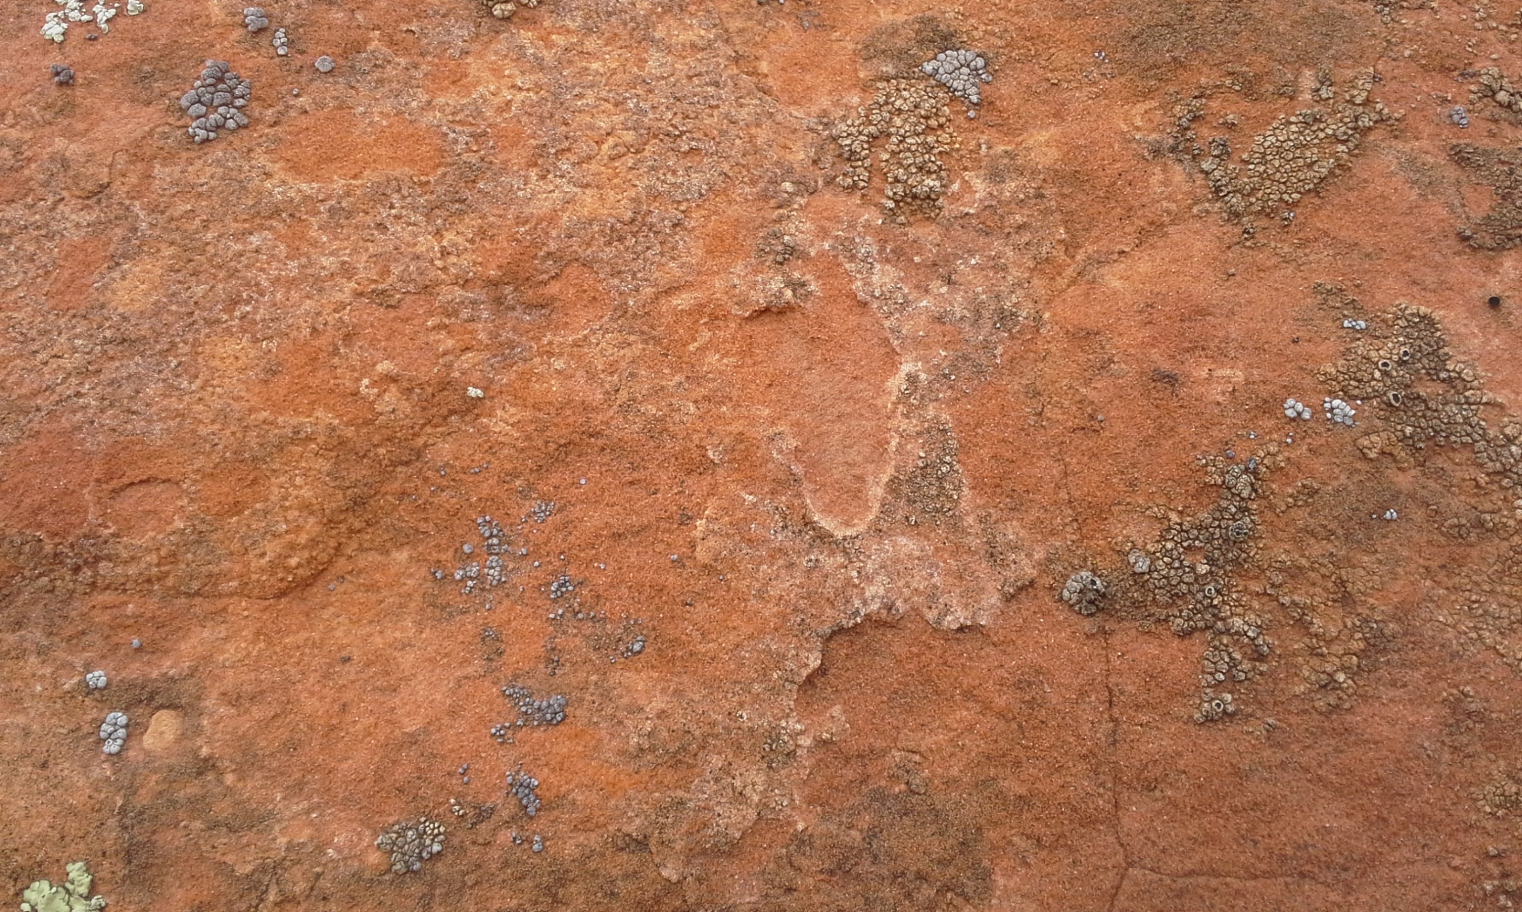

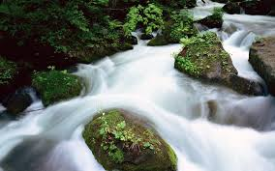
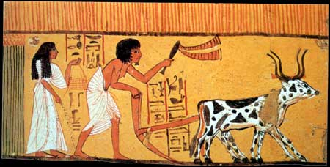
Changes
Before the Fall:
Challenges After the Fall:
Adam and Eve did not need to labor for their food
Adam and Eve had to:
Till the earth
Domesticate animals for help
Survive through hard work
Adam and Eve lived in God’s presence and spoke with Him face to face
The Bible does not mention the survival lessons Adam and Eve had to go through
Moses 5:1

Slide 3
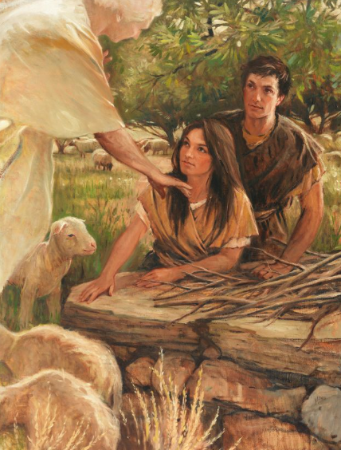
Savior to Provide
The Lord continued to bless Adam and Eve by providing clothing and giving commandments to help them overcome the Fall.
The Lord gave them a commandment to offer up the firstlings of the flocks for an offering to the Lord.
This thing is a similitude of the sacrifice of the Only Begotten of the Father, which is full of grace and truth.
Unto Adam, and also unto his wife, did I, the Lord God, make coats of skins, and clothed them.
Through the Atonement of Jesus Christ, we can be redeemed from the Fall
Moses 4:27; 5:5-9

Slide 4
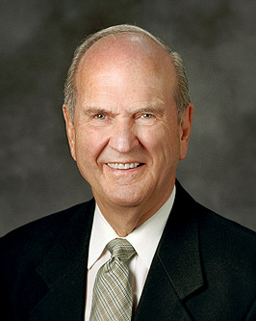
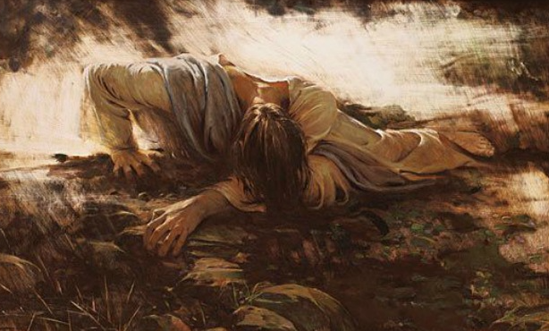
Kaphar
In Hebrew, the basic word for atonement is kaphar, a verb that means “to cover” or “to forgive.” Closely related is the Aramaic and Arabic word kafat, meaning “a close embrace.” …
I weep for joy when I contemplate the significance of it all. To be redeemed is to be atoned—received in the close embrace of God with an expression not only of His forgiveness, but of our oneness of heart and mind. President Russell M. Nelson
Moses 5:5-9

Slide 5
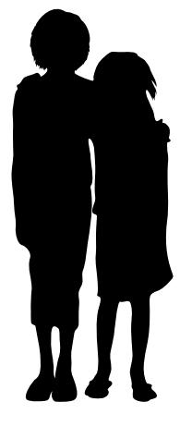
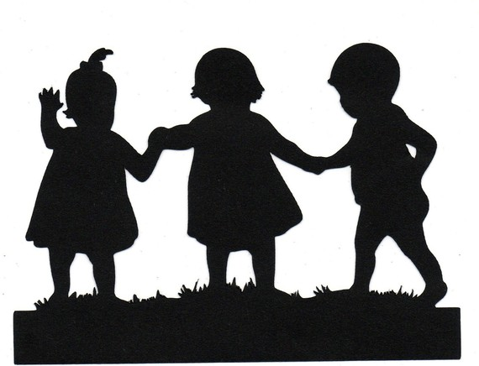


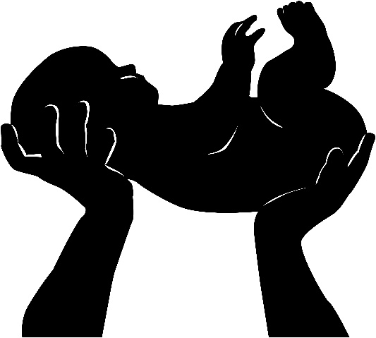
Children To Be Born
Knew—The covenant marriage between man and woman
Bare/Begat— It seems that there were sons and daughters born to Adam and Eve before Cain and Abel
One of the commandments for Adam and Eve was to bare children…and their children to also multiply
Moses 5:2-3

Slide 6
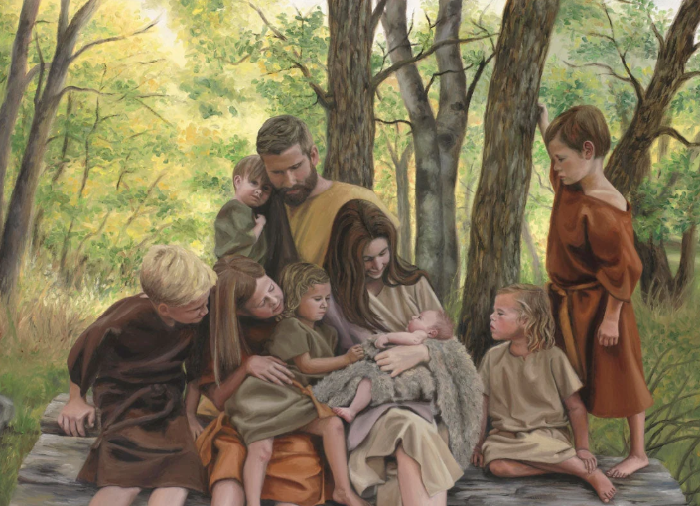
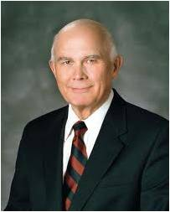
Multiply and Replenish
When Adam and Eve received the first commandment, they were in a transitional state, no longer in the spirit world but with physical bodies not yet subject to death and not yet capable of procreation.
They could not fulfill the Father’s first commandment [to multiply and replenish the earth] without transgressing the barrier between the bliss of the Garden of Eden and the terrible trials and wonderful opportunities of mortal life. President Dallin H. Oaks
Moses 5:2-3

Slide 7
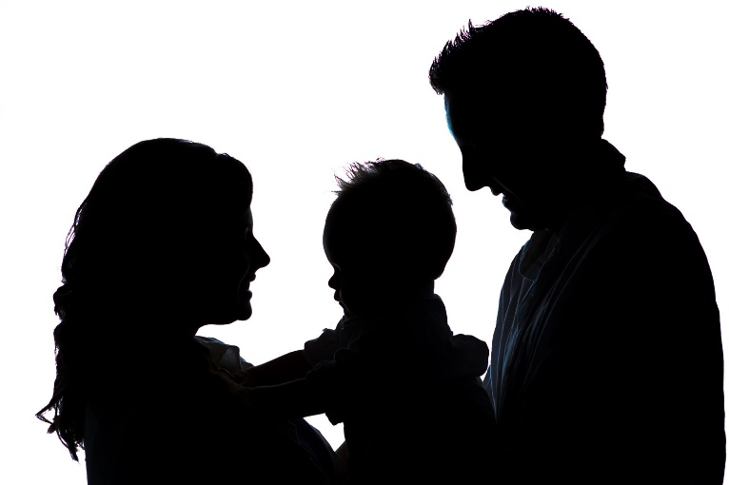



Divide The Land
Two by Two
The children also learned to work and provide for their families
Moses 5:3

Slide 8


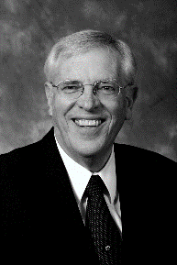
Call Upon
“Although Adam and Eve had suffered banishment from the Lord’s presence, He did not cut them off entirely.
Rather, is loving care brought Him to continue to guide them as they continued to pray to Him.
Richard D. Draper
Moses 5:4

Slide 9
Spiritual Death
Wherefore, I command you again to repent, lest I humble you with my almighty power; and that you confess your sins, lest you suffer these punishments of which I have spoken, of which in the smallest, yea, even in the least degree you have tasted at the time I withdrew my Spirit.
D&C 19:20
“The scriptures teach of two sources of spiritual death. The first source is the Fall, and the second is our own disobedience” True to the Faith
How does the Fall of Adam and Eve cause us to experience spiritual death?
We are born into a fallen world in which we are separated from our Heavenly Father.
How does our own disobedience cause us to experience spiritual death?
When we sin, we become spiritually unclean and unworthy to be in our Heavenly Father’s presence.
Moses 5:4

Slide 10
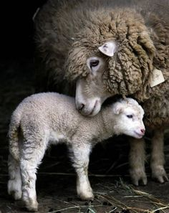
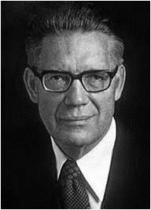
Overcoming Effects of Death
Offering the firstlings of their flocks:
To sacrifice the firstborn male lambs upon an altar.
How does sacrificing the firstborn male lambs help Adam and Eve understand Heavenly Father’s plan of redemption and what would be required for them to be able to return to God’s presence?
“Sacrifice is a similitude. It is performed to typify the coming sacrifice of the Son of God.
For four thousand long years, from Adam to that…day when our Lord was lifted up by sinful men, all of His righteous followers sought remission of their sins through sacrifice. It was an ordinance of the Melchizedek Priesthood…the lesser law given to Moses…”
Elder Bruce R. McConkie
Moses 5:5-7

Slide 11
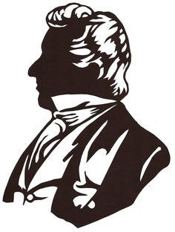

“Certainly, the shedding of the blood of a beast could be beneficial to no man, except it was done in imitation, or as a type, or explanation of what was to be offered through the gift of God Himself—and this performance done with an eye looking forward in faith on the power of that great Sacrifice for the remission of sins. …
“… We conclude that whenever the Lord revealed Himself to men in ancient days, and commanded them to offer sacrifice to Him, that it was done that they might look forward in faith to the time of His coming, and rely upon the power of that atonement for a remission of their sins”
President Joseph Smith
Moses 5:5-7

Slide 12
The Similitude
Symbol | Sacrifice | Atonement
A Lamb | “Take to them…A lamb for an house.” Exodus 12:3 | “Behold the Lamb of God.” John 1:29; 36
Male | “Your lamb shall be…A male of the first year.” Exodus 12:5 | This is the Son of God.” John 1:34
Firstborn | “Offer the firstling of their flock.” Moses 5:5 | “Christ is the image of the invisible god, the firstborn of every creature.” Colossians 1:15
Perfect | “If there be any blemish therein, as if it be lame, or blind, or have any ill blemish, thou shalt not sacrifice it unto the Lord.” Deuteronomy 15:21 | “Christ…a lamb without blemish and without spot.” 1 Peter 1:19
Shedding of Blood | “They shall take of the blood.” Exodus 12:7 | “Suffering caused Christ…to bleed at every pore.” D&C 19:18
H. Donl Peterson

Slide 13


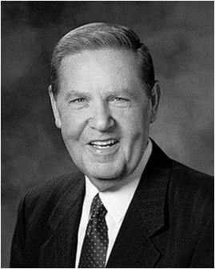
“Why are they to call upon God? Is this a social visit? Is it a friendly neighborhood chat? No, this is a call for help from the lone and dreary world. This is a call from the brink of despair.
… This is a call from the personal prison of a sinful heart. It is a call for the forgiveness of sins.”
Elder Jeffrey R. Holland
Moses 5:8

Slide 14
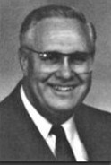

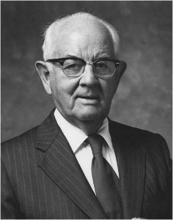
Repentance
“Individuals are to undertake personal acts of repentance and prayer in the Son’s name.” H. Donl Peterson
If we repent and call upon God for forgiveness, then we can be redeemed from our sins
“Since all of us sin in greater or lesser degree, we are all in need of constant repentance, of continual raising our sights and our performance. …This is an effort which must be extended through the remainder of one’s years.”
President Spencer W. Kimball
Moses 5:9

Slide 15


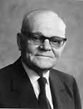
Adam And Eve
Transgressor-- partaking of the fruit that resulted in the Fall of Adam and Eve.
Without the Fall and the Atonement, we could not obtain the blessings of eternal life
“I do not look upon Adam’s action as a sin. I think it was a deliberate act of free agency. He chose to do that which had to be done to further the purposes of God. The consequences of his act made necessary the atonement of the Redeemer.” Marion G. Romney
Adam fell that men might be—2 Nephi 2:25
Moses 5:10-11

Slide 16
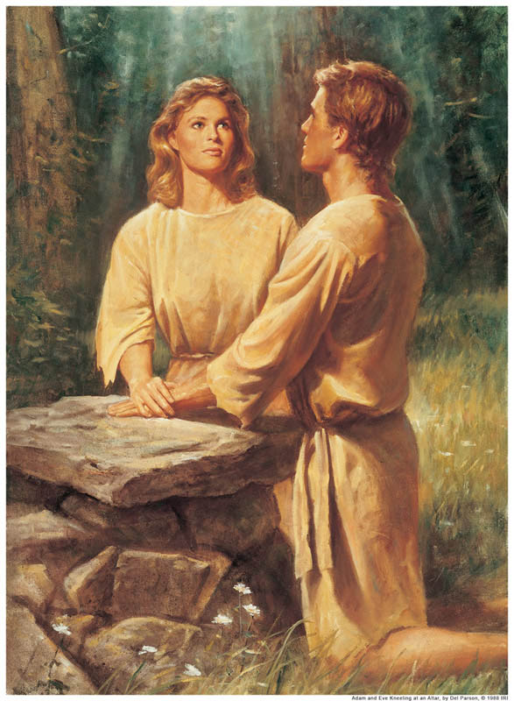
Sources:
Richard D. Draper, S. Kent Brown, Michael D. Rhodes The Pearl of Great Price Verse by Verse Commentary
True to the Faith: A Gospel Reference [2004], 48.
President Russell M. Nelson (“The Atonement,” Ensign, Nov. 1996, 34)
President Dallin H. Oaks(“The Great Plan of Happiness,” Ensign, Nov. 1993, 72–73)
Elder Bruce R. McConkie Promised Messiah pp. 379-80
Presentation by ©http://fashionsbylynda.com/blog/
H. Donl Peterson The Pearl of Great Price, The History and Commentary p. 155
President Joseph Smith (Teachings of the Presidents of the Church: Joseph Smith [2007],48–49).
Elder Jeffrey R. Holland (“I Stand All Amazed,” Ensign, Aug. 1986, 69).
President Spencer W. Kimball Miracle of Forgiveness p. 202
Marion G. Romney, Conf. Report April. 1953 p. 124

Slide 17
BEFORE THE FALL Moses 5:1-4 | AFTER THE FALL
Adam and Eve did not need to labor for their food.
Adam and Eve could not have children.
Adam and Eve lived in God’s presence and spoke with Him face to face
BEFORE THE FALL Moses 5:1-4 | AFTER THE FALL
Adam and Eve did not need to labor for their food.
Adam and Eve could not have children.
Adam and Eve lived in God’s presence and spoke with Him face to face
BEFORE THE FALL Moses 5:1-4 | AFTER THE FALL
Adam and Eve did not need to labor for their food.
Adam and Eve could not have children.
Adam and Eve lived in God’s presence and spoke with Him face to face

Slide 18
Symbol | Sacrifice | Atonement
A Lamb | “Take to them…A lamb for an house.” Exodus 12:3 | “Behold the Lamb of God.” John 1:29; 36
Male | “Your lamb shall be…A male of the first year.” Exodus 12:5 | This is the Son of God.” John 1:34
Firstborn | “Offer the firstling of their flock.” Moses 5:5 | “Christ is the image of the invisible god, the firstborn of every creature.” Colossians 1:15
Perfect | “If there be any blemish therein, as if it be lame, or blind, or have any ill blemish, thou shalt not sacrifice it unto the Lord.” Deuteronomy 15:21 | “Christ…a lamb without blemish and without spot.” 1 Peter 1:19
Shedding of Blood | “They shall take of the blood.” Exodus 12:7 | “Suffering caused Christ…to bleed at every pore.” D&C 19:18
H. Donl Peterson The Pearl of Great Price, The History and Commentary p. 55

Slide 19
Elder Jeffrey R. Holland of the Quorum of the Twelve Apostles taught:
“The Fall was an essential part of Heavenly Father’s divine plan. Without it no mortal children would have been born to Adam and Eve, and there would have been no human family to experience opposition and growth, moral agency, and the joy of resurrection, redemption, and eternal life” (“The Atonement of Jesus Christ,” Ensign, Mar. 2008, 35).
Regarding Adam and Eve’s different perspectives of their transgression, Elder Richard G. Scott of the Quorum of the Twelve Apostles explained:
“Later, ‘Adam blessed God … and began to prophesy concerning all the families of the earth, saying: Blessed be the name of God, for because of my transgression my eyes are opened, and in this life I shall have joy, and again in the flesh I shall see God’ [Moses 5:10; emphasis added]. Adam was thinking about his responsibilities. He was trying to align his performance with the desires of the Lord. Eve said, ‘Were it not for our transgression we never should have had seed, and never should have known good and evil, and the joy of our redemption, and the eternal life which God giveth unto all the obedient’ [Moses 5:11; emphasis added]. Eve’s response was characteristic of a woman. She embraced all, wanted to make sure that everyone was considered. One response was not more correct than the other. The two perspectives resulted from the traits inherent in men and women. The Lord intends that we use those differences to fulfill His plan for happiness, personal growth, and development. By counseling together they arrived at a broader, more correct understanding of truth” (“The Joy of Living the Great Plan of Happiness,” Ensign, Nov. 1996, 74).
Elder Dallin H. Oaks of the Quorum of the Twelve Apostles explained why the act of Adam and Eve is considered a transgression rather than a sin:
“Elder Joseph Fielding Smith said: ‘I never speak of the part Eve took in this fall as a sin, nor do I accuse Adam of a sin. … This was a transgression of the law, but not a sin … for it was something that Adam and Eve had to do!’ [Doctrines of Salvation, comp. Bruce R. McConkie, 3 vols. (1954–56), 1:114–15].
“This suggested contrast between a sin and a transgression reminds us of the careful wording in the second article of faith: ‘We believe that men will be punished for their own sins, and not for Adam’s transgression’ (emphasis added). It also echoes a familiar distinction in the law. Some acts, like murder, are crimes because they are inherently wrong. Other acts, like operating without a license, are crimes only because they are legally prohibited. Under these distinctions, the act that produced the Fall was not a sin—inherently wrong—but a transgression—wrong because it was formally prohibited. These words are not always used to denote something different, but this distinction seems meaningful in the circumstances of the Fall.
“Modern revelation shows that our first parents understood the necessity of the Fall. Adam declared, ‘Blessed be the name of God, for because of my transgression my eyes are opened, and in this life I shall have joy, and again in the flesh I shall see God’ (Moses 5:10).
“Note the different perspective and the special wisdom of Eve, who focused on the purpose and effect of the great plan of happiness: ‘Were it not for our transgression we never should have had seed, and never should have known good and evil, and the joy of our redemption, and the eternal life which God giveth unto all the obedient’ (v. 11)” (“The Great Plan Of Happiness,” Ensign, Nov. 1993, 73).
Coats of Skin: In Hebrew, the basic word for atonement is kaphar, a verb that means “to cover” or “to forgive.” Closely related is the Aramaic and Arabic word kafat, meaning “a close embrace.” …
I weep for joy when I contemplate the significance of it all. To be redeemed is to be atoned—received in the close embrace of God with an expression not only of His forgiveness, but of our oneness of heart and mind. President Russell M. Nelson (“The Atonement,” Ensign, Nov. 1996, 34)

