Slide 1

Cain and Abel
Moses 5:12-59
Genesis 4
Not as Cain, who was of that wicked one, and slew his brother. And wherefore slew he him? Because his own works were evil, and his brother’s righteous.
1 John 3:12

Slide 2


Influential Voices
Some voices or influences we encounter prompt us to do good while others entice us toward temptation and sin.

Slide 3
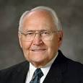
Made Things Known
“No parent can escape that obligation and that responsibility…the Lord will hold us to a strict accountability.”
The First Presidency
Lessons taught in the home by goodly parents are becoming increasingly important in today’s world, where the influence of the adversary is so widespread. As we know, he is attempting to erode and destroy the very foundation of our society—the family. In clever and carefully camouflaged ways, he is attacking commitment to family life throughout the world and undermining the culture and covenants of faithful Latter-day Saints.
Elder L. Tom Perry
Moses 5:12

Slide 4
Influence of Satan
The Beginning of Apostasy
When individuals or groups of people turn away from the principles of the gospel.
Topical Guide
Devilish means to be influenced by the devil.
What happened when the children of Adam and Eve chose to listen to Satan rather than believe in the words of their parents?
Pleasure Land
Satan is a son of God, but not in the same way the Savior is, though Satan’s words here seem intended to equate himself with the Only Begotten.” Draper
carnal and sensual refer to being preoccupied with worldliness and with gratifying physical desires, lusts, and pleasures.
Moses 5:13

Slide 5
Return and Repent
“This requirement was one of the elements of the “firm decree” that “went forth out of the mouth of God.”
The Lord calls on us to repent through the promptings of the Holy Ghost.
“The Lord called upon them by the mouths of his servants, who were inspired and guided by the Holy Ghost, not that unclean persons received the prompting of that Holy beings.”
Bruce R. McConkie
How do you know if the Holy Ghost is prompting you to repent?
Repentance is a great blessing that allows us to feel the Lord’s forgiveness and love and that helps us prepare to return to our Father in Heaven.
Moses 5:14-15

Slide 6
Abel
He was a righteous son of Adam and Eve, and one for whom the Lord respected
He came into mortality after Eve had already born unto Adam other “sons and daughters”
(Moses 5:2)
He was taught in the gospel by his parents
He was a keeper of sheep
He is singled out for his devotion and righteousness “who walked in holiness before the Lord.”
He was willing to comply with the divine commandment of sacrifice
He was murdered by his older brother Cain, thus becoming the first martyr on the earth
(D&C 138:40)
He was also mentioned in the Doctrine and Covenants as one receiving the Priesthood
(D&C 84:16)
He was also mentioned in Doctrine and Covenants 138, viewed by President Joseph F. Smith in his vision of the spirit realm
Who’s Who

Slide 7
Cain
He was a son of Adam and Eve and older brother to Abel
He came into mortality after Eve had already born unto Adam other “sons and daughters”
(Moses 5:2)
He was taught in the gospel by his parents
He married one of his brothers’ daughters (Moses 5:28)
He and his family followed the path of selfishness and evil
The Lord rejected his offering and he became jealous of his brother
He entered into a covenant with Satan and was known as “Master Mahan, or “master of this great secret.” (Moses 5:29-31)
He murdered his younger brother Abel and became the prime example of evil and Satanic conspiracy
He was cast out of God’s presence and a mark was set upon him by which he could be distinguished from the other children of Adam
Cain and his descendants lived separately from the other descendants of Adam in the land of Nod
He was to bear the title of “father of all lies” along with Satan
Who’s Who and LDS Bible Dictionary

Slide 8
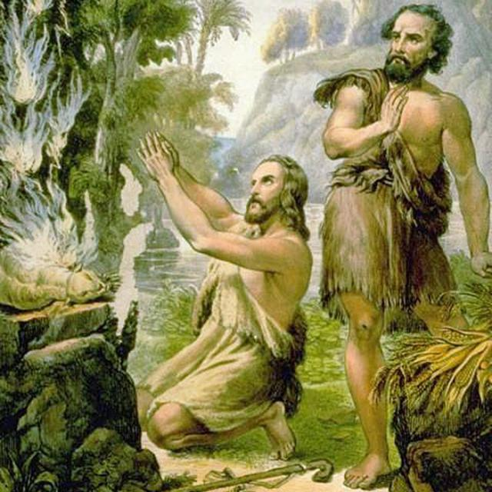
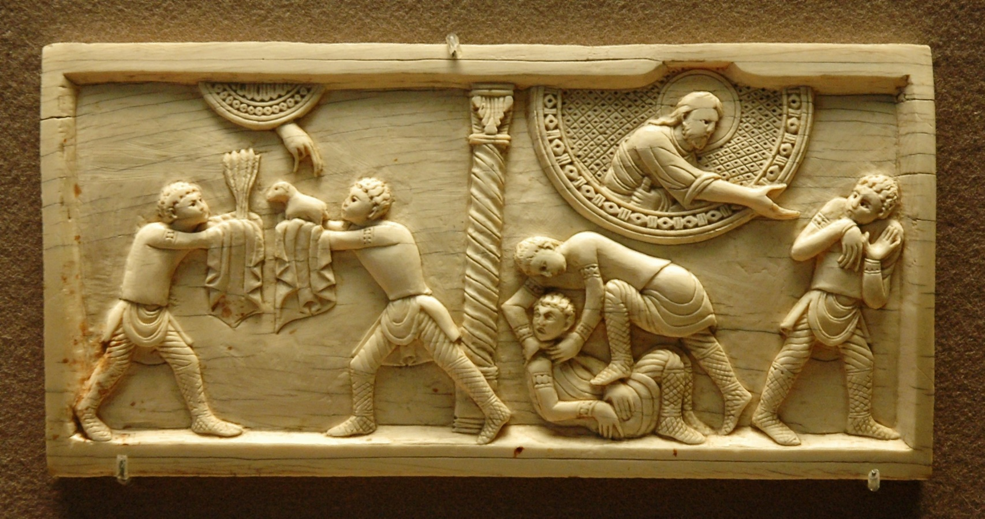
An Offering
Had not respect—the Lord refused Cain’s offering and chose to offer his own type of offering
Hearken—listen attentively
Abel was to obtaining information through offering up sacrifices. He received blessings by doing so.
Cain was following Satan’s counsel, not God’s
Cain loved Satan more than God
Cain had rebelled by making an offering that did not symbolize the blood sacrifice of Jesus Christ
Moses 5:19-23

Slide 9
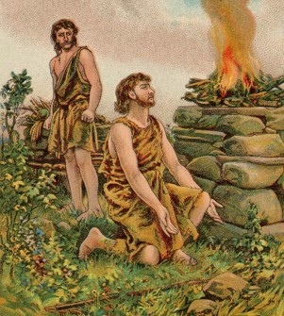
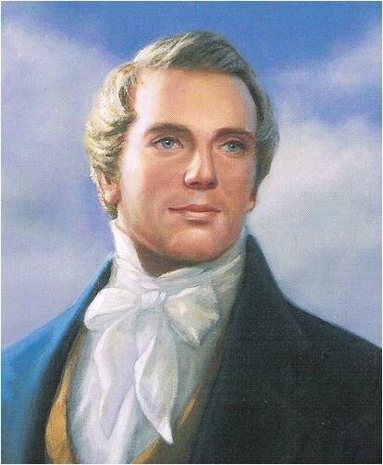
“Salvation could not come to the world without the mediation of Jesus Christ.”
“By faith in this atonement or plan of redemption, Abel offered to God a sacrifice that was accepted, which was the firstlings of the flock.
Cain offered of the fruit of the ground, and was not accepted, because he could not do it in faith; he … could not exercise faith contrary to the plan of heaven…
As the sacrifice was instituted for a type by which man was to discern the great Sacrifice which God had prepared, to offer a sacrifice contrary to that, no faith could be exercised.”
Joseph Smith

Slide 10

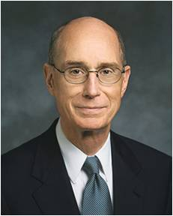
The Warning
Cain rejected the warnings from the Lord and listened to the advice of Satan
“There seems to be no end to the Savior’s desire to lead us to safety. And there is constancy in the way He shows us the path. He calls by more than one means so that it will reach those willing to accept it.
And those means always include sending the message by the mouths of His prophets whenever people have qualified to have the prophets of God among them.
Those authorized servants are always charged with warning the people, telling them the way to safety.”
Henry B. Eyring
Moses 5:22-26

Slide 11

Perdition
Latin—perditus—meaning lost
The companion to Satan
Turned back away from God
Those who are not redeemed by the Atonement of Jesus Christ.
Satan’s Offer
“The prospect that Cain would hold power over Satan was frightful and would lead to serious consequences…a person with a body holds power over one who does not posses a body.
Moses 5:23-24, 29-30

Slide 12
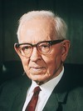
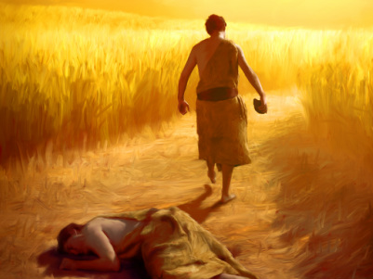
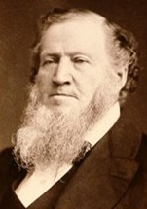
The Murder
“Cain chose knowingly but not intelligently that he killed his brother, not so much for his flocks as for the glory of being Master Mahan. Not so much with the expectancy of obtaining his brother’s worldly possessions, but to cut off without posterity that righteous brother, and, because Satan had commanded him.”
Joseph Fielding Smith
“The difference between God and the devil is that God Creates and organizes while the whole study of the devil is to destroy.”
Brigham Young
Moses 5:32-37 Genesis 4:8

Slide 13
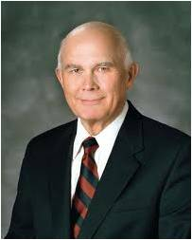
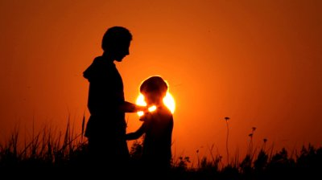

My Brother’s Keeper
“…are we responsible to look after the well-being of our neighbors as we seek to earn our daily bread? The Savior’s Golden Rule say we are. Satan says we are not.”
“Tempted of Satan, some have followed the example of Cain. They covet property and then sin to obtain it. The sin may be murder, robbery, or theft. It may be fraud or deception. It may even be some clever but legal manipulation of facts or influence to take unfair advantage of another. Always the excuse is the same: “Am I my brother’s keeper?”
Moses 5:34 Genesis 4:9 Elder Dallin H. Oaks

Slide 14
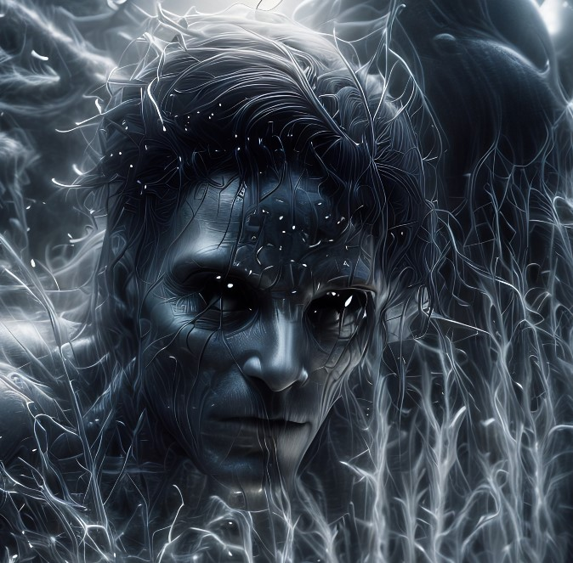
Curse of Cain
“The taking of life was condemned when Cain slew Abel, and for his dreadful sin Can was punished far worse than to have been put to death.”
Joseph Fielding Smith
The mark set upon Cain was not the same thing as the curse that he received.
Cain was cursed as a result of his wickedness.
The curse included being “shut out from the presence of the Lord” he mark was a token or reminder of the curse, used to distinguish him as the one who had been cursed by the Lord.
The mark was placed upon Cain so that no one finding him would kill him. (Manual)
Moses 5:36-41 Genesis 11-15

Slide 15
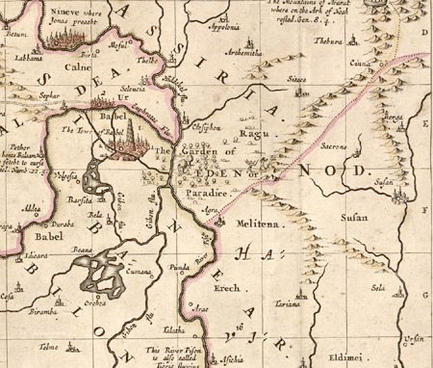
To Wander
Some of Cain’s descendants chose wickedness
The Land of Nod—east of Eden
The “land of Nod” has no other reference in Scripture. It represents no known geographical name or place.
The name seems to derive from the Hebrew, “nad,” which means “to wander.” Cain himself described his fate in just that way: “from thy face I shall be hidden; I shall be a fugitive and a wanderer on the earth.“
These stone walls
Moses 5:41 Genesis 4:14

Slide 16
Lord’s Warning VS Satan’s Temptation
If we hearken to Satan’s temptations, our sins will be known by the Lord.
If we hearken to the Lord’s warnings, then we will be accepted by Him.
If we hearken to Satan’s temptations, we will eventually receive the consequences of our sins
If we hearken to the Lord’s warnings, then we can avoid sin and the consequences of sin.

Slide 17
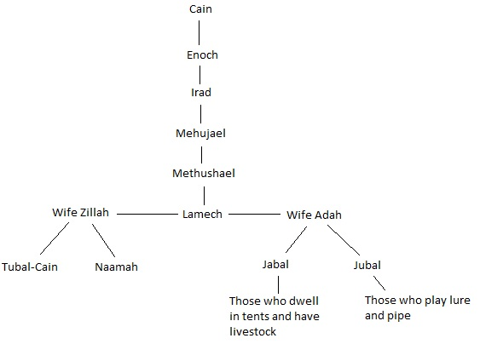
Lamech became Master Mahan Moses 5:51-54
Moses 5:42-47 Genesis 4:17-24

Slide 18
Lamech
He was the son of Mehujael and the 5th descent from Cain
He had two sons, Jabal, and Jubal from his wife, Adah, and Tubal-cain and Naamah from his wife Zillah
He entered into a covenant with Satan, after the manner of Cain
He became Master Mahan, after the manner of Cain
He killed his son Irad because of an oath
The Lord cursed his house and all those who covenanted with Satan
He was despised and cast out
Jabal, his son, was the father of the tent dwellers and those who have livestock.
Jubal, his son, was the father of the harp and flute players
Tubal-cain, his son, was a craftsmen in bronze and iron
His wives rebelled against him

Slide 19
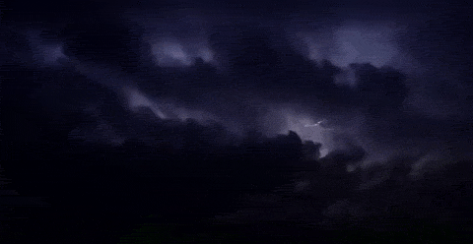
Into the Darkness
The 7th generation from Adam
“The activities of Cain’s secret society took place in darkness, and evidently only men participated in them.” (Moses 5:51)
“It was in Enoch’s day that God began to reveal the coming Flood and the survival of Noah (Moses 7:38, 42).”
“The universal appeal of Satan’s secret sets the stage for the later Flood narrative.”
Moses 5:55-56 Draper

Slide 20
The Roles of Angels
To warn and reveal
“Angels come as revealers of the secret of the Atonement, preceding the arrival of the Holy Ghost.”
Moses 5:57-59 Draper

Slide 21
Coming up Next…
Adam’s righteous posterity keep a book of remembrance, taught the gospel to their families, and invited all men to repent.
Enoch, one of Adam’s descendants, was called to preach repentance to the people and was called a seer.

Slide 22
Sources:
The First Presidency: Heber J. Grant, J. Reuben Clark Jr., and David O. McKay, in James R. Clark, Comp., Messages of the First Presidency, 6:178
Elder L. Tom Perry Becoming Goodly Parents October 2012 Gen. Conf.
Richard D. Draper, S. Kent Brown, Michael D. Rhodes The Pearl of Great Price Verse by Verse Commentary p. 62
Joseph Smith, Teachings of Presidents of the Church: Joseph Smith [2007], 48).
Old Testament Who’s Who by Ed J. Pinegar and Richard J. Allen pp. 2-3, 31-32
Henry B. Eyring Finding Safety in Counsel April 1997 Gen. Conf.
Presentation by ©http://fashionsbylynda.com/blog/
Joseph Fielding Smith Way to Perfection pp. 100-101 Answers to Gospel Questions, 4:32
Brigham Young Journal of Discourses; 13:4
Elder Dallin H. Oaks “Brother’s Keeper” November 1986 Gen. Conf.
Old Testament Seminary Teacher’s Manual Lesson 12
These stone walls
Wikipedia and http://thesestonewalls.com/gordon-macrae/in-the-land-of-nod-east-of-eden
Richard D. Draper, S. Kent Brown, Michael D. Rhodes The Pearl of Great Price Verse by Verse Commentary pp. 77-78

Slide 23
For the Parents:
First, parents can pray in earnest, asking our Eternal Father to help them love, understand, and guide the children He has sent to them.
Second, they can hold family prayer, scripture study, and family home evenings and eat together as often as possible, making dinner a time of communication and the teaching of values.
Third, parents can fully avail themselves of the Church’s support network, communicating with their children’s Primary teachers, youth leaders, and class and quorum presidencies. By communicating with those who are called and set apart to work with their children, parents can provide essential understanding of a child’s special and specific needs.
Fourth, parents can share their testimonies often with their children, commit them to keep the commandments of God, and promise the blessings that our Heavenly Father promises His faithful children.
Fifth, we can organize our families based on clear, simple family rules and expectations, wholesome family traditions and rituals, and “family economics,” where children have household responsibilities and can earn allowances so that they can learn to budget, save, and pay tithing on the money they earn.
Parents have a sacred duty to rear their children in love and righteousness, to provide for their physical and spiritual needs, and to teach them to love and serve one another, observe the commandments of God, and be law-abiding citizens wherever they live. …
Elder L. Tom Perry Becoming Goodly Parents October 2012 Gen. Conf.
“Salvation could not come to the world without the mediation of Jesus Christ.”
“By faith in this atonement or plan of redemption, Abel offered to God a sacrifice that was accepted, which was the firstlings of the flock. Cain offered of the fruit of the ground, and was not accepted, because he could not do it in faith; he … could not exercise faith contrary to the plan of heaven. … As the sacrifice was instituted for a type by which man was to discern the great Sacrifice which God had prepared, to offer a sacrifice contrary to that, no faith could be exercised” (Teachings of Presidents of the Church: Joseph Smith [2007], 48).
Sons of Perdition:
Those who are not redeemed by the Atonement are in outer darkness, which is the dwelling place of the devil, his angels, and the sons of perdition. Sons of perdition are those who receive “no forgiveness in this world nor in the world to come—having denied the Holy Spirit after having received it, and having denied the Only Begotten Son of the Father, having crucified him unto themselves and put him to an open shame” Such individuals will not inherit a place in any kingdom of glory; for them the conditions of hell remain. Topical Guide LDS
The “land of Nod” has no other reference in Scripture. It represents no known geographical name or place. The name seems to derive from the Hebrew, “nad,” which means “to wander.” Cain himself described his fate in just that way: “from thy face I shall be hidden; I shall be a fugitive and a wanderer on the earth” (Genesis 4:14).
Therefore to dwell in the land of Nod is usually taken to mean that one takes up a wandering life. Genesis 4:17 relates that after arriving in the Land of Nod, Cain's wife bore him a son, Enoch, in whose name he built the first city.
Wikipedia and http://thesestonewalls.com/gordon-macrae/in-the-land-of-nod-east-of-eden/
Giving in to Satan:
“Lucifer and his followers know the habits, weaknesses, and vulnerable spots of everyone and take advantage of them to lead us to spiritual destruction. With one person it may be thirst for liquor; another may have an insatiable hunger; another has permitted his sex urges to dominate; another loves money, and the luxuries and comforts it can buy; another craves power; and so on.” Spencer W. Kimball Miracle of Forgiveness pp. 218-219
Believe it or Not:
“No greater ideal has been revealed than the supernal truth that we are the children of God, and we differ, by virtue of our creation, from all other living things. (See Moses 6:8–10, 22, 59.)
“No idea has been more destructive of happiness; no philosophy has produced more sorrow, more heartbreak and mischief; no idea has done more to destroy the family than the idea that we are not the offspring of God, only advanced animals, compelled to yield to every carnal urge” (Boyd K. Packer, “Our Moral Environment,” Ensign, May 1992, 67).
My Brother’s Keeper:
Tempted of Satan, some have followed the example of Cain. They covet property and then sin to obtain it. The sin may be murder, robbery, or theft. It may be fraud or deception. It may even be some clever but legal manipulation of facts or influence to take unfair advantage of another. Always the excuse is the same: “Am I my brother’s keeper?” Elder Dallin H. Oaks “Brother’s Keeper” November 1986 Gen. Conf.

