Slide 1

The City of Holiness
Moses 7
And Enoch and all his people walked with God, and he dwelt in the midst of Zion; and it came to pass that Zion was not, for God received it up into his own bosom; and from thence went forth the saying, Zion is Fled.
Moses 7:69

Slide 2

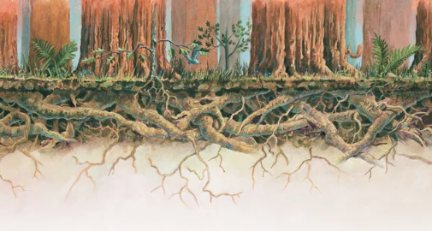
Roots of a Tree
The roots of redwoods are only about 3–6 feet (1–2 m) deep. However, these roots spread out several hundred feet (more than 100 m) and become intertwined with the roots of other trees.
The tallest trees in the world are redwood trees.
They can grow more than 300 feet (92 m) high.
This interconnectedness enables redwoods to stand strong for hundreds of years amid winds and floods.
Richard H. Winkel
How do others help and support you, especially in your efforts to come closer to the Savior?
How do you try to support others and help them feel closer to the Savior?

Slide 3

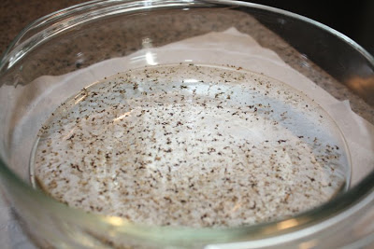
Surrounded By Wickedness
Enoch lived in a world full of wickedness.
Pepper
Wicked influences

Slide 4
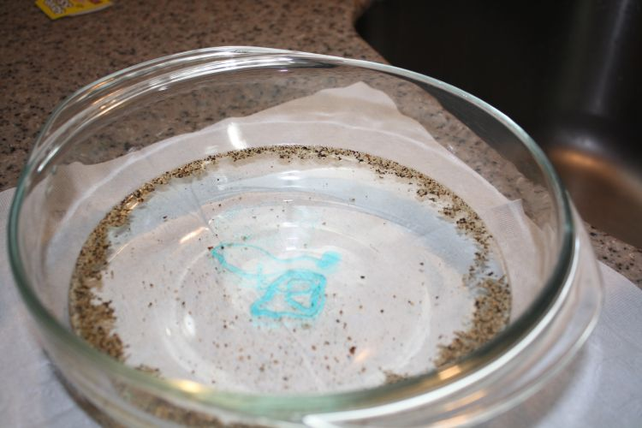
Dispersed By the Truth
Enoch’s
Teachings
As Enoch preached the gospel the people began to disperse.

Slide 5
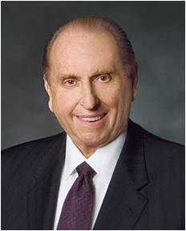
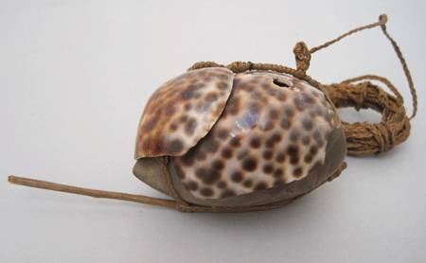
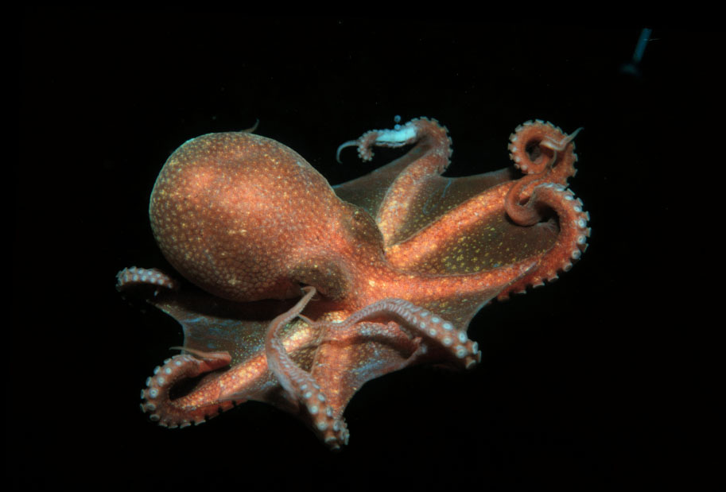
Maka-Fekes
To lure and to trap
Today we are surrounded by the maka-fekes which the evil one dangles before us and with which he attempts to entice us and then to ensnare us. Once grasped, such maka-fekes are ever so difficult—and sometimes nearly impossible—to relinquish.
To be safe, we must recognize them for what they are and then be unwavering in our determination to avoid them.
President Thomas S. Monson

Slide 6
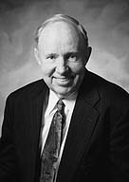

Puppets On A String
Our culture tends to determine what foods we like, how we dress, what constitutes polite behavior, what sports we should follow, what our taste in music should be, the importance of education, and our attitudes toward honesty.
It also influences men as to the importance of recreation or religion, influences women about the priority of career or childbearing, and has a powerful effect on how we approach procreation and moral issues. All too often, we are like puppets on a string, as our culture determines what is “cool.”
David R. Stone

Slide 7
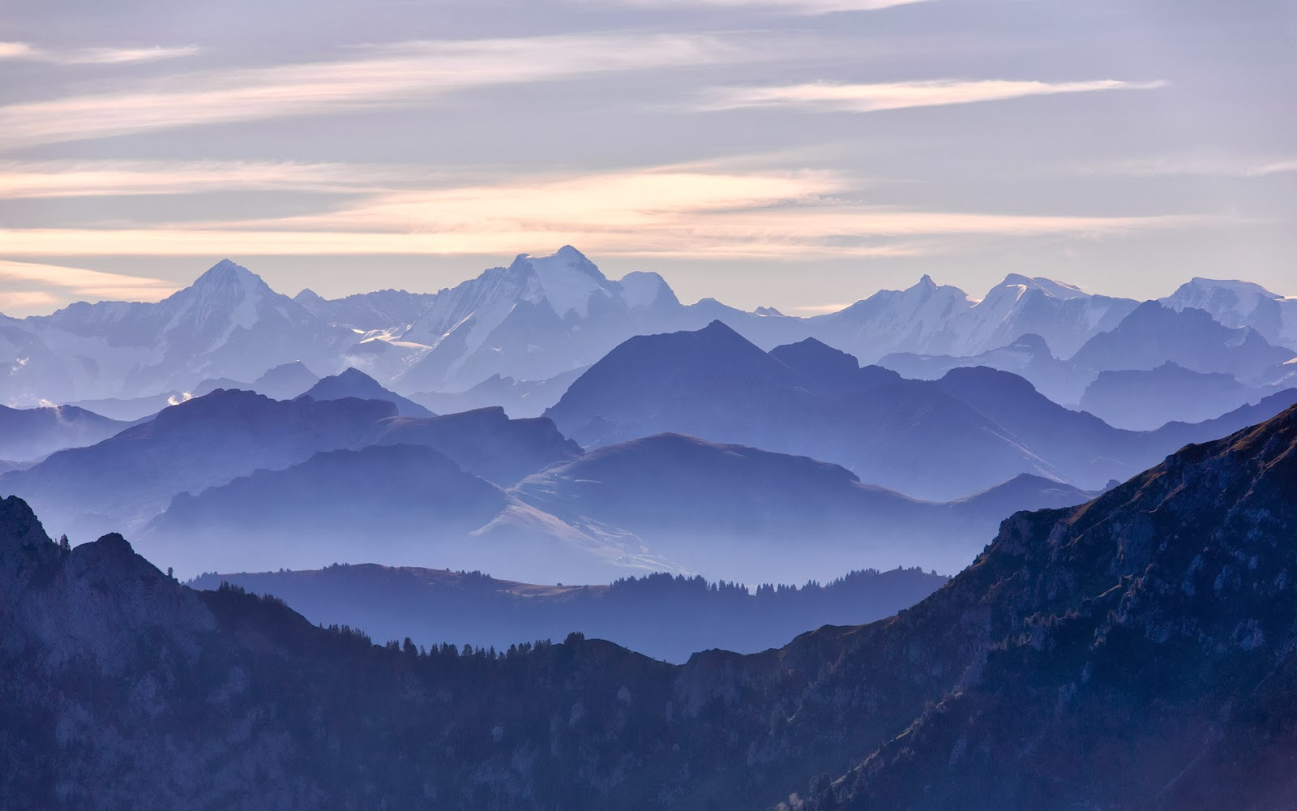
Mahujah—Mount Simeon
The Hebrew equivalent of Simeon is Shimʼon, which means “hearing.”
Enoch Has Two Major Visions
Vision 1
He sees peoples and places of his time
Valley of Shum and People of Canaan battle
He was to go to the Land of Sharon, Enoch, Omner, Heni, Shem, Haner, and Hanannihah and preach repentance and perform baptisms
Moses 7:4-12

Slide 8
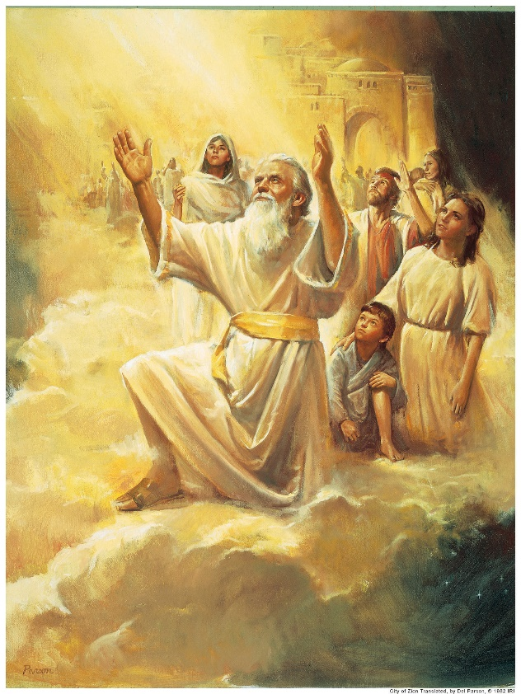
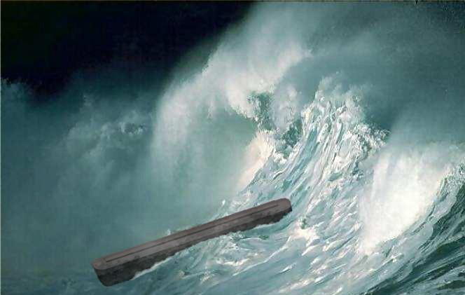
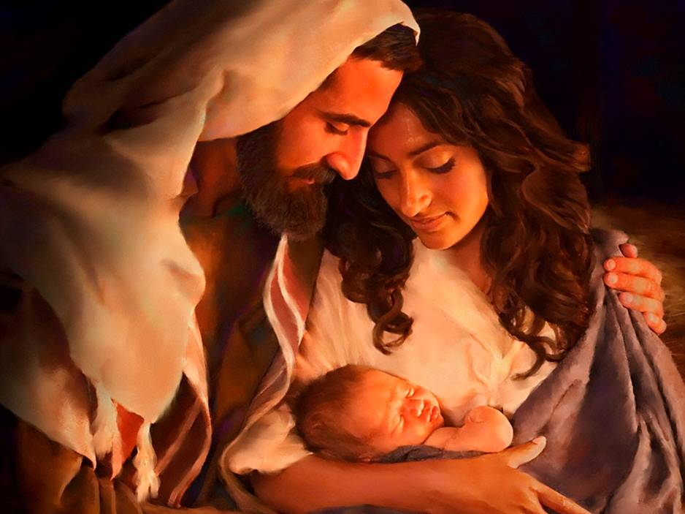
Vision 2
He sees the grand vision of “all the inhabitants of the earth” until “the endo of the world”
He sees the City of Zion taken to heaven
He sees the Flood
He sees the coming of the Son of God and Jesus lifted on the cross
Moses 7:21, 23-25, 28, 34, 47, 67

Slide 9
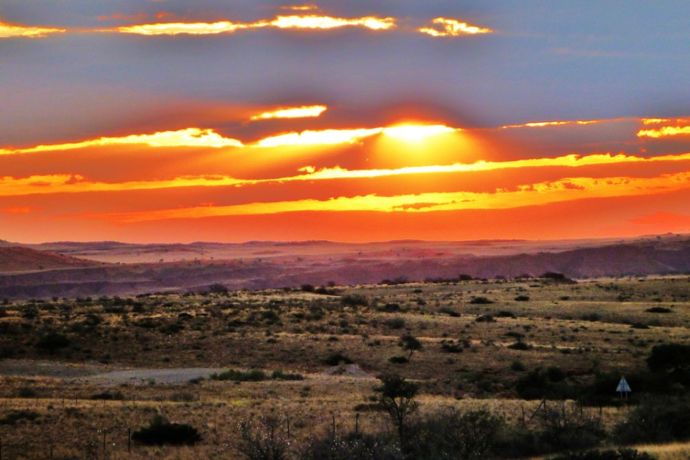
Blessings of the People of Enoch
The Lord came and dwelt with the people
The land was blessed
High Places—Mountains—Sanctuaries—a place to receive revelations and perform sacred ordinations
Moses 7:16-17

Slide 10

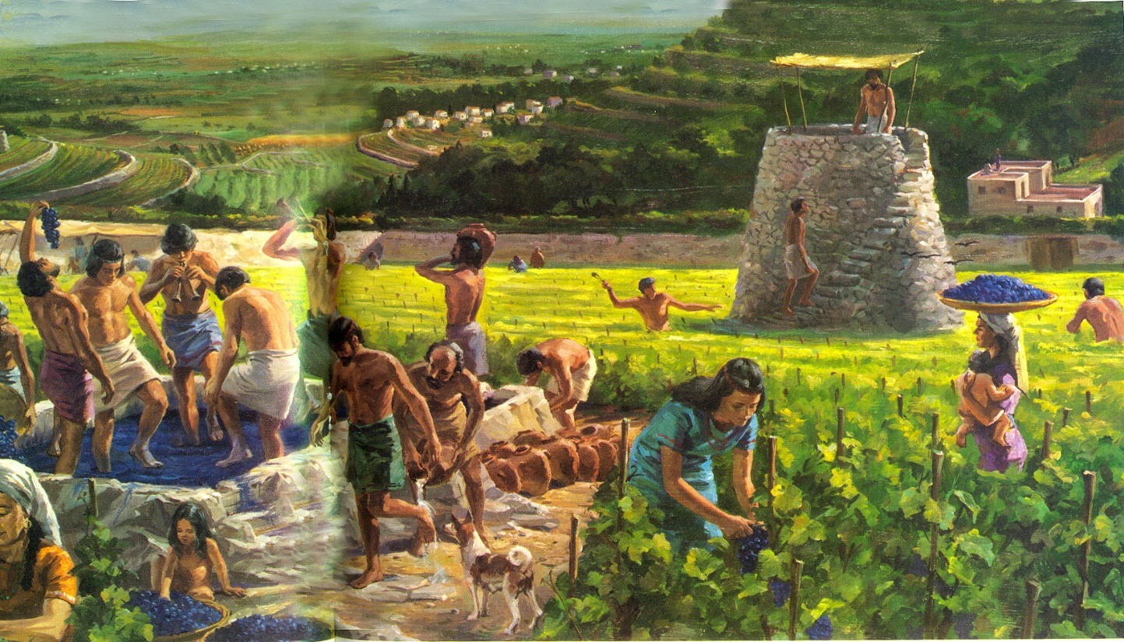
Zion—One Heart—One Mind
The name points to a people…not a place
The Lord will call His people Zion when they are of one heart and one mind, live righteously, and care for one another
Moses 7:18

Slide 11
Doctrinal Mastery
Old Testament
Moses 7:18
And the Lord called his people Zion, because they were of one heart and one mind, and dwelt in righteousness; and there was no poor among them.

Slide 12
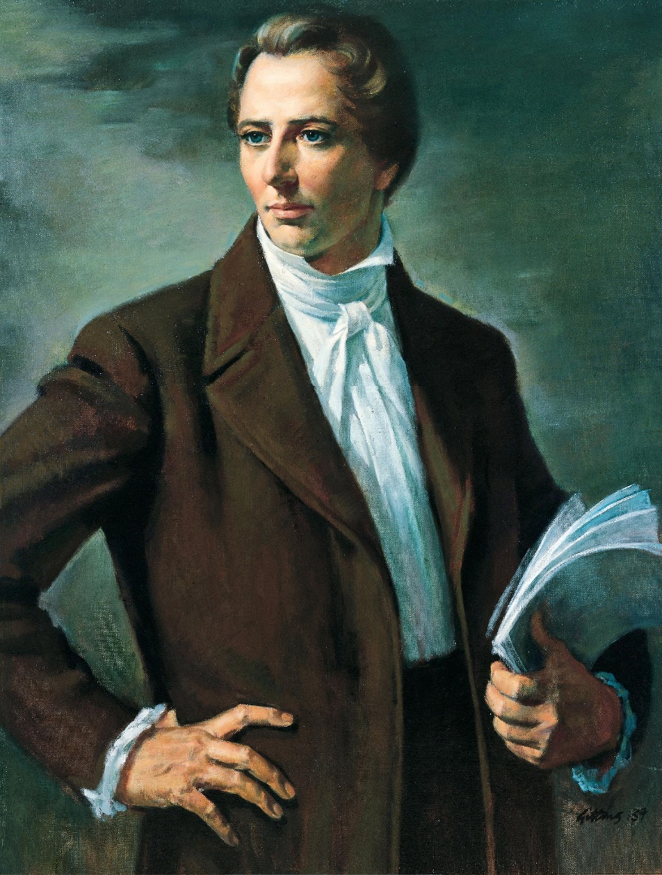
Joseph Smith
“The building up of Zion is a cause that has interested the people of God in every age; it is a theme upon which prophets, priests and kings have dwelt with peculiar delight; they have looked forward with joyful anticipation to the day in which we live; and fired with heavenly and joyful anticipations they have sung and written and prophesied of this our day; but they died without the sight; we are the favored people that God has made choice of to bring about the Latter-day glory.”

Slide 13
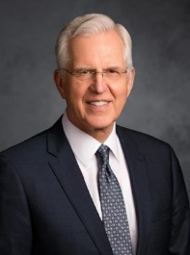
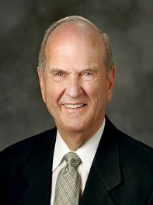
Unity, Righteousness, Caring for the Poor
And the Lord called his people Zion, because they were of one heart and one mind, and dwelt in righteousness; and there was no poor among them.
We are too diverse and at times too discordant to be able to come together as one on any other basis or under any other name. Only in Jesus Christ can we truly become one…
It is only in and through our individual loyalty to and love of Jesus Christ that we can hope to be one.
Elder D. Todd Christofferson
As we strive to live the higher laws of Jesus Christ, our hearts and our very natures begin to change.
The Savior lifts us above the pull of this fallen world by blessing us with greater charity, humility, generosity, kindness, self-discipline, peace, and rest.
President Russell M. Nelson
As we pursue the cause of Zion, each of us should prayerfully consider whether we are doing … all that we should in the Lord’s eyes with respect to the poor and the needy.
Elder D. Todd Christofferson
A Zion People
Moses 7:18

Slide 14



Unity in the Home
Dwell in righteousness
Care more effectively for one another.
Become unified in heart and in mind
Moses 7:18

Slide 15
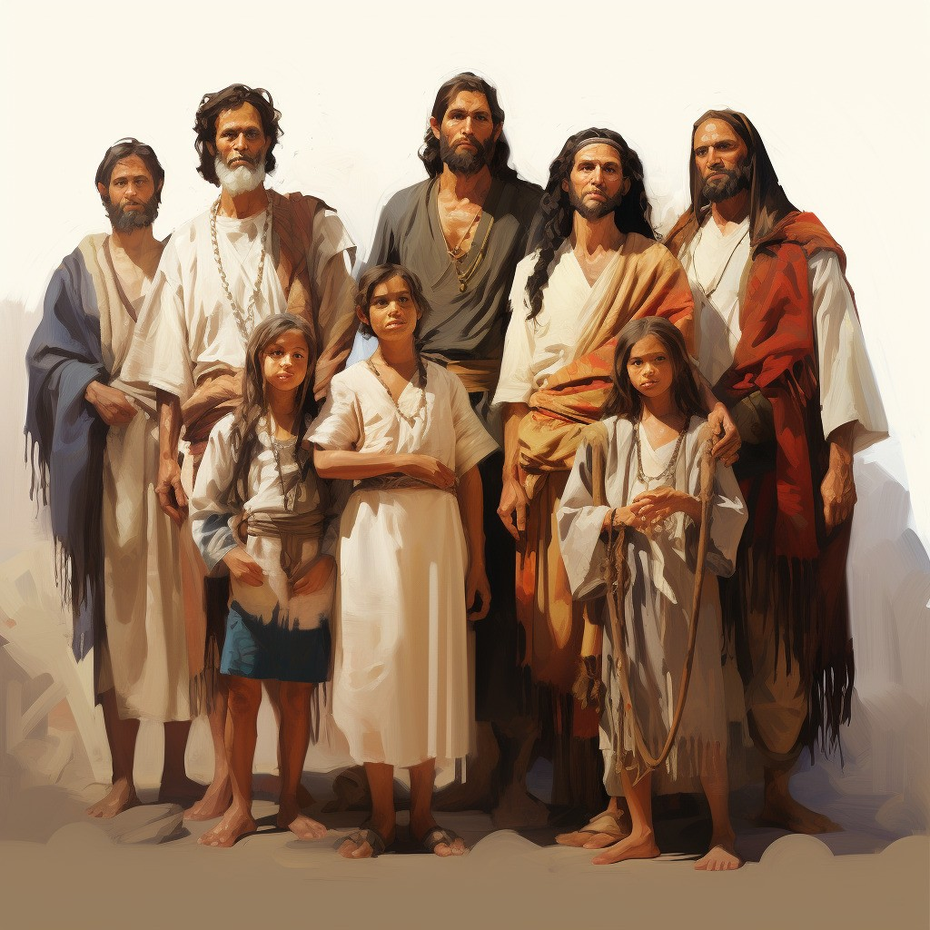
4 Nephi 1—Thirty and Sixth Year
The Nephites and the Lamanites are all converted unto the Lord—They have all things in common, work miracles, and prosper in the land—
…the people were all converted unto the Lord, upon all the face of the land, both Nephites and Lamanites, and there were no contentions and disputations among them, and every man did deal justly one with another.
And they had all things common among them; therefore there were not rich and poor, bond and free, but they were all made free, and partakers of the heavenly gift.
4 Nephi 1-3

Slide 16
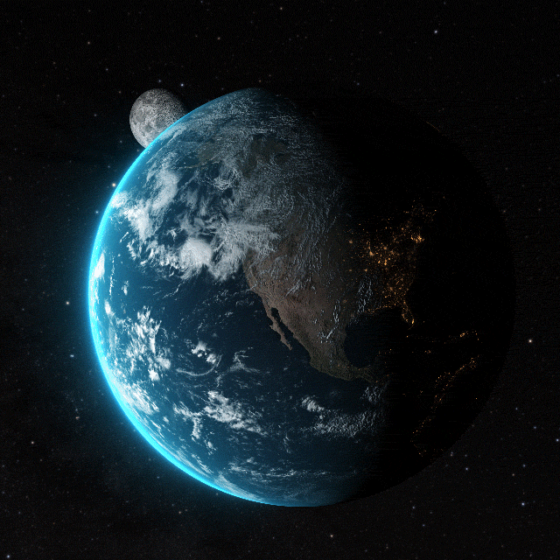
The Earth’s History
The Lord showed Enoch a vision of the earth’s history from his own day to the Millennium.
Moses 7:22

Slide 17
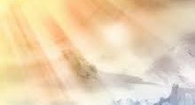
City Taken to Heaven
Enoch saw in a vision that the city would eventually be taken up to heaven because of the righteousness of his people.
Enoch and his people were translated—in other words, their bodies were changed so they would be free of physical pain and would not experience death until the time of their resurrection.
Enoch’s city had two names, Zion and City of Holiness. The second name becomes more meaningful when we remember that Heavenly Father’s name in the language of Adam is Man of Holiness
Institute Manual
Moses 7:19-21

Slide 18
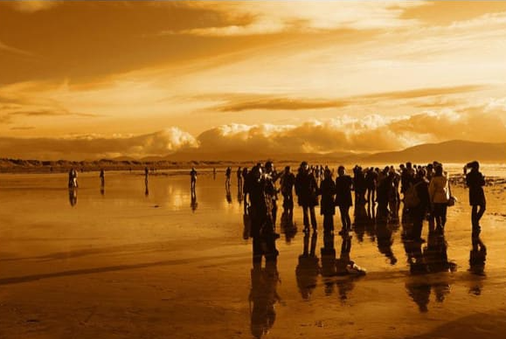
“Residue of People”
Those people who were left on the earth because they would not follow the Savior.
Moses 7:22

Slide 19
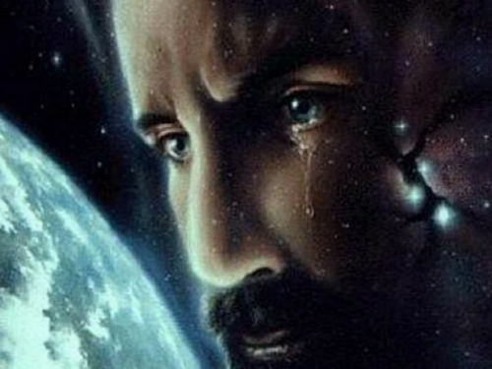

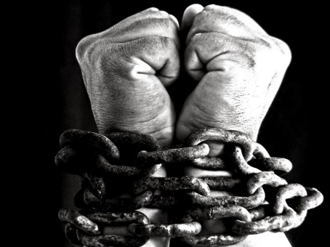
Chains of Darkness
What did Enoch learn about Satan?
What do you think the “great chain in his hand” represents?
Why do you think Satan and his followers laughed and rejoiced?
Satan promotes works of darkness and seeks to bind, captivate, and destroy mankind.
God does not work in darkness, and He seeks to save mankind.
Furthermore, in stark contrast to Satan and his angels, who laughed at the wickedness of mankind, tells us that God wept over the wickedness of His children.
Moses 7:26-36

Slide 20
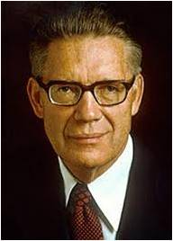
Caught Up
“After those in the City of Holiness were translated and taken up into heaven without tasting death, so that Zion as a people and a congregation had fled from the battle-scarred surface of the earth, the Lord sought others among men who would serve him.
From the days of Enoch to the flood, new converts and true believers, except those needed to carry out the Lord’s purposes among mortals, were translated.”
Elder Bruce R. McConkie
Moses 7:27

Slide 21
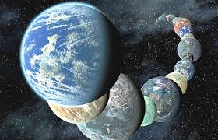
Created Worlds Without Number
God has created worlds without number, yet He is aware of and cares about us.
“The God we worship is more powerful than we can comprehend. The Father, through His Son, not only created the heavens and the earth but also is the power that sustains those creations. Speaking of the Savior and the light, or power, by which He creates and governs.”
R. Val Johnson
Moses 7:28-30

Slide 22
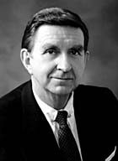
Sorrow
Heavenly Father feels sorrow when we choose to commit sin
“God, from whom all blessings come, asked of his children only that they should love each other and choose him, their Father.
“But as in our day, many neither sought the Lord nor had love for each other, and when God foresaw the suffering that would inevitably follow this self-willed, rebellious course of sin, he wept. That, he told Enoch, was what he had to cry about.”
Elder Marion D. Hanks
Moses 7:32-40

Slide 23
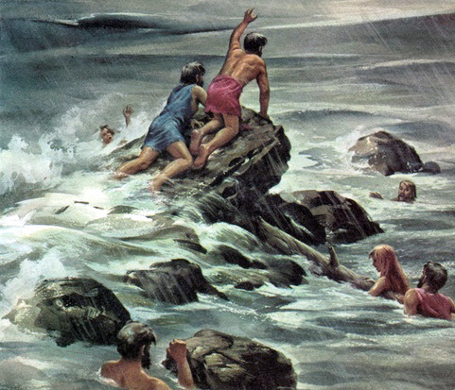
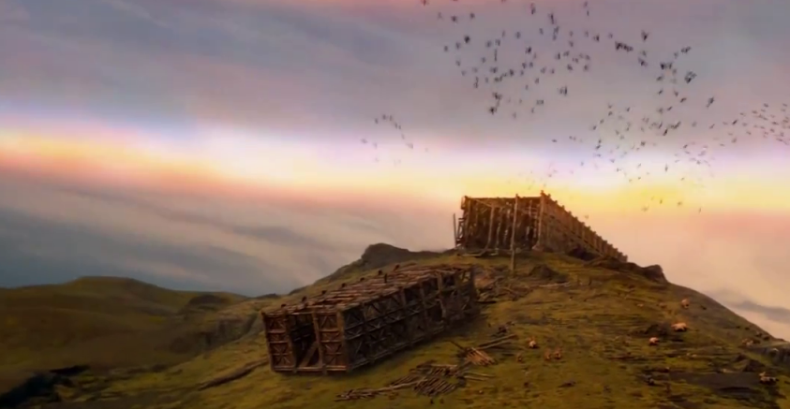
Enoch Learns of the Plan of Salvation
Enoch wept again when he heard the earth mourn because of the wickedness of the people.
Enoch prayed and asked God if he would have compassion on the earth and bless the children of Noah.
The Lord promised Enoch that He would never again flood the earth.
The Lord also promised that He would “call upon the children of Noah,” which means that He would invite them to accept the gospel.
The Lord also taught Enoch that those who build their lives upon the Savior would never fall
Moses 7:41-44

Slide 24
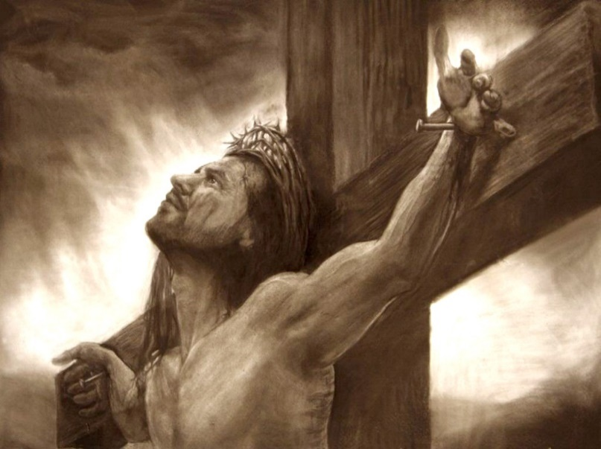
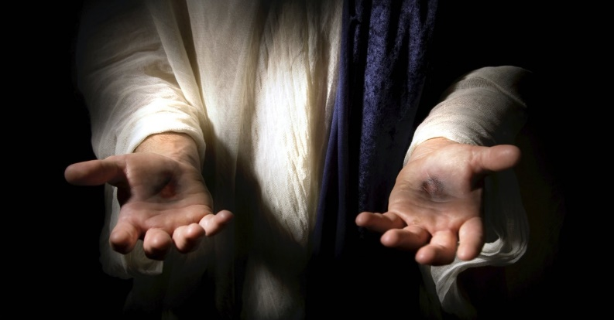
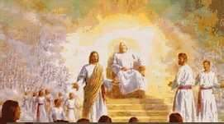
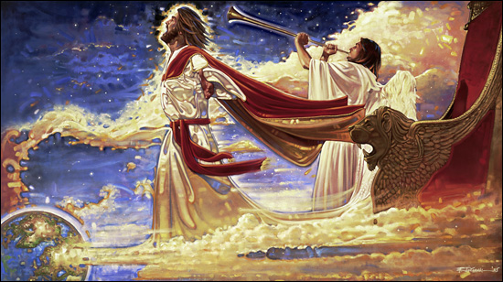
Enoch Sees the Rest of The Plan of Salvation
Enoch saw the resurrection of Jesus Christ
Enoch wept when he saw the Savior lifted on the cross, and the heavens groaned, and the rocks were rent.
Enoch saw the earth rest and the Second Coming of Christ
Enoch saw the spirits in heaven who stood on the right hand of God
And the righteous sent down to earth to testify of the Savior
Moses 7:55-62

Slide 25
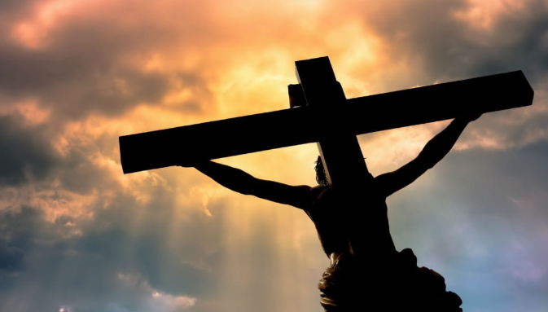
The Righteous-Title for Jesus Christ
The Righteous is lifted up, and the Lamb is slain from the foundation of the world; and through faith I am in the bosom of the Father, and behold, Zion is with me.
For Christ also hath once suffered for sins, the just for the unjust, that he might bring us to God, being put to death in the flesh, but quickened by the Spirit:
1 Peter 3:18
Moses 7:45-47

Slide 26
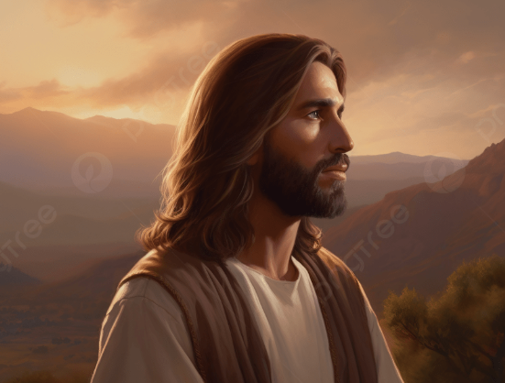
The King of Zion
He watches over His people, and in the last days He will preserve them from the great tribulations that will occur.
Moses 7:53

Slide 27
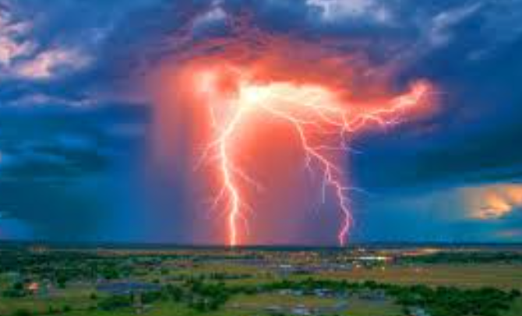
Preserve in the Last Days
The Lord promised they would “dwell in safety forever”
As I live, even so will I come in the last days, in the days of wickedness and vengeance, to fulfil the oath which I have made unto you concerning the children of Noah;
And the day shall come that the earth shall rest, but before that day the heavens shall be darkened, and a veil of darkness shall cover the earth; and the heavens shall shake, and also the earth; and great tribulations shall be among the children of men, but my people will I preserve;
Moses 7:53, 60-61

Slide 28

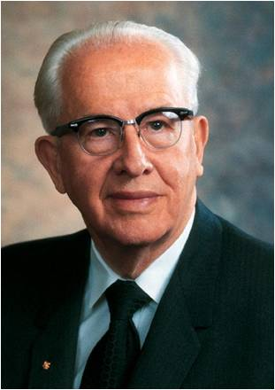
“The Lord promised that “righteousness would come from heaven and truth out of the earth. We have seen the marvelous fulfillment of that prophecy in our generation.
The Book of Mormon has come forth out of the earth, filled with truth, serving as the very ‘keystone of our religion’.
God has also sent down righteousness from heaven. The Father Himself appeared with His Son to the Prophet Joseph Smith.
The angel Moroni, John the Baptist, Peter, James, and numerous other angels were directed by heaven to restore the necessary powers to the kingdom.
Further, the Prophet Joseph Smith received revelation after revelation from the heavens during those first critical years of the Church’s growth.
These revelations have been preserved for us in the Doctrine and Covenants”
President Ezra Taft Benson

Slide 29
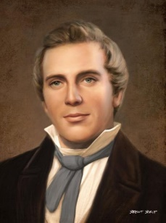

Will every righteous person be preserved from all the tribulations in the last days?
[I] explained concerning the coming of the Son of Man; also that it is a false idea that the Saints will escape all the judgments, whilst the wicked suffer; for all flesh is subject to suffer, and ‘the righteous shall hardly escape’ still many of the Saints will escape, for the just shall live by faith; yet many of the righteous shall fall a prey to disease, to pestilence, etc., by reason of the weakness of the flesh, and yet be saved in the Kingdom of God.
Prophet Joseph Smith
D&C 63:34; Habakkuk 2:4; Moses 7:67-69

Slide 30

Enoch and the City of Zion Walk With God
Moses 7:67-69

Slide 31
Sources:
Videos:
“Charity: An Example of the Believers” (4:50)
“To Sweep the Earth as with a Flood” (2:56).
Richard H. Winkel, “Web of Friendship,” New Era, Aug. 2003, 10–11
Elder D. Todd Christofferson “One in Christ,” Liahona, May 2023, 78, 79)
President Russell M. Nelson (“Overcome the World and Find Rest,” Liahona, Nov. 2022, 97)
Elder D. Todd Christofferson (“Come to Zion,” Ensign or Liahona, Nov. 2008, 39)
Sharon G. Larsen Standing in Holy Places April 2002 Gen. Conf.
http://michellesjournalcorner.blogspot.com/2010/07/preschool-science-pepper-and-dish-soap.html
President Thomas S. Monson True to the Faith April 2006 Gen. Conf.
https://www.youtube.com/watch?v=d2HCF8_g4ss
David R. Stone Zion in the Midst of Babylon April 2006 Gen. Conf.
(Teachings of Presidents of the Church: Joseph Smith [Melchizedek Priesthood and Relief Society course of study, 2007], 186).
Presentation by ©http://fashionsbylynda.com/blog/
Institute Manual. Pearl of Great Price
Elder Bruce R. McConkie (The Millennial Messiah, 284).
R. Val Johnson Worlds without Number August 2013 Ensign
https://www.lds.org/ensign/2013/08/worlds-without-number?lang=eng
Elder Marion D. Hanks(in Conference Report, Apr. 1980, 40–41; or Ensign, May 1980, 29).
President Ezra Taft Benson (“The Gift of Modern Revelation,” Ensign, Nov. 1986, 79–80)
Joseph Smith (Teachings of the Presidents of the Church: Joseph Smith [2007], 253)

Slide 32
Fitting In?
A sense of belonging is important to our physical, mental, and spiritual well-being. Yet it is quite possible that at times each of us might feel that we don’t fit in. In discouraging moments, we may feel that we will never measure up to the Lord’s high standards or the expectations of others. We may unwittingly impose expectations on others—or even ourselves—that are not the Lord’s expectations. We may communicate in subtle ways that the worth of a soul is based on certain achievements or callings, but these are not the measure of our standing in the Lord’s eyes. “The Lord looketh on the heart” [1 Samuel 16:7]. He cares about our desires and longings and what we are becoming. …
A … facet of the doctrine of belonging has to do with our own contributions. Although we rarely think about it, much of our belonging comes from our service and the sacrifices we make for others and for the Lord. Excessive focus on our personal needs or our own comfort can frustrate that sense of belonging. Elder D. Todd Christofferson (“The Doctrine of Belonging,” Liahona, Nov. 2022, 54, 55)
Heavenly Father Loves:
In the midst of a grand vision of humankind which heaven opened to his view, Enoch, observing both the blessings and challenges of mortality, turns his gaze toward the Father and is stunned to see Him weeping. He says in wonder and amazement to this most powerful Being in the universe: “How is it that thou canst weep?” …
That single, riveting scene does more to teach the true nature of God than any theological treatise could ever convey. …
What an indelible image of God’s engagement in our lives! What anguish in a parent when His children do not choose Him nor “the gospel of God” He sent! [Romans 1:1]. How easy to love someone who so singularly loves us! …
I bear personal witness this day of a personal, living God, who knows our names, hears and answers prayers, and cherishes us eternally as children of His spirit. Pres. Jeffrey R. Holland (”The Grandeur of God,” Ensign or Liahona, Nov. 2003, 72)
Unified despite Our Differences:
Unity is enhanced when people are treated with dignity and respect, even though they are different in outward characteristics. …
With our all-inclusive doctrine, we can be an oasis of unity and celebrate diversity. Unity and diversity are not opposites. We can achieve greater unity as we foster an atmosphere of inclusion and respect for diversity. …
The culture of the gospel of Jesus Christ is not … determined by the color of one’s skin or where one lives. While we rejoice in distinctive cultures, we should leave behind aspects of those cultures that conflict with the gospel of Jesus Christ. Elder Quentin L. Cook (“Hearts Knit in Righteousness and Unity,” Ensign or Liahona, Nov. 2020, 18, 19, 21)
Why does God weep?
We are children of God. Each one of us is precious to the point of bringing the Lord God Almighty to a fulness of joy if we are faithful, or to tears if we are not. M. Russell Ballard (“The Atonement and the Value of One Soul,” Ensign or Liahona, May 2004, 87)

Slide 33
Surrounding Yourself With Those That Are Making Right Choices
“It is possible the loneliest times are when we are surrounded by people, even friends, who are making wrong choices, and we have to stand alone. There are some places it would not be safe for you to go even to help someone in need. The Lord said to stand in holy places. There are places where the Spirit would never be. You know where those places are. Stay away from them. Do not encourage a curiosity that ought to be stopped. Pay attention to what you are feeling so you will know when you are feeling unsure or uneasy.”
Sharon G. Larsen Standing in Holy Places April 2002 Gen. Conf.
The People of Canaan and Shum
“The Valley of Shum: Here is an early instance of a place and a trive that share the same name…it is probable that these people carried the name of an ancestor and then transferred that name to the valley. ..it is important for understanding how the names in Moses 7:9 became attached to certain lands or regions. Shum: the name is likely a variant of Shem.
Geographically, both “the place Mahujah” and “the mount Simeon” lay to the south of the homeland of the “the people of Canaan, which dwelt in tents” (Moses 7:2,6)
The People of Canaan: This people is not the same as “the seed of Cain” (Moses 7:22)
Although both groups were ostracized largely because of skin pigmentation (Moses 7:8, 22), their tribal names are of different origin.
One of the results of the war of extermination against the people of Shum was that the people of Canaan came into possession of the entire desert region, which they had evidently shared with the people of Shum. The people of Canaan would not receive the call to repent from Enoch.”
The people of Shum were exterminated by the people of Canaan thus resulting in the land to be cursed. Enoch had that knowledge before hand, establishing himself as a prophet.
Richard D. Draper, S. Kent Brown, Michael D. Rhodes The Pearl of Great Price Verse by Verse Commentary pp. 115-117
Coincidence in a name:
A giant or a Watcher called Mahujah or Mahijah. But far more than a coincidence when taken in its context. The only thing the Mahijah in the Book of Moses is remarkable for is his putting of bold direct questions to Enoch, thus giving the patriarch an opening for calling upon the people to repent, referring them to the book of remembrance, and telling them of the plan of salvation. And this is exactly the role, and the only role, that the Aramaic Mahujah plays in the story. The name is found in none of the other Enoch texts and neither is the story: it is peculiar to the version Joseph Smith gave us and the oldest known Enoch manuscripts. The following translation is from Milik and Black, lest the writer be charged with forcing the text.
As the grandfather of Enoch, transliterated in the King James Bible as Mehuja-el, which name also appears in the Greek Septuagint as Mai-el and in the Latin Vulgate as Mavia-el, showing that Mahujah and Mahijah were the same name.
Could this be the same name?
A Strange Thing in the Land: The Return of the Book of Enoch, Part 13
By Hugh Nibley August 1977 Ensign
Translated Beings:
President Joseph Fielding Smith explained: “Translated beings are still mortal and will have to pass through the experience of death, or the separation of the spirit and the body, although this will be instantaneous, for the people of the City of Enoch, Elijah, and others who received this great blessing in ancient times, before the coming of our Lord, could not have received the resurrection, or the change from mortality to immortality, because our Lord had not [yet] paid the debt which frees us from mortality and grants to us the resurrection” (Answers to Gospel Questions, 1:165).
Translated Beings:
The Prophet Joseph Smith said: “Many have supposed that the doctrine of translation was a doctrine whereby men were taken immediately into the presence of God, and into an eternal fullness, but this is a mistaken idea. Their place of habitation is that of the terrestrial order, and a place prepared for such characters He held in reserve to be ministering angels unto many planets, and who as yet have not entered into so great a fullness as those who are resurrected from the dead” (Teachings of the Prophet Joseph Smith, 170).

Slide 34
Fun Fact
August 3, 2025
“This Is The Lightning Strike That Shattered Records” 500-Mile Flash From Texas To Kansas City Reveals Nature’s Deadly Power
An unprecedented lightning flash spanning over 500 miles across the United States has set a new world record, illuminating the sky from eastern Texas to Kansas City and highlighting the power and unpredictability of nature's most electrifying phenomena. Gabriel Cruz

