Slide 1

Noah Cries For Repentance
Moses 8
Genesis 6:1-12
Which sometime were disobedient, when once the long suffering of God waited in the days of Noah, while the ark was a preparing, wherein few, that is, eight souls were saved by water.
1 Peter 3:20

Slide 2

Methuselah—Enoch’s Son
v
To fulfill the covenant the Lord made with Enoch that Noah would be his descendant Methuselah was not taken with the city of Enoch when it was translated.
Noah was born when Lamech was 182 years old
Lamech was born when Methuselah was 180 years old
After Lamech was born Methuselah lived 782 years more. He was the oldest living human recorded at age 969.
After Noah was born Lamech lived 595 years more.
Lamech died 5 years before the flood at age 777
Moses 8:1-11

Slide 3
Japheth
He was an elder son of Noah that is mentioned in the Bible, Noah being 450 years old when he was born
He walked with God (Moses 8:27)
As Noah was sedated under the influence of wine, Ham came upon him and informed his brothers, Shem and Japheth. They discretely covered their father, and later Noah pronounced a curse on Ham while blessing the other two sons Japheth and Shem
He and family settled in a region extending from the eastern Mediterranean coasts to the Black Sea and the Caspian Sea
He and his family were to dwell in tents of Shem
His sons are: Gomer, Magog, Madai, Javan, Tubal, Meshech, and Tiras (1 Chronicles 1:5)
Moses 8:1-11
Who’s Who

Slide 4
Shem
He was born when Noah was 492 years old.
Him and his wife were part of the 8 that embarked on the ark
The fact that Shem, not the eldest, held a more prominent role in the priesthood is a situation shared by many other families in scripture
Abram—later changed to Abraham was one of his descendants
His sons were: Elam, and Asshur, and Arphaxad, and Lud, and Aram
He is considered to be the ancestor of the Semitic races, including the Hebrews, Phoenician, Arabs, Armaeans (or Syrians), Babylonians, and Assyrians
He is mentioned in the Doctrine and Covenants as a “great high priest” (138:41)
He is listed in the genealogy of Jesus Christ as Sem (Luke 3:36)
Moses 8:1-12, 27; Genesis 9:18; 26; 10:21-31; 11:10-27; 1 Chronicles 1:17-28
Who’s Who

Slide 5
Ham
He was the third son mentioned in the Bible of Noah and born when Noah was 500 years old.
His name means “hot”
He was righteous and was one of the 8 that survived the flood
After the flood while Noah was sedated under the influence of wine, Ham came upon him and his behavior was indiscreet and offensive. His progeny were cursed by Noah.
Ham’s wife and daughter were Egyptus and some of Ham’s descendants settle in Egypt (Abraham 1:21-27)
Ham had 4 sons: Cush, Mizraim, Phut, and Canann (Genesis 10:6)
The destination of Cush—the dark-skinned race—went to eastern Africa and southern Arabia
Mizraim—Egyptians
Phut—Libyans
Canaan—inhabitants of Palestine before the arrival of the Semitic races
Moses 8:12,27, Genesis 5:32; 6:10; 7:13; 9:18-22, 25-27
Who’s Who and Bible Dictionary

Slide 6
Noah Had Other Sons
Daughters of these “sons of God,” or followers of God, became wives of the “sons of men,” meaning that Noah’s righteous sons had daughters who married the unrighteous.
Thereafter, the unrighteous sons-in-law boasted of their accomplishments rather than repenting as they were urged to do.
Presumably, these unrighteous descendants of Noah perished in the Flood.
Joseph B. Romney
In choosing to marry wicked men, Noah’s granddaughters forfeited the opportunity to receive the full blessings Heavenly Father offers those who marry in His covenant.
Moses 8:14-22

Slide 7
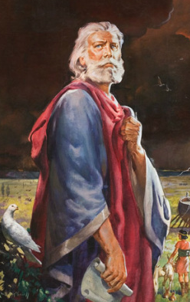
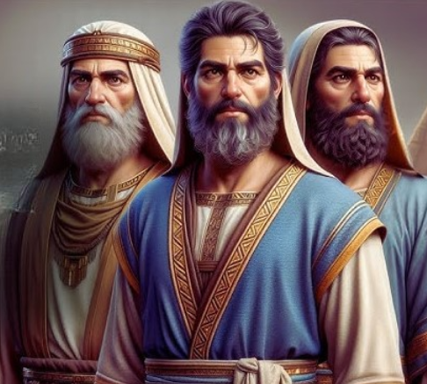
Noah
The Lord called Noah to be a prophet at a time when the people were described as “being only evil continually”
Even amid so much wickedness, Noah and his sons chose to follow Jesus Christ.
Moses 8:22

Slide 8
Living in, but not of, the world
Is it possible for an object to remain dry if it’s placed in a bucket of water?
How?
For behold, again I say unto you that if ye will enter in by the way, and receive the Holy Ghost, it will show unto you all things what ye should do. 2 Nephi 32:5
How can we remain righteous in a wicked world??
Moses 8

Slide 9
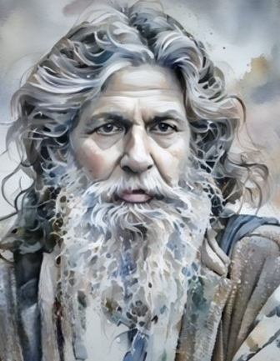
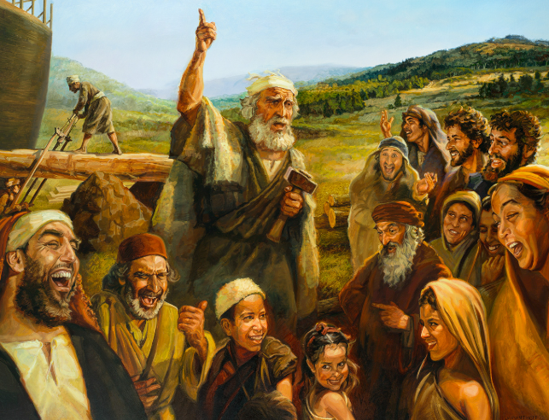
Walking With God
Methuselah, remained on the earth.
Methuselah’s grandson, Noah, and Noah’s three sons “walked with God”, while most people who remained on the earth chose wickedness.
Moses 8:2; 27

Slide 10
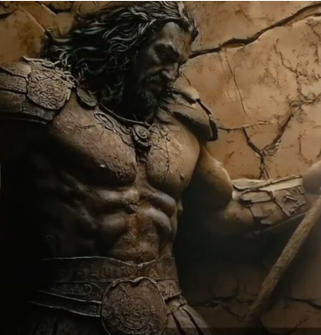
Sons of God-Daughters of Men
Giants=Nephilim
The Hebrew name for “giants” in Genesis 6:4 and Moses 8:18 is Nephilim, which comes from the verb naphal, meaning “to fall.” Therefore, these may have been people who had apostatized or fallen away from the true religion.
There were giants in the earth in those days; and also after that, when the sons of God came in unto the daughters of men, and they bare children to them, the same became mighty men which were of old, men of renown.
The Nephilim appear in only two verses of the Bible — Genesis 6:4 and Numbers 13:33
The Nephilim were mentioned as existing. But it doesn't say what or who they were. The remainder of the verse is often misinterpreted. LDS teachings say that the ancient meaning of this passage was that the “Sons of God” were men who held the priesthood and were of the true faith, but had fallen.
Genisis 6:1-4; Moses 8:18

Slide 11
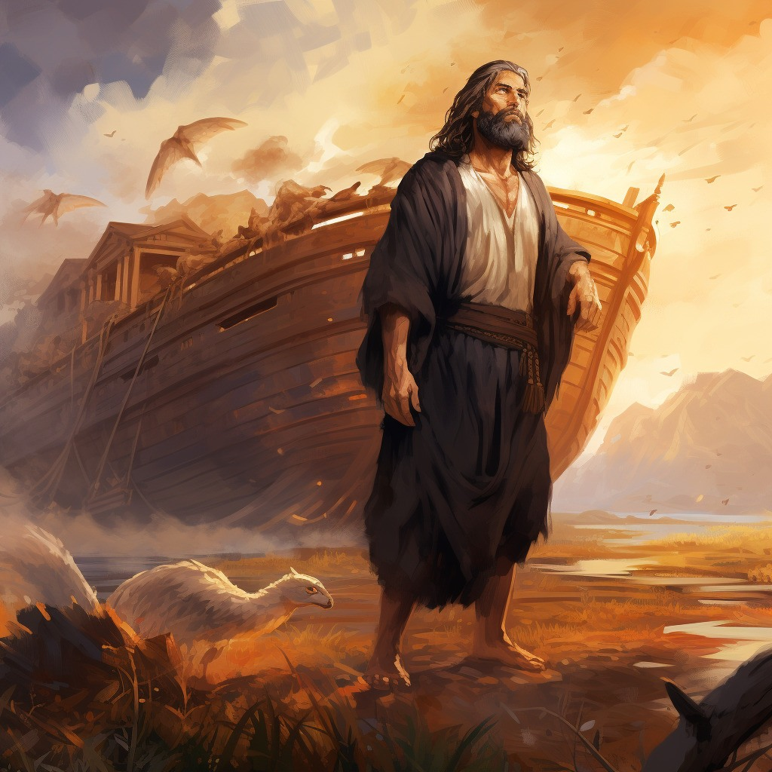
Noah Preaches in Vain
“These sins caused Noah, rather than the Lord as stated in Genesis, to repent or cry bitterly over the creation of mankind on the earth.”
The Bible says that the wickedness of man during Noah’s time “was great in the earth, and that every imagination of the thoughts of his heart was only evil continually,” that all of the earth “was corrupt before God, and the earth was filled with violence.”
How long did the Lord give them to repent?
120 Years
Moses 8:16-26; Genesis 6:5-6, 11 Joseph B. Romney

Slide 12

If People Don’t Repent
God will bring a flood of waters upon the earth to destroy all flesh
During Noah’s time the earth was completely covered with water. This was the baptism of the earth and symbolized a cleansing.
Which sometime were disobedient, when once the longsuffering of God waited in the days of Noah, while the ark was a preparing, wherein few, that is, eight souls were saved by water.
The like figure whereunto even baptism doth also now save us (not the putting away of the filth of the flesh, but the answer of a good conscience toward God,) by the resurrection of Jesus Christ: 1 Peter 3:20-21
Gensis 6:17; Moses 7:34,43,50-52; Moses 8:17, 30

Slide 13
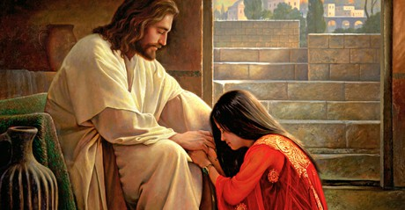
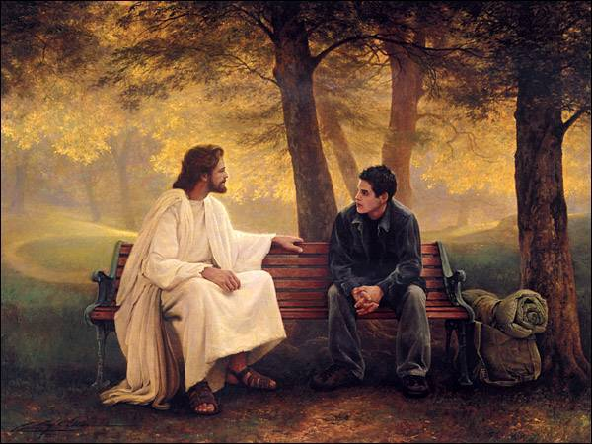


An Invitation to Repent
If we do not hearken to the Lord’s invitations to repent, then we will suffer the consequences of continuing in our sins

Slide 14
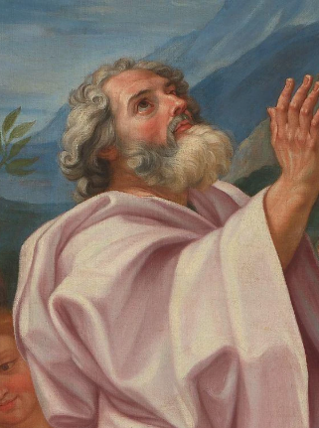
“it repented Noah, and his heart was pained”
This verse is an important and inspired correction to Genesis 6:6, which reads,
“And it repented the Lord that he had made man on the earth, and it grieved him at his heart.”
The Hebrew word used here, and translated repented in the Bible, is nacham (naw-kham), which means “to sigh,” “to be sorry,” or “to pity.”
Genesis 6:6

Slide 15

The Earth is Corrupt
He doeth not anything save it be for the benefit of the world; for he loveth the world, even that he layeth down his own life that he may draw all men unto him. Wherefore, he commandeth none that they shall not partake of his salvation.
2 Nephi 26:24
The Bible says that the wickedness of man during Noah’s time “was great in the earth, and that every imagination of the thoughts of his heart was only evil continually,” that all of the earth “was corrupt before God, and the earth was filled with violence.”
All that God does is for the benefit of His children.
Moses 8:30

Slide 16
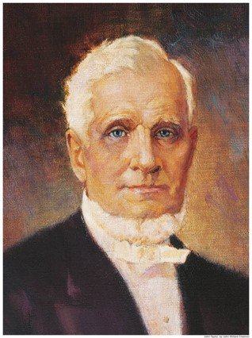
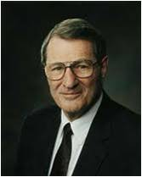
Intervention of God
“When corruption had reached an agency-destroying point that spirits could not, in justice, be sent here.”
Elder Neal A. Maxwell
“By taking away their earthly existence [God] prevented them from entailing their sins upon their posterity and degenerating [or corrupting] them, and also prevented them from committing further acts of wickedness.”
President John Taylor
Moses 8:29-30

Slide 17
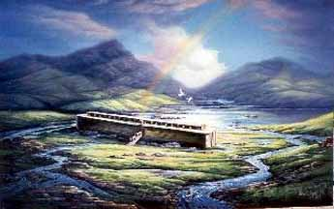
Benefit of the Flood
The Flood also benefited those who were wicked because they were brought into the spirit world, where they could eventually repent and be taught the gospel of Jesus Christ.
For Christ also hath once suffered for sins, the just for the unjust, that he might bring us to God, being put to death in the flesh, but quickened by the Spirit:
By which also he went and preached unto the spirits in prison;
Which sometime were disobedient, when once the longsuffering of God waited in the days of Noah, while the ark was a preparing, wherein few, that is, eight souls were saved by water.
1 Peter 3:18-20
Moses 8:29-30

Slide 18


In my experience, a key to survival in a wicked world is letting our friends and work associates know what we believe.
I have been protected and defended many times by friends who know I am a Latter-day Saint and know what I stand for.
Peter F. Meurs

Slide 19
Sources:
Video: “Dare to Stand Alone” (4:20)
Suggested Hymn: #266 The Time is Far Spent
See: Early Families of the Earth By Edward J. Brandt March 1973 Ensign
Old Testament Who’s Who by Ed J. Pinegar and Richard J. Allen pp 85, 66, 172
See: Noah, The Great Preacher of Righteousness By Joseph B. Romney February 1998 Ensign
Presentation by ©http://fashionsbylynda.com/blog/
Elder Neal A. Maxwell (We Will Prove Them Herewith[1982], 58).
President John Taylor (“Discourse Delivered by Pres. John Taylor,” Deseret News, Jan. 16, 1878, 787).
Peter F. Meurs (“Living Righteously in a Wicked World,” Ensign, Feb. 2018, 51)

Slide 20
Methuselah:
A careful examination of the record of the patriarchs in this section of Genesis shows that Methuselah died in the year of the Flood. Some have wondered why he was not taken on the ark with Noah and have concluded that he may have been wicked. The book of Moses, however, shows that the lineage given in this part of the record traces the righteous patriarchal line (see Moses 6:23), and Methuselah was in that line. Moses 8:3 records that Methuselah was not taken with the city of Enoch so that the line could be continued. Also, Methuselah prophesied that through his own seed would spring all nations of the earth (through the righteous Noah). Clearly, he too was righteous. Then is added this sentence: “And he took glory unto himself” (Moses 8:3). Once his work was done he may have been translated too, for during the nearly seven hundred years from the time the city of Enoch was translated until the time of the Flood the righteous Saints were translated and joined Enoch’s people (see Moses 7:27; see also McConkie, Mormon Doctrine, p. 804).
“Methuselah lived till the very year in which the flood came, of which his name is supposed to have been prophetical … methu, ‘he dieth,’ and shalach, ‘he sendeth out’; as if God had designed to teach men that as soon as Methuselah died the flood should be sent forth to drown an ungodly world. If this were then so understood, even the name of this patriarch contained in it a gracious warning.” (Clarke, Bible Commentary,1:68.)
Institute Student Manual Old Testament
Sons of God, Daughters of Men:
“Because the daughters of Noah married the sons of men contrary to the teachings of the Lord, his anger was kindled, and this offense was one cause that brought to pass the universal flood. You will see that the condition appears reversed in the Book of Moses. It was the daughters of the sons of God who were marrying the sons of men, which was displeasing unto the Lord. The fact was, as we see it revealed, that the daughters who had been born, evidently under the covenant, and were the daughters of the sons of God, that is to say of those who held the priesthood, were transgressing the commandment of the Lord and were marrying out of the Church. Thus they were cutting themselves off from the blessings of the priesthood contrary to the teachings of Noah and the will of God.” Elder Joseph Fielding Smith (Answers to Gospel Questions, 1:136–37.)
Perfect Men:
Elder Russell M. Nelson of the Quorum of the Twelve Apostles explained:
“Scriptures have described Noah, Seth, and Job as perfect men. …
“This does not mean that these people never made mistakes or never had need of correction. The process of perfection includes challenges to overcome and steps to repentance that may be very painful. …
“Mortal perfection can be achieved as we try to perform every duty, keep every law, and strive to be as perfect in our sphere as our Heavenly Father is in his. If we do the best we can, the Lord will bless us according to our deeds and the desires of our hearts” (“Perfection Pending,” Ensign, Nov. 1995, 86).
Longevity of Life:
Some have wondered why those who lived before the flood lived such long lives. “The reasons for the longevity of the Patriarchs are not made completely clear in scripture. Yet several propositions have been put forth. Some have interpreted 2 Nephi 2:21 as referring to the antediluvians [those who live before the Flood]: ‘The days of the children of men were prolonged, according to the will of God, that they might repent while in the flesh; wherefore their state became a state of probation, and their time was lengthened.’ … Others have suggested that it was righteousness that affected so profoundly the longevity of their lives. Josephus [a Jewish historian] asserted that God ‘afforded [the ancients] a longer time of life on account of their virtue …’ (Antiquities of the Jews, bk. 1, ch. 3, par. 9)” (Thomas R. Valletta, in “I Have a Question,” Ensign, Feb. 1994, 61).
For an interesting read only:
Chasing Giants https://chasingthegiants.com/every-nephilim-reference-in-the-bible-explained/

Slide 21
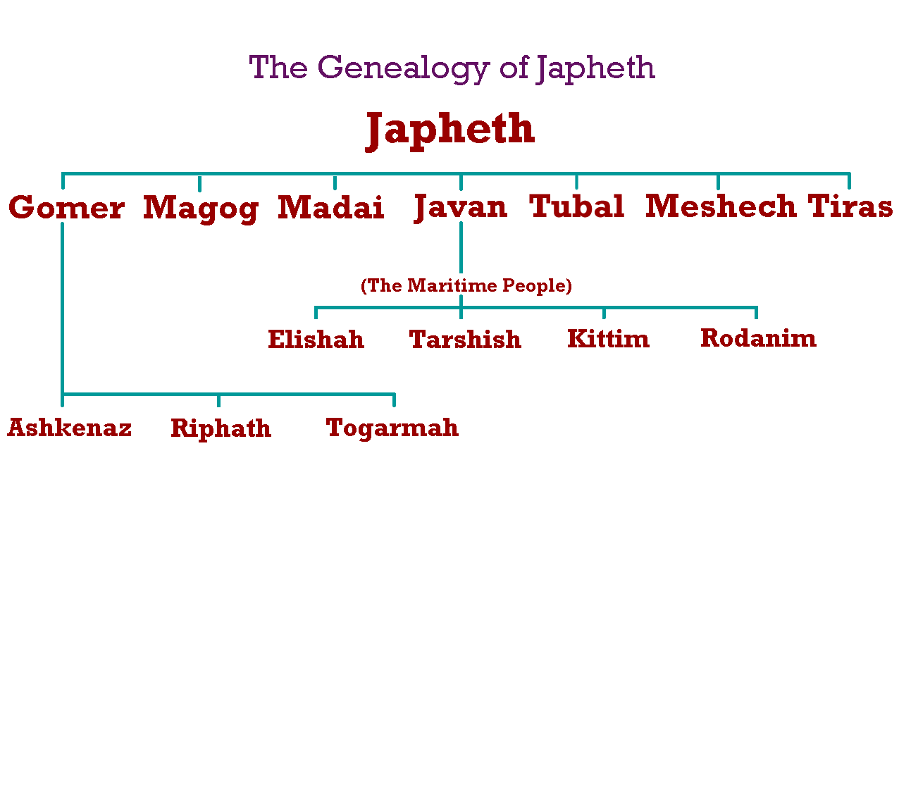

Slide 22
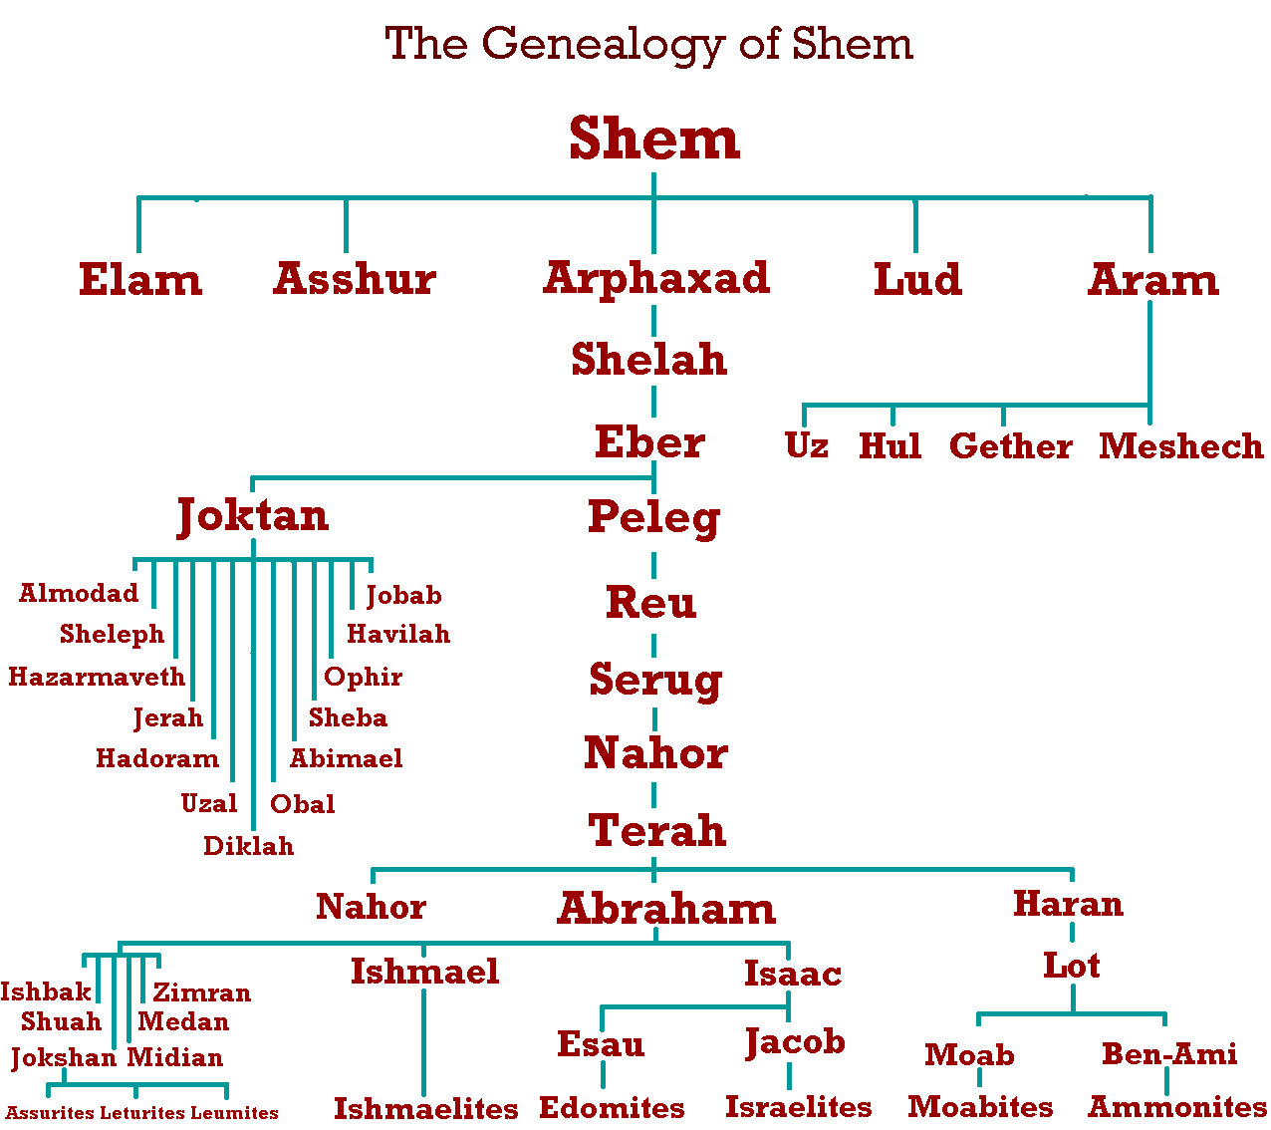

Slide 23
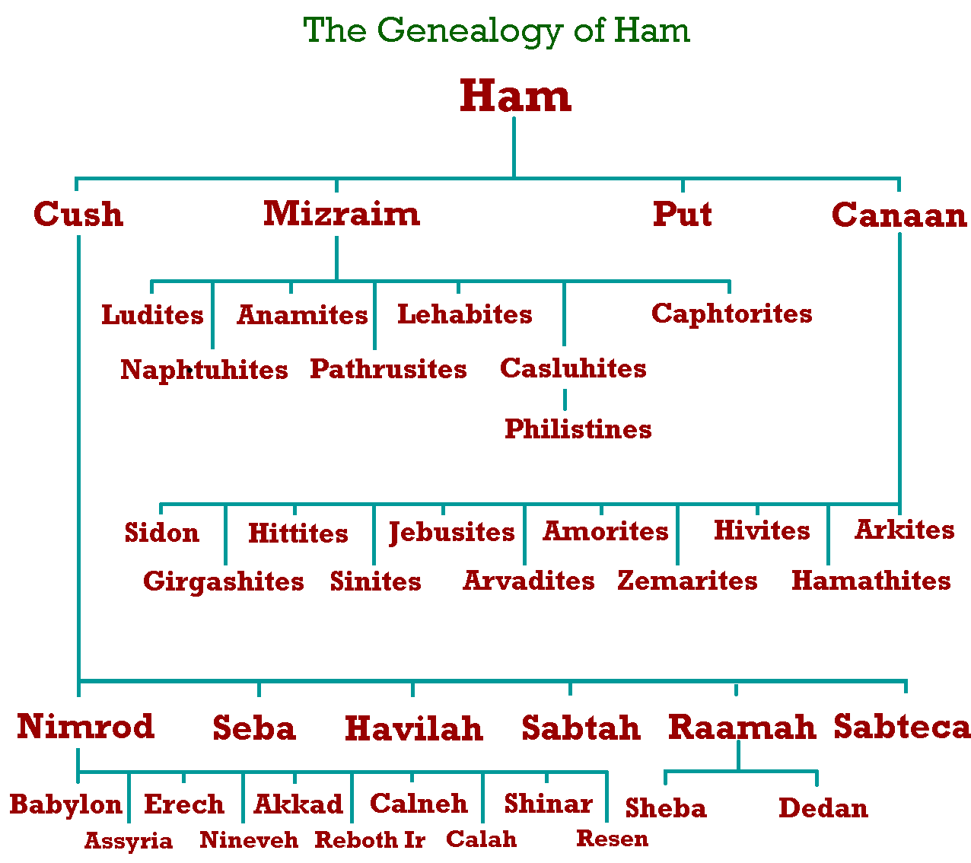

Slide 24
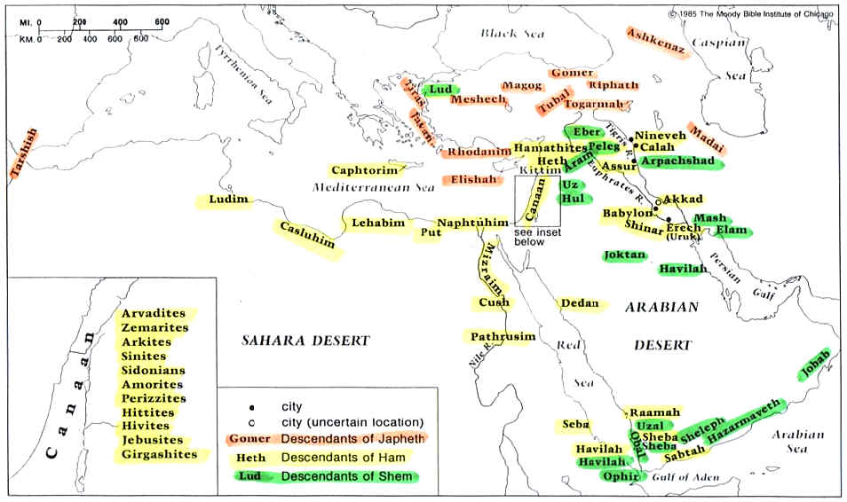
Dr. Joel Freeman http://www.freemaninstitute.com/JAFbio.htm
The following pages are only of interest…Not LDS doctrine

Slide 25
1. The Youngest Son of Noah:
The youngest son of Noah, from whom sprang the western and southwestern nations known to the Hebrews. His name first occurs in Genesis 5:32, where, as in 6:10 and elsewhere, it occupies the second place. In Genesis 9:18 Ham is described as "the father of Canaan".
2. Ham as a Nationality (30 Nations came out of Ham):
The name given, in Psalms 105:23,17; 106:22 (compare 78:51), to Egypt as a descendant of Ham, son of Noah. As Shem means "dusky," or the like, and Japheth "fair," it has been supposed that Ham meant, as is not improbable, "black." This is supported by the evidence of Hebrew and Arabic, in which the word chamam means "to be hot" and "to be black," the latter signification being derived from the former.
It is interesting to note that the Biblical record defines Egypt as the Land of Ham.
-- Psalm 105: 23 "Israel also came into Egypt...the land of Ham."
3. Meaning of the Word:
That Ham is connected with the native name of Egypt, Kem, or, in full pa ta' en Kem, "the land of Egypt," in Bashmurian Coptic Kheme, is unlikely, as this form is probably of a much later date than the composition of Gen, and, moreover, as the Arabic shows, the guttural is not a true kh, but the hard breathing h, which are both represented by the Hebrew cheth.
4. The Nations Descending from Ham:
First on the list, as being the darkest, is Cush or Ethiopia (Genesis 10:6), after which comes Mitsrayim, or Egypt, then PuT or Libyia, and Canaan last. The sons or descendants of each of these are then taken in turn, and it is noteworthy that some of them, like the Ethiopians and the Canaanites, spoke Semitic, and not Hamitic, languages--Seba (if connected with the Sabeans), Havilah (Yemen), and Sheba, whose queen visited Solomon. Professor Sayce, moreover, has pointed out that Caphtor is the original home of the Phoenicians, who spoke a Semitic language.
The explanation of this probably is that other tongues were forced upon these nationalities in consequence of their migrations, or because they fell under the dominion of nationalities alien to them. The non-Sem Babylonians, described as descendants of Nimrod (Merodach), as is well known, spoke Sumerian, and adopted Semitic Babylonian only on account of mingling with the Semites whom they found there.
Another explanation is that the nationalities described as Hamitic--a parallel to those of the Semitic section--were so called because they fell under Egyptian dominion. This would make the original Hamitic race to have been Egyptian and account for Ham as a (poetical) designation of that nationality. Professor F. L. Griffith has pointed out that the Egyptian Priapic god of Panopolis (Akhmim), sometimes called Menu, but also apparently known as Khem, may have been identified with the ancestor of the Hamitic race--he was worshipped from the coast of the Red Sea to Coptos, and must have been well known to Egypt's eastern neighbors. He regards the characteristics of Menu as being in accord with the shamelessness of Ham as recorded in Genesis 9:20.
4. Four Sons of Ham (see map below):
1. Mizraim (Egypt)
2. Cush (Sudan, Ethiopia)
3. Put (Lybia)
4. Canaan (Hivites, Jebusites, Arvadites, Girgashites, Amorites, Arkites, Sinites, Hittites,
Sidonians, Perizzites, Zemarites)
5. CURSE OF CANAAN
1. Canaan was cursed, not Ham. (Gen. 9:25, "...cursed be Canaan..."
2. Genesis 9:25-27 "...servitude to his brothers..."
3. Exodus 20:5 --" A curse lasts three to four generations..."
4. Canaan does not exist as a nation today. Other three nations exist -- Egypt, Ethiopia
and Lybia.
"Ham" actually means many or multitude -- Father of many nations

Slide 26
1. Position in Noah's Family:
His Name:
The eldest son of Noah, from whom the Jews, as well as the Semitic ("Shemitic") nations in general have descended. When giving the names of Noah's three sons, Shem is always mentioned first (Genesis 9:18; 10:1, etc.); and though "the elder" in "Shem the brother of Japheth the elder" (Genesis 10:21 margin) is explained as referring to Shem, this is not the rendering of Onkelos.
His five sons peopled the greater part of West Asia's finest tracts, from Elam on the East to the Mediterranean on the West. Though generally regarded as meaning "dusky" (compare the Assyr-Babylonian samu--also Ham--possibly = "black," Japheth, "fair"), it is considered possible that Shem may be the usual Hebrew word for "name" (shem), given him because he was the firstborn--a parallel to the Assyr-Babylonian usage, in which "son," "name" (sumu) are synonyms (W. A. Inscriptions, V, plural 23, 11,29-32abc).
2. History, and the Nations Descended from Him (26 Nations came out of Shem):
Shem, who is called "the father of all the children of Eber," was born when Noah had attained the age of 500 years (Genesis 5:32). Though married at the time of the Flood, Shem was then childless. Aided by Japheth, he covered the nakedness of their father, which Ham, the youngest brother, had revealed to them; but unlike the last, Shem and Japheth, in their filial piety, approached their father walking backward, in order not to look upon him. Two years after the Flood, Shem being then 100 years old, his son Arpachshad was born (Genesis 11:10), and was followed by further sons and daughters during the remaining 500 years which preceded Shem's death.
Noah's prophetic blessing, on awakening from his wine, may be regarded as having been fulfilled in his descendants, who occupied Syria (Aramaic), Palestine (Canaan), Chaldea (Arpachshad), Assyria (Asshur), part of Persia (Elam), and Arabia (Joktan). In the first three of these, as well as in Elam, Canaanites had settled (if not in the other districts mentioned), but Shemites ruled, at some time or other, over the Canaanites, and Canaan thus became "his servant" (Genesis 9:25,26). The tablets found in Cappadocia seem to show that Shemites (Assyrians) had settled in that district also, but this was apparently an unimportant colony. Though designated sons of Shem, some of his descendants (e.g. the Elamites) did not speak a Semitic language, while other nationalities, not his descendants (e.g. the Canaanites), did.
3. Five Sons of Shem (see map below):
1. Elam (Arabia)
2. Asshur (Assyria)
3. Lud (Lydians)
4. Aram (Aramaic, Armenia, Mesopotamia, Syria)
5. Arphaxad (From which Abraham descended)
1. Etymologies of Japheth:
This name, in Genesis 9:27, seems to be explained by the phrase "may God make wide (yapht, the American Standard Revised Version "enlarge") for Japheth," where yapht and Japheth are represented by the same consonants, but with different vowel-points. The root of yapht is pathach, "to make wide."
This etymology, however, is not universally accepted, as the word-play is so obvious, and the association of Japheth with Shem ("dark") and Ham ("black") suggests a name on similar lines--either gentilic, or descriptive of race. Japheth has therefore been explained as meaning "fair," from yaphah, the non-Sem and non-Hamitic races known to the Jews being all more or less whiteskinned. The Targum of Onkelos agrees with the English Versions of the Bible, but that of Jonathan has "God shall beautify Japheth," as though from yaphah.
2. His Descendants (14 Nations came out of Japheth):
The immediate descendants of Japheth were seven in number, and are represented by the nations designated Gomer, Magog, Madai, Javan, Tubal, Mesech, and Tiras; or, roughly, the Armenians, Lydians, Medes, Greeks, Tibarenians, and Moschians, the last, Tiras, remaining still obscure. The sons of Gomer (Ashkenaz, Riphath and Togarmah) were all settled in the West Asian tract; while the sons of Javan (Elisah, Tarshish, Kittim and Dodanim or Rodanim) occupied the Mediterranean coast and the adjacent islands.
3. His Place among the Sons of Noah:
In Genesis 9:27, as in other passages, Japheth occupies the 3rd place in the enumeration of the sons of Noah, but he is really regarded as the 2nd son, Ham being the youngest. In the genealogical table, however (Genesis 10:1), the descendants of Japheth are given first, and those of Shem last, in order to set forth Semitic affinities at greater length. Though this would seem to indicate that the fair races were the least known to the Jews, it implies that the latter were well disposed toward them, for Japheth was (ultimately) to dwell in the tents of Shem, and therefore to take part in Shem's spiritual privileges.
4. Seven Sons of Japheth (see map below):
1. Javan (Greece, Romans, Romance -- French, Italians, Spanish, Portuguese)
2. Magog (Scythians, Slavs, Russians, Bulgarians, Bohemians, Poles, Slovaks, Croatians)
3. Madai (Indians & Iranic: Medes, Persians, Afghans, Kurds)
4. Tubal (South of Black Sea)
5. Tiras (Thracians, Teutons, Germans, Scandinavian, Anglo-Saxon, Jutes)
6. Meshech (Russia)
7. Gomer (Celtic)

