Slide 1

Noah Builds An Ark
Genesis 6-9
And of every living thing of all flesh, two of every sort shalt thou bring into the ark, to keep them alive with thee; they shall be male and female.
D&C 6:19

Slide 2


Caring for Others
Imagine you are caring for a large group of young children in this campground.
What specific rules might you give the children to keep them safe?
If the children were mad at you for setting rules, what would you explain to them?
Why do you think that God wants you, personally, to keep His commandments?

Slide 3
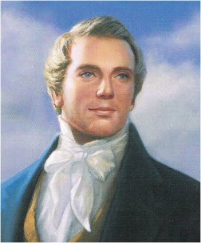
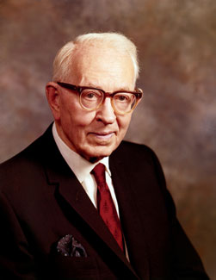
The Man Noah
“‘… Noah, who is Gabriel; he stands next in authority to Adam in the Priesthood; he was called of God to this office, and was the father of all living in his day, and to him was given the dominion. These men held keys first on earth, and then in heaven. … ’
“Luke reveals the coming of the angel Gabriel to Zacharias to inform him that his wife would bear a son. He also appeared to Mary and announced the birth of our Lord and Savior…
“Gabriel then is Noah according to this revelation.”
Genesis 6:9 Prophet Joseph Smith and Joseph Fielding Smith

Slide 4
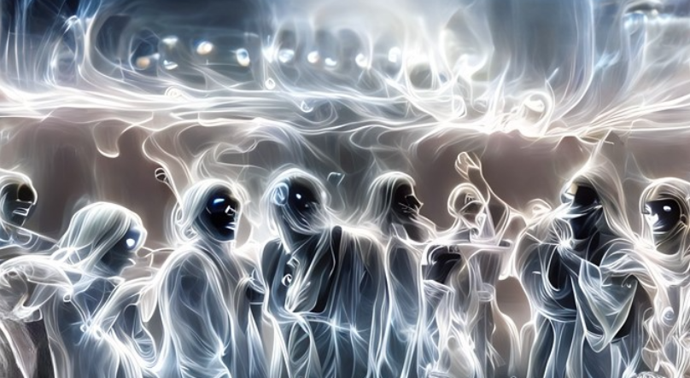
Spiritual Condition in Noah’s Day
Moses 8:17
Moses 8:20
Moses 8:22
Moses 8:28-29
The Spirit was not with them
Their hearts were hardened
Their thought were only on evil things
They were filled with corruption

Slide 5
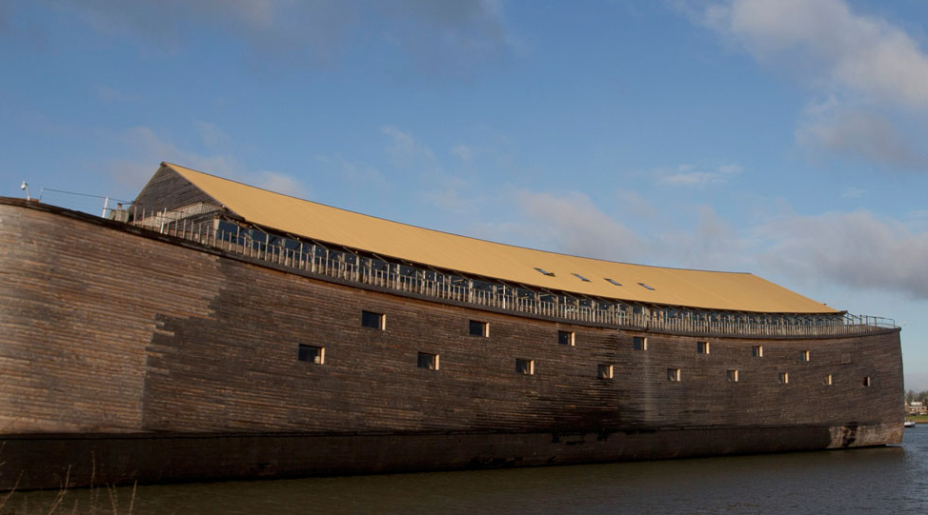
How to Build an Ark
“The ark: the Hebrew word means ‘box’ or ‘chest.’ It is used elsewhere only for the watertight ‘basket’ in which the baby Moses floated on the Nile—an interesting parallel.
“The ark is vast, designed to float, not sail—and there were no launching problems! An 18-inch cubit gives the measurements as 450 x 76 x 45 feet or 137 x 23 x 14 metres.”
Institute Manual
“pitch it” means to cover the ark with a tar-like substance to seal it and make it waterproof.
A cubit was a unit of measurement used by the Hebrews in biblical times. The measurement is based on the distance between an adult’s elbow and the tip of the longest finger.
About 450 feet long (about 138 meters), 75 feet wide (about 23 meters), and 45 feet high (about 14 meters).
Genesis 6:13-16

Slide 6
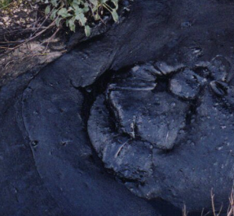
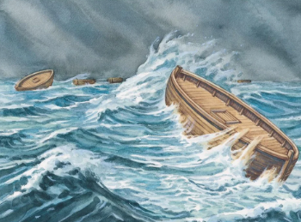
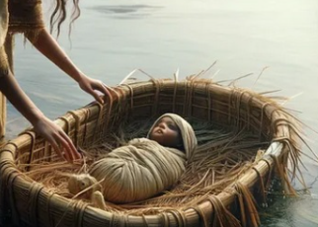
Pitch It Within and Without
Pitch is a tar-like substance used for waterproofing.
Symbolizing: protection or destruction
And when she could not longer hide him, she took for him an ark of bulrushes, and daubed it with slime and with pitch, and put the child therein; and she laid it in the flags by the river’s brink. Exodus 2:3
Tight Like Unto a Dish
Ether 2:17
Isaiah Referring to Second Coming:
And the streams thereof shall be turned into pitch, and the dust thereof into brimstone, and the land thereof shall become burning pitch. Isaiah 34:9
Genesis 6:14

Slide 7
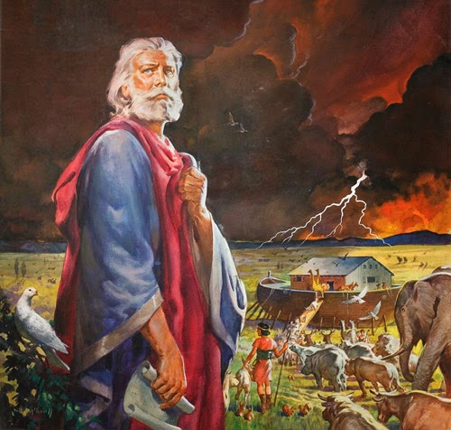

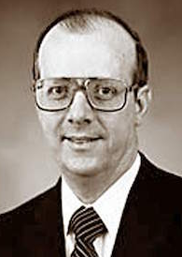
The Ark—Symbol of Refuge
“According to divine instruction, Noah prepared an ark of safety for his family. The Lord established with him and his family a covenant whereby they might enjoy the spiritual safety of the gospel and the priesthood of God.”
Pinegar and Allen
“We all need to build a personal ark, to fortify ourselves against this rising tide of evil, to protect ourselves and our families against the floodwaters of iniquity around us. And we shouldn’t wait until it starts raining but prepare in advance.”
W. Don Ladd
Genesis 6:18

Slide 8
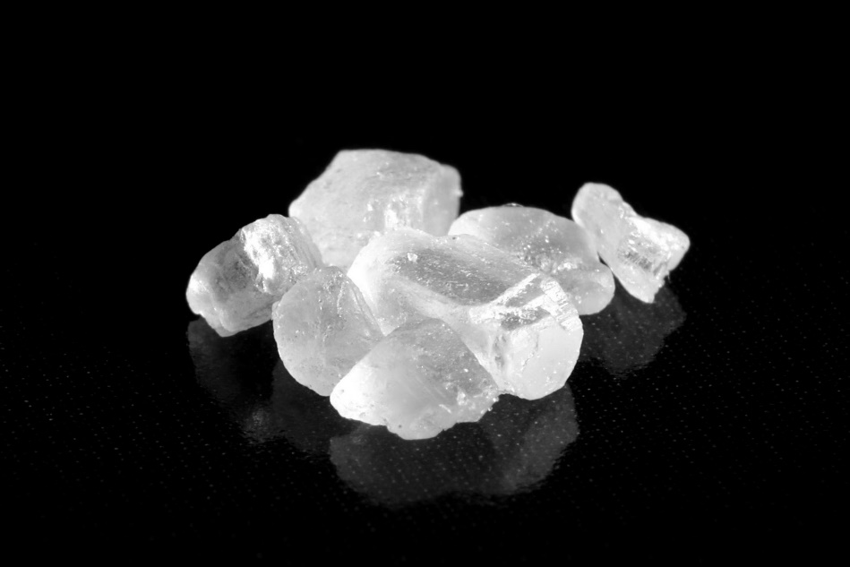
The Window
The word window was translated from the Hebrew word tsohar. Some rabbis believed that this word referred to “a precious stone that shone in the ark”
Compare this to the experience of the Jaredites, who later traveled across the ocean in barges lit by stones that shone in the dark
These are not the exact stones
tzohar to be a kind of luminous gemstone holding the primordial light of creation.
Genesis 6:16

Slide 9
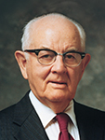
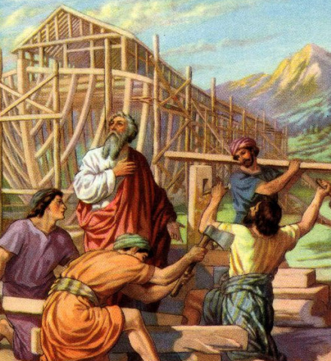
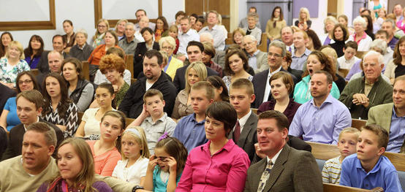
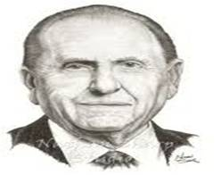
Trials
“As yet there was no evidence of rain and flood. His people mocked and called him a fool. His preaching fell on deaf ears. His warnings were considered irrational. There was no precedent; never had it been known that a deluge [or flood] could cover the earth. How foolish to build an ark on dry ground with the sun shining and life moving forward as usual!”
President Spencer W. Kimball
“Noah had the unwavering faith to follow God’s commandments. May we ever do likewise. May we remember that the wisdom of God oft times appears as foolishness to men; but the greatest lesson we can learn in mortality is that when God speaks and we obey, we will always be right.”
President Thomas S. Monson
Genesis 6:17-22

Slide 10
True or False
T
1. ____ Noah took seven of some animals on the ark.
2. ____ Noah was 60 years old when the Flood came.
3. ____ Rain was the only source of water that flooded the earth.
4. ____ The rain did not cease for forty days.
5. ____ Eight people were saved on the ark.
6. ____ In addition to Noah’s family and the animals on the ark, one other family also survived the Flood by staying on the top of a mountain.
F
F
T
T
F
Genesis 6:17-22

Slide 11
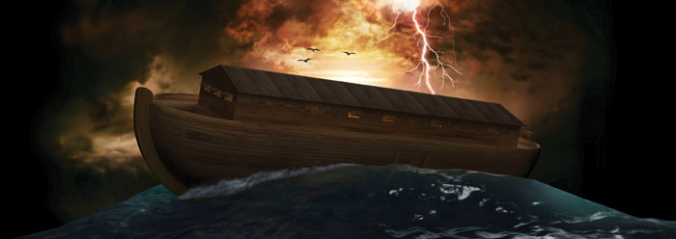
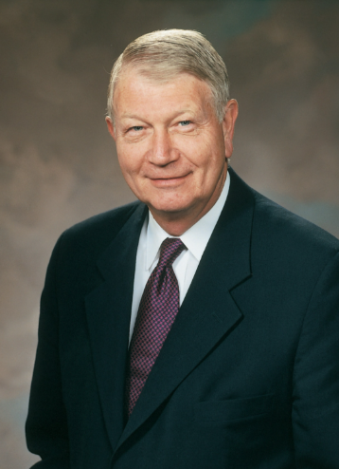
Receiving Blessings For Obedience
“Because of the conflicts and challenges we face in today’s world, I wish to suggest a single choice—a choice of peace and protection and a choice that is appropriate for all. That choice is faith…”
As we obey the Lord in faith, He will bless and protect us.
“Choose faith over doubt, choose faith over fear, choose faith over the unknown and the unseen, and choose faith over pessimism…”
“…Yes, faith is a choice, and it must be sought after and developed. Thus, we are responsible for our own faith. We are also responsible for our lack of faith. The choice is yours.”
Genesis 6:17-22 Elder Richard C. Edgley

Slide 12
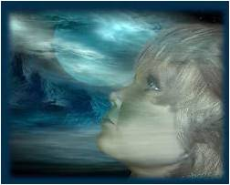
Because of Faith
Can you activate the power of the priesthood that you hold and be a partaker of the sweetness of the gospel and embrace the saving ordinances?
Can you work through the struggles and difficulties in life with peace and assurance?
Can you turn questions and even doubts into assurances and understanding?
Can you approach the unknown, unseen, and unexplained with unquestioning assurance?
In the seemingly worst of times, can you recognize with peace and gratitude that it is in reality the best of times?
Genesis 6:17-22 Adapted from Elder Richard C. Edgley’s talk

Slide 13
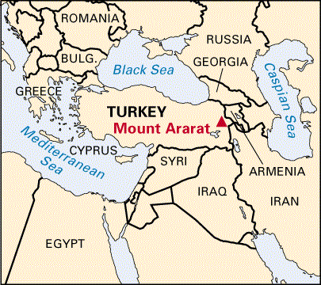
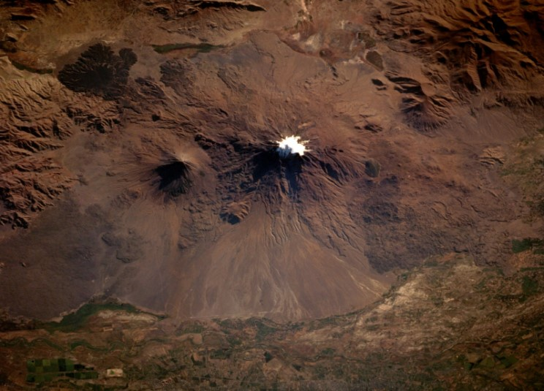
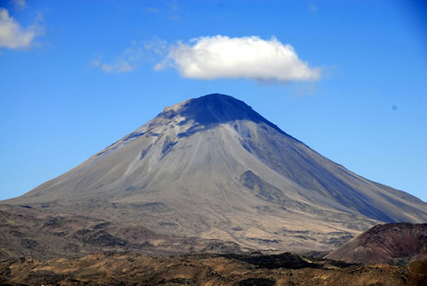
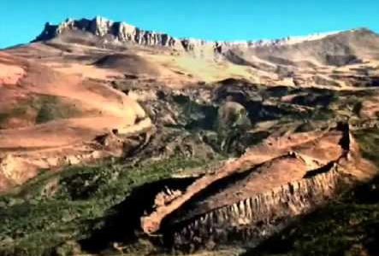
The Landing
It should be remembered that the Garden of Eden was in the land now known as North America.
Although it is not known how far men had moved from that general location in the sixteen hundred years between the fall of Adam and the Flood, it is likely that Noah and his family lived somewhere in the general area.
The Bible says that they landed on Mount Ararat when the ark finally came to rest.
No location for Mount Ararat is given in the scriptures.
The traditional site is a mountain found in northeastern Turkey near the border of Russia.
Mt. Ararat from space shuttle 1994
Genesis 8:4 Institute Manual (4-17)

Slide 14
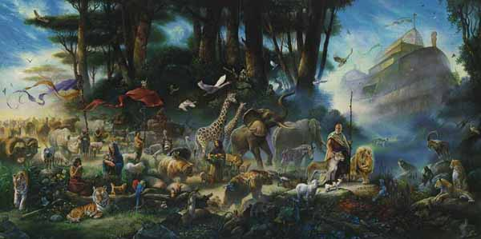
Noah and Family Exit the Ark
After Noah and his family had been on the ark for about a year, God directed them to exit the ark.
And Noah builded an altar unto the Lord, and took of every clean beast, and of every clean fowl, and offered burnt offerings on the altar; and gave thanks unto the Lord, and rejoiced in his heart.
JST Genesis 9:4
The Lord commanded Noah and his family to multiply and replenish the earth, instructed them on how to treat living things, and commanded them not to shed man’s blood (murder).
Genesis 8:20

Slide 15
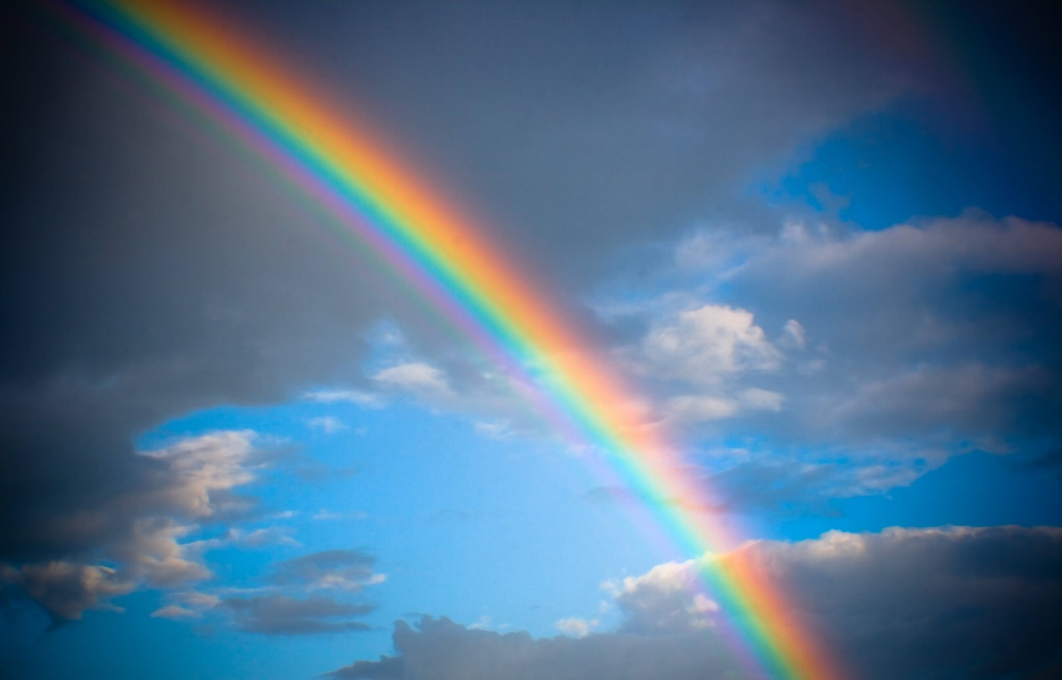
The Covenant
The rainbow is a token, or sign, of the everlasting covenant—a reminder of God’s promises, including to never flood the earth again.
This token or sign had first been given to Enoch, and now the covenant and token were renewed with Noah.
God uses tokens as reminders of covenants.
Genesis 9:9-17

Slide 16
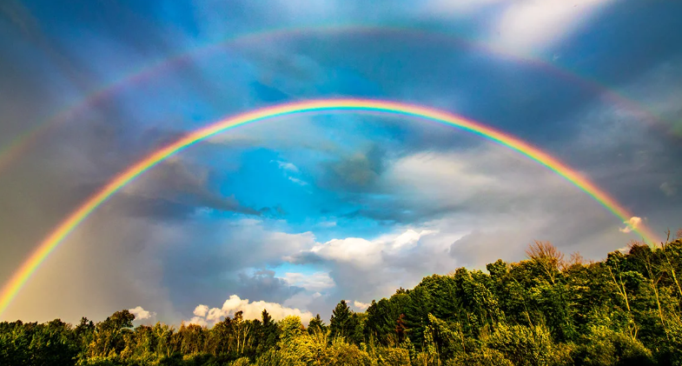

The Rainbow
We do not know if this was the first rainbow Noah saw, causing some to believe that the earth was covered by clouds from the fall of Adam down to the flood, or if this was just a reminder that when it rains the earth is cleansed as a symbolic reminder of our baptism and our covenants with Heavenly Father.
Something of interest:
If there are two rainbows together, they reflect their image…
Starting with the bottom rainbow from top down: Red, Orange, Yellow, Green, Blue, Indigo and Violet.
Starting with the top rainbow: Violet, Indigo, Blue, Green, Yellow, Orange, Red.
Genesis 9:9-17

Slide 17
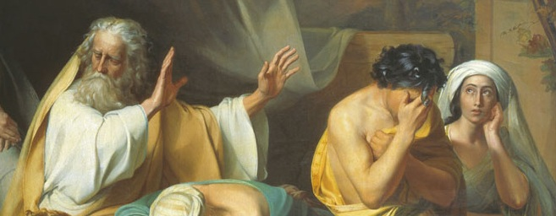
The Curse of Ham
It appears that Ham disrespected something sacred. Even though we know that Ham’s actions were deliberate and the consequences were severe, we likely do not have all of the relevant details of the story.
We therefore do
not know exactly what
happened or the meaning of
what transpired.
Genesis 9:19-29

Slide 18
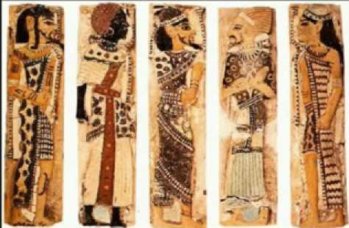
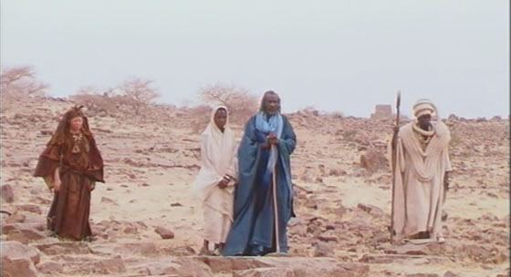
Condemn All Racism
Our understanding of the events in Genesis 9:18–27 is limited.
Although we know that Ham’s actions were deliberate and the consequences were severe, some have incorrectly used Noah’s cursing of his grandson Canaan recorded in Genesis 9:25–27 to justify slavery—particularly of people of black African descent.
“It is not right that any man should be in bondage one to another” (D&C 101:79).
Any theories suggested in the past that black skin is a curse or an indication of unworthiness in a premortal life; that mixed-race relationships are a sin; or that people of any race or ethnicity are inferior to anyone else are not true doctrine.
Church leaders today unequivocally condemn all racism, past and present, in any form.
Genesis 9:18-27

Slide 19
Sources:
Joseph Smith [Smith, Teachings, pp. 157–58.]
Joseph Fielding Smith, Answers to Gospel Questions, 3:138–41.)
Institute Manual (Alexander and Alexander, eds., Eerdmans’ Handbook to the Bible, p. 132.)
Latter-Day Commentary on the Old Testament by Ed J. Pinegar and Richard J. Allen
W. Don Ladd “Make Thee an Ark” Oct. 1994 Gen. Conf.
Presentation by http://fashionsbylynda.com/blog/
President Spencer W. Kimball (Teachings of Presidents of the Church: Spencer W. Kimball [2006], 140–41).
President Thomas S. Monson (“Models to Follow,” Ensign, Nov. 2002, 61).
Elder Richard C. Edgley Faith—the Choice is Yours Oct. 2010 Gen. Conf.
Ancient Lands: A Photo Essay September 1980 Ensign Article

Slide 20
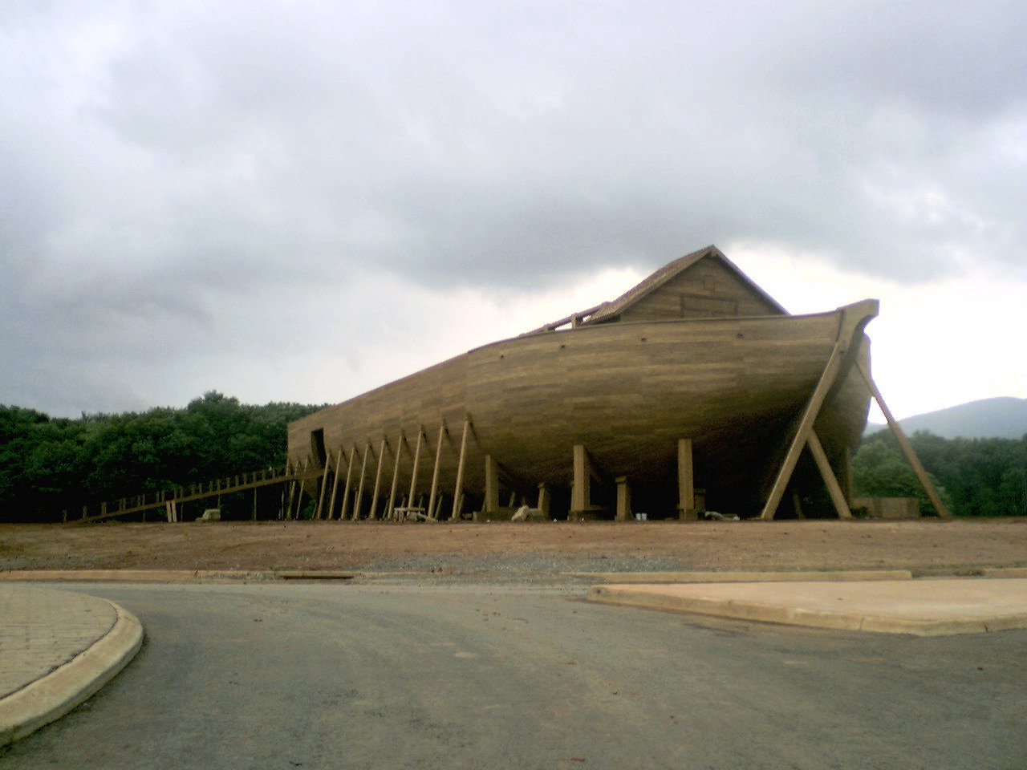
Something of Interest
Evan Almighty Ark:
Construction of the ark began in January 2006 and the scenes involving the ark were shot in a Crozet, Virginia subdivision called Old Trail.[The ark was designed to meet the actual measurements of the biblical ark, measuring 450 feet (140 m) long, 80 feet (24 m) wide, and 51 feet (16 m) high. The ark's layout was also based on pictures in several children's books that crew members had read in their childhoods. When the characters were filmed during the day building the ark or were on location elsewhere, crew members would further construct the ark at night. A concrete base was built to support the weight of the large ark; after filming was completed, the ark was taken down in a week, and the base in another week

Slide 21
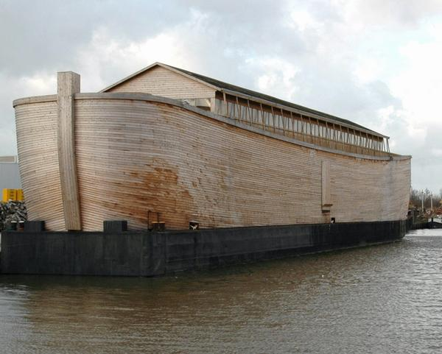
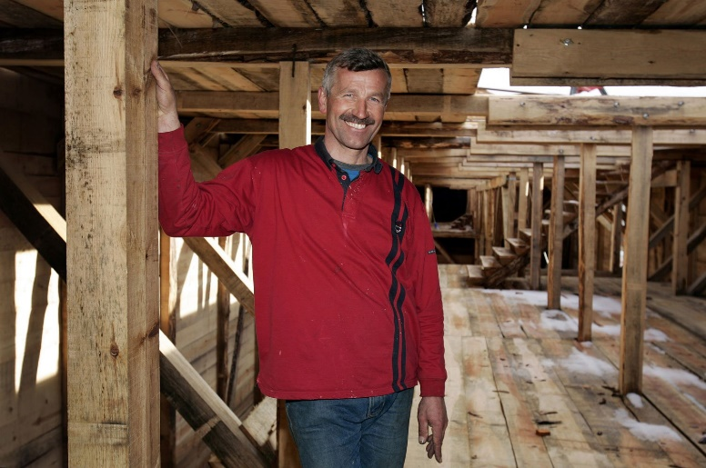
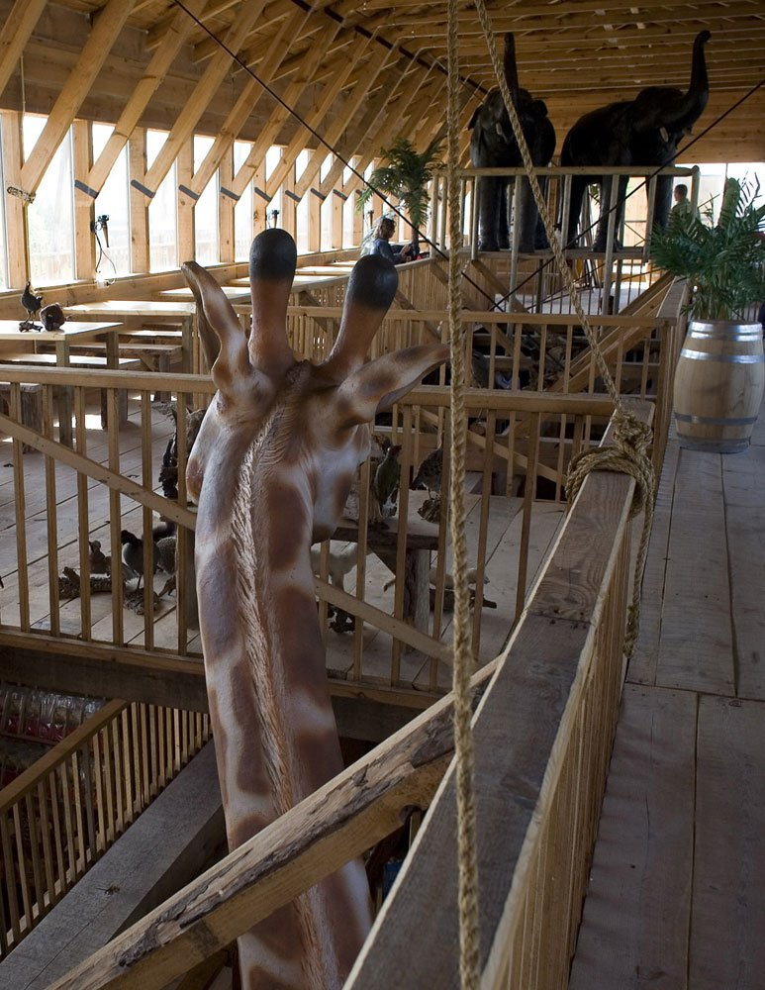
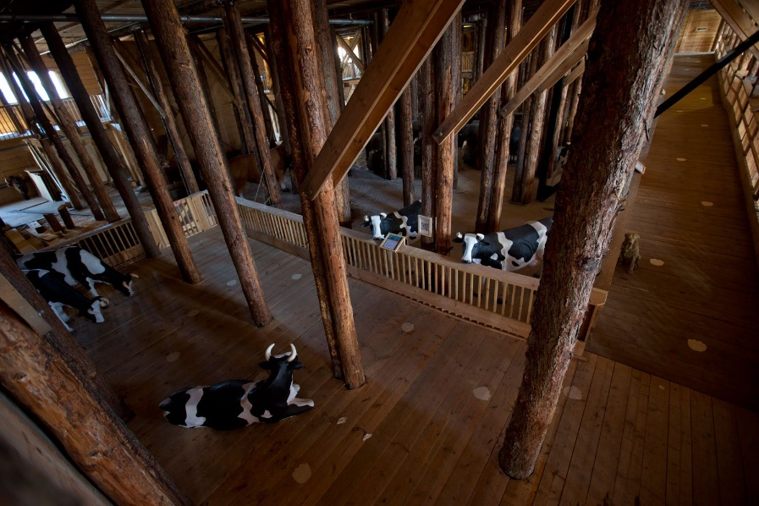
One Dutch man, Johan Huibers, created an ark based on the Biblical proportions Noah used in the oft-recounted story.
“The drawings, the blueprints are in the Bible,” Huibers explained when discussing the mammoth structure he sought to create. This ark, which he began building in 2008, is not his first. In 2004, he completed a half-scale model that was used for tourists.
Huibers completed his ark and opened it to the public as a museum in 2012. “We wanted to build something that can help explain the Bible in real terms.”
This massive undertaking began by welding together metal hulls from 25 barges to create the frame. Then, Huibers and his team covered the boat with wood, adhering to the guidelines laid out for him in the Bible: 300 cubits long (about 450 feet), 50 cubits wide (about 70 feet), and 30 cubits high (about 45 feet ).
And since no ark would be complete without animals, Huibers has been filling his according to the Bible’s recommendation–two by two. “We get the animals for free, people bring them here,” Huibers said. But the animals that aren’t donated? They’re plastic or stuffed replicas of the real thing.
Huibers is hoping to have his ark set sail for the United States “sometime early next year,” although it likely won’t make the trip by see–at least not by itself. Huibers revealed that his creation would likely “sink like a stone” if it tried to cross the Atlantic.
By ASHLEIGH SCHMITZ

Slide 22
Is it too late?
Unfortunately, we don’t always heed the clear warnings of our prophets. We coast complacently along until calamity strikes, and then we panic.
When it starts raining, it is too late to begin building the ark. However, we do need to listen to the Lord’s spokesmen. We need to calmly continue to move ahead and to prepare for what will surely come. We need not panic or fear, for if we are prepared, spiritually and temporally, we and our families will survive any flood. Our arks will float on a sea of faith if our works have been steadily and surely preparing for the future.
W. Don Ladd “Make Thee an Ark” Oct. 1994 Gen. Conf.
“The ark: the Hebrew word means ‘box’ or ‘chest.’ It is used elsewhere only for the watertight ‘basket’ in which the baby Moses floated on the Nile—an interesting parallel.
“The ark is vast, designed to float, not sail—and there were no launching problems! An 18-inch cubit gives the measurements as 450 x 76 x 45 feet or 137 x 23 x 14 metres.” (Alexander and Alexander, eds., Eerdmans’ Handbook to the Bible, p. 132.)
Institute Manual

Slide 23
Because of My Faith:
Because of my faith I have activated the power of the priesthood that I hold and have been a partaker of the sweetness of the gospel and have embraced the saving ordinances.
Because of my faith I work through the struggles and difficulties in life with peace and assurance.
Because of my faith I have been able to turn questions and even doubts into assurances and understanding.
Because of my faith I approach the unknown, unseen, and unexplained with unquestioning assurance.
And because of my faith—even in the seemingly worst of times—I recognize with peace and gratitude that in reality it is the best of times.
Elder Richard C. Edgley
Tzohar
by Rabbi Geoffrey W. Dennis
A luminous gemstone holding the primordial light of creation. Those who possessed it not only had illumination, but access to the secrets of the Torah and all its powers. God created it, but then hid it away for the sole use of the righteous. The angel Raziel gave it to Adam after the Fall. Adam gave to his children. Noah used it to illumine the Ark (Gen. 6:16). Abraham possessed this stone, and used it heal all who came to him. According to one legend, he returned to heaven and hung it on the sun. But other traditions track its continued use by the righteous of each generation. Joseph used it for his dream interpretations. Moses recovered it from the Bone of Joseph and placed it in the Tabernacle. Zohar claims that Ben Yochai possessed it in the Rabbinic era (B. B. 16b; Lev. R. 11; Gen. R 31:11; Zohar I:11; Otzer ha-Midrash).
This window, Tzohar in Hebrew, was a means of maintaining contact with the outside world, while protecting those within.
Symbolism of Baptism:
The Flood, like baptism, represented a new beginning for the earth. Elder John A. Widtsoe of the Quorum of the Twelve Apostles taught:
“Latter-day Saints look upon the earth as a living organism, one which is gloriously filling ‘the measure of its creation.’ They look upon the flood as a baptism of the earth, symbolizing a cleansing of the impurities of the past, and the beginning of a new life” (Evidences and Reconciliations, arr. G. Homer Durham, 3 vols. in 1 [1960], 127).

Slide 24
How Could the Flood Cover the Whole Earth?
“I would like to know by what known law the immersion of the globe could be accomplished. It is explained here in a few words: ‘The windows of heaven were opened’ that is, the waters that exist throughout the space surrounding the earth from whence come these clouds from which the rain descends. That was one cause. Another cause was ‘the fountains of the great deep were broken up’—that is something beyond the oceans, something outside of the seas, some reservoirs of which we have no knowledge, were made to contribute to this event, and the waters were let loose by the hand and by the power of God; for God said He would bring a flood upon the earth and He brought it, but He had to let loose the fountains of the great deep, and pour out the waters from there, and when the flood commenced to subside, we are told ‘that the fountains also of the deep and the windows of heaven were stopped, and the rain from heaven was restrained, and the waters returned from off the earth.’ Where did they go to?
From whence they came. Now, I will show you something else on the back of that. Some people talk very philosophically about tidal waves coming along. But the question is—How could you get a tidal wave out of the Pacific ocean, say, to cover the Sierra Nevadas? But the Bible does not tell us it was a tidal wave. It simply tells that ‘all the high hills that were under the whole heaven were covered. Fifteen cubits upwards did the waters prevail; and the mountains were covered.’ That is, the earth was immersed. It was a period of baptism.” (John Taylor, in Journal of Discourses, 26:74–75.)
Lack of a Rainbow:
“I have asked of the Lord concerning His coming; and while asking the Lord, He gave a sign and said, ‘In the days of Noah I set a bow in the heavens as a sign and token that in any year that the bow should be seen the Lord would not come; but there should be seed time and harvest during that year: but whenever you see the bow withdrawn, it shall be a token that there shall be famine, pestilence, and great distress among the nations, and that the coming of the Messiah is not far distant’” (Smith, Teachings, pp. 340–41).
Rainbows are caused when rays of light from the Sun hit water droplets which reflect some of the light back towards an observer. The water droplets are usually raindrops, but could also be water spray from a waterfall, a fountain, or even fog.
To be able to see a rainbow, you must have the Sun shining behind you and the water droplets in front of you.
It was the Greek philosopher Aristotle who first started contemplating rainbows and their colours, back in 350 BC.
Throughout the ages, thinkers, philosophers and naturalists examined the phenomenon of the rainbow effect, noting its appearance not just in the sky but in other circumstances too. In all of these cases two elements were essential for the characteristic burst of “rainbow” colour - water vapour or droplets and sunlight.
Our modern understanding of light and colour comes from Isaac Newton (1642-1726). He proved that white light is made up of a spectrum of colours by splitting light with a prism. His discovery, together with the work of others before him, finally explained how rainbows are formed.
The colours of a rainbow are a spectrum - rather than separate standalone colours.
Newton thought it would be easier to discuss the structure of a spectrum (or rainbow), if it was broken down into simplified sections.
He also noted that the sequence of colours in a rainbow never changes, they always appear in the same order. It was Newton who coined the idea that there are seven identifiable colours in a spectrum (and rainbow).
Those colours are Red, Orange, Yellow, Green, Blue, Indigo and Violet.
The idea that there are seven colours in a rainbow remains today. You may think this is the case - but on closer inspection you will see that there are many more hues of colour than seven.
The colours of a rainbow are not a pure spectrum - it is actually made up of a multitude of individual spectral colours that have overlapped and mixed.
https://www.megainteresting.com/nature/questions-answers/how-many-colours-are-in-a-rainbow-341585741669
Orson Pratt declared:
“The first ordinance instituted for the cleansing of the earth, was that of immersion in water; it was buried in the liquid element, and all things sinful upon the face of the earth were washed away. As it came forth from the ocean floor, like the new-born child, it was innocent; it rose to newness of life. It was its second birth from the womb of mighty waters—a new world issuing from the ruins of the old, clothed with all the innocence of this first creation.” (In Smith, Answers to Gospel Questions,4:20.)
“The earth, in its present condition and situation, is not a fit habitation for the sanctified; but it abides the law of its creation, has been baptized with water, will be baptized by fire and the Holy Ghost, and by-and-by will be prepared for the faithful to dwell upon” (Brigham Young, in Smith, Answers to Gospel Questions, 4:20).
Mt. Ararat:
Elder Joseph Fielding Smith said:
“We read that it was in the seventeenth day of the second month when the great deep was broken up, and the rain was forty days. The Ark landed at Ararat on the seventeenth day of the seventh month, therefore there were five full months of travel when the Lord drove the Ark to its final destiny. Without any question a considerable distance separated the point where the Ark commenced the journey and where it landed. There can be no question to contradict the fact that during the flood great changes were made on the face of the earth. The land surface was in the process of division into continents. The rivers mentioned in Genesis were rivers that existed in the garden of Eden long before the land was divided into continents and islands. [Genesis 2:11]” (Answers to Gospel Questions, 2:94.)

Slide 25
Something of Interest
Nakedness:
Most members of the Church are aware that a priesthood garment, symbolic of the covenants made in the temple, is worn by those who have participated in the endowment ceremony in the temple. This garment is a representation of the coat of skins made by the Lord for Adam and Eve after the Fall.
The idea of a garment made of skins that signified that one had power in the priesthood is found in several ancient writings. Hugh Nibley discussed some of these ancient writings and their implications for the passage in Genesis.
Nimrod claimed he was in possession of the “garment of Adam” He was the grandson of Ham. (The Talmud)
The Apocryphal writers, Jewish and Christian, have a good deal to say about this garment.
To quote one of them: ‘the garments of skin which God made for Adam and his wife when they went out of the garden and were given after the death of Adam … to Enoch’; hence they passed to Methuselah, and then to Noah, from whom Ham stole them as the people were leaving the ark. Ham’s grandson Nimrod obtained them from his father Cush. As for the legitimate inheritance of this clothing, a very old fragment recently discovered says that Michael ‘disrobed Enoch of his earthly garments, and put on him his angelic clothing,’ taking him into the presence of God. …
Institute Student Manual
The Rainbow: Torah
When you think about the hallmarks of Parshat Noach, an image that instantly
comes to mind is the rainbow. In Parshat Noach, the rainbow is a sign that Hashem has made a promise that he will never destroy the Earth via the means He used in Noach’s time. The covenant itself seems sensible but a question that comes to mind is what is the nature of the rainbow? Why did Hashem choose a rainbow and not some vast miracle? And why has the rainbow taken on such significance?
In Beraishit 9:13-16, it is written, “I have set My bow in the cloud, and it shall be for a token of a covenant between Me and the earth. And it shall come to pass, when I bring clouds over the earth…I will remember My covenant…and the waters shall no more become a flood to destroy all flesh. And the bow shall be in the cloud; and I will look upon it, that I may remember the everlasting covenant…” Hashem mentions the word “cloud” three times in this passage describing His transaction with Noach. What is the purpose of stressing clouds? According to the Ramban in Braishit 1:9, the rainbow was created during the days of creation but had not yet been seen in cloudy weather. When Hashem presented Noach with the covenant, He formed a rainbow in the clouds for the first time.
This answers the question as to why Hashem chose a rainbow over what we would think of as an outward miracle. Hashem’s presentation of the rainbow was miraculous in its own subtle way. He was making something appear in a way that Noach was unaccustomed to. So too, Hashem was making a statement that Noach was unaccustomed to. Noach had only seen Hashem’s harsh side up until now. He had seen the earth destroyed and was now witnessing, for the first time, Hashem’s mercy. The new rainbow, the one that appears even in cloudy times, represents Hashem’s new, unconditional promise to Noach and his children. Even in cloudy times, Hashem will remember the rainbow and His promise.
Now that we understand why Hashem chose a rainbow, it’s important to understand why the rainbow is significant. A Mishnah in Pirkei Avot states that there are ten things that were created on twilight of the sixth day. Included in this list is the rainbow. It’s interesting that the Mishna suggests that a rainbow is a creation in of itself. Scientifically, a rainbow is simply a natural result of the division of white light into its colors, not its own entity. The Torah shows us that the rainbow is in fact its own “being.” Hashem says in Braishit 9:13, “I have set My bow in the cloud.” The implication here is that the rainbow is Hashem’s own special creation and has intrinsic value as such. Looking at the rainbow as a creation instead of just a side effect, it helps us realize its significance. Perhaps, the next time you see a rainbow, you will be reminded of the importance of Hashem’s promises that He keeps for eternity.
written by Elana Forman
Stolen Garment?---Hugh Nibley
“Incidentally the story of the stolen garment as told by the rabbis, including the great Eleazer, calls for an entirely different rendering of the strange story in Genesis [9] from the version in our King James Bible. They seemed to think that the ’erwath of Genesis [9:22] did not mean ‘nakedness’ at all, but should be given its primary root meaning of ‘skin covering.’ Read thus, we are to understand that Ham took the garment of his father while he was sleeping and showed it to his brethren, Shem and Japheth, who took a pattern or copy of it (salmah) or else a woven garment like it(simlah) which they put upon their own shoulders, returning the skin garment to their father. Upon awaking, Noah recognized the priesthood of two sons but cursed the son who tried to rob him of his garment. Therefore, although Ham himself had the right to the priesthood, Canaan, his son, did not. Ham had married Egyptus, a descendant of Cain (Abraham 1:21–24), and so his sons were denied the priesthood.”
Hugh Nibley(Lehi in the Desert and the World of Jaredites,pp. 160–62.)
Institute Student Manual (4-20)

