Slide 1

Abrahamic Covenant
Abraham 2
Genesis 12
And it shall come to pass that my people, which are of the house of Israel, shall be gathered home unto the lands of their possessions; and my word also shall be gathered in one. And I will show unto them that fight against my word and against my people, who are of the house of Israel, that I am God, and that I covenanted with Abraham that I would remember his seed forever.
2 Nephi 29:14

Slide 2


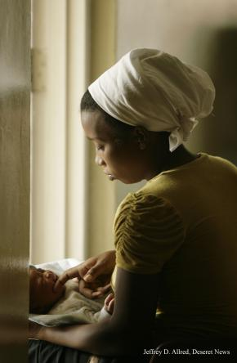
Who Are You?
“You may enjoy music, athletics, or be mechanically inclined, and someday you may work in a trade or a profession or in the arts. As important as such activities and occupations can be, they do not define who we are.
First and foremost, we are spiritual beings.
We are sons [and daughters] of
__________
and the seed of _______________________.”
God
Abraham
(Elder David A. Bednar)

Slide 3
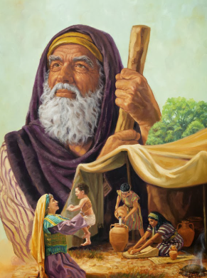
What is the Abrahamic Covenant?
Abraham desired “the blessings of the fathers” and to be a “follower of righteousness”
Abraham made covenants with God when he received the gospel, when he was ordained a high priest, and when he entered into celestial marriage. In these covenants, God promised great blessings to Abraham and his family. These blessings, which extend to all of Abraham’s seed, are called the Abrahamic covenant.
Among the promises made to Abraham were the following:
His posterity would be numerous.
His seed, or descendants, would receive the gospel and bear the priesthood.
Through the ministry of his seed, “all the families of the earth [would] be blessed, even with the blessings of the Gospel, which are the blessings of salvation, even of life eternal.”
A person can receive all the blessings of the Abrahamic covenant—even if he or she is not a literal descendant of Abraham—by obeying the laws and ordinances of the gospel.
^{Topics and Questions}
Abraham 1:2, 18

Slide 4
The Abrahamic Covenant
Responsibilities
Blessings
Be a minister of Jesus Christ
Hearken to the Lord’s voice
Receive land for an everlasting possession.
Abraham 2:6

Slide 5
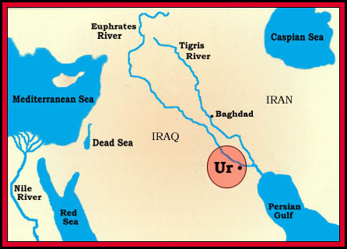
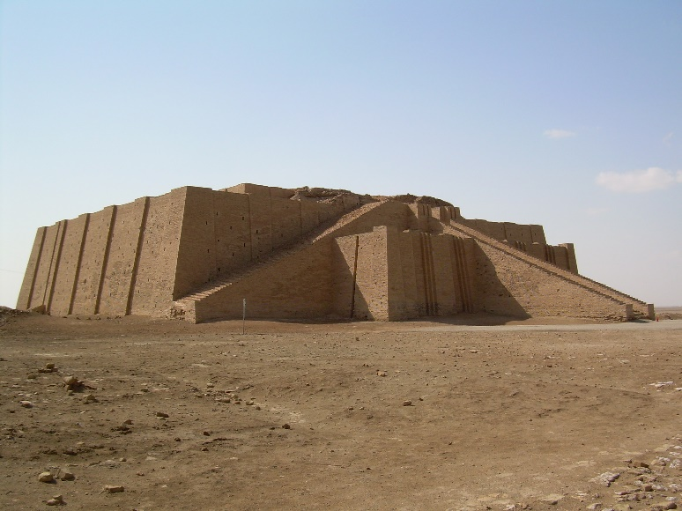
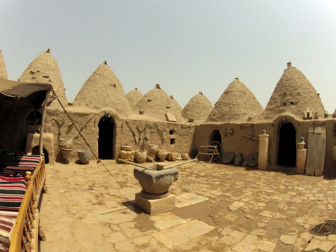
Abraham Moves
Ur First residence of Abraham, near the mouth of the Euphrates, where he was almost a victim of
human sacrifice, saw the
angel of Jehovah, and
received the Urim and
Thummim.
Haran
Canaan
Ur
Haran Abraham settled here for a time before going to Canaan. Abraham’s father and brother remained here. Rebekah (Isaac’s wife), and Rachel, Leah, Bilhah, and Zilpah (Jacob’s wives), came from this area.
Canaan Abraham, Isaac, Jacob, and their descendants were given this land for an everlasting possession.
Haran
Abraham 2:1-5
(Bible maps 9)

Slide 6

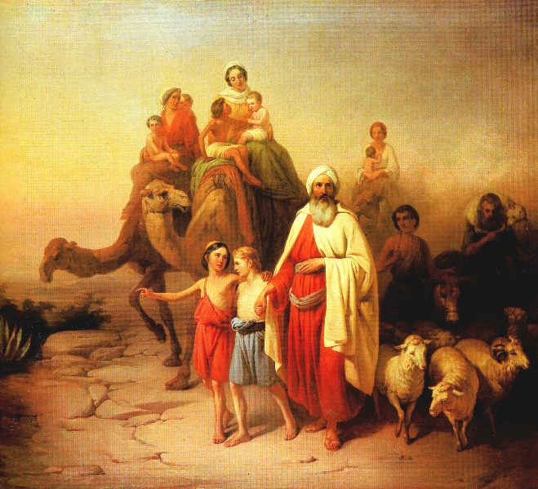
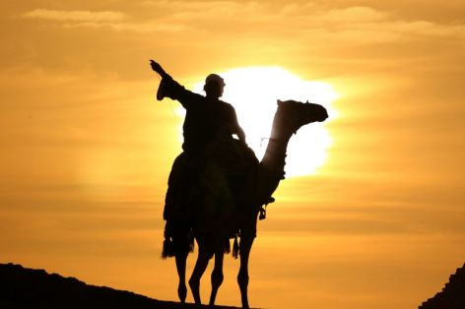
What did the Lord want Abraham to be?
What did the Lord promise to give Abraham and his seed?
What did Abraham’s posterity
need to do in order to receive
the land?
Abraham 2:6

Slide 7
Doctrinal Mastery
9 And I will make of thee a great nation, and I will bless thee above measure, and make thy name great among all nations, and thou shalt be a blessing unto thy seed after thee, that in their hands they shall bear this ministry and Priesthood unto all nations;
10 And I will bless them through thy name; for as many as receive this Gospel shall be called after thy name, and shall be accounted thy seed, and shall rise up and bless thee, as their father;
11 And I will bless them that bless thee, and curse them that curse thee; and in thee (that is, in thy Priesthood) and in thy seed (that is, thy Priesthood), for I give unto thee a promise that this right shall continue in thee, and in thy seed after thee (that is to say, the literal seed, or the seed of the body) shall all the families of the earth be blessed, even with the blessings of the Gospel, which are the blessings of salvation, even of life eternal.
Abraham 2:9-11

Slide 8
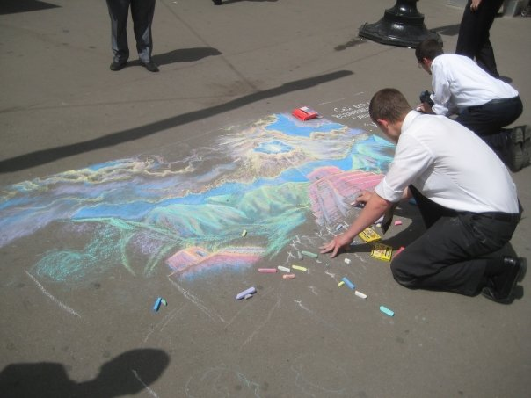
To All the Nations
The Lord promised Abraham that his descendants would take the priesthood and the blessings of the gospel of Jesus Christ to all the nations of the earth.
All those who receive the ordinances and live the gospel of Jesus Christ receive the same promises that the Lord gave to Abraham. They will be called Abraham’s seed (posterity) and will receive eternal life.
Abraham 2:9-11; Genesis 12:2-3
(Pearl of Great Price)

Slide 9
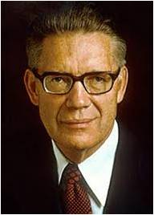
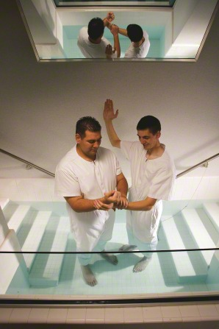
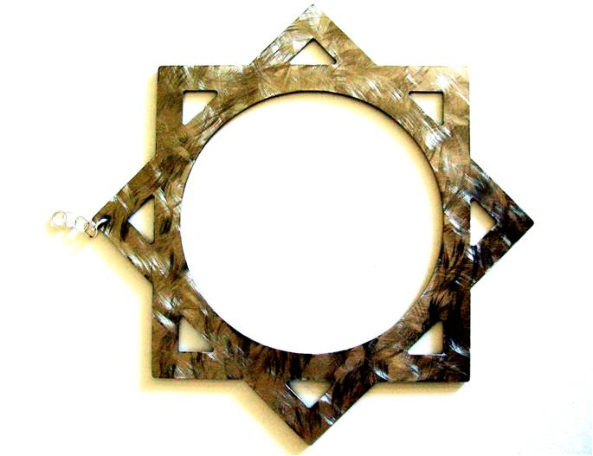


Promises
“Abraham first received the gospel by baptism (which is the covenant of salvation);
then he had conferred upon him the higher priesthood, and he entered into celestial marriage (which is the covenant of exaltation), gaining assurance thereby that he would have eternal increase;
finally, he received a promise that all of these blessings would be offered to all of his mortal posterity.”
Abraham 2:9-11; Genesis 12:2-3
(Bruce R. McConkie)

Slide 10
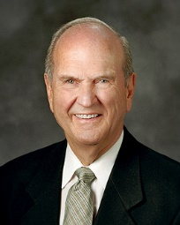

Joint Heirs
When we embrace the gospel and are baptized, we take upon ourselves the sacred name of Jesus Christ. Baptism is the gate that leads to becoming joint heirs to all the promises given anciently by the Lord to Abraham, Isaac, Jacob, and their posterity.
“The new and everlasting covenant” and the Abrahamic covenant are essentially the same—two ways of phrasing the covenant God made with mortal men and women at different times. …
… [Y]ou and I personally entered the covenant path at baptism. Then we enter it more completely in the temple. The blessings of the Abrahamic covenant are conferred in holy temples. These blessings allow us, upon being resurrected, to “inherit thrones, kingdoms, powers, principalities, and dominions, to our ‘exaltation and glory in all things’.”
Russell M. Nelson
As we make and keep covenants with God, we become heirs to the blessings given to Abraham.
Doctrine and Covenants 132:6, 19

Slide 11
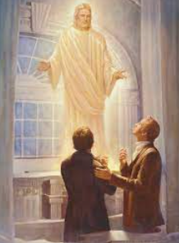
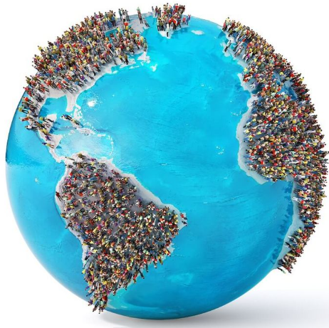

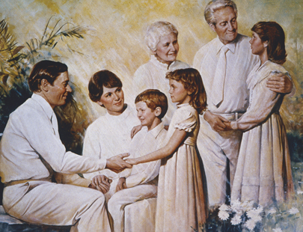
Blessing For Me
Doctrine and Covenants
132:19-22, 30-31
Doctrine and Covenants
88:18-20
inheritance in the celestial kingdom
Eternal families (“continuation of the seeds” and “continuation of the lives”)
Gospel shared with all the families of the earth; salvation and exaltation
The blessings of the priesthood, including all that the Father has
Doctrine and Covenants
84:33-38
Abraham 2:9-11

Slide 12
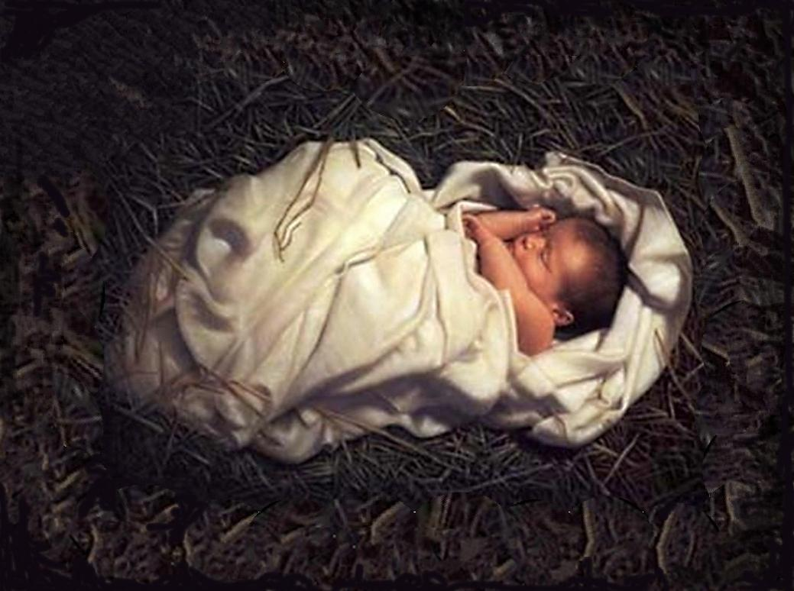
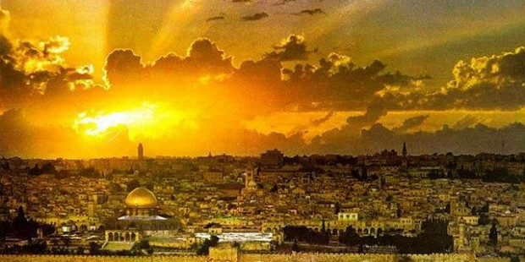
Lineage of Christ
“Included in the divine promises to Abraham was the assurance that Christ would come through his lineage, and the assurance that Abraham’s posterity would receive certain choice, promised lands as an eternal inheritance.”
Matthew 1:1; Genesis 17

Slide 13


Above Measure/Innumerable
…Abraham and his seed, out of the world they should continue; both in the world and out of the world should they continue as innumerable as the stars; or, if ye were to count the sand upon the seashore ye could not number them.
D&C 132:30
Abraham 2:9; Abraham 3:14

Slide 14
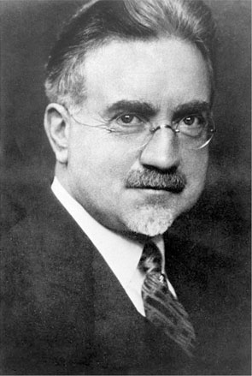
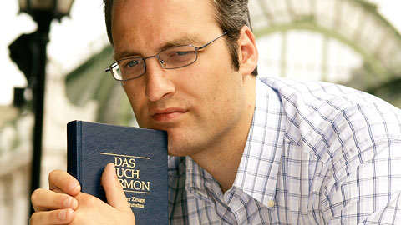
Who is Abraham’s Seed?
“…All who accept the gospel become by adoption members of the family of Abraham.”
“All who accept God’s plan for his children on earth and who live it…Those who reject the gospel forfeit the promises made to Abraham and are not children of Abraham.”
Abraham 2:10
(John A. Widtsoe )

Slide 15

Minister
As the seed of Abraham, the Savior has given us a responsibility to bless all the families of the earth with the blessings of His gospel
Ours is the responsibility to help fulfill the Abrahamic covenant.
Ours is the seed foreordained and prepared to bless all people of the world.
That is why priesthood duty includes missionary work. After some 4,000 years of anticipation and preparation, this is the appointed day when the gospel is to be taken to the kindreds of the earth.
This is the time of the promised gathering of Israel. And we get to participate! Isn’t that exciting?
Anytime we do anything that helps anyone—on either side of the veil—to make and keep their covenants with God, we are helping to gather Israel.
President Russell M. Nelson
Abraham 2:11

Slide 16
“Truly, great responsibility rests upon the seed of Abraham in these latter days. …
“… We are here upon the earth at this time to magnify the priesthood and to preach the gospel. That is who we are, and that is why we are here.”
Abraham 2:11

Slide 17
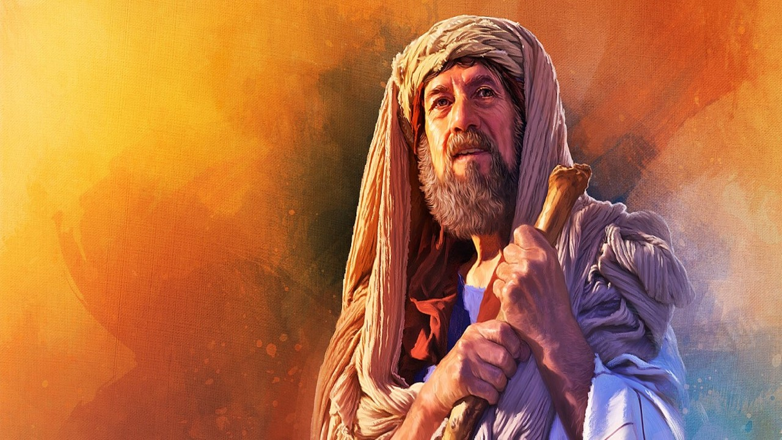
Now, after the Lord had withdrawn from speaking to me, and withdrawn his face from me, I said in my heart: Thy servant has sought thee earnestly; now I have found thee;
If we seek the Lord earnestly, we will find Him
Abraham 2:12

Slide 18
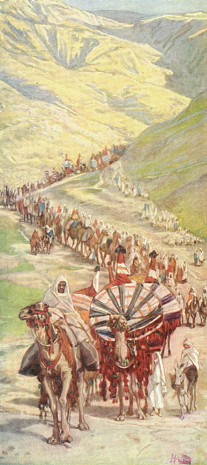
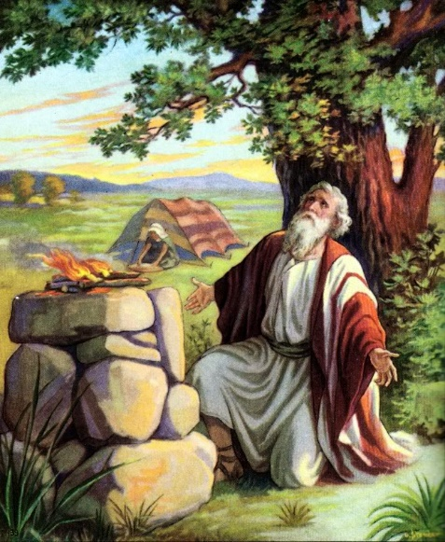
Canaan
Abraham was 62 years old when he left Haran, whereas Genesis 12:4 says he was 75 years old.
He took his wife, and nephew Lot, and those followers. The scriptures say he obtained many servants.
At one time he had 318 trained servants armed and fighting men.(Gen. 14:14)
He also had many flocks in Haran. (Abr. 2:5)
Canaan was given as the promised land to Abraham and his seed as part of the Abrahamic Covenant
Abraham 2:14-20

Slide 19
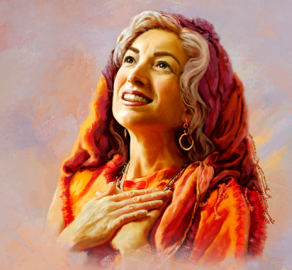
Famine in Canaan
Before Abraham entered Egypt, the Lord warned him that the Egyptians would see how beautiful Sarai was and would kill Abraham so they could take her.
Therefore, the Lord instructed Sarai to say that she was Abraham’s sister to save Abraham’s life and to protect herself.
Both Sarai and Abraham acted in faith, believing that God would deliver them.
Canaan
Egypt
Abraham 2:22–25; Genesis 12:14–20

Slide 20
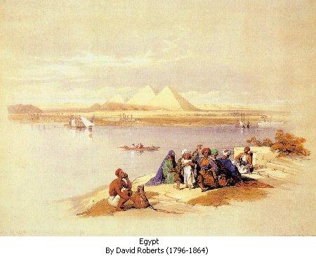
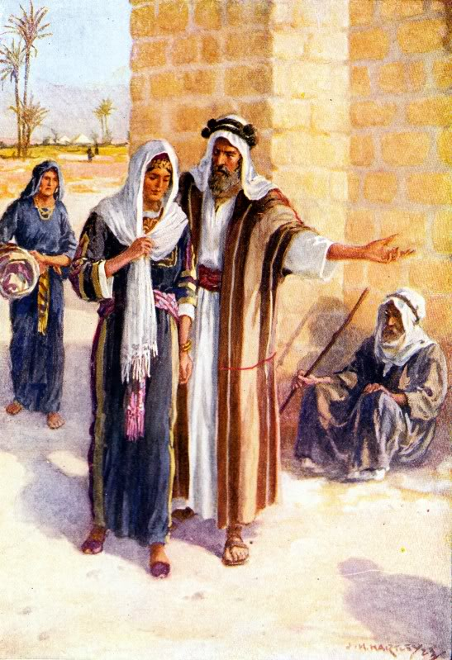
Sarai and Abraham in Egypt
Both Sarai and Abraham acted in faith, believing that God would deliver them. Sarai was taken into Pharaoh’s house, and Abraham was given riches..
The Lord sent a plague to Pharaoh and his house, and Pharaoh realized that Sarai was being protected by God and that she was married to Abraham. Pharaoh then sent Abraham and Sarai away.
Abraham 2:22–25; Genesis 12:14–20

Slide 21
Sources:
Videos:
The Abrahamic Covenant (7:16)
“Elder Nelson Talks about Covenants” (4:45)
Elder David A. Bednar (“Becoming a Missionary,” Ensign or Liahona, Nov. 2005, 47).
(“Becoming a Missionary,” 47).
Presentation by ©http://fashionsbylynda.com/blog/
Bible Maps (map 9)
The Pearl of Great Price: Teacher Manual, (2000), 40–42
Bruce R. McConkie Mormon Doctrine, p. 13
Russell M. Nelson (“The Everlasting Covenant,” Liahona, Oct. 2022, 4, 6); (“Covenants,” Ensign or Liahona, Nov. 2011, 88); . (“Let God Prevail,” Ensign or Liahona, Nov. 2020, 92–93)
John A. Widtsoe Evidences and Reconciliations, 3:28. See also Brigham Young, Journal of Discourses, 7:290-91

Slide 22

“You may enjoy music, athletics, or be mechanically inclined, and someday you may work in a trade or a profession or in the arts. As important as such activities and occupations can be, they do not define who we are. First and foremost, we are spiritual beings. We are sons [and daughters] _____________________of and the seed of _________________________________”
(David A. Bednar, “Becoming a Missionary,” Ensign or Liahona, Nov. 2005, 47).
“You may enjoy music, athletics, or be mechanically inclined, and someday you may work in a trade or a profession or in the arts. As important as such activities and occupations can be, they do not define who we are. First and foremost, we are spiritual beings. We are sons [and daughters] _____________________of and the seed of _________________________________”
(David A. Bednar, “Becoming a Missionary,” Ensign or Liahona, Nov. 2005, 47).
“You may enjoy music, athletics, or be mechanically inclined, and someday you may work in a trade or a profession or in the arts. As important as such activities and occupations can be, they do not define who we are. First and foremost, we are spiritual beings. We are sons [and daughters] _____________________of and the seed of _________________________________”
(David A. Bednar, “Becoming a Missionary,” Ensign or Liahona, Nov. 2005, 47).
“You may enjoy music, athletics, or be mechanically inclined, and someday you may work in a trade or a profession or in the arts. As important as such activities and occupations can be, they do not define who we are. First and foremost, we are spiritual beings. We are sons [and daughters] _____________________of and the seed of _________________________________”
(David A. Bednar, “Becoming a Missionary,” Ensign or Liahona, Nov. 2005, 47).
“You may enjoy music, athletics, or be mechanically inclined, and someday you may work in a trade or a profession or in the arts. As important as such activities and occupations can be, they do not define who we are. First and foremost, we are spiritual beings. We are sons [and daughters] _____________________of and the seed of _________________________________”
(David A. Bednar, “Becoming a Missionary,” Ensign or Liahona, Nov. 2005, 47).
“You may enjoy music, athletics, or be mechanically inclined, and someday you may work in a trade or a profession or in the arts. As important as such activities and occupations can be, they do not define who we are. First and foremost, we are spiritual beings. We are sons [and daughters] _____________________of and the seed of _________________________________”
(David A. Bednar, “Becoming a Missionary,” Ensign or Liahona, Nov. 2005, 47).
“You may enjoy music, athletics, or be mechanically inclined, and someday you may work in a trade or a profession or in the arts. As important as such activities and occupations can be, they do not define who we are. First and foremost, we are spiritual beings. We are sons [and daughters] _____________________of and the seed of _________________________________”
(David A. Bednar, “Becoming a Missionary,” Ensign or Liahona, Nov. 2005, 47).
“You may enjoy music, athletics, or be mechanically inclined, and someday you may work in a trade or a profession or in the arts. As important as such activities and occupations can be, they do not define who we are. First and foremost, we are spiritual beings. We are sons [and daughters] _____________________of and the seed of _________________________________”
(David A. Bednar, “Becoming a Missionary,” Ensign or Liahona, Nov. 2005, 47).

Slide 23
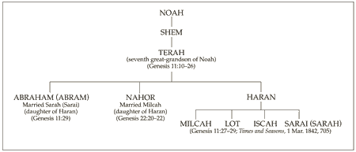
For Further Reading:
The Abrahamic Covenant
By S. Michael Wilcox
January 1998 Ensign
Abraham called his wife sister:
The idea that Abraham, the great man of righteousness, deceived Pharaoh in order to protect his own life has troubled many students of the Old Testament. That his life was in danger because of Sarah’s beauty seems quite clear. It seems peculiar, but whereas the Egyptian pharaohs had a strong aversion to committing adultery with another man’s wife, they had no qualms about murdering the man to free his spouse for remarriage.
“To kill the husband in order to possess himself of his wife seems to have been a common royal custom in those days. A papyrus tells of a Pharaoh who, acting on the advice of one of his princes, sent armed men to fetch a beautiful woman and make away with her husband. Another Pharaoh is promised by his priest on his tombstone, that even after death he will kill Palestinian sheiks and include their wives in his harem.” (Kasher, Encyclopedia of Biblical Interpretation, 2:128.)
Abraham could validly state that Sarah was his sister. In the Bible the Hebrew words brother and sister are often used for other blood relatives. (See Genesis 14:14, in which Lot, Abraham’s nephew, is called “his brother.”) Because Abraham and Haran, Sarah’s father, were brothers, Sarah was Abraham’s niece and thus could be called sister. The accompanying pedigree chart shows this relationship.
Another ancient custom that might shed light on the relationship permitted a woman to be adopted as a man’s sister upon their marriage to give her greater legal and social status (see Encyclopaedia Judaica,s.v. “Sarah,” 14:866).
Even though Abraham was correct in calling her his sister, he did deceive the Egyptians. How can this action be justified? The answer is very simple. His action was justified because God told him to do it (see Abraham 2:22–25). Old Testament Institute manual
Abrahamic Covenant:
“The covenant was renewed with Isaac (Genesis 24:60) and again with Jacob. (Gen. 28; 35:9-13.) Those portions of it which pertain to personal exaltation and eternal increase are renewed with each member of the House of Israel who enters the order of celestial marriage; through that order the participating parties become inheritors of all the blessings of the Abraham, Isaac, and Jacob. (D&C 132; Romans 9:4; Galatians 3;4) Bruce R. McConkie Mormon Doctrine, p. 13
Lineage:
Elder David A. Bednar of the Quorum of the Twelve Apostles explained when we accepted the responsibility to be part of Abraham’s posterity:
“We were foreordained in the premortal existence to the blessings associated with birth through a particular lineage, even the chosen lineage of Abraham—not because we are better, not because we are more special, but because we have particular responsibilities that we covenanted we would fulfill. Therefore we came to the earth through a lineage with the birthright blessing of the priesthood. Every man who holds the priesthood was foreordained to that very responsibility in the premortal existence” (“Teach Them to Understand” [Brigham Young University–Idaho Education Week devotional, June 4, 1998];byui.edu).

Slide 24
Sarai as a sister:
“Sarai was instructed to tell the Egyptians that she was Abraham’s sister. It was a test of her faith, just as it was undoubtedly a difficult experience for Abraham. Whatever the Lord commands a person to do is right and must be obeyed (see Teachings of the Prophet Joseph Smith, 256). Abraham and Sarai understood this principle and passed the divine test the Lord had put before them. Elder Mark E. Petersen [of the Quorum of the Twelve Apostles] wrote: ‘To protect himself, Abraham had told Pharaoh that [Sarai] was his sister, which of course she was. Had he divulged that she was his wife, he might have been slain. But as his sister, Pharaoh was willing to buy her at a good price’ (Abraham, Friend of God [1979], 69; see also Genesis 20:12; for further discussion of this, see S. Kent Brown, “Biblical Egypt: Land of Refuge, Land of Bondage,” Ensign, Sept. 1980, pp. 45, 47)” (The Pearl of Great Price Student Manual [Church Educational System manual, 2000], 35).
Name Change:
In Genesis 12, Abraham and Sarah are still called Abram and Sarai. But later, when the Lord formalized His covenant with Abram and Sarai, they received new names.
Genesis 17:5 records that Abram’s name was changed to Abraham. Ab means “father.” Rah means “exalted.” Am means “nations.” Thus, Abraham symbolizes the covenant by which Abraham would become an exalted father of nations or a god (see D&C 132:37).
Sarai, which possibly means “contentions,” was changed to Sarah, which means “princess” (see Genesis 17:15) and also indicates Sarah’s future eternal role and exaltation (see Bible Dictionary, “Sarah or Sarai”). Accompanying Sarah’s new name was a blessing that her posterity would be great and that kings would descend from her (see Genesis 17:16).
The covenant God made with Abraham and later reaffirmed with Isaac and Jacob is of transcendent significance. It contained several promises, including:
Jesus the Christ would be born through Abraham’s lineage.
Abraham’s posterity would be numerous, entitled to an eternal increase, and also entitled to bear the priesthood.
Abraham would become a father of many nations.
Certain lands would be inherited by his posterity.
All nations of the earth would be blessed by his seed.
And that covenant would be everlasting—even through “a thousand generations.”
President Russell M. Nelson (“Covenants,” Ensign or Liahona, Nov. 2011, 87)
Adam and Eve, Noah and his wife, Abraham and Sarah, Lehi and Sariah, and all other devoted disciples of Jesus Christ—since the world was created—have made the same covenants with God. They have received the same ordinances that we as members of the Lord’s restored Church today have made: those covenants that we receive at baptism and in the temple. President Russell M. Nelson (“Come, Follow Me,” Ensign or Liahona, May 2019, 89)

